Slide 1
Water Needs v.s. Water Supply
Spring City, Utah

Slide 2
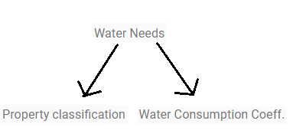
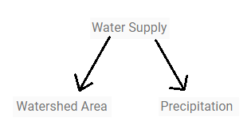
Overview

Slide 3
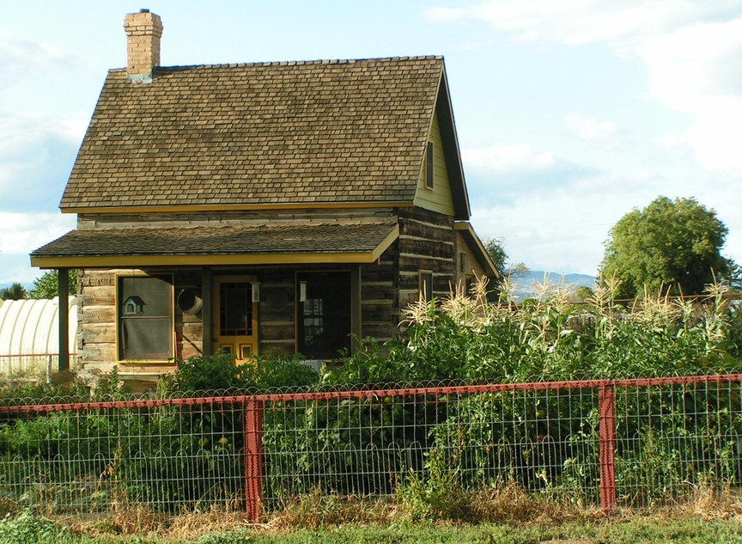
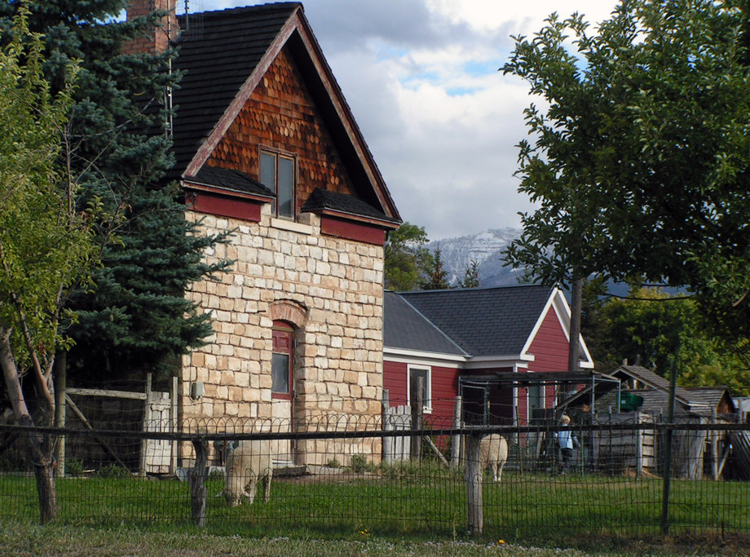
Spring City, Utah
Small Agricultural Town
Population about 1000

Slide 4
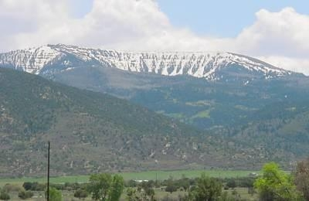
Spring City, Utah
Sheep and Cattle Production -Hay Crops and Pastures
Horseshoe Irrigation Company
-220 second/feet in Water Rights
-Horseshoe Mountain

Slide 5
Horseshoe Irrigation Company
12 Irrigation Systems
5820 Irrigated Acres
85 miles of Pipeline
9 Regulation Ponds
System Names
Chimney | City Lots & Fields
Crawfield | First North
Flat | Last Chance
Pete Hansen | Point Ditch
Second North | Third North
SouthFields-West | SouthFields-South

Slide 6
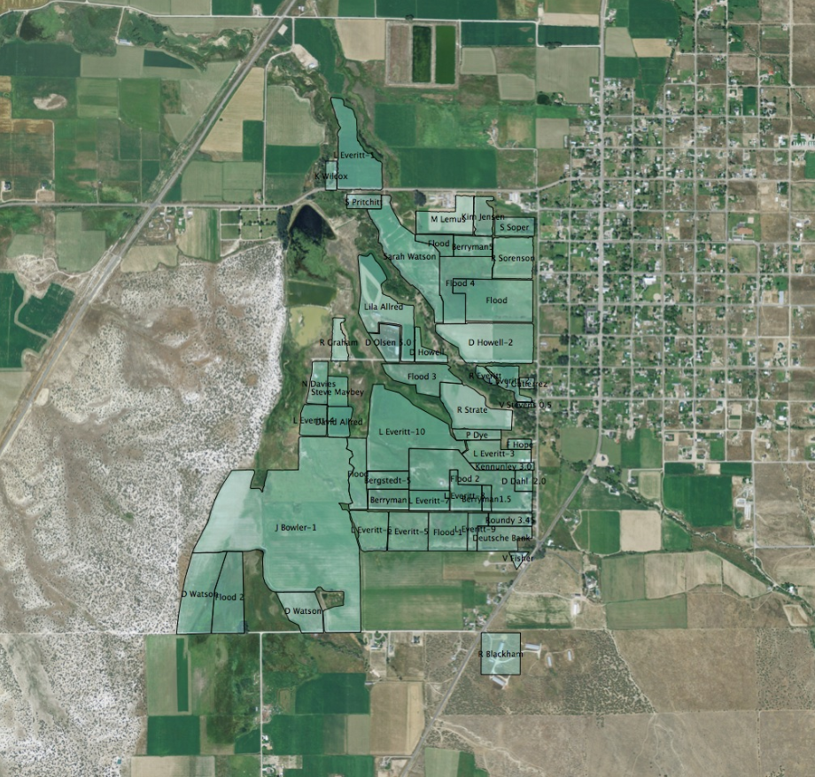
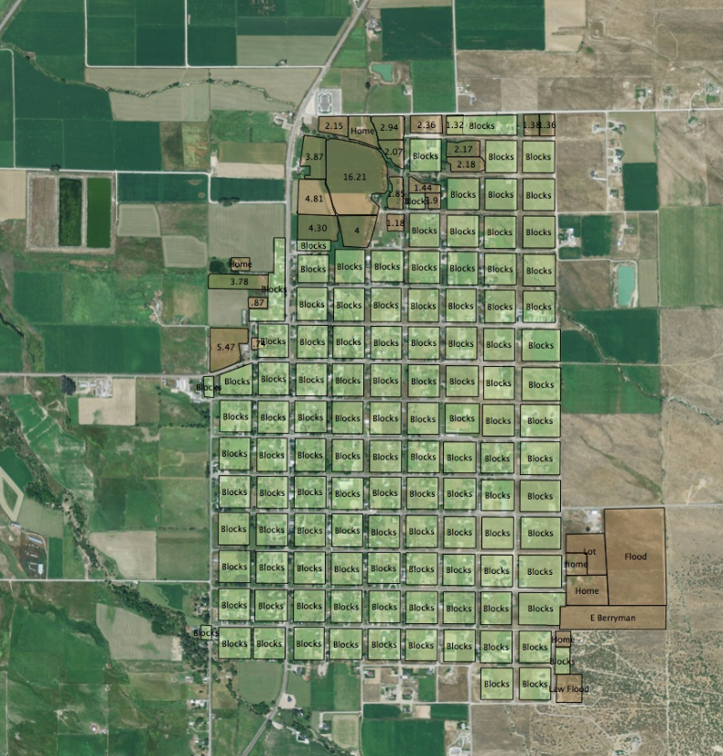
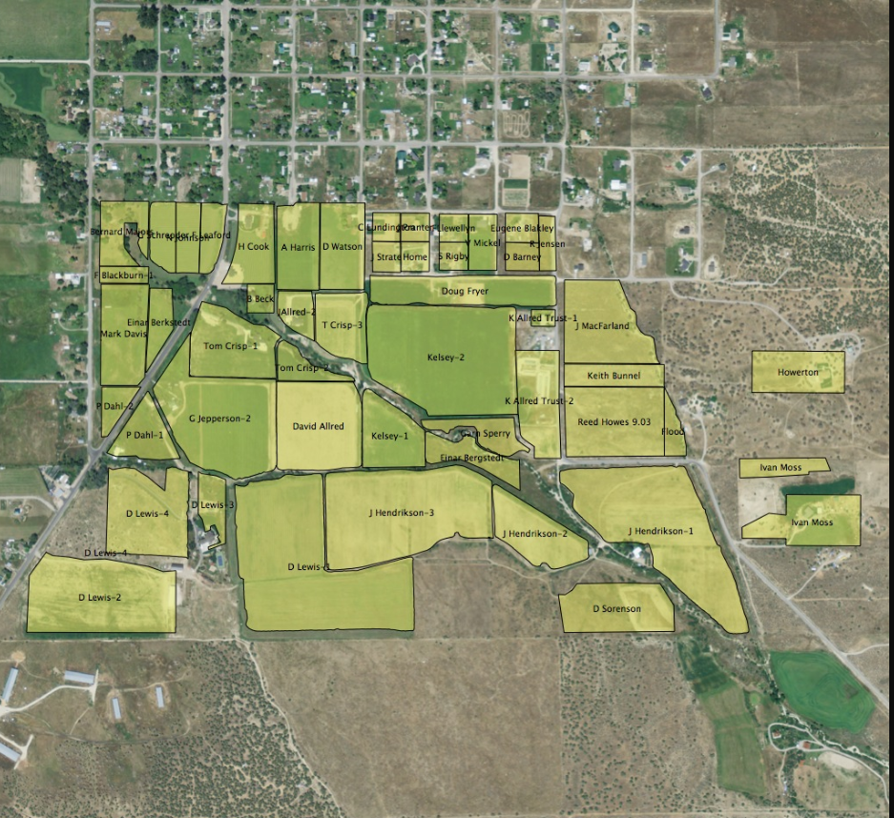
Southfields and City System
Horseshoe.irrigation.com

Slide 7
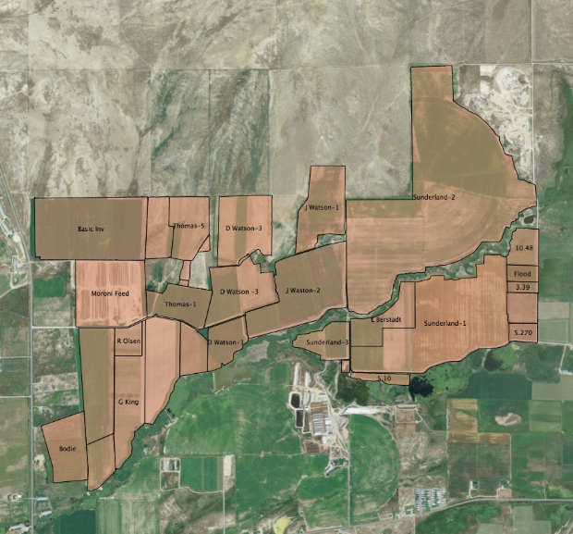
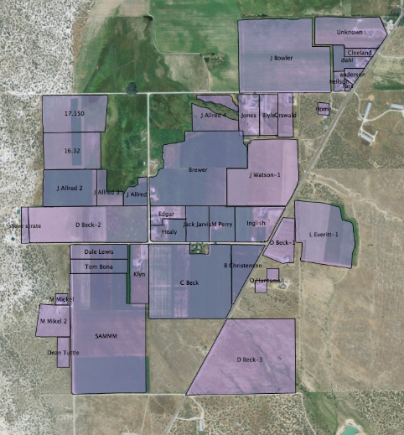
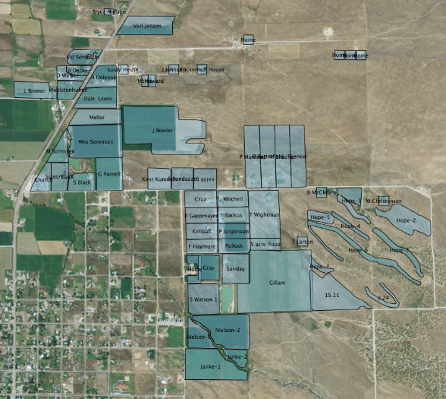
Chimney, Crawford, Last Chance Systems
Horseshoe.irrigation.com

Slide 8
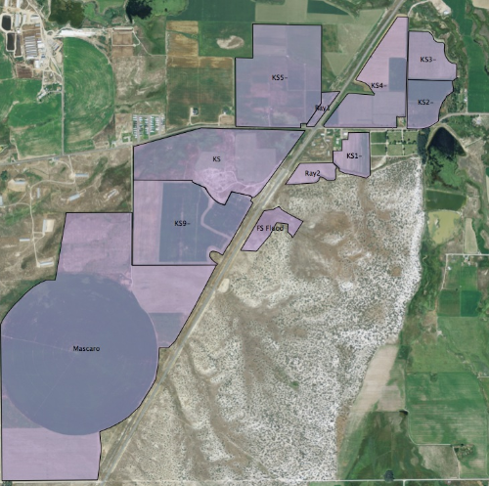
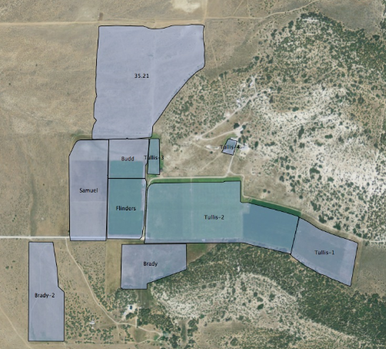
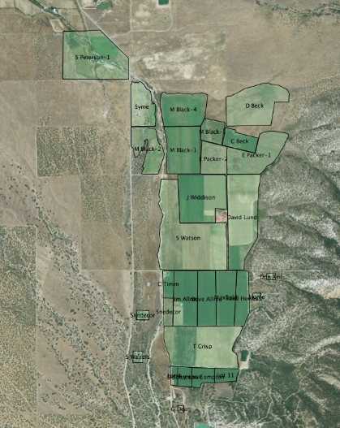
Point Ditch, Pete Hansen,The Flat
Horseshoe.irrigation.com

Slide 9
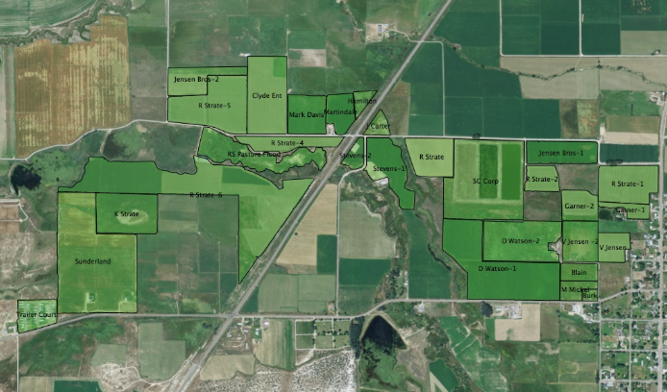
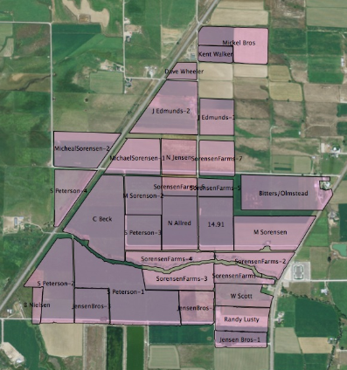
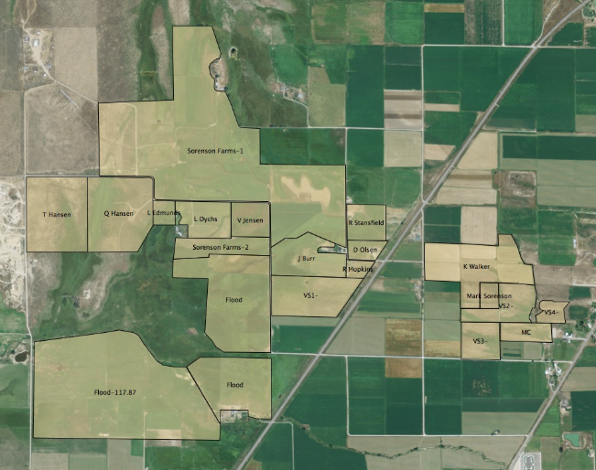
First, Second, and Third North
Horseshoe.irrigation.com

Slide 10
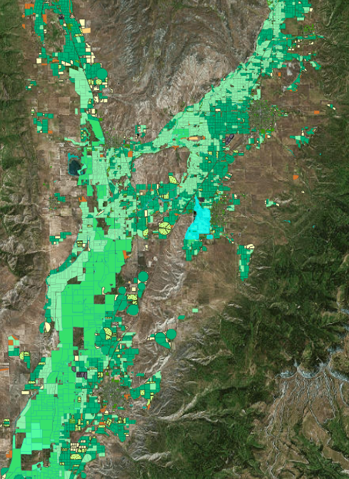
Crop Type Data
Sanpete County RMP Public Map

Slide 11
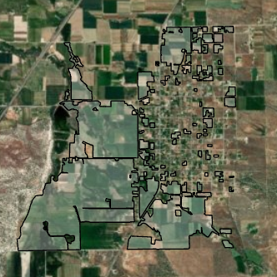
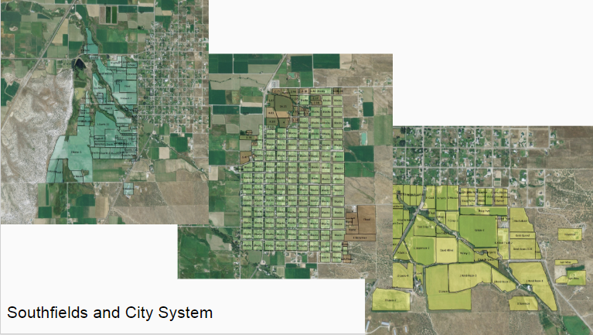
Southfields System

Slide 12
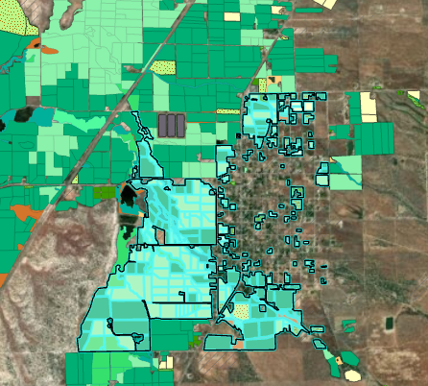
Southfields and City Systems
333 property shapes
Unable to clip data

Slide 13
Blaney-Criddle Formula
U=K*F (1)
U=the growing season consumptive use of water by the crop (inches)
K=the consumptive use coefficient for a given crop for the growth season
F=the growing season consumptive use factor

Slide 14
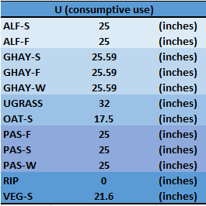
Blaney-Criddle Coefficients
Coefficient: (U)
- Yearly Consumptive use of Water
Majority of Values from State Engineer’s Report:
“Consumptive Use and Water
Requirements for Utah”, (1982)

Slide 15
Southfields Water Needs
5 month irrigation period
Yearly Crop Water Consumption=
Sum of (Crop Acreage X Yearly Consumptive Use Coeff. (U)).
Results: Approx. 270,000 acre/feet

Slide 16
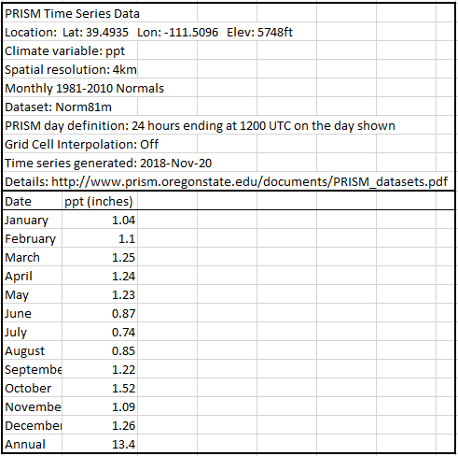
Crop Precipitation Factor
Reduction of Crop Water Consumption Needs.
Total Precipitation/Crop Season=(Crop Area) X (Crop Season Precipitation)

Slide 17
Corrected Water Needs
(Yearly Crop Consumption (Sum of Systems)) - (Precipitation) =
South Fields and City System Water Consumption Need

Slide 18
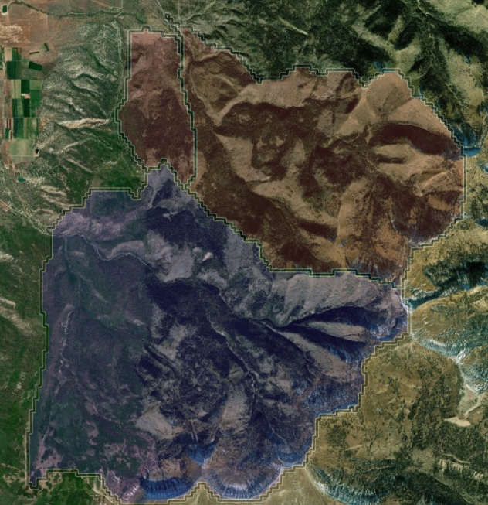
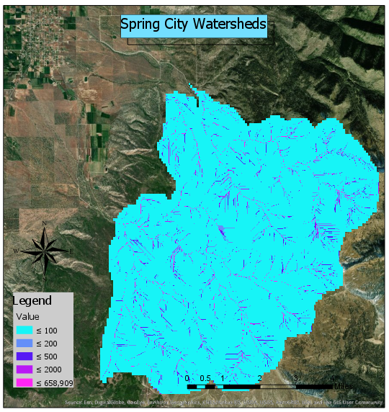
Watershed
3 Watersheds
Area Total=
67.3 km^2 ~ 16630.2 acres

Slide 19
Mean Annual Precipitation data
Mean Annual Precipitation: 29.00 inches from Streamstats, 25.14 inches from Horse Irrigation Company Website

Slide 20
Water Supply
(Watershed Area) X (Mean Annual Precipitation Rate) X
(Reduction Factor) = (Water Supply)

Slide 21
Conclusion
What's left:
Crop Water Consumption Use for 9 more systems
Watershed to Irrigation losses

Slide 22
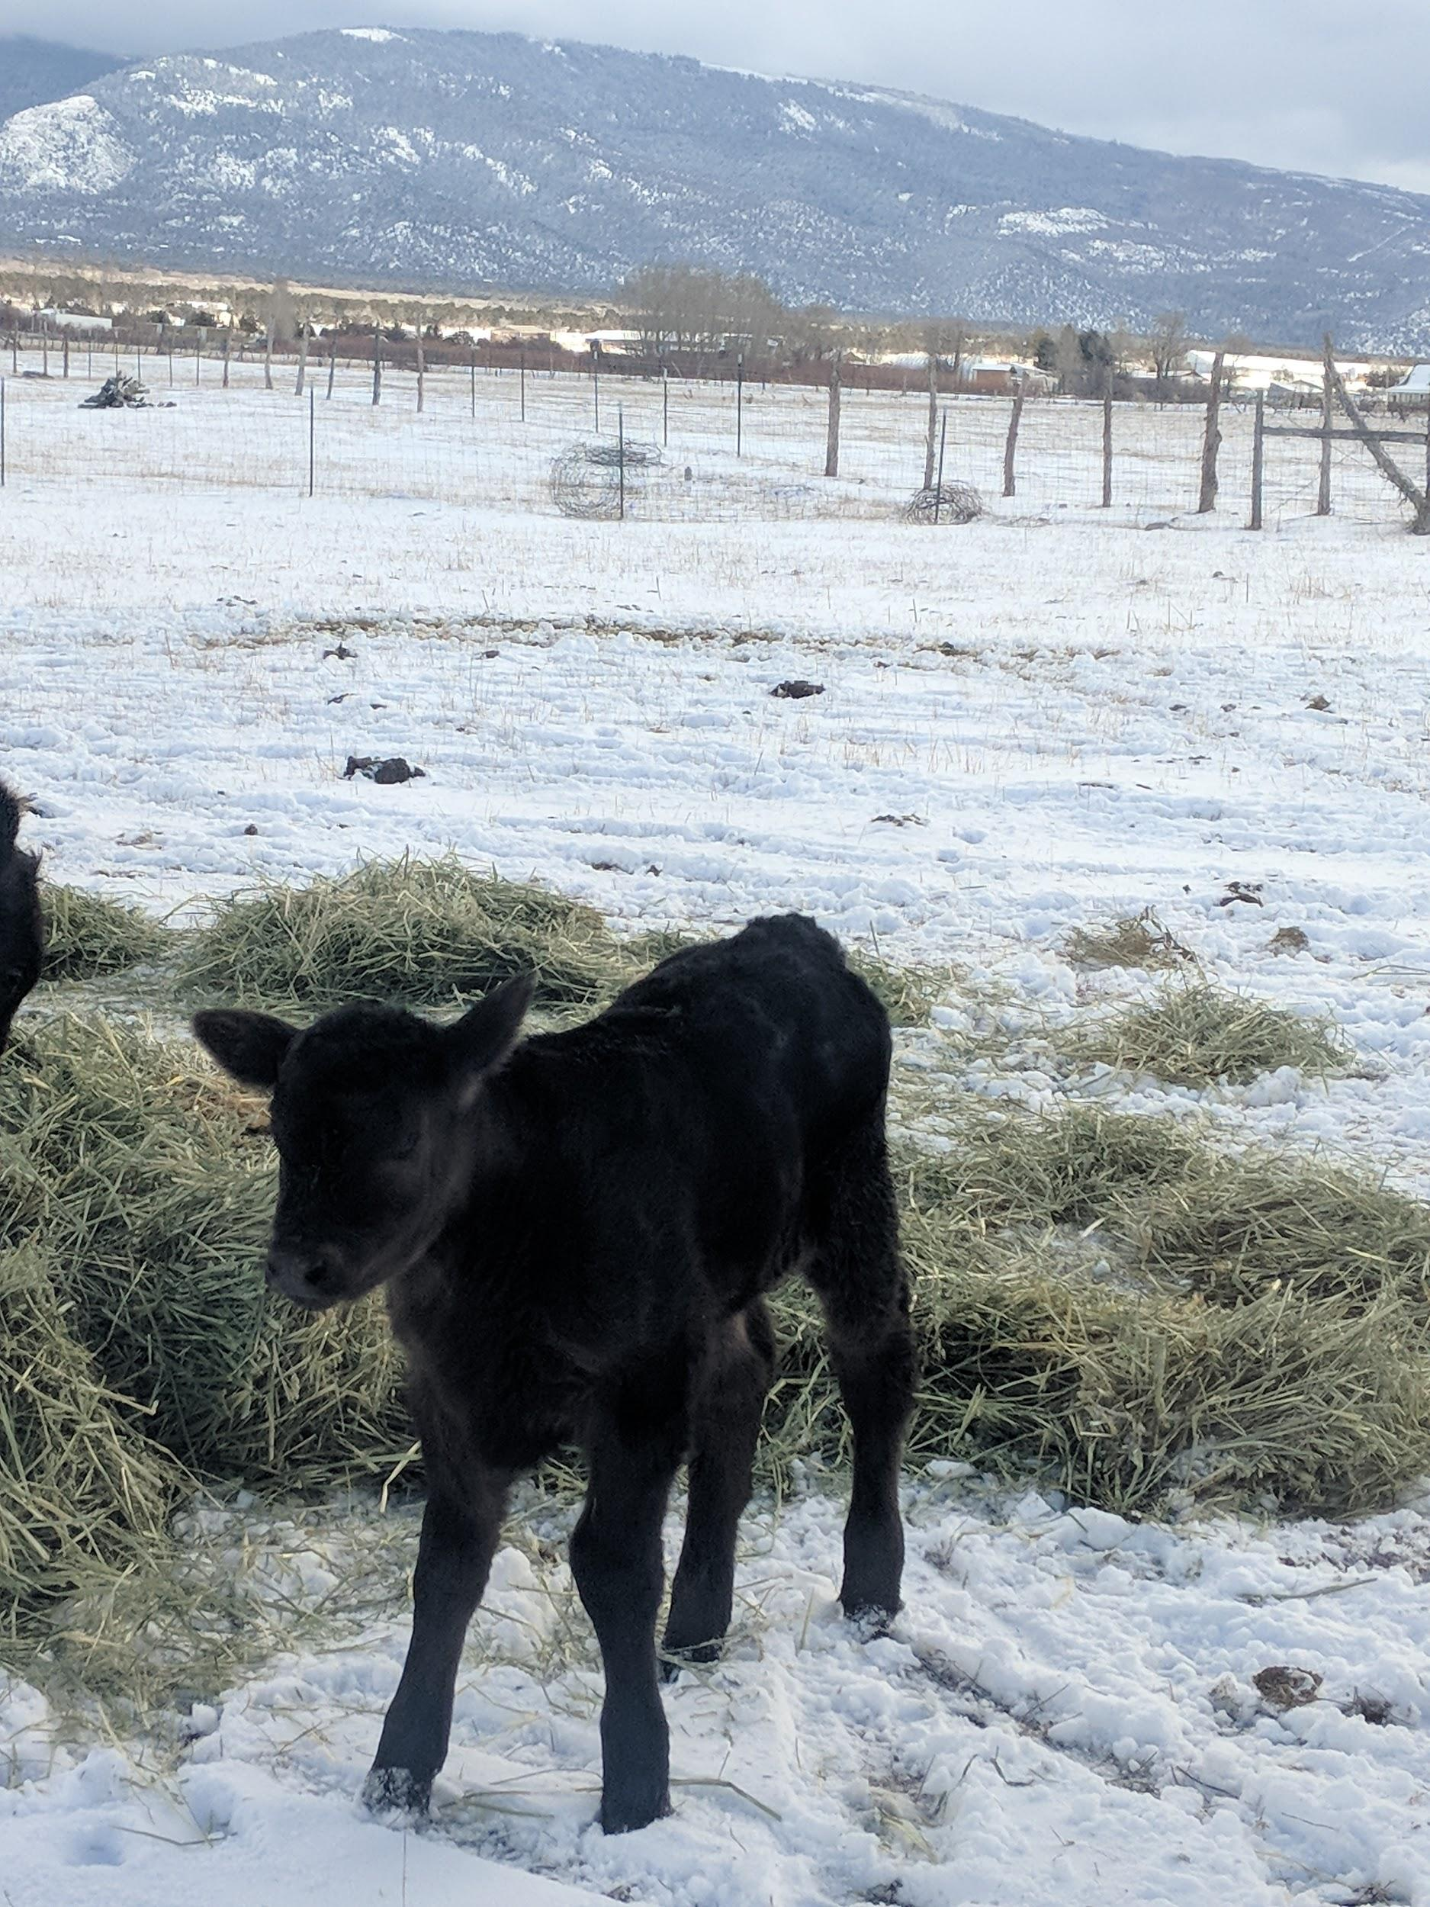
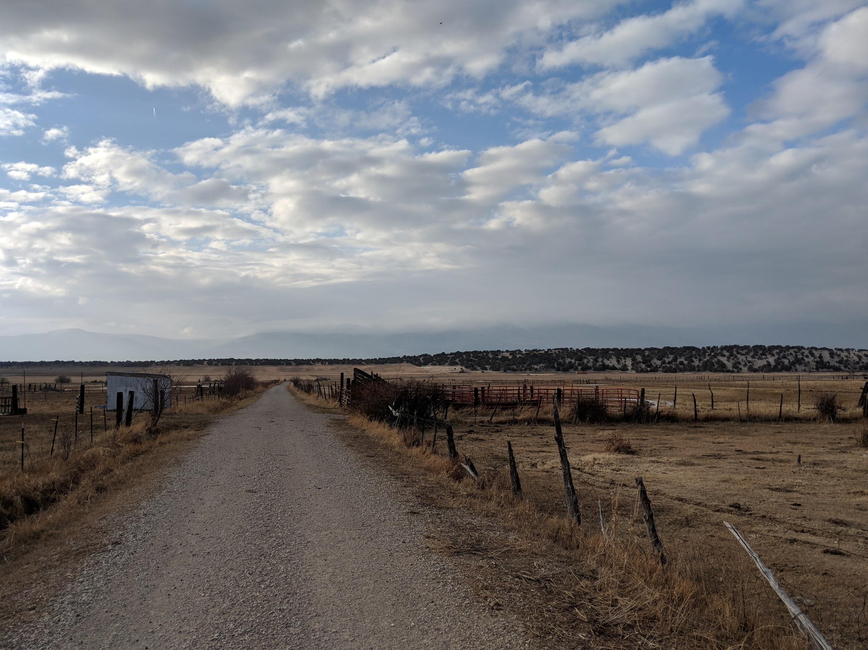
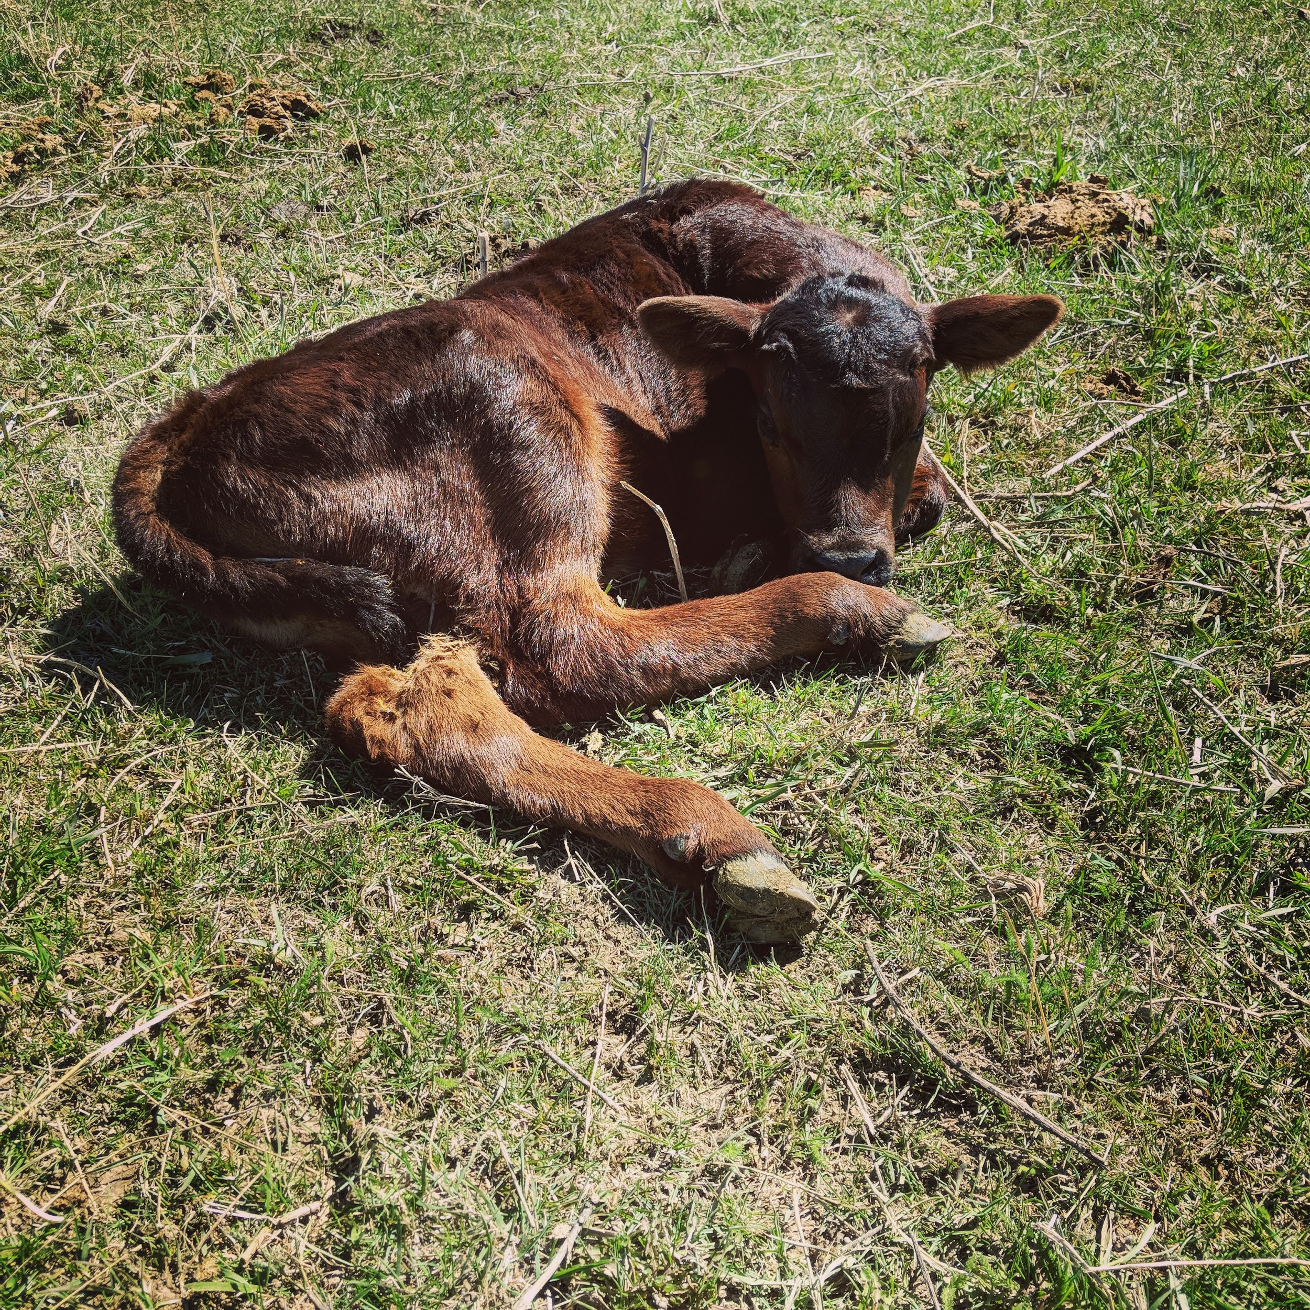
Questions?

