Slide 1
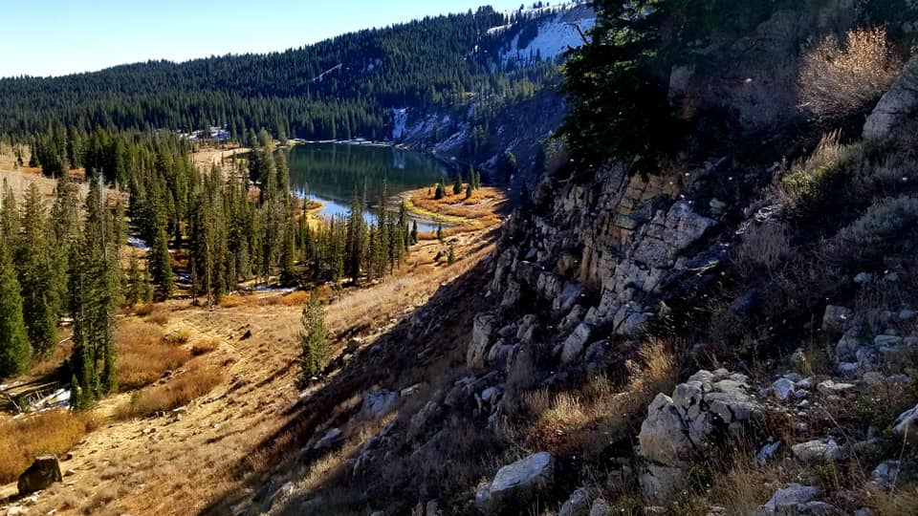
Remotely Mapping Karst
Testing a Method to Map the Abundant Karst Features within Logan Canyon
Dane Brophy
CEE 6440-001

Slide 2
Presentation Outline
Overview
Setting and Background
Details of Research
Analysis
Summary

Slide 3
Setting and Background
Located in Logan Canyon
Complex geologic history
Snowmelt dominated hydrograph
Karst is very influential

Slide 4
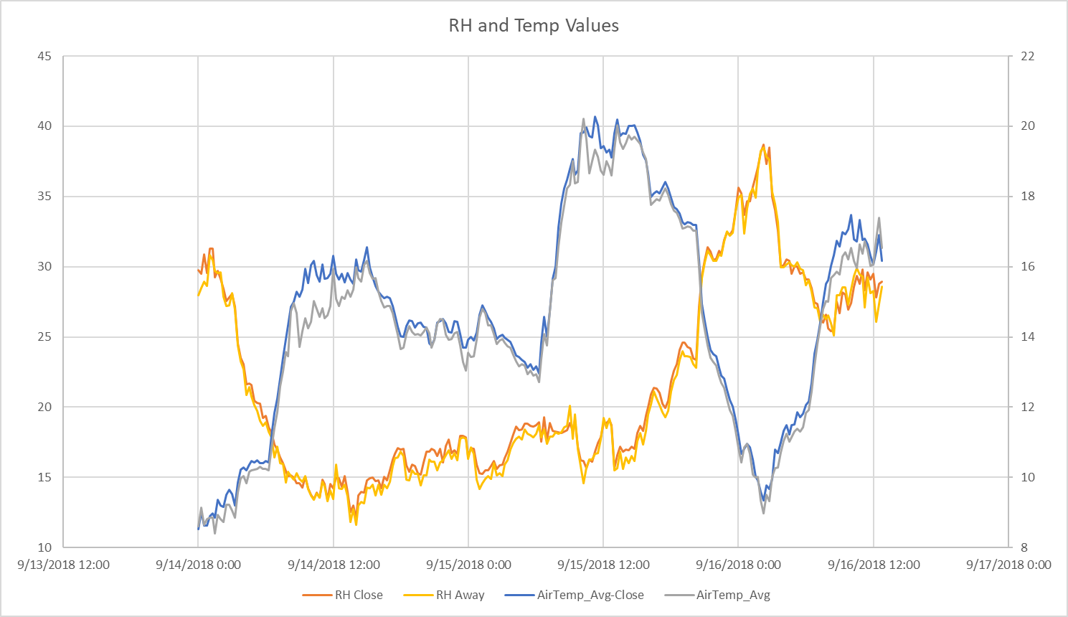
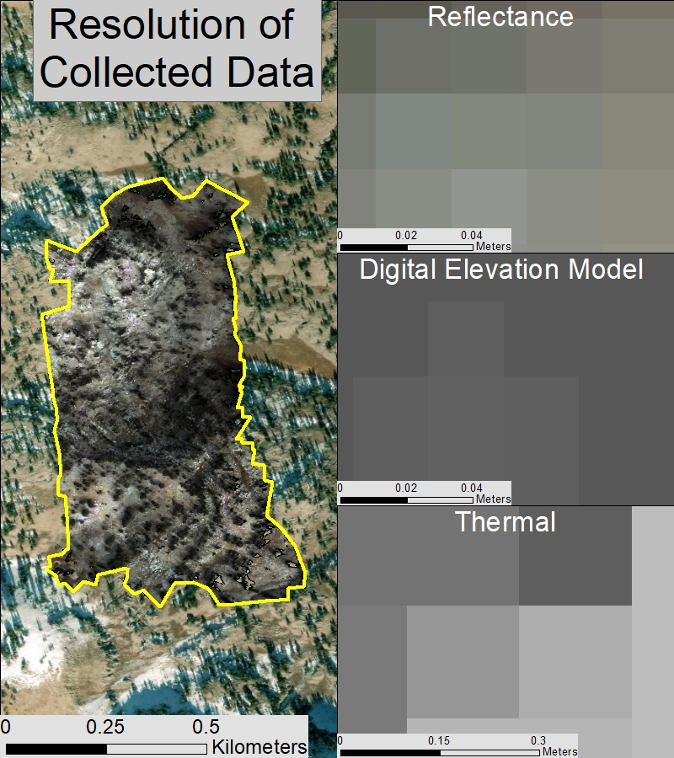
Details of Research
Spectral analysis
Terrain analysis
Creating required data

Slide 5
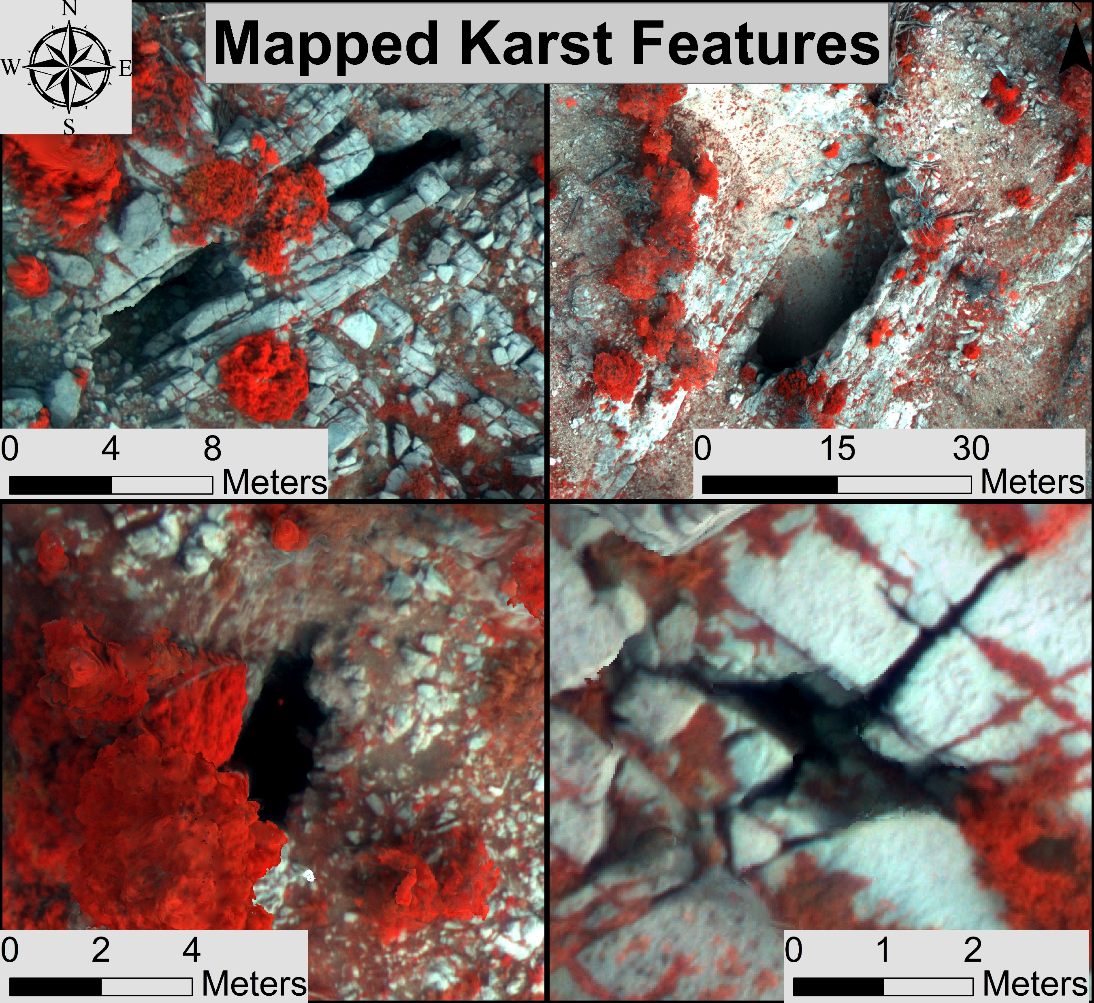
Sample Locations
Vary widely in size
Coordinates of known features
Federal restrictions

Slide 6
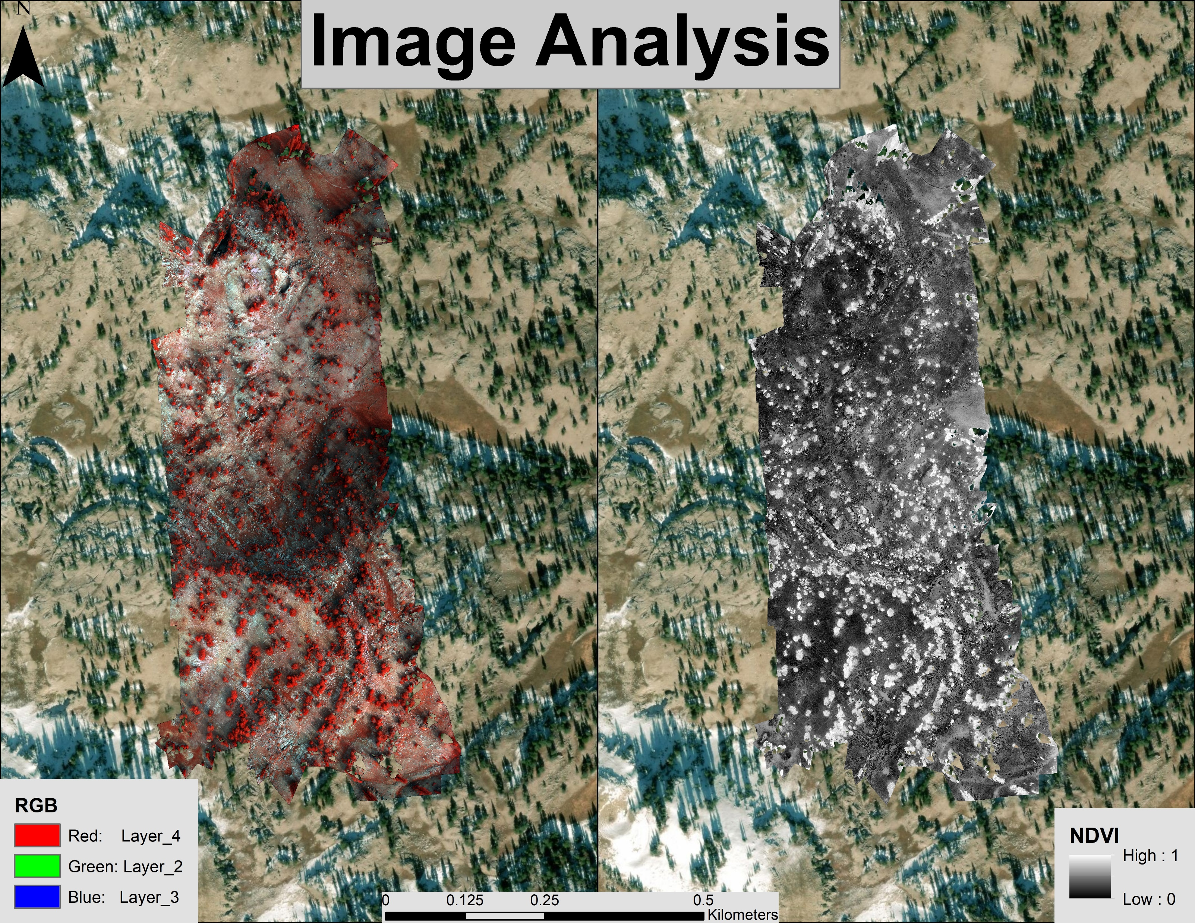
Spectral Analysis
NDVI formula
(IR – R)/(IR + R)
Sample known features
Raster calculations
Extract by attribute

Slide 7
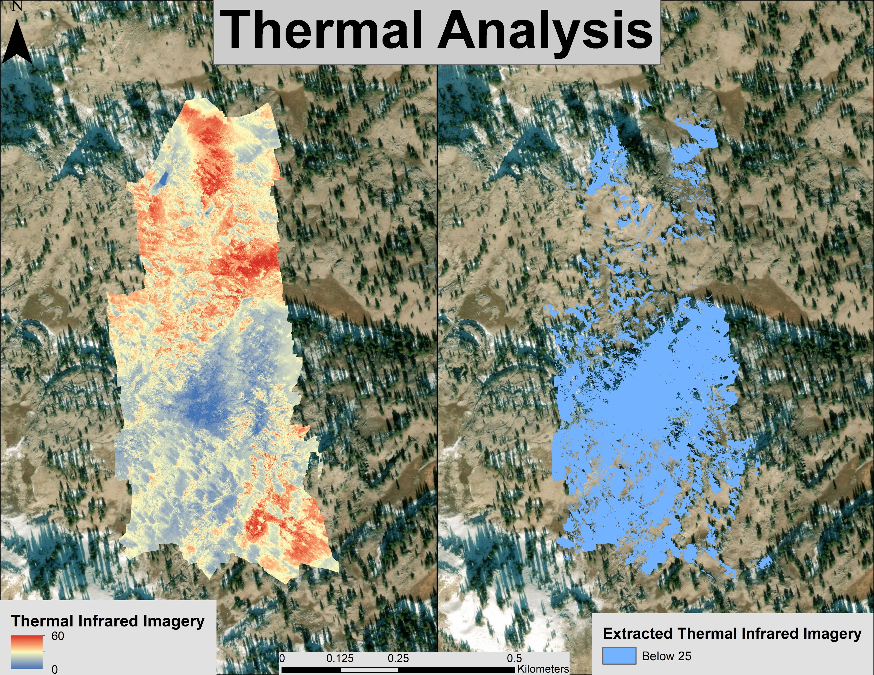
Thermal Analysis
Sample known features
Raster Calculator
Less than 25
Extract by Attribute

Slide 8
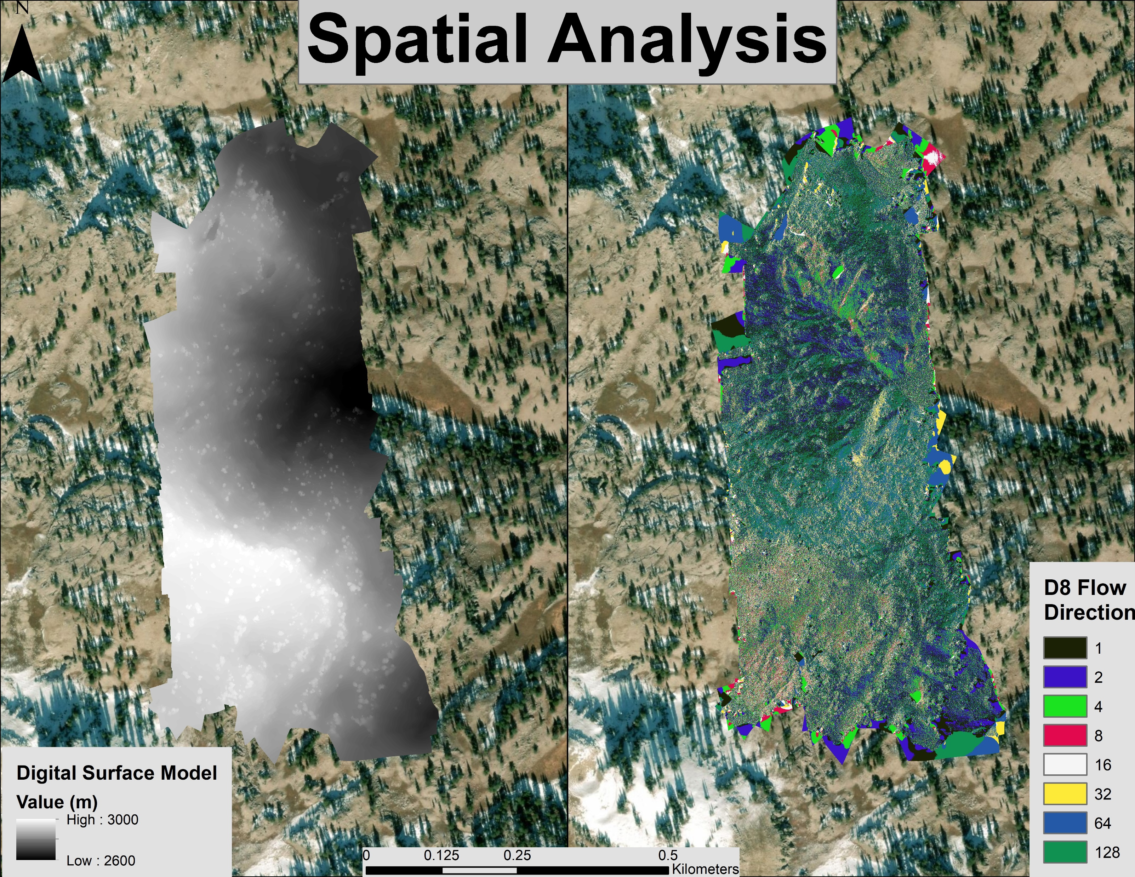
Terrain Analysis
Sub-watershed delineation
Karst features as pour points

Slide 9
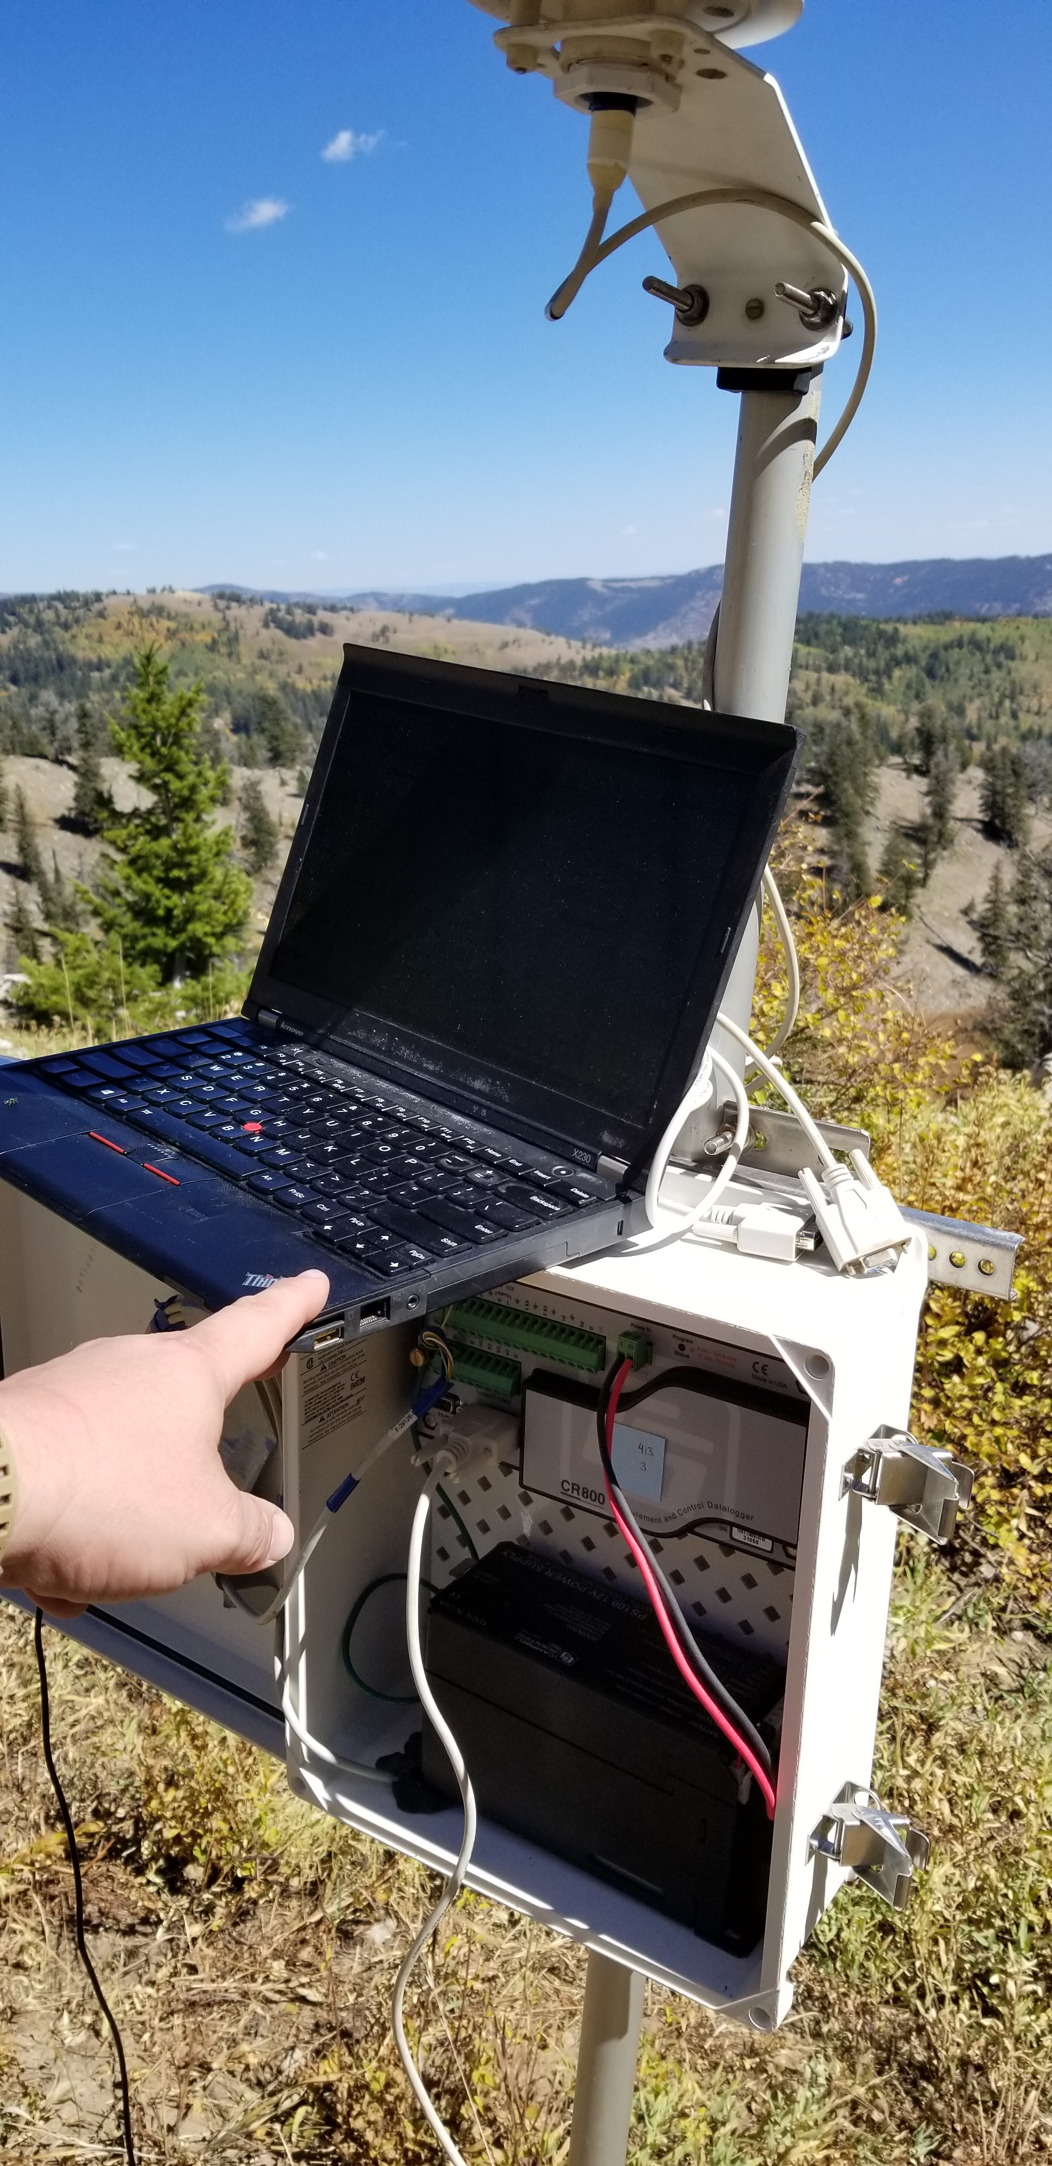
Karst Predictions
Random Forest landcover classification
Python code
Prediction of additional locations

Slide 10
Summary
Logan’s karst networks
Multiple skills utilized
Broad applications

Slide 11
Citations:
Bahr, K., (2016)"Structural and Lithological Influences on the Tony Grove Alpine Karst System, Bear River Range, North Central Utah". All Graduate Theses and Dissertations. Paper 5015.
Neilson, B., Tennant, H., Stout, T. L., Miller, M., Gabor, R. S., Jameel, Y., Millington, M., Gelderoos, A., Bowen, G., & Brooks, P. (2018) Stream centric methods for establishing groundwater contributions in karst mountain watersheds. Water Resources Research. In review.
Spangler, L. (2011). Karst hydrogeology of the Bear River Range in the vicinity of the Logan River, northern Utah. Geological Society of America Rocky Mountain-Cordilleran Section Meeting. Retrieved May 17, 2011.
Utah State University. “AggieAir.” AggieAir | USU, Utah Water Research Laboratory, www.aggieair.usu.edu/.
Thank you!

