Slide 1
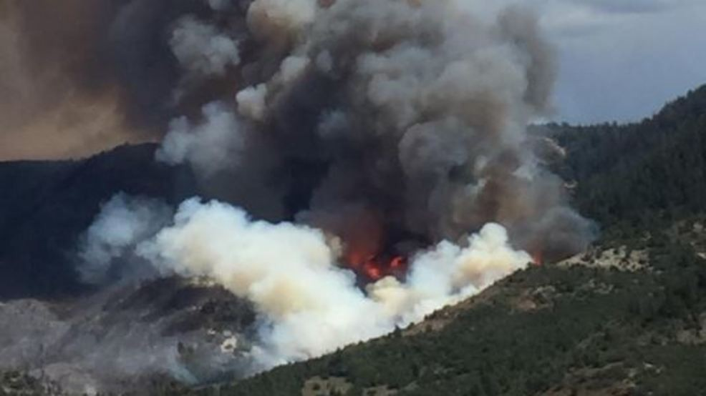
The Tank Hollow Fire and the Increase of Flood Potential for Spanish Fork
Jaxon White

Slide 2
Introduction
Tank Hollow Fire 11,067 acres
Forest fires can cause a lower infiltration rate
Will the fire cause increase in downstream stage height?
Hypothesis: The fire will cause increase in risk of flooding

Slide 3
Methods
Develop flood map using Height Above Nearest Drainage (HAND) method
Develop flow-rating curve for section of the Spanish Fork River
Determine the pre-fire and post-fire runoff
SCS Curve Number method
1-year, 10-year, and 25-year 2-hour storm events
HAND
Flow-Rating Curve
Results
Runoff

Slide 4
Area of Interest

Slide 5
Flood Map
HAND associates the stream bed elevation to a cell of interest

Slide 6
Flow Rating Curve
Manning’s Equation
$Q=\frac{1}{n}AR^{\frac{2}{3}}S^{\frac{1}{2}}$

Slide 7
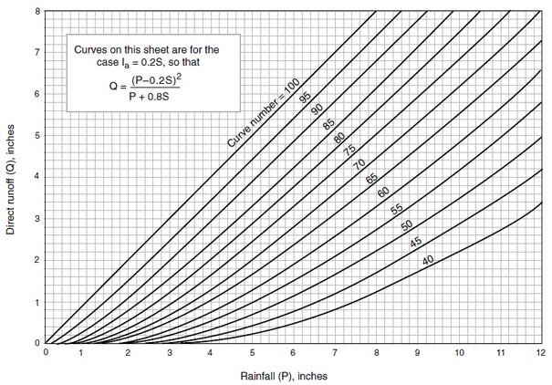
Runoff
SCS Curve Number method
$Q=\frac{{(P−0.2S)}^{2}}{(P+0.8S)}$
$S= \frac{1000}{CN}+10$
Purdue Engineering. Curve Number. [Photograph]Retrieved from https://engineering.purdue.edu/mapserve/LTHIA7/documentation/scs.htm

Slide 8
Curve Number
Based on the hydrologic soil group and land use
Soil Group C
Pre-fire curve number of 73
Post-fire curve number of 88
Higginson and Jarnecke method add 15

Slide 9
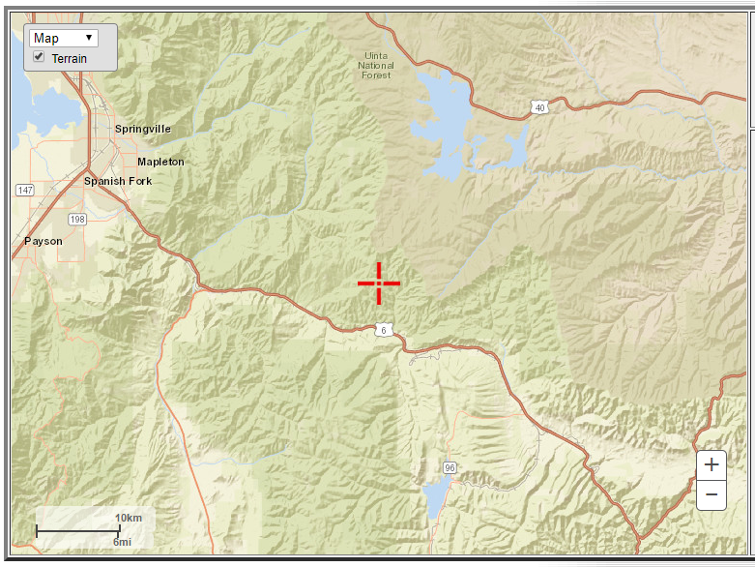
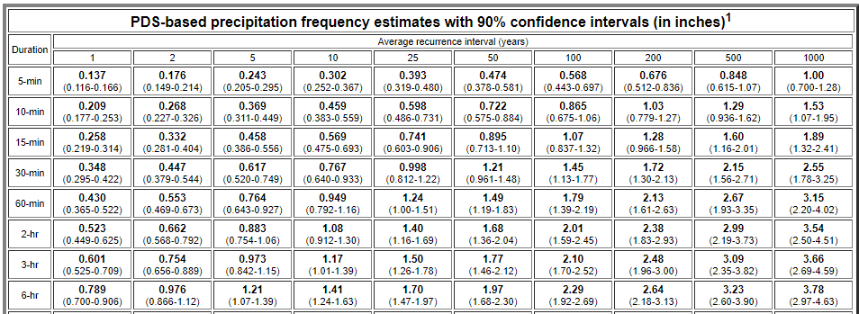
Precipitation
NOAA point precipitation web tool

Slide 10
Runoff Results

Slide 11
USGS Streamflow Gages

Slide 12
Flooded Addresses

Slide 13
Questions?

