Slide 1
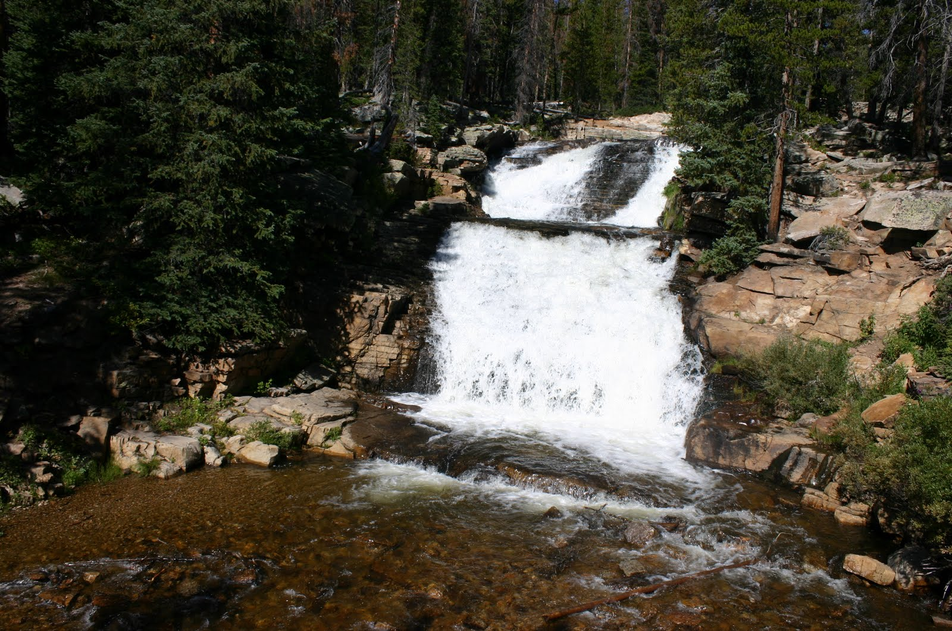
Forecasting Spring Runoff Volumes for jordanelle reservoir
Ryan Weller
CEE 6440
Photo Credit: http://liveandthrivewaterfallhikes.blogspot.com/

Slide 2
Overview of Presentation
Introduction
Methods
Results
Conclusion

Slide 3
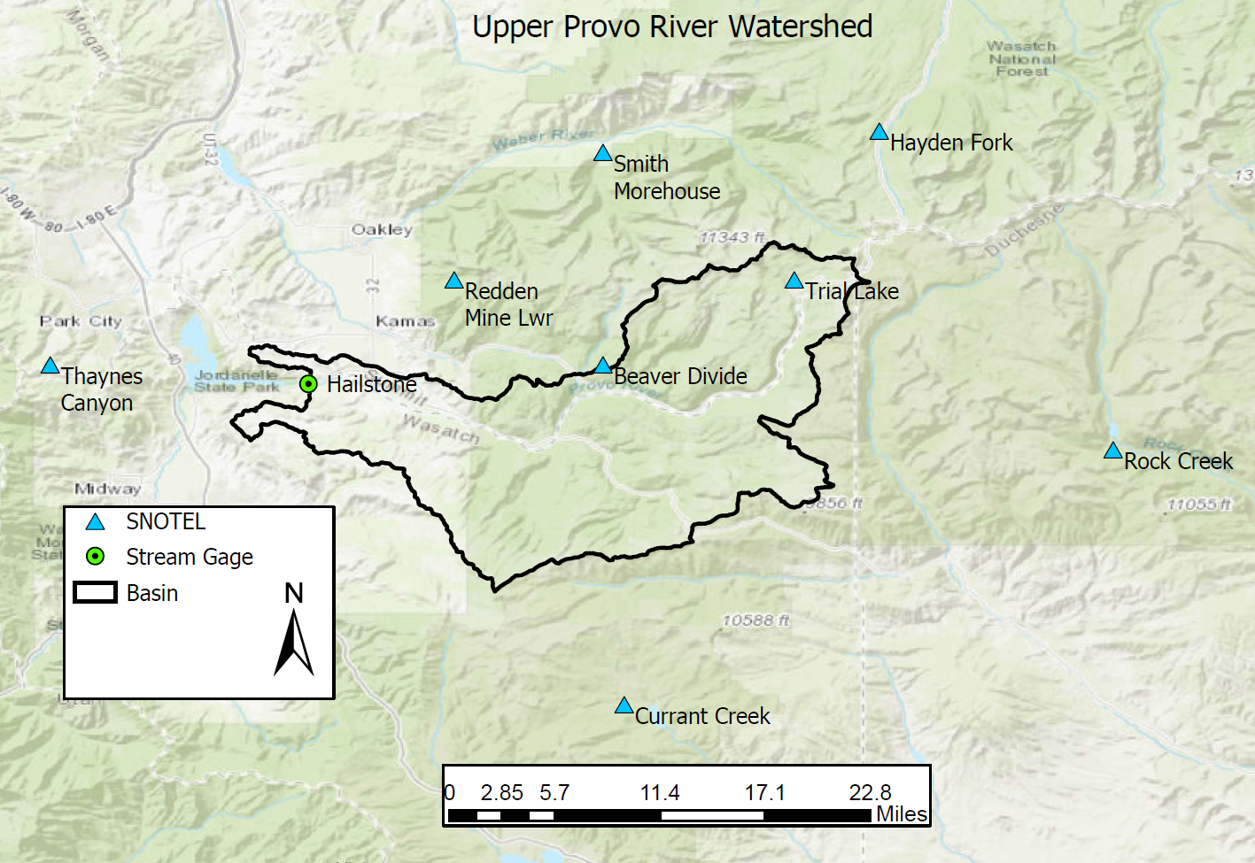
Introduction
58% of Utah’s water comes in the winter months (UDWR)
Spring and summer streamflow
Reservoir Filling
Objective:
Determine if the inflow volume to Jordanelle reservoir can be estimated using the maximum snow water equivalent (swe) values of the contributing watershed.

Slide 4
Methods
Main Inputs:
Determine basin maximum swe values
Compute the inflow volume to Jordanelle Reservoir
Programs:
ArcGIS Pro
Excel
Data Sources:
SNOTEL (NRCS)- swe, depth, and precipitation
United States Geological Survey (USGS)- stream flow data
Colorado Basin River Forecasting Center (CBRFC)- inflow volumes

Slide 5
Methods
Determining basin maximum swe values:
Thiessen polygons
SWE vs. Elevation relationship
Direct comparison of SWE values

Slide 6
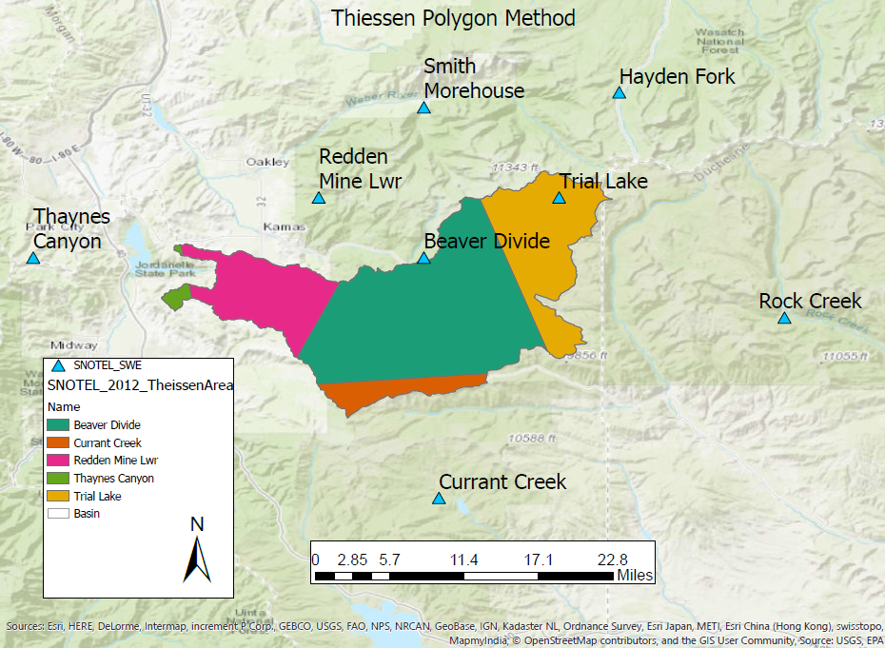
Methods
Determining basin maximum swe values:
Thiessen polygons
$$P_{avg}=\frac{1}{A}∗\sum_{j=1}^{J}{A_{j}∗P_{j}}$$

Slide 7
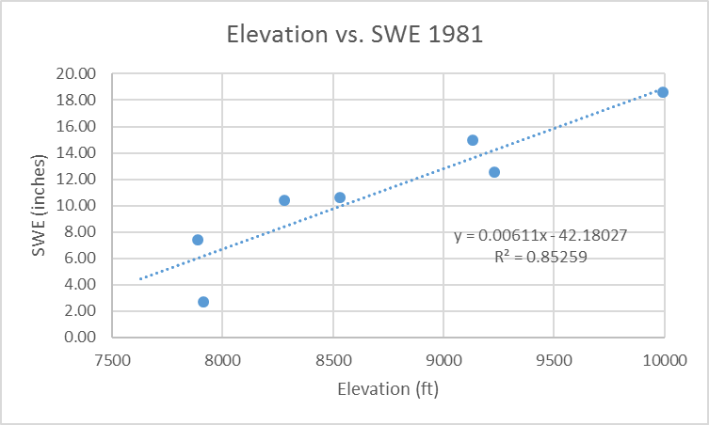
Methods
Determining basin maximum swe values:
SWE vs. Elevation relationship

Slide 8
Methods
Computing the inflow volume to Jordanelle Reservoir
USGS stream flow data
CBRFC data

Slide 9
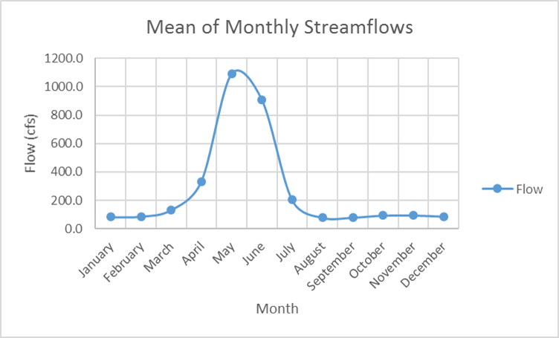
Methods
Computing the inflow volume to Jordanelle Reservoir
USGS stream flow data

Slide 10
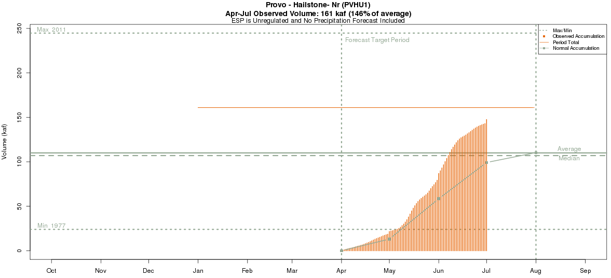
Methods
Computing the inflow volume to Jordanelle Reservoir
CBRFC data

Slide 11
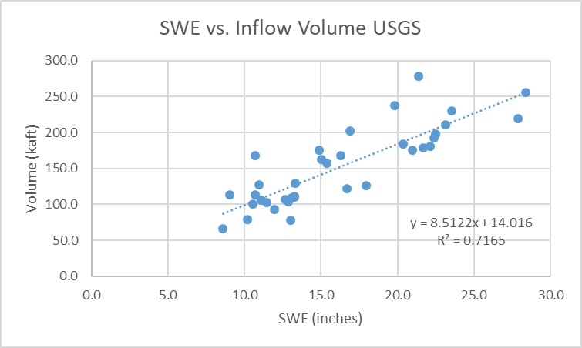
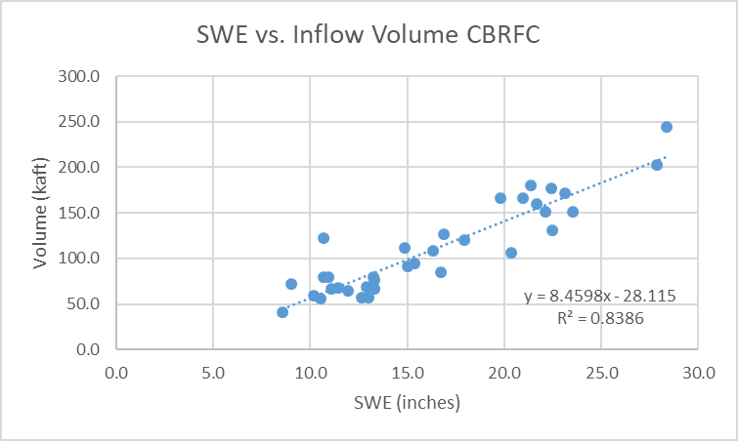
Results
Elevation vs. SWE

Slide 12
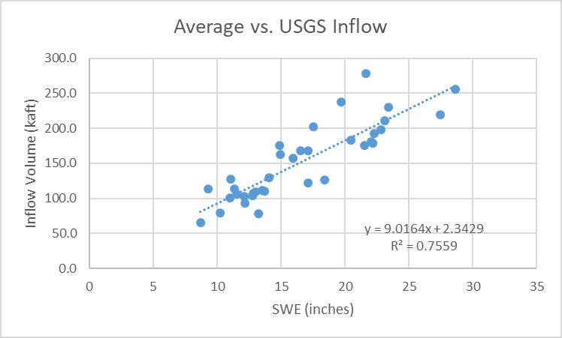
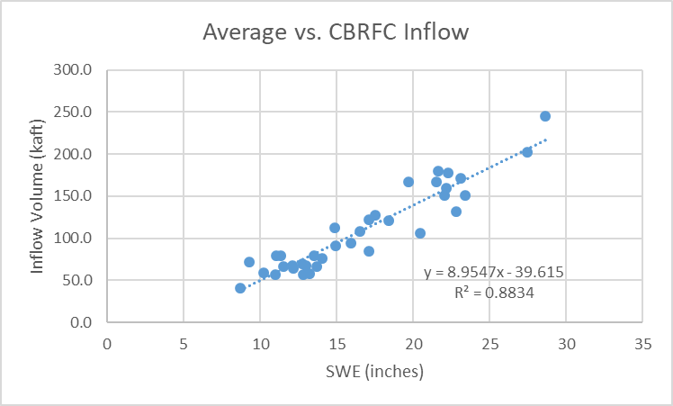
Results
Direct Comparison

Slide 13
Results
Estimating Inflow vs. Actual Inflow

Slide 14
Conclusion
Main findings:
Thiessen polygon method does not do well for this watershed
A direct comparison worked the best
Why does this matter:
Inflow volume into Jordanelle reservoir can be estimated
Determining spring runoff storage
Limitations:
Minimum basin elevation is 6220 ft. The lowest SNOTEL station was at 7631 ft.
Limited data within the watershed
Notes:
Main findings:
Thiessen polygon method does not do well in mountainous regions.
A direct comparison of maximum swe values at each station and CBRFC inflow volumes returns the best result for estimating inflow volumes into Jordanelle reservoir.
Scientific Context
Once swe values reach a maximum value for the current winter, the inflow volume into Jordanelle reservoir can be estimated using this relationship.
Estimating the inflow volume can help prepare for spring runoff storage in the reservoir and determining the firm yield of the reservoir.
Limitations;
Minimum basin elevation is 6220 ft. The lowest SNOTEL station was at 7631 ft.
Does not account for other precipitation
Disregards other physical processes that occur during transport of the water

