Slide 1
Forest Fire Rehabilitation
By: Nathan Wallentine

Slide 2
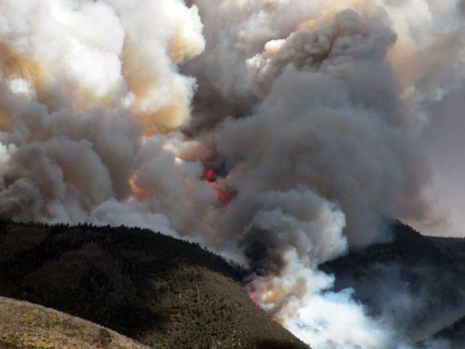
Twitchell Canyon Fire

Slide 3
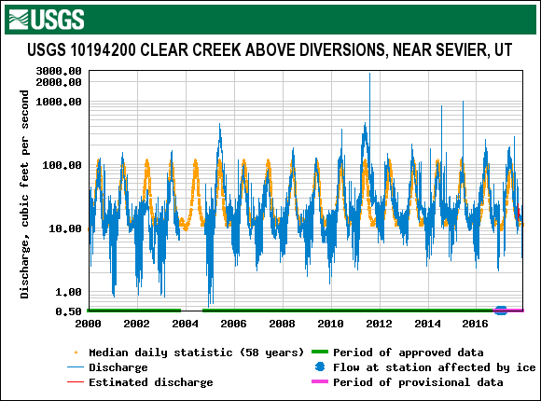
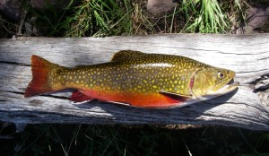
Post Fire Flooding
Record high flow
Fish habitat destroyed

Slide 4
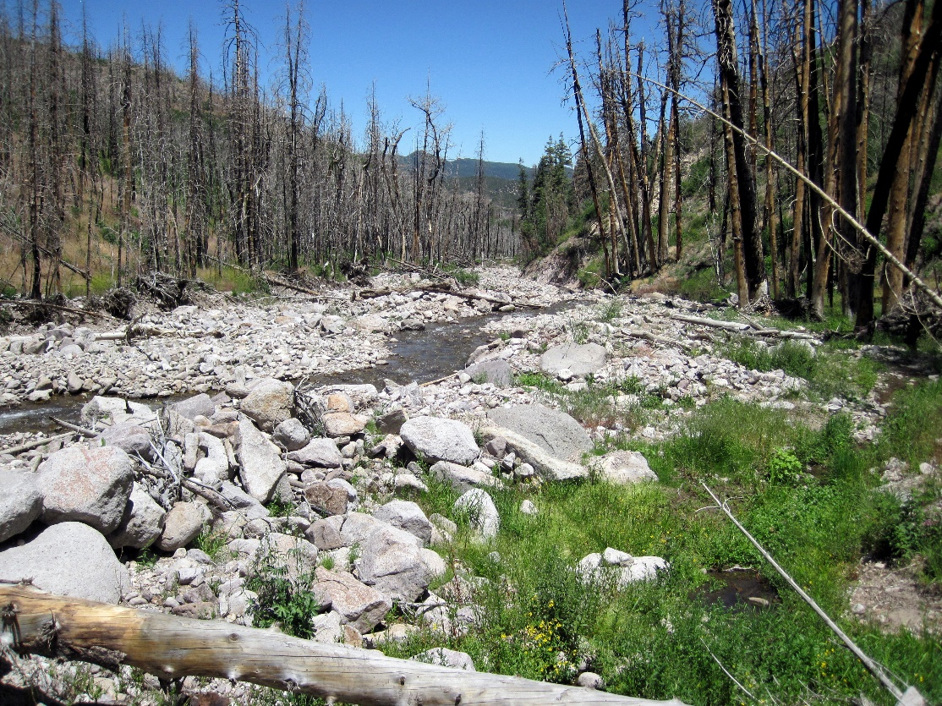
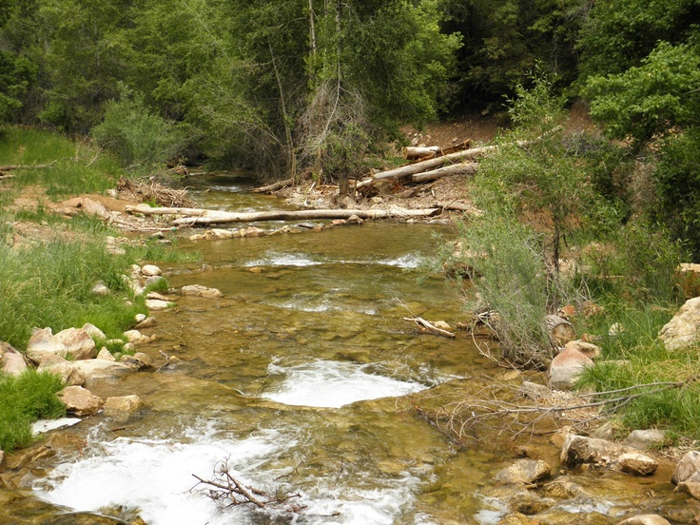
Objective
Predict watershed recovery time

Slide 5
Procedure
NHDPlus
Watershed Boundary
Q/P
Ratio
PRISM
Precipitation Data
USGS
Stream Gage Data

Slide 6
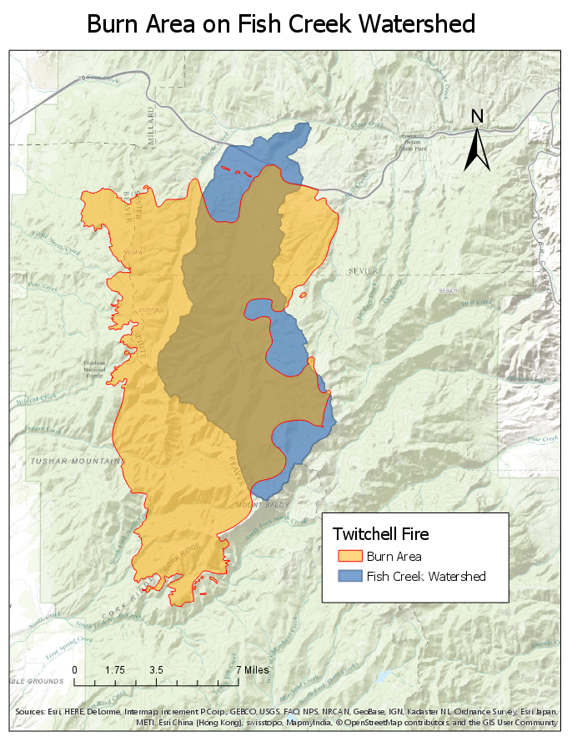
Fire Boundary & Effected Watersheds

Slide 7
Storm Data
USGS stream gage data

Slide 8
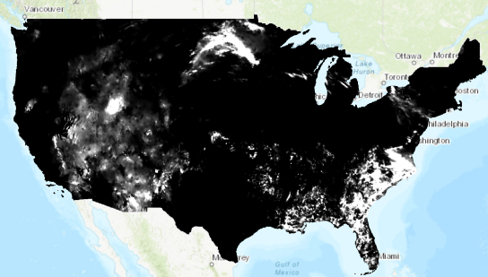
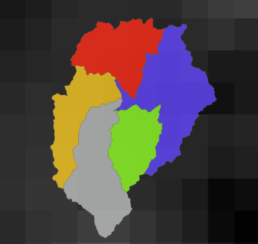
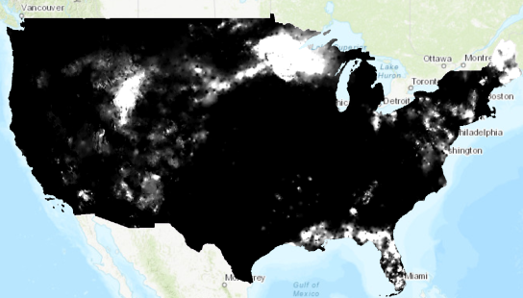
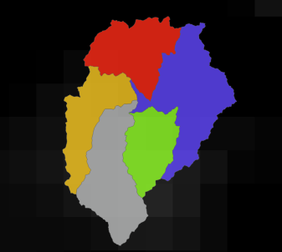
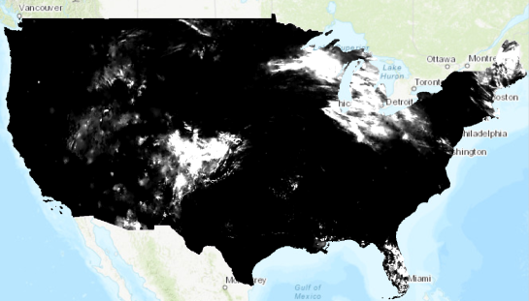
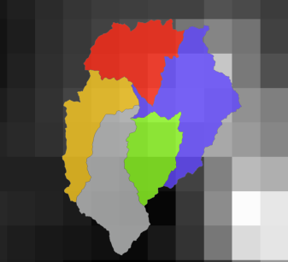
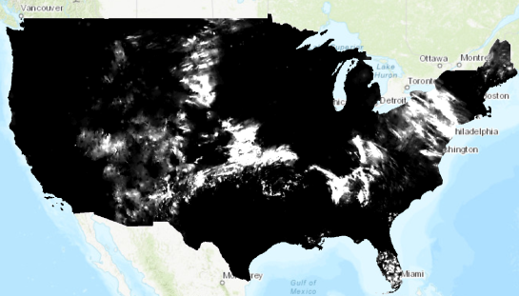
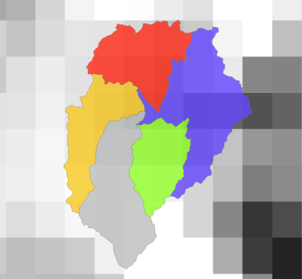
Precipitation
Prism Climate Group
Average Daily Precipitation
Volume In

Slide 9
Clear Creek Discharge
Volume Out
Adjusted Volume Out

Slide 10
Computed Adjusted Runoff Ratio
$Adjusted Runoff Ratio=\frac{Adjusted Volume Out}{Volume In (Precipitation)}$

Slide 11
Conclusion
Format polynomial
Zero slope at Intersection
Normalization 2022
HAPPY FISH

Slide 12
Questions?

