Slide 1
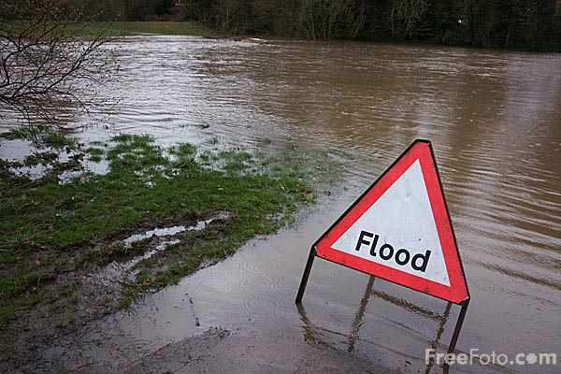
What Causes Flooding along the Logan river
By Garrick Stephenson
Graduate Student in Hydraulics and Fluid Mechanics
CEE 6440

Slide 2
overview
Background
Objective and purpose
Analysis of flood factors
Height above nearest drainage (hand) map
summary

Slide 3
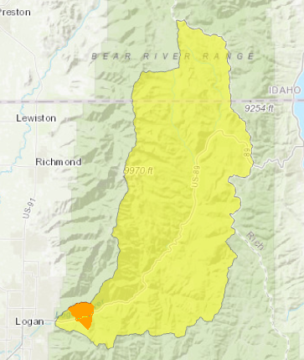
Background

Slide 4
Introduction
Each spring the Logan river has the potential of flooding during spring runoff
Objectives and purpose
Analyze the Logan river watershed to determine factors leading to flooding
Precipitation (snow pack)
Temperature
discharge
Compile height above nearest drainage (HAND) map for Logan canyon

Slide 5
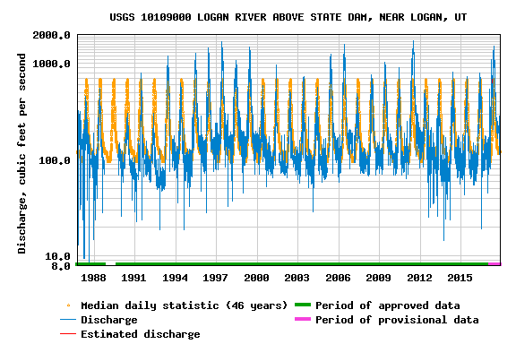
Years of study
Flooding criteria
Full bank (1370 cfs)
Flood stage (1500 cfs)
Flood years
2011 (1710 cfs) , 2017 (1510 cfs)
Normal year
2016 (797 cfs)

Slide 6
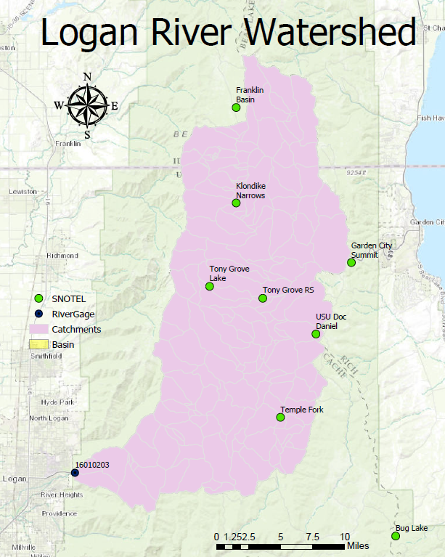
Data Retrieval
Temperature Data
Natural Resources Conservation Service
Snowpack Data
National Oceanic and atmospheric administration
Flow data
U.s. geological survey

Slide 7
Results
Snowpack
Larger snowpack leads to greater runoff

Slide 8
results
Temperature
Larger temperature flux results in smaller runoff

Slide 9
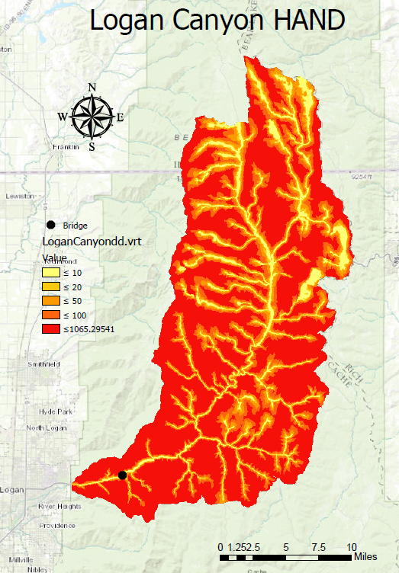
Height Above Nearest Drainage (HAND)
1/3 arc-sec dem from usgs
Cyber gis d8 flow accumulation for stream raster
Cyber gis d-infinity distance down for hand map

Slide 10
Height Above Nearest Drainage (HAND)
Stage-discharge curve for years of study
Stage h (ft) | 0.82 | 1.64 | 2.46 | 3.28 | 4.92 | 6.56 | 13.12
Stage h (m) | 0.25 | 0.50 | 0.75 | 1.00 | 1.50 | 2.00 | 4.00
A_{s} (m²) | 77400.00 | 92000.00 | 107100.00 | 118900.00 | 142600.00 | 167300.00 | 243500.00
A_{b} (m²) | 77500.60 | 92110.40 | 107229.00 | 119061.00 | 142861.00 | 167635.00 | 244961.00
V (m³) | 17802.00 | 39090.80 | 63831.60 | 92254.51 | 157844.00 | 234220.00 | 648197.00
L (m) | 2782.00 | 2782.00 | 2782.00 | 2782.00 | 2782.00 | 2782.00 | 2782.00
A = V/L (m²) | 6.40 | 14.05 | 22.94 | 33.16 | 56.74 | 84.19 | 233.00
P = A_{b}/L (m) | 27.86 | 33.11 | 38.54 | 42.80 | 51.35 | 60.26 | 88.05
R =A/P (m) | 0.23 | 0.42 | 0.60 | 0.77 | 1.10 | 1.40 | 2.65
S_{o} | 0.01 | 0.01 | 0.01 | 0.01 | 0.01 | 0.01 | 0.01
n | 0.05 | 0.05 | 0.05 | 0.05 | 0.05 | 0.05 | 0.05
Q (m³/s) | 5.43 | 17.94 | 36.71 | 63.25 | 137.09 | 237.89 | 1007.75
Q (cfs) | 191.54 | 633.28 | 1295.78 | 2232.61 | 4839.31 | 8397.35 | 35573.46
 |  | Q (cfs) | stage h (m)
 | 2017 | 1510 | 0.8
 | 2011 | 1710 | 0.85
 | 2016 | 797 | 0.6

Slide 11
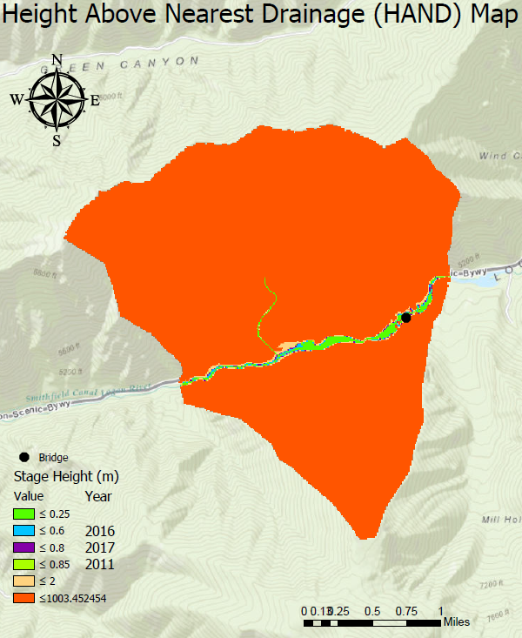
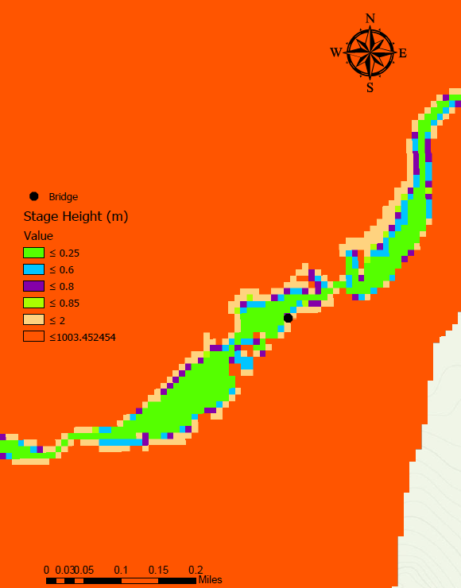
Height Above Nearest Drainage (HAND)

Slide 12
summary
Factors contributing to flooding
Larger snowpack will lead to greater runoff.
Consistent Warm temperatures will lead to greater runoff.
Limitations
Availability of historical data (number of years used)
Thiessen polygon method (number of Snotel sites)
Other factors leading to flooding (debris, rain, etc.)
What’s next?
increase years of study
Forecast future flood events

Slide 13
Questions?

