Slide 1
Determining Future Water Supply in Washington County
Megan Montgomery
Cee 6440
Fall 2017
science.time.com

Slide 2
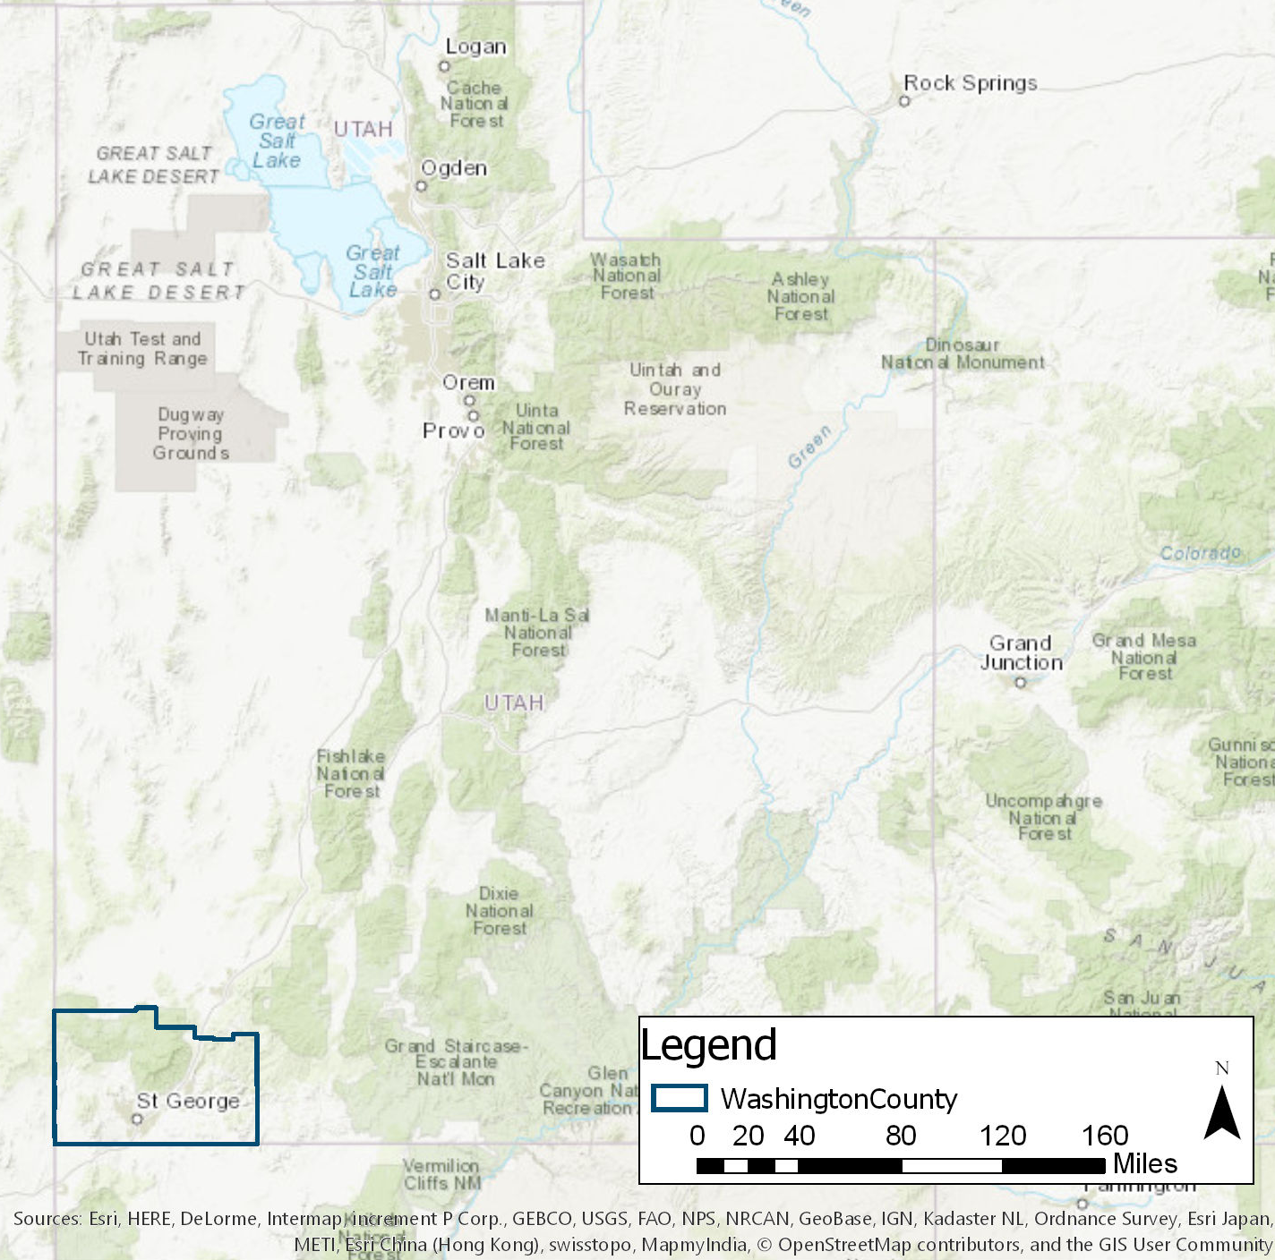
Introduction
Arid climate
Rapid Population growth
Climate Change

Slide 3
Objective
Determine if there an adequate water supply to sustain the population through 2060
tripadvisor.com

Slide 4
Methods
Use as of 2010
325 Gallons Per Capita Per Day (GPCD)
Yearly water Demand of 50,500 Acre-Feet
68,000 Acre-Feet Per Year of reliable yield
Use By 2060
285 GPCD
Yearly water Demand of 186,000 Acre-Feet
210,000 Acre-Feet Per Year of reliable yield
sandhollowresorts.com

Slide 5
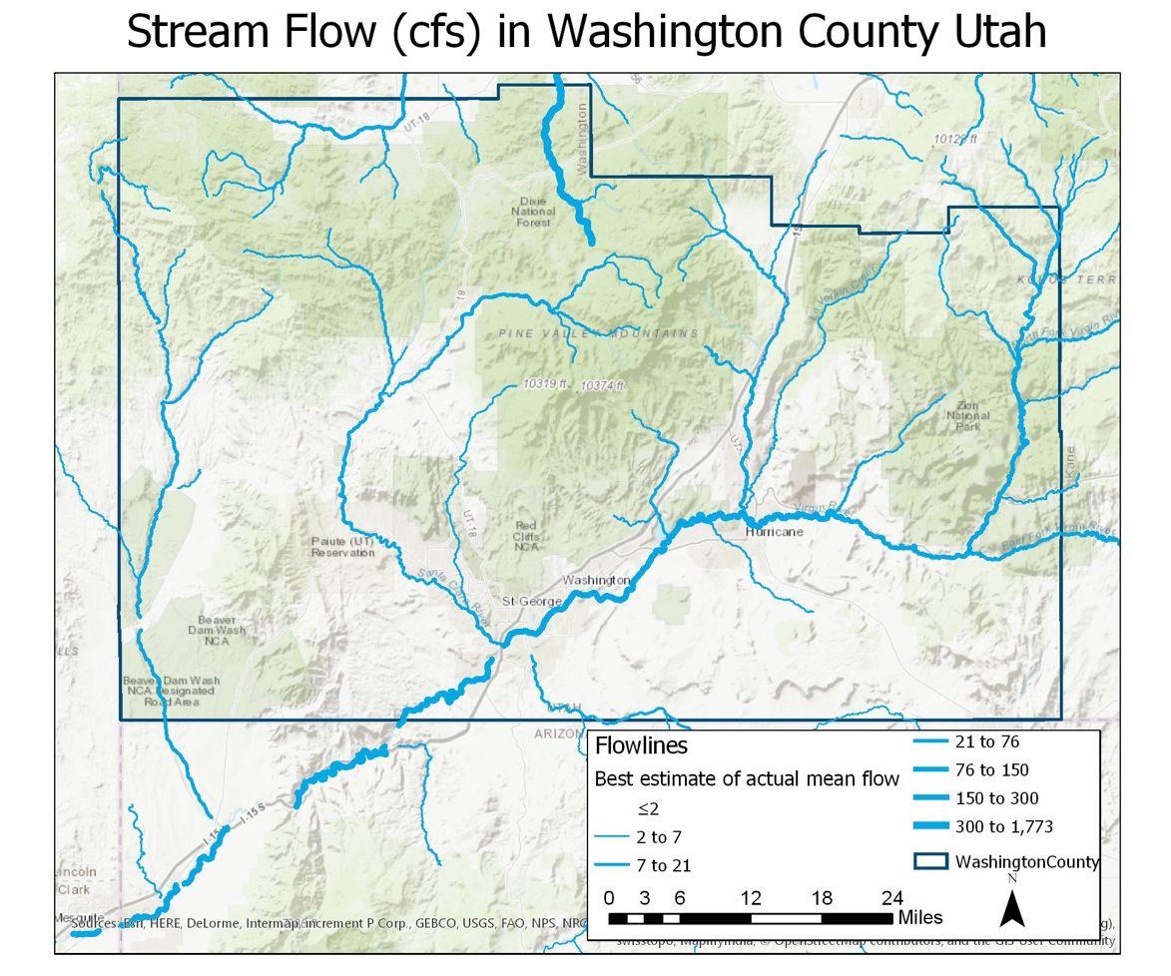
Methods
Average Temperature 57.7 ° F
Average Precipitation 1.11 feet
Net flow out of county 0.05 Feet

Slide 6
Methods
Method | Change in Temperature (°F) | % Change in Flow | % Change in Precipitation
Linear Regression | 3.30 | -17.2 | N/A
RCP 2.6 | 1.33 | -6.96 | -20.5
RCP 4.5 | 2.63 | -13.8 | 1.49
RCP 6.0 | 2.05 | -10.7 | 20.5
RCP 8.5 | 3.61 | -18.9 | 14.1

Slide 7
Methods
Potential Evapotranspiration (PET) is 4.12 Feet
For Average Change in Temperature of 3.30°F
Change in flow ($\frac{δQ}{Q}$) of 17.2%
Climate Elasticity ($ε$) 2.68
$$PET=1.2∗{10}^{10}∗e^{−4620∗T}$$
$$\frac{δQ}{Q}=−\frac{5.54∗{10}^{13}∗e^{−\frac{4620}{T}}}{T^{2}∗P∗{\left[1+{\left(\frac{PET}{P}\right)}^{w}\right]}^{1+\frac{1}{w}}∗\left[1−\frac{PET}{{\left(P^{w}+{PET}^{w}\right)}^{1/w}}\right]}∗dT$$
$$ε\left(Q,P\right)=\frac{dQ/Q}{dP/P}=\frac{1−\frac{1}{{\left[1+{\left(\frac{PET}{P}\right)}^{w}\right]}^{1+\frac{1}{w}}}}{1−\frac{PET}{{\left(P^{w}+{PET}^{w}\right)}^{1/w}}}$$

Slide 8
Results

Slide 9
Results

Slide 10
Results

Slide 11
Conclusions
Enough water to sustain population Growth through 2060
Conservation is essential
Development of Local resources
Limited by Available Data
travel.mapquest.com

