Slide 1
GIS Analysis of Impaired Waters in Utah
Ridley Griggs
CEE 6440: GIS in Water Resources
December 5, 2017

Slide 2
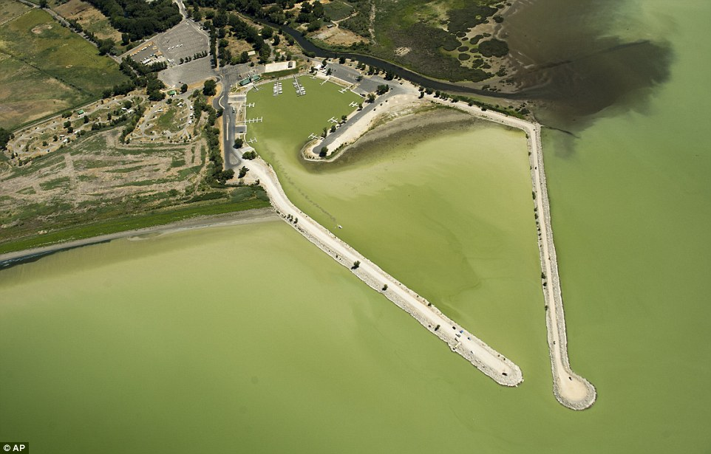
EPA Impaired Waters
Waters that do not meet state water quality guidelines
Possibilities:
Nutrients
Temperature
Oxygen
Etc.
[1]

Slide 3
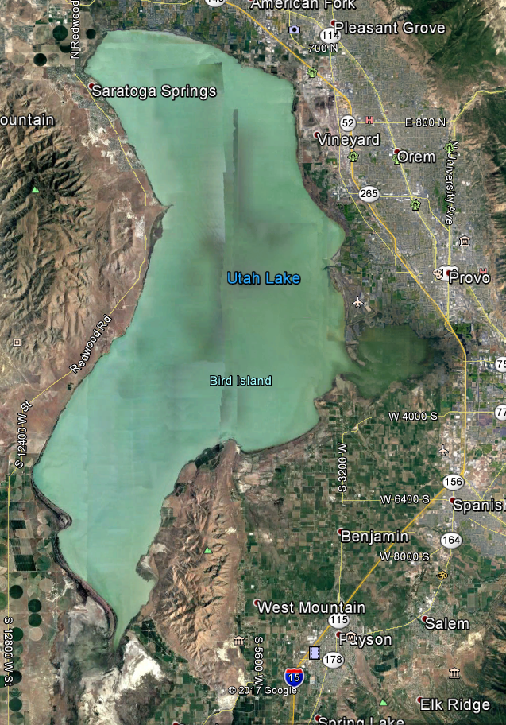
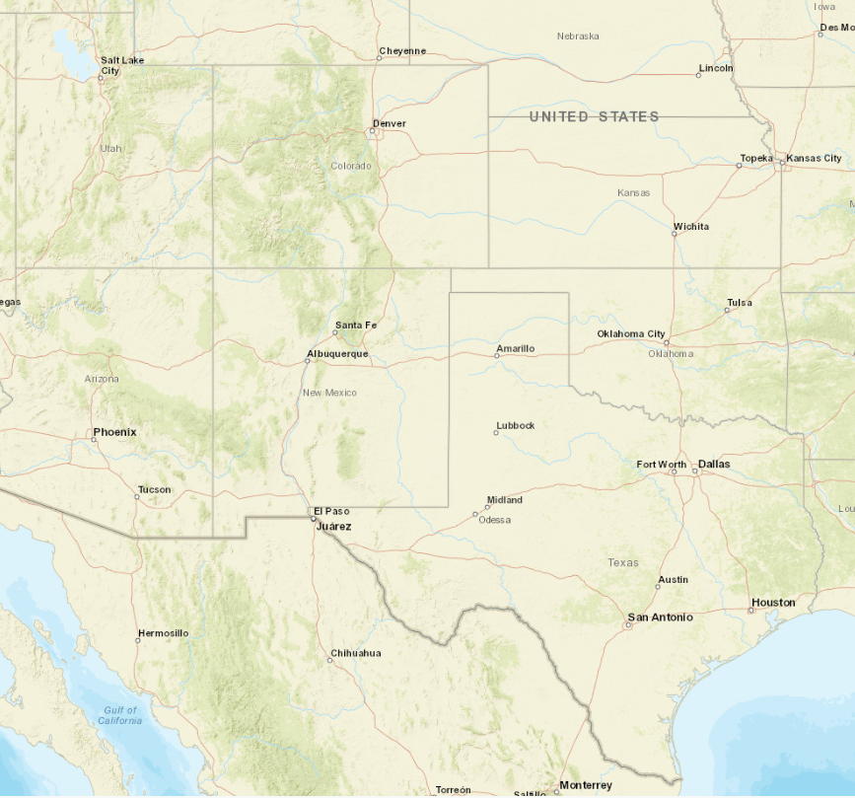
[1]

Slide 4
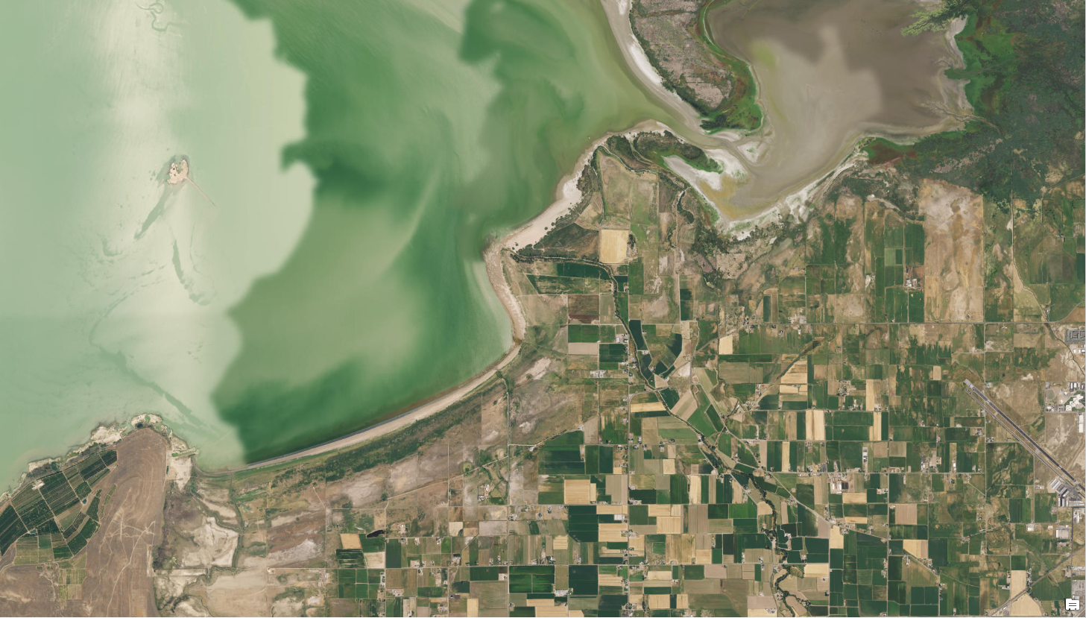

Slide 5
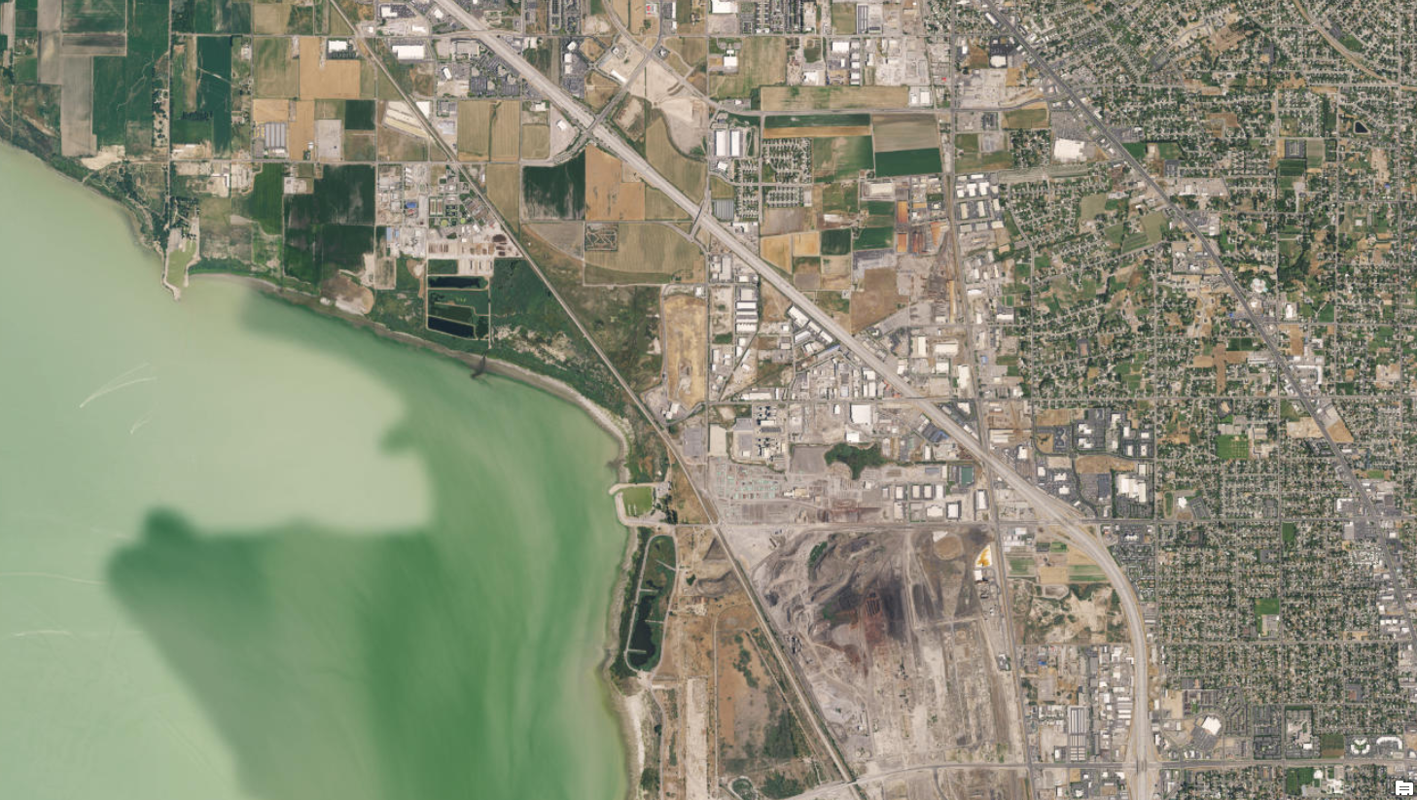
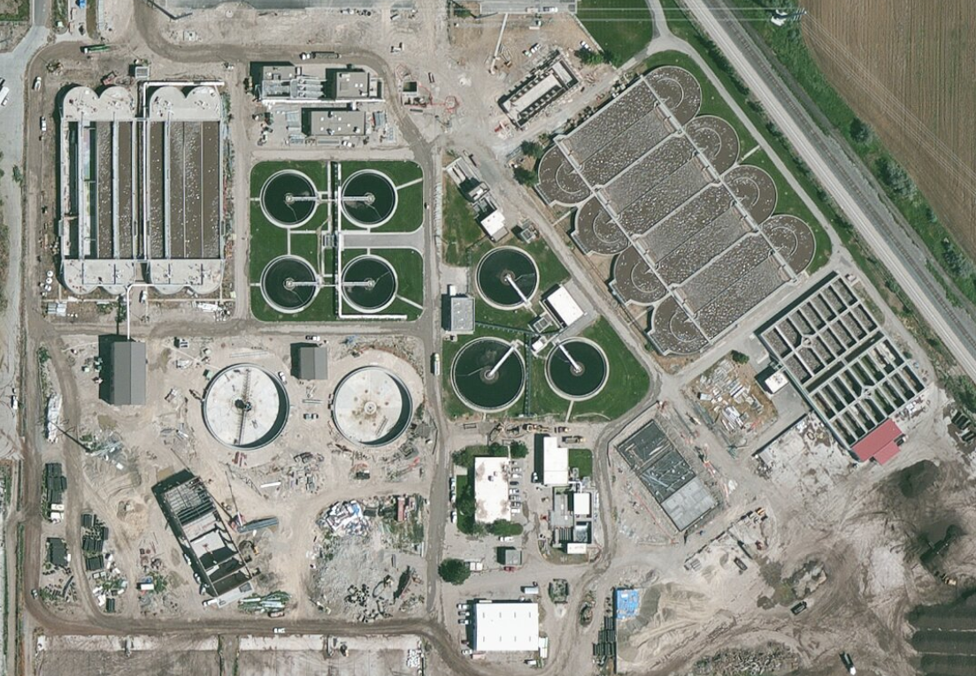
Notes:
Population of Utah County is ~575,000
Timp SSD treatment plant
4 WTPs, 3 not meeting phosphorus rule

Slide 6
[7]

Slide 7
Objectives
Use GIS to investigate watersheds of impaired waters
Investigate land cover and land use as possible indicators of impairment
Investigate other factors, including point sources and irrigated land

Slide 8
Methodology
Define three classes of water body for study:
Large warm water lakes/reservoirs
Large mid-elevation lakes/reservoirs
High-altitude lakes
Select two impaired water bodies of a similar class
Select two non-impaired water bodies of a similar class to act as a control
Analyze all water bodies in a similar manner and test for differences

Slide 9
Hypothesis
Land cover and use contribute to water quality issues
Agricultural land and developed land will contribute to impairment
Developed land is likely surrogate for point sources
Large lakes/watersheds will display strongest correlation
Small watersheds will be most uncertain

Slide 10
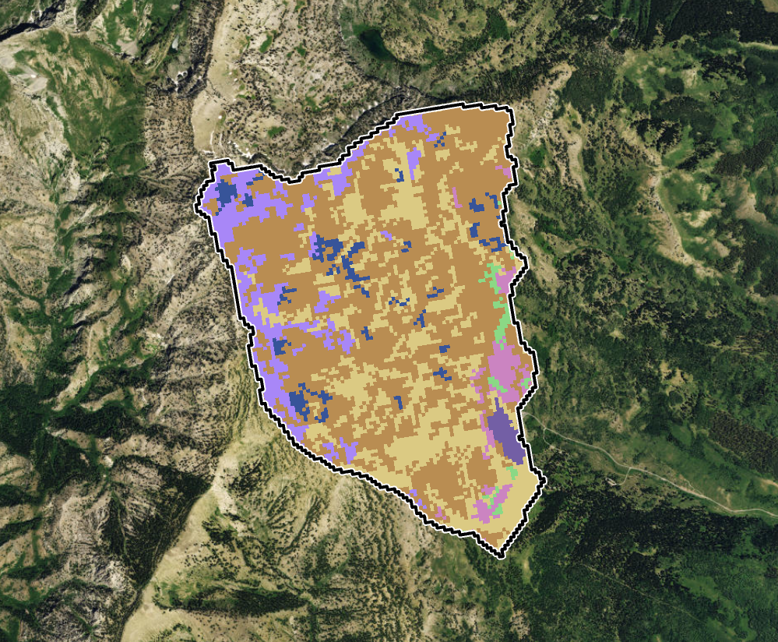
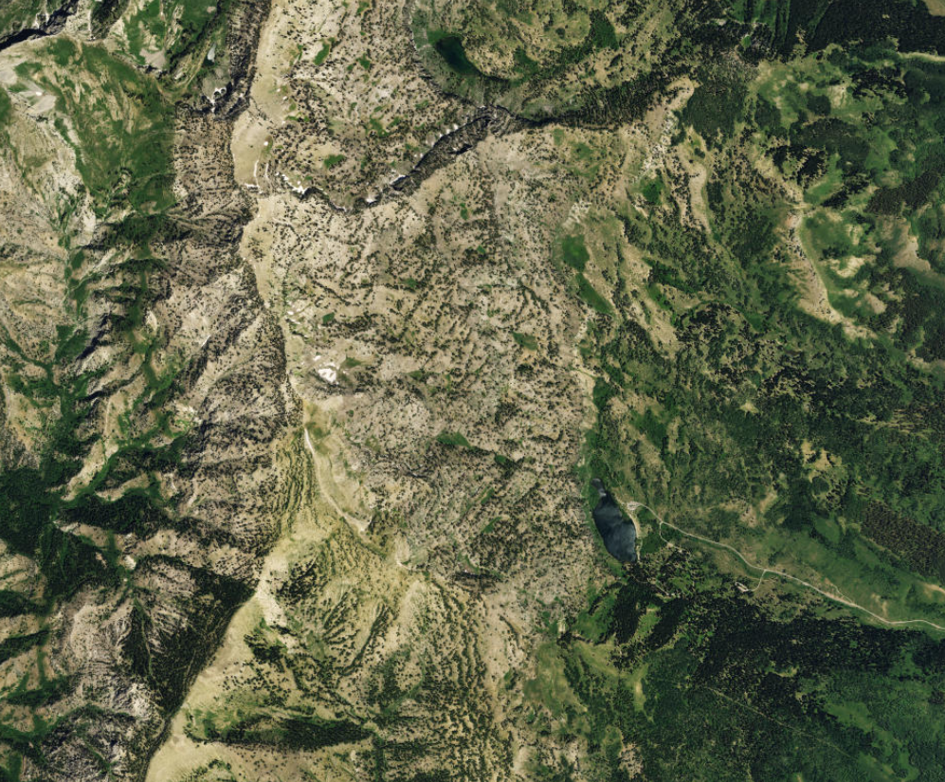
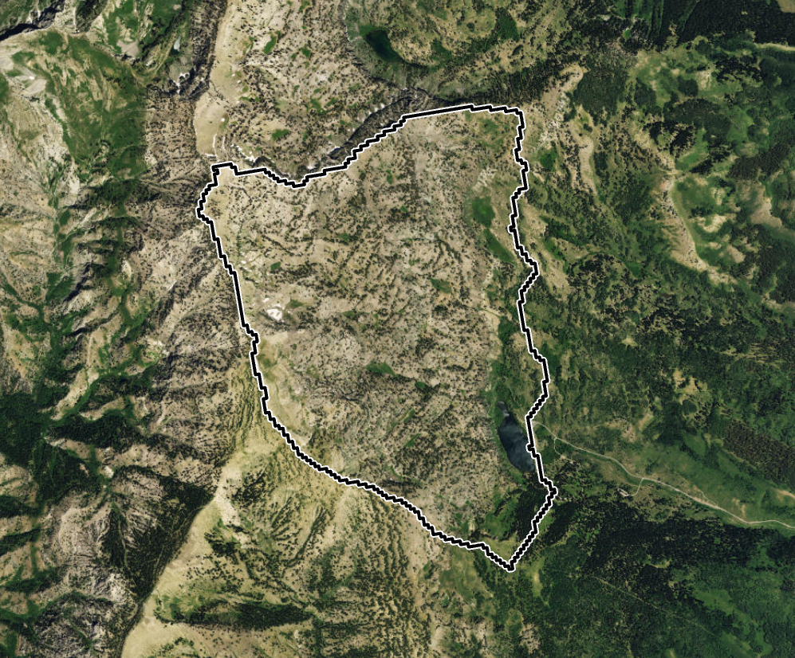

Slide 11
Large Warm Water Lakes/Reservoirs

Slide 12
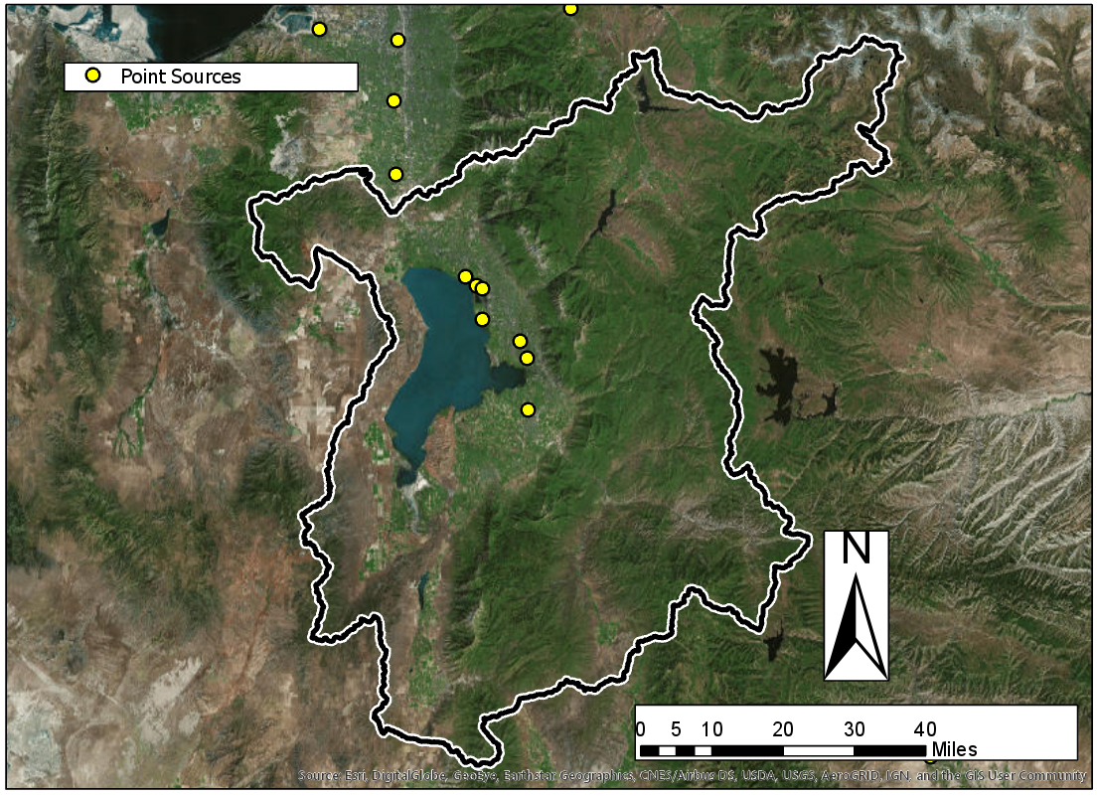
Impaired: Utah Lake

Slide 13
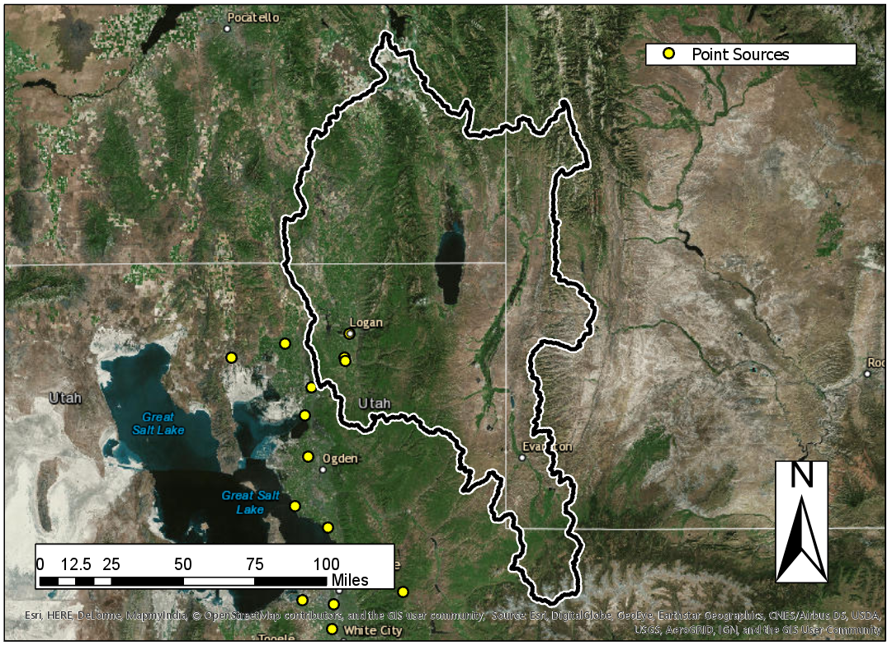
Impaired: Cutler Reservoir

Slide 14
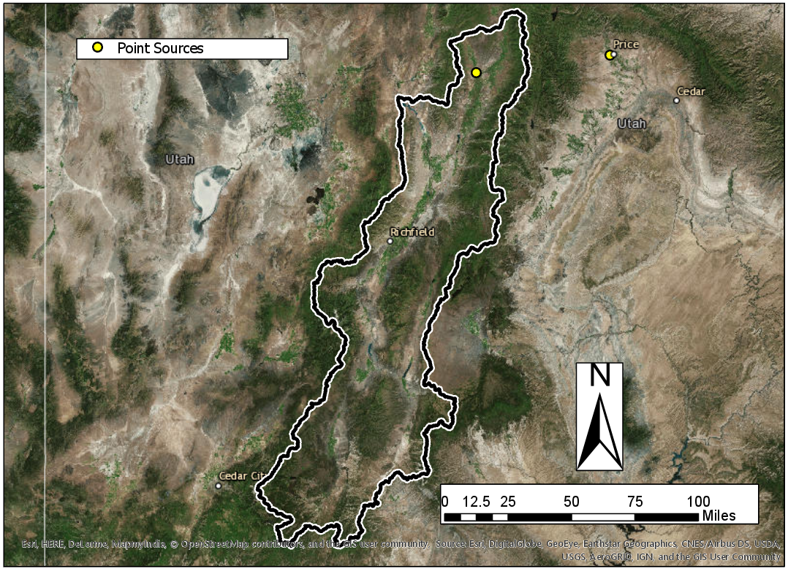
Control: Yuba Reservoir

Slide 15
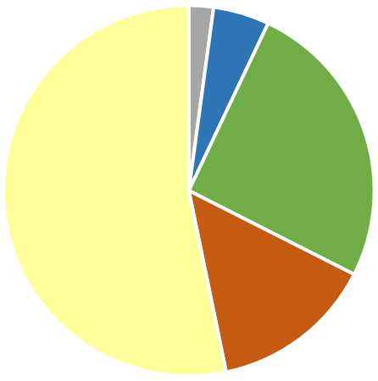
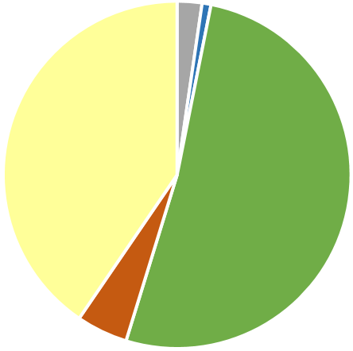
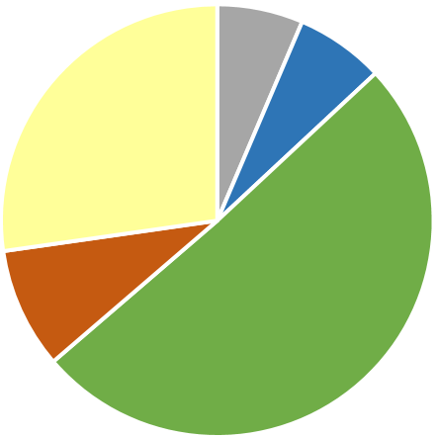
Impaired Not Impaired
Cutler
Reservoir
Yuba
Reservoir
Utah Lake

Slide 16
Large Mid-elevation Reservoirs

Slide 17
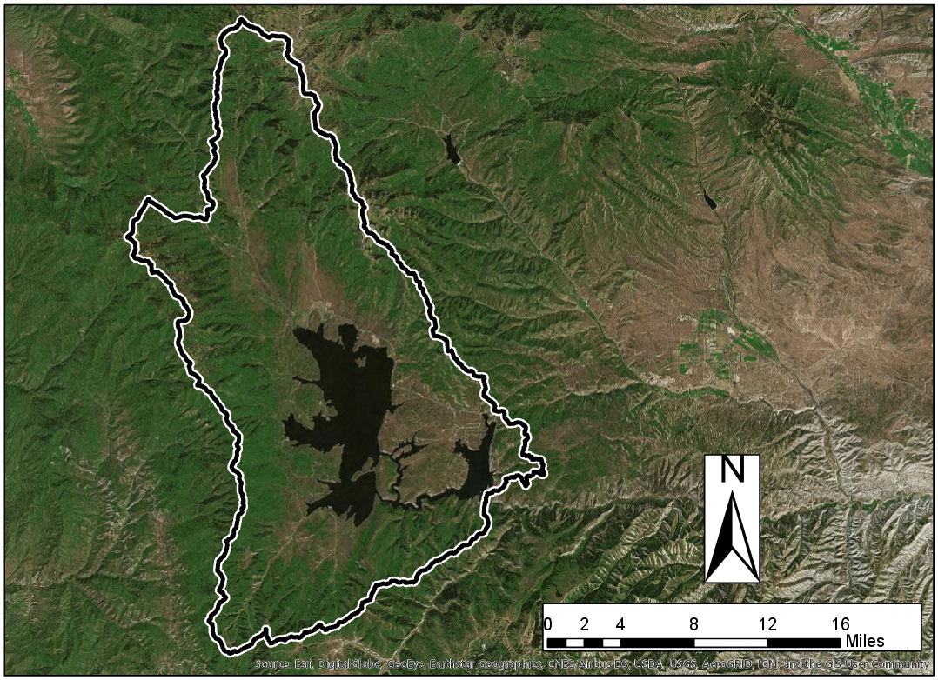
Control: Strawberry Reservoir

Slide 18
Control: Jordanelle Reservoir

Slide 19
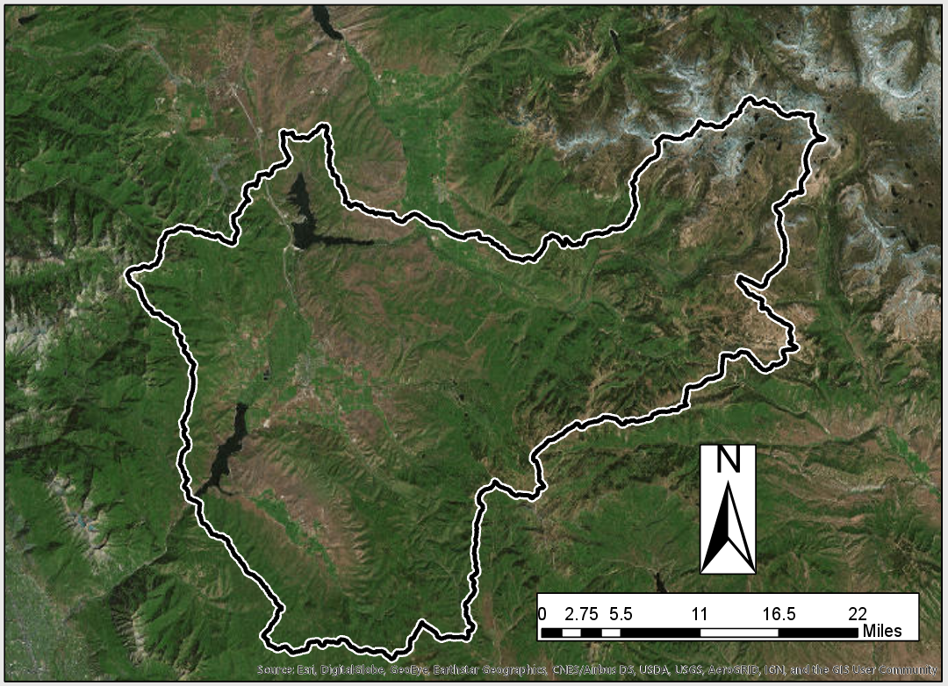
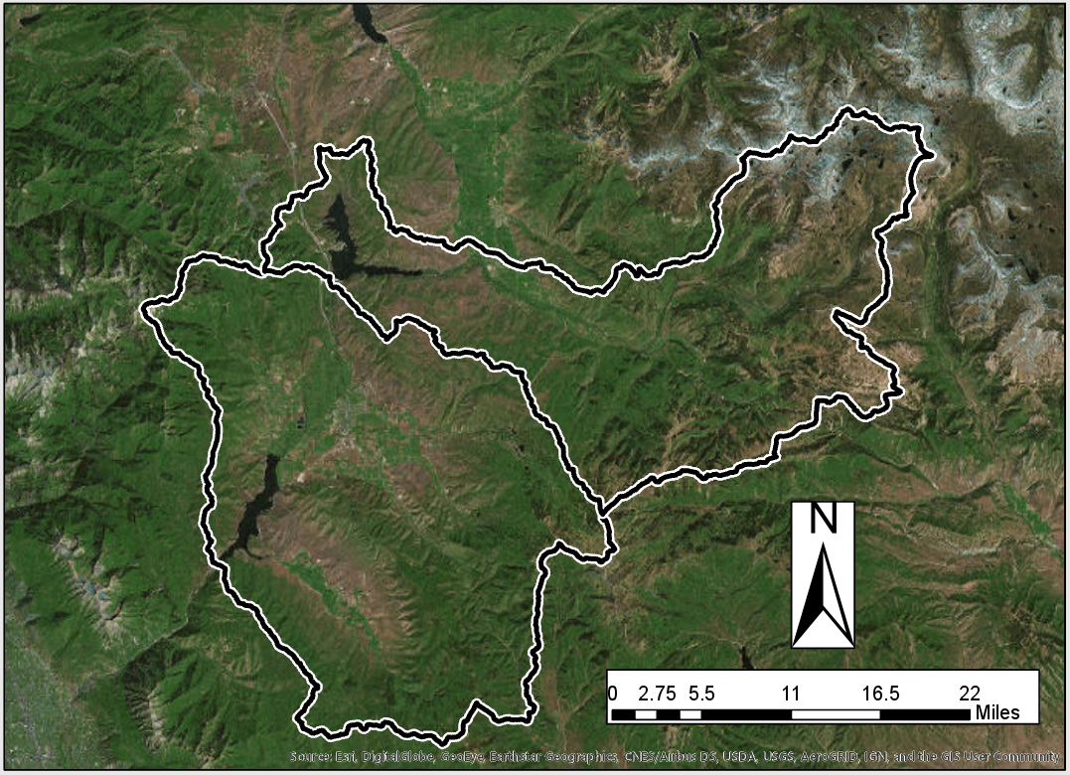
Impaired: Deer Creek Reservoir

Slide 20
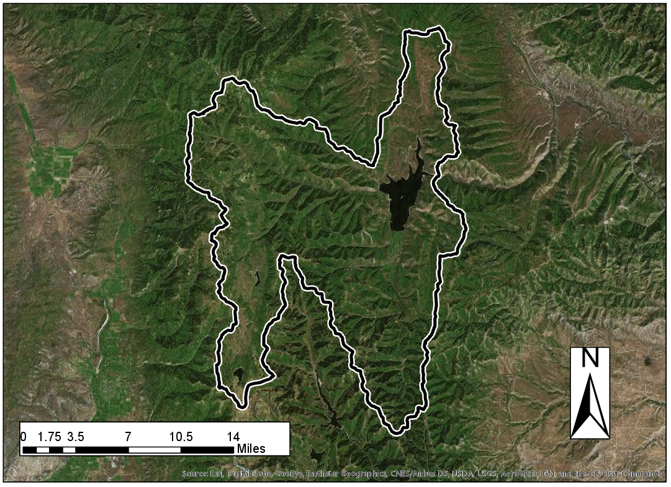
Impaired: Scofield Reservoir

Slide 21
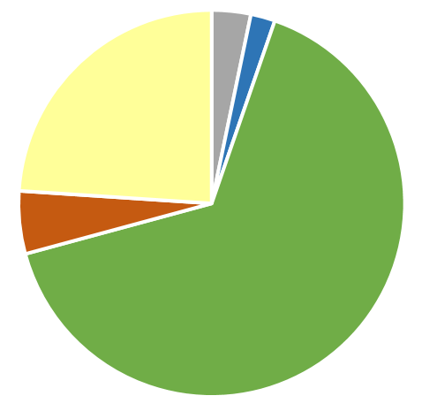
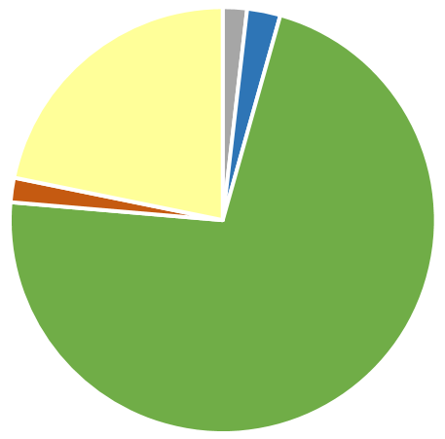
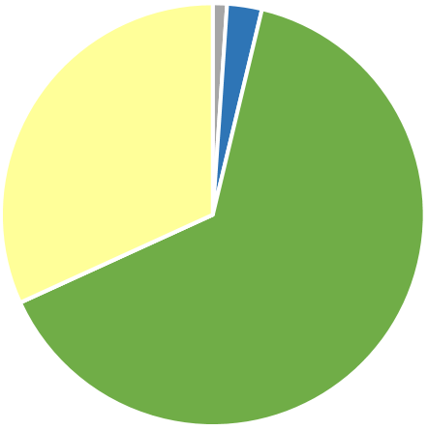
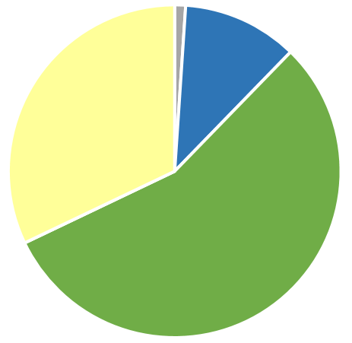
Impaired Not Impaired
Deer Creek
Reservoir
Jordanelle
Reservoir
Scofield
Reservoir
Strawberry
Reservoir

Slide 22
High-Altitude Lakes

Slide 23
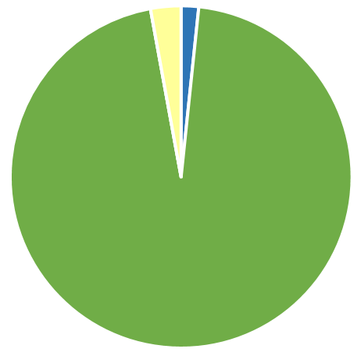
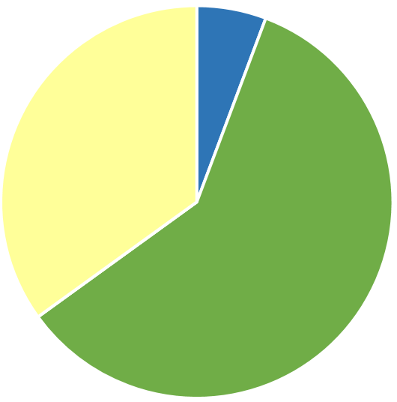
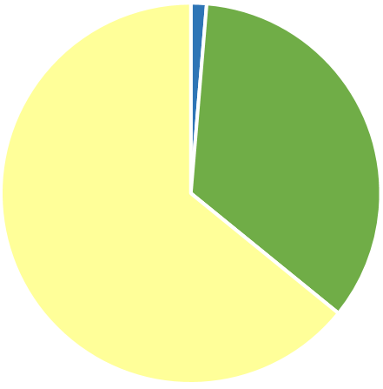
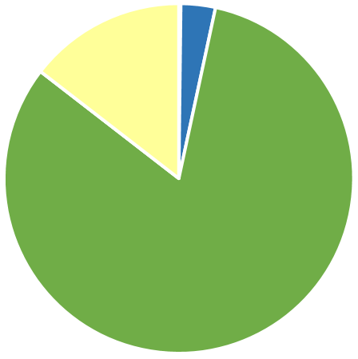
Impaired Not Impaired
Bridger Lake
Lake Mary
Tony Grove Lake
Whitney
Reservoir

Slide 24
Other Factors

Slide 26
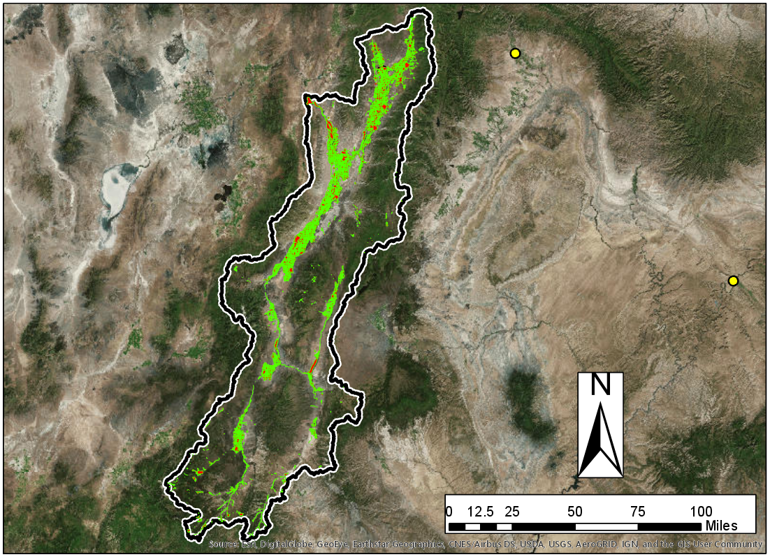

Slide 27
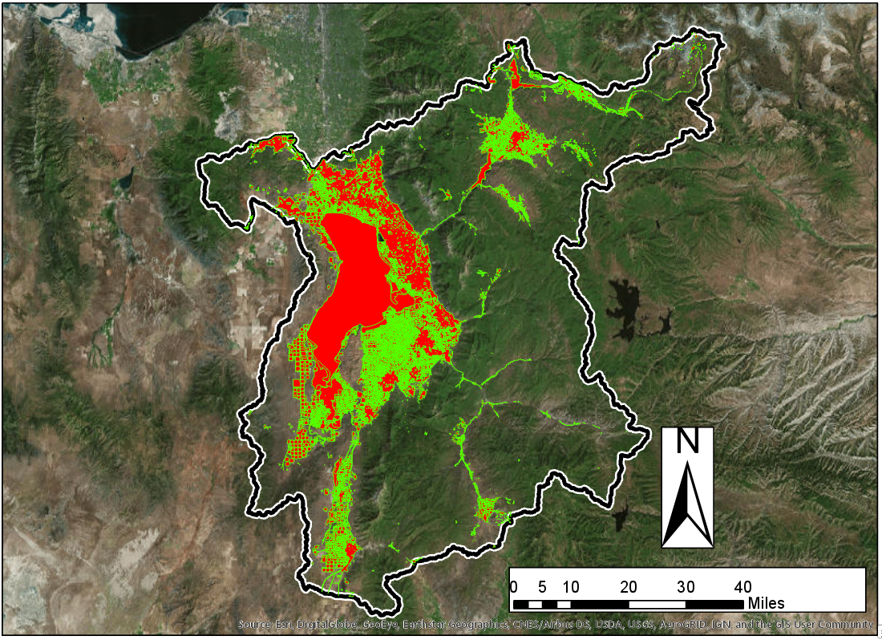

Slide 28
Conclusions
Data for larger watersheds generally supported the hypothesis
Characteristics of water body contribute significantly to water quality
Uncertainty makes a quantitative approach difficult
GIS tools provided a quick way to qualitatively evaluate watershed characteristics

Slide 29
References
[1] http://archive.sltrib.com/article.php?id=4299784&itype=CMSID

