Slide 1
Evaluating the long-term future of fine sediment in Lake Powell
Madeline Friend
CEE 6440
December 7, 2017

Slide 2
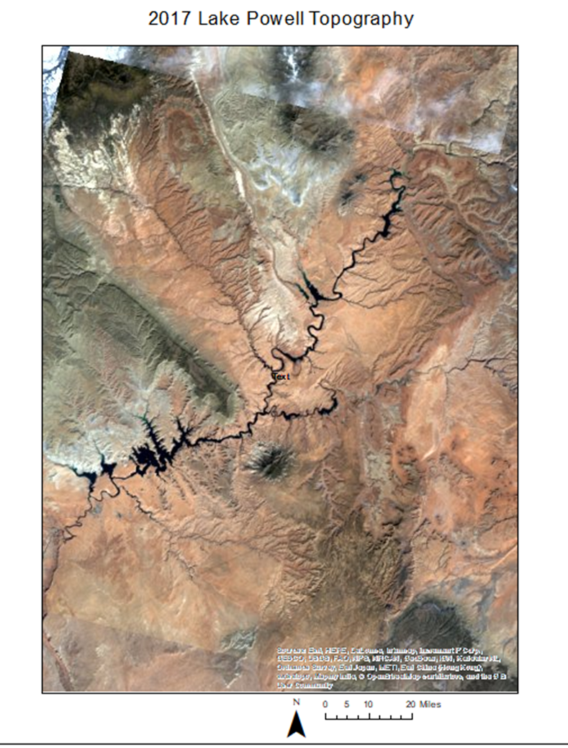
Overview
Lake Powell Aerial View
Introduction: Where? When? Who?
Purpose: Why?
Analysis: How?
Case Study
Summary: What?
Beyond this course: What’s next?

Slide 3
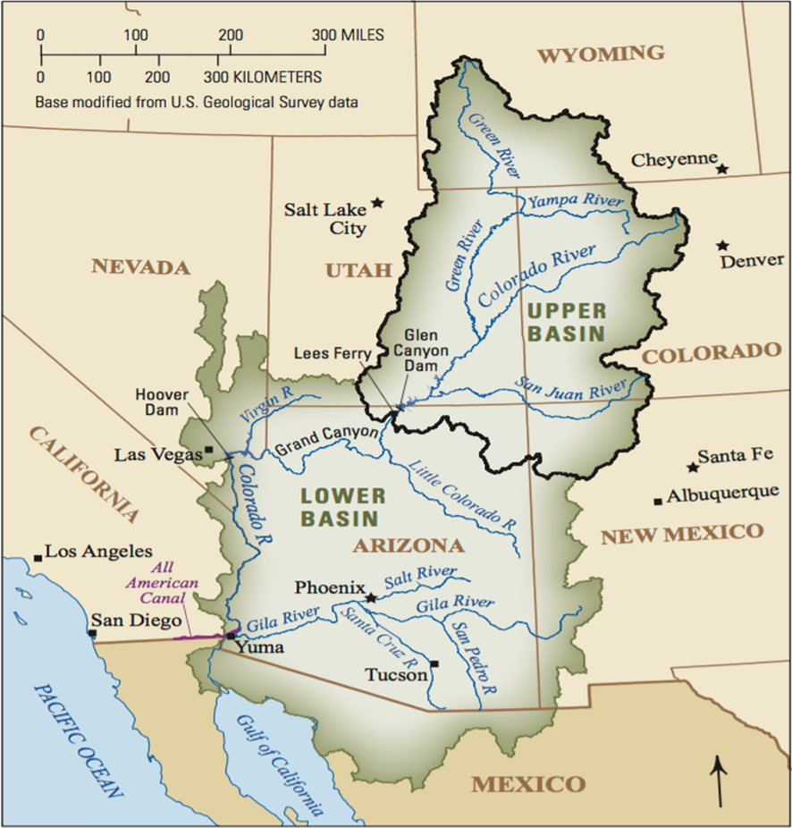
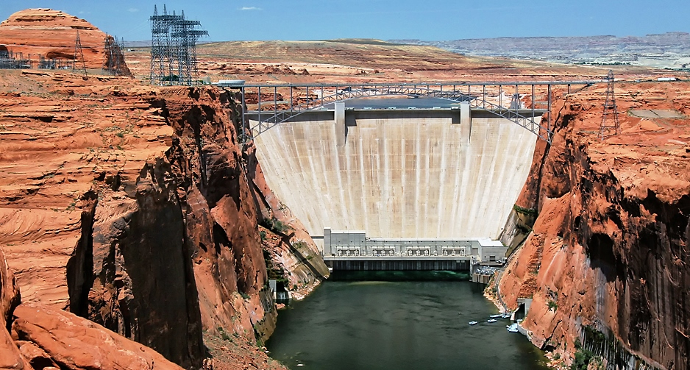
Introduction
Lake Powell and Glen Canyon Dam
Second-largest reservoir in the United States
Supports more than 38 million people
Upper Basin water repository on Colorado River
Law of the River mandates 8.23 million acre feet transferred from Lake Powell to Lake Mead annually
Photo: Bureau of Reclamation

Slide 4
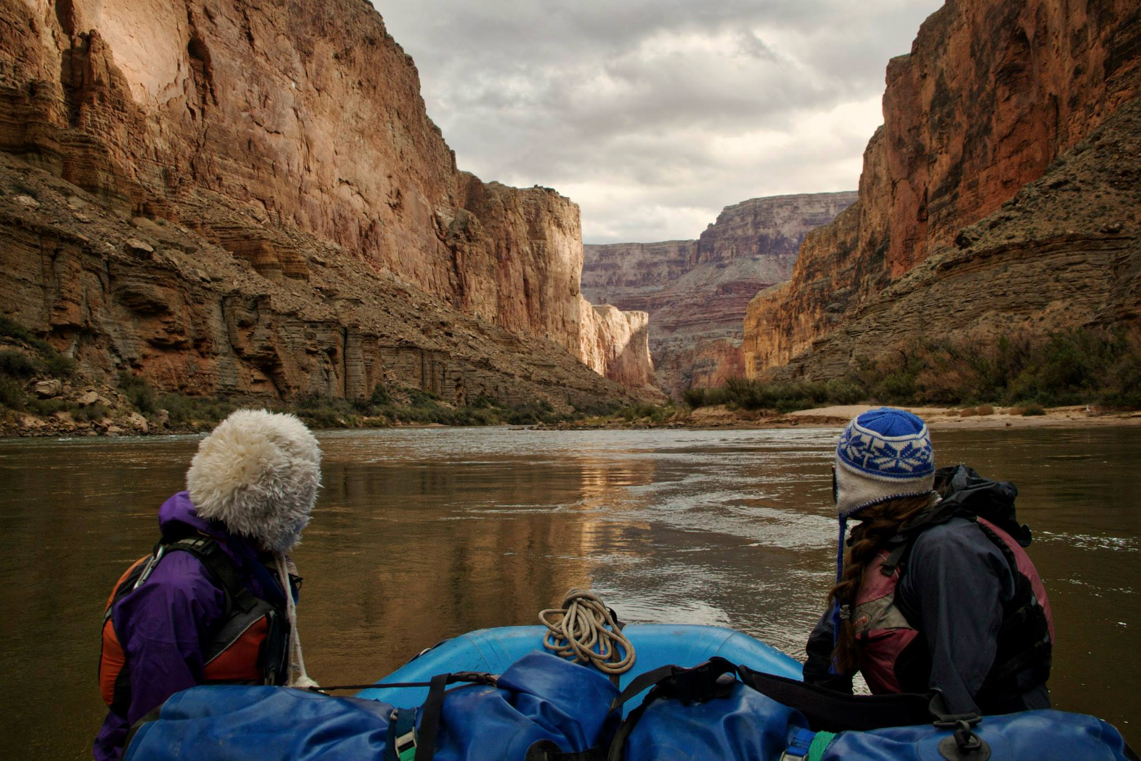
Introduction
Downstream importance: Grand Canyon and beyond
Photo: Amy Martin

Slide 5
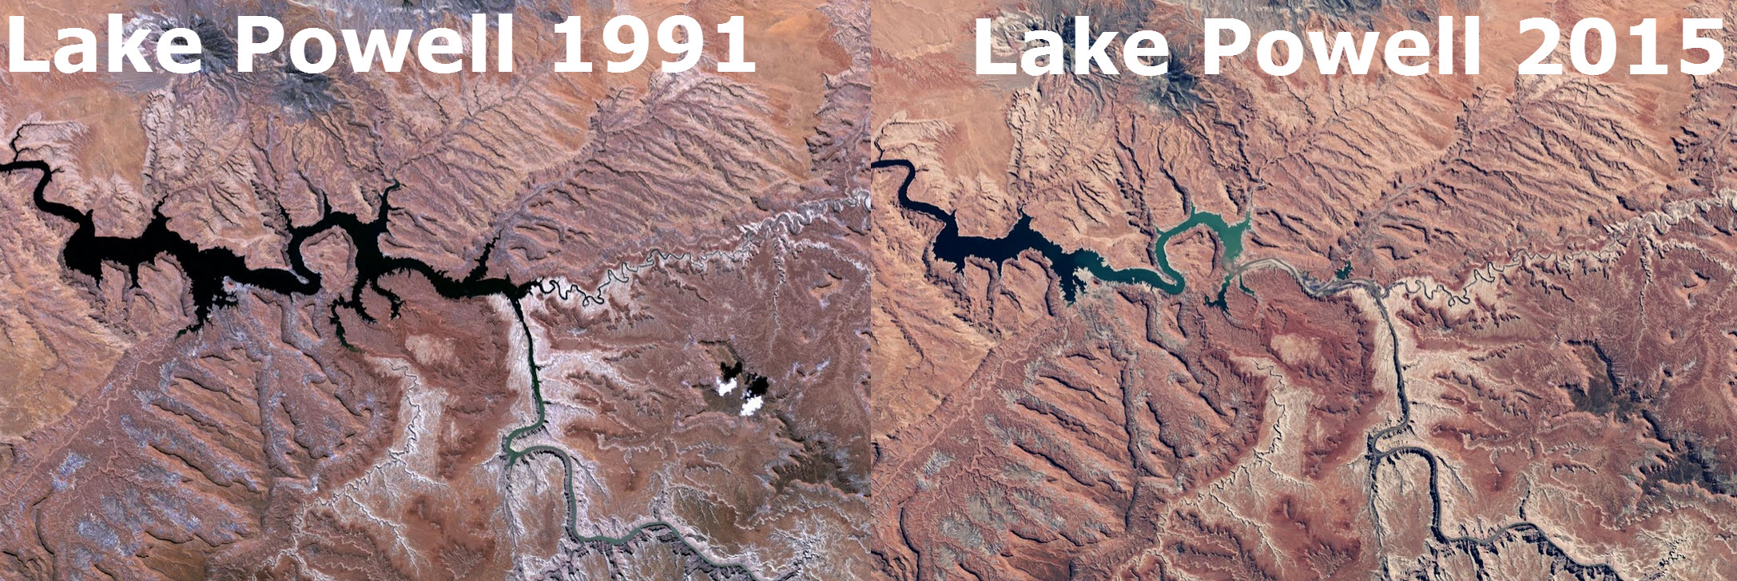
Purpose
How much storage capacity of Lake Powell is filled with sediment?
Relationship between changing reservoir levels, catchment input, and geology

Slide 6
Analysis: Data Sources
Elevation
ArcGis online servers
Streams
NHDPlus
USGS Stream Stats, Version 4 (Beta)
Valuable for understanding basin characteristics of ungaged sites
Geology
USGS integrated geologic databases

Slide 7
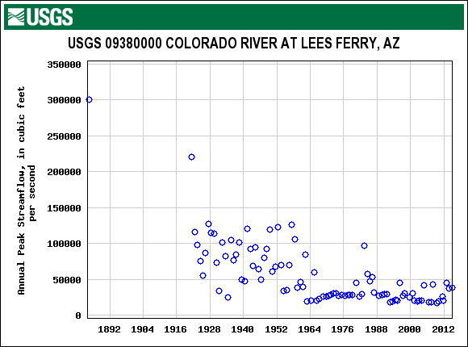
Analysis: Basin Delineation
Upstream of Colorado River at Lees Ferry
USGS Gage 09380000

Slide 9
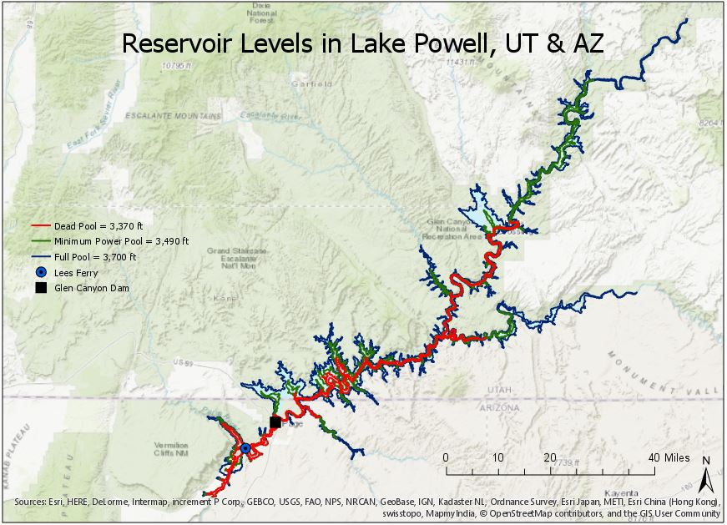
Analysis: Stream Properties & Hydrologic Terrain

Slide 11
Analysis
Calculated contributing catchments at various reservoir levels
Full pool (3,700 ft. = 1,128 m)
Minimum power pool (3,490 ft. = 1,064 m)
Dead pool (3,370 ft. = 1,027 m)

Slide 12
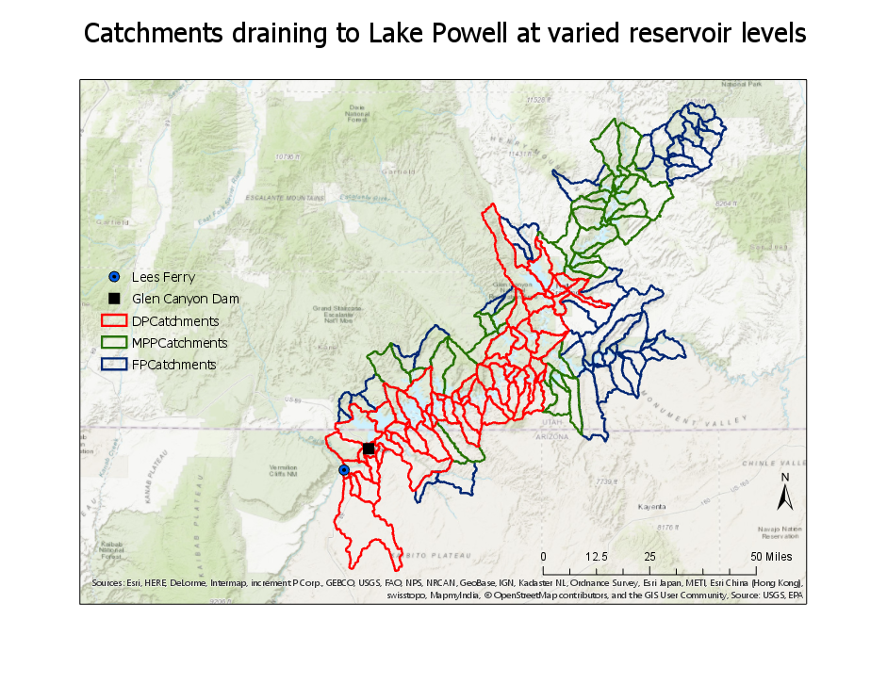

Slide 13
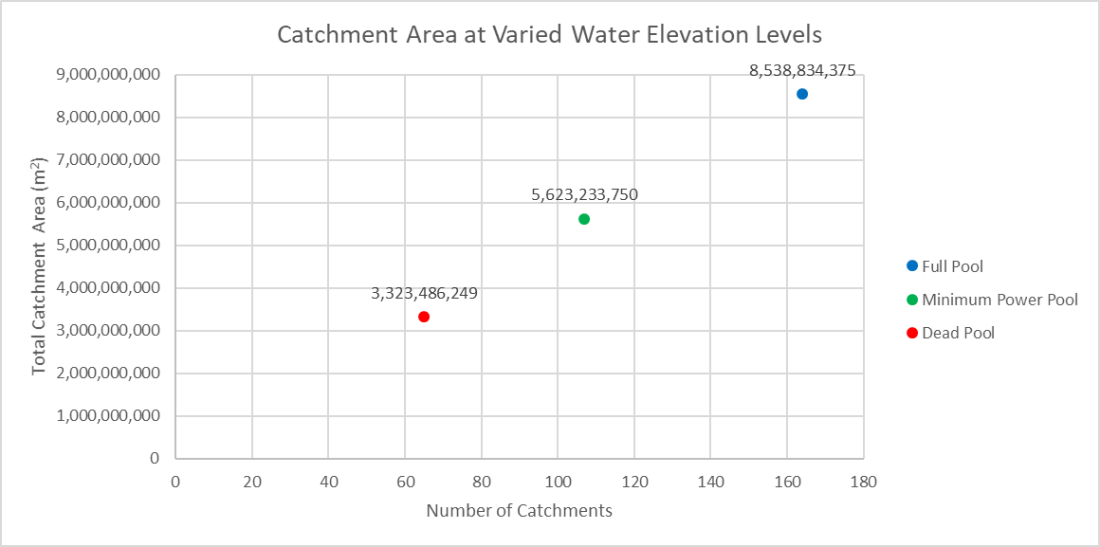
Analysis: Area

Slide 14
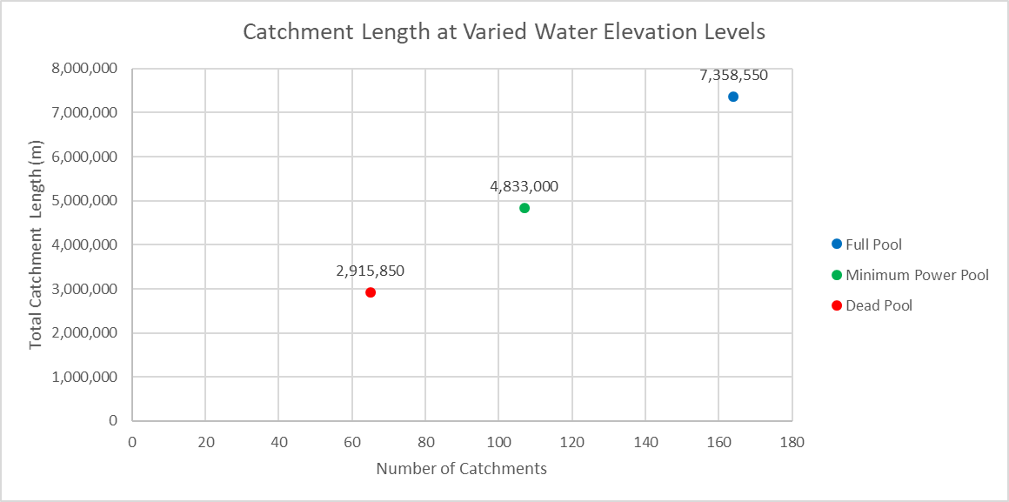
Analysis: Length

Slide 15
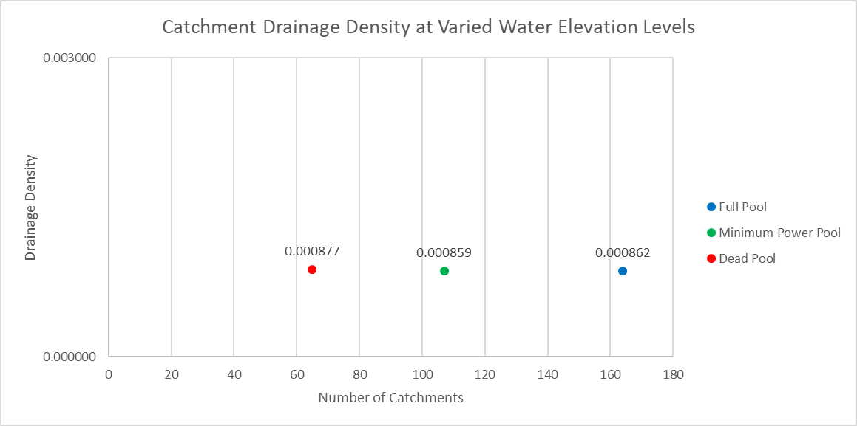
Analysis: Drainage Density

Slide 16
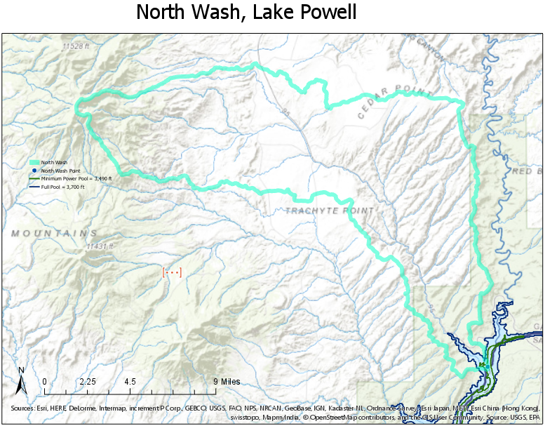
Analysis: Case Study

Slide 17
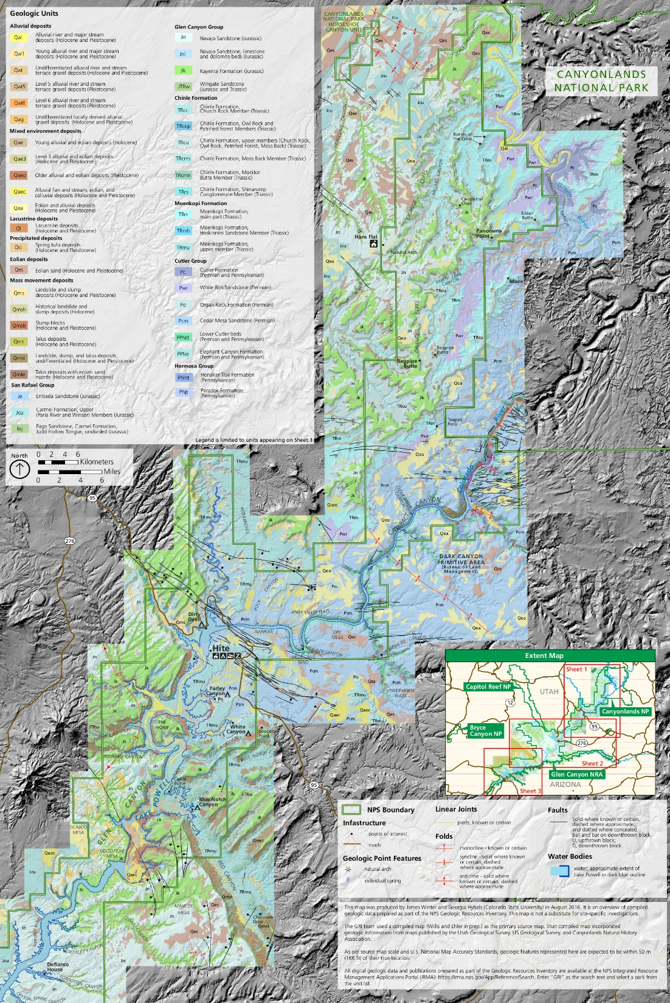
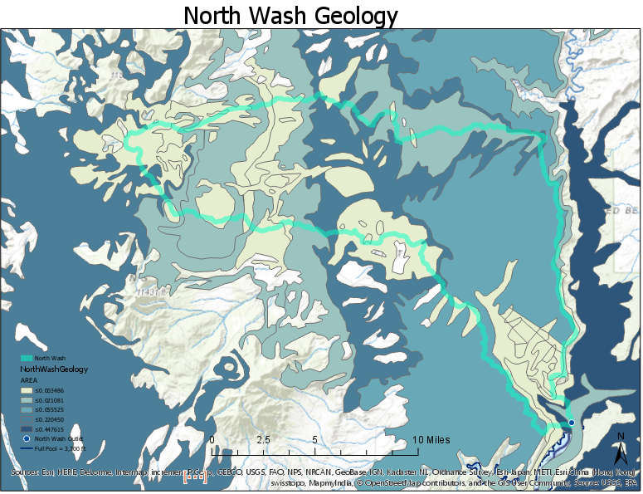
Analysis: Case Study

Slide 18
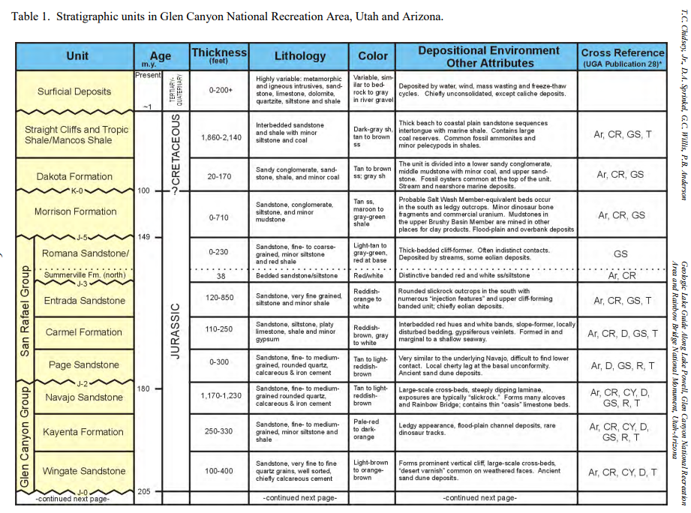
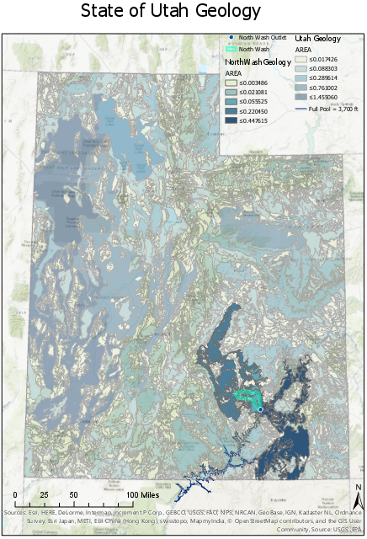
Analysis: Case Study
North Wash Geology

Slide 19
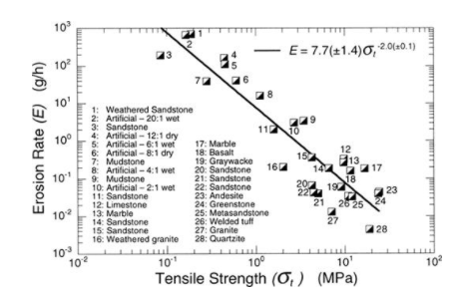
Analysis: Case Study
Erosion rates
Non-linear function of sediment supply, grain size, and bedrock tensile strength
Sklar and Dietrich (2001)
Tensile strength of Glen Canyon Group
Bursztyn et al. (2015)
Sklar and Dietrich (2001)

Slide 20
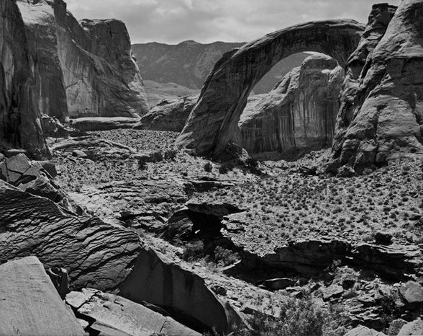
Summary
Necessity of Colorado River water management
Climate change, increased demand, less available water
Analysis
Interoperability with online and desktop services
Overlaying various physical data sets
Rainbow Bridge, 1962
Photo by Philip Hyde

Slide 21
Beyond this course…
Focus on full pool to minimum power pool
Relevant parameter for policy discussion and adaptive management
Categorize watershed by erodibility
Calculate total volume available for tributary sedimentation
Pre-dam topography and full pool
Evaluate total volume filled for erodible and resistant rock

Slide 22
Questions? Thank you!

