Slide 1
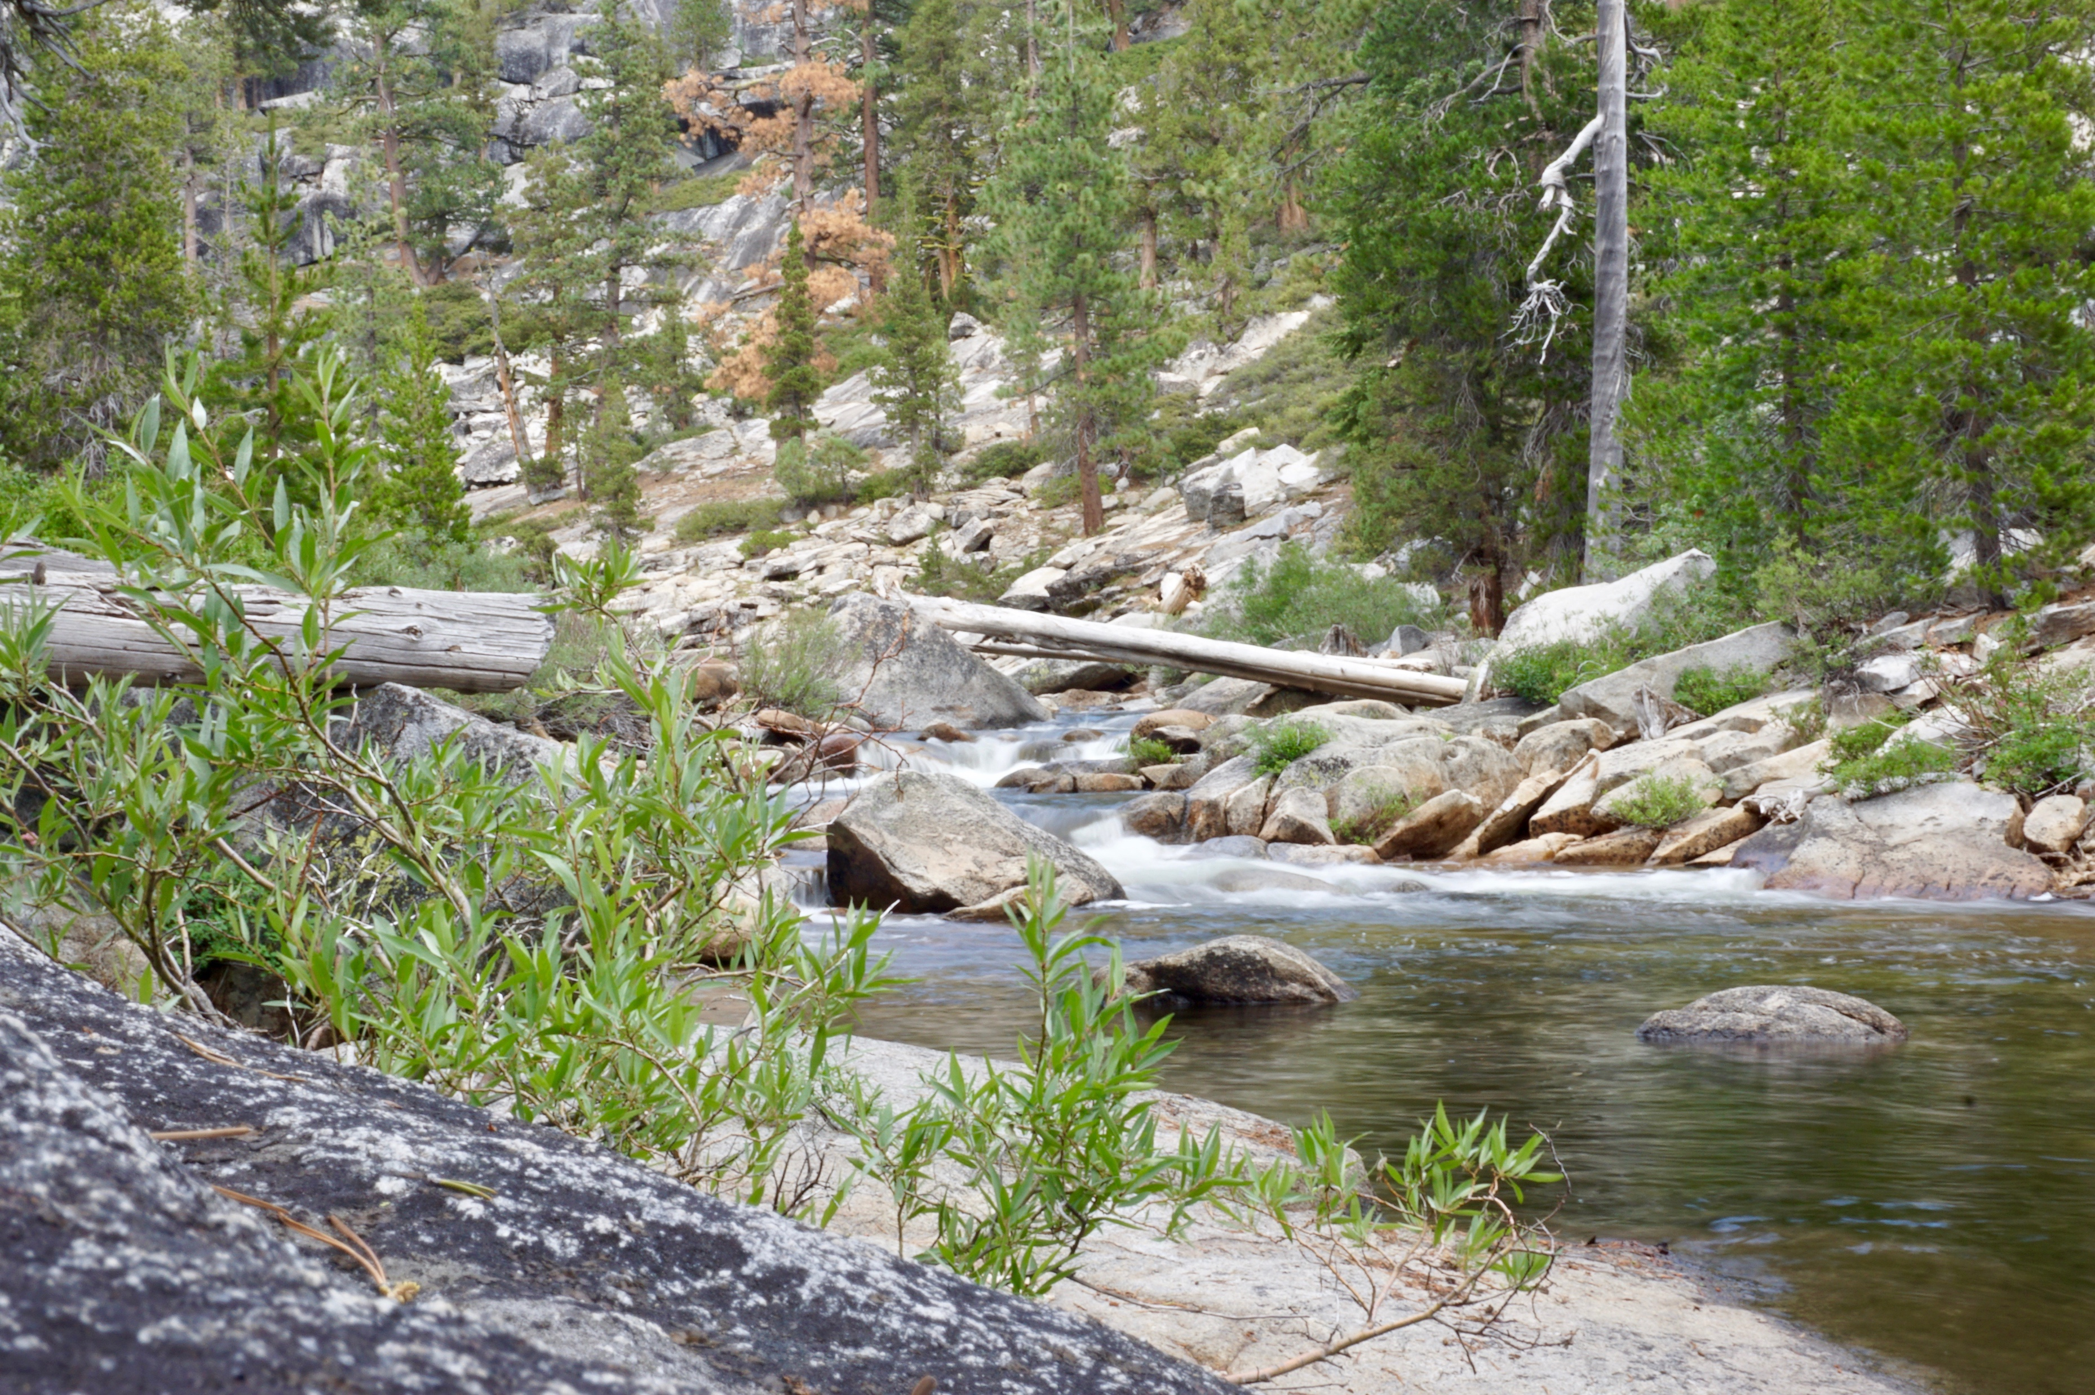
Automated Unimpaired Hydrologic Metric Scaling for California Streams
By Karl Christensen

Slide 2
Introduction
Karl Christensen
Masters Student at Utah State University
Civil Engineering
Emphasis in Hydraulics and Hydrology

Slide 3
Overview
Understanding the Project Components
Predicting Flow Regimes
Case Study
Testing the Scaling Methods
Review
Future Direction for Work

Slide 4
Project Title Automated Unimpaired Hydrologic Metric Scaling for California Streams
Automated – Python based ArcGIS script
Unimpaired – Natural Stream-flow regimes
Hydrologic Metric Scaling – Method of scaling from known hydrographs to a daily flow regime
California Streams
Notes:
I know it’s long!

Slide 5
Unimpaired vs Impaired Flow
Unimpaired
Natural flow regimes
Impairments
Dams
Irrigation
Industrial/municipal consumption

Slide 6
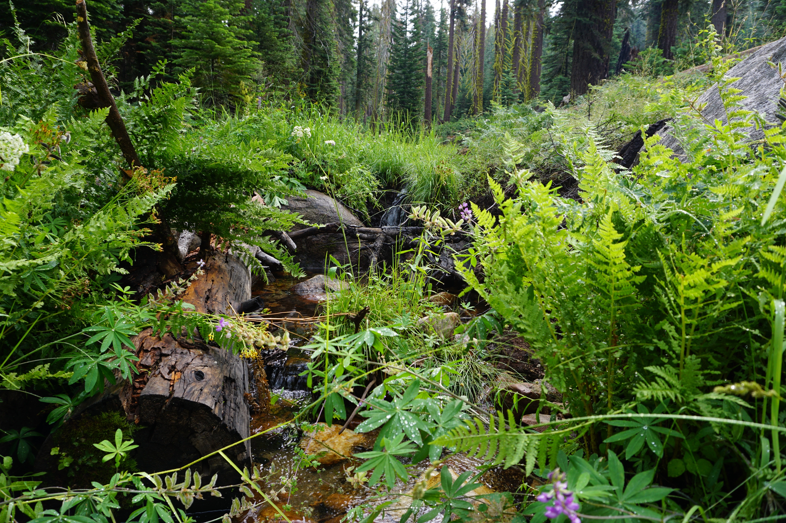
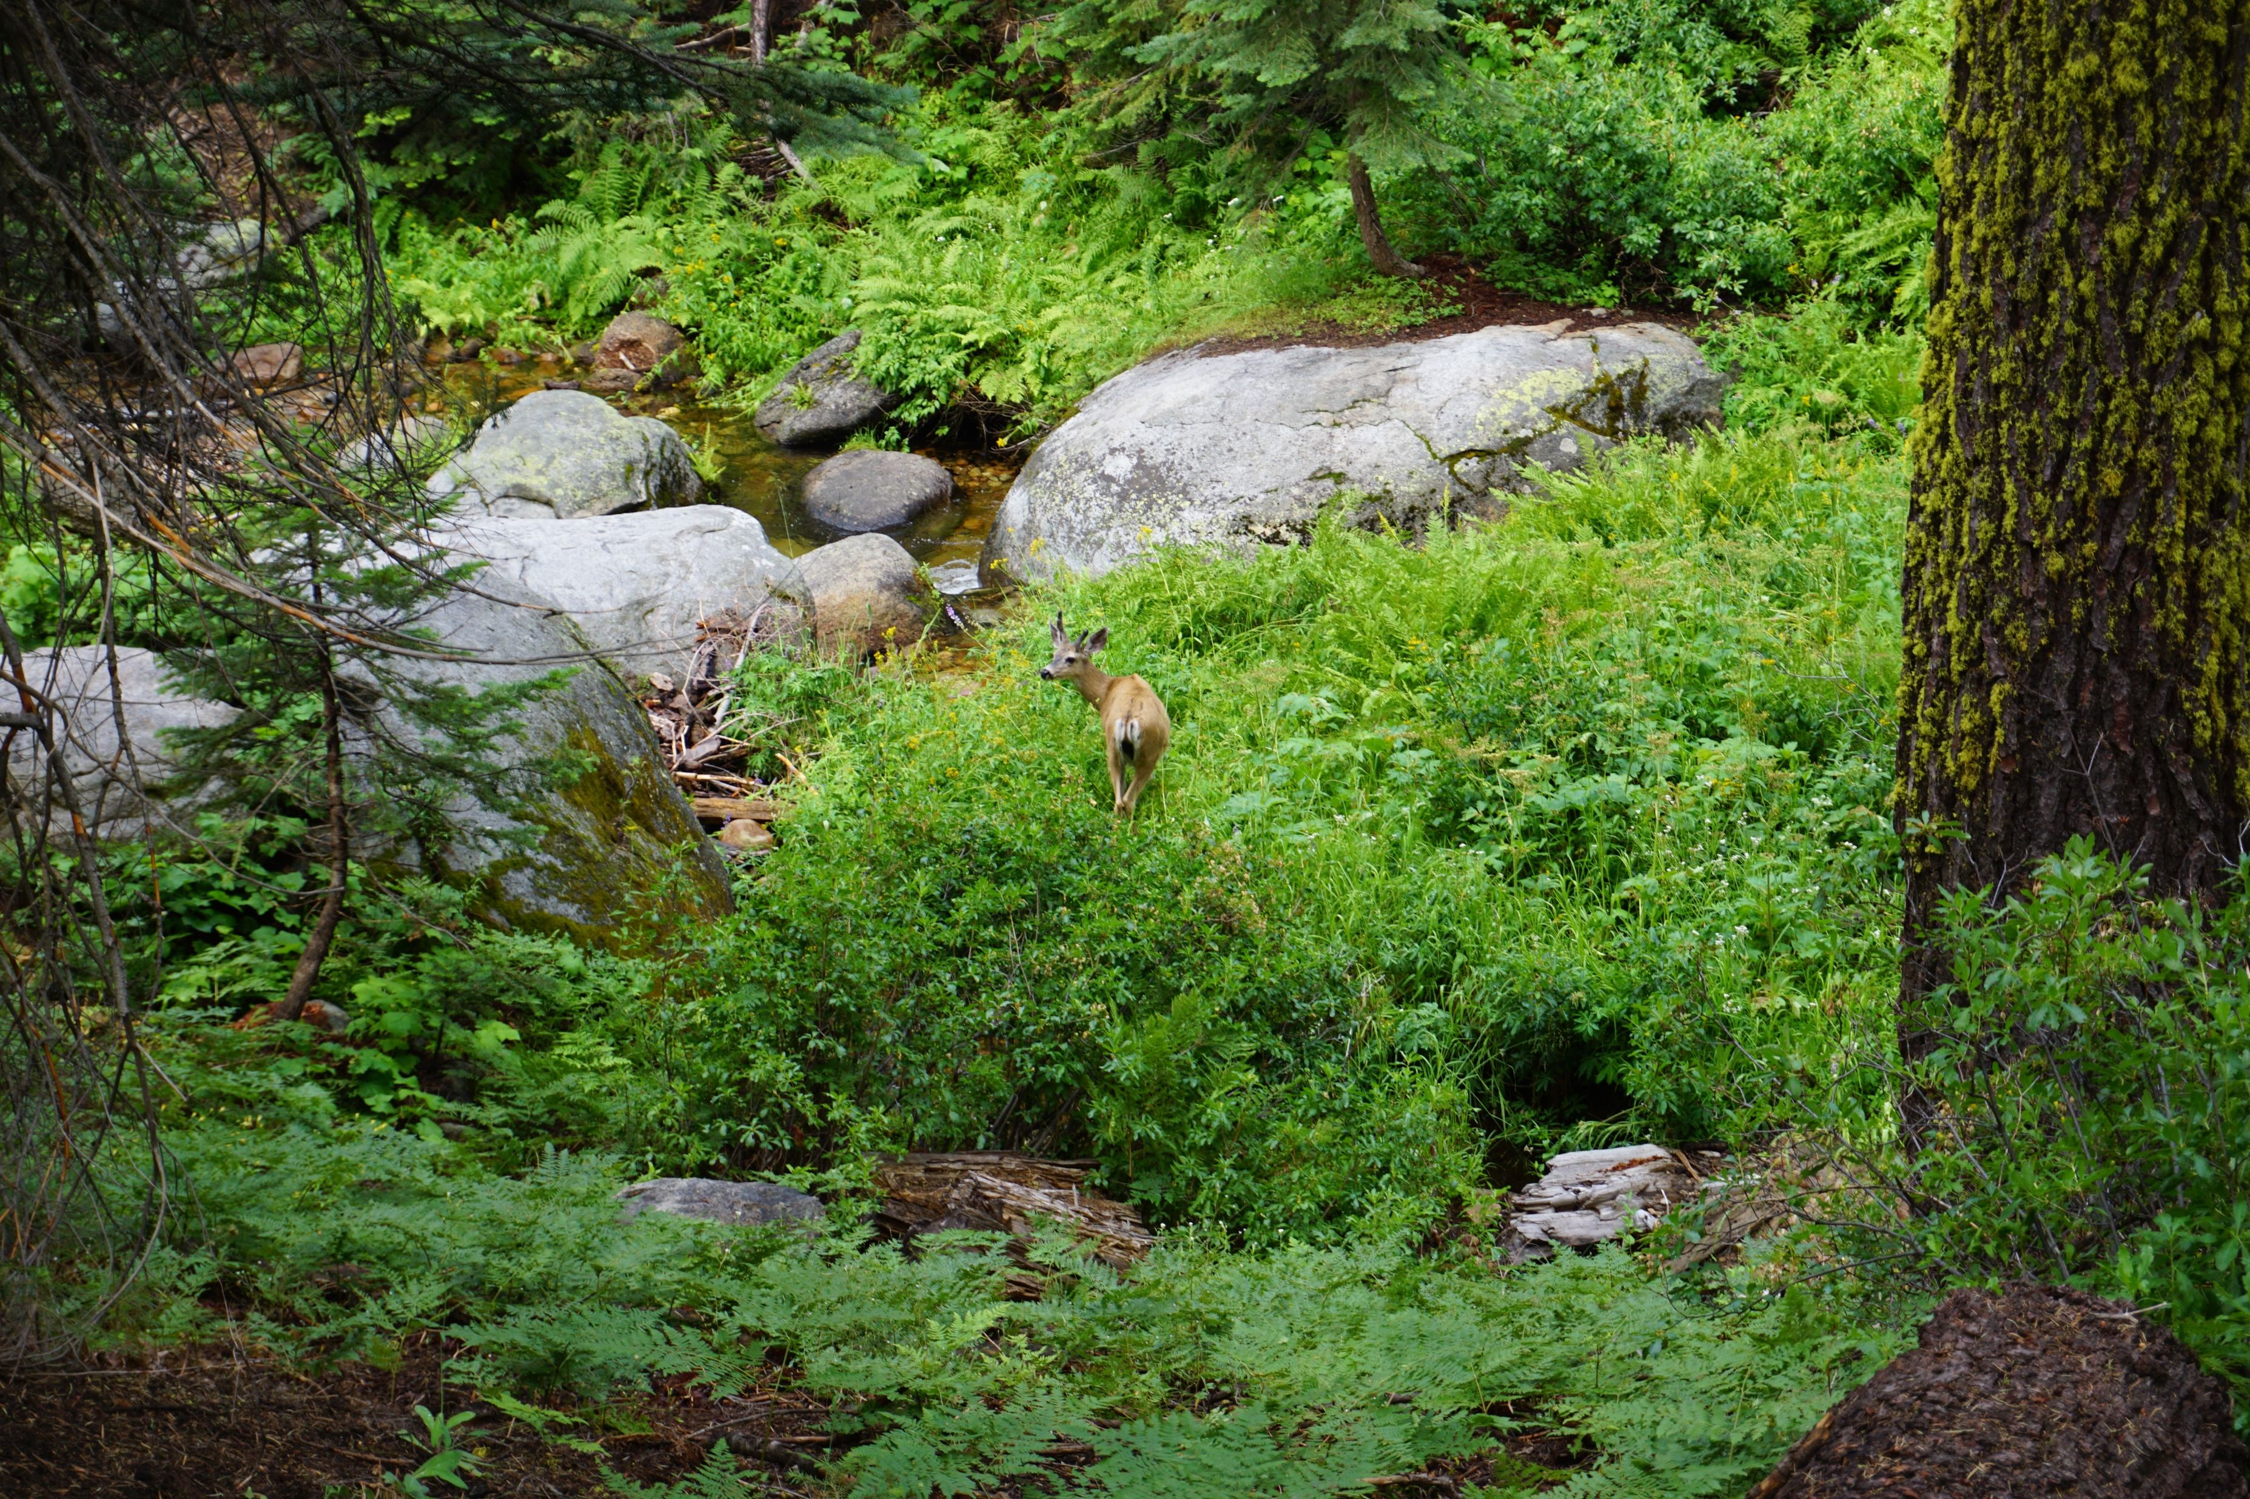
Impact of Flow Regimes
Connection between aquatic biodiversity and hydrology (Bunn and Arthington, 2002)
Habitat
Adaptation by species
Longitudinal and Lateral connectivity
Invasive species
Notes:
flow is a major determinant of the habitat, a key driver of the aquatic composition
aquatic species have evolved life-history strategies in response to the natural flow regime
the natural pattern of the longitudinal and lateral connectivity in the river system is important for supporting populations of aquatic species
the invasion and success of non-native species is facilitated by alterations to streamflow.

Slide 7
Predicting Flow Regimes
Why do we need to predict flow regimes?
Data before impairment may not be available
Conditions in the future may be subject to change
Flow estimations may be an indicator of stream ‘health’
Notes:
After a stream becomes impaired we might not have pre-impairment data to return the natural stream course
Changing conditions allow for prediction of future flows
Estimations of flow regimes can be used to identify healthy/unhealthy streams or determine if a stream is impaired or not

Slide 8
Predicting Flow Regimes
How do we predict flow regimes?
Options considered in this project
Three Traditional Methods
Stream Classification Approach
Notes:
Several Methods

Slide 9
Predicting Flow Regimes
Traditional Methods
Drainage-area ratio technique (DAR)
Mean streamflow ratio
Mean and standard deviation ratio
Notes:
Benefit:
This is a very direct approach.
Disadvantage:
Does not account for factors other than streamflow or area.

Slide 10
Predicting Flow Regimes
Stream Classification
Creates regions of similar characteristics
Has the potential to overcome limitations of traditional scaling methods
Notes:
Benefit:
Handles variance in stream characteristics
Requires less inputs
Disadvantage
Over generalization may lead to inaccuracies
More effort to create

Slide 11
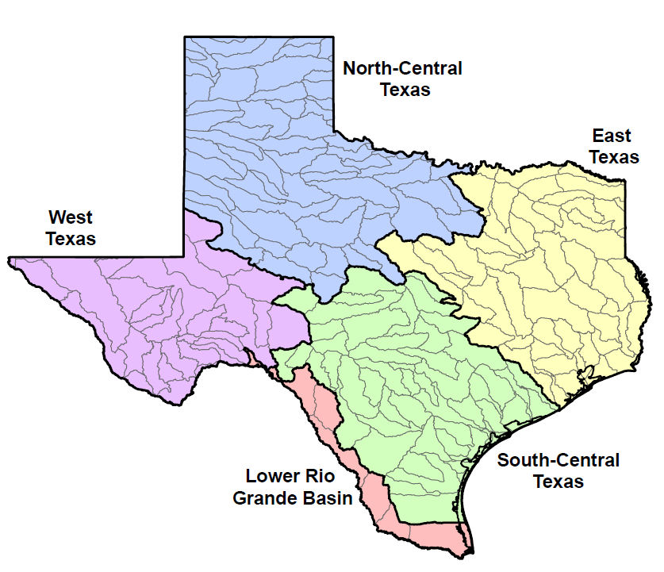
Predicting Flow Regimes
Regional Characteristics (Hersch and Maidment, 2007)
Water quality
Climatology
Hydrology & Hydraulics
Geomorphology & Physical processes
Biology
Texas
(Hersch & Maidment, 2007)
Notes:
Creating regional flow characteristics is common all over the world, including Texas!

Slide 12
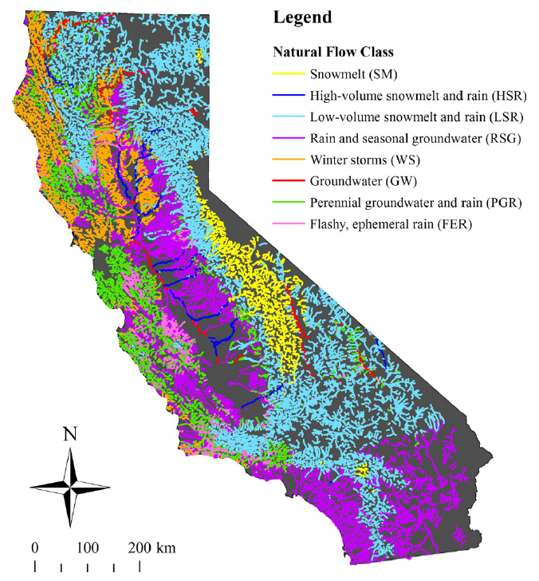
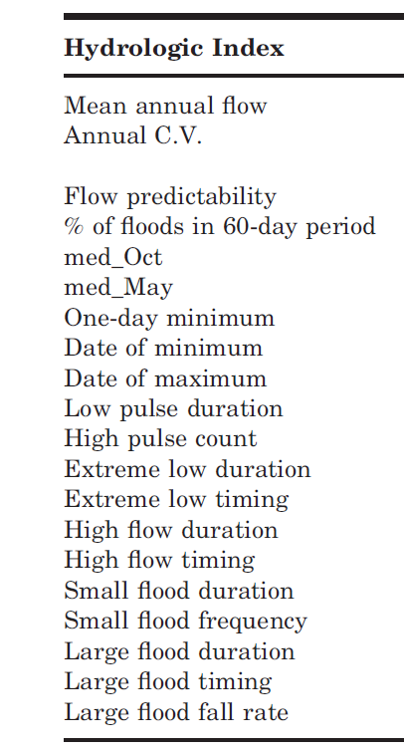
Predicting Flow Regimes
Regional Characteristics
20 ‘Hydrologic Indexes’
8 Flow Classes
(Lane et al, 2017)
Notes:
Flow regimes for California have to handle a very diverse range of geography
Point to hydrologic indices
Names of regions name by the primary source of flow for collective reaches
Lowest and Highest elevations in the contiguous united states!

Slide 13
Predicting Flow Regimes
Notes:
Compare the regions

Slide 14
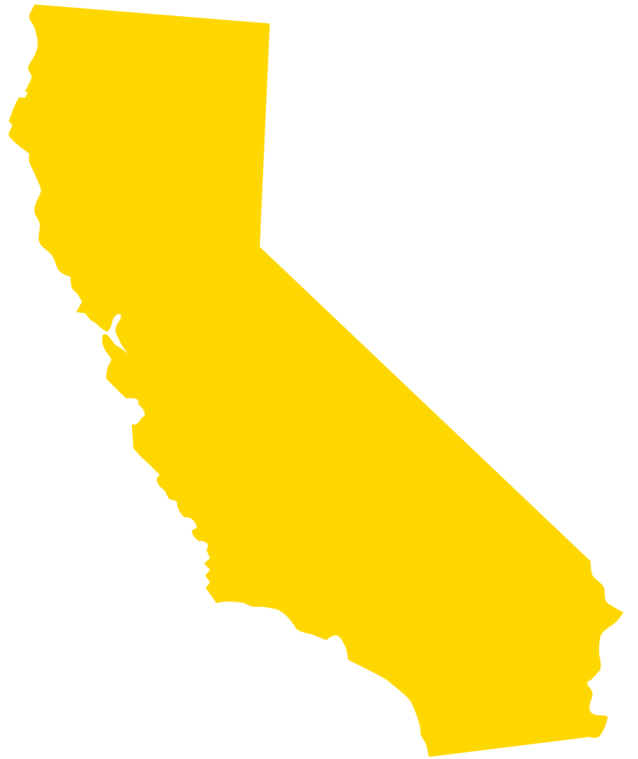
Flow Regime: Case Study
Unimpaired Daily Flow Regime for Merced River Happy Isles Bridge (Near Yosemite, CA)
Class 1 – Snowmelt Region
USGS Gauge 11264500
Notes:
Example of an unimpaired flow regime.
What would it look like if a dam was place upstream, and the flow was forced to be constant throughout the year?
Notice the relatively low flows in the summer and fall and the peak of flow from spring runoff. This hydrograph represents a Class 1 stream flow. (More about that later)

Slide 15
Flow Regime: Case Study
USGS Gauge 11264500
Unimpaired Daily Flow Regime for Merced River Happy Isles Bridge (Near Yosemite, CA)
Notes:
Example of an unimpaired flow regime.
What would it look like if a dam was place upstream, and the flow was forced to be constant throughout the year?
Notice the relatively low flows in the summer and fall and the peak of flow from spring runoff. This hydrograph represents a Class 1 stream flow. (More about that later)

Slide 16
Flow Regime: Case Study
USGS Gauge 11264500
Initial Gauge
Class 1 - Snowmelt
Nearby Gauge
Class 2 – Low Volume
Snowmelt and Rain
Notes:
Can you see how the traditional methods wouldn’t account for location of the peak?
Can you see the hump in the summer? That does not fit the shape of the stream flow hydrograph.

Slide 17
Flow Regime: Case Study
USGS Gauge 11264500
Initial Gauge
Class 1 - Snowmelt
DRH
Accounts for 20 years of flow
Notes:
Compare Daily to DRH
See the slope. The peak appears to be slightly to the left of the actual data. This shift may be due to variance over 20 years.

Slide 18
Flow Regime: Case Study
USGS Gauge 11264500
Notes:
Class 1 average is definitely skewed left. Very smooth curve. Still maintains that gentle curve

Slide 19
Testing the Scaling Methods
How can we compare the different methods of scaling and choose the best one?
Are some methods better for some classes than others?

Slide 20
Testing the Scaling Methods
Three gauge sites are selected in ArcGIS that are the same Class and are relatively close geographically
Results will be 20 years of daily flow data
Reference Gauges
California

Slide 21
Testing the Scaling Methods
Classification
Traditional
10 Different Ratios
DRH for entire Class x Annual Average Flow
DRH for entire Class x Monthly Average Flow
DRH for nearest site x Annual Average Flow
DRH for nearest site x Monthly Average Flow
DRH for three nearest sites x Annual Average Flow
DRH for three nearest sites x Monthly Average Flow
Direct Area Ratio x Nearest Daily Flow
Monthly Average Ratio x Nearest Daily Flow
Annual Average Ratio x Nearest Daily Flow
Monthly Average/Stand. Dev. Ratio x Nearest Daily Flow

Slide 22
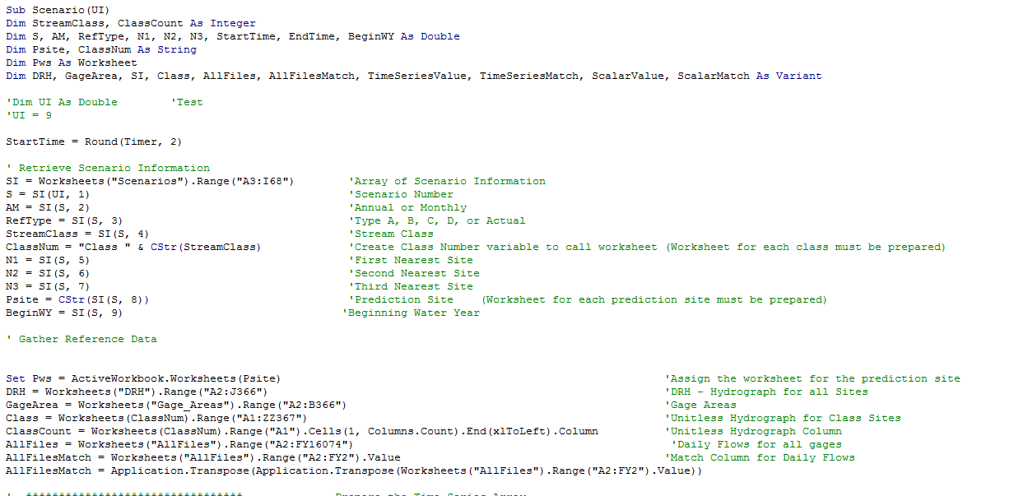
Testing the Scaling Methods
Visual Basic in Excel was used to automate the testing
Scenario | Stream Class | USGS Ref Gage (List FID(s)) |  |  | Prediction Site | Begin WY | Successful Run | Run Time
 |  | Nearest | 2nd/3rd Nearest |  |  |  | Date and Time | Seconds
1 | 1 |  |  |  | 11264500 | 1969 | 12/4/17 5:43 PM | 4.49
2 | 1 |  |  |  | 11264500 | 1969 | 12/4/17 5:43 PM | 6.33
3 | 1 | 11266500 |  |  | 11264500 | 1969 | 12/4/17 5:43 PM | 4.44
4 | 1 | 11266500 |  |  | 11264500 | 1969 | 12/4/17 5:43 PM | 6.33
5 | 1 | 11266500 | 11226500 | 11275000 | 11264500 | 1969 | 12/4/17 5:43 PM | 4.42
6 | 1 | 11266500 | 11226500 | 11275000 | 11264500 | 1969 | 12/4/17 5:43 PM | 6.25
7 | 1 | 11266500 |  |  | 11264500 | 1969 | 12/4/17 5:44 PM | 64.23
8 | 1 | 11266500 |  |  | 11264500 | 1969 | 12/4/17 5:46 PM | 64.29
9 | 1 | 11266500 |  |  | 11264500 | 1969 | 12/4/17 5:47 PM | 67.09
10 | 1 | 11266500 |  |  | 11264500 | 1969 | 12/4/17 5:48 PM | 63.18
11 | 1 |  |  |  | 11264500 | 1969 | 12/4/17 5:49 PM | 63.94
VBA Code Snippet

Slide 23
Testing the Scaling Methods
Example Results for USGS Gauge 11264500 (1975 Water Year)
Results show a great deal of variability
Notes:
Accuracy of the traditional methods

Slide 24
Testing the Scaling Methods
Example Results for USGS Gauge 11264500 (1975 Water Year)
Can be compared to the actual results using excel’s correlation command ‘Correl()’

Slide 25
Review
Importance of flow regimes in stream ecology
Traditional Ratios vs Regional Classification Methods
Testing methods produce daily hydrographs

Slide 26
Direction for Work
Analyze several sites from each class
Compare accuracy of scaling methods
Select method(s) best suited for each region
Write ArcPy script to automate stream gauge estimation
Modify ArcPy script to estimate stream flows in areas without any gauge data

Slide 27
Questions?

