Slide 1
Upper Stillwater Reservoir Firm Yield Forecasting Weston Bellon
OUTLINE:
Introduction
Methods
Results
conclusions

Slide 2
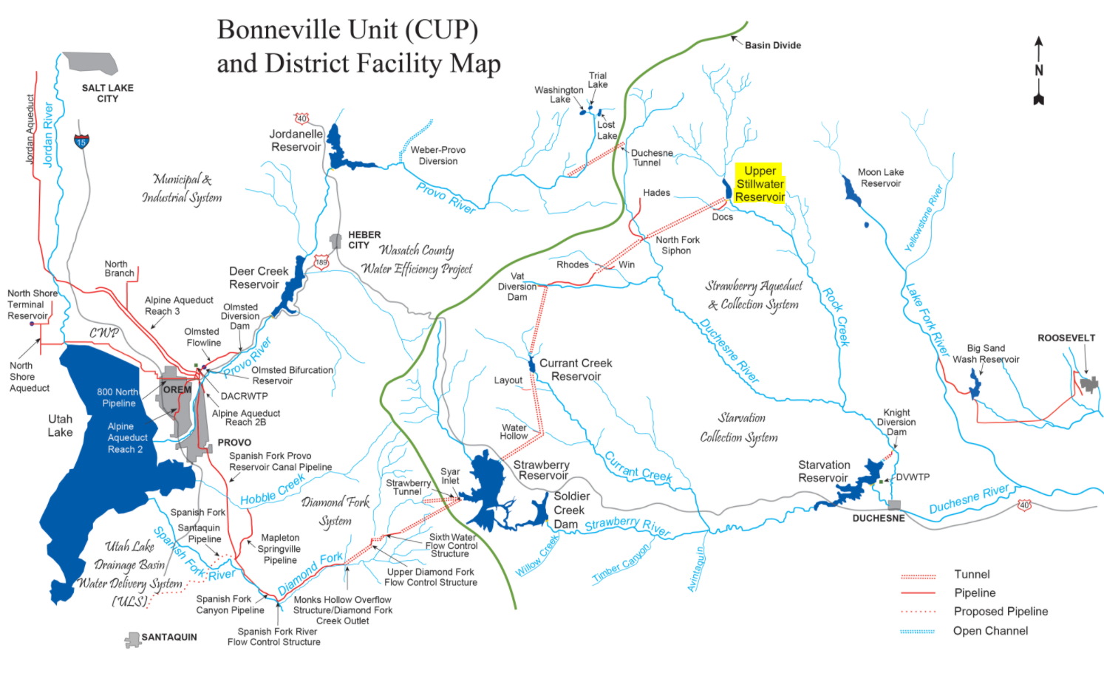
Upper Stillwater Reservoir
Provides water to Utah County
177% Increase in Population by 2065
Climate change could decrease Firm Yield

Slide 3
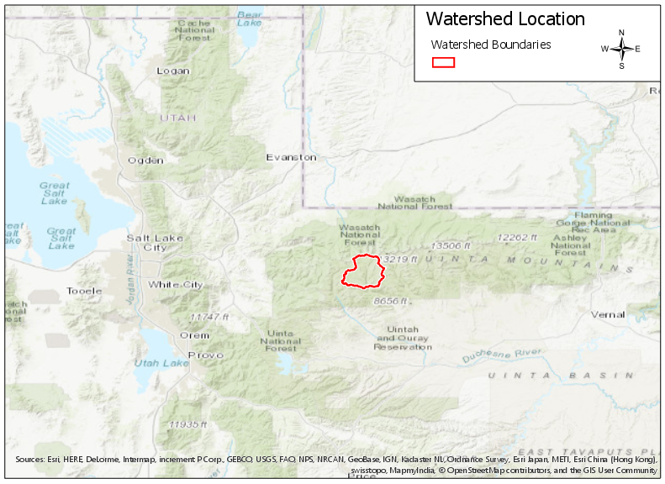
Data Inputs
USGS Climate Projection Data
Precipitation, Evapotranspiration, Temperature
Large grid size
Current/recent conditions from SNOTEL
To calibrate climate projection data

Slide 4
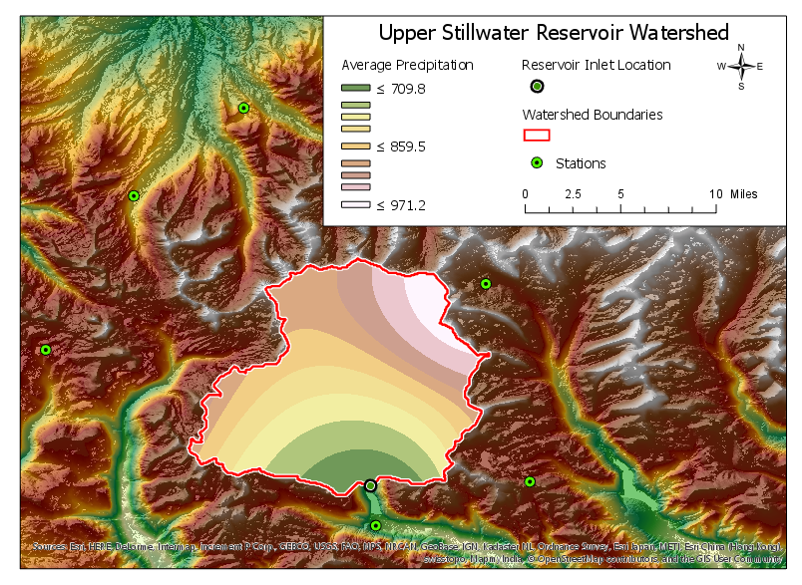
Data Calibration
Average SNOTEL and Projection data compared
IDW interpolation used for SNOTEL data
Ratio developed and applied

Slide 5
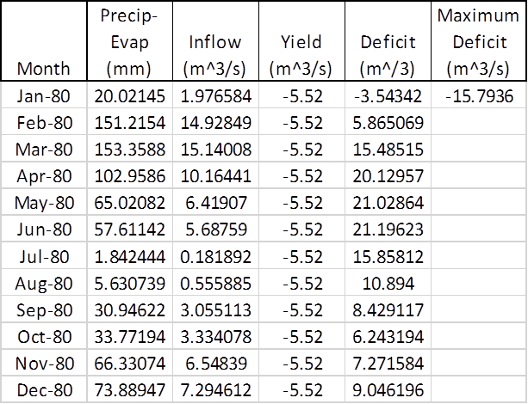
Firm Yield Projection Calculations
Precipitation – Evapotranspiration = Flow to the Reservoir
Mass Balance, Sequent Peak Analysis
Performed in five year increments
Iterative yield determination

Slide 6
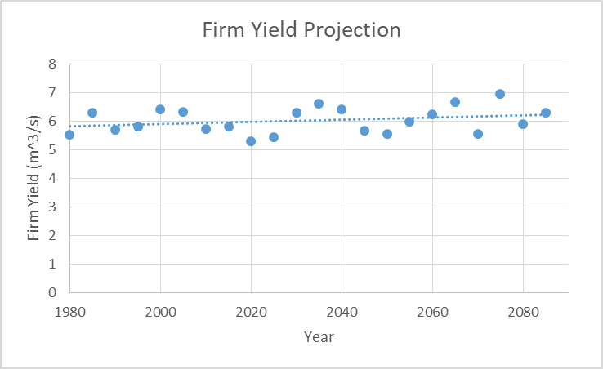
Results
Firm yield will increase over time.
Firm yield will become more variable.

Slide 7
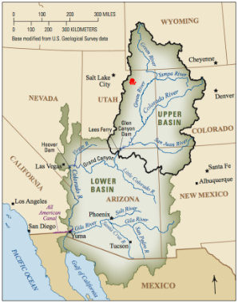
Conclusion
Upper Stillwater Firm Yield not in jeopardy
Colorado River Basin precipitation debate
Limited to available data
Other data sources should be examined

Slide 8
Questions?

