Slide 1
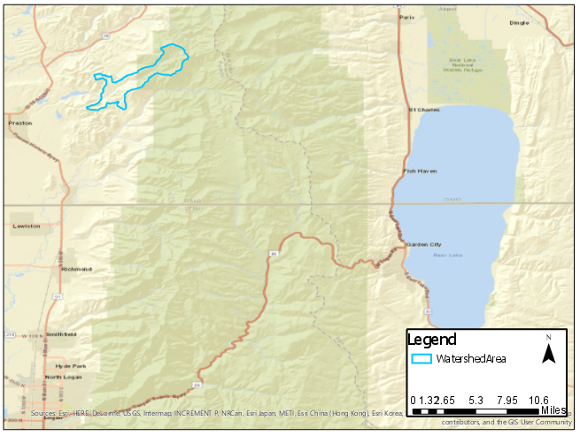
Are My Parents in Danger of Flooding?
CEE 6440
Kade Beck

Slide 3
Overview
Background
Data Sources
Methods
Progress
Summary

Slide 4
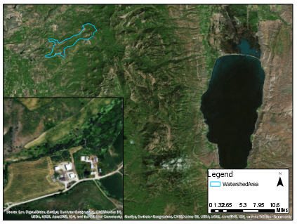
Background

Slide 5
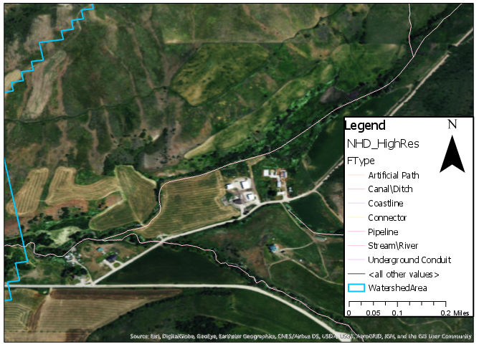
Background

Slide 6
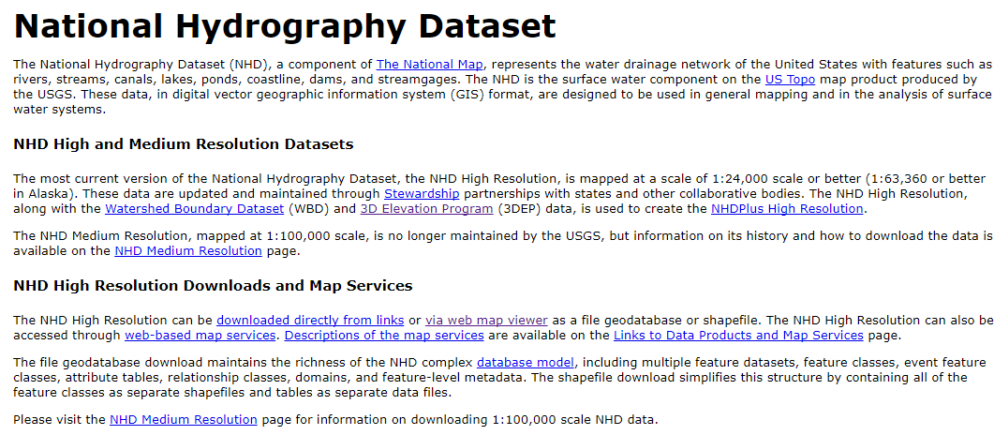
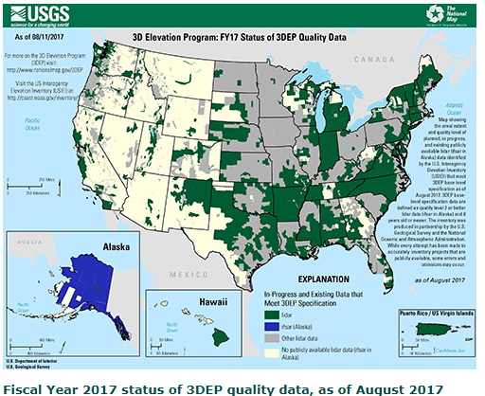
Data Sources

Slide 7
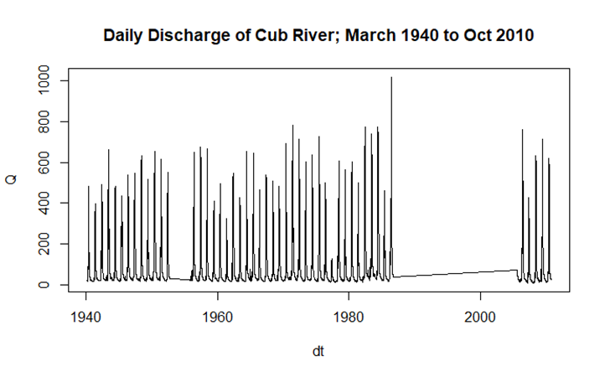
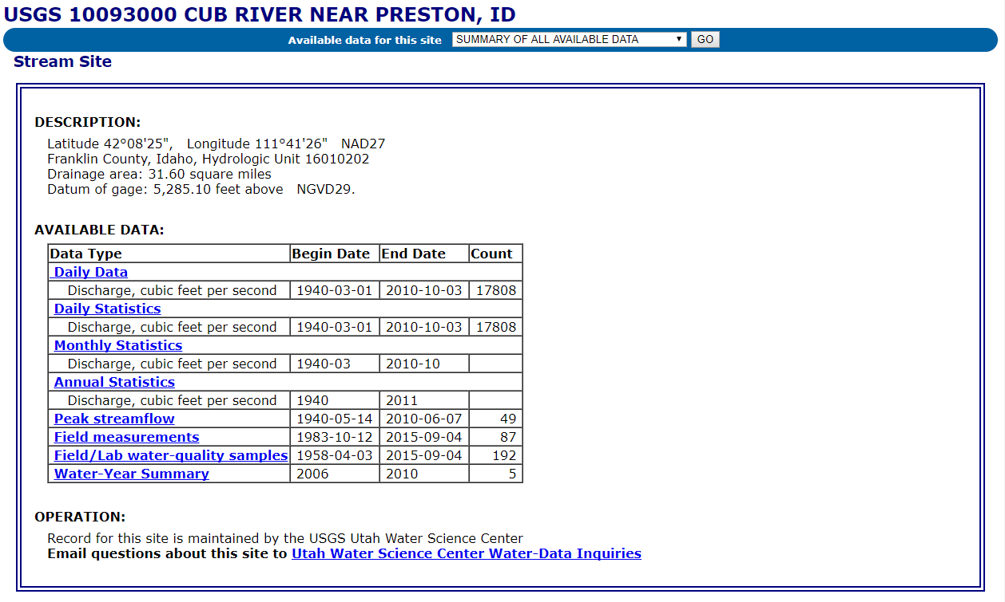
Data Sources
Notes:
1070 cfs in 1986

Slide 8
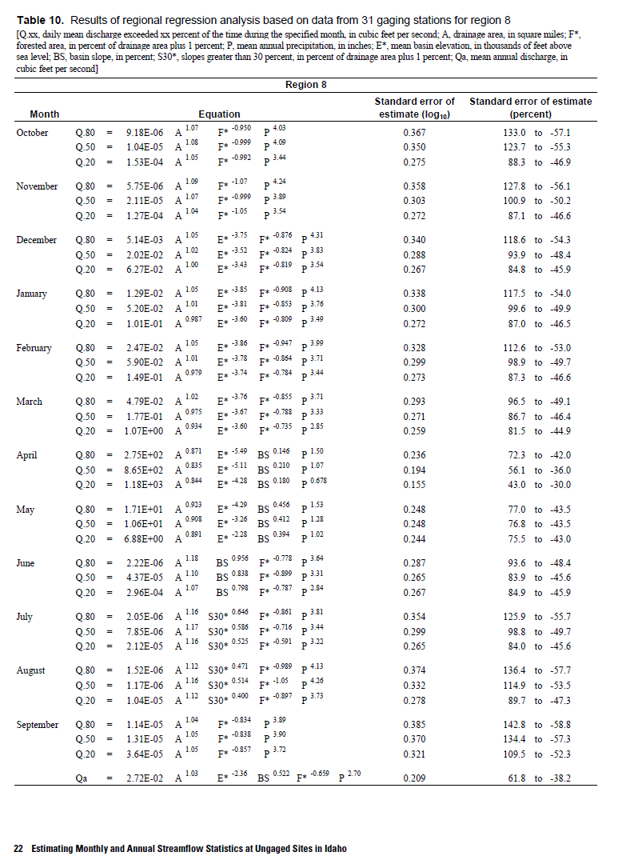
Methods

Slide 9
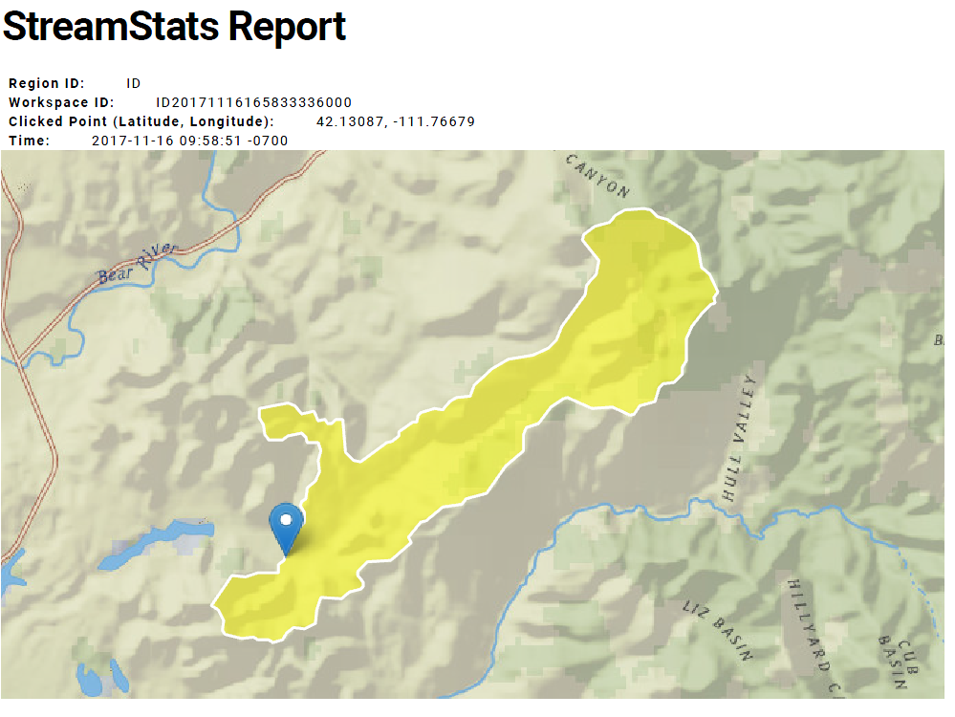
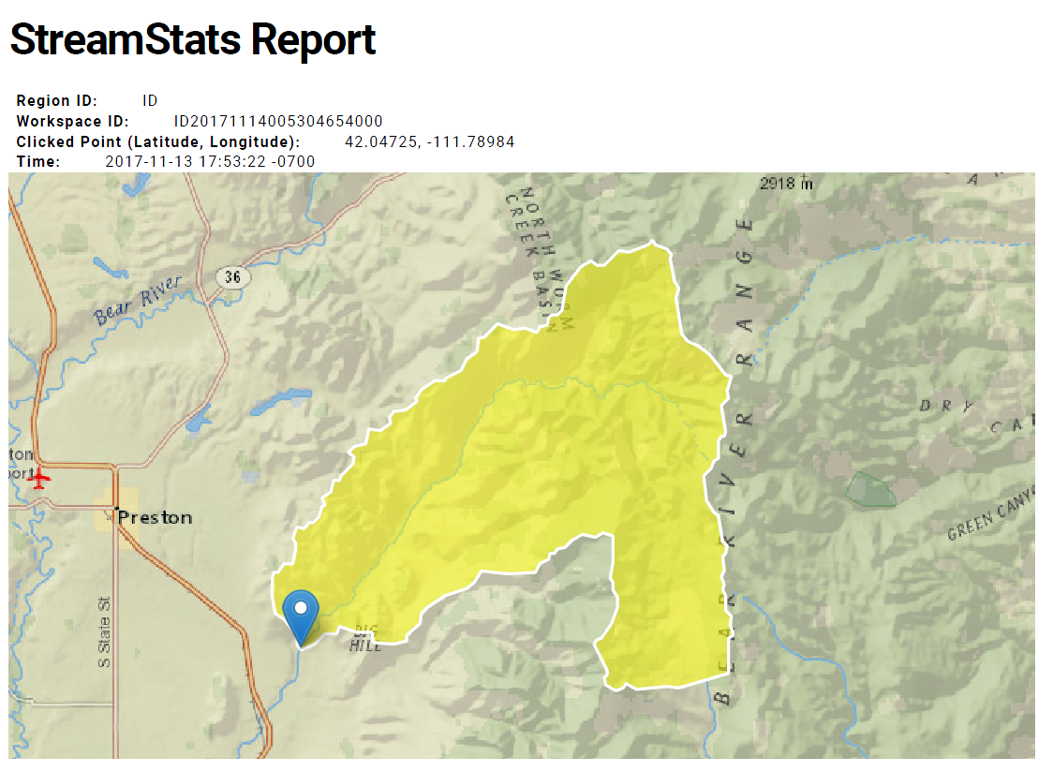
Progress

Slide 10
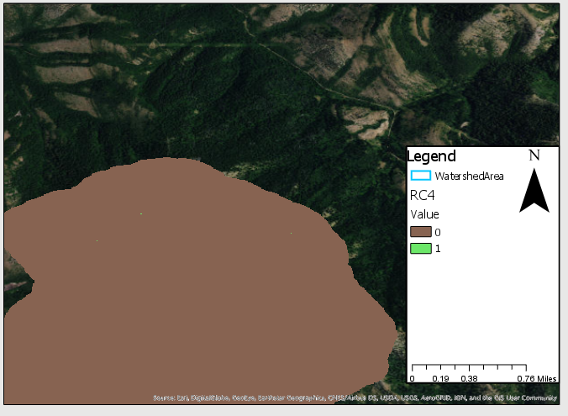
Progress

Slide 11
Work Remaining
HAND
Rating Curve
Flood Maps

Slide 12
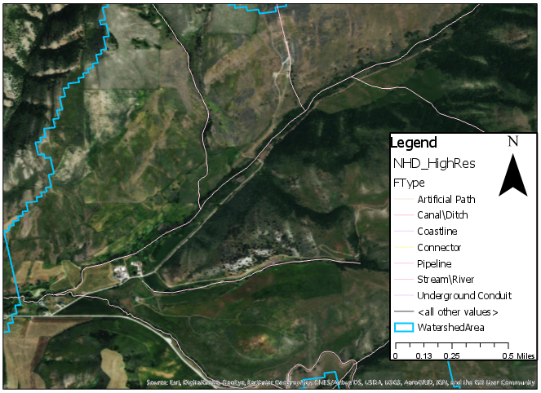
Summary

