Slide 1
Correlating USGS gages based on hydrologic and watershed characteristics to extract hydrologic metrics of non-gaged rivers.
Jacob Stout
CEE 6440
Utah State University

Slide 2
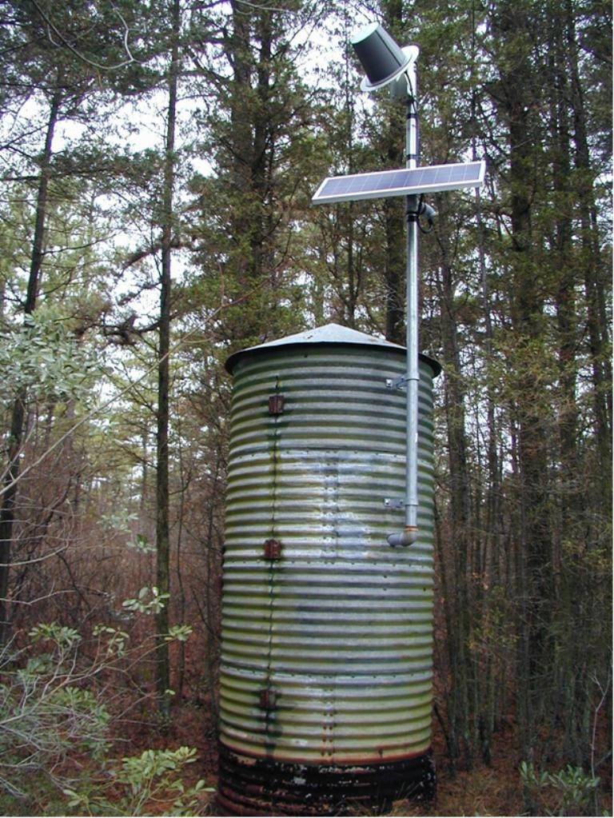
Introduction
USGS gage data is very useful.
Not located everywhere (Utah: 153 sites, Texas: 561 sites)
Common to rely on nearby gages for non-gaged rivers or gaged rivers with poor records.
How similar are the watersheds that are being compared?
Which gages are best to use to compare to my watershed?

Slide 3
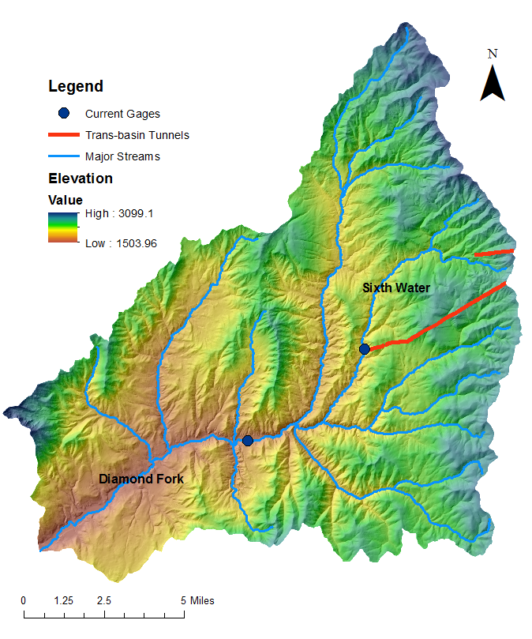
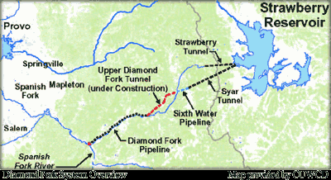
Study Site:
Diamond Fork River Watershed

Slide 4
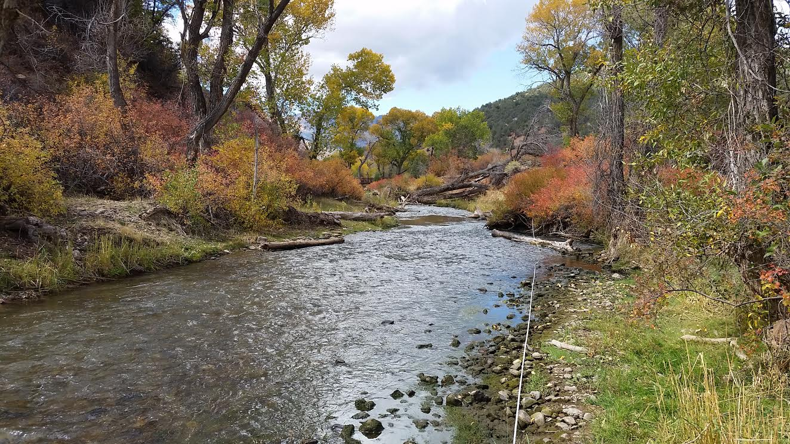
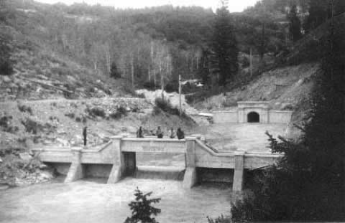
Background
Diamond Fork River Watershed
Used as delivery system for irrigators (1913-Present).
400-500 cfs during the summer.
Natural 2yr flood ~ 163 cfs
Natural 10yr flood ~ 267 cfs

Slide 5
Overall Objective:
Prescribe a flow regime that will yield a healthy ecosystem.
Identify hydrologic parameters of ecologic and geomorphic importance

Slide 6
GIS Project Objective:
Compare surrounding watersheds that have USGS gages to the Diamond Fork River Watershed
  Use gage record of the watershed that is most similar to the Diamond Fork River Watershed to extract hydrologic parameters of ecologic and geomorphic importance.
    Magnitude
    Frequency
    Timing
    Duration
    Rate of Change
    Predictability

Slide 7
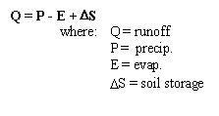
Hydrology and Watershed Characteristics
Basic Water Balance Equation
Data Needed
  Topography
  Soil/Geology
  Weather
  Land Cover

Slide 8
Data
Gage Locations (USGS.gov)
10 meter NED DEM (USDA:NRCS:Geospatial Data Gateway)
National Land Cover Database (USDA:NRCS:Geospatial Data Gateway)
STATSGO (USDA:NRCS:Geospatial Data Gateway)
Geology of Utah (http://pubs.usgs.gov/of/2005/1305)
PRISM data (precipitation and temperature) (PRISM Climate Group)

Slide 9
Methods
USGS Gages:
~ 50 miles of
Diamond Fork
Select Most
“Natural”
Watersheds

Slide 10
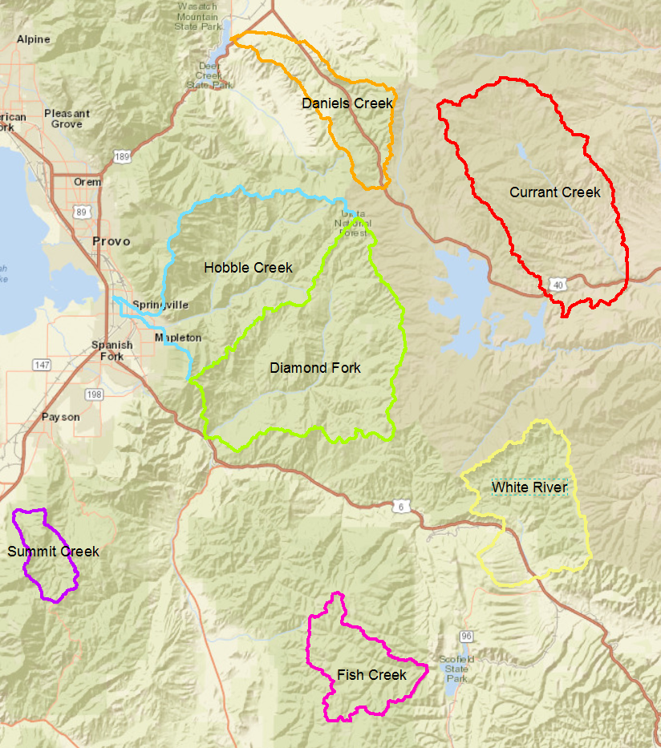
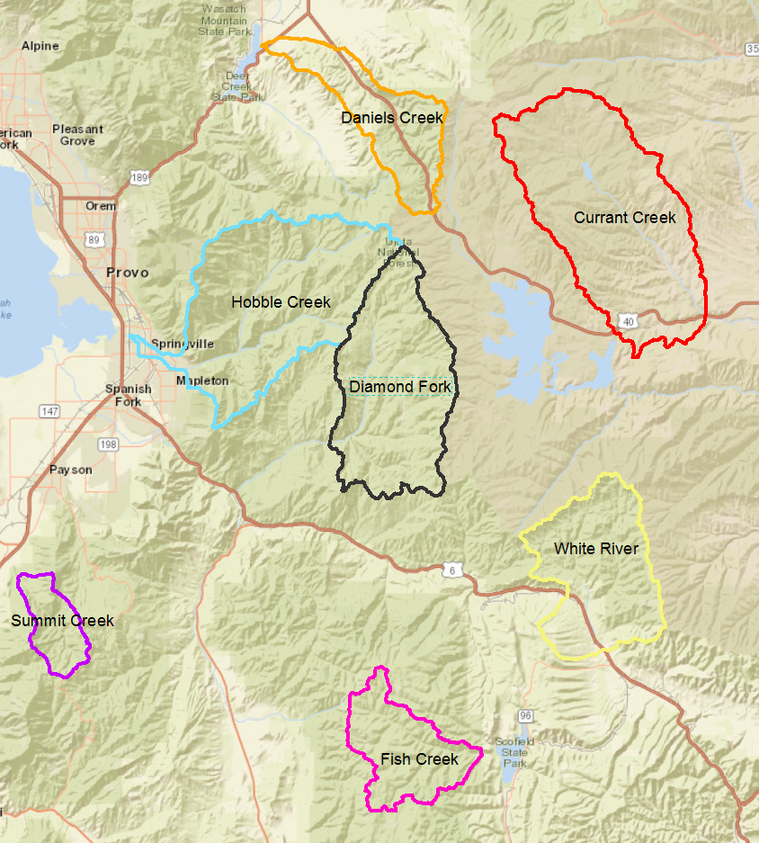

Slide 11
Methods
Delineate Watersheds from USGS gages
Clip characteristic data to watershed (using Batch)
Using Zonal Statistics, extract watershed characteristics
Watershed Characteristics
Area
Drainage Density
Elevation (Mean, Max, Min, St.Dev)
Mean Precipitation (30yr Normal)
Mean, Max, Min Temperature (30yr Normal)
Land Cover (%)
Soil (%)
Slope(Mean, St.Dev)
Geology (%)

Slide 12
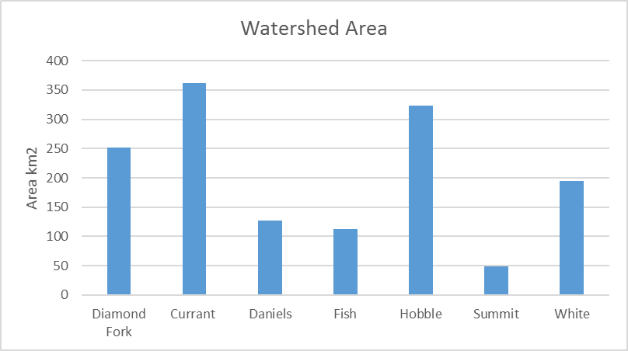
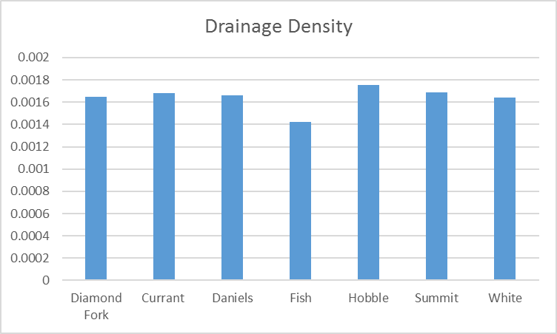
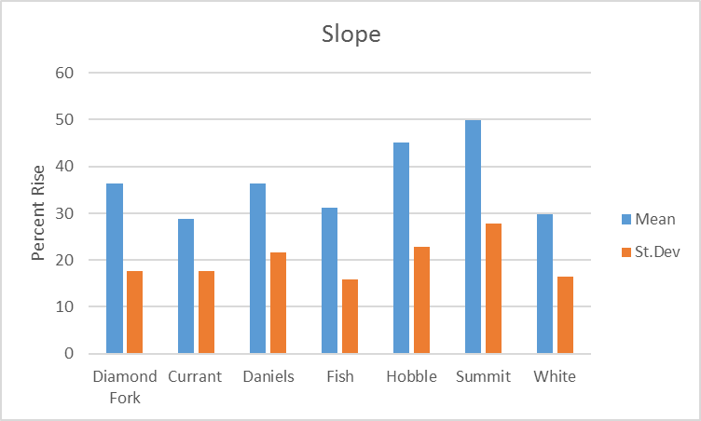
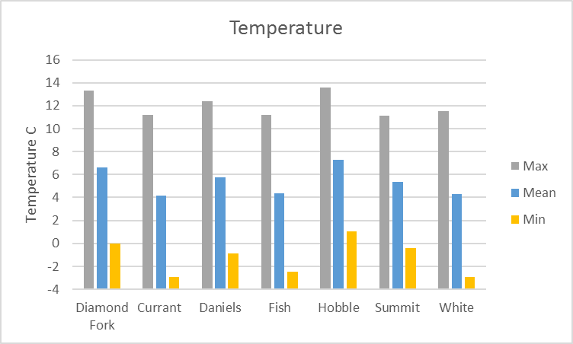
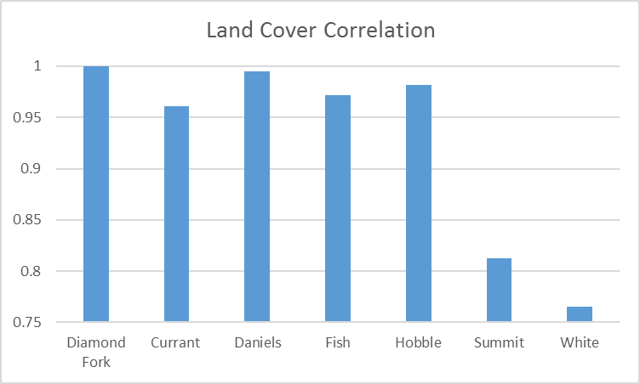
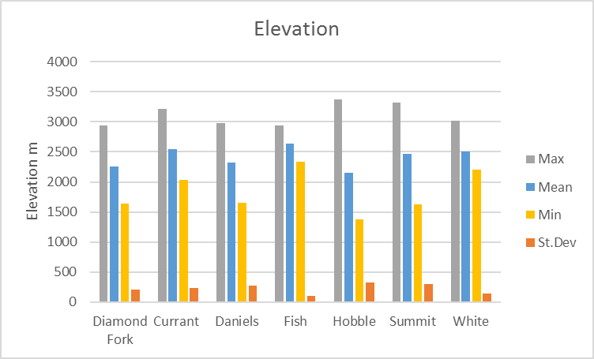
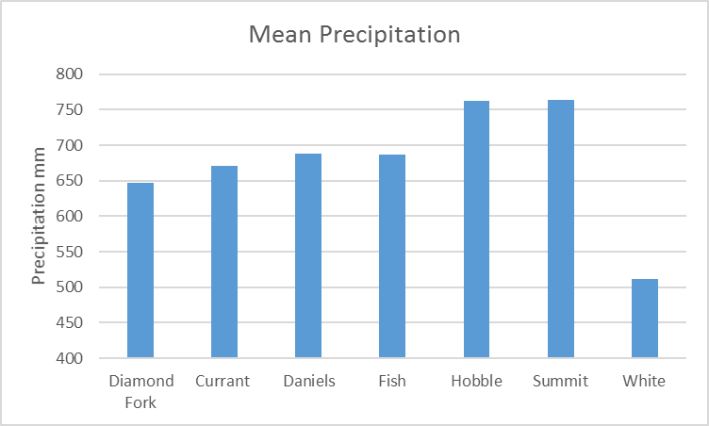
Results

Slide 13
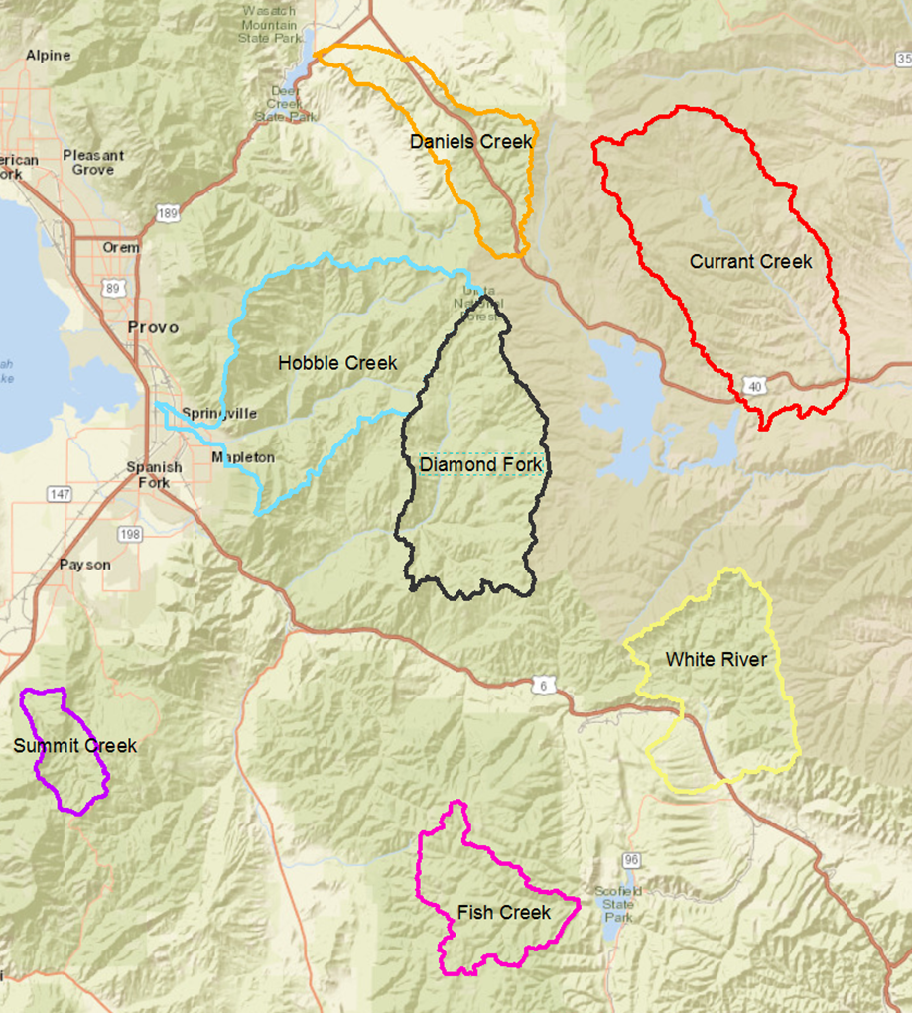
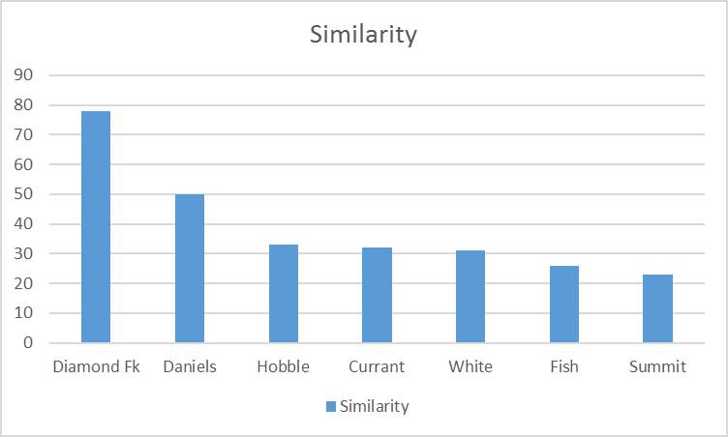
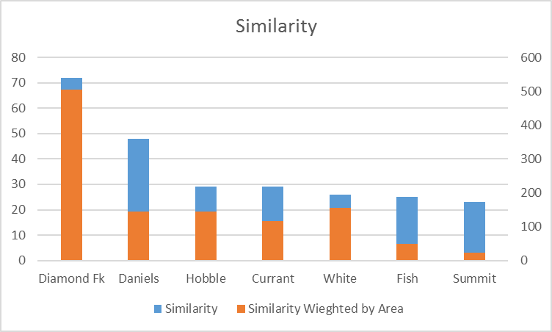
Results
Statistical Methods to test for Similarity:
Dissertation: Characterizing Ecologically Relevant Variations in Streamflow Regimes, by Kiran J. Chinnayakanahalli
  Linear Discriminant Analysis
  Classification and Regression Trees
  Random Forests
  Support Vector Machines
Basic Weighting Scheme

Slide 14
Future Work
Conduct thorough statistical analysis
Possibly include more gages in project, automate in python, R.
Hydrologic analysis of most similar watershed.

Slide 15

Questions?

