Slide 1
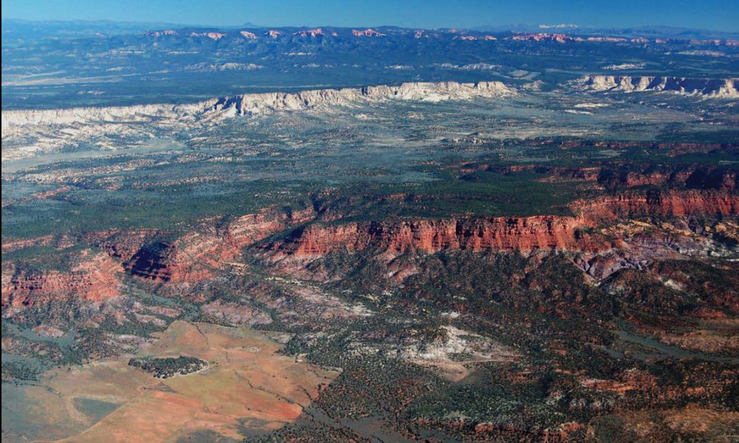
Characterization of Fluvial terrace deposits in the grand staircase region of southern Utah
Presented by: Alexander Short

Slide 2
outline
Project Overview
The GIS Component
Work to be done

Slide 3
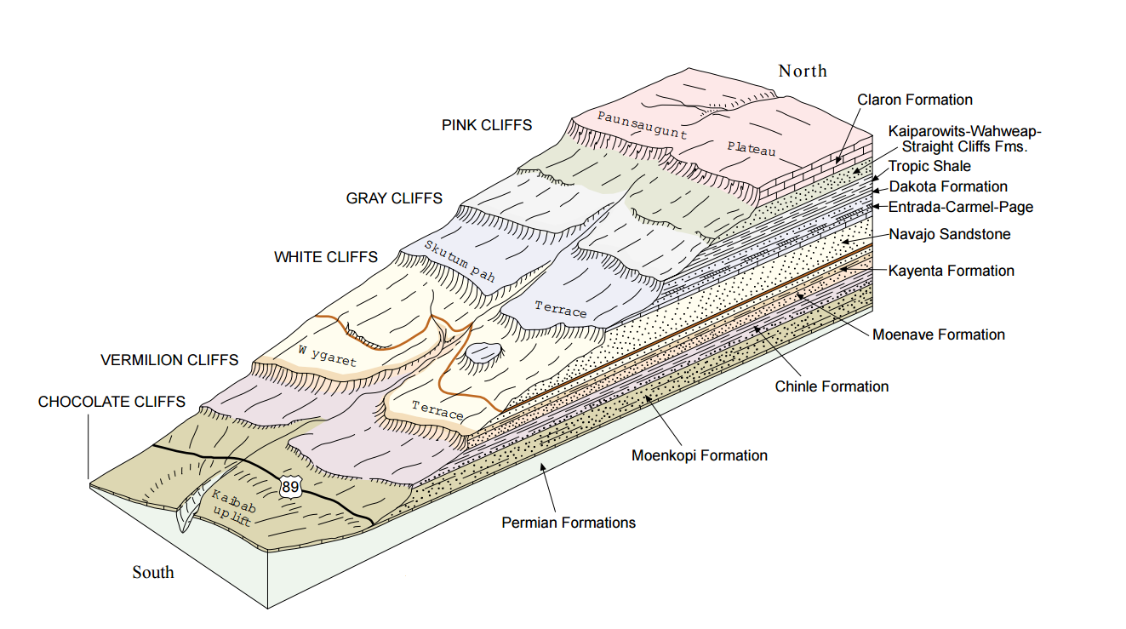
Project overview
Goal: To understand and develop the erosional history in the Grand Staircase during the Pleistocene.
Doelling et al. 2000

Slide 4
Terrace Characterization methods
Field Characterization
Spatial Analysis
Depositional Ages

Slide 5
Project overview

Slide 6
Spatial Analysis of terrace deposits

Slide 7
Spatial Analysis of terrace deposits

Slide 8
Spatial Analysis of terrace deposits

Slide 9
Spatial Analysis of terrace deposits

Slide 10
Spatial Analysis of terrace deposits
JW Slope = 0.0292

Slide 11
Spatial Analysis of terrace deposits
JW Slope = 0.0292

Slide 12
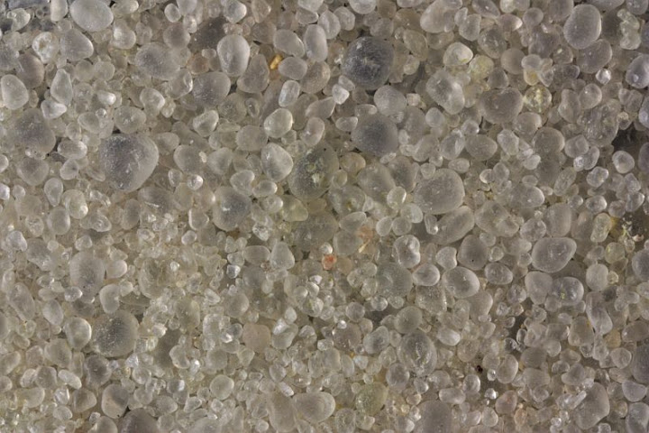
OSL Data
Using Optically Stimulated Luminescence (OSL) these terraces can be dated.

Slide 13
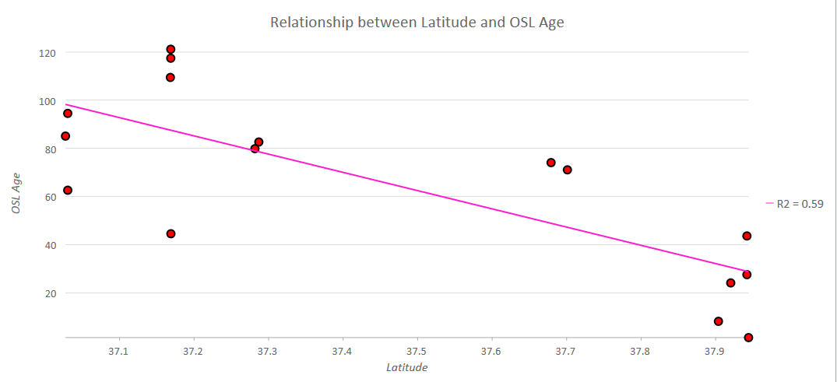
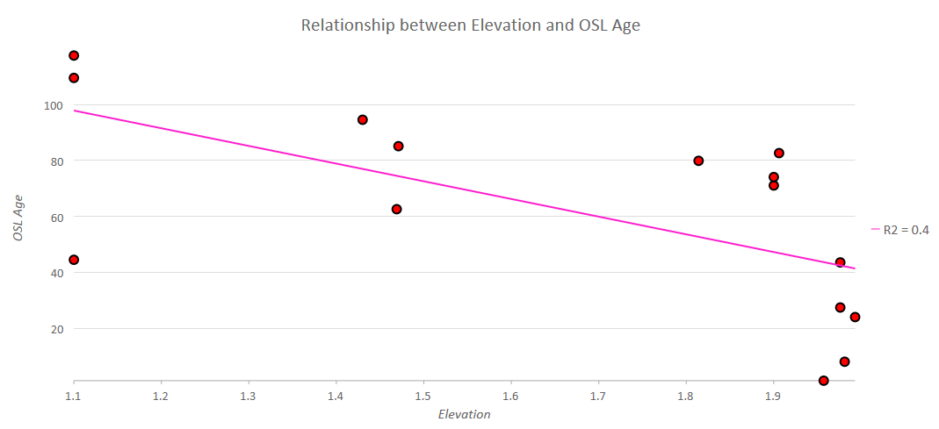
OSL Data - Spatial Relationships

Slide 14
What’s left
Complete analysis for each of the three watersheds
Compile more robust OSL dataset from available data
Possibly automate steps using Python
Develop preliminary interpretations regarding erosional history

