Slide 1


Significant Factor of Soil Forming in Cache valley
GIS in Water Resources, Fall 2016
Utah State University
Plant, Soil, Climate Department
Hiroaki Shimada

Slide 2
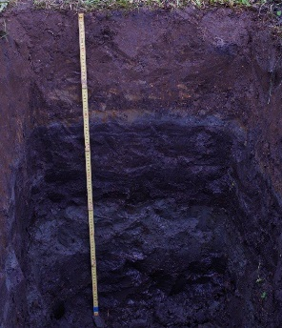
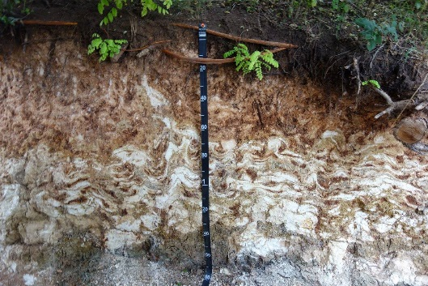
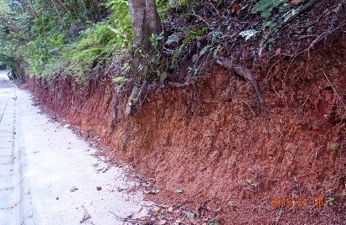
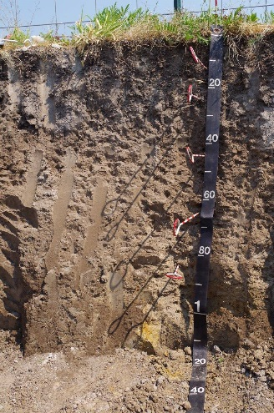
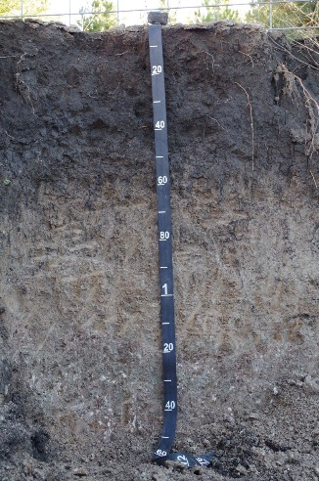
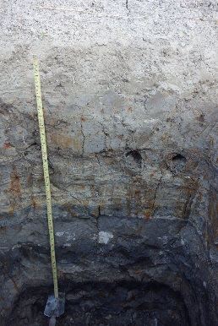
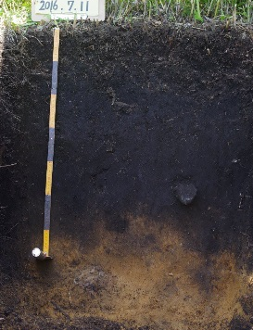
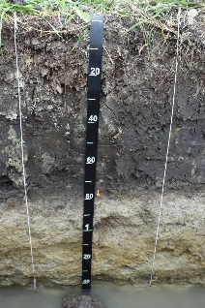
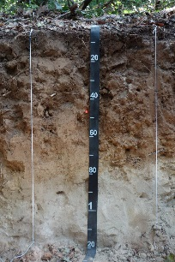
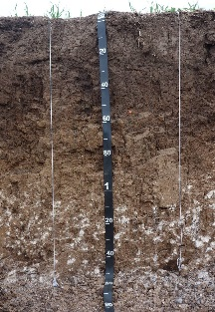
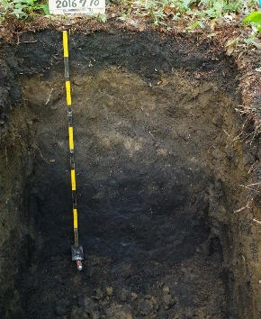
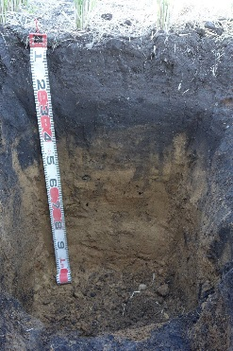
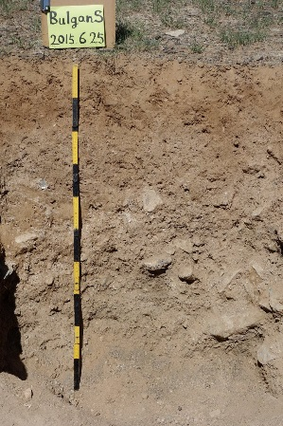
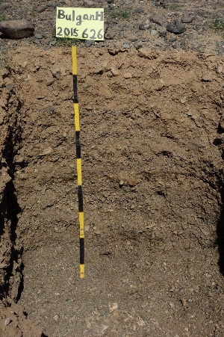
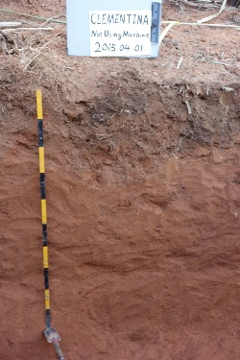
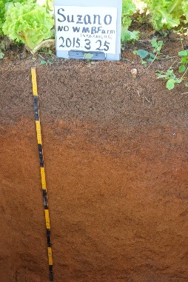
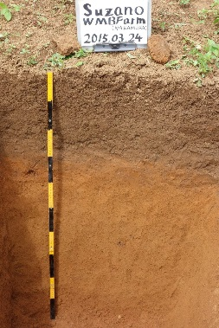
Introduction
Japan
Hungary
Utah (Logan)
Mongolia
Brazil
Notes:
Soils have a many variety as those pictures shows.

Slide 3
Introduction
Soil forming factors
S_{c}=f(cl,o,r,p,t)
Climate
Organisms
Relief
Parent material
Time
(Jenny,1941)
S_{a}or S_{c} = f(s,c,o,r,p,a,n,)+ε
Soil
Climate
Organisms
Relief
Parent material
Age
Spatial location
ε :estimated error
(McBratney et al., 2003)

Slide 4
Introduction
Soils as carbon pool
2,248 Pg Carbon in soil (0 – 100 cm)
K. Zamanian et al., 2016

Slide 5
Introduction
Objective
To estimate significant factors to soil forming
(especially focusing on movement of Carbon in Cache valley)

Slide 6
Study site and data
USDA Natural Resources Conservation Service
Cache valley area, Parts of Cache and box elder counties, Utah/ UT603/ Tabular and Spatial, complete
http://websoilsurvey.sc.egov.usda.gov/App/WebSoilSurvey.aspx
USGS
NED 10m
https://viewer.nationalmap.gov/basic/#productSearch

Slide 7
Methods
To calculate each properties from DEM with ArcGIS (e.g. Hillshade, Drop)
To make table with Zonal statistics as Table
To plot data and make a trendline with Excel

Slide 8
Result

Slide 9
Result
Percentage (%) x thickness of horizon [m]
Not correlated

Slide 10
Result
Percentage (%) x thickness of horizon [km] x area [km^2]
Not correlated

Slide 11
Things to be done
To try another tools and estimation
(please give me suggestions…)

Slide 12
Thank you for your attention
Questions

Slide 14
Slope
Questions

