Slide 1
Utah, will we have enough water?
James Saunders
Utah State University
CEE 6410
November 8, 2016

Slide 2
Overview
Project overview
Population growth over the next 50 years
Methodology to track water flow
Precipitation + Stream Flow = Water Use + Evaporation + Transpiration + Stream Flow Out + Change in Storage (Groundwater & Surface Water)
Current progress
Material left to finish

Slide 3
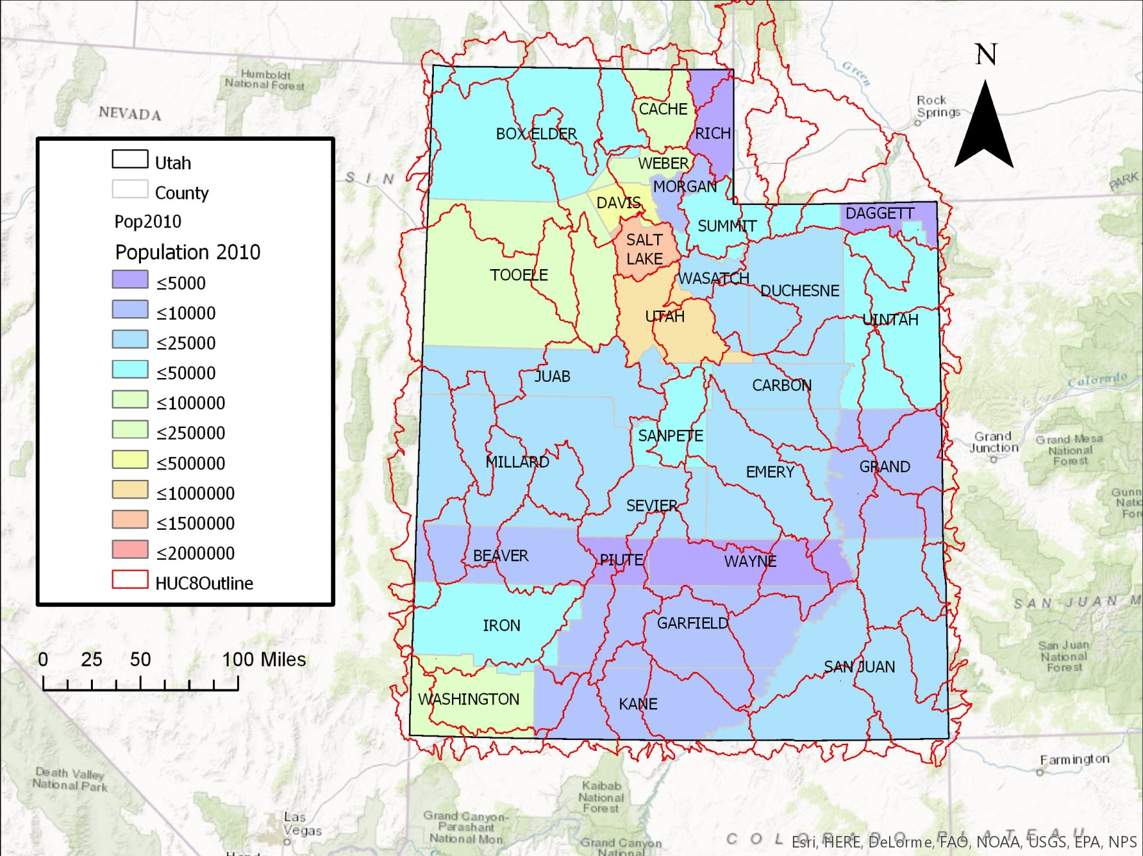
Purpose
Notes:
The purpose of this project is to identify watersheds that are using the most water. Each watershed has annual average of water flow in and out and with population growing every year, we all need to make the effort to effectively and responsibly utilize the water we are given.

Slide 4
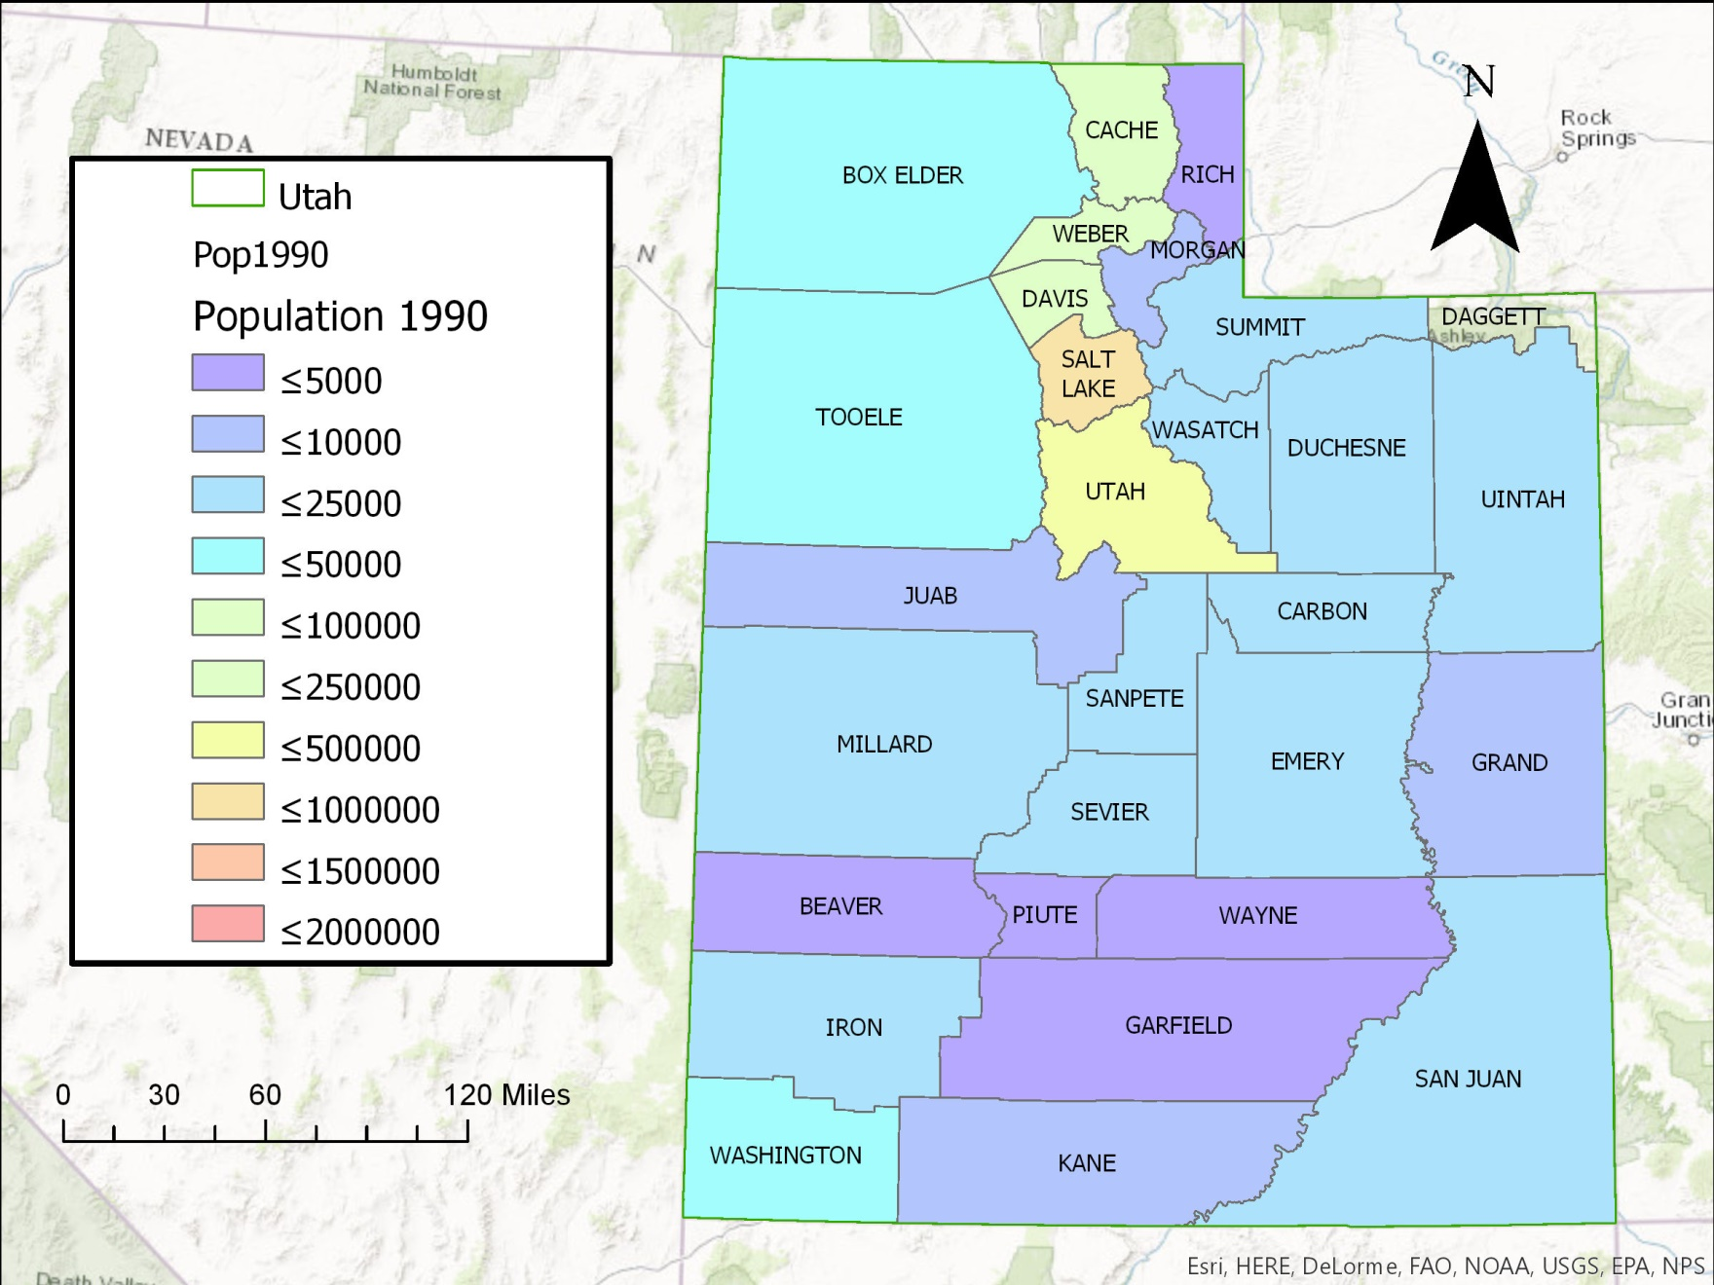
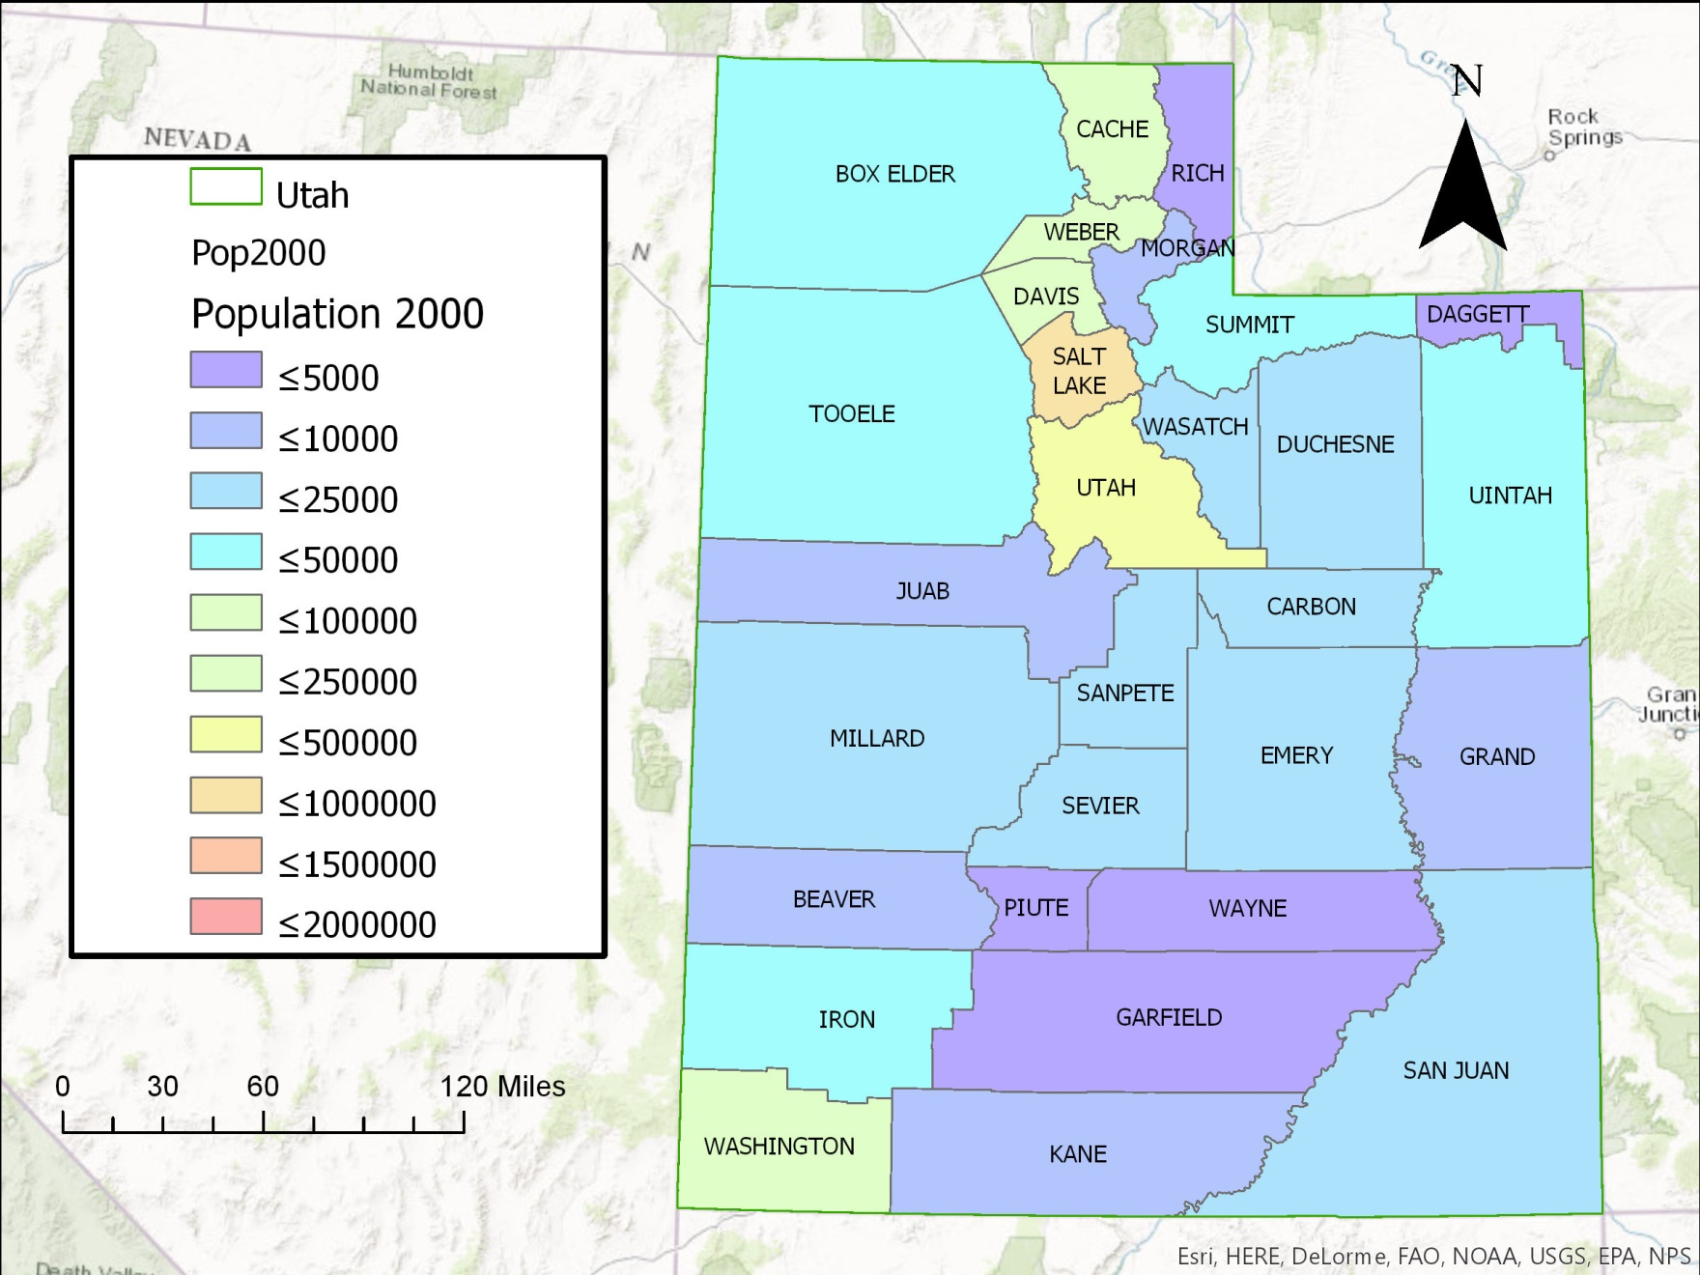
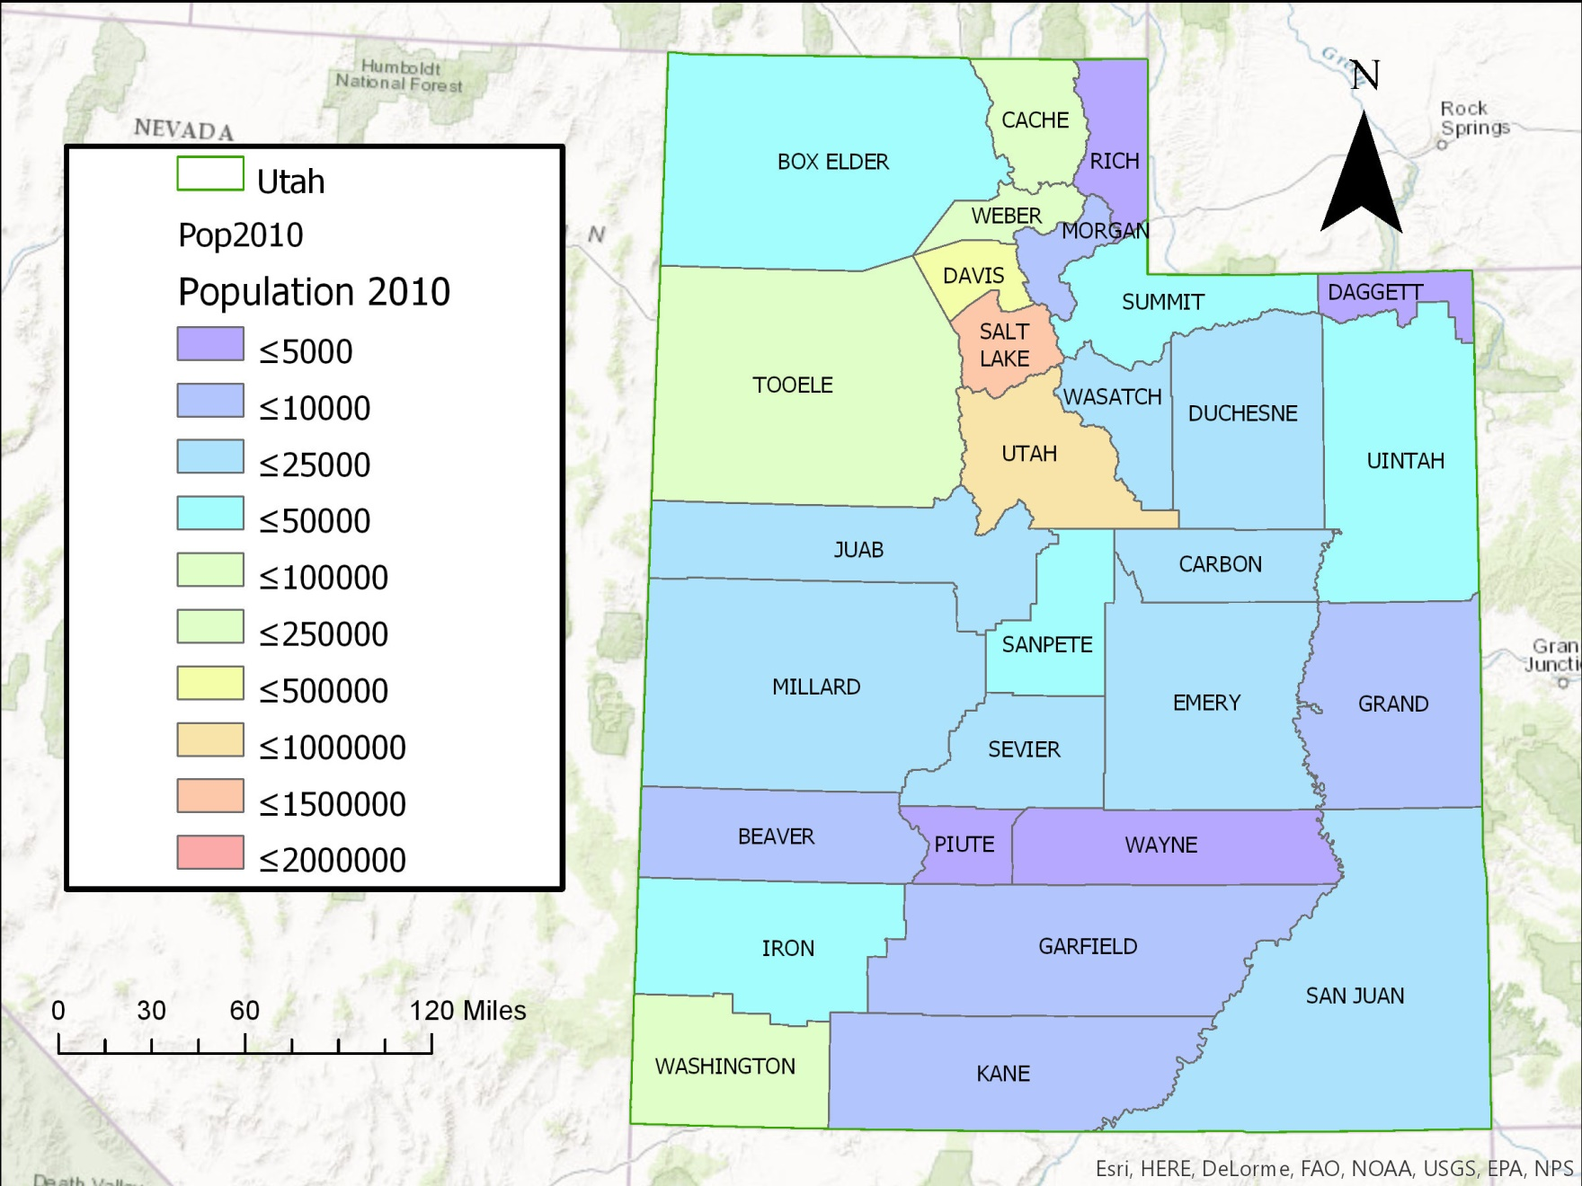
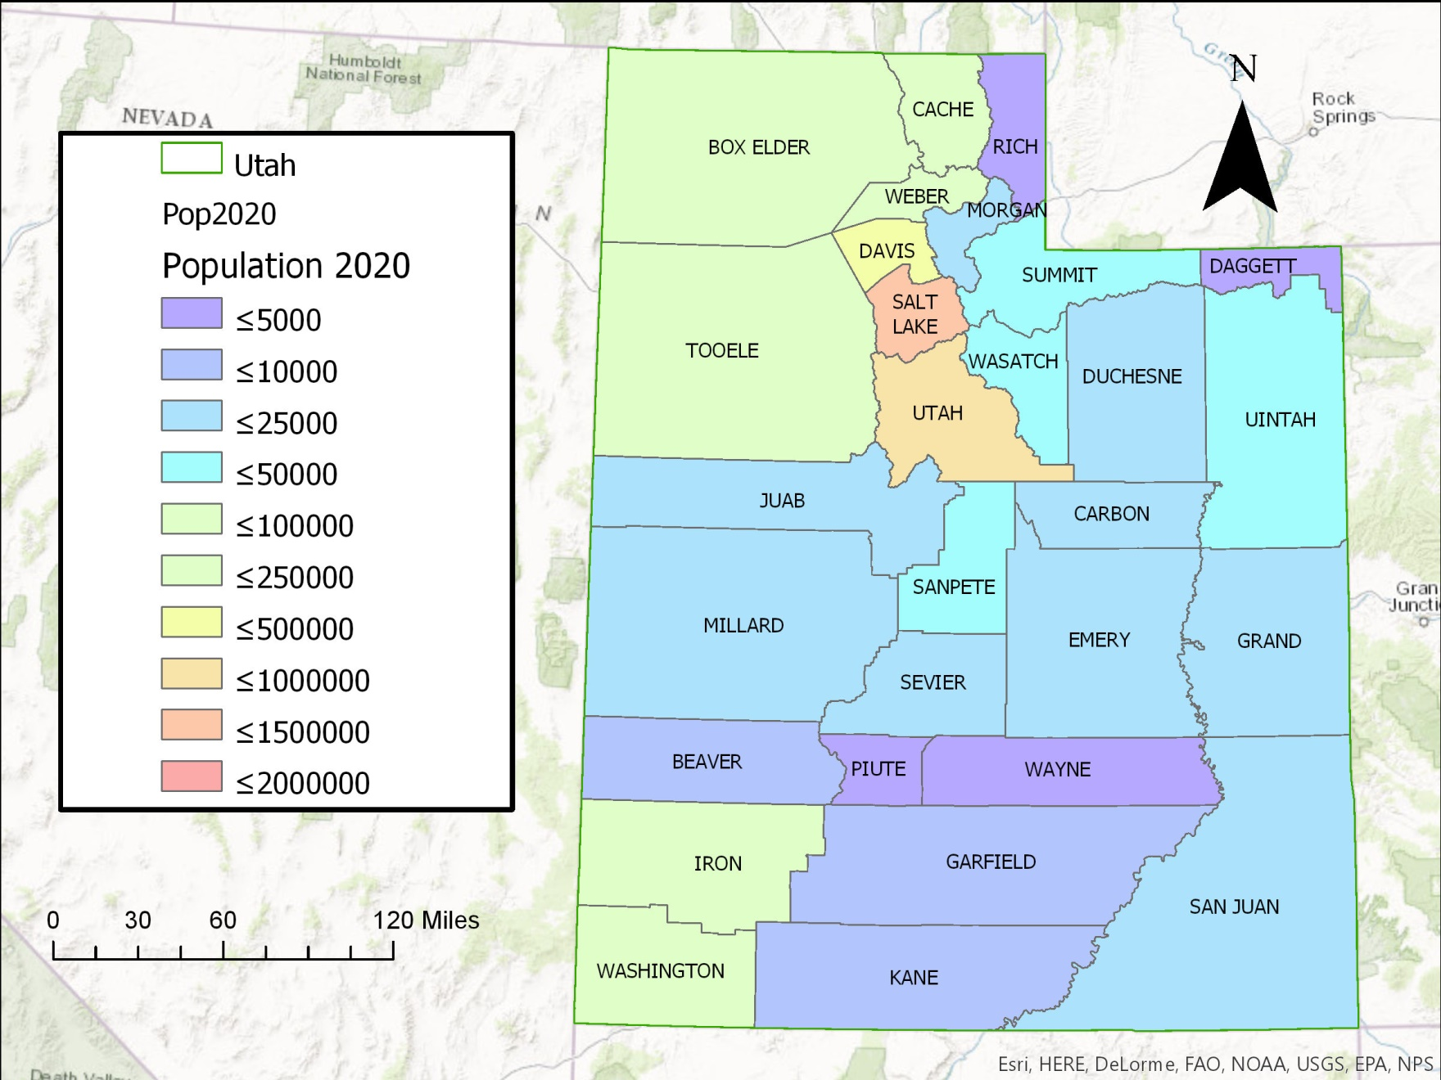
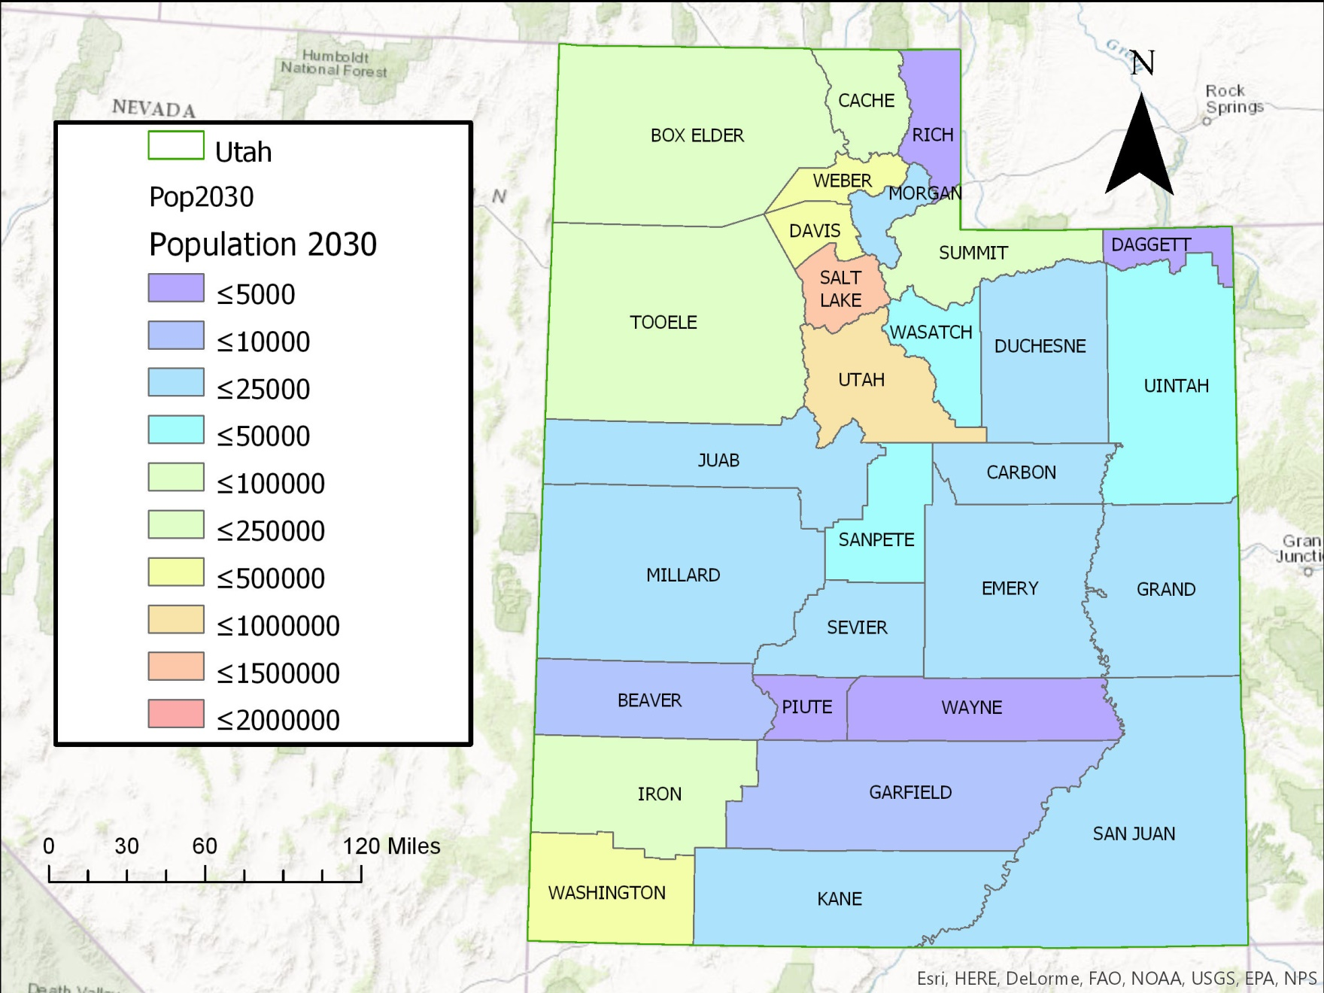
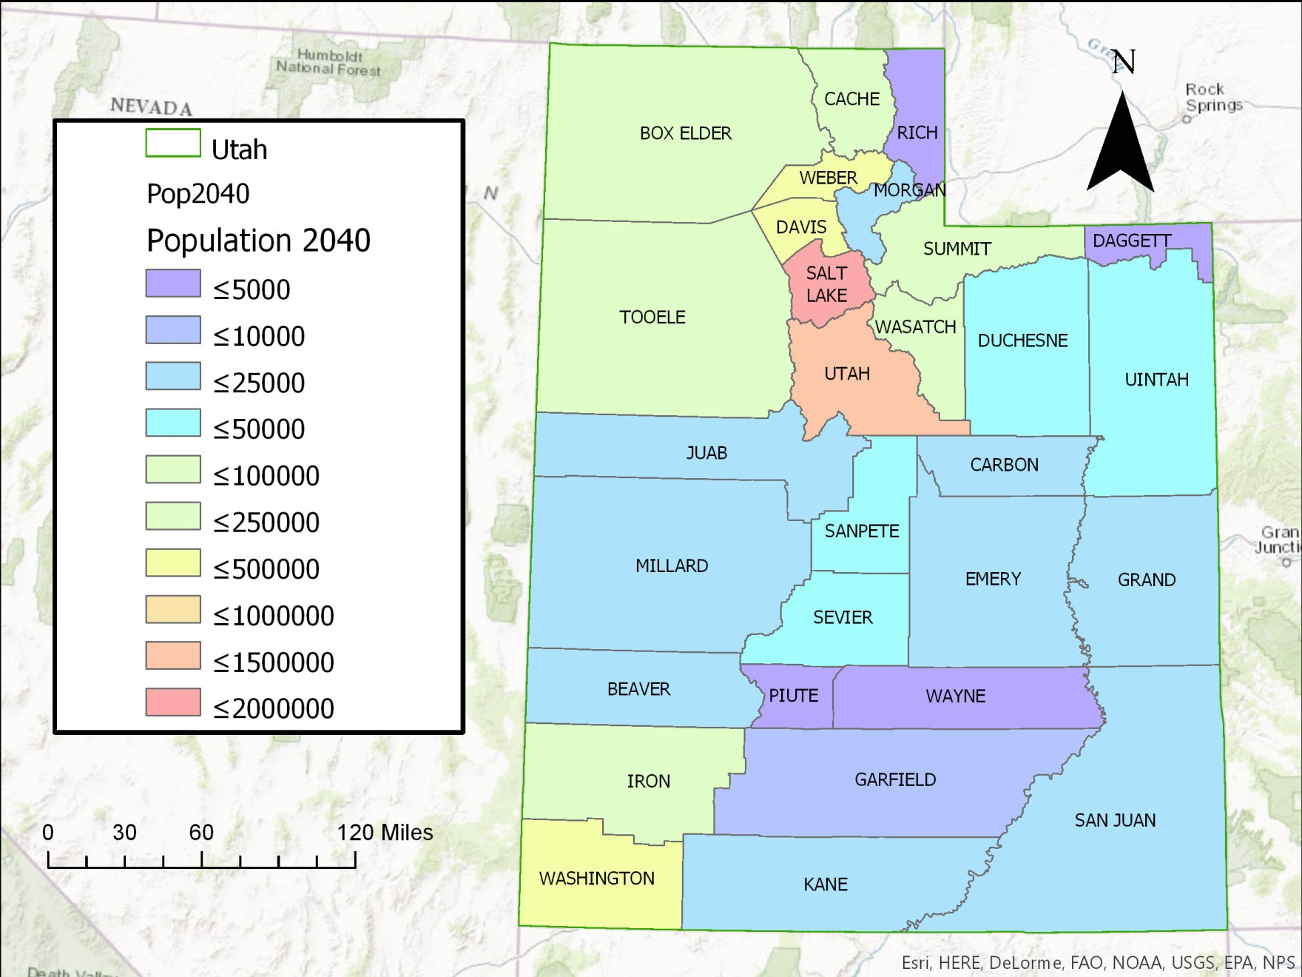
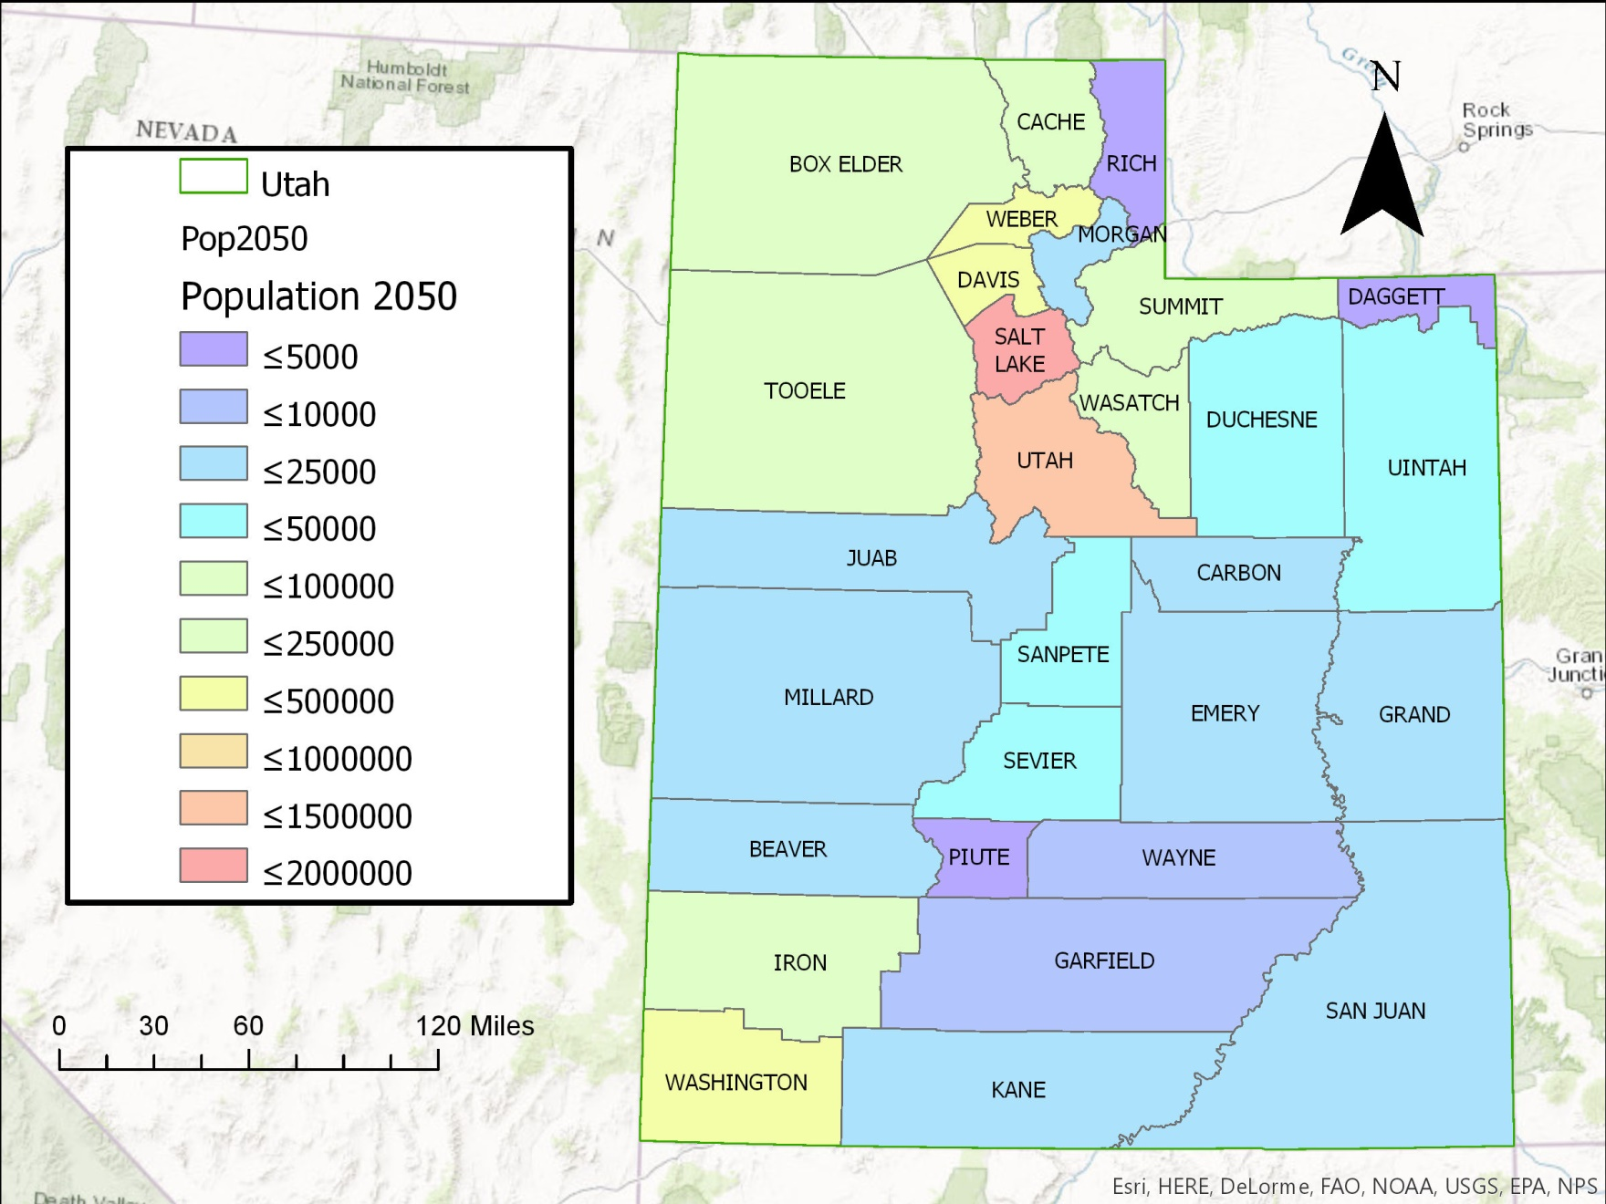
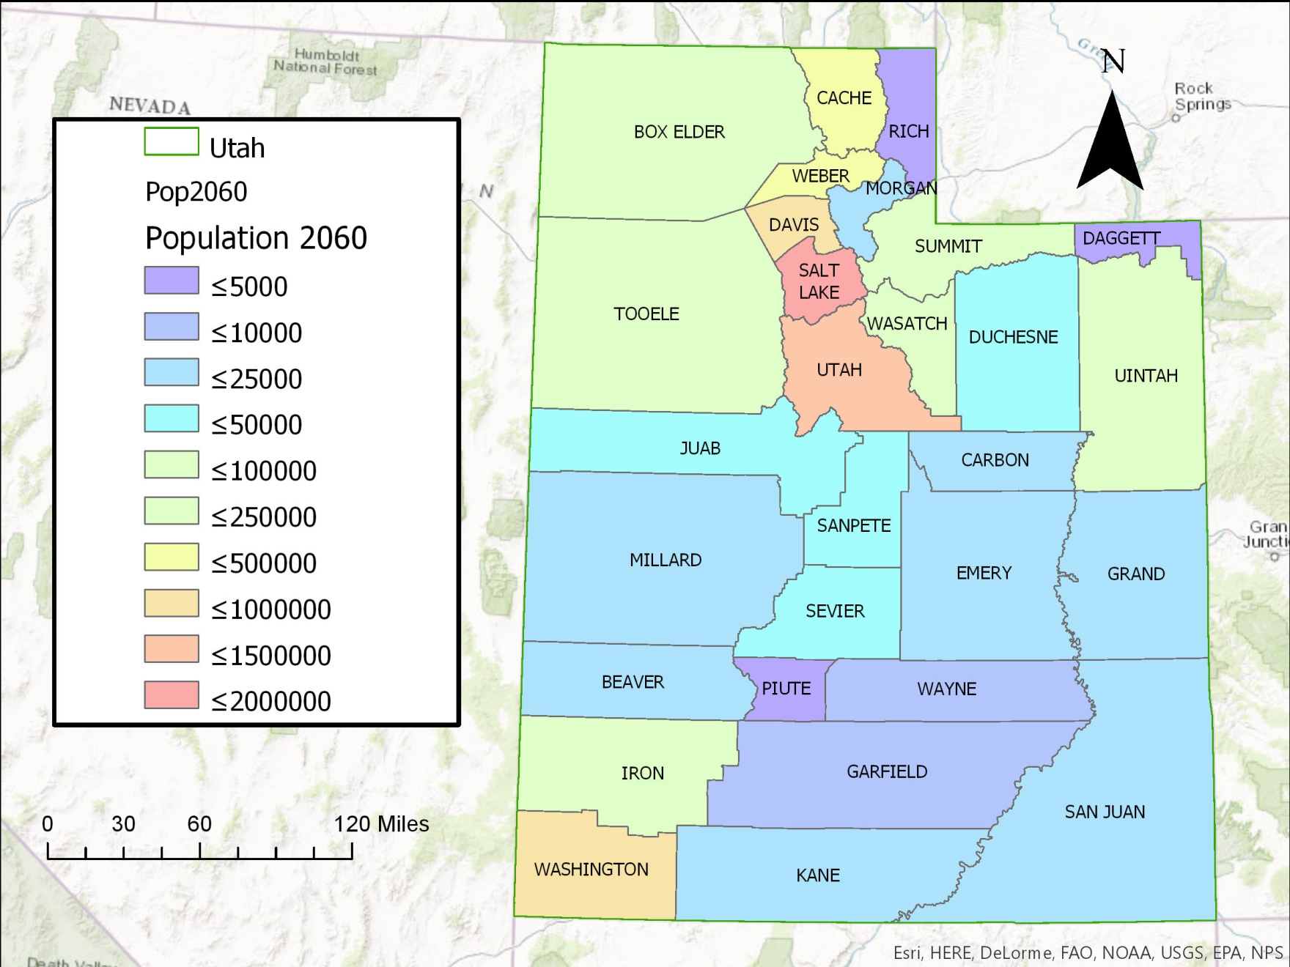
The Challenge - Population Growth
Notes:
Utah is a great place to be. And as growing business and growing families are associated with Utah, that leads to the overall population growth.

Slide 5
Supply and Demand
We have currently can supply an estimated 1.194 million ac-ft. of water
Sustains 4.776 million people
(1 ac-ft. sustains 4 people)
However, Utah is projected to have around 6 million people by 2060
Need an additional 306,000 ac-ft., not including other uses for water.
Governor Gary Herbert proposed 25% per capita water use reduction
Only need 230,000 ac-ft. to supply future demand.
Notes:
Forecasted demand presents a challenge for politicians, engineers, city planners, public health, economy, etc.

Slide 6
Precipitation-PRISM (Parameter-elevation Regressions on Independent Slopes Model)
Notes:
A new approach to computerized climate mapping was first developed by Chris Daly in 1991 when he was a Ph.D. student at Oregon State University. The algorithm was written to mimic the thought process an expert climatologist goes through while drawing a climate map.
14.46 in average precip

Slide 7
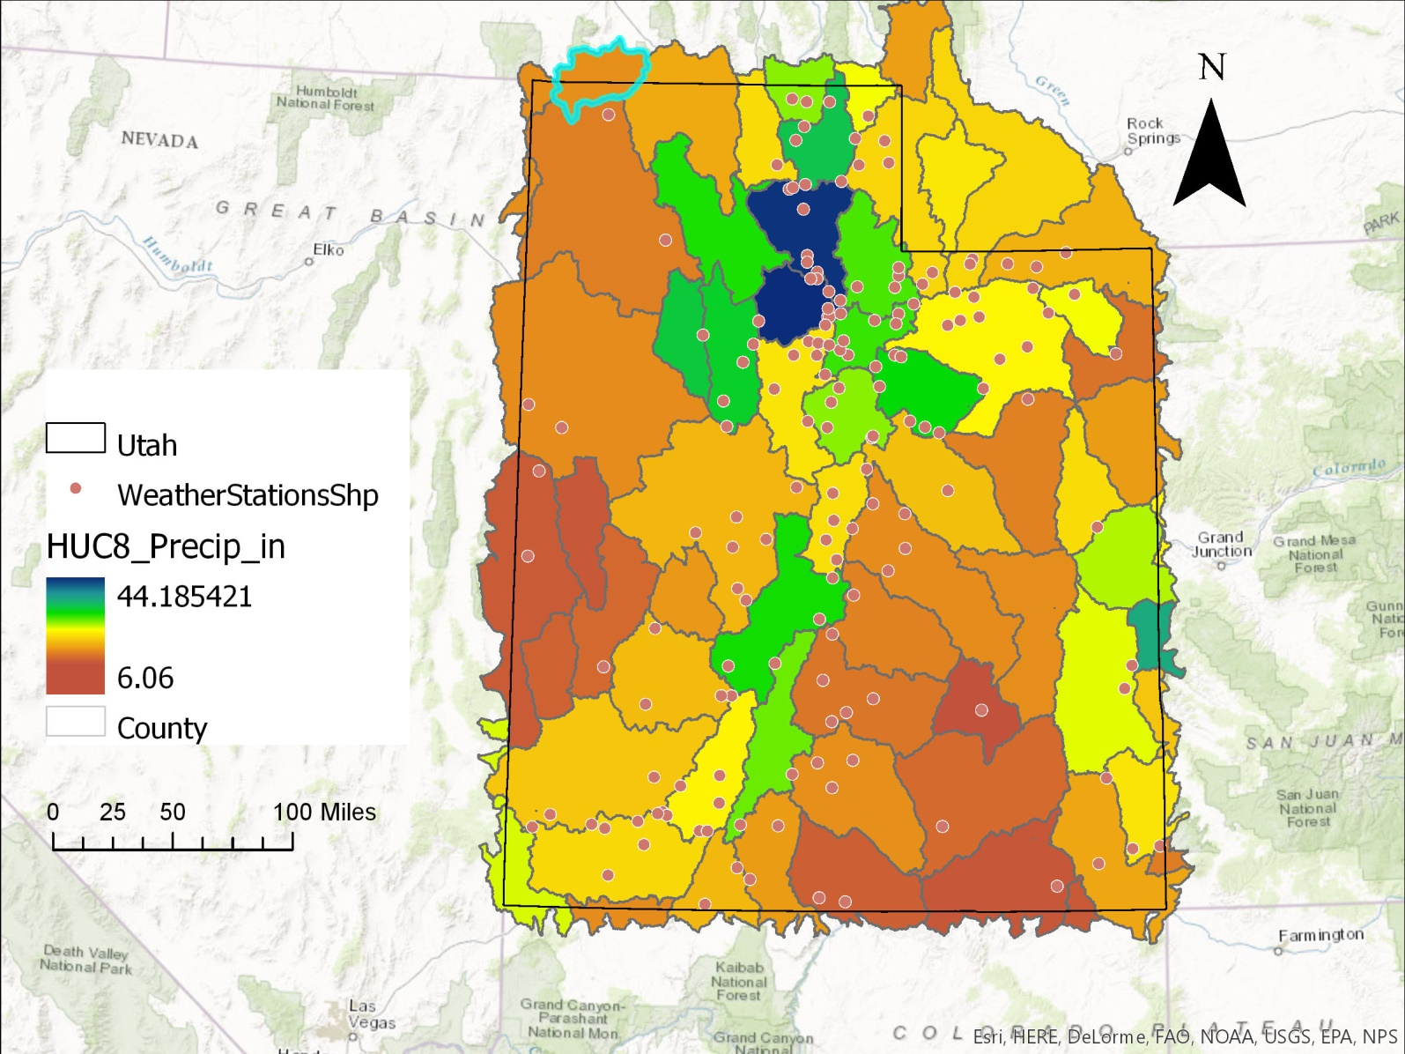
Precipitation - Thiesson Polygon
Average rainfall 13 inches of rain each year.
About 61.5 million ac-ft. per year.
To satisfy the water needs of an average family of 4, one ac-ft. of water is required.
So I guess we’re all good!
Notes:
So then my project was for nothing and I’m no just wasting your time. Not quite.
Like I said earlier this current supply also includes water that needs to be allocated to other users and some of that rainfall is lost, period!

Slide 8
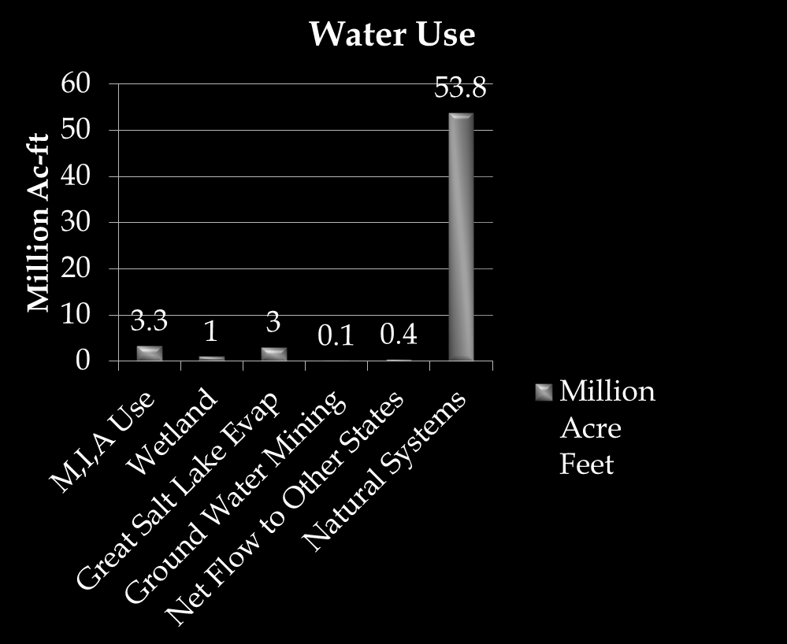
Where does all that water go? Solving the Mass Balance Equation
Domestic, Public, Industrial, Agricultural use
Stream Flow
Colorado
Evaporation
Lakes, Reservoirs
Transpiration
Vegetation
Groundwater
Governor’s Office of Management and Budget-Water-Report-2.25.16.pdf
Notes:
http://gomb.utah.gov/wp-content/uploads/sites/7/2016/03/GOMB-Water-Report-2.25.16.pdf

Slide 9
Water Use
Notes:
Utah had highest per capita water use in Nation in 2010
Possibly due to different reporting methods, installation of newer model meters, errors in reading old meters etc.
For this project I will take an average of the data shown to be conservative in my report.

Slide 10
Water Related Land Use
Notes:
Salt Lake County

Slide 11
Water Rights
Initially a good way to start
But only data is land use, no amounts
Only amounts are by county
Maybe someday
Notes:
Initially started as a great way to find flow in and out of the watersheds

Slide 12
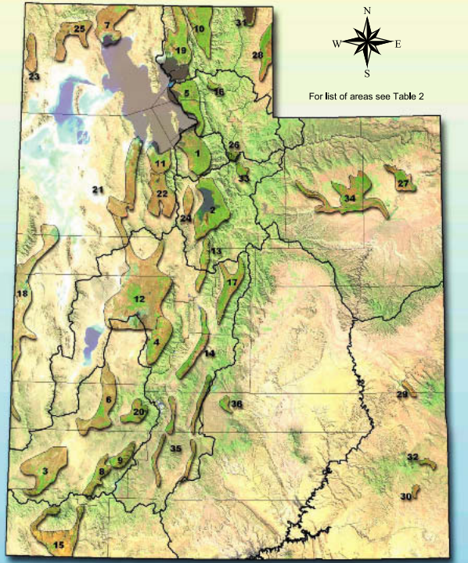
Ground Water - Aquifers
http://www.water.utah.gov/Planning/SWP/StatePlans/SWP2001/SWP_pff.pdf
Notes:
Estimated 851,00 ac-ft. of water in ground water

Slide 13
The Solution

Slide 14
The Real Fix - Recommendations
Conservation
1 gallon saved by all will allow water for 13,000 new people
Better Management
Water Development
Further data collection in Groundwater
State/Nationally defined

