Slide 1
GIS As A Tool For Visualizing Water Quality Data
Jared Richens
CEE 6440

Slide 2
Overview
Site Description & Introduction
Methods
Current Progress
Future Work
Questions

Slide 3
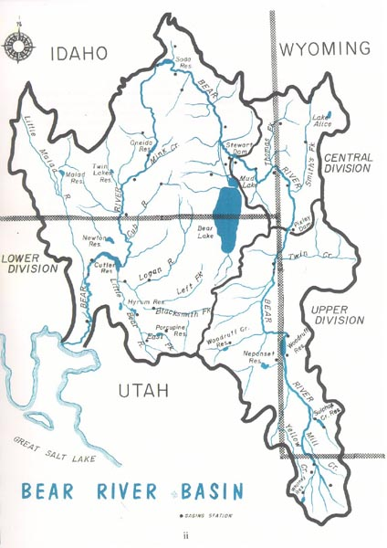
Site Description and Introduction
Little Bear River, Cache County, Utah
Drains the southern-end of Cache Valley
Highly utilized – Agriculture
Listed as impaired for:
Phosphorus
TSS
Issues thought to result from non-point sources – agriculture
Difficult to communicate issues
Photo Courtesy: Utah Division of Water Rights (utah.gov)

Slide 4
Methods
Water Quality Data
UWRL – Not available
NWQMC (USGS/EPA)
Lots of numbers, unknown quality
National Land Cover Database
NHD Flow Lines
Utah AGRC
Sub-watersheds
Water Related Land Use
Bear River Commission
UPDES Dischargers

Slide 5
Current Progress – 2015 TDP

Slide 6
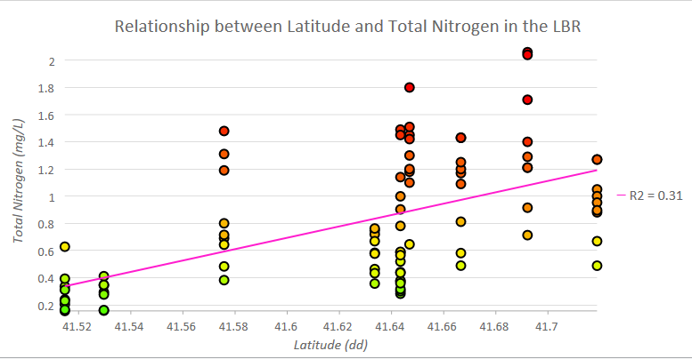
Current Progress – 2015 Total N

Slide 7
Current Progress – 2015 Temp.

Slide 8
Current Progress – 2015 DO

Slide 9
Future Work
Add Additional data from 2005 and 1995 and compare for temporal changes in water quality
Identify areas of the LBR which are gaining nutrients and compare to land cover information to determine if there is a correlation between agricultural use and increased water quality impairment.

Slide 10
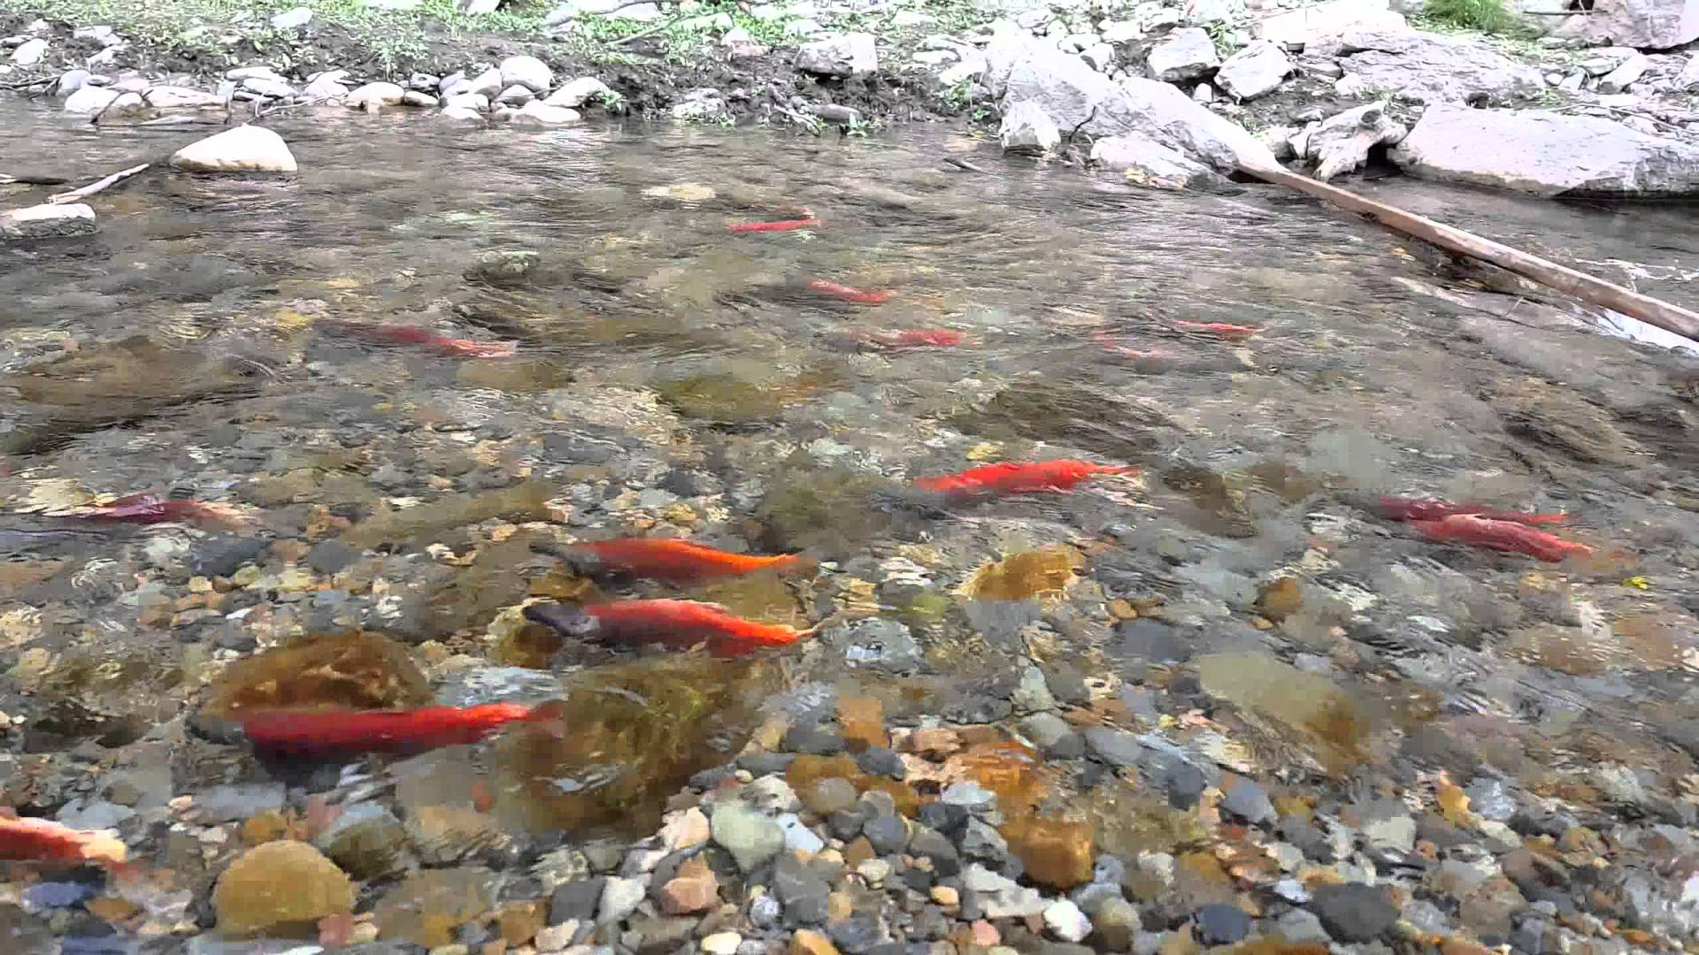
Conclusion
ArcGIS is a very effective tool at illustrated deteriorating water quality through a water shed
Ability of ArcGIS to combine geographic, tabular, and graphical data is especially useful
ArcGIS could improve scientists’ and engineers’ ability to communicate water quality issues to the public
Fall Kokanee Salmon Run in LBR Headwaters
Photo Courtesy: Tanwir Zaman (youtube.com)

Slide 11
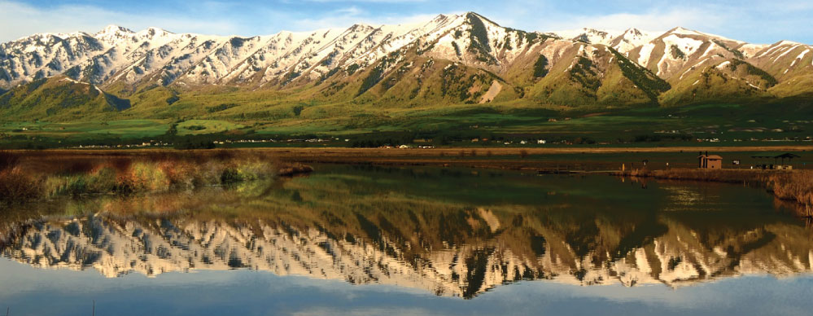
Questions?
Photo Courtesy: Cache Valley Visitors Bureau (explorelogan.com)

