Slide 1
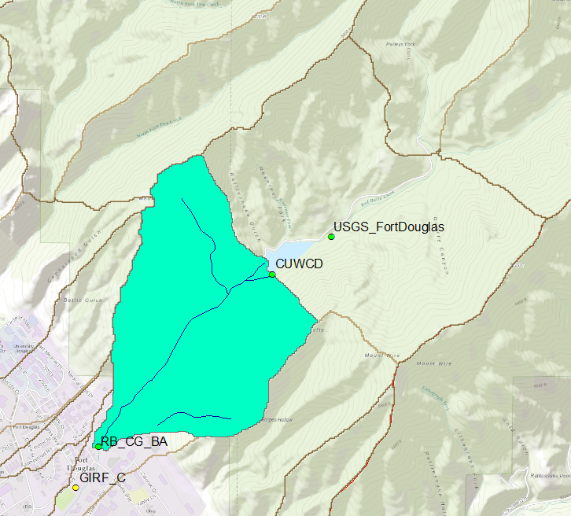
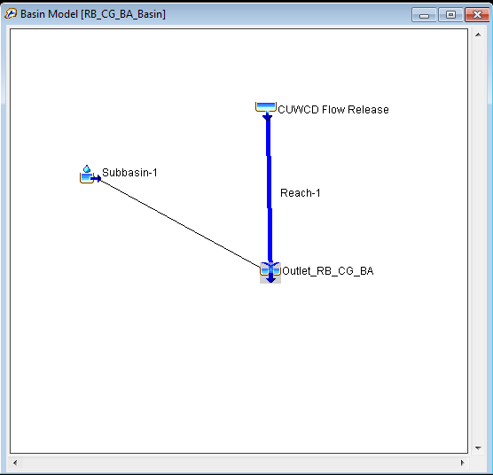
Continuous runoff simulation model below Red Butte Creek Reservoir including snowmelt
Term Project, CEE6440, Fall2016

Slide 2
Objective:
snow parameter calibration using snow water equivalent (SWE).
analyze mass balance through simulation result.
Work Description:
Work Description | Method | Tool
Snowmelt | Temperature Index | ArcGIS & HEC-HMS 4.1
Canopy Loss | Simple Canopy | ArcGIS & HEC-HMS 4.1
Surface Depression Loss | Simple surface | ArcGIS & HEC-HMS 4.1
Infiltration Loss | Soill Moisture Accounting | ArcGIS & HEC-HMS 4.1
Evapotranspiration | Monthly average | HEC-HMS4.1
Baseflow | Recession | HEC-HMS4.1
Routing | Muskingham | HEC-HMS4.1

Slide 3
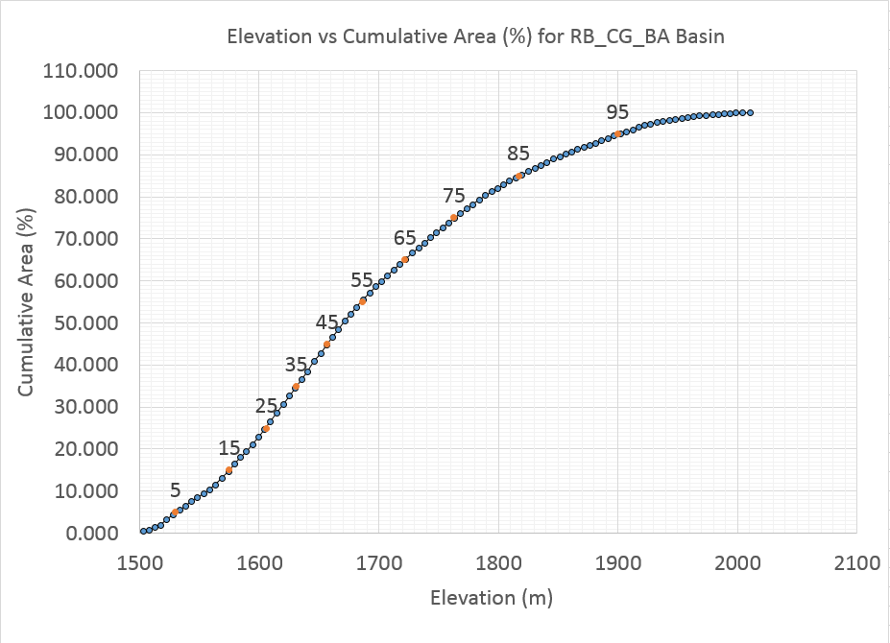
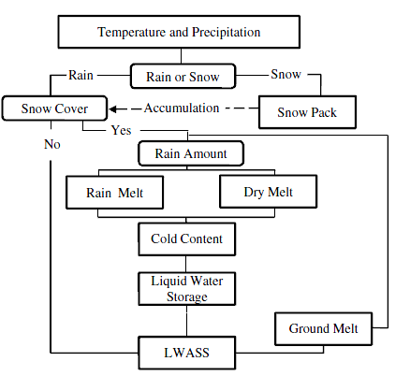
Temperature Index Snowmelt:
Shook and Gray, 1994
Wind, Seasonal and aged factors

Slide 4
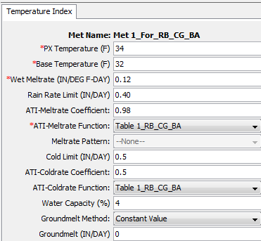
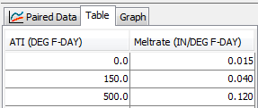
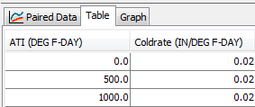
Snow Parameters:

Slide 5
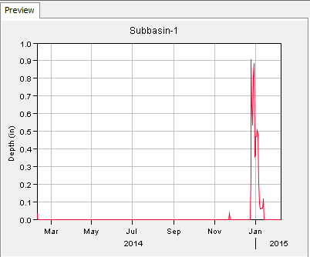
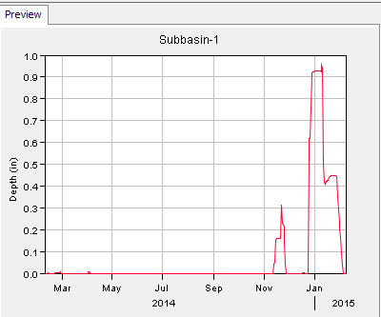
Snowmelt Results:
Calculated/Observed SWE
Simulated SWE

Slide 6
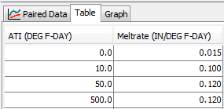
Snow parameter calibration:
Engineer Research And Development Center suggest snow parameter to be calibrated
Calibrated Parameter
http://www.erdc.usace.army.mil/

Slide 7
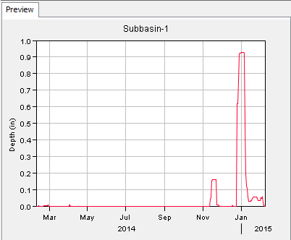
Calibrated Result:
Calculated SWE Simulated SWE Calibrated SWE

Slide 8
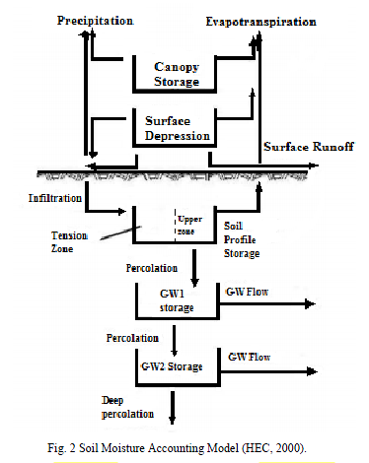
Required parameter determined for SMA losses using ArcGIS
Parameter | Value | Tool | Data Source
Maximum Canopy Storage (mm) | 2.1 | ArcGIS | NLCD 2011
Maximum Surface Storage (mm) | 3.11 | ArcGIS | SSURGO
Impervious percent (%) | 0.75 | ArcGIS | NLCD 2011
Maximum soil storage (Porosity) (mm) | 180.03 | ArcGIS | SSURGO
Maximum tension storage (mm) | 150.89 | ArcGIS | SSURGO
Maximum soil infiltration rate (mm/hr) | 34.07 | ArcGIS | SSURGO
Maximum percolation rate (mm/hr) | 60.247 | ArcGIS | SSURGO
GW1 maximum percolation rate (mm/hr) | 60.247 | ArcGIS | SSURGO
GW1 maximum Storage (mm) |  | Excel | Recession Limb analysis
GW 1 Coefficient (hr) |  | Excel | Recession Limb analysis
GW2 Maximum percolation rate (mm/hr) |  | HEC-HMS | Model Calibration
GW2 maximum Storage (mm) |  | Excel | Recession Limb analysis
GW 2 Coefficient (hr) |  | Excel | Recession Limb analysis

Slide 9
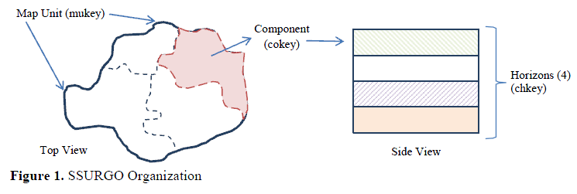
SSURGO Data Information:
Horizen1 (Chkey)
Component1(Cokey)
Horizen2 (Chkey)
Horizen3 (Chkey)
Horizen1 (Chkey)
Map Unit (Mukey)
Component2 (Cokey)
Horizen2 (Chkey)
Horizen1 (Chkey)
Component3 (Cokey)
Horizen2 (Chkey)
Horizen3 (Chkey)
Horizen4 (Chkey)

Slide 10
QUESTIONS??

