Slide 1
Use of ArcGIS to extract river geometry as an input to HECRAS model and prepare inundation, and velocity maps
  Term Project, CEE 6440, Fall 2016
  Presented by:
  Rezaul Haider
  Graduate student, CEE
  USU

Slide 2
Presentation Overview
Research Challenge
Study area
Methodology
Results
Way Forward

Slide 3
Research Challenge
Total Surface Heat Flux, Jatm = Jsn + Jan – (Jbr + Jc + Je)
Jsn = net solar shortwave radiation
Jan = net atmospheric longwave radiation
Jbr = longwave back radiation from the water
Jc = conduction
Je = evaporation
Surface
Heat Fluxes
Radiation terms
Jbr
Jc
Je
Air-water interface
Jsn
Jan
Chapra, S. C. (1997). "Surface Water-Quality Modeling." Waveland Press Inc

Slide 4



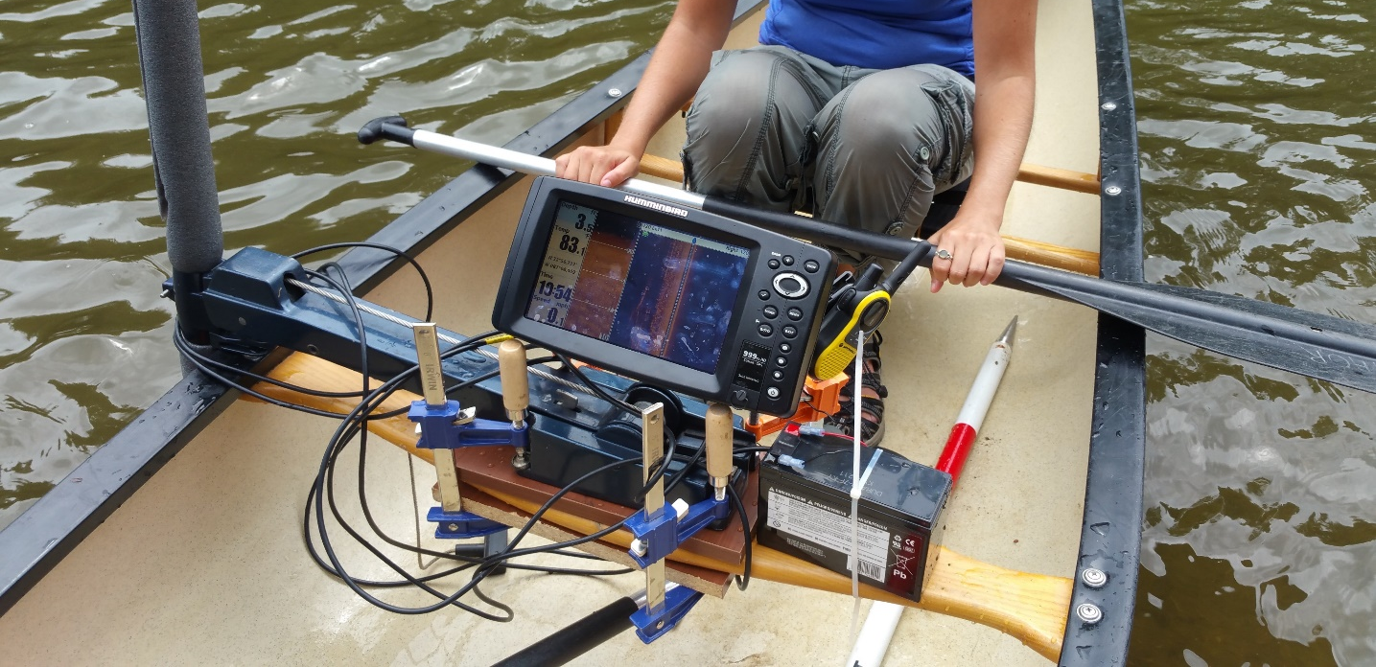
1. Densified Measurements
ADCP
Humminbird Helix Radar
Sommer Radar
Slide from Lecture by Dr. Maidment

Slide 5
Scenarios
Flow scenarios to model
Low flow (06.02.2014 to 06.062014)
Low flow (05.04.2015 to 05.22.2015 )
Hydropeaking condition (September 2016)

Slide 6
Objective of the study
Objective:
To extract river width and cross section from high resolution DEM using ArcGIS.
(ii) To prepare inundation and velocity maps for floods of different return periods.

Slide 7
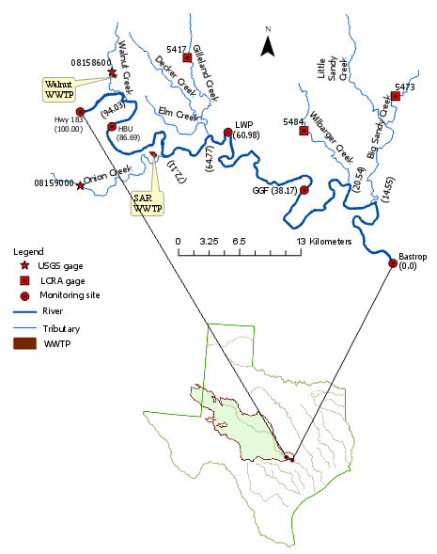
Study area

Slide 8
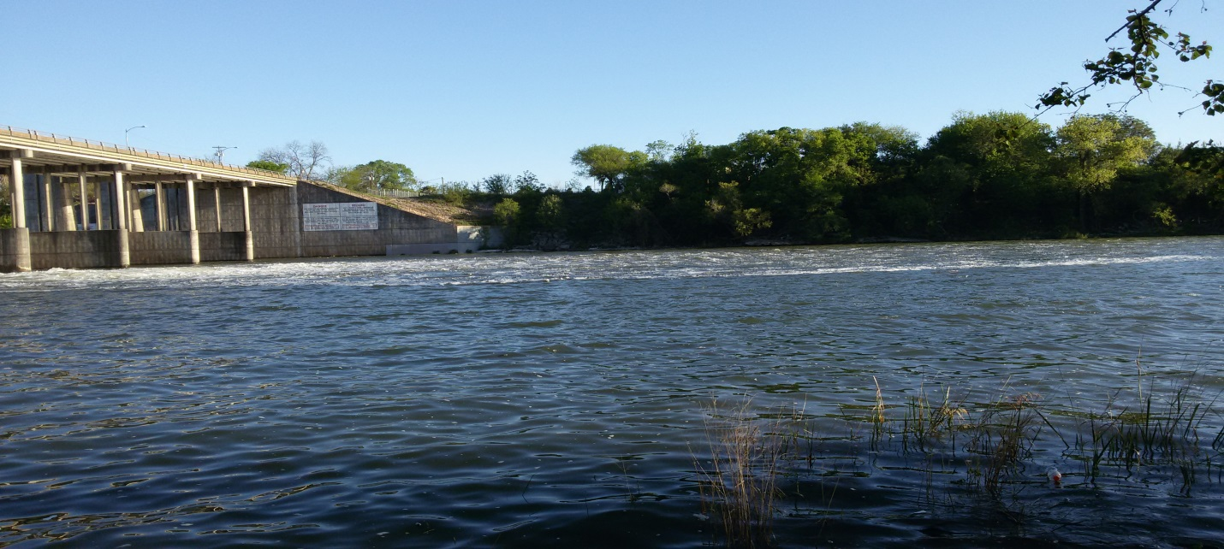
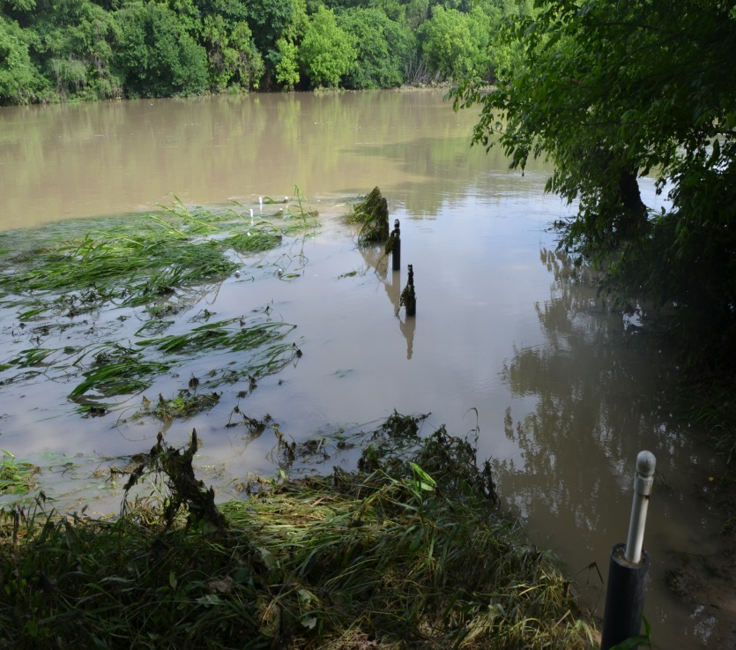
Study area

Slide 9
Methodology
ArcGIS 10.x
HEC-GeoRAS
HEC-RAS
DEM: USGS elevation data at a resolution of 1/3 arc-second (approximately 10 meters) from The National Map Viewer .
http://viewer.nationalmap.gov/basic/.
http://www.hec.usace.army.mil/software/

Slide 10
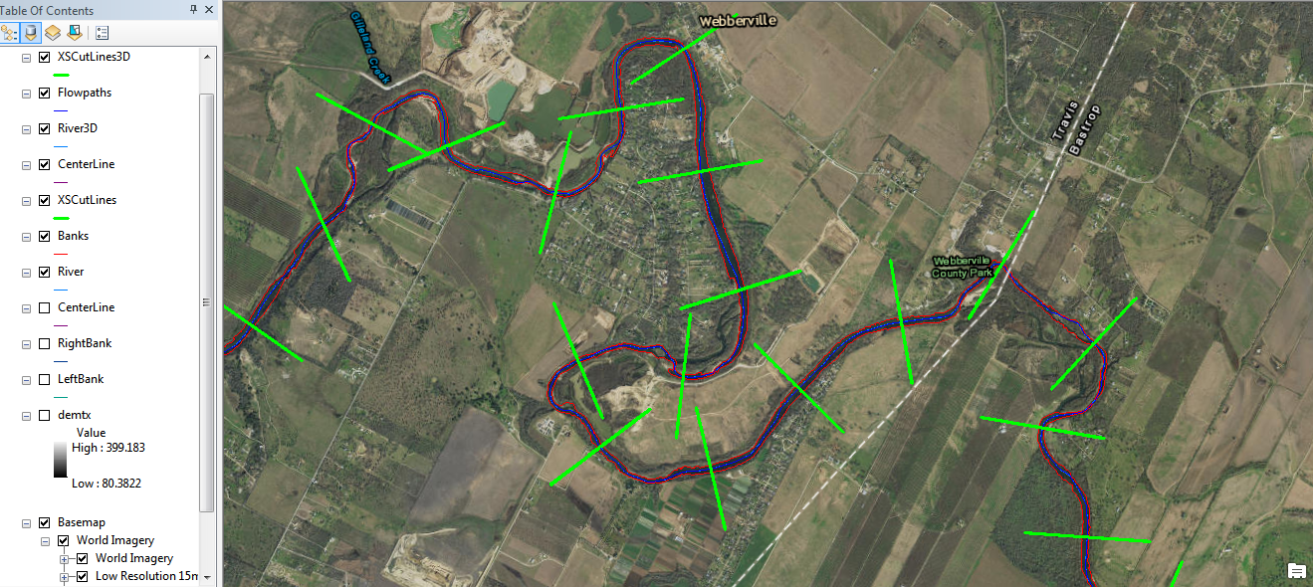
Methodology cont’d
Creating banklines, centerline
Projection
Extraction of cross-section in HEC-GeoRAS

Slide 11
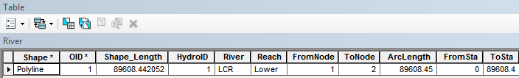
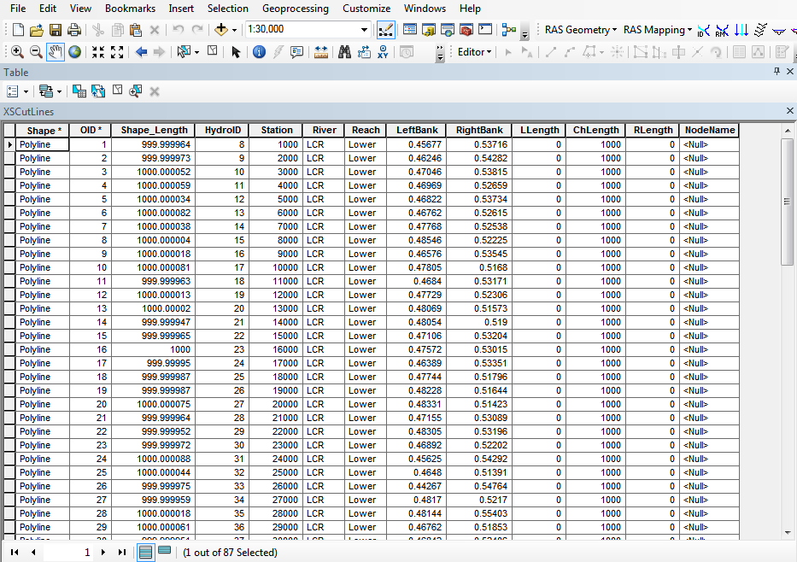
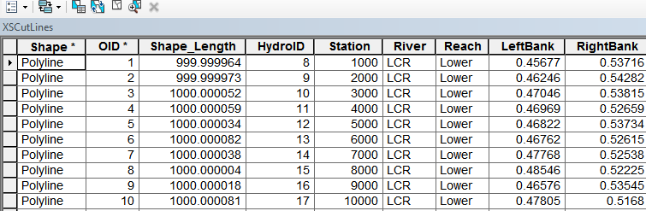
Results

Slide 12
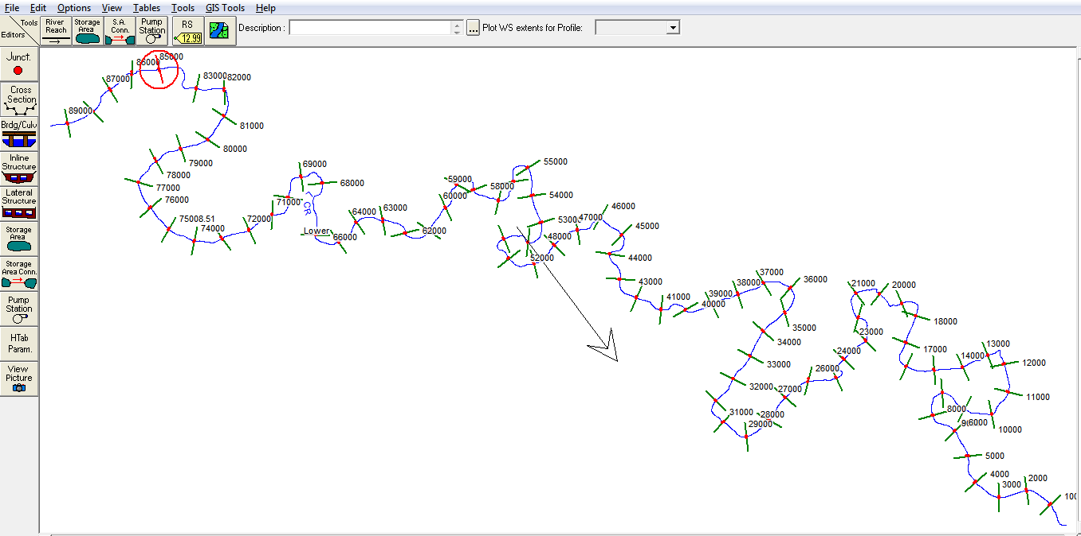
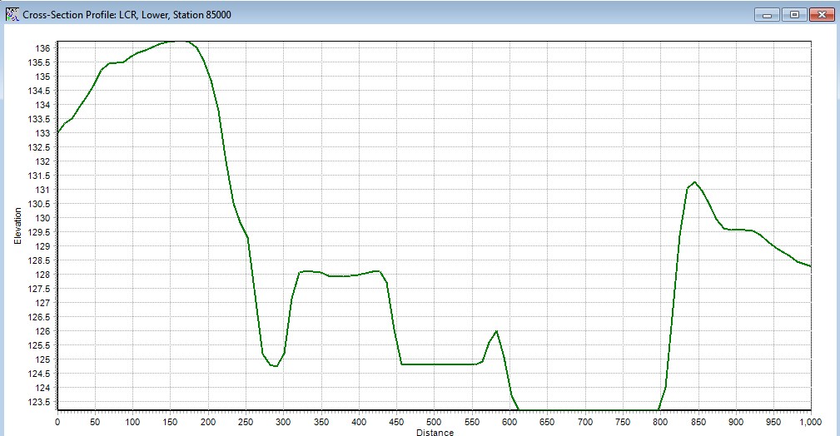
Cross-section
X-section (85 km)
Walnut Creek

Slide 13
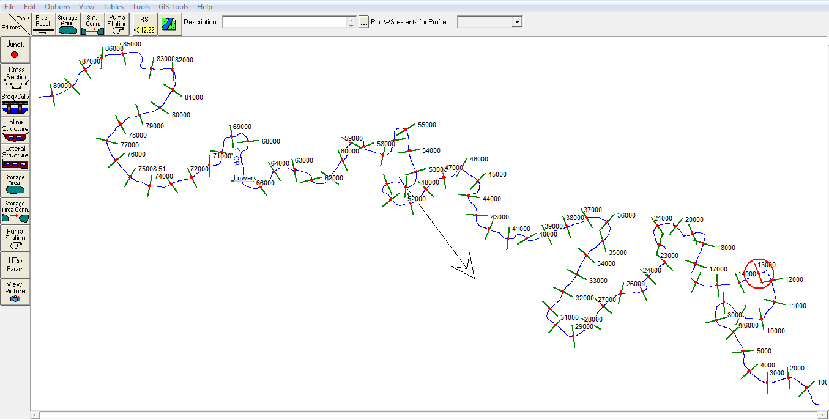
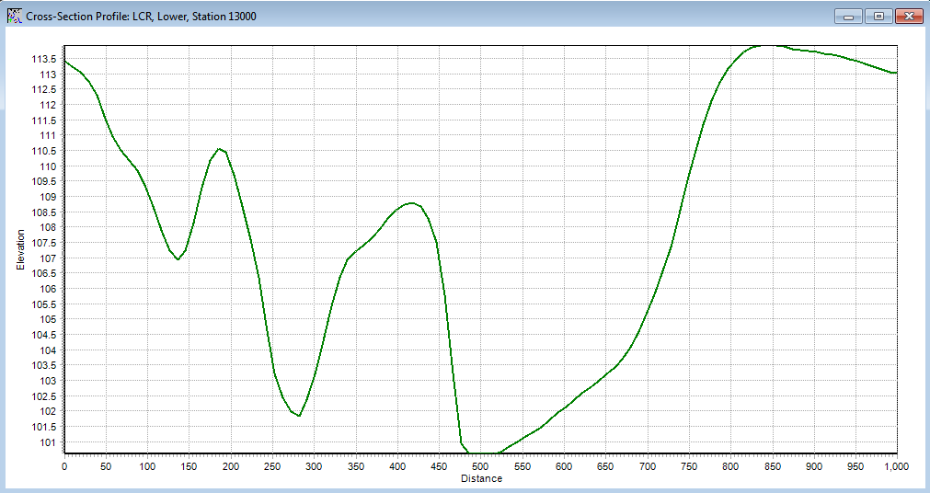
Cross-section cont’d
X-section (13 km)
Walnut Creek

Slide 14
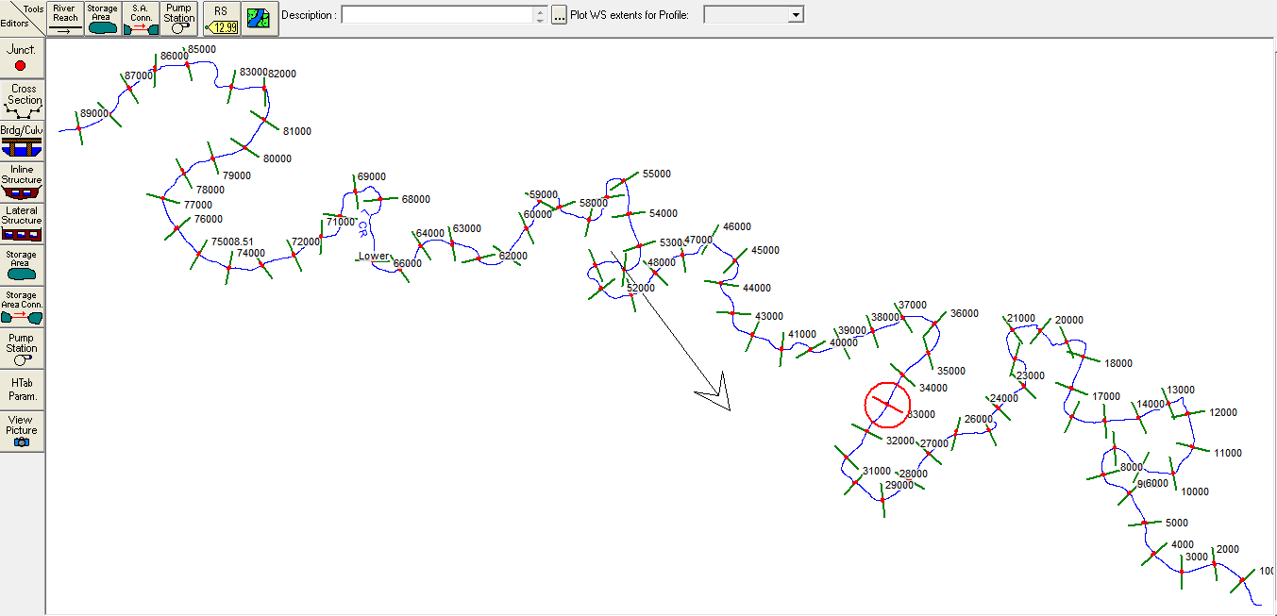
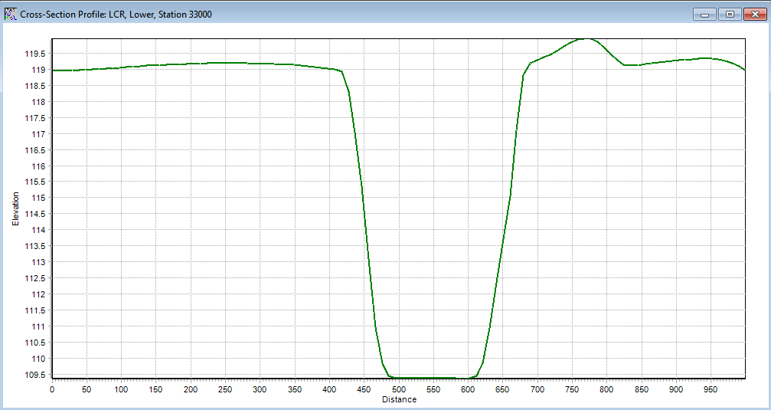
Cross-section cont’d
X-section (33 km)

Slide 15
Longitudinal Profile
Overall bed slope = -0.00032
Overall water surface slope = -0.0003

Slide 16
Geometry
Flow direction
Min | 56
Max | 81
Median | 66

Slide 17
Way Forward
Hydraulic modeling in HECRAS
Inundation and velocity mapping
‘HAND’ analysis to generate rating curve.

Slide 18
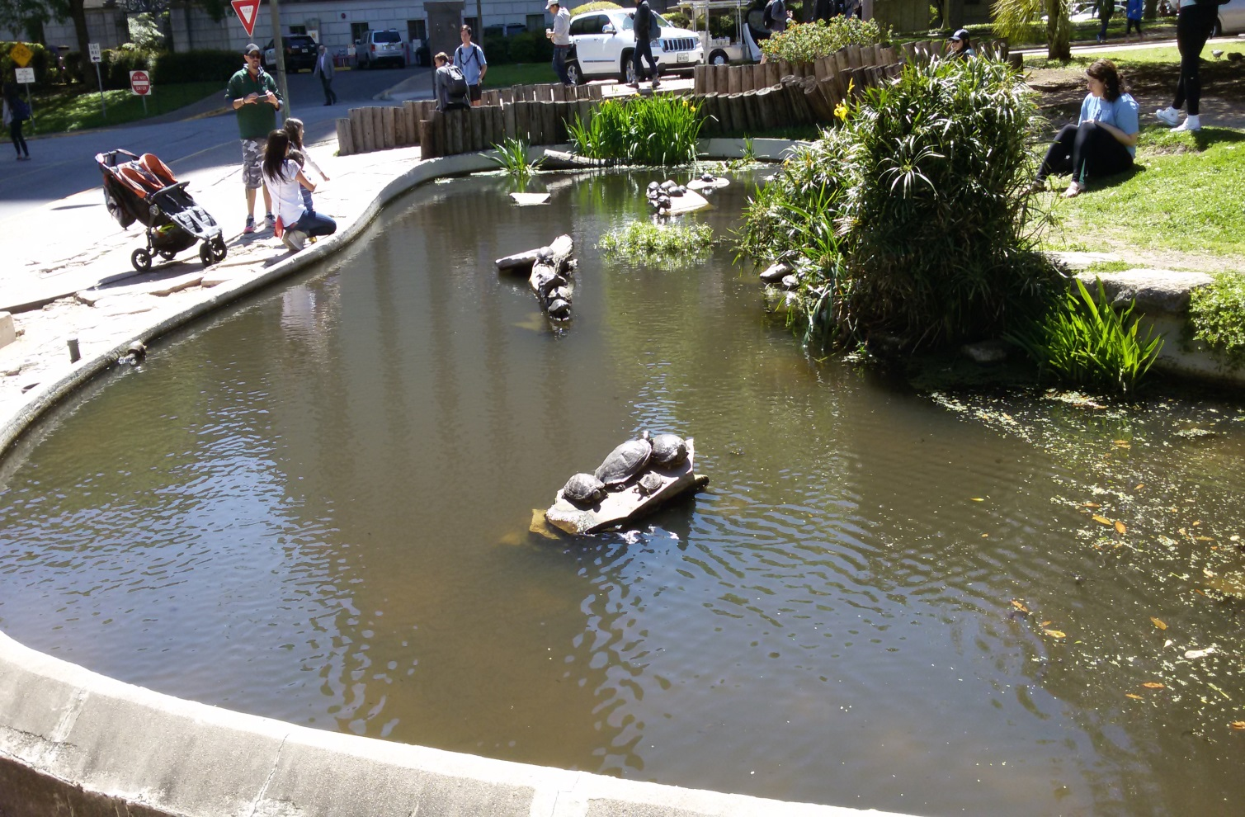
Question???

