Slide 1
An Enhanced Canopy Cover Layer for Hydrologic Modeling
Sara A. Goeking

Slide 2
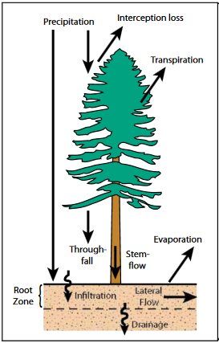
Why tree canopy cover?
It may affect partitioning of precipitation into runoff versus evapotranspiration:
P = Q + E
From Winkler et al. 2010:
Hydrologic Processes and Watershed Response

Slide 3
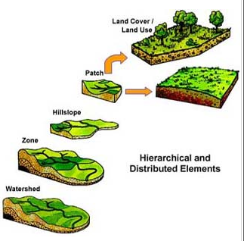
Purpose
Improve canopy cover data for use in distributed hydrologic models

Slide 4
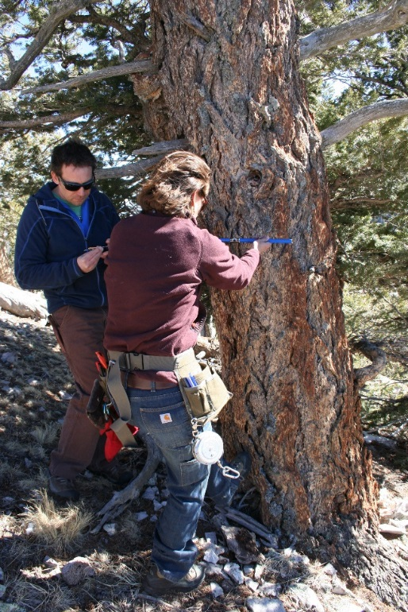
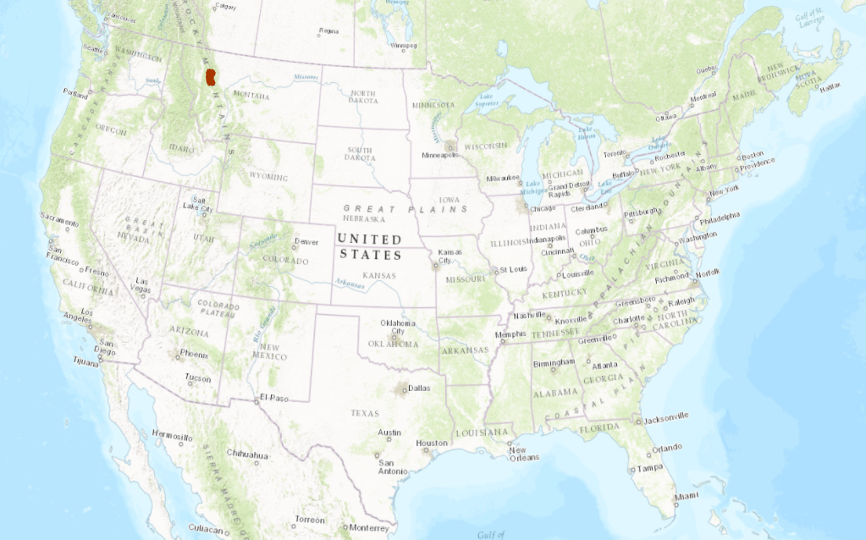
Specific objectives
Short-term: To prepare inputs to a statistical model for interpolating canopy cover
Long-term: To produce a spatially continuous tree canopy cover layer

Slide 5
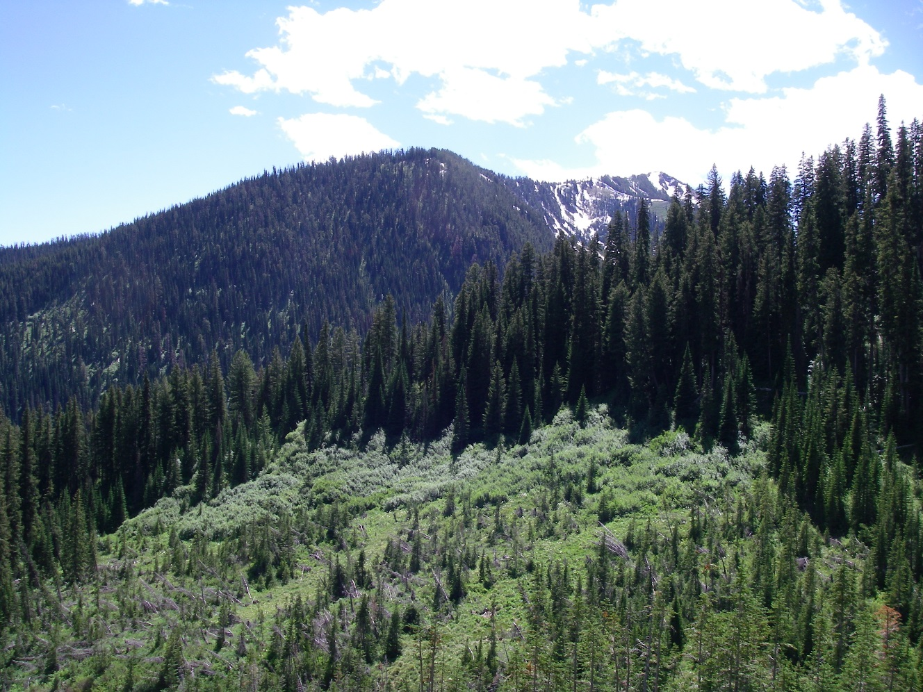
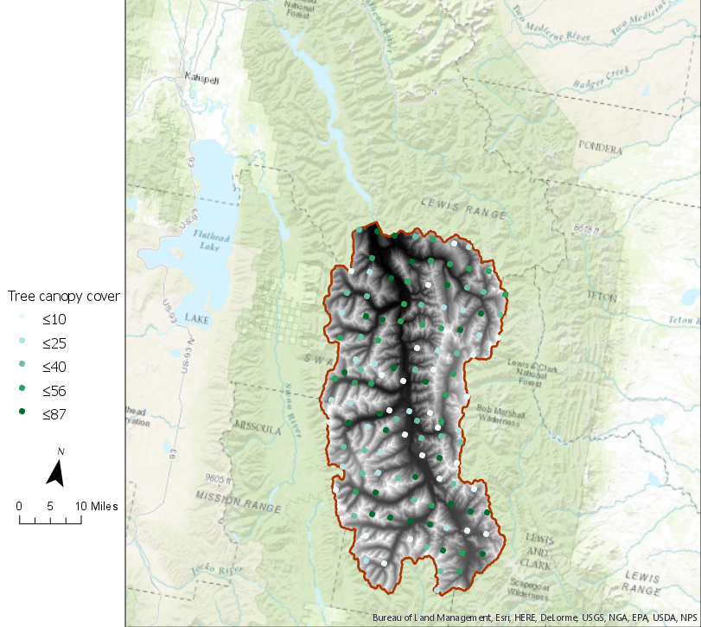
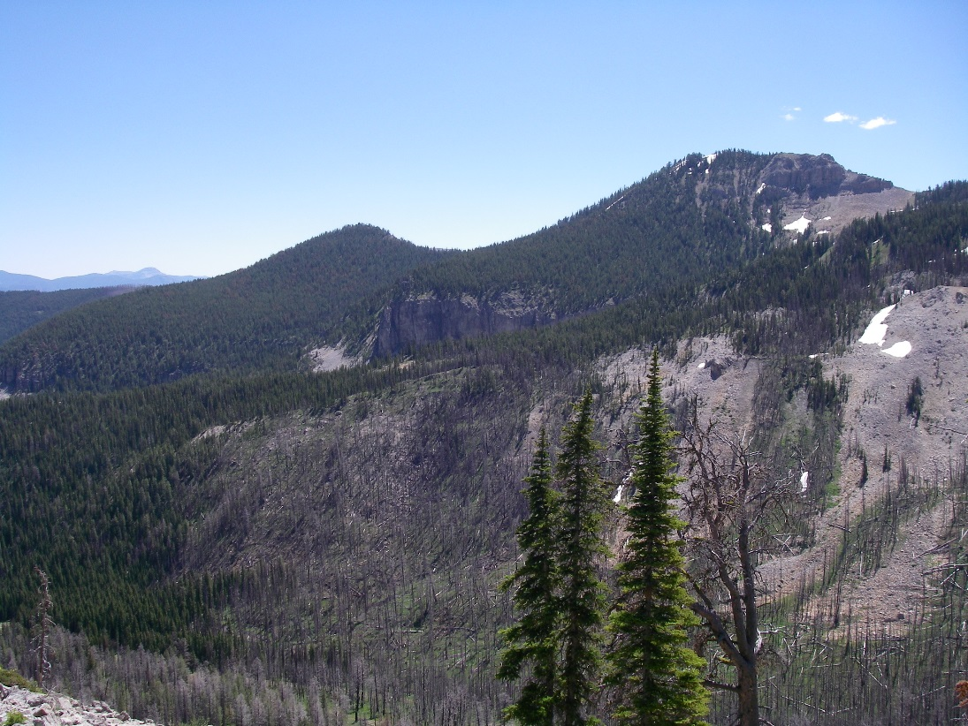
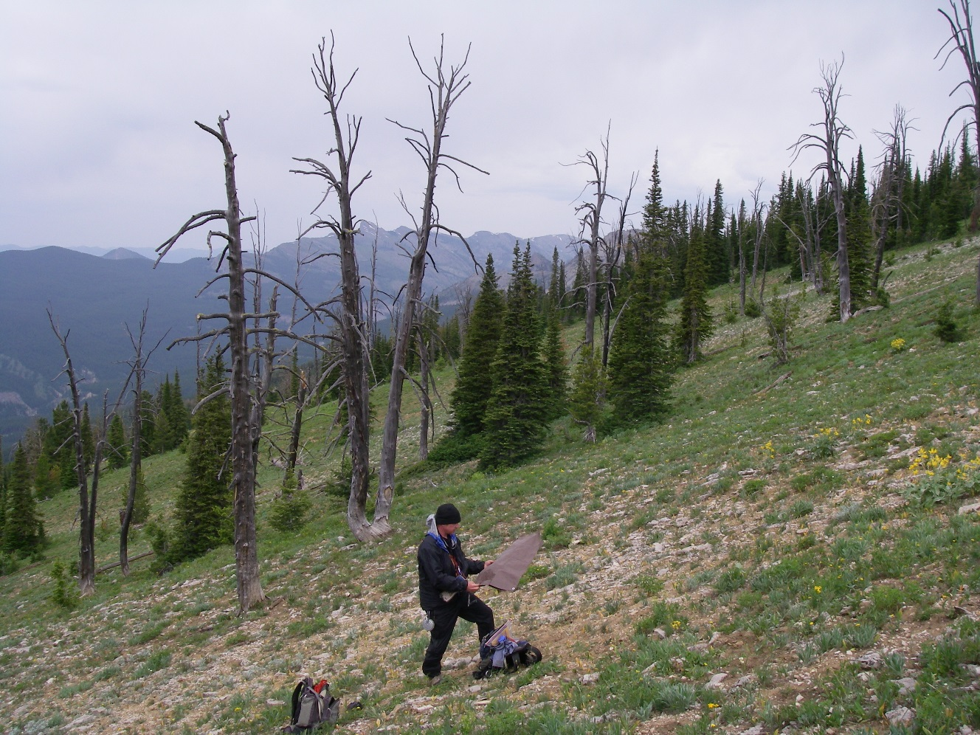
Study area: South Fork Flathead River, Montana
n=119 forest plots
outlet

Slide 6
Methods
Data acquisition
Forest cover data (y)
Predictor layers (x1, x2, x3, etc.)
Model development
Model validation

Slide 7
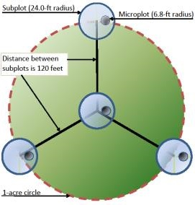
Tree cover data
Forest Inventory & Analysis (FIA) program (US Forest Service)
Plots ~5 km apart
Measured every 10 years
119 plots in test watershed

Slide 8
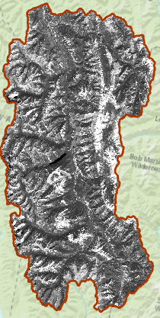
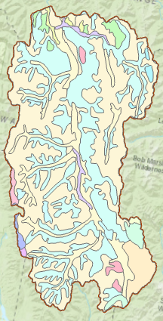
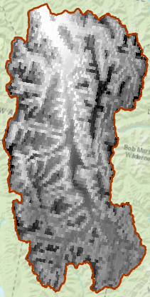
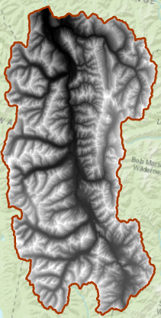
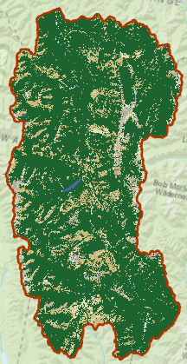
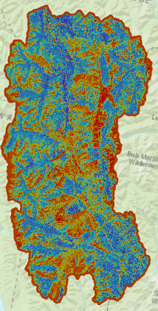
Data inputs: Predictor data
LANDSAT imagery
STATSGO soil map units
PRISM normals (precip and temp)
NED: 30-m DEM
National Land Cover Dataset
2011 land cover classes
2011 tree canopy cover
Mean difference = 11.8%
RMSE = 22.8

Slide 9
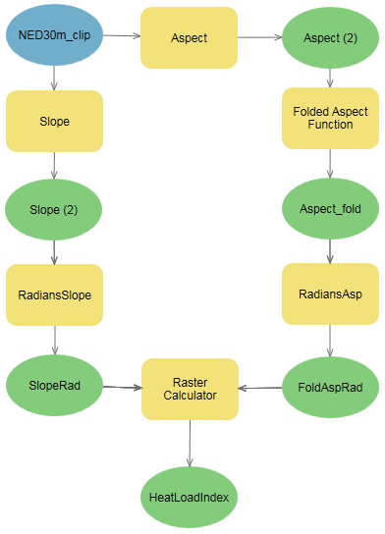
Data inputs: DEM derivatives
Slope
Aspect (“folded” around 45°/225°)
Heat load index = f(slope, aspect, latitude)
Wetness index = f(contributing area, slope)
45°
45
135
45
225°
135

Slide 10
Statistical analysis methods: R
Open-source statistical software
Rasters must have identical resolution and extent
Flexible and efficient:
Statistical models
Validation tools

Slide 11
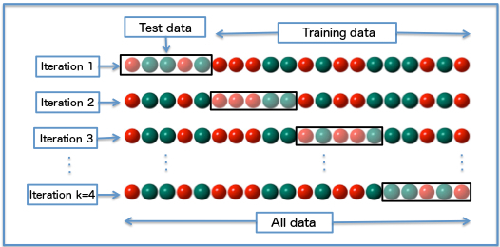
Validation: k-fold cross-validation
Root mean square error (RMSE) for each of k repetitions
Accuracy = mean RMSE of k repetitions
Compare to RMSE of canopy from plots vs. NLCD 2011

Slide 12
Next steps
Short-term: Export raster data to R for statistical analysis and validation
Long-term:
Expand geographic scope
Repeat for other cover layers that may affect partitioning of precipitation
Understory vegetation
Litter

Slide 13
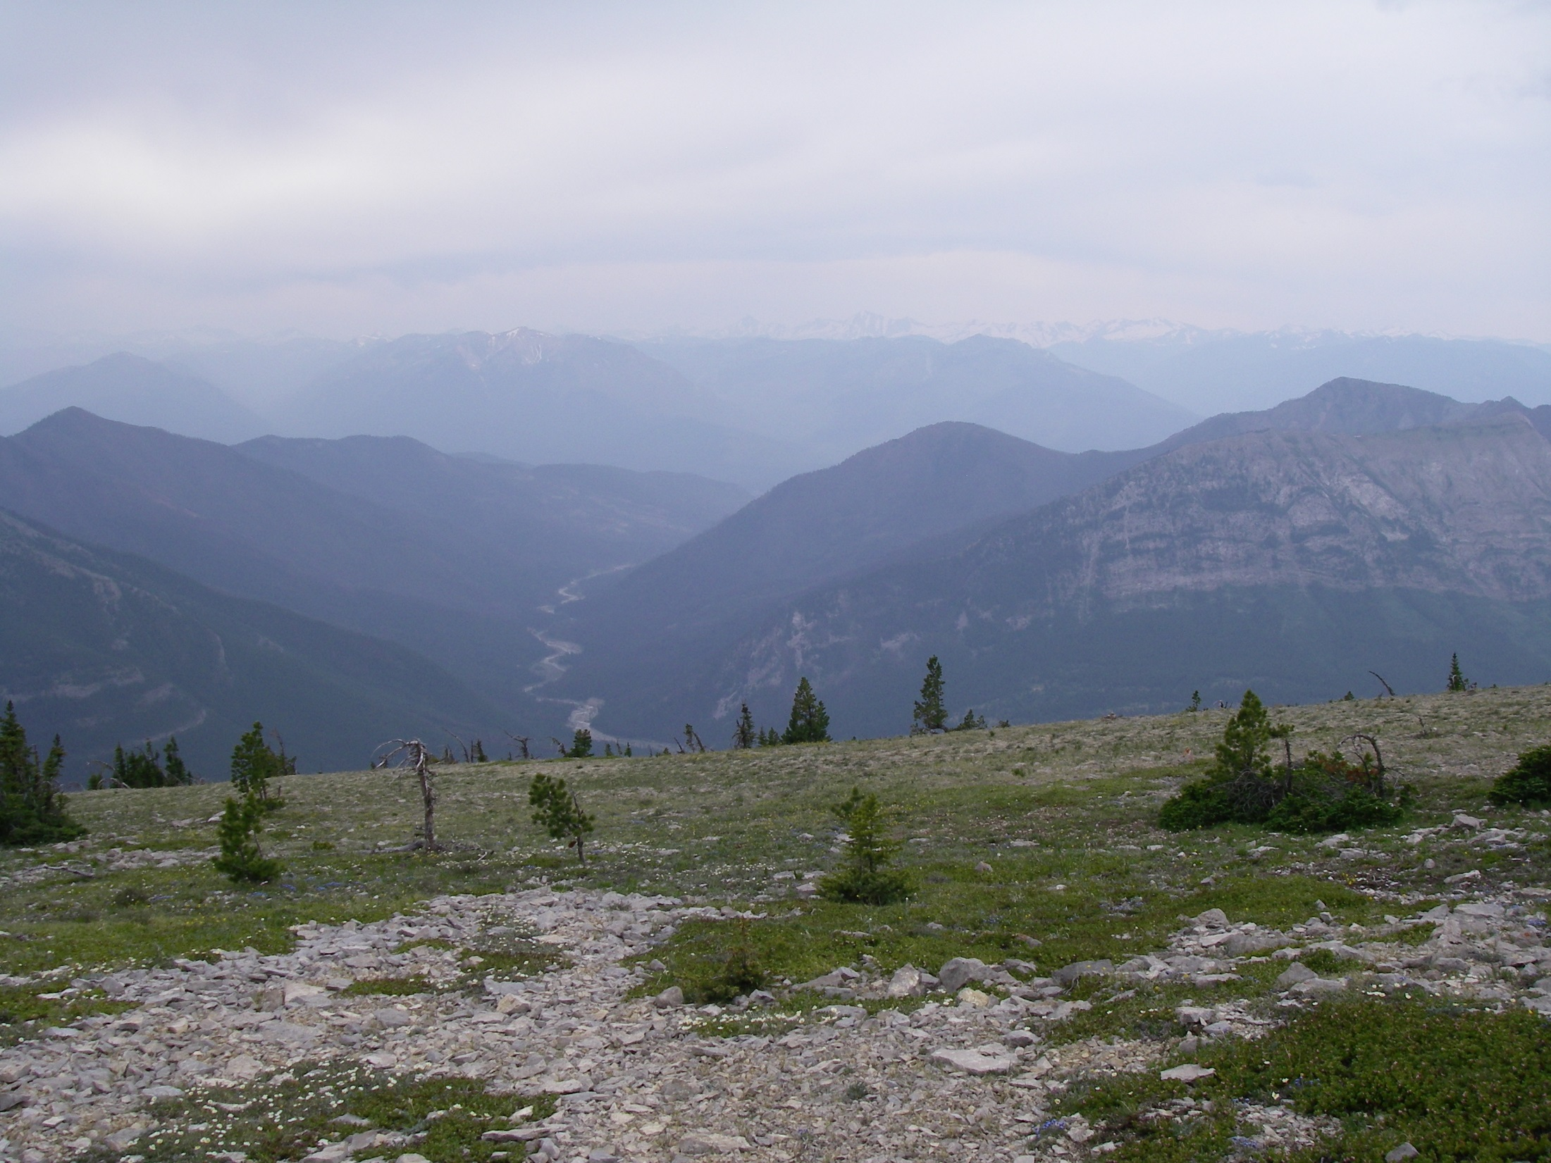
Questions?
Contact:
Sara Goeking
sgoeking@fs.fed.us

