Slide 1
Implement GIS as a tool to prepare inputs data of WRF-Hydro to run and compare with NWM outputs for a small watershed in the Great Salt Lake Basins
Presentation of final term project, CEE 6440
Irene Garousi-Nejad
Ph.D. student, Civil and Environmental Engineering, Utah State University
Under supervision of: David Tarboton
Professor, Civil and Environmental Engineering, Utah State University
Fall 2016

Slide 2
Presentation of final term project, CEE 6440, 2016
Introduction and objective
Streamflow forecast has been an imperative issue and has remained an unsolved scientific problem among hydrologists.
The National Water Model (NWM) is a hydrologic model that simulates observed and forecast streamflow over the entire continental United States (CONUS).
The core of NWM is WRF-Hydro which uses the Noah-MP land surface model.
The objective is to evaluate streamflow forecast in the Logan River basin, using WRF-Hydro, and compare the results with the NWM outputs.

Slide 3
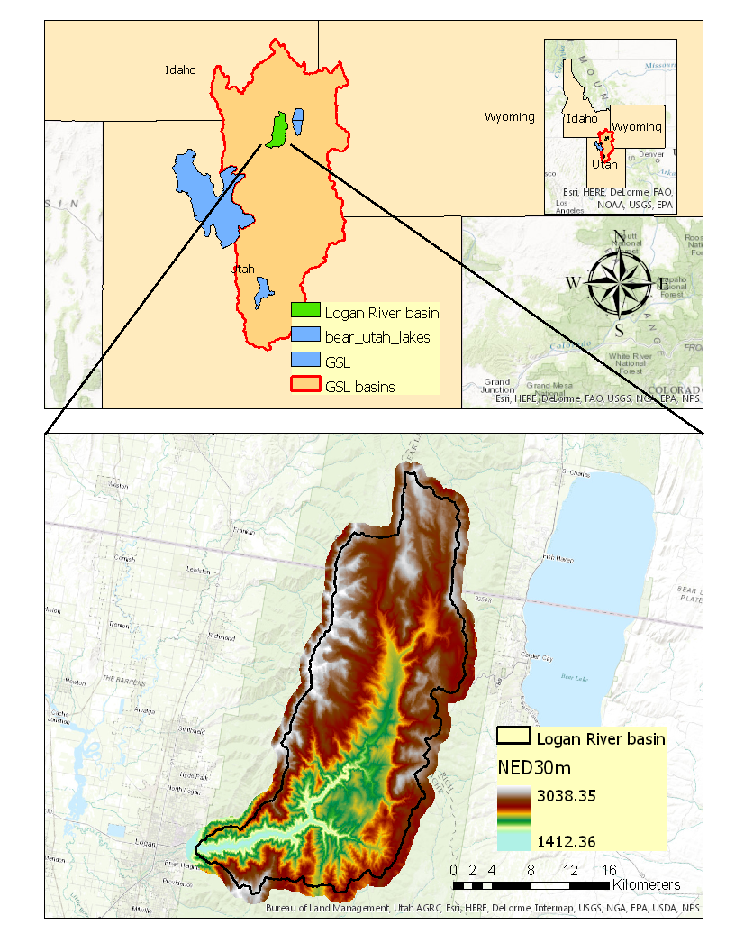
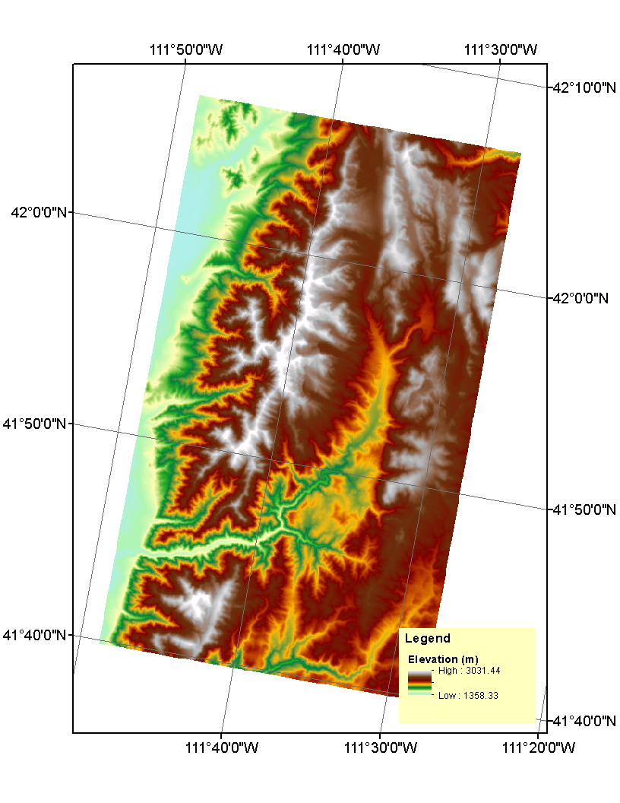
Presentation of final term project, CEE 6440, 2016
Case Study
The Logan River watershed is located in the heart of Bear River in the western United States. The Digital Elevation Model (DEM) of the Logan River watershed from USGS (Tarboton, 2016). The resolution of this DEM is 30*30 meters and the projection coordinate system is North America Lambert Conformal Conic since it is well suited for mid-latitudes.

Slide 4
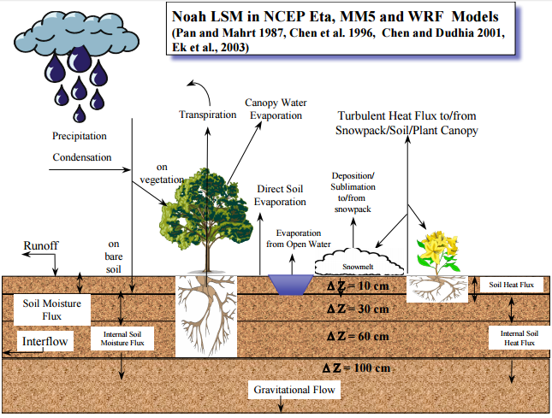
Presentation of final term project, CEE 6440, 2016
WRF-Hydro
2-way coupling
Land Surface Model
Terrain Routing model Model
Output:
Evapotranspiration
Soil moisture
Snowpack
Snow melt
Runoff
Radiative exchange
Energy fluxes
Output:
Stream inflow,
Surface water depth,
Groundwater depth,
Soil moisture
Output:
Streamflow
River stage
Flow velocity
Reservoir storage and discharge
1-way or
2-way coupling
Channel and Reservoir routing models

Slide 5
Presentation of final term project, CEE 6440, 2016
WRF-Hydro
Sub-grid aggregation/disaggregation is used to represent overland and subsurface flow processes on grid scales much finer than the native land surface model grid.

Slide 6
Presentation of final term project, CEE 6440, 2016
WRF-Hydro
The inputs of WRF-Hydro can be categorized in two main groups:
Land surface and routing data
Meteorological Forcing data
Using WRF-Hydro pre-processing utilities.
GEOGRID_STANDALONE.pyt
Developed by Kevin Sampson, GISP
Associate Scientist, NCAR
Using NCAR command language utilities.
Download NLDAS2 data from NASA and then
re-grid NLDAS2 data to WRF-Hydro domain
Developed by David Gochis,
Scientist III, NCAR

Slide 7
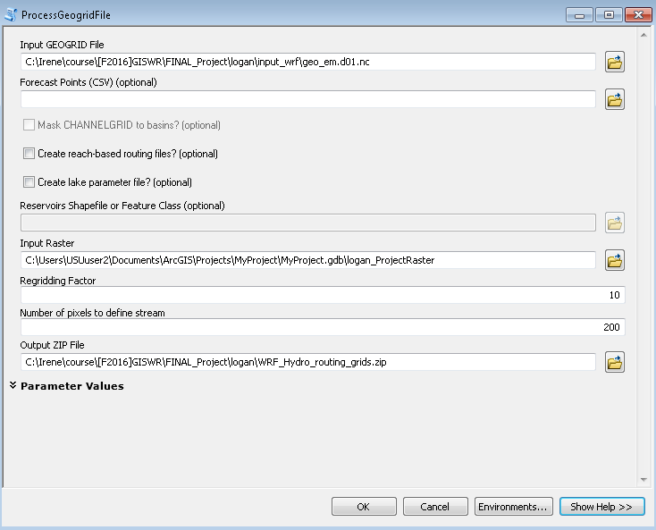
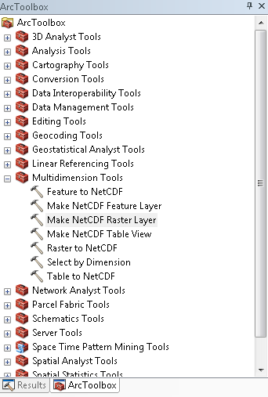
Presentation of final term project, CEE 6440, 2016
GEOGRID_STANDALONE.pyt
Input
Output
Topography.nc
Str_order.nc
retdeprtfac.nc
ovroughrtfac.nc
longitude.nc
latitude.nc
landuse.nc
lAKEGRID.nc
gw_basns.nc
frxst_pts.nc
flowdirection.nc
flowacc.nc
Other parameters
CHANNELGRID.nc

Slide 8
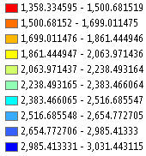
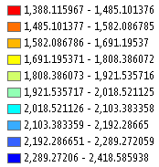
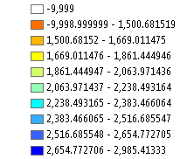
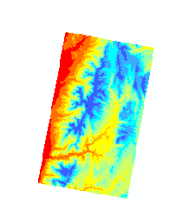
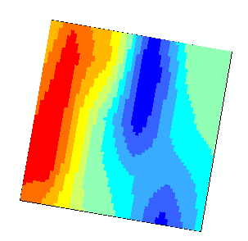
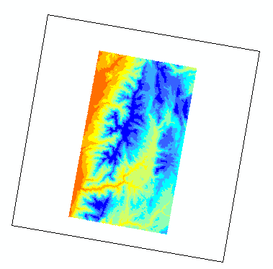
Presentation of final term project, CEE 6440, 2016
Topography
DEM Raster
Number of columns: 1179
Number of rows: 1696
Cell Size: 30 m
Geogrid NetCDF
Number of columns: 59
Number of rows: 59
Cell Size: 1000 m
High-resolution NetCDF
Number of columns: 590
Number of rows: 590
Cell Size: 100 m

Slide 9
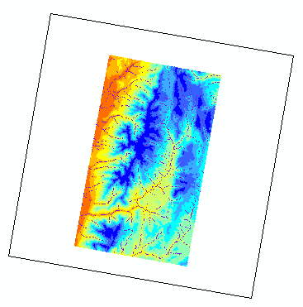
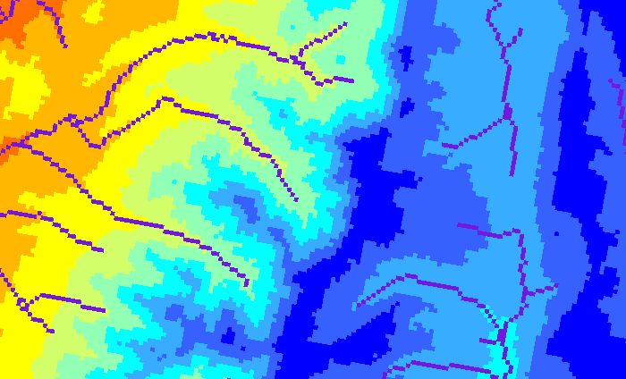
Presentation of final term project, CEE 6440, 2016
Channel Grid
DEM

Slide 10
Presentation of final term project, CEE 6440, 2016
Work left: Run WRF-Hydro
The simulation period is for the month of August 2016.
The simulation time step is hourly.
The case study, including all variables and parameters, is submitted on HPC cluster.
The streamflow output of WRF-Hydro will be compared to those from NWM.

Slide 11
Presentation of final term project, CEE 6440, 2016
References
Tarboton, D. (2016). Logan Digital Elevation Model, HydroShare, http://www.hydroshare.org/resource/b7822782896143ca8712395f6814c44b
User’s guide for the advanced research WRF modeling system, version 3, http://www2.mmm.ucar.edu/wrf/users/docs/user_guide_V3.8/ARWUsersGuideV3.8.pdf
Sampson, K. and Gochis, D. (2015). WRF Hydro GIS Pre-Processing Tools, Version 2.2.
Thank you

Slide 12
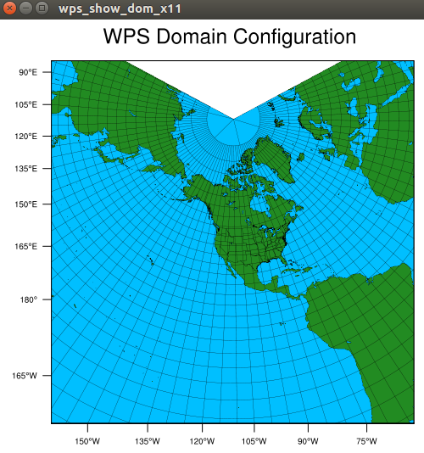
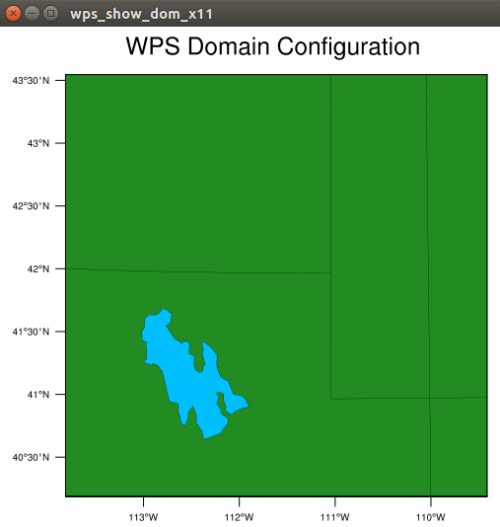
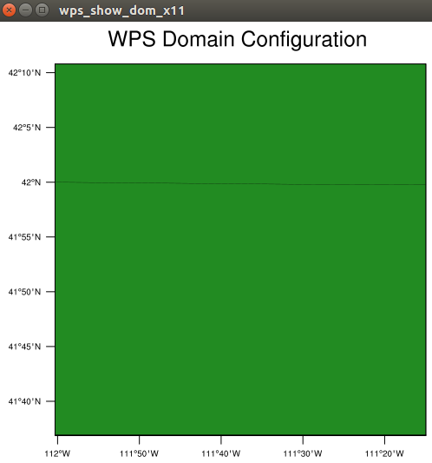
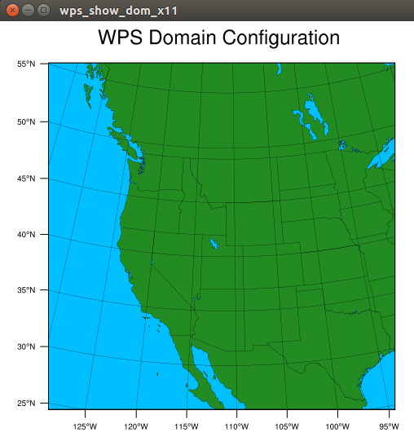
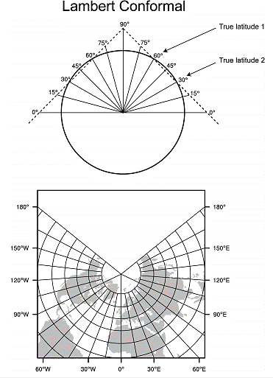
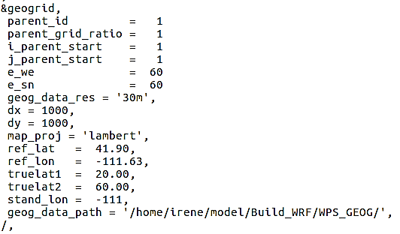
Presentation of final term project, CEE 6440, 2016
GEOGRID
GEOGRID is the land surface model pre-processor component of WPS
It acquires and interpolates land surface terrain, soils, and vegetation data from standard and readily available data products to the WRF-Hydro grid modelling.

