Slide 1
Characterization of Dunefields in Southern & Central Utah
Harriet Cornachione
CEE 6440
November 8, 2016

Slide 2
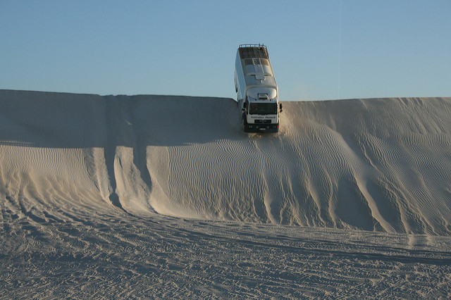
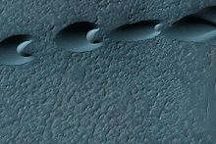
Why Study Sand Dunes?
Window to past climate conditions
Formed in many environments
99% associated with arid / desert climatic conditions
Age dating (OSL, Radiocarbon)
Proxy for paleoclimate (pollen, tree rings)

Slide 3
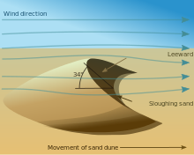
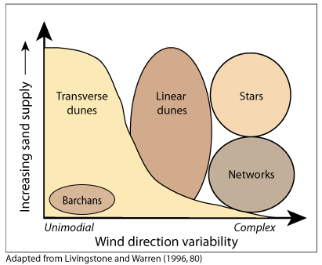
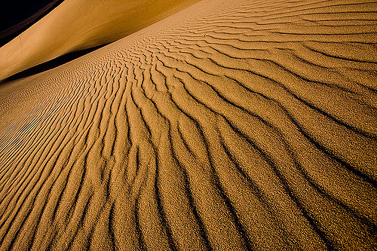
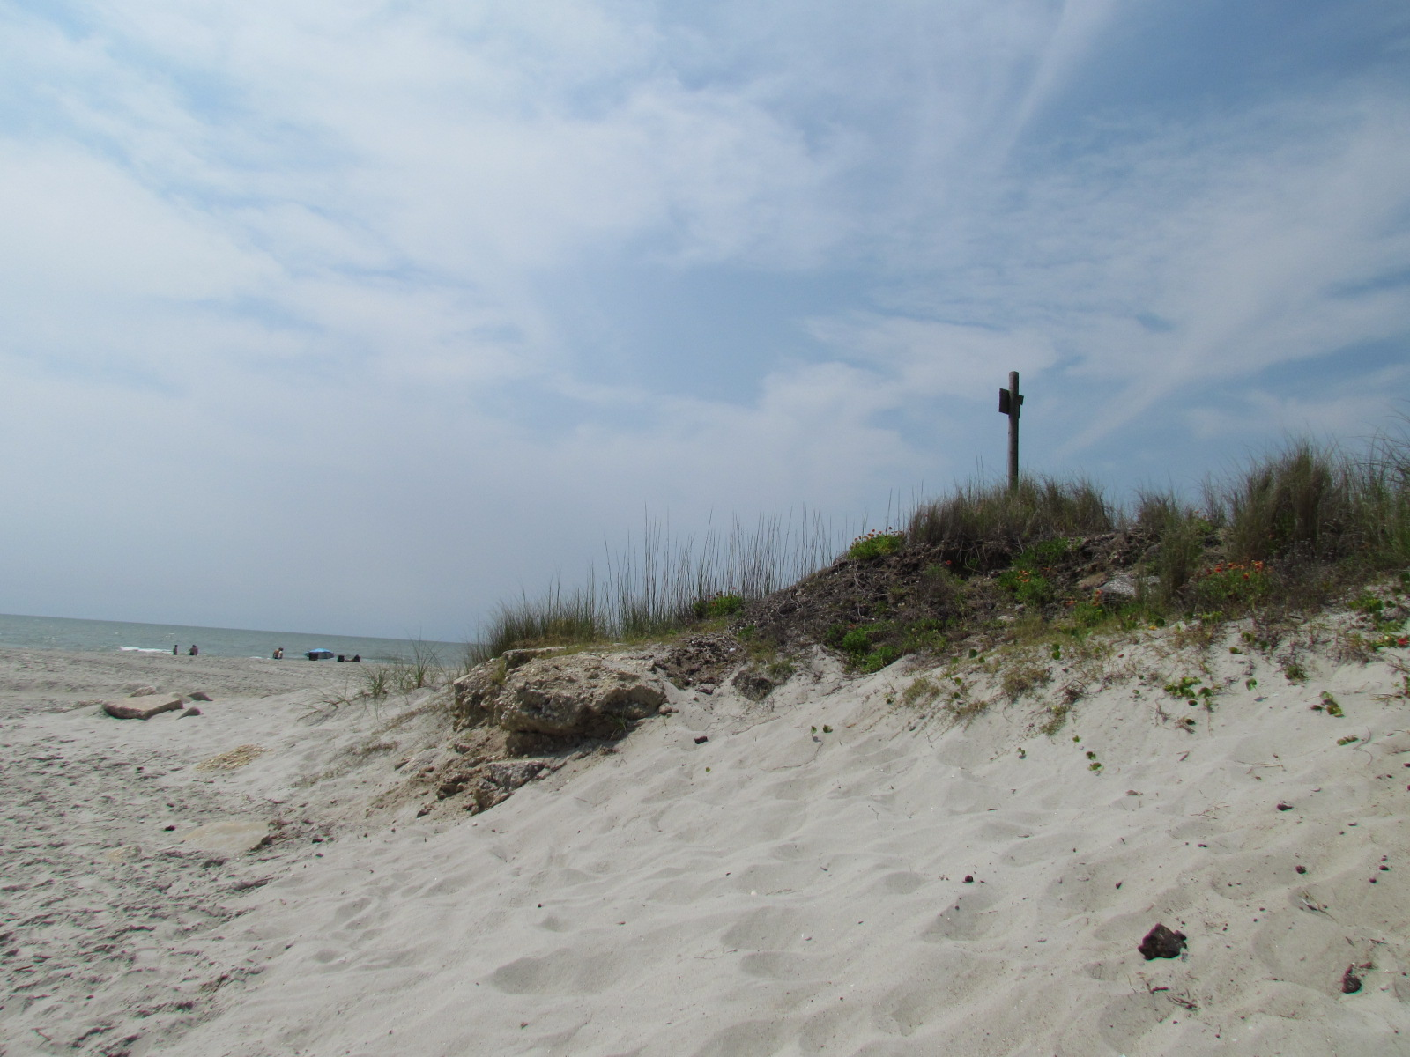
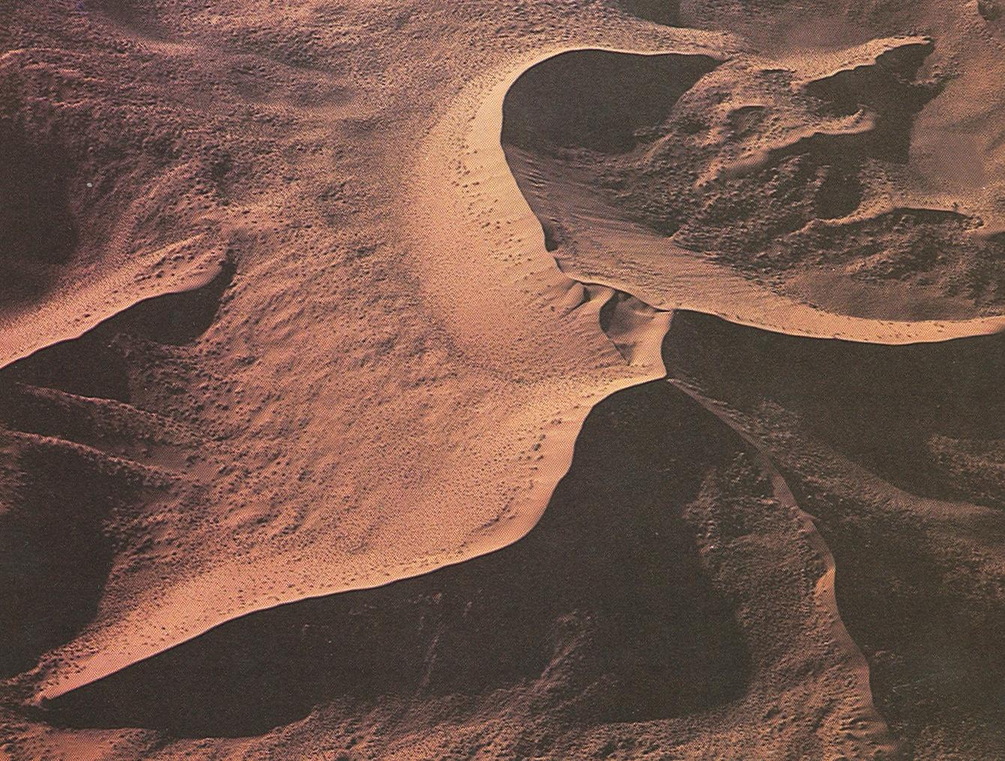
Dune Formation & Morphology
Morphologies
Conditions:
Sediment source (fine sand)
Wind (strength, gusts)
Precipitation

Slide 4
Escalante Desert Dunes
What is the geologic setting?

Slide 5
Escalante Desert Dunes
What is the dune morphology?
What is the nature of the dune activity?

Slide 6
Escalante Desert Dunes
What are the soils and landcover?

Slide 7
Escalante Desert Dunes
What is the stream proximity?
What are the groundwater conditions?

Slide 8
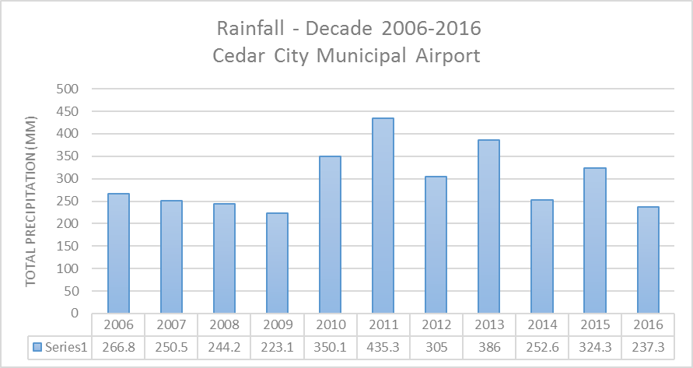
Escalante Desert Dunes
What is the rainfall history?
What are the wind conditions?

Slide 9
Coral Pink Sand Dunes
What is the geologic setting?

Slide 10
Coral Pink Sand Dunes
What is the dune morphology?
What is the nature of the dune activity?

Slide 11
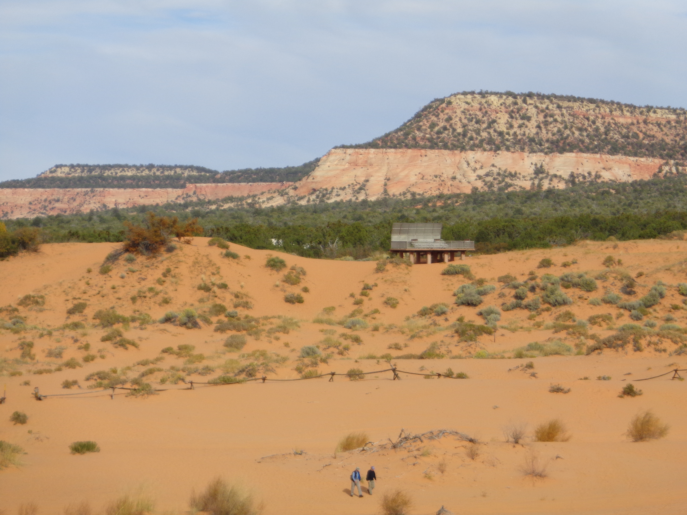
Coral Pink Sand Dunes
What are the soils and landcover?
Soils not mapped here

Slide 12
Coral Pink Sand Dunes
What is the stream proximity?
What are the groundwater conditions?

Slide 13
Coral Pink Sand Dunes
What is the rainfall history?
What are the wind conditions?

Slide 14
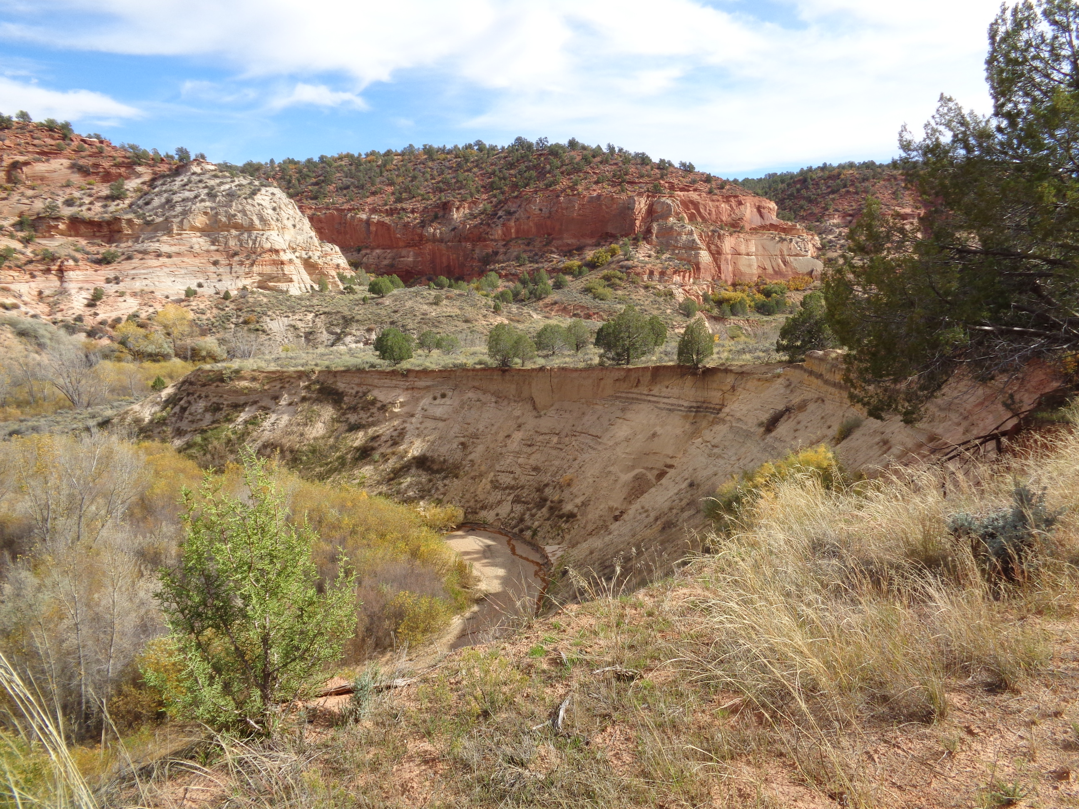
Remaining tasks
Findings to date
Escalante Desert dunes:
Playa sediment source
Fluvial dominated transport
Sand sheet, high wind regime
Coral Pink Sand dunes:
Weathered bedrock, adjacent ranges
Aeolian transport
Tectonic controlled morphology
Develop sand rose diagrams
Evaluate elevation data
Complete San Rafael Dunes characterization
Finish report

Slide 15
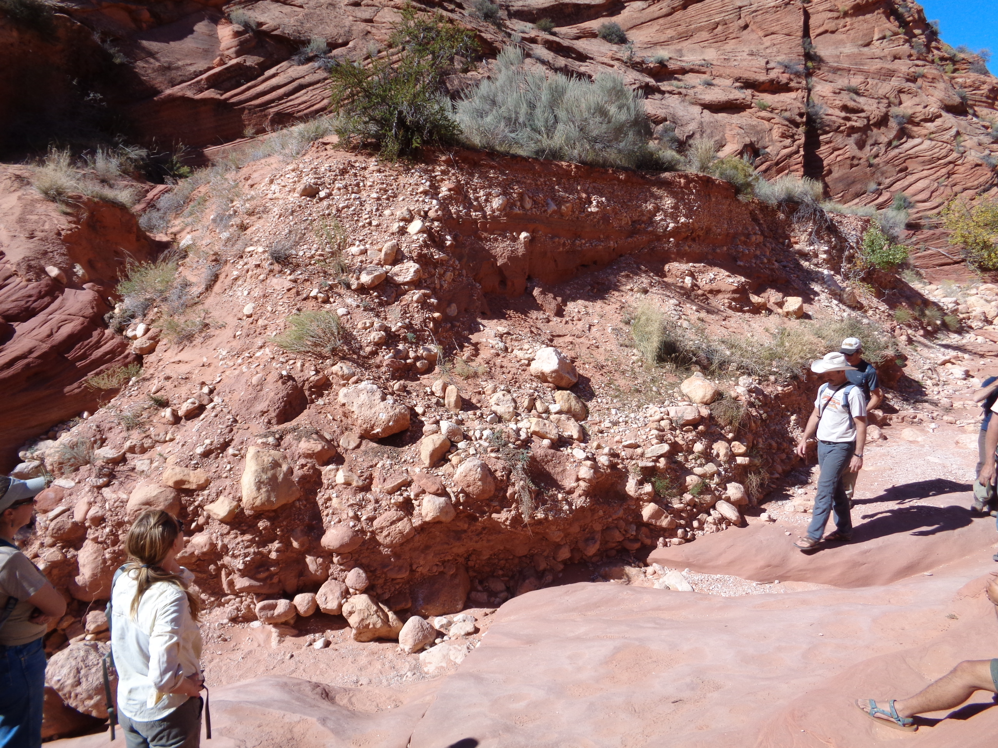
Thank You! Any Questions?

