Slide 1
Best Management Practices Implemented in Lower Bear River
Presented by: Nour Atallah
Nov. 2016

Slide 2
OUTLINE
Introduction
Study Area
Watershed Delineation
Watershed Characteristics
GIS Application
Water Quality Tracking

Slide 3
INTRODUCTION
What are Best Management Practices and why we need them?
Water Pollution Control – Clean Water Act!
Types:
Structural
Non-Structural

Slide 4
The Lower Bear – Malad River Watershed (LBMR) suffers from loads of Phosphorus and Sediments loads caused by point and nonpoint sources. The TMDL (2002) study recommended several BMPs action to reduce these loads.
INTRODUCTION

Slide 5
Utilization GIS in BMPs evaluation! The spatial presentation can help the water managers in providing prospective vision and judgement of how effective was the implementation of BMPs within the watershed. [Targeting the critical areas (sources of pollution)]
INTRODUCTION

Slide 6
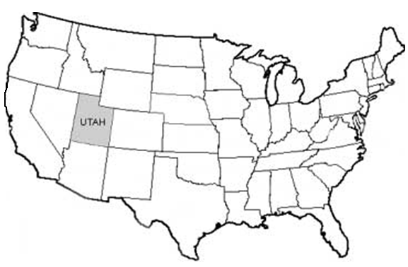
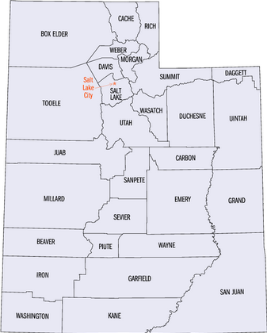
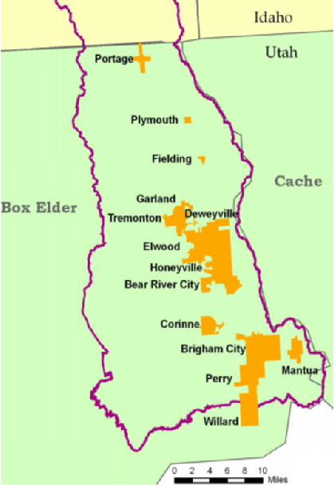
STUDY AREA
The LBMR watershed is located in Box Elder County in Northern Utah

Slide 7
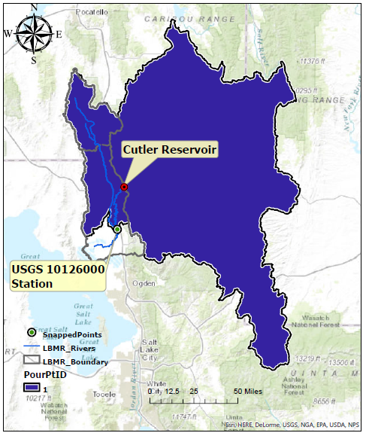
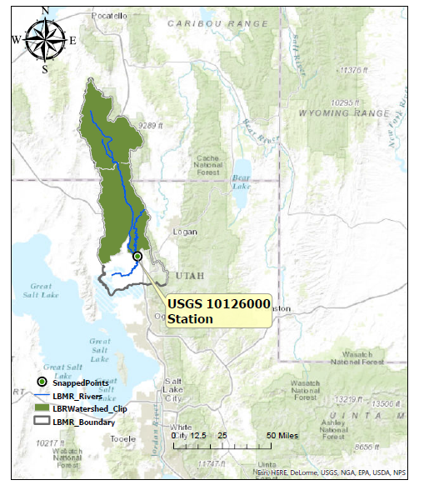
WATERSHED DELINEATION

Slide 8
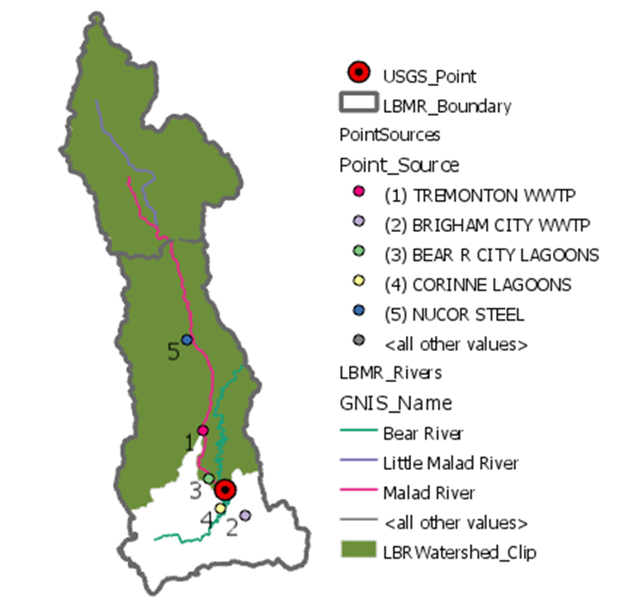
WATERSHED FEATURES
Water Bodies:
Main Bear River
Malad River
Little Malad River
Outlet: Station Located after the confluence of Lower Bear and Malad Rivers, near Corinne. (USGS 10126000).
Point Sources

Slide 9
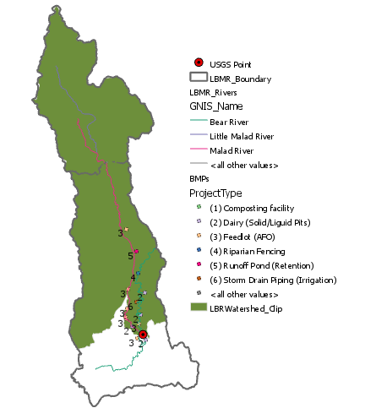
WATERSHED FEATURES
BMPs

Slide 10
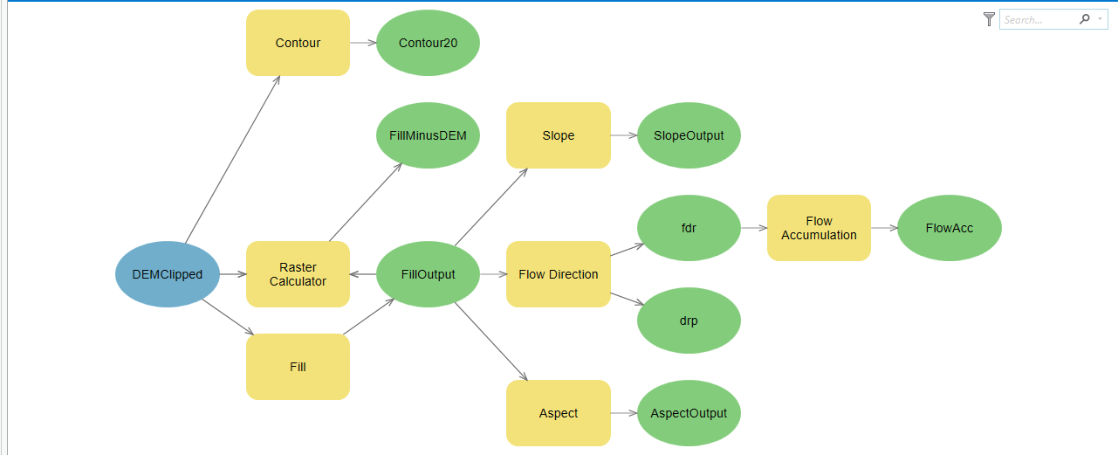
GIS Processing and Outputs
WATERSHED CHARACTERISTICS
GIS - Model Builder
DEM
Fill
Hydrologic Slope
Topographic Slope
Contour
Flow Direction
Flow Accumulation

Slide 11
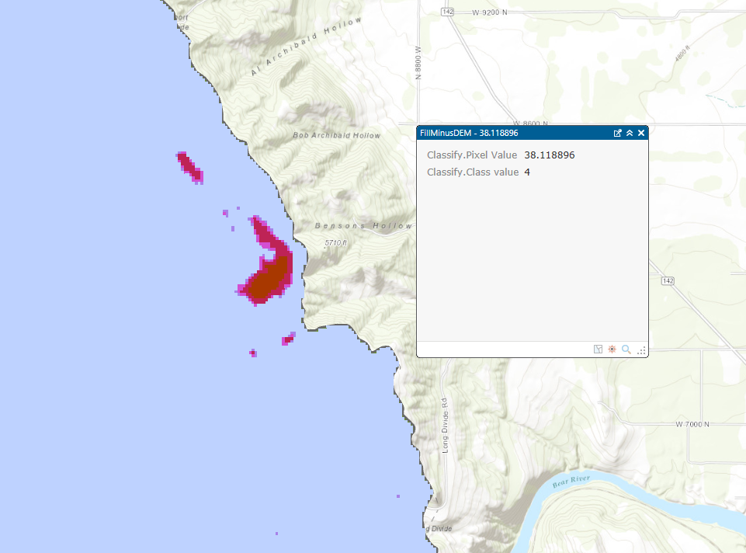
GIS APPLICATION
Fill Impact Examination

Slide 12
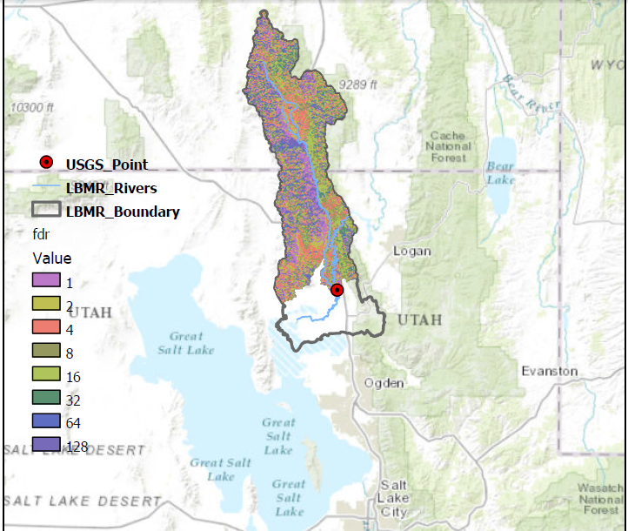
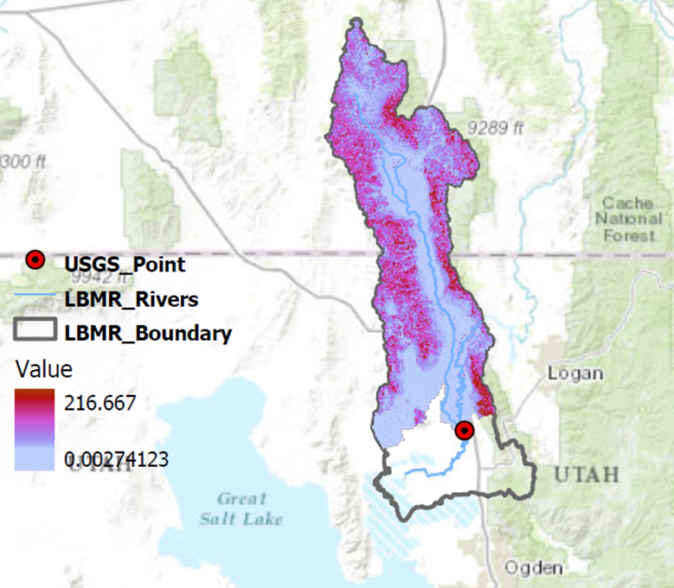
Flow Direction (Drp, Fdr)
GIS APPLICATION

Slide 13
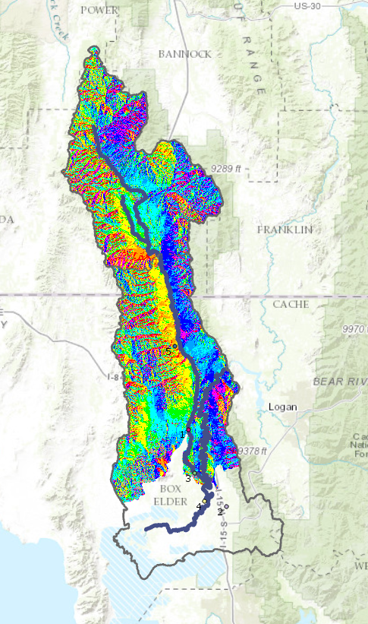
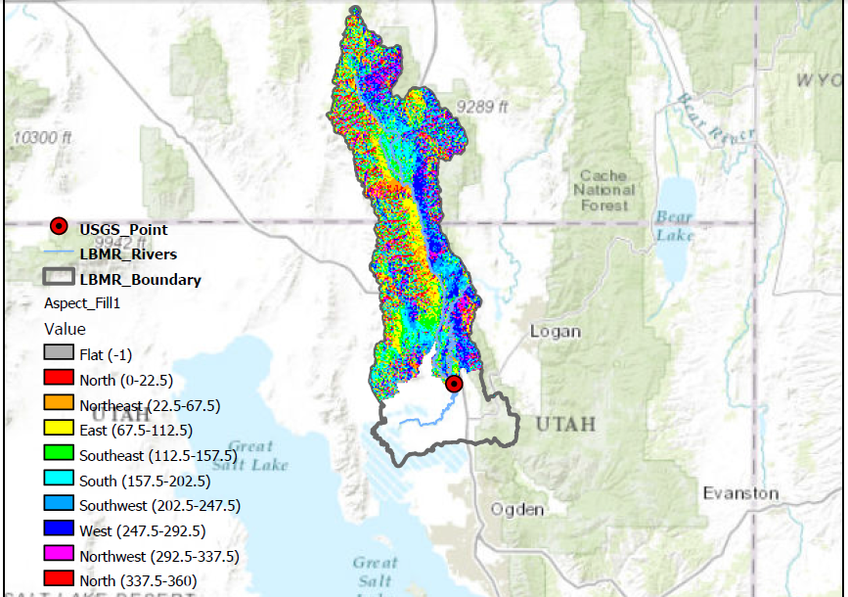
Topographic Slope (Slope/Aspect)
GIS APPLICATION

Slide 14
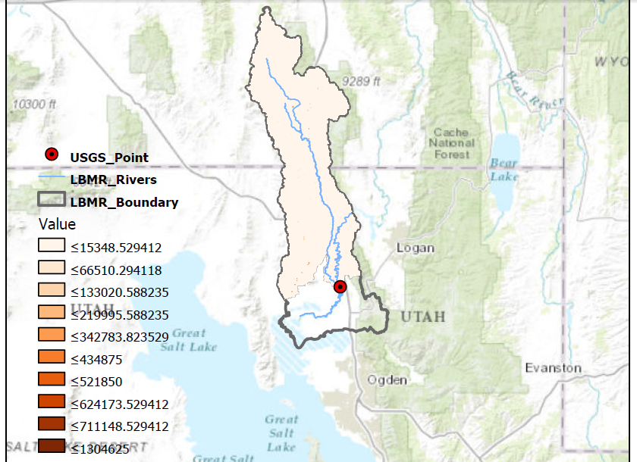
Flow Accumulation
GIS APPLICATION

Slide 15
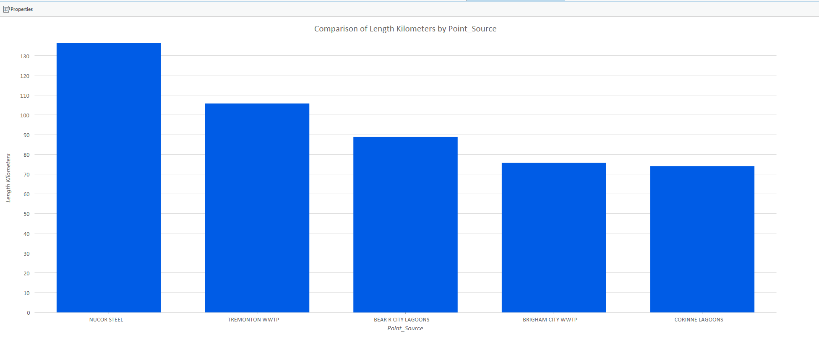
Source Points Trace Line
GIS APPLICATION

Slide 16
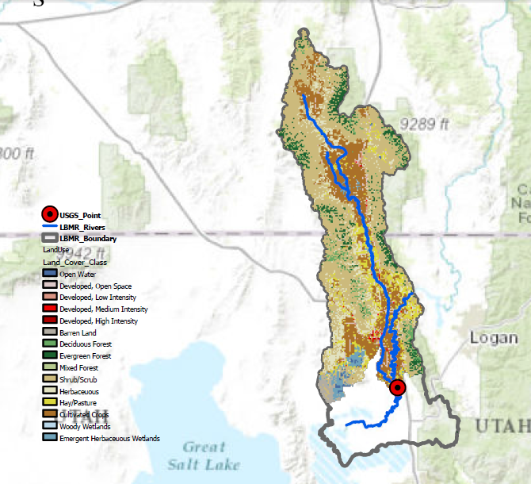
Dominant Land Cover within the Watershed
GIS APPLICATION
Land Cover | Area (%)
Open Water | 0.54
Developed, Open Space | 2.50
Developed, Low Intensity | 0.51
Developed, Medium Intensity | 0.21
Developed, High Intensity | 0.07
Barren Land | 1.43
Deciduous Forest | 2.49
Evergreen Forest | 5.82
Mixed Forest | 0.02
Shrub/Scrub | 43.60
Herbaceuous | 9.67
Hay/Pasture | 9.17
Cultivated Crops | 21.12
Woody Wetlands | 0.32
Emergent Herbaceuous Wetlands | 2.52

Slide 17
What is Next ?
Trace how water quality in LBMR improved over time after BMP’s implementation.

Slide 18
Thanks !

