Slide 1
Prediction of the immigrant location choices under the lack of water for entire U.S.
Term Project Presentation
Mahyar Aboutalebi
November 8, 2016
CEE 6440 – GIS in Water Resources

Slide 2
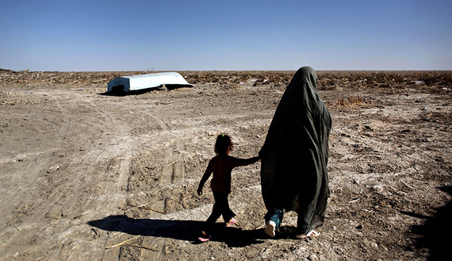
Introduction
Why do people migrate? People migrate for many different reasons.
The reasons for migration
Economical Migration
Social Migration
Political Migration
Environmental
Migration
Moving to find work
Moving for a better quality of life
Moving to escape war
Moving to escape drought
http://fightforflorida.com/2015/08/31/how-big-business-is-screwing-floridas-unemployed/
http://eurasiadiary.az/news/conflicts/37262-muharibenin-usaqlari
http://www.al-monitor.com/pulse/originals/2015/05/iran-water-crisis.html
http://www.chinadaily.com.cn/cndy/2013-03/12/content_16300071.htm

Slide 3
Introduction
Where do people go? It completely depends upon the push factors and pull factors.
What do they want {Job, Safety, Food, Better Life Quality} and What do they escape {War, Natural disaster, Famine}?
http://www.bbc.co.uk/education/guides/zkg82hv/revision/5

Slide 4
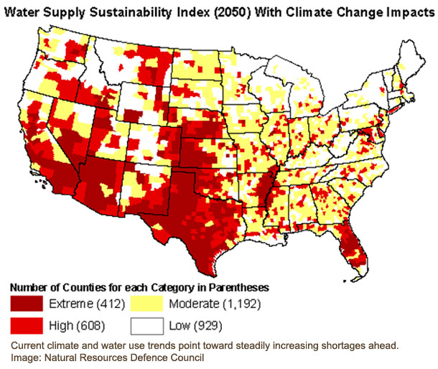
Introduction
One of the most important factor that influence the destination of people is “the availability of water” classified in “Environmental Migration”
http://www.esdaw.eu/environmental-degradation.html
http://www.esdaw.eu/environmental-degradation.html
http://learn.eartheasy.com/2014/03/the-outlook-for-water-availability-in-your-region/

Slide 5
What about Water Shortage as a Push Factor in United State?

Slide 6
Objects
This study covers the following questions:
Which states will be faced with water shortage?
Which states would be the destination of people who want to change their location because of water shortage?
What would be the rate of decreasing water storage and increasing water storage for each state?
http://arilikeairy.org/what-are-network-goals/

Slide 7
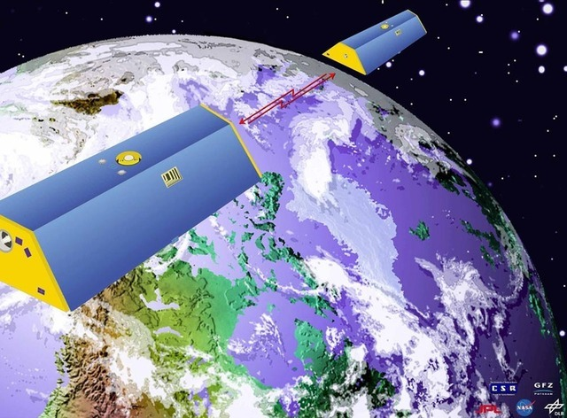
Materials and Methods
Water Equivalent Anomaly
Step 1: Obtain the database for calculating water storage
Step 2: Extract the time series of water storage for each state
Step 3: Calculate the slopes of trend line
Step 4: Analyze the results and developed an index
The slide of Map projection presentation prepared by Dr. Maidment and Dr. Tarboton

Slide 8
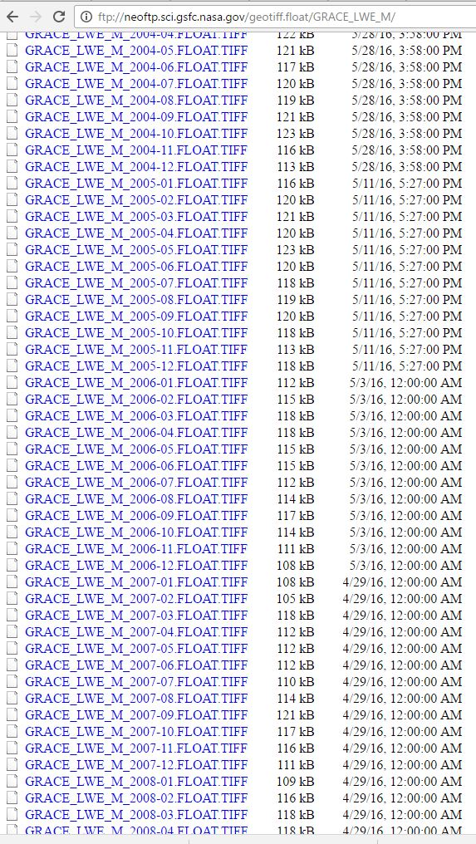
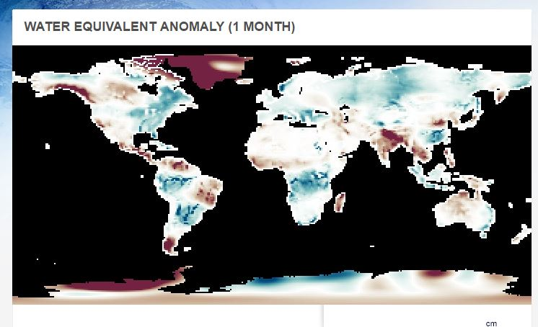
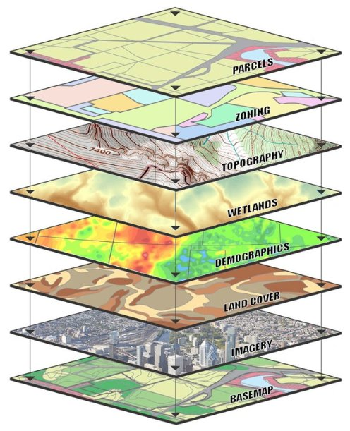
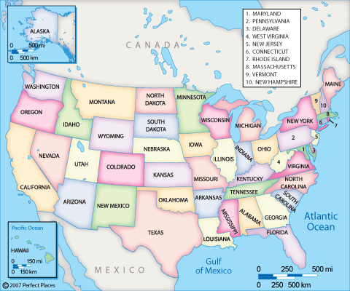
Materials and Methods
What are the challenges and How GIS can help us?
https://www.linkedin.com/pulse/stages-setting-up-use-gis-lydiah-wanjiru
http://www.perfectplaces.com/United_States-Vacation-Rentals.htm

Slide 9
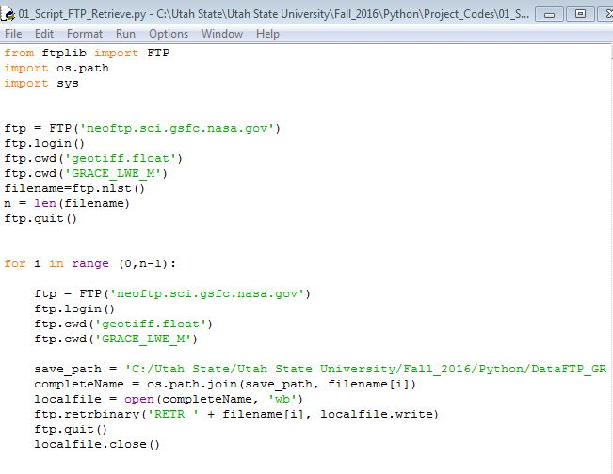
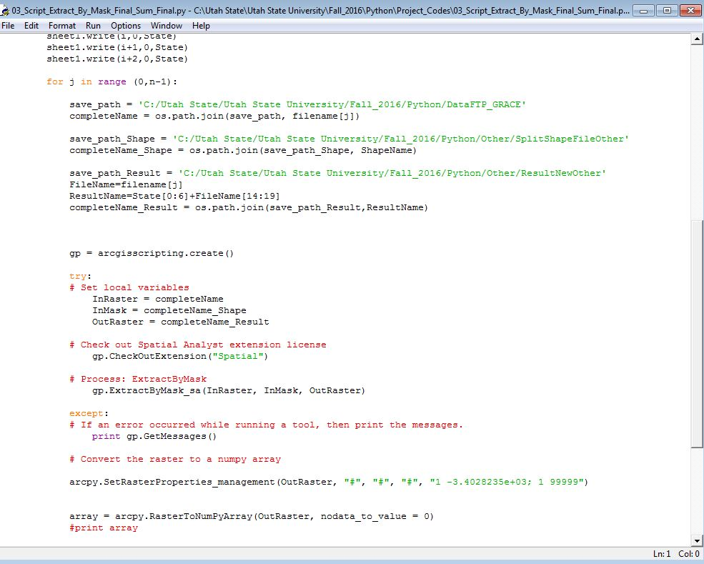
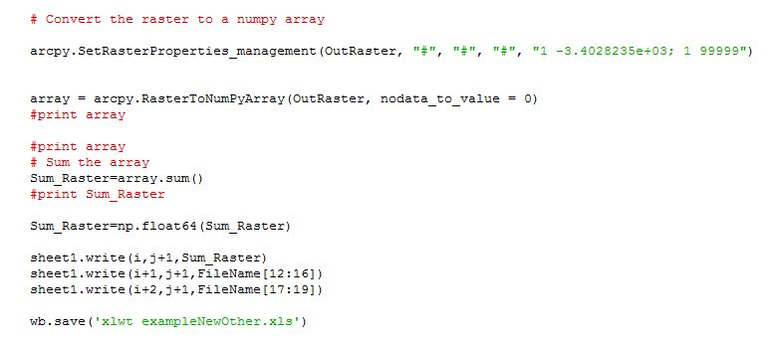
Materials and Methods
What are the challenges and How GIS can help us?
Python
Retrieve Data from FTP
Preprocess and Store data in spreadsheet
Use Extract by Mask to retrieve data for each state

Slide 10
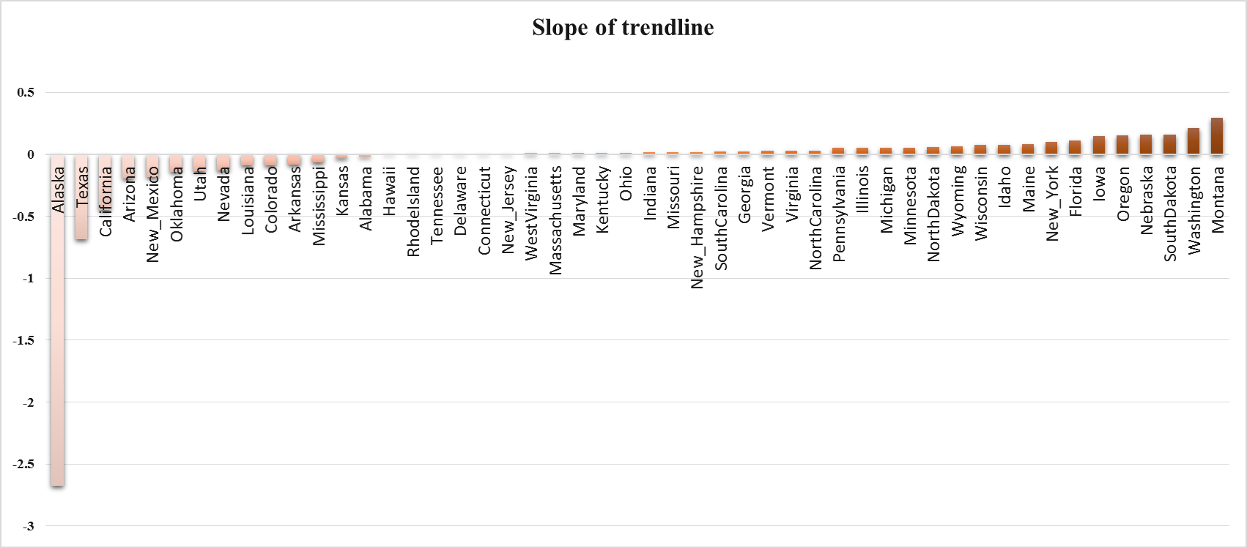
Results and Discussions

Slide 11
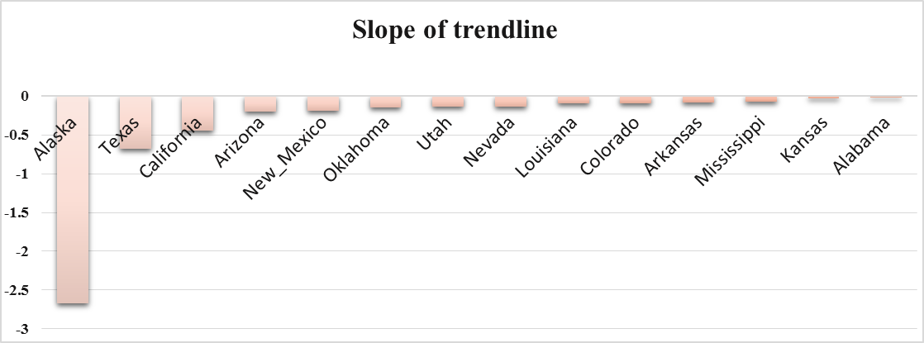
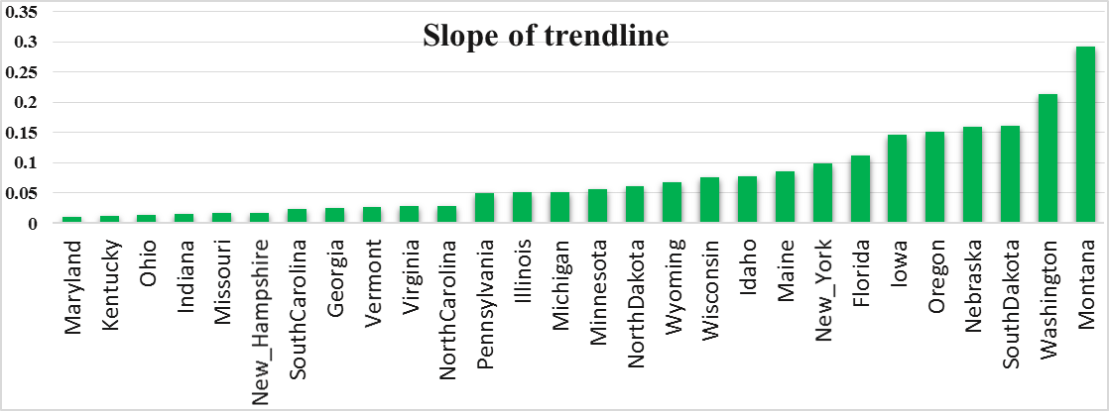
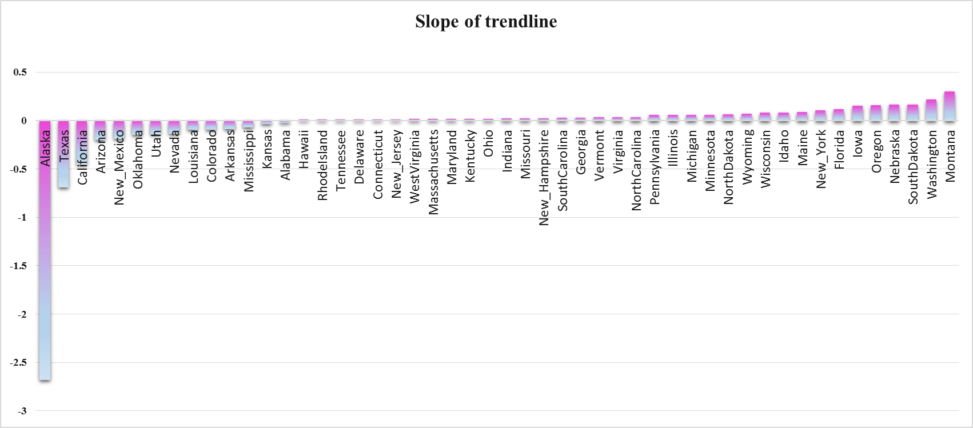
Summary and Conclusion
Which states will be faced with water shortage?
Which states would be the destination of people who want to change their location because of water shortage?
What would be the rate of decreasing water storage and increasing water storage for each state?

Slide 12
QUESTIONS?

