Slide 1
GIS as a tool to help determine the effects of aquatic systems polluted with nutrients
Term Project
Phillip Udom
December 1, 2015
CEE 6440 – GIS in Water Resources

Slide 2
Introduction
An aquatic system is said to be polluted with nutrients when there is a noticeable increase in oxygen concentration due to photosynthesis during the day and a drop in oxygen concentrations at night due to respiration.
Of all the nutrients required for aquatic plant growth, phosphorus typically limits plant growth.
An increase or addition of phosphorus to an aquatic system leads to an explosion of plant growth, a process called eutrophication.

Slide 3
Introduction
  The problem with Eutrophication
  The purpose of this project is to use GIS as a tool to help facilitate analyses and integrate information from the Utah Water Research Laboratory, College of Engineering, Utah State University and other data obtained using CUAHSI HydroDesktop.

Slide 4
Materials and Methods
Samples and data from the Logan River and Little Bear River will be compared to determine if the river system is clean or polluted.
Three methods were used to determine dissolved oxygen concentrations namely: Iodometric (with azide modification), field kit, and membrane probes.

Slide 5
Materials and Methods
CUAHSI HydroDesktop was used to obtain 24-hr continuous monitoring data of dissolved oxygen from the Logan River and Little Bear River.
Data from the Utah Water Research Laboratory, College of Engineering, Utah State University was also used to obtain a time series of observation from water quality monitoring site in the both Rivers.

Slide 6

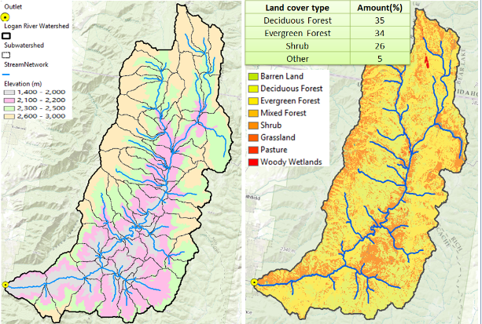
Results and Discussions
Figure 1. Logan River watershed/land cover

Slide 7

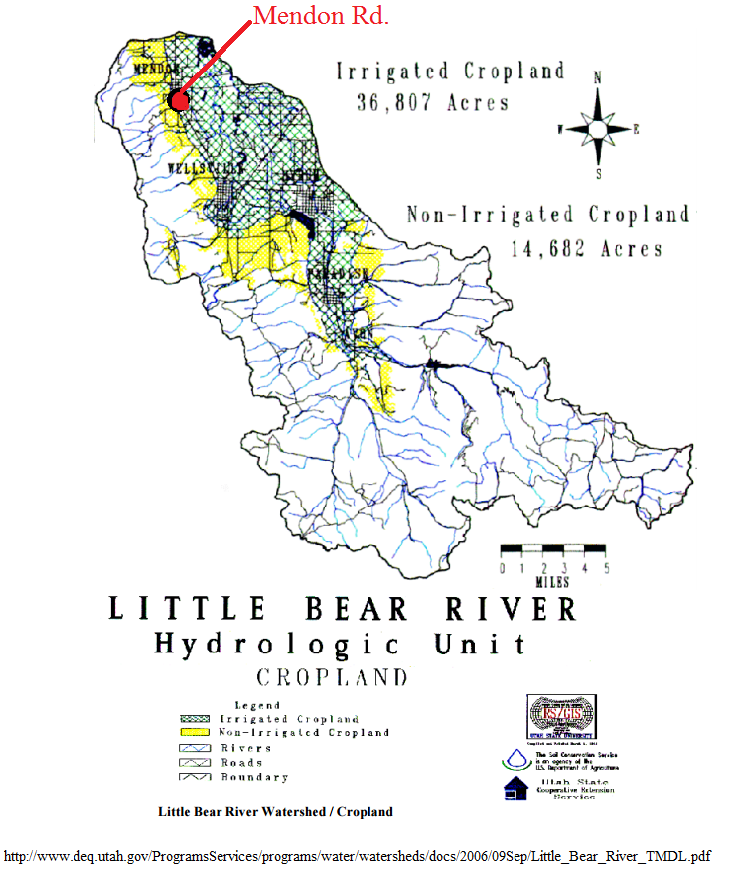
Results and Discussions
Figure 2. Little Bear River Watershed/Cropland

Slide 8

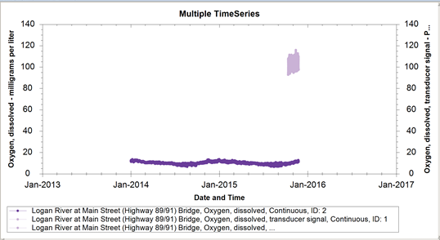
Results and Discussions
Figure 3. Graph of DO levels in the Logan River

Slide 9
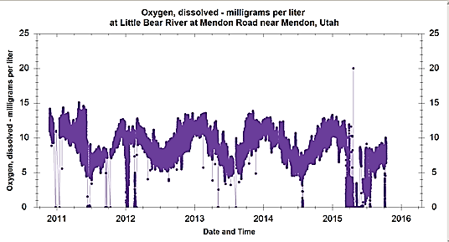
Results and Discussions
Figure 4. Graph of DO levels in the Little Bear River

Slide 10

Results and Discussions
Figure 5. Graphical illustration of the Temperature and Percent DO Saturation versus time

Slide 11
Summary and Conclusion
The data obtained from the water lab and GIS based tools helped show the effects of a polluted aquatic system.
The Logan River is not polluted with nutrients compared to the Little Bear River that shows effects of a polluted aquatic system.`
Better management practices can help control the phosphorus problem.

Slide 12
QUESTIONS?

