Slide 1
A GIS approach to understanding groundwater – surface water interactions in the Logan River and Red Butte Creek, Utah
Trinity Stout
CEE 6440

Slide 2
Introduction
Groundwater-Surface Water (GW-SW) interactions significantly vary temporally and spatially
The majority of GW research focuses on basin-fill aquifers, with little attention given to mountain regions
Estimating recharge to aquifers includes a variety of methods, all of which require instrumentation and relatively extensive data collection

Slide 3
Introduction
Cherkauer and Ansari (2005) developed a method to estimate groundwater recharge based on readily available GIS data
They developed a relationship between precipitation, aquifer recharge, and surface characteristics
Assumptions:
Baseflow records can be used as estimate of aquifer recharge
Surface and groundwater drainage basin boundaries coincide
Uniform precipitation across the watershed
Heterogeneity in soil, geology, and precipitation

Slide 4
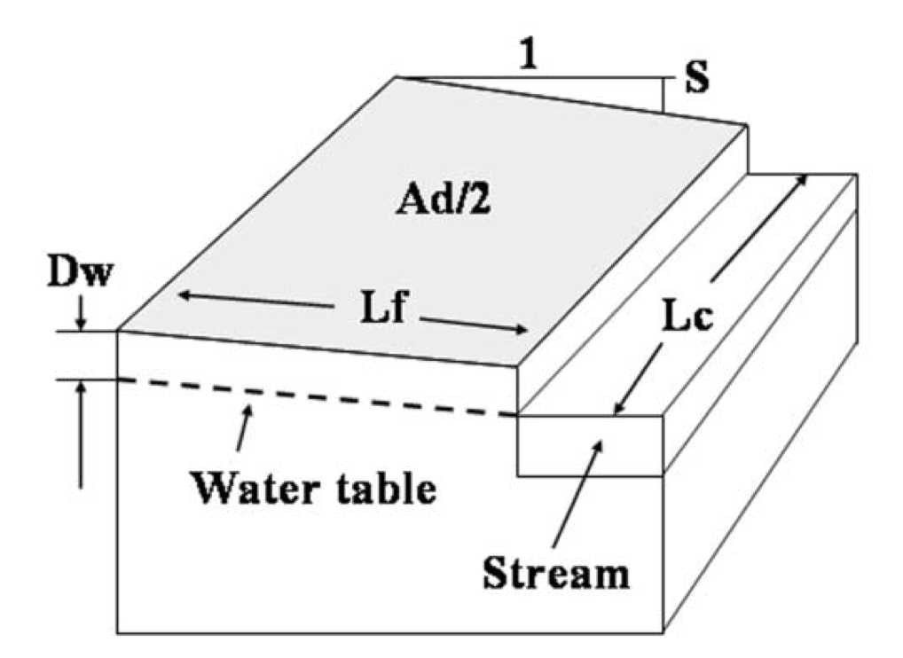

Slide 5
Objectives
How do GW-SW interactions vary temporally and spatially on Red Butte Creek and Logan River?
What surface characteristics are most correlated with increased GW-SW interactions?
How do earlier methods of using surface characteristics to estimate groundwater recharge compare when applied in karst watersheds?
What can be done to improve the applicability of the method so it better represents our watersheds of interest?

Slide 6
Site Description
Some terms:
iUTAH: innovative Urban Transitions and Aridregion Hydro-sustainability
GAMUT: Gradient Along Mountain to Urban Transitions
Intermediate sites to measure temporal and spatial variability in GW-SW interactions
Nested watersheds delineated at each differential gaging site

Slide 7
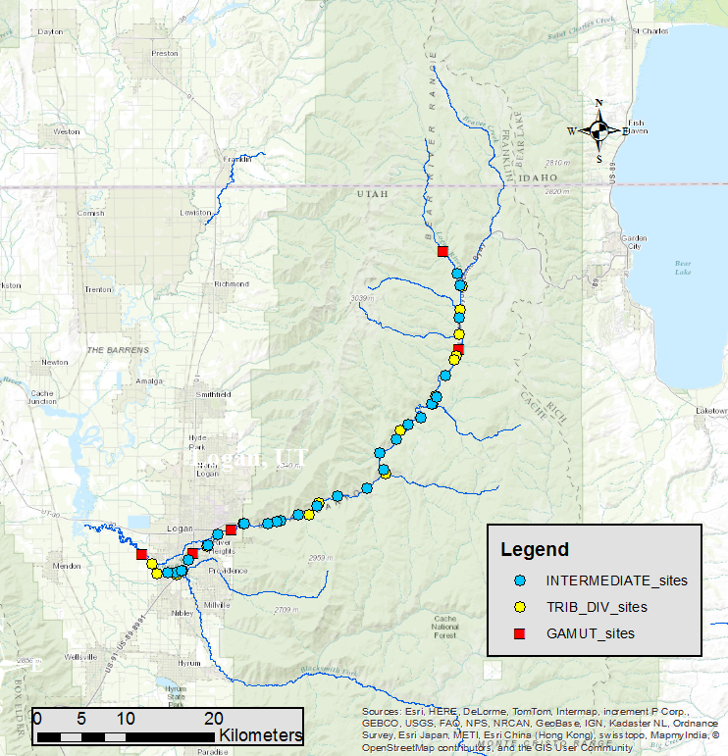
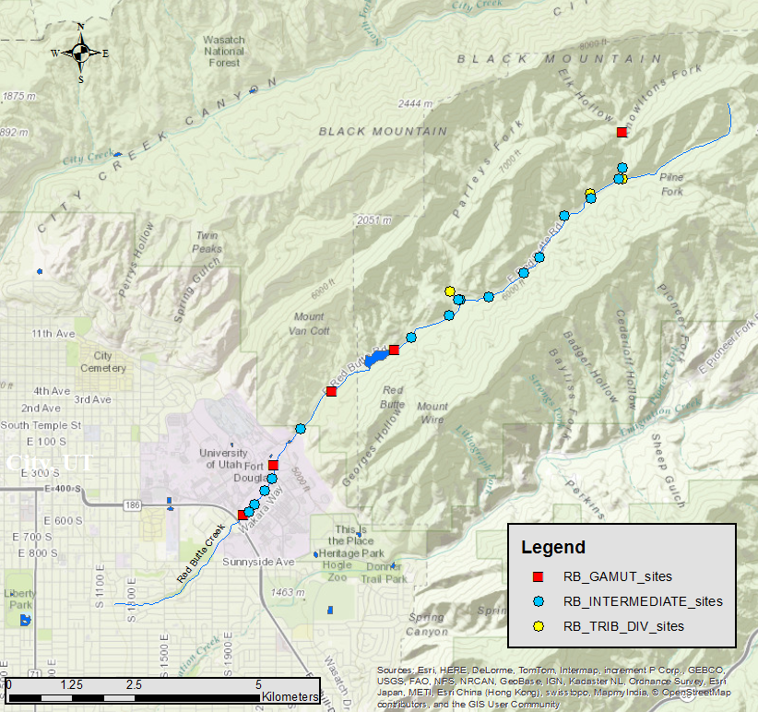
Site Description
Logan River
Red Butte Creek

Slide 8
Methods
Develop shapefiles to represent differential gaging sites and determine gain and loss areas.
Obtain surface datasets including: geology, soil, hydrogeology, land cover, topography, precipitation.
Delineate nested watersheds from each gaging site. Return statistics for each coverage.
Perform a hydrograph baseflow separation for USGS and GAMUT flow data as an estimate of GW recharge to compare to Cherkauer and Ansari’s method.
Automate portions of the project with Python (piece of cake, right?)

Slide 9
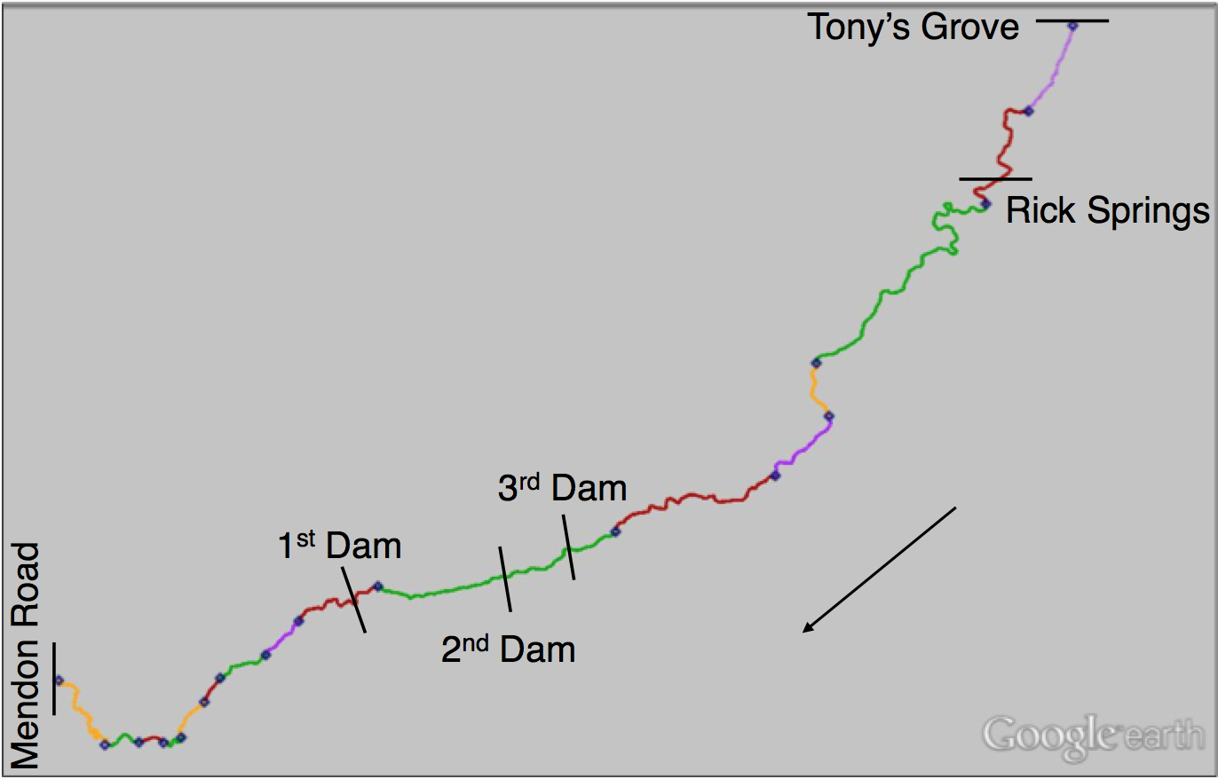
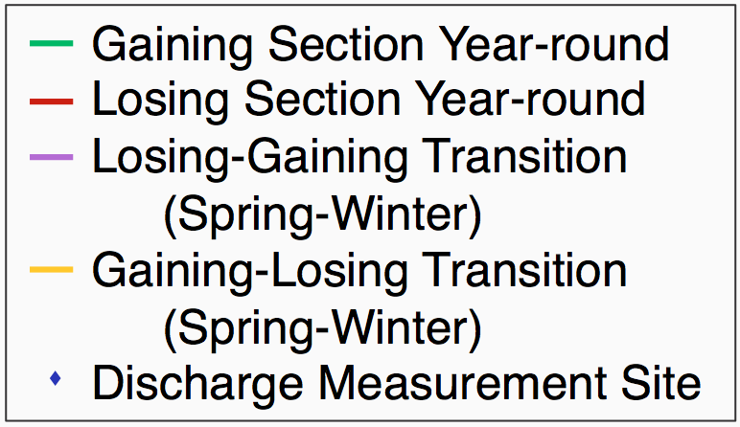
Results – Objective 1

Slide 10
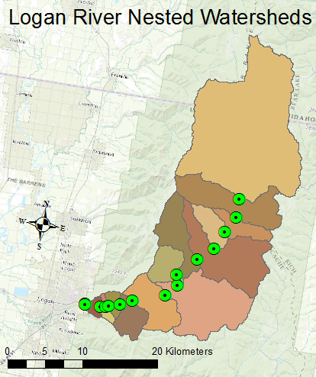
Results – Objective 2
Needed Python script to delineate multiple watersheds
Watershed tool in Hydro ArcGIS server
Wanted to be able to alter drainage density
Developed code
Time sink…

Slide 11
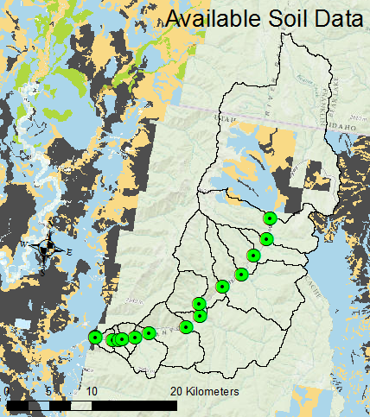
Results – Objective 2
Develop file geodatabase of layers from Landscape and Elevation GIS servers
Zonal statistics by nested watershed
Write to csv
There is a hole in the surface data right over Logan Canyon…

Slide 12
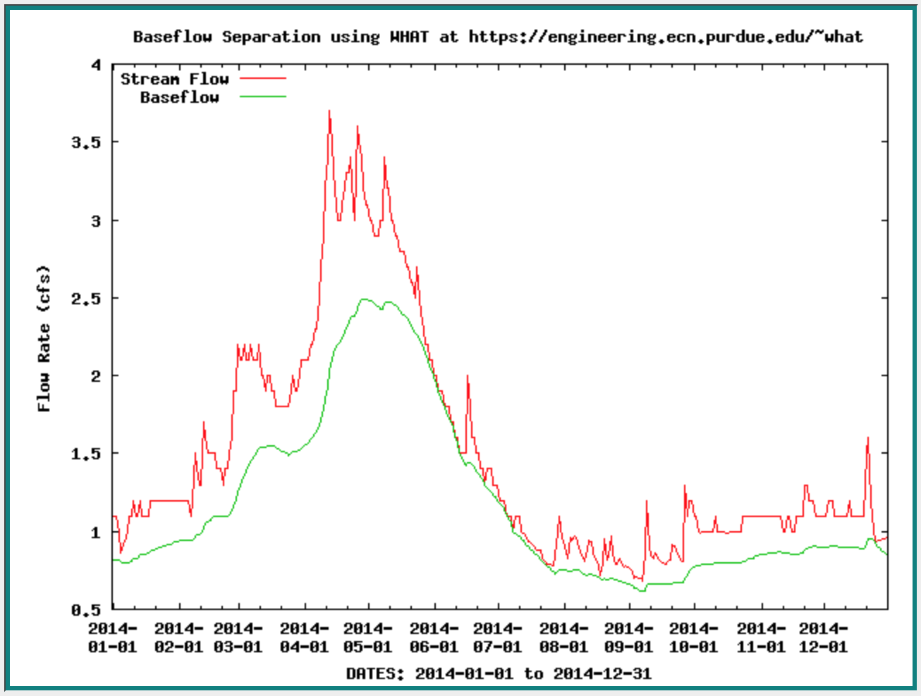
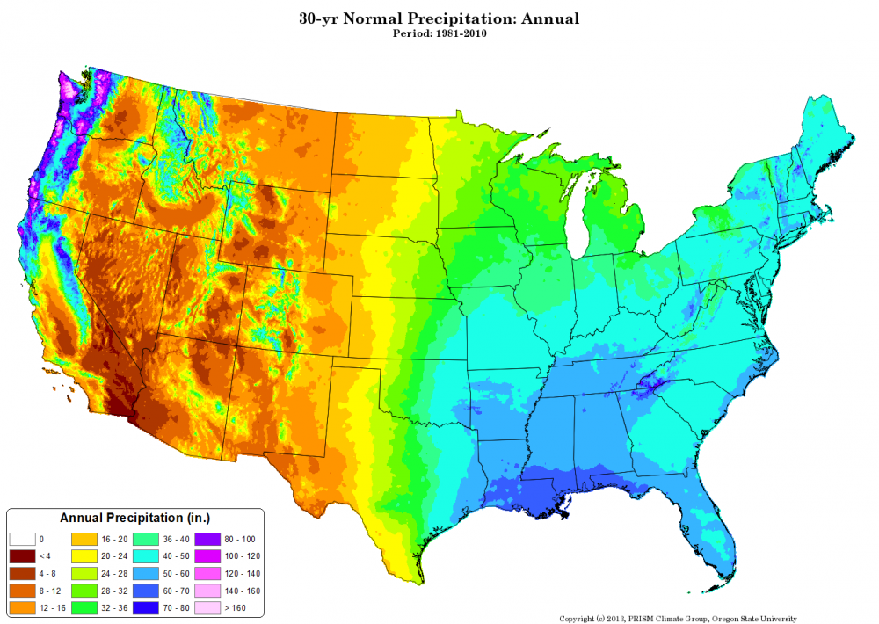
Results – Objective 3
Baseflow and Precipitation data from 1981 – 2014
The USGS gaging station on the Logan River does not represent baseflow…
Highline Canal Diversion – irrigation
Dewitt Springs – drinking water

Slide 13
A GIS approach to understanding groundwater – surface water interactions in the Logan River and Red Butte Creek, Utah
Trinity Stout
CEE 6440

Slide 14
Results (Current work) – Objective 3
Use the summary of surface characteristics and the average R/P to check the applicability of Cherkauer and Ansari’s method

Slide 15
Future work – Objective 4
What can be done to improve the applicability of the method so it better represents our watersheds of interest?
Macropores and fracture flow dominate hydrology in Logan canyon
Include data regarding sinks, faults, springs?

Slide 16
Questions?

