Slide 1
Using GIS to Map Chromium Occurrence in Drinking Water
Nate Rogers
CEE 6440

Slide 2
Introduction
Background of chromium
Cr(III)↔Cr(VI)
Health effects of chromium
Cr(III) is a trace nutrient
Cr(VI) is known carcinogen by inhalation, suspected by ingestion
Sources of chromium in drinking water
Source water: Naturally occurring, anthropogenic
System infrastructure
Treatment chemicals
Regulations
Maximum Contaminant Level (MCL) of 100 ppb TotCr (Cr(III) + Cr(VI))
Possible federal regulation of Cr(VI)
California MCL = 10 ppb Cr(VI)
Notes:
State what Maximum Contaminant Level (MCL) is, measured at the entry point

Slide 3
Data
Population Data – 2010 Census
Chromium Data – EPA
1996 - Safe Drinking Water Act (SDWA)
Third Unregulated Contaminant Monitoring Rule (UCMR3)
All Public Water Systems (PWS) serving <10,000 people
Limitations
Data linked by zip codes

Slide 4
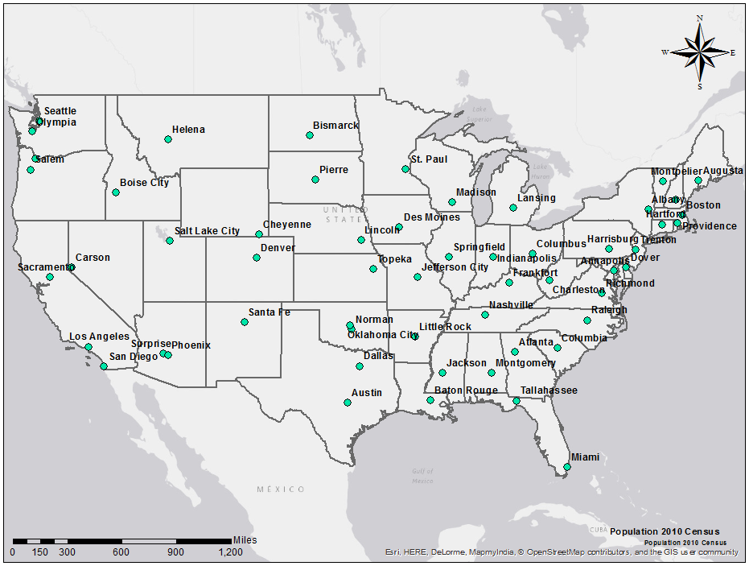
Population
Notes:
Map of USA with capital cities, some high Cr6 concentrated cities as well as some other noteworthy cities

Slide 5
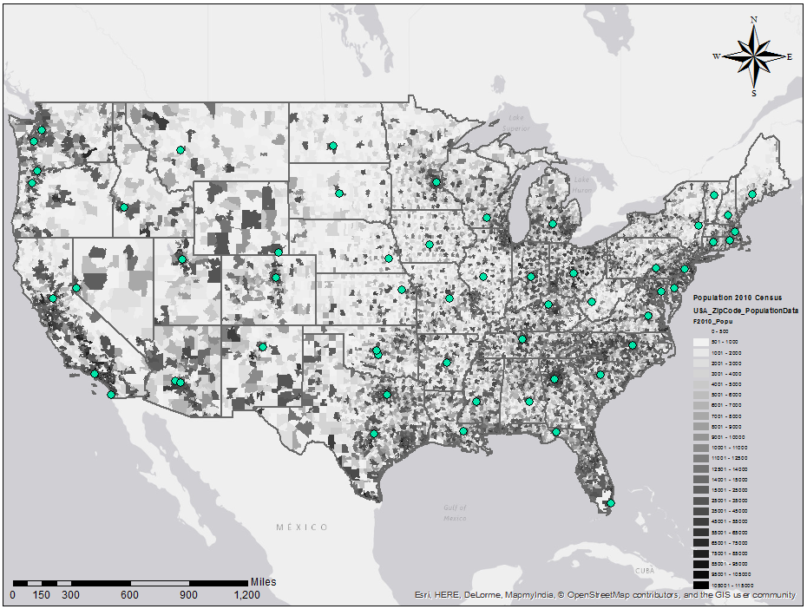
Population
Notes:
Map of USA with complete population by zip code from the 2010 census with same cities highlighted

Slide 6
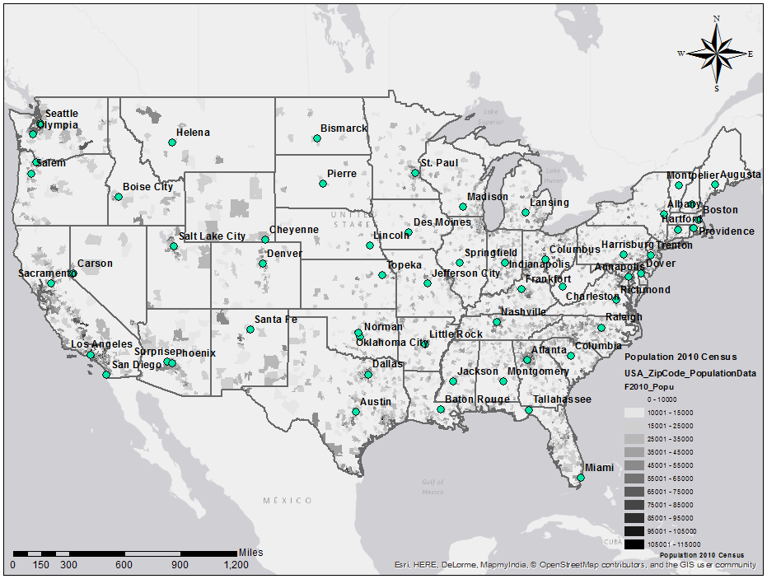
Population
Notes:
Map of USA with population greater than 10,000 by zip code from the 2010 census with same cities highlighted

Slide 7
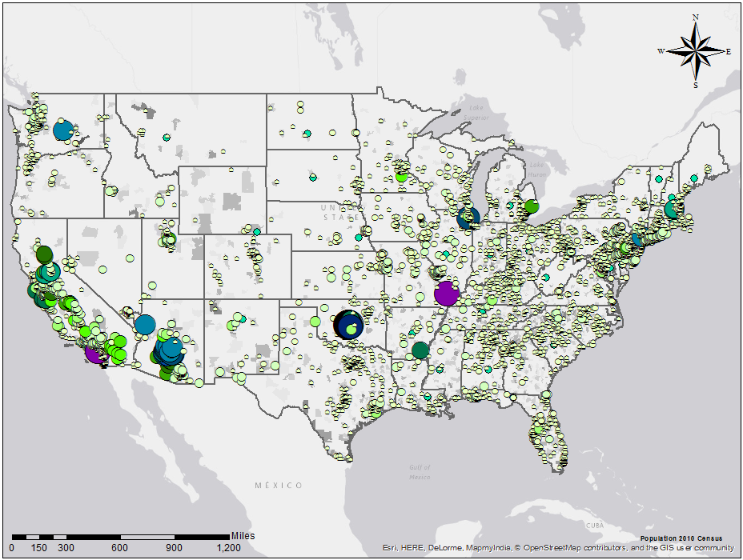
Total Chromium - Max
Notes:
Map of USA with population greater than 10,000 by zip code from the 2010 census with same cities highlighted

Slide 8
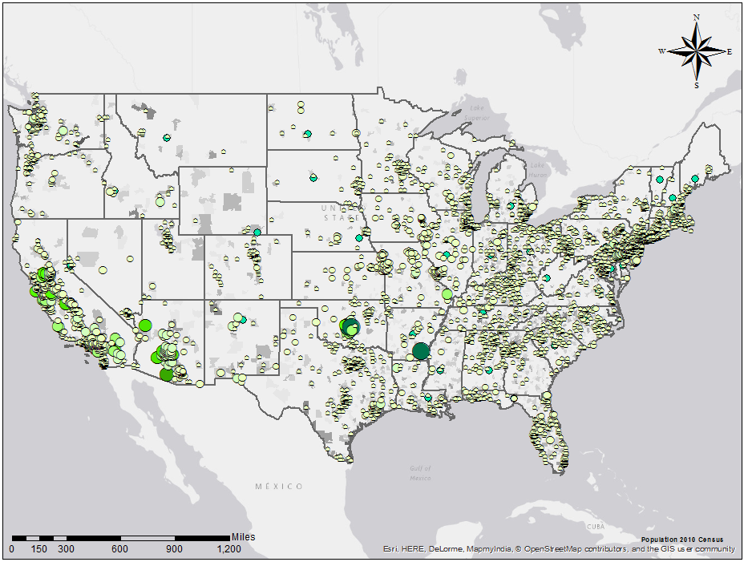
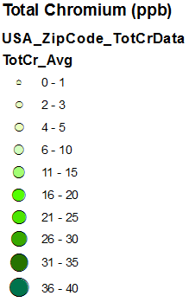
Total Chromium - Average
Notes:
Map of USA with population greater than 10,000 by zip code from the 2010 census with same cities highlighted

Slide 9
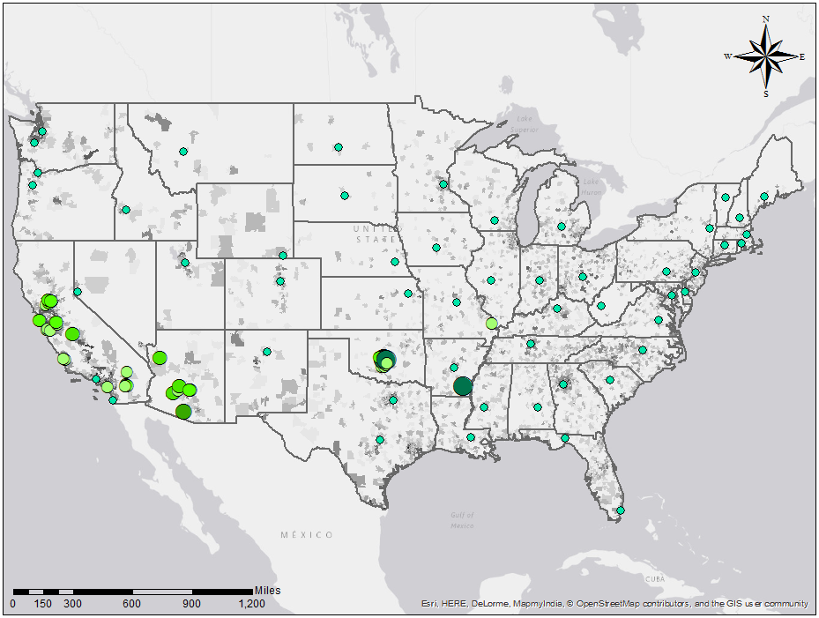
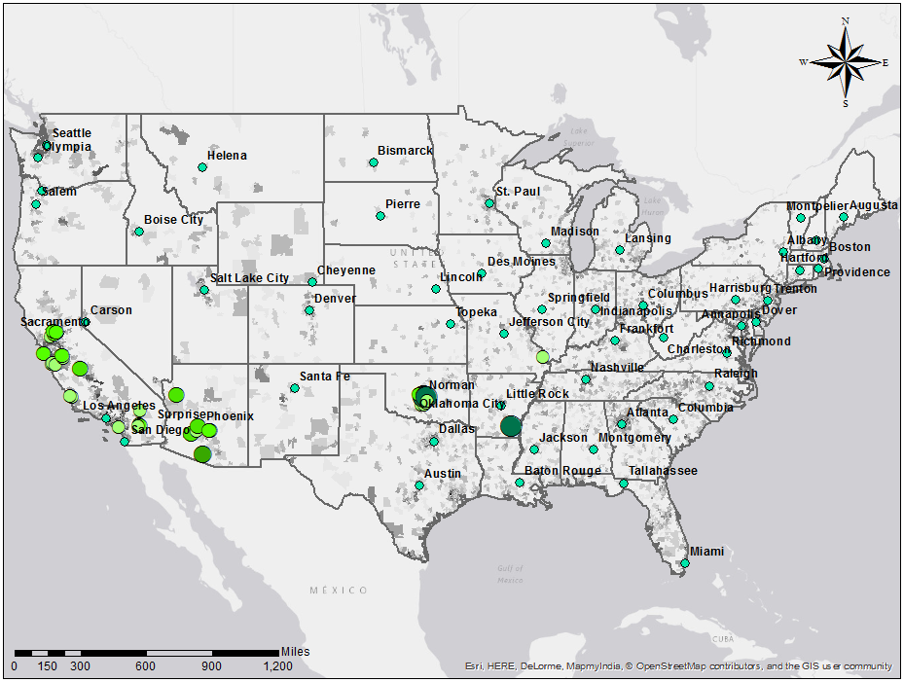
Total Chromium - Average
Notes:
Map of USA with population greater than 10,000 by zip code from the 2010 census with same cities highlighted

Slide 10
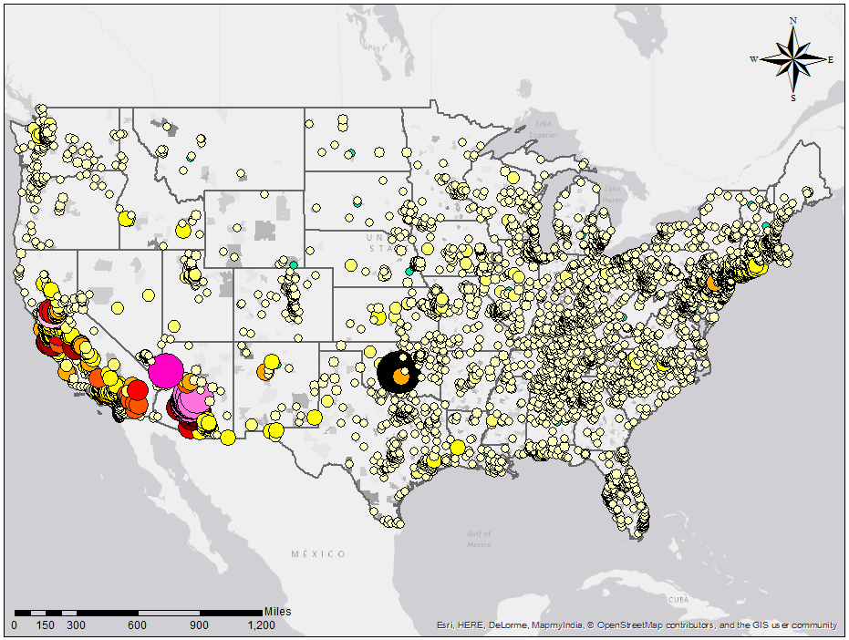
Chromium 6 - Max
Notes:
Map of USA with population greater than 10,000 by zip code from the 2010 census with same cities highlighted

Slide 11
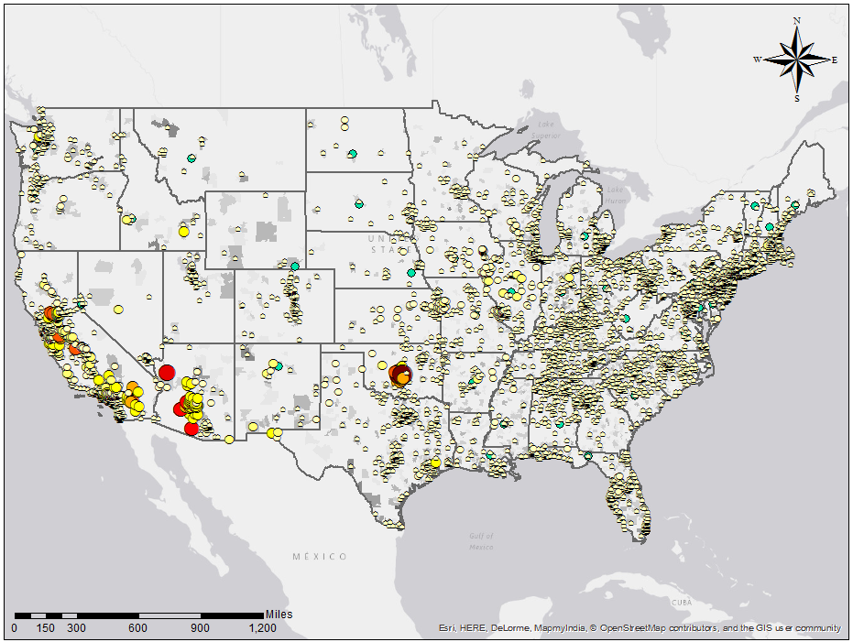
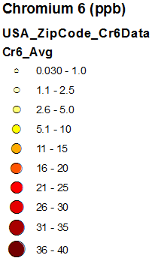
Chromium 6 - Average
Notes:
Map of USA with population greater than 10,000 by zip code from the 2010 census with same cities highlighted

Slide 12
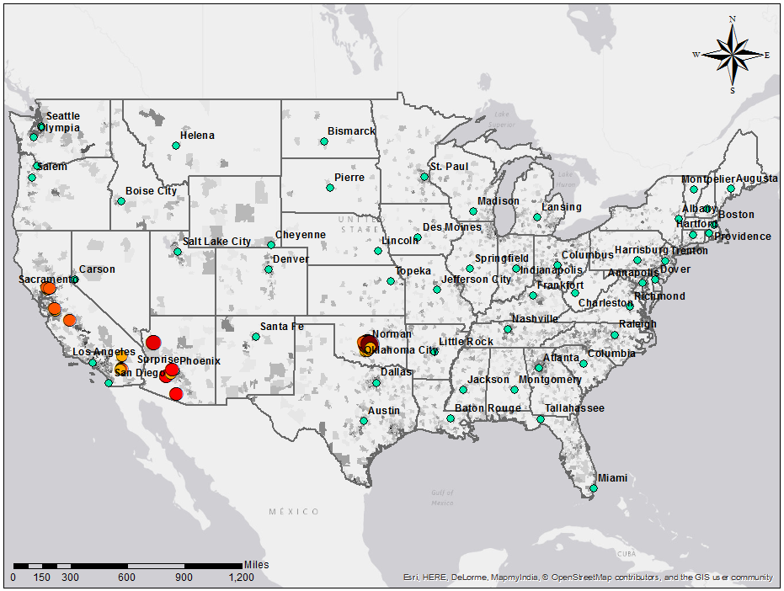
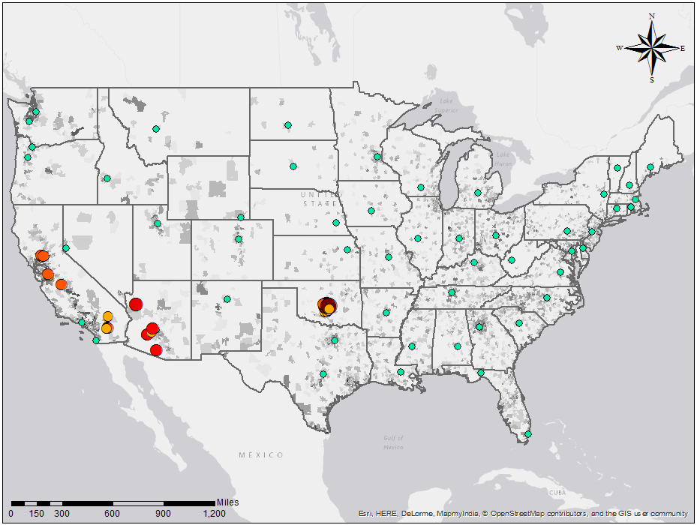
Chromium 6 - Average
Notes:
Map of USA with population greater than 10,000 by zip code from the 2010 census with same cities highlighted

Slide 13
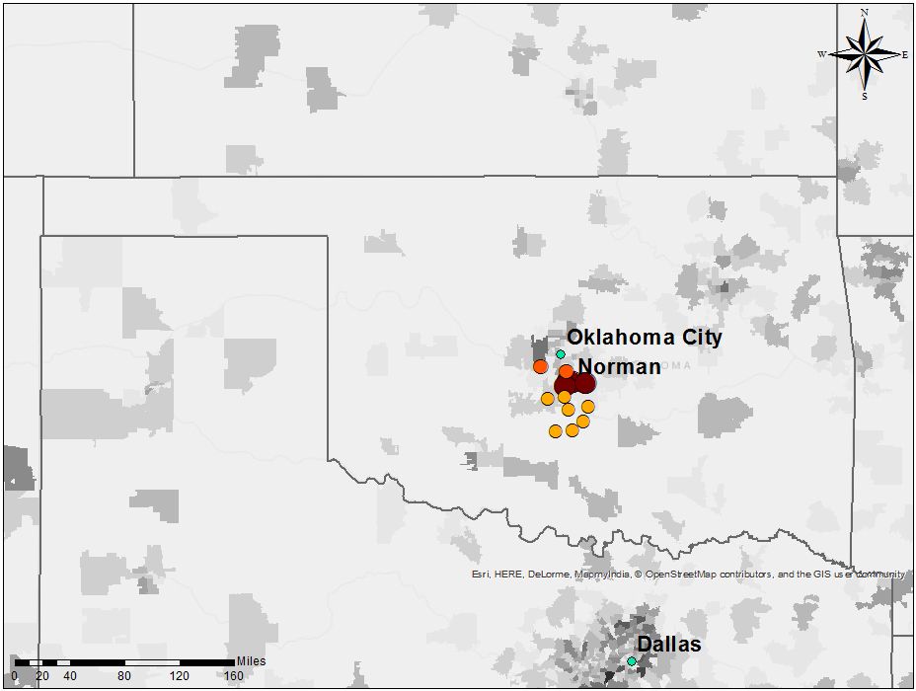
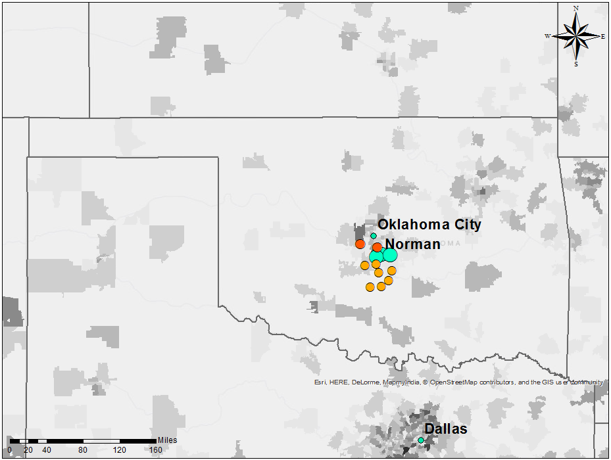
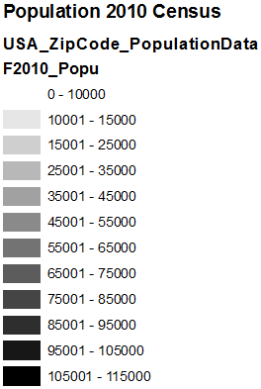
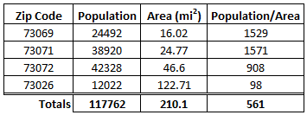
Cr6 Evaluation of Norman, OK
Notes:
Map of USA with population greater than 10,000 by zip code from the 2010 census with same cities highlighted

Slide 14
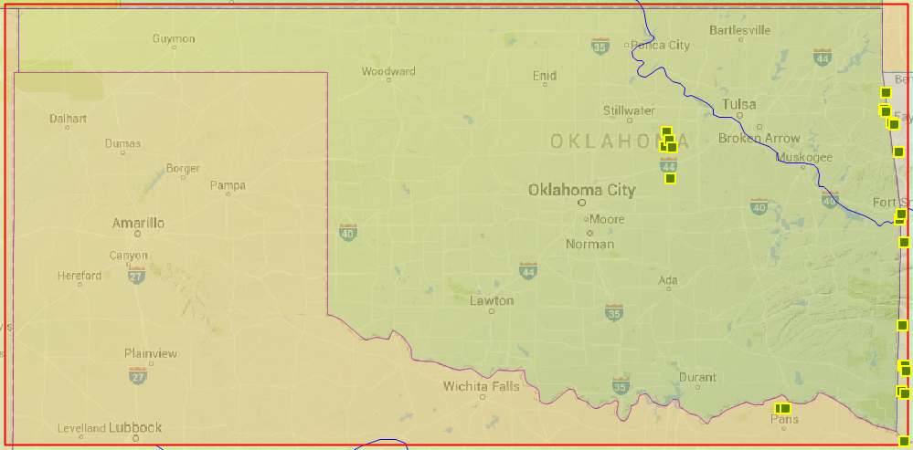
Summary & Next Steps
Using GIS to analyze chromium occurrence in the US
Identify areas requiring treatment system upgrades
Affected populations
Federal Regulation Feasibility
California’s success
Economic feasibility
Utilize CUAHSI HydroDesktop
Pinpoint sources of chromium
Evaluate areas with large concentrations
Mapping potential water sources without chromium
Notes:
State what Maximum Contaminant Level (MCL) is, measured at the entry point

Slide 15
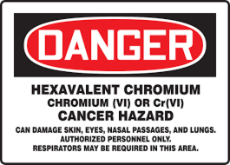
Questions?

