Slide 1
Use of GIS and Hydrologic Modeling for Outdoor Recreation in the Bear River Range
Tomsen Reed
Fall 2015
CEE 6440 - GISWR
Utah State University

Slide 2
Overview:
Purpose:
Use ArcGIS to model possible routes for trail running, cross country skiing
Create useable maps to form a guide for these activities in the Bear River Range
Methods:
Gather data resources
Analyze data using ArcGIS
Results:
Select cross country skiing and trail running guide the Bear River Range

Slide 3
Quantification of Outdoor Recreation
North Arizona Recreation Management Definitions
XC Skiing:

Slide 4
Trail Running:
Same qualifications as XC Skiing, but not as stringent
Snowshoeing/Hiking:
Can be done on all trails that XC Skiing and Trail Running can be done on, but with more ease

Slide 5
Data Collected

Slide 6
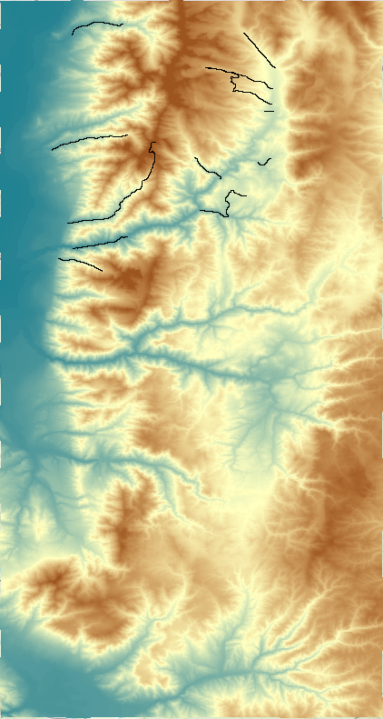
NED 10m DEM
Focused on the Utah section of the Bear River Range, from -111.45° E to -111.85° E and from 41.25° N to 42.00° N

Slide 7
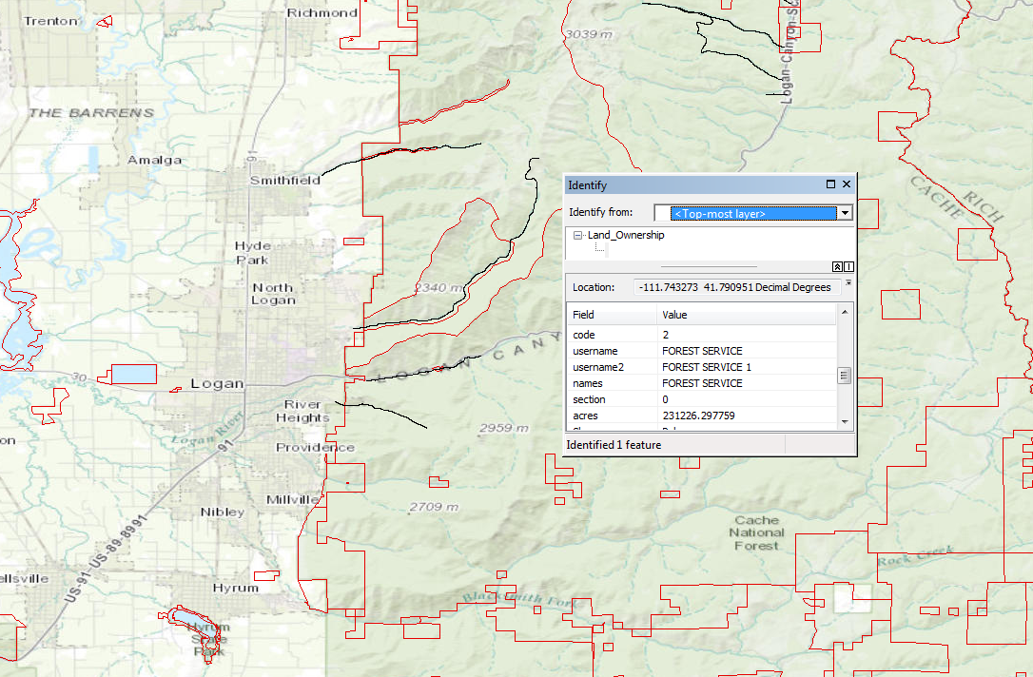
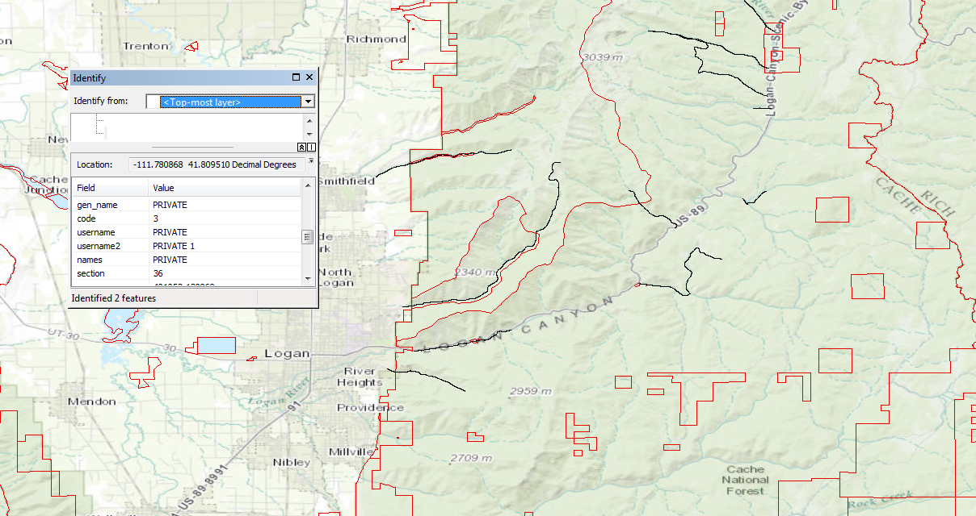
Public/Private Property
Identification tool can be used to
identify if an area is privately or
publicly owned

Slide 8
NCLD 2011
Land cover data used to determine suitability of certain area based on vegetation cover.

Slide 9
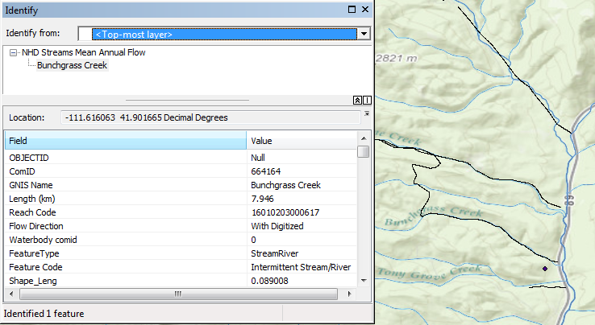
NHD Plus
Used to determine suitability
of area based on stream
crossings, whether it is
perennial or interminttent,
and discharge of streams

Slide 10
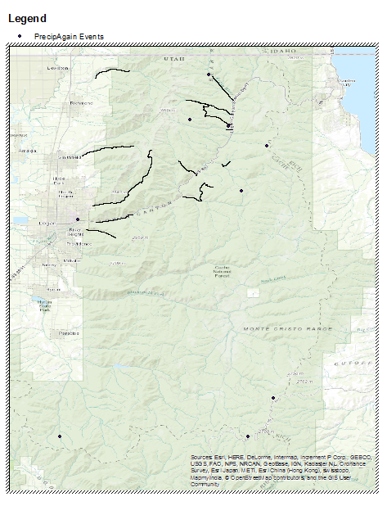
NOAA Precipitation Data
Average annual snowfall data used to
determine suitability for snowshoeing
and skiing, taken from SNOTELs and
other measurements from NOAA

Slide 11
Analysis Tools

Slide 12
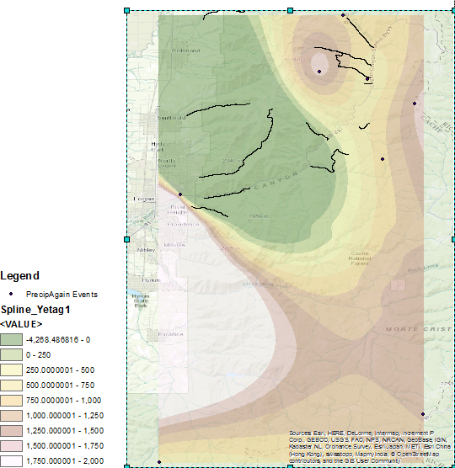
Spline Interpolation
Interpolation of precipitation
(specifically maxmimum snow
depth data) stations throughout
the Bear River Range

Slide 13
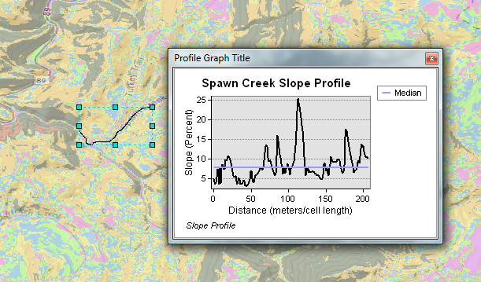
Slope Tool/Profile
Slope Tool
3D Analyst to create a profile graph of the slope along the distance of any route chosen, using the Interpolate Line and Graph Profile functions

Slide 14
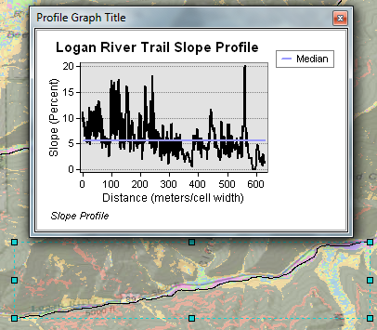
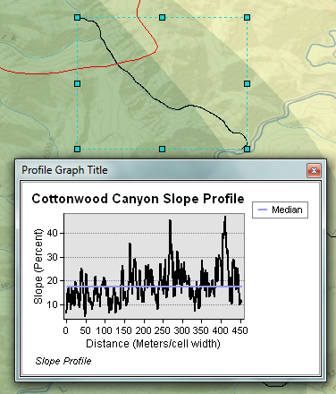
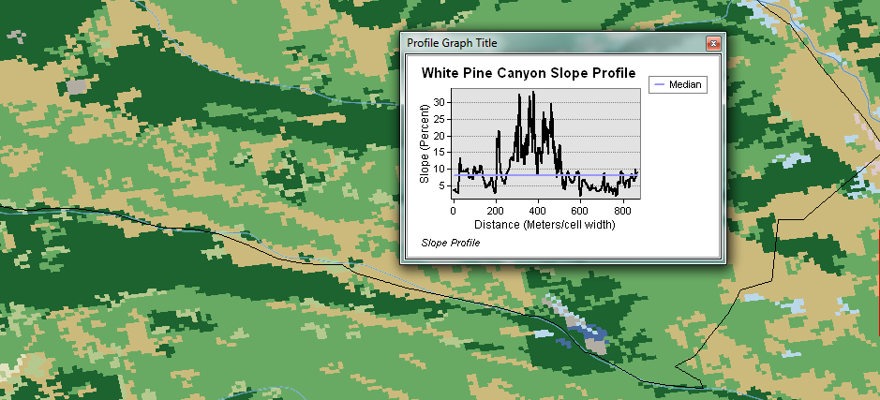
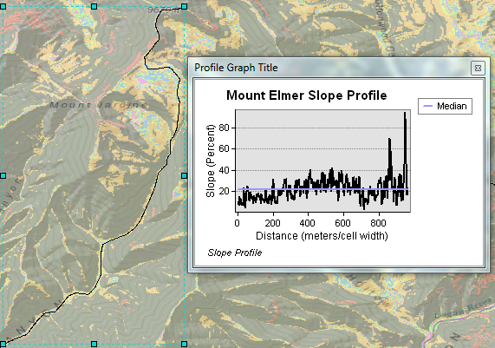
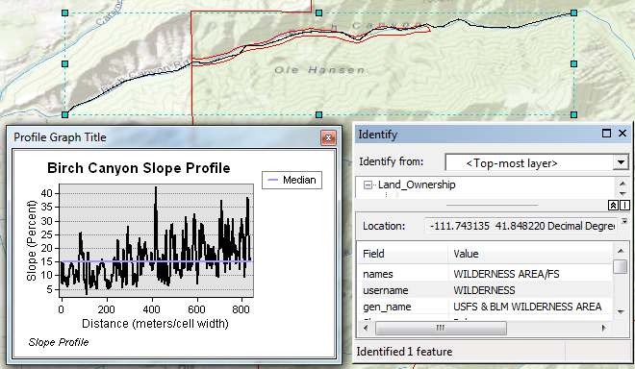
Recommended Areas
Beginners:
Logan River Trail - T.R. Spawn Creek - XC Skiing
Intermediate:
Cottonwood Canyon - T.R. White Pine Canyon - XC Skiing
Experts:
Mount Elmer from Green Canyon - T.R. Birch Canyon - XC Skiing

Slide 15
Problems/Future Work
Confirmation of results through experience and observation - cannot confirm terrain
Acquire higher resolution land cover data
Acquire more extensive precipitation data to accurately portray this data
Acquire and use higher resolution DEM/slope data to include roads and existing trails
Determine slope acceptability values for Backcountry Skiing and other activities

Slide 16
Questions

