Slide 1
Relationships between lake water levels and Habitat at Bear Lake,UT
Matthew Meier, Jereme Gaeta, and Hayley Glassic
Quinney College of Natural Resources, Department of Watershed Sciences, Utah State University, Logan, Utah 84322
Lake Ecology Lab

Slide 2
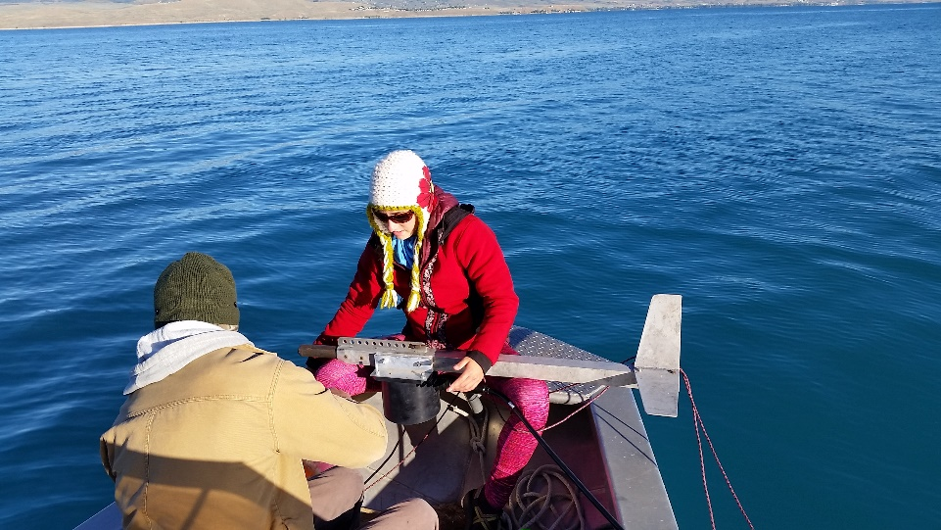
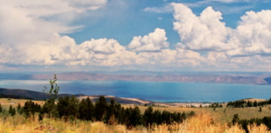
Background

Slide 3
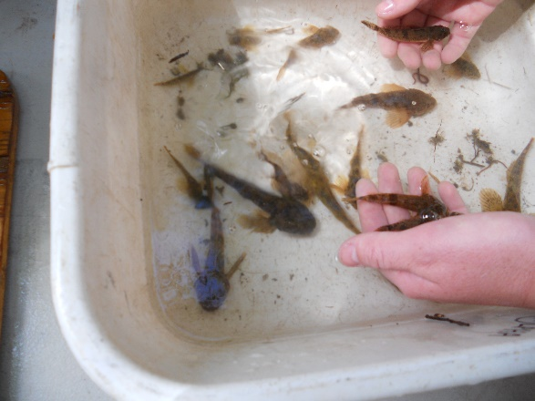
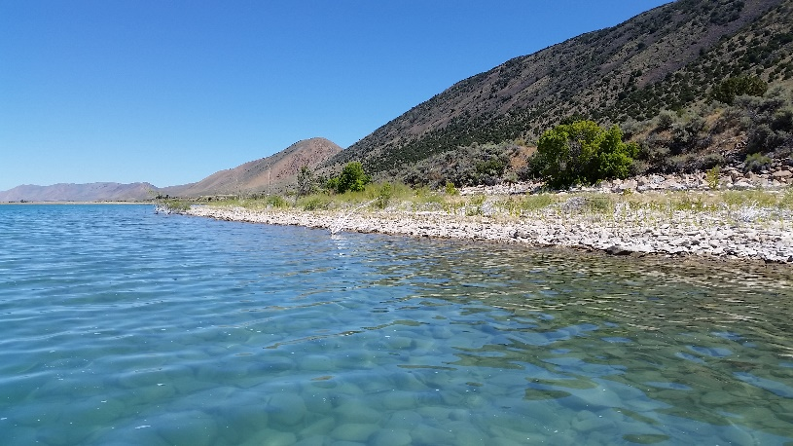
Lake levels and Habitat
Importance of understanding the Littoral zone
Substrate type
Vegetation
Primary Productivity
Figure 2: Littoral zone
Figure from: http://www.lakeaccess.org/ecology/lakeecologyprim9.html

Slide 4
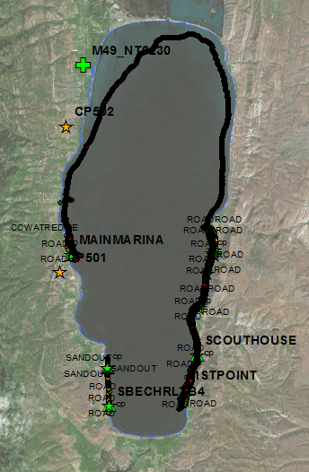
Data Collection
Real Time Kinematic
Split Beam Ecosounder

Slide 5
Methods
Constructing…
Habitat Map
DEM
Run the python tool
Constructing…
Tool to automate the process of relating elevation to a shapefile

Slide 6
Results
Habitat Map
A New DEM

Slide 7
Habitat Percentages

Slide 8
Surface Area relation to Lake Water Levels

Slide 9
Future Work and Applications
Complete the atomization process through the Python Toolbox
Relate the habitat layer to specific ranges in elevation
Surface Area applications
Alluvial fan growth
Habitat, soil, land cover, or geology classifications related to elevations

Slide 10
Questions

