Slide 1
Analyzing Irrigation Practices: Bear River Canal Company December 3, 2015 By Carl W. Mackley, P.E. Utah Division of Water Rights and M.E. Student, Utah State University

Slide 2
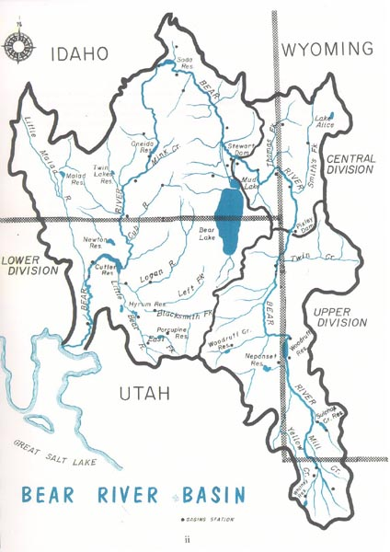
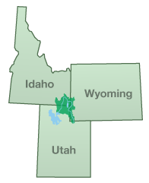
Bear River Basin Located in Utah, Idaho, and Wyoming

Slide 3
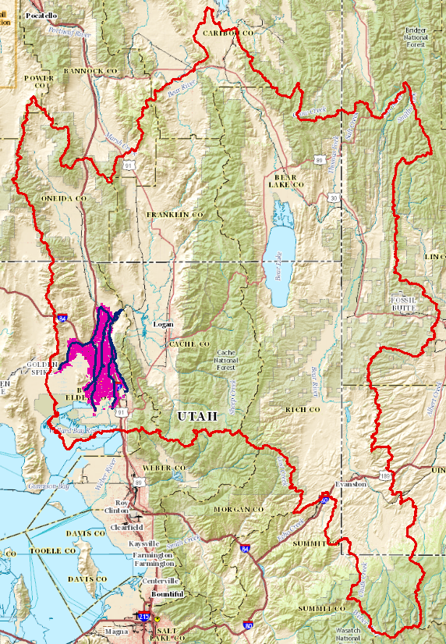
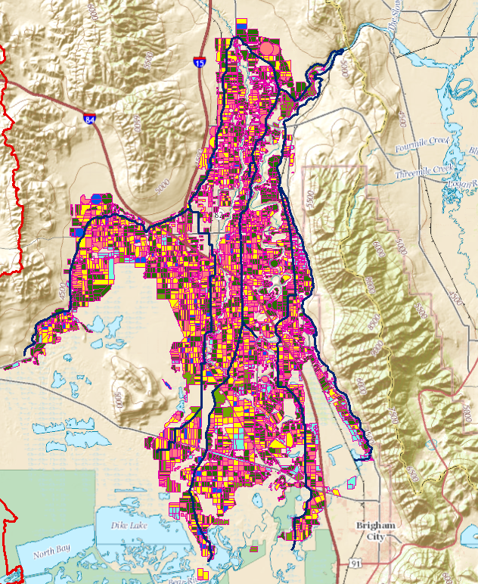
Project Area
Close-up of Bear River Canal Company Service Area
Location in B.R. Basin

Slide 4
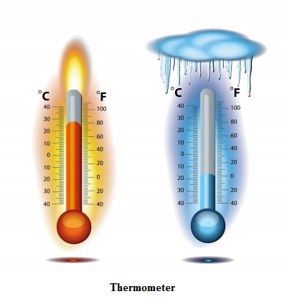
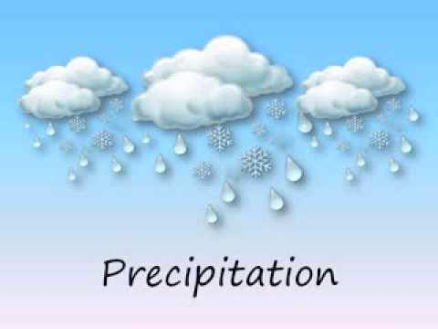
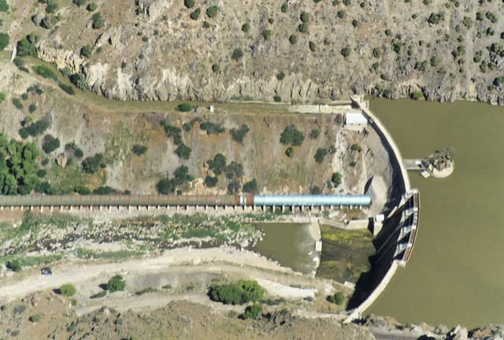
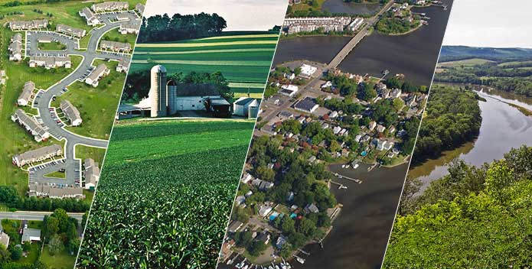
Determine What Factors Affect Water Use (What Data To Gather)
Precipitation
Temperature
Land Use
Water Availability

Slide 5
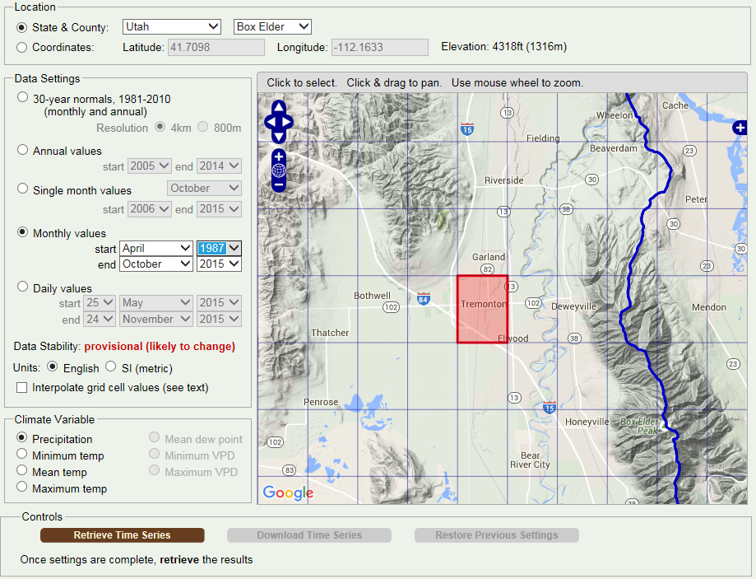
Gathering Data: Precipitation and Temperature (PRISM Climate Group)

Slide 6
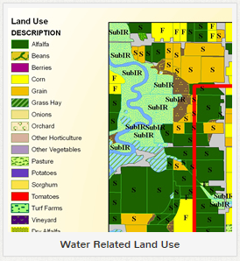
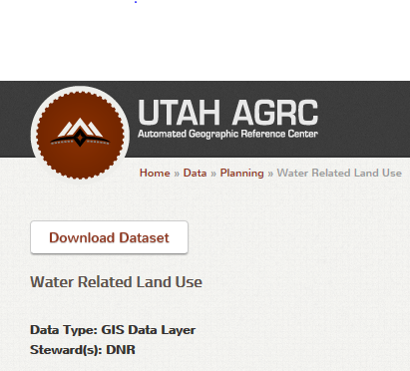
Gathering Data: Land Use From Utah Div. of Water Resources & AGRC

Slide 7
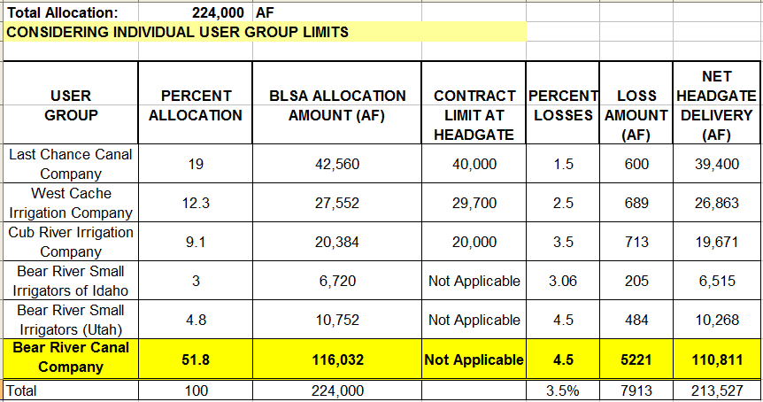
Gathering Data: Water Availability From USGS and Pacificorp
Natural Flow at USGS Corinne Gage
Bear Lake Storage Allocation Data Courtesy Of:

Slide 8
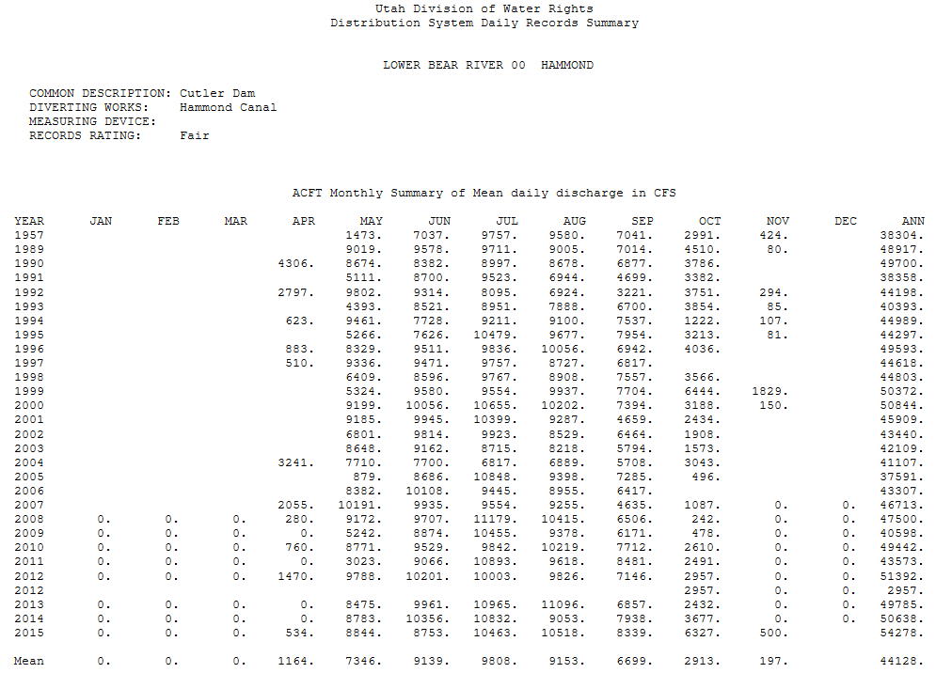
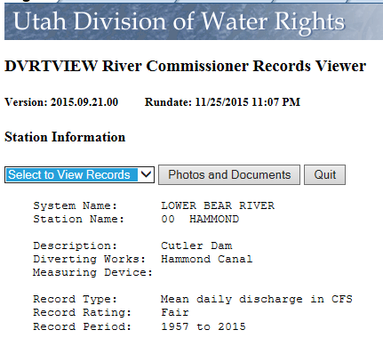
Gathering Data: Canal Diversions
Data Gathered from Utah Division of Water Rights Divert Database from Hammond and Westside Canal Streamgages

Slide 9
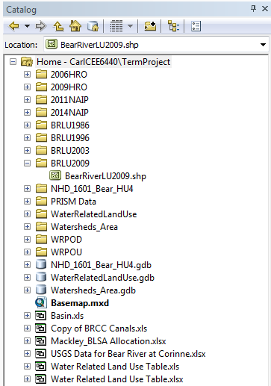
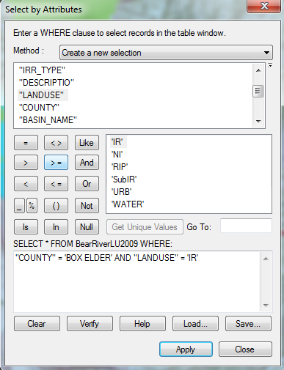
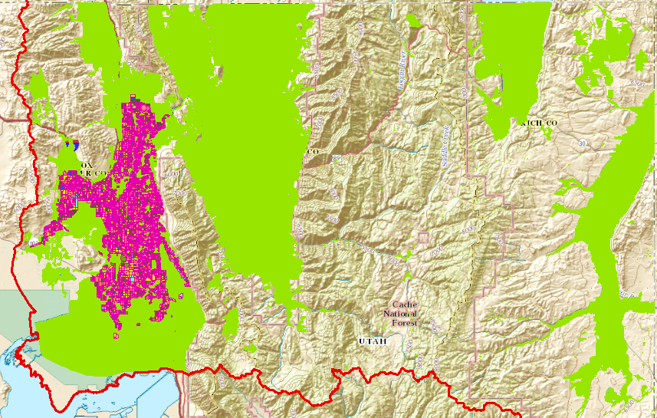
How GIS Was Used:
1. Input Data: Shapefiles,etc.
2. Filter/Join Data
3. Display Data

Slide 10
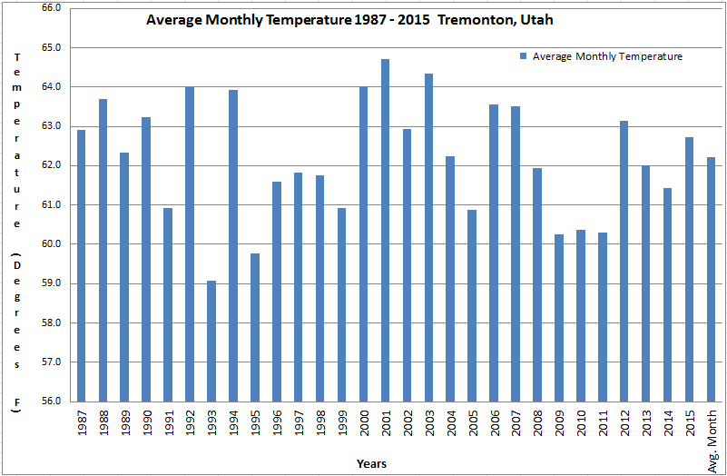
Results: Temperature & Precipitation

Slide 11
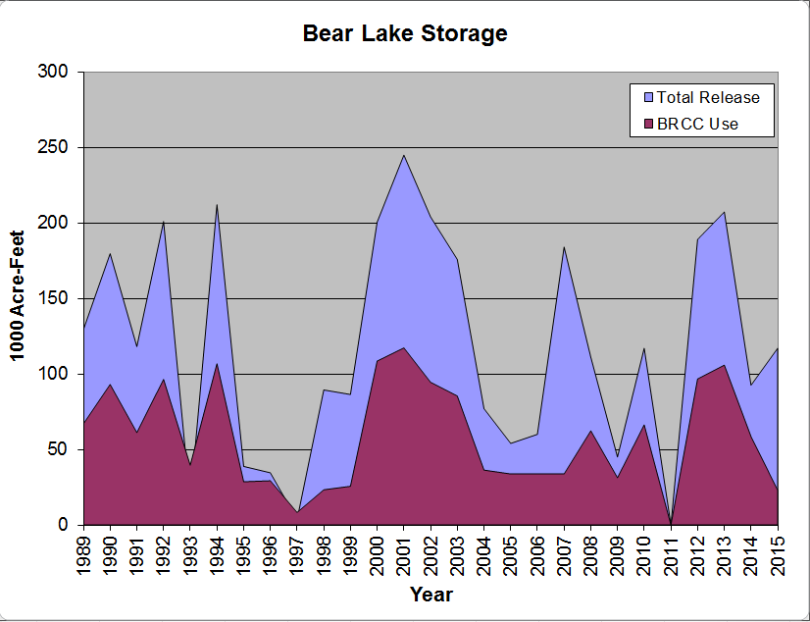
Results: Water Availability
Natural Flow Diversions
Bear Lake Storage Use

Slide 12
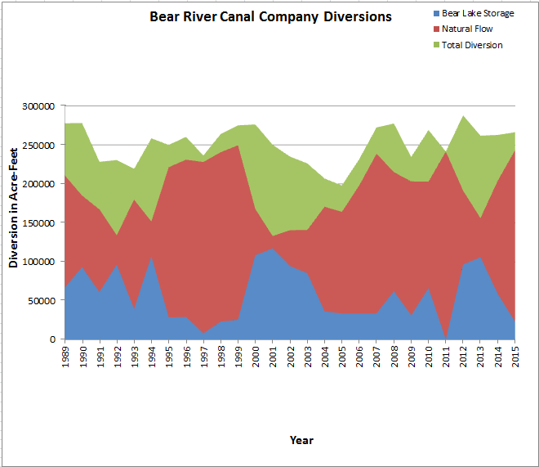
Results: Water Use
Canal Diversions
Total Crop Use

Slide 13
Results: Land Use
By Percentage
By Acreage

Slide 14
Results: Scoring Each Year (Lower Score = Higher Ranking)

Slide 15
Conclusions:
Temperature plays a fairly insignificant role.
In-season precipitation reduces diversions.
The quantity of natural flow available affects storage use.
Because of a senior priority, BRCC regularly receives its water.
Land use acreage and crop type really affects the amount of water diverted.

Slide 16
Are there any questions? Such as…..
Data Use or Sources
How GIS Was Used
Conclusions
Others…

