Slide 1
Using GIS To Distinguish Wetland Vegetation/Shorelines from Current Drought Conditions in The Great Salt Lake.
By Mitch Jenkins

Slide 2
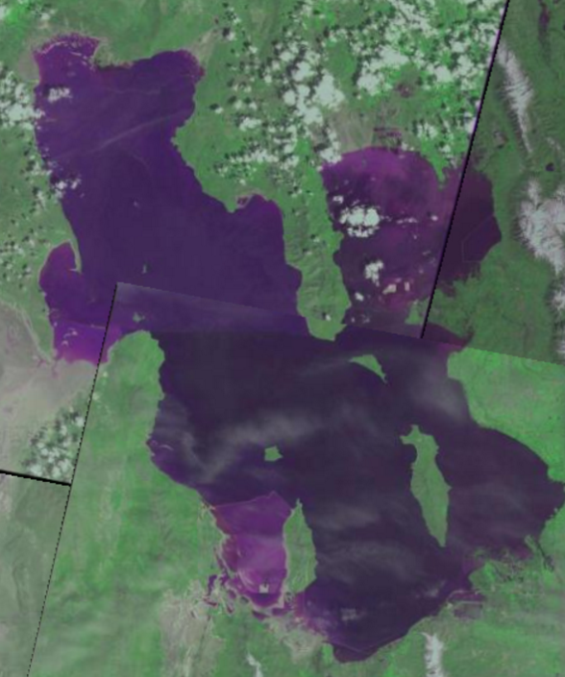
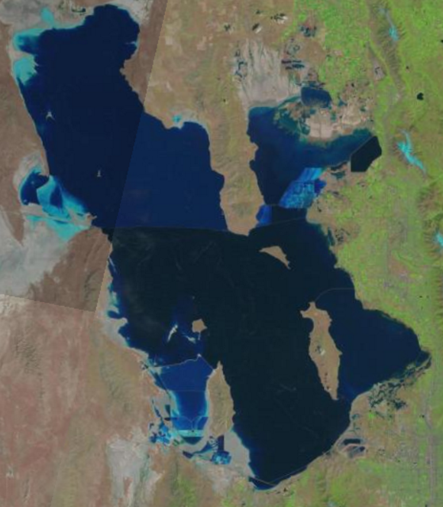
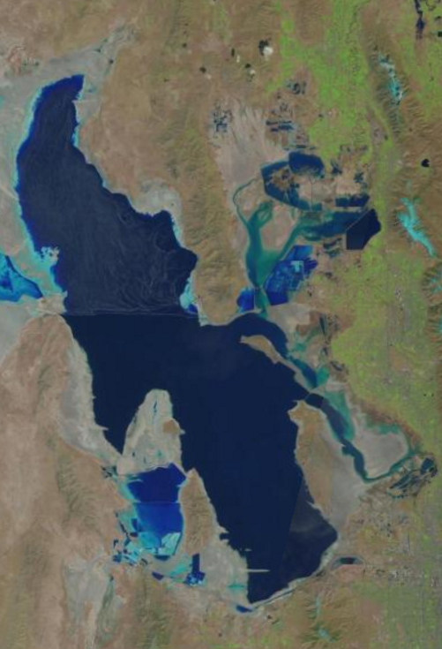
Introduction
May 1986
May 2000
April 2015
The Great Salt Lake shoreline is highly variable
Prolonged drought has reduced the lakes area over the past 20 years.

Slide 3
Divisions of the lake
Emergent Wetland
Briefly Flooded Lake Area (24 distinctions)
Seasonally Flooded Lake Area (30+ distinctions)
Permanently Flooded Lake Area

Slide 4
Vegetation In Briefly Flooded Areas
Dominant Vegetation in Briefly Flooded Regions
Flooded for the early growing season
1169 Square Kilometer area of potential shoreline change
Derived from orthophotography and field mapping

Slide 5
Seasonal Flooding
Dominant Vegetation in Briefly Flooded Regions

Slide 6
Vegetation In Seasonally Flooded Areas
Flooded for the entire growing season or longer
Utah AGRC Dominant vegetation data within seasonally flooded areas

Slide 7
Interpretation
Less submersible vegetation dominates briefly flooded regions
Salt Grass- Tolerant to submersion and saline environments
Greasewood- Tolerant to saline environments and submersion for less than 40 days

Slide 8
Further Study
Using Remote Sensing to classify specific wetland vegetation such as Phragmites and Cat Tails
Inputting imagery into GIS to calculate area and extent

