Slide 1
Snow Distribution:
An Alternative Approach to Analysis Accumulation
Ryan James
Professor David Tarboton
CEE 6440: Geographic Information Systems
November 23, 2015

Slide 2
Introduction and Objective:
Slides:
  Describe Problem
  Data Analysis and Accumulation
  Solution Approach – Regression Analysis
  SWE Volume vs Peak River Flow
Goal:
  Build a model that predicts SWE volume without using the spline interpolation tool.
  Compare SWE volume to spring runoff peak values.

Slide 3
Problem:
Lack of Data to Work With
Snow Water Equivalent (SWE) is the amount of water contained within a snowpack.
It can be thought of as the depth of water that would theoretically result if a snowpack melted instantaneously.
SWE (m) = snow depth (m) x snow density (kg/m3) / water density (kg/m3)
  density based on air temperature

Slide 4
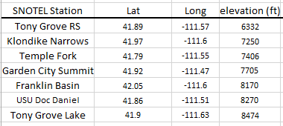
Problem:
SNOTTEL Sites
SNOTEL is an automated system of snowpack and related climate sensors operated by the Natural Resources Conservation Service (NRCS) of the United States Department of Agriculture in the Western United States.

Slide 5
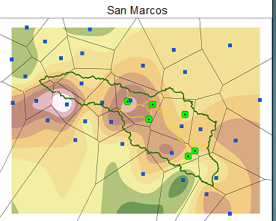
Problem:
Spline Interpolation
Classroom example of spline interpolation
Works best when there is sufficient amounts of sites to interrupt data from.
Points in between the sites are assigned a value that is based on the relationship to the sites.
Essentially fills in the missing pieces.

Slide 6
Problem:
Spline Interpolation
Spline interpolation applied to SNOTEL sites.
Does not fill in basin completely….

Slide 7
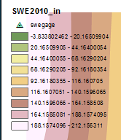
Problem: Spline Interpolation
force interpolation to fit basin, but produces bad results
?

Slide 8
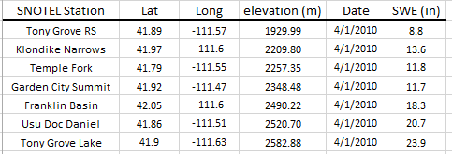
Solution Approach: SWE vs Elevation
Work with what is available. SWE and elevation.
Use regression analysis to build a relationship between elevation and SWE.
Use raster calculation to find volume of SWE in basin.

Slide 9

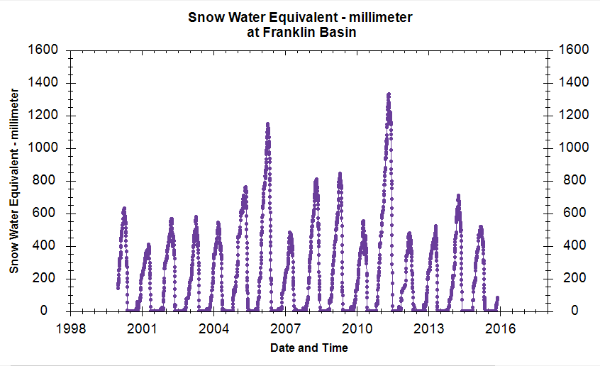
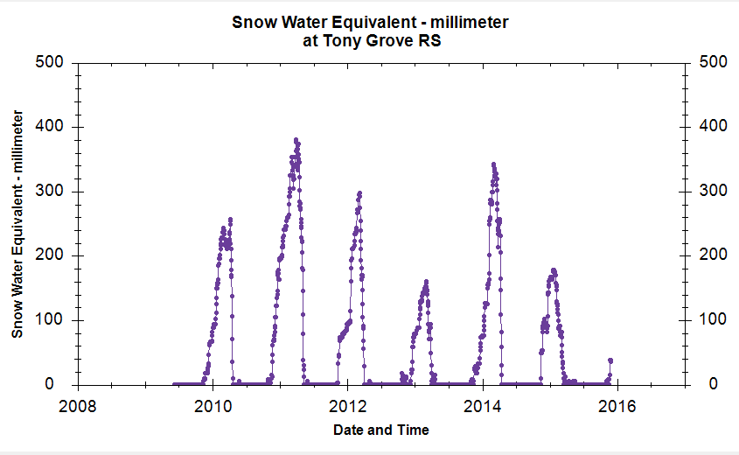
Solution Approach: Data Retrieval
Data retrieved using the HydroShare Software
Only chose to use data as far back as year 2010
Some SNOTEL sites are still relatively new

Slide 10
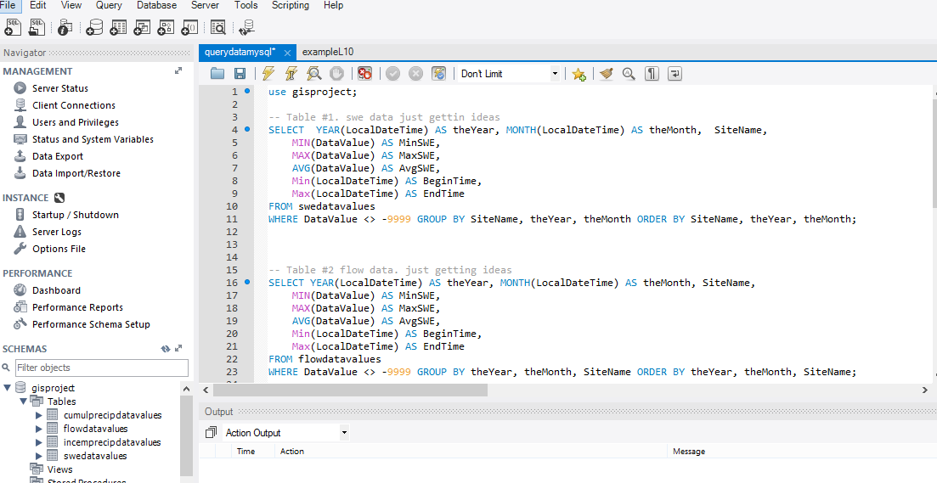
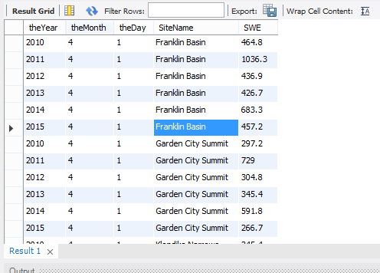
Solution Approach: Database
Build a database using MySQL software
Use query statements to parse data (saves on time).
  Ex: Find yearly peak SWE values for each site. Find yearly April 1st SWE values.

Slide 11
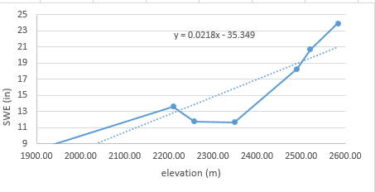
Solution Approach:
Regression Analysis
  Regression analysis is a statistical process for estimating the relationships among variables.
  It includes many techniques for modeling and analyzing several variables when the focus is on the relationship between a dependent variable and one or more independent variables.
  For project, used simple linear relationship of the form y = mx + b. Used April 1st 2010 SWE values for demonstration

Slide 12
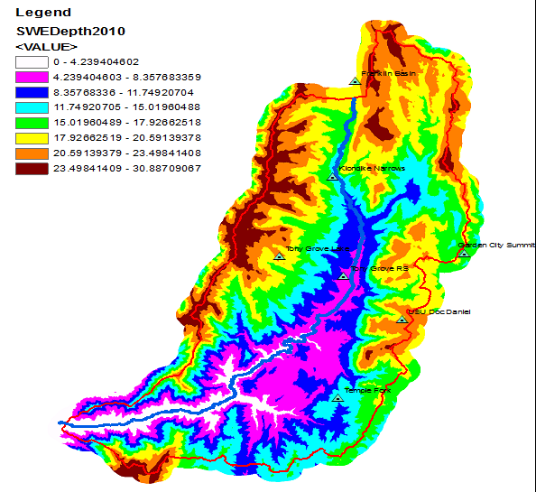
Solution Approach:
Raster Calculation
  y = 0.0218x - 35.349 for raster calculation, set x = dem (digital elevation model)
  Remove negative values
  Produces SWE vs Elevation model (see figure).
  Find SWE volume in basin (ft^3)

Slide 13
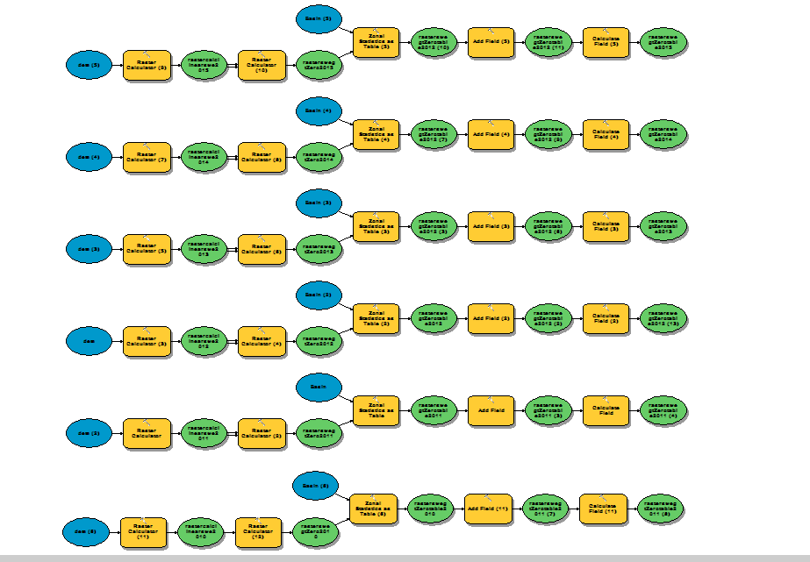
Solution Approach: Model Builder

Slide 14
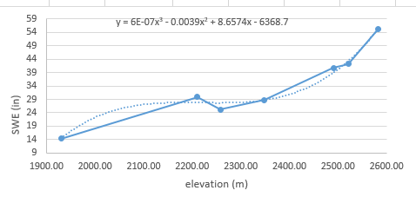
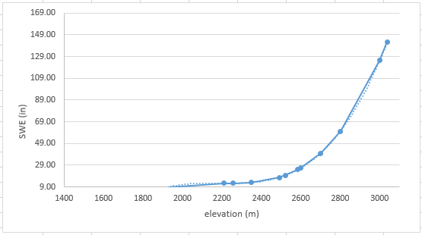
Alternative Approach: Polynomial
Also tried using polynomial instead of linear relationship for regression analysis.
3rd degree worked best. Seemed to fit better.
Inherent problems when using polynomial.
Rises exponentially.

Slide 15
Solution Approach:
Polynomial approach
Produces non-feasible results.
Within range okay (blue, green)
but beyond is not
    (ex. 142 inches SWE depth).

Slide 16
Spring Runoff : SWE Volume vs Flow
SWE vs Elevation model is built. Find a use for it.
Q1: “How does the maximum snow accumulation model relate to the quantity of spring runoff?”
Goal. Compare volume of SWE to yearly peak values of river flow.
  Model A) use April 1st SWE values ( date selected for estimated spring runoff period)
  Model B) use yearly peak SWE values.
Reasoning: snow does not just accumulate then melt. You get periods of melt mixed in with accumulation.

Slide 17

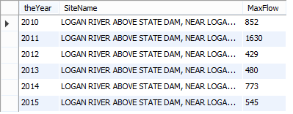
Spring Runoff : River Flow
River Flow Site: United States Geological Survey (USGS) services for the Logan River Above State Dam, site ID 10109000, location.
Peak river flow are synonymous with flooding events.

Slide 18
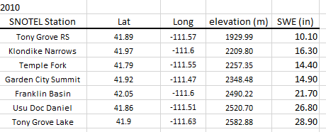
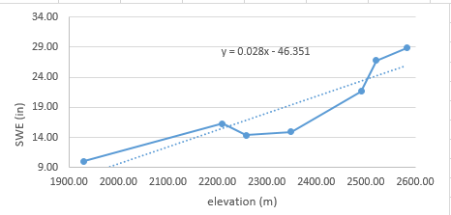
Spring Runoff :
Peak SWE Volume vs Flow

Slide 19
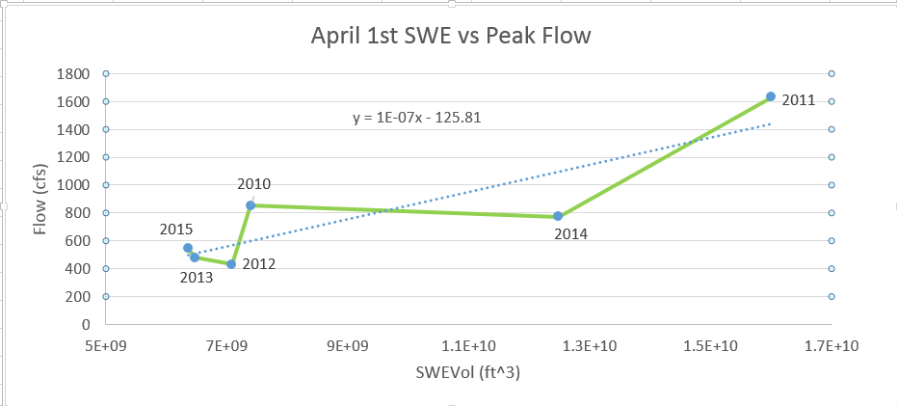
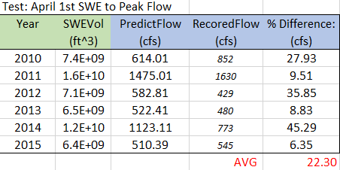
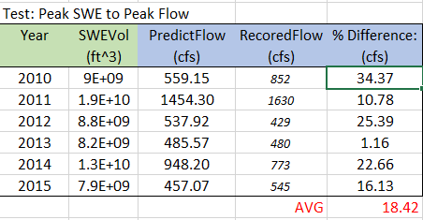
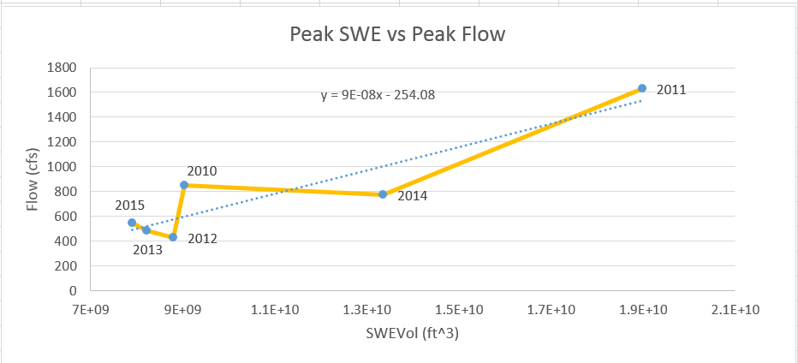
Spring Runoff : Comparison
Using Peak SWE values did a better job of predicting stream flow peak

Slide 20
Finishing Remarks
Spline interpolation doesn’t always work.
Build model that compares SWE to elevation.
Found peak SWE values predict peak stream flow better.

Slide 21
Acknowledgments
Professor David Tarboton. Utah State University.
Professor David Madiment. University of Texas.
References
SNOTEL. NRCS. Retrieved 01 Nov 2015. http://www.nrcs.usda.gov/wps/portal/nrcs/site/national/home/.
CUAHSI. HydroShare Software. Retrieved 30 Nov 2015. https://www.hydroshare.org/
MySQL. MySQL Software. Retrieved 30 Nov 2015. https://www.mysql.com/
Esri. ArcGIS Software. Retrieved 30 Nov 2015. https://www.arcgis.com/features/

