Slide 1
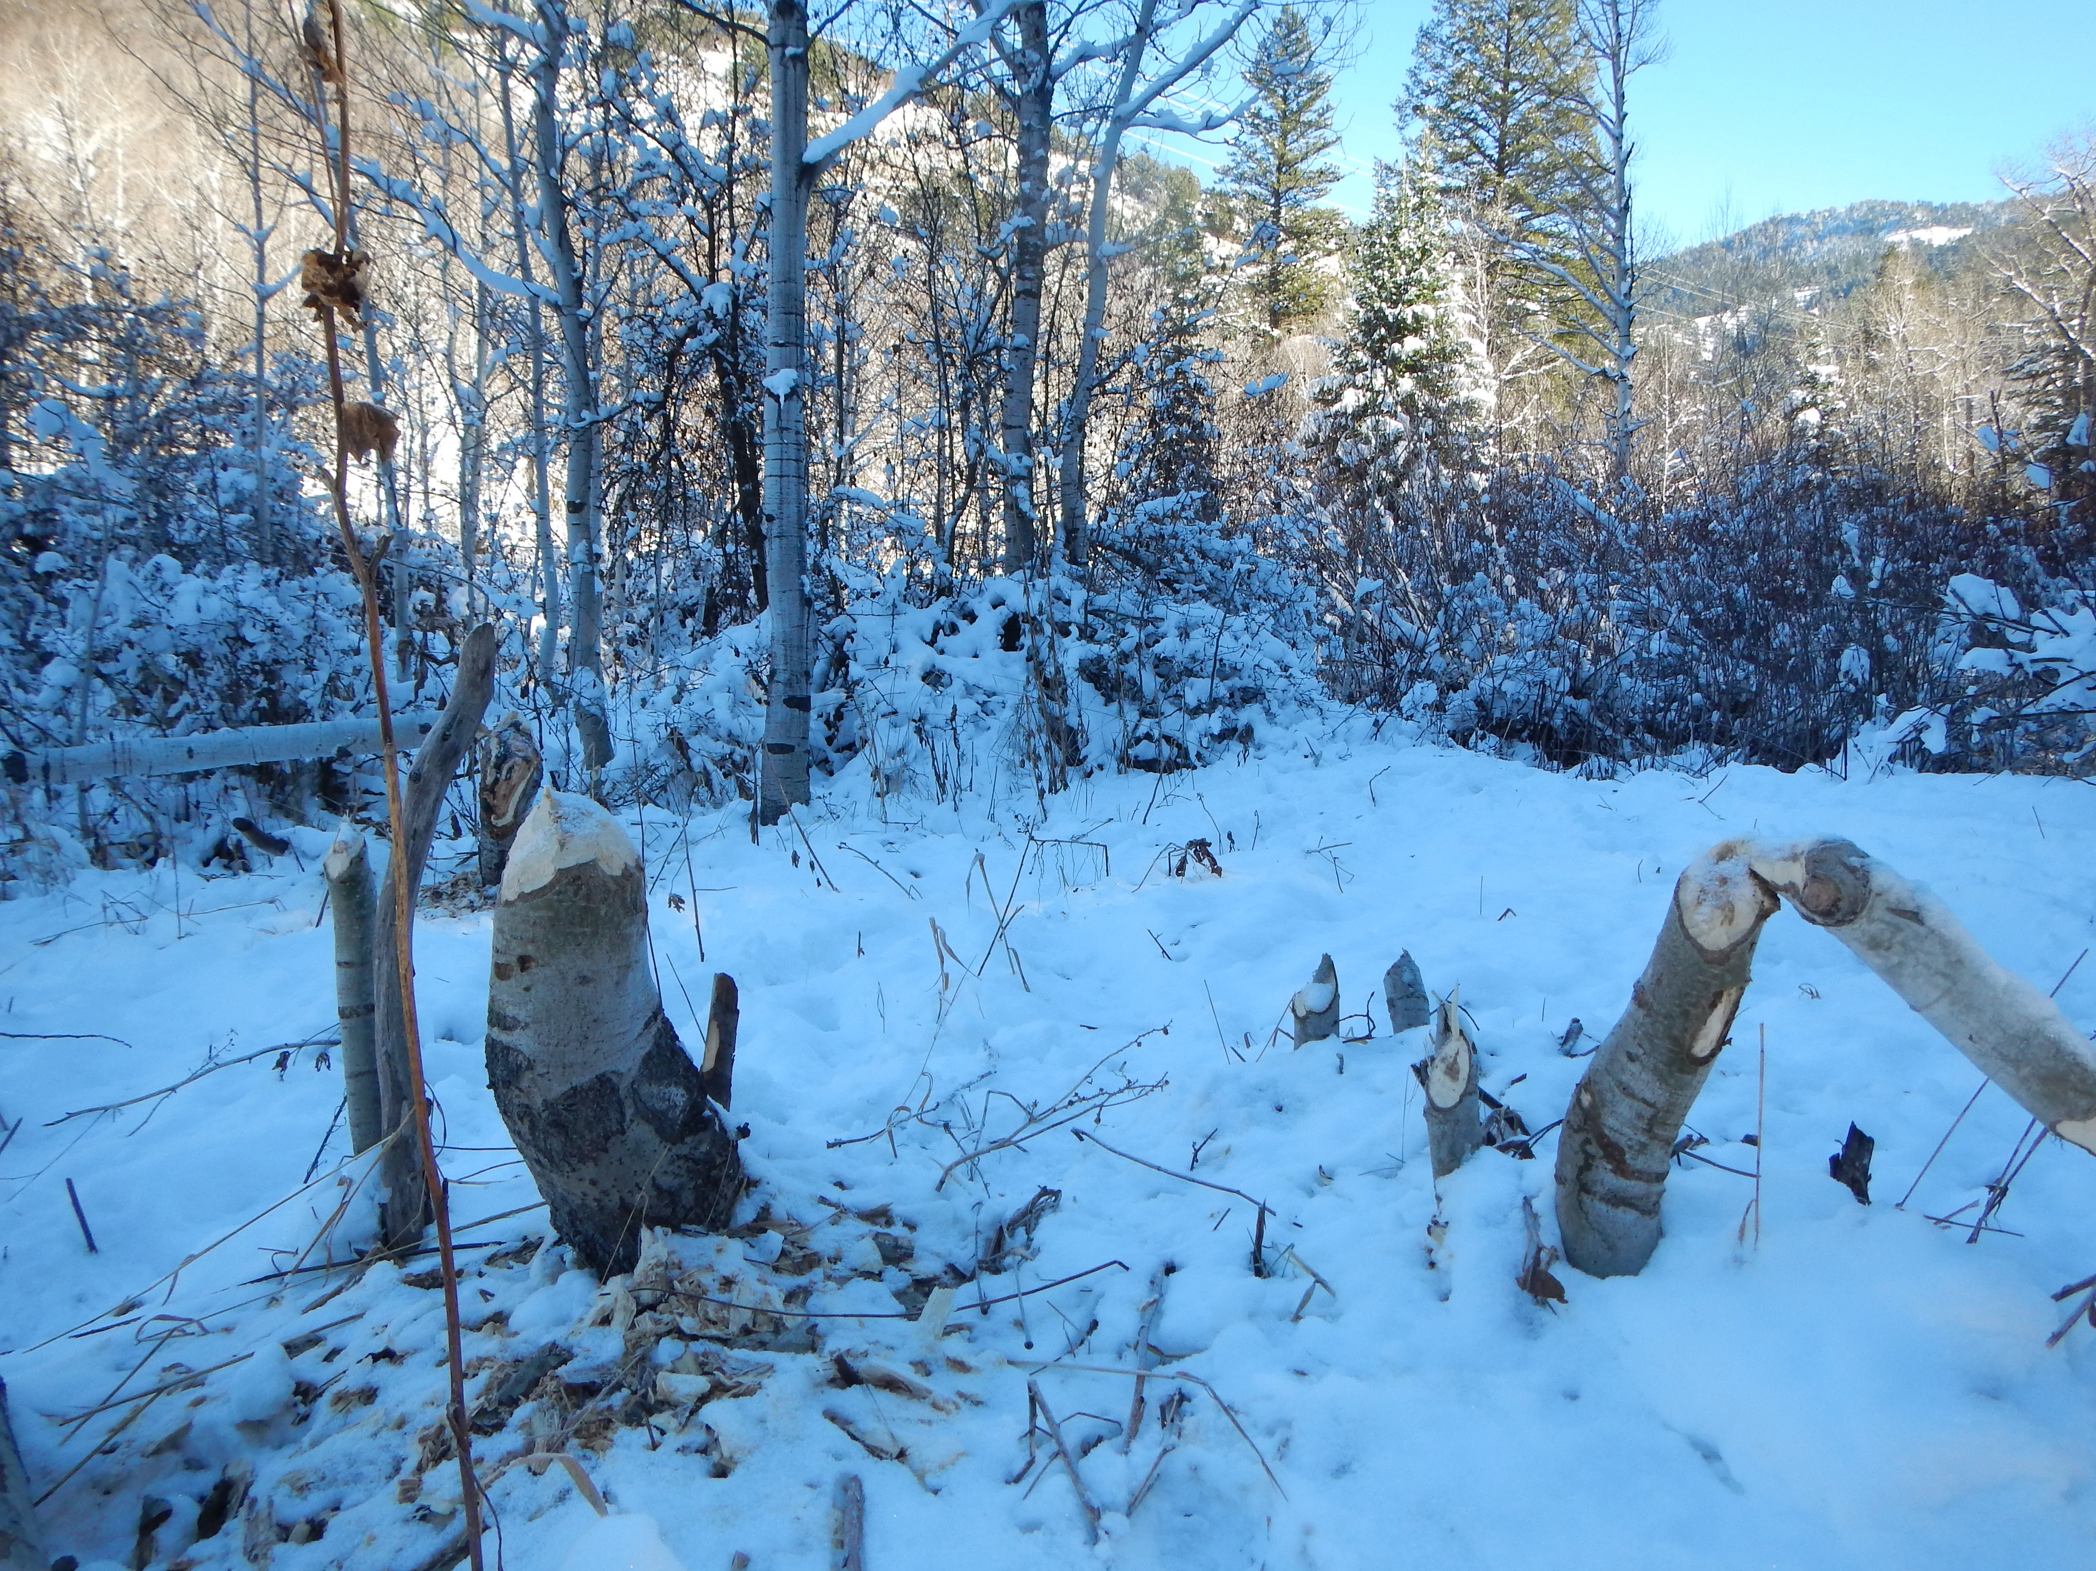
Modeling Beaver Pond Surface Storage in the Temple Fork Watershed
Konrad Hafen

Slide 2
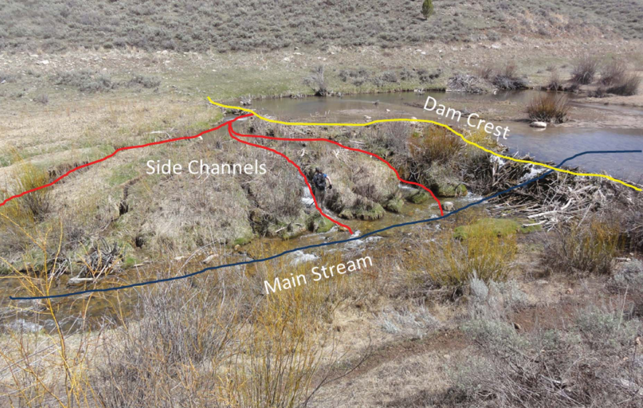
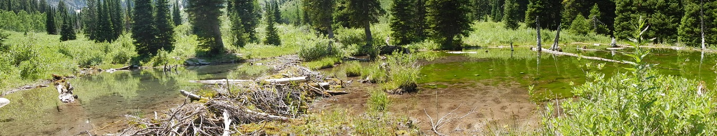
Effects of Beaver Dams on Hydrology
Beaver build dams mainly to evade predators, survive cold, and store food
Raise surface and groundwater elevation
Increase hydraulic head
Create overbank flooding
Increase evapotranspiration
Lack of a predictive dam capacity model has prevented modeling of dam scenarios

Slide 3
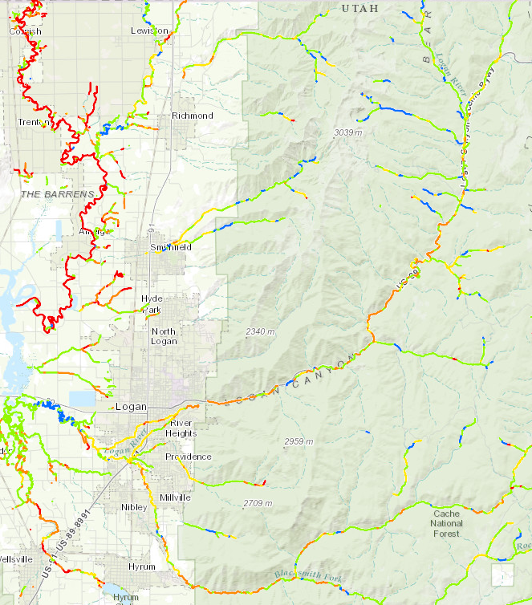
BRAT – Beaver Restoration Assessment Tool
Beaver dam capacity model
Based mainly on stream power and vegetation
Estimates the density of dams a stream segment can support
Outputs available for the entire state of Utah
brat.joewheaton.org

Slide 4
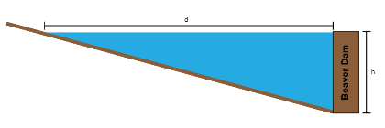
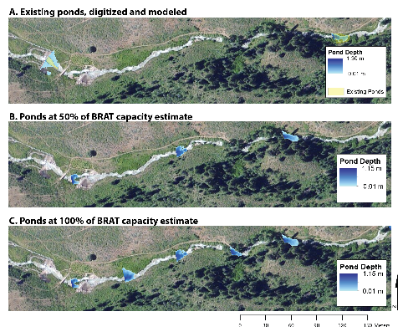
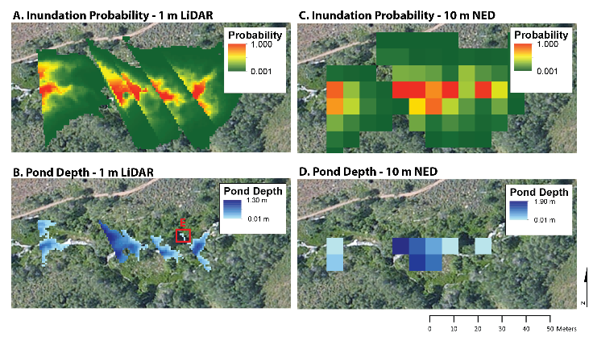
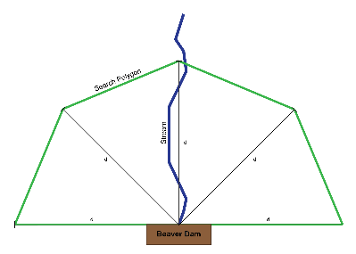
Objectives
Develop a model describing the surface storage of a beaver dam
Quantify changes in water storage and residence time under different dam density scenarios at the watershed scale
Identify the effects of data resolution on model results
1.
2.
3.

Slide 5
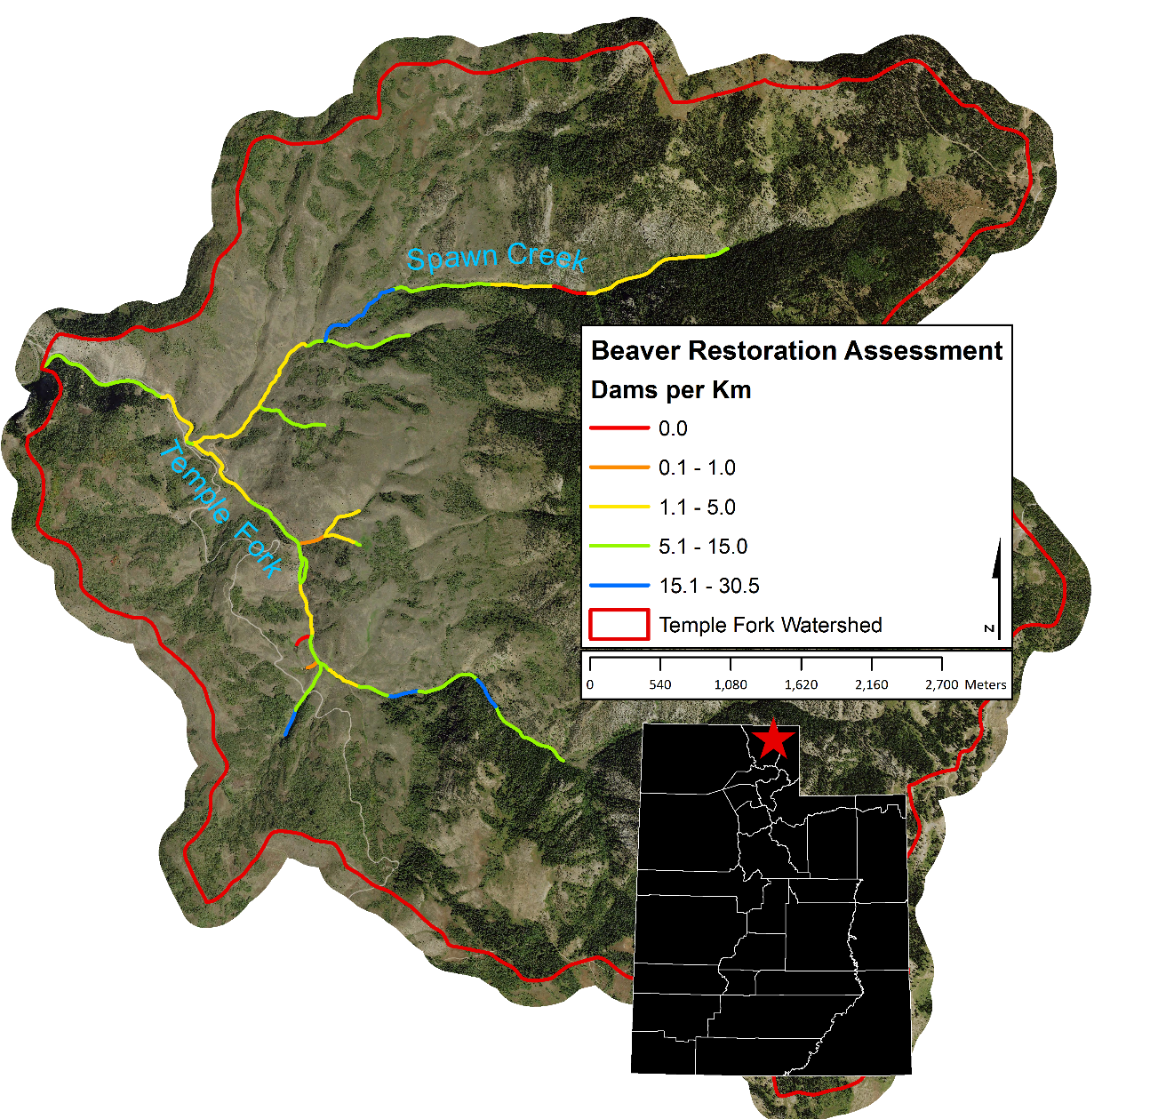
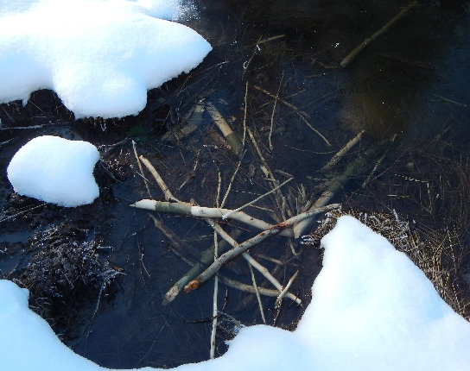
Temple Fork Beaver Dam Restoration Assessment
Drains 41 km²
Two main tributaries; Temple Fork, Spawn Creek
1 m LiDAR available
Focus of previous studies (mainly fish)
Considerable beaver activity

Slide 6

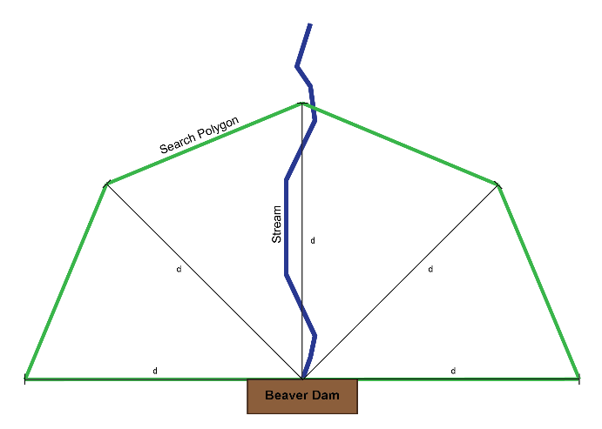
Model Logic and Data
Distance of upstream inundation determined by dam height divided by stream slope
Create a polygon representing the maximum area of inundation for a given dam height on a given reach
1/3 Arc Second DEM from the National Elevation Dataset (~8.92 m)
1 m LiDAR DEM for Temple Fork (available: www.opentopography.org)
Existing pond area digitized from Google Earth imagery

Slide 7
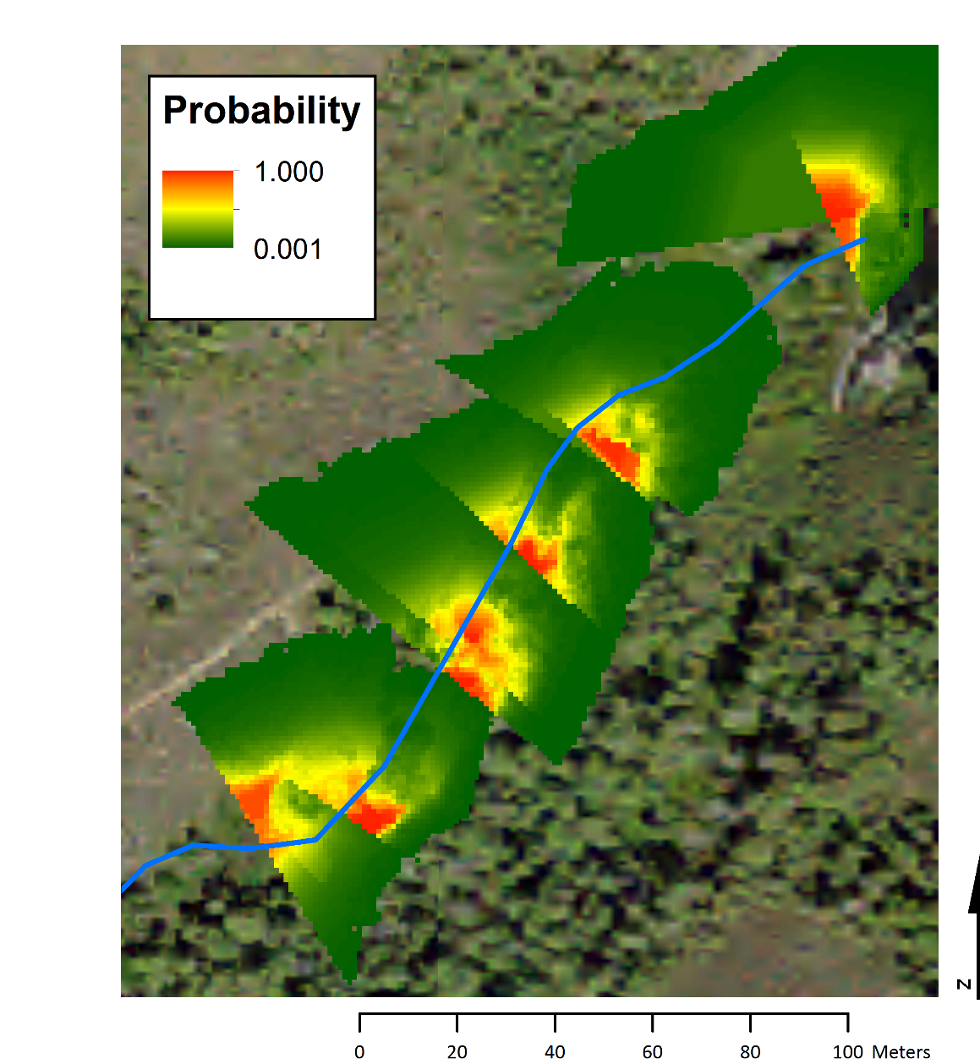
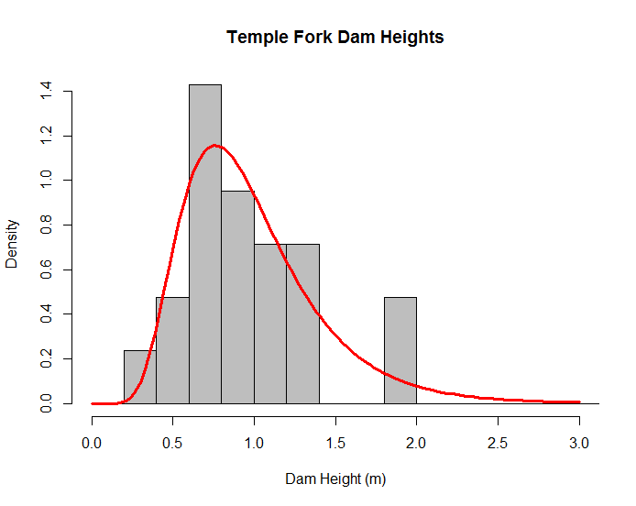
Modeling Dam Height
Stochasticity in dam height
1000 iterations according to dam height distribution
Create raster representing probability of inundation
From Lokteff et al. 2013

Slide 8
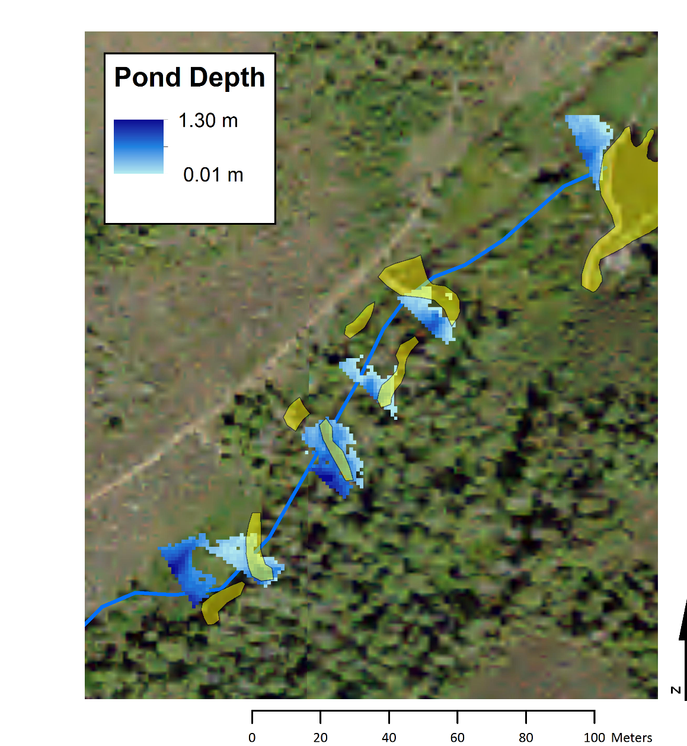
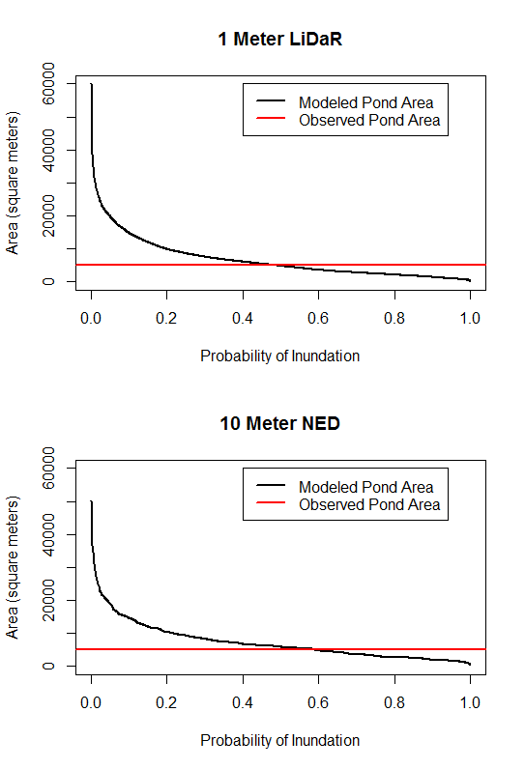
Modeling Pond Area and Depth
Identified inundation probability corresponding to observed inundation area
Fill all cells with a probability greater than or equal to the determined probability of inundation
Water surface elevation of the pond determined by highest inundated elevation + 0.01m

Slide 9
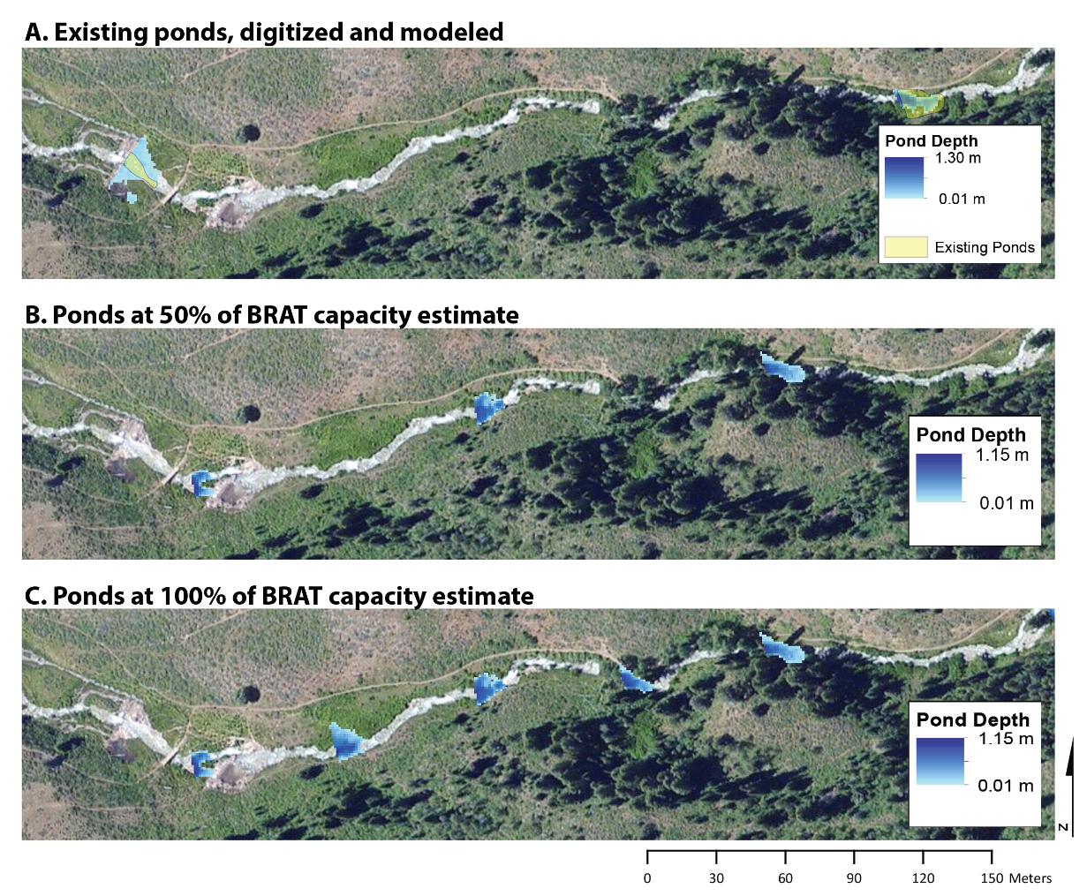
Dam Density Scenarios
Residence time calculated for mean (0.47 m³/s), peak (1.06 m³/s), and low (0.31 m³/s).
Discharge obtained from USGS stream stats
Residence time, volume increase with more beaver ponds
Differences between 1 m and 10 m DEMs
Dam Capacity | Ponds | Area (m²) | Mean Pond Area (m²) | Volume (m³) | RT Mean (hours) | RT Peak (hours) | RT Low (hours)
Digitized Existing (2014)* | 35 | 5194.9 | 144.3 | - | - | - | -
Existing (1m) | 43 | 5198.0 | 120.9 | 2410.2 | 1.42 | 0.63 | 2.16
Existing (10m) | 35 | 5193.7 | 198.9 | 2258.1 | 1.33 | 0.59 | 2.02
BRAT 50% (1m) | 50 | 5374.0 | 103.3 | 2326.8 | 1.38 | 0.61 | 2.08
BRAT 50% (10m) | 37 | 7830.5 | 206.8 | 2470.5 | 1.46 | 0.65 | 2.21
BRAT 100% (1m) | 86 | 14288.0 | 106.6 | 6153.1 | 3.64 | 1.61 | 5.51
BRAT 100% (10m) | 134 | 17658.7 | 204.5 | 4714.1 | 2.79 | 1.24 | 4.22

Slide 10
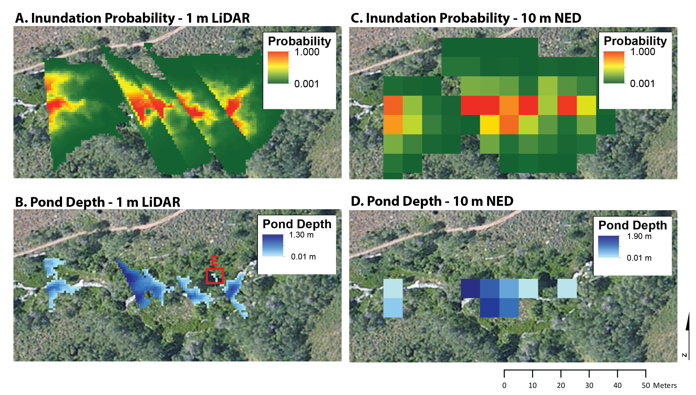
Effects of Data Resolution

Slide 11
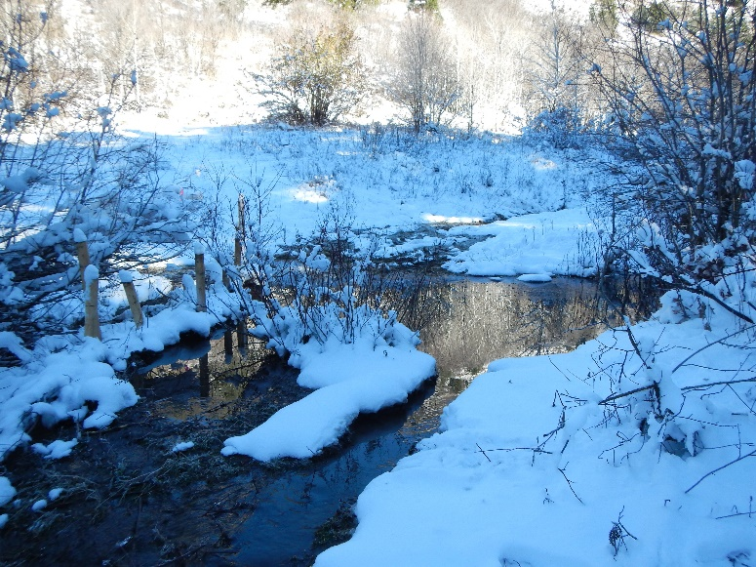
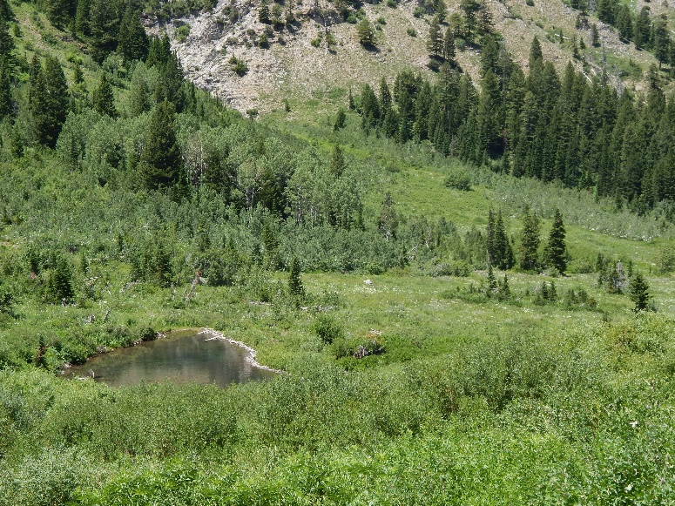
Conclusions
Successfully modeled the surface storage of beaver ponds in the Temple Fork Watershed
More dam heights needed to implement at larger spatial scale
Should determine/validate probability thresholds across multiple watersheds
Effect of ponds on residence time is dependent on discharge at pond location
Surface storage may be negligible when compared with pond effects on groundwater.

Slide 12
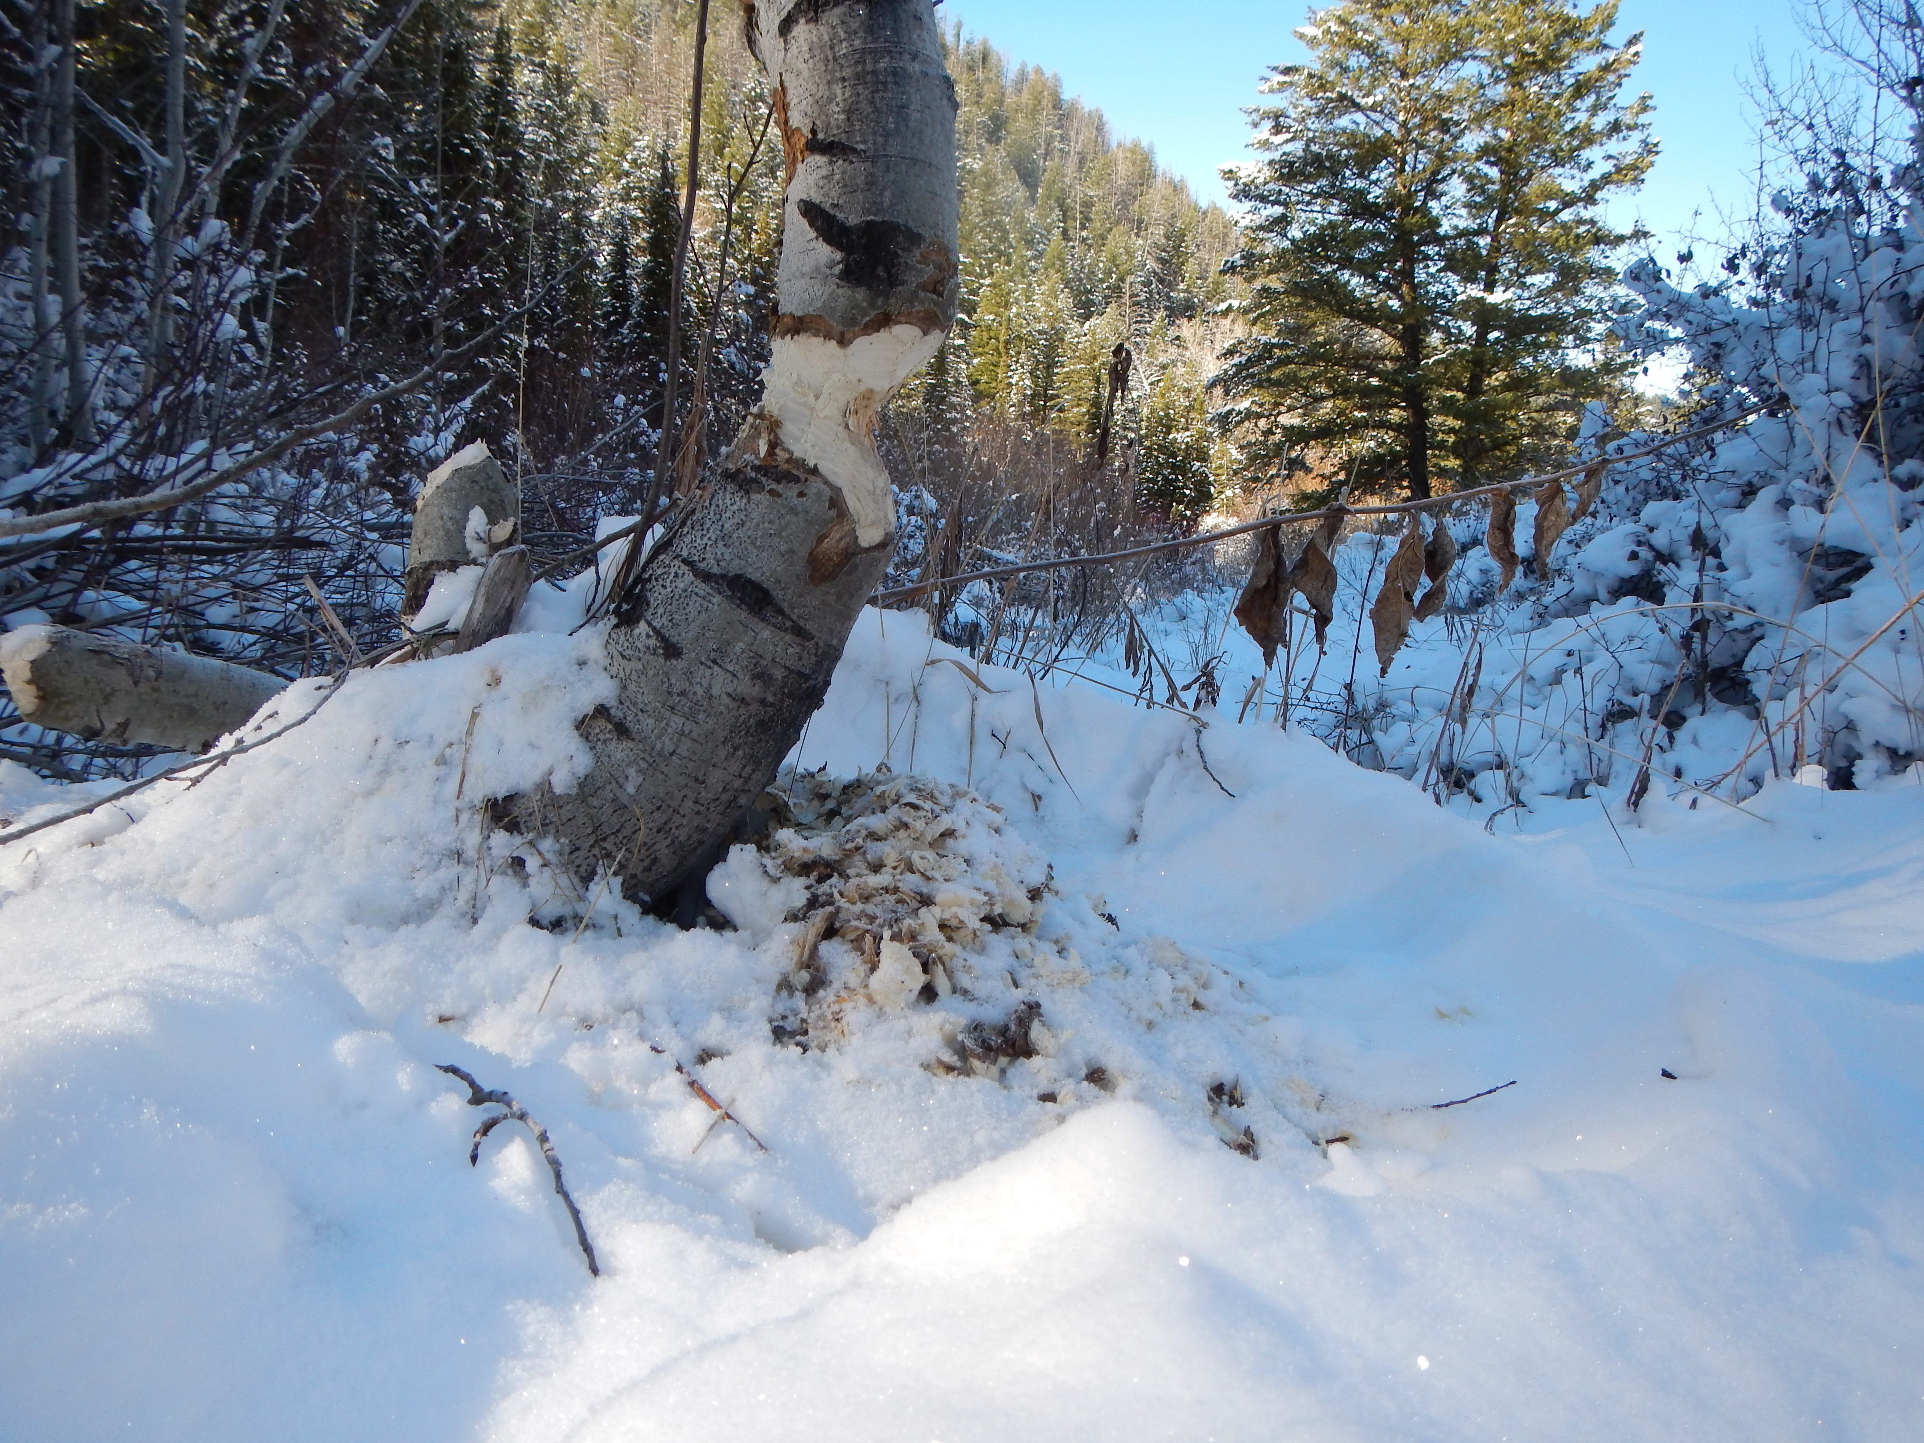


Thank You!
Questions?
. . .

