Slide 1

Analysis of Water Resources of Metropolitan Water District of Salt Lake and Sandy
Presented By: Dan Ethington E.I.T.

Slide 2


Introduction
Established in 1935
Serves a population of over 300,000
Salt Lake Aqueduct completed 1951 to supplement water from LCC
  42 mile pipeline From Deer Creek to Salt Lake City

Slide 3
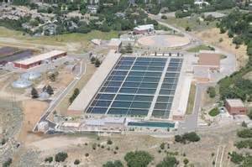
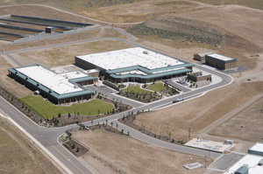
Introduction
Little Cottonwood Water Treatment Plant
Point of the Mountain Water Treatment Plant
Design Capacity: 150 MGD
Design Capacity: 70 MGD

Slide 4
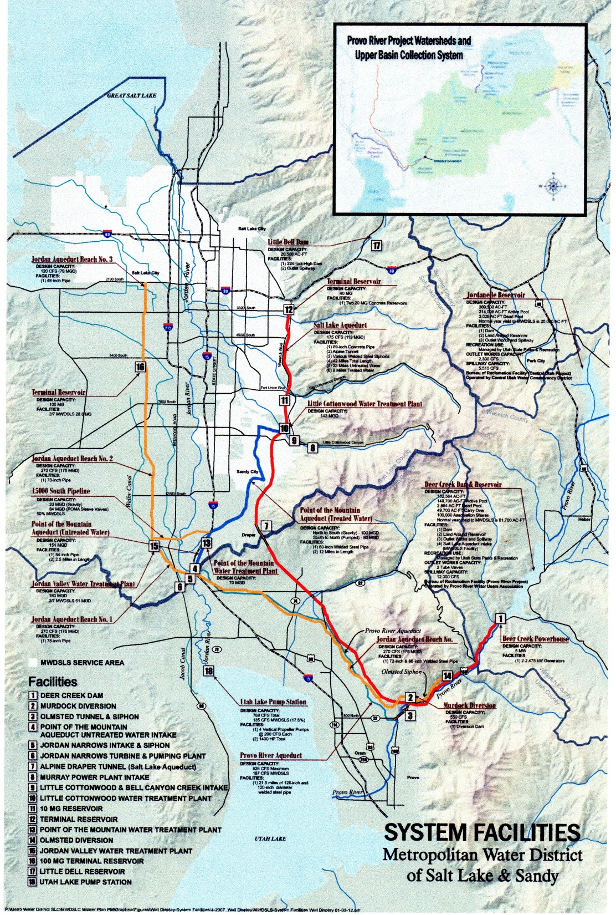

Slide 5
Project Objectives
Determination of Districts water resources
Analysis of water/watersheds
Determination of water demands
Determination of water resource adequacy

Slide 6
District Water Sources
Little Cottonwood Creek
Deer Creek Reservoir
  Jordanelle Reservoir
Little Dell Reservoir

Slide 7
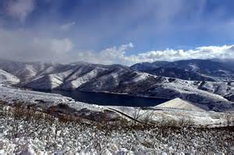

Slide 8
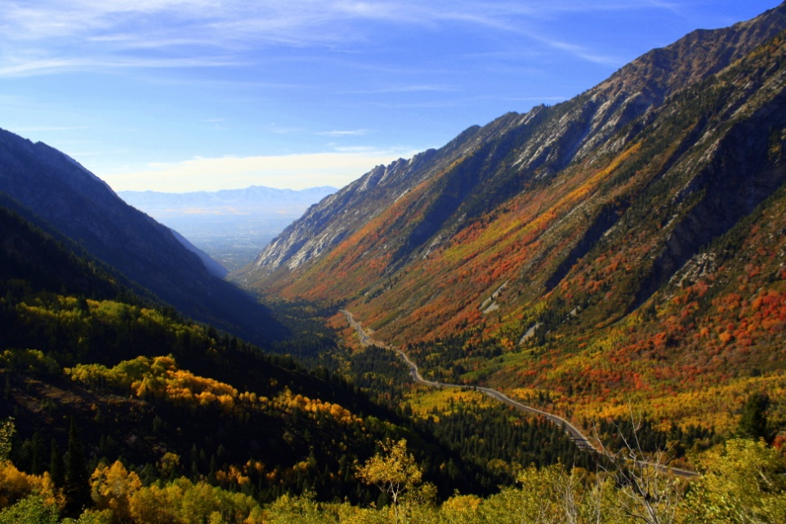



Slide 9
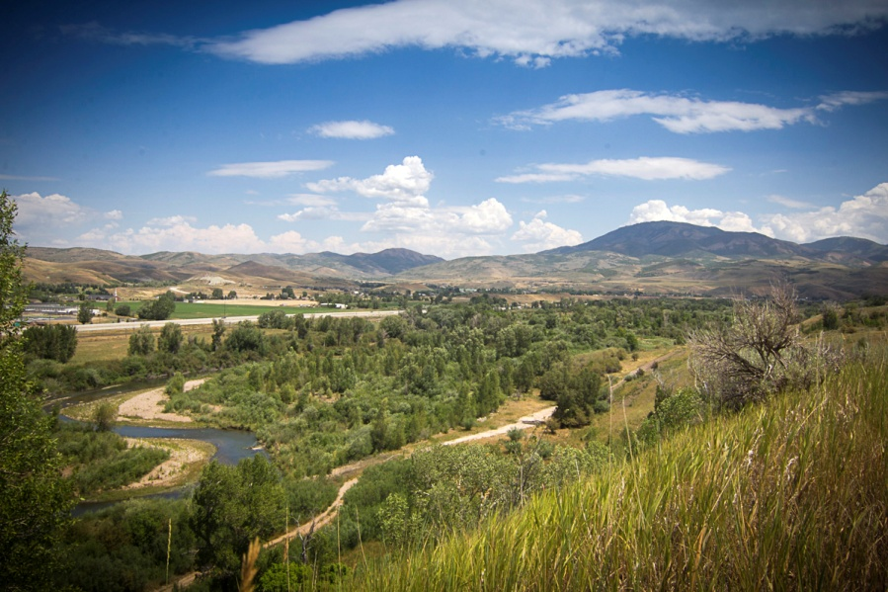

Slide 10
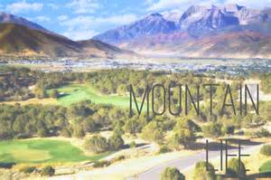
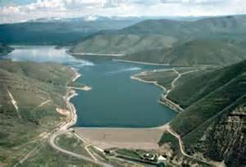

Slide 11
District Water/Watershed Analysis
Little Cottonwood Creek Watershed
  Landcover and Imperviousness Unchanged 2006 to 2011
  No water impairments
Little Dell Reservoir Watershed
  Landcover and Imperviousness Unchanged 2006 to 2011
  No water impairments

Slide 12
District Water/Watershed Analysis
Deer Creek Watershed
41 Stream reaches have impaired water dating back to at least 1992
Impairments Include:
Mercury, High Ph, E. Coli/ Pathogens, Temperature
Note the location of these impaired waters
Total Land Cover Change = 0.63%
Occurred from 2006 to 2011
22 mi^2 of agricultural land
18 mi^2 of developed space

Slide 13
Demand Forecasting
Utilization of State of Utah Governors Population forecast
Determine trend to forecast even farther
  Linear Regression
City | 2010 | 2020 | 2030 | 2040 | 2050 | 2060
SLC | 186,440 | 210,592 | 227,824 | 229,985 | 233,031 | 234,704
% growth | - | 12.954 | 8.183 | 0.948 | 1.324 | 0.718
Sandy | 87,461 | 97,826 | 102,107 | 104,993 | 106,471 | 105,929
% growth | - | 11.851 | 4.377 | 2.826 | 1.407 | -0.509
Total Pop. | 273,901 | 308,417 | 329,932 | 334,978 | 339,502 | 340,633
% growth |  | 12.602 | 6.976 | 1.530 | 1.350 | 0.333
Demand (ac-ft) | 61945 | 69751 | 74617 | 75758 | 76781 | 77037
 | Sandy City | Salt Lake City | Total
Avg. Demand per year (ac-ft) | 16432 | 45513 | 61945
Demand (ac-ft) /pers./yr | total demand/ total pop. | 0.226

Slide 14
Demand Analysis
 | Jordanelle Reservoir | Deer Creek Reservoir | Little Cottonwood Creek | Little Dell Reservoir | Total
Capacity (ac-ft) | 360500 | 152564 | - | 20500 | 533564
MWDSLS Supply per year (ac-ft) | 20000 | 41416 | 20318 | 4830 | 86564
With > 1% growth every 10 yrs current water supply will be inadequate in 2170

Slide 15
Questions

