Slide 1
Preparing input for the TOPKAPI (TOPographic Kinematic Approximation and Integration) model
Prasanna Dahal

Slide 2
Introduction to TOPKAPI
TOPKAPI is physically-based fully-distributed rainfall-runoff model, used mainly in Europe
Beside subsurface, overland and channel flow, it includes components representing infiltration, percolation, evapo-transpiration and snowmelt.
It can be applied at increasing spatial scales without losing model and parameter physical interpretation
Allows to study the evolution of all the hydrological state variables of the catchment, such as rainfall, temperature, evapotranspiration, soil moisture conditions, snow accumulation and runoff generation.
pyTOPKAPI is the open source version of TOPKAPI

Slide 3
Parameters used in the model
Slope of overland
Slope of channel
Soil Depth
Saturated hydraulic conductivity
Residual soil moisture content
Initial Saturation of soil reservoir
Water content overland
Saturated soil moisture content
Manning’s coefficient for overland
Manning’s coefficient for channel
Bubbling pressure
Pore size distribution

Slide 4
Challenges in use of TOPKAPI in the US
TOPKAPI Recommended approach
TOPKAPI has modules to prepare those data, but require rasters not common to the US these days, viz.
GLCC land cover
Soil type as classified by SIRI,
Soil texture as defined by Midgley et al (1994)
In the US, we have better data (finer resolution and measured values instead of derived ones) available
Hence, GIS services and SSURGO data was used to derive the same final watershed parameters required by the model
* This project is an attempt to meet the challenge

Slide 5
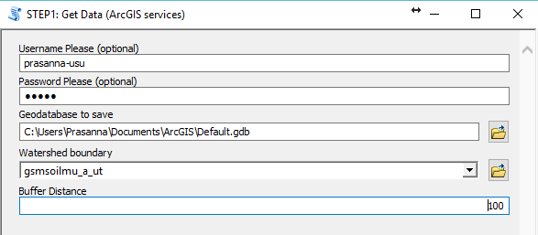
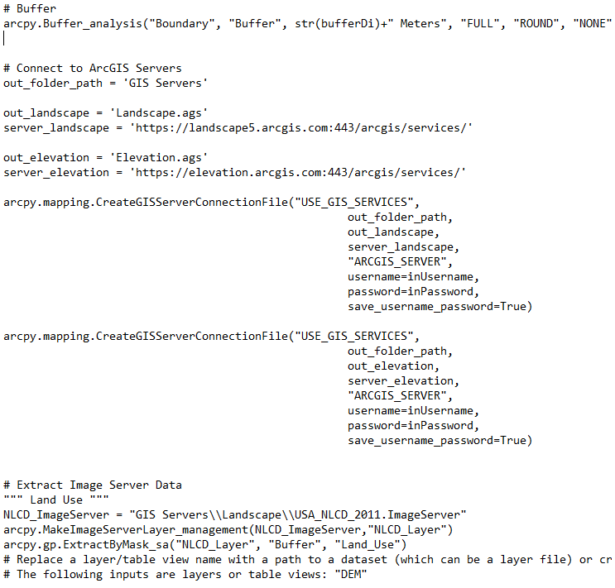
Step 1:GIS services
A slice of the code
A ArcGIS tool to download data
Use of ArcGIS services to get:
National Land Cover Dataset (NLCD) map
NHDplus streams (not required)
Soils HSG, USDA (not required)
*Used part of the same code written by Cynthia V. Castro, student of Dr. Maidment.

Slide 6
Step2: DEM processing
WorkFlow in the DEM processing code
Project the files to Projected coordinates (UTM)
Following ArcGIS tools were used to obtain three input rasters: a)Flow direction, b)Strahler order, and c)Stream
Fill
Flow direction
Flow Accumulation
Raster Calculation
Extract by mask
StreamLink
StreamToFeature
StreamOrder

Slide 7
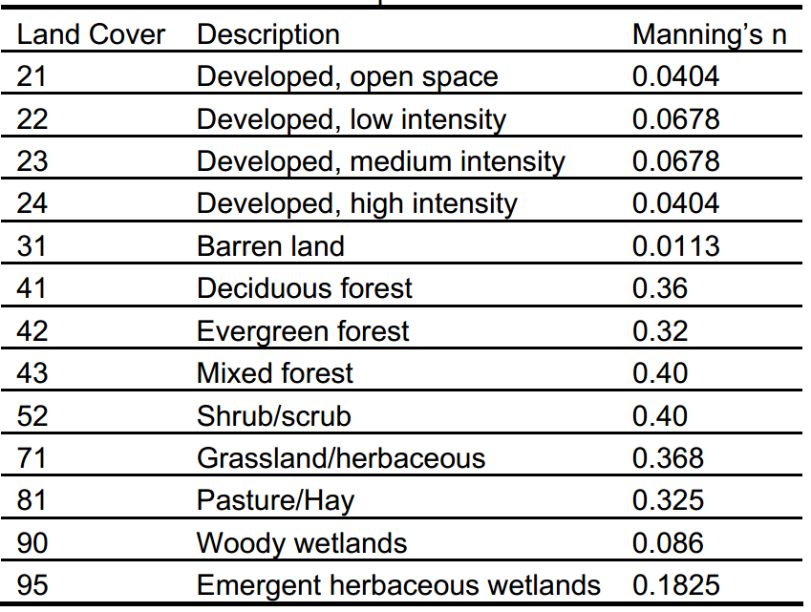
Step2: continued...
Loop-up tables
Reclassifying
Reclassify tool was used to reclassify:
NLCD raster to Manning’s coefficient
Strahler order to Manning’s Coefficient
Reclassifying results in two more input rasters; Overland and channel manning’s coefficient

Slide 8
Step3: Use of SSURGO to obtain data
Rest of the data obtained using SSURGO
First; SSURGO data was downloaded for study region from web (https://gdg.sc.egov.usda .gov/)
SSURGO divides our region into multiple polygon called map-units
Python code was used to extract the required data for each map units

Slide 9
SSURGO database (a relational database)
Tables below were joint into one using keys from the same colored fields
Values were averaged out; one for one Mukey (i.e. corresponding to one map unit)

Slide 10
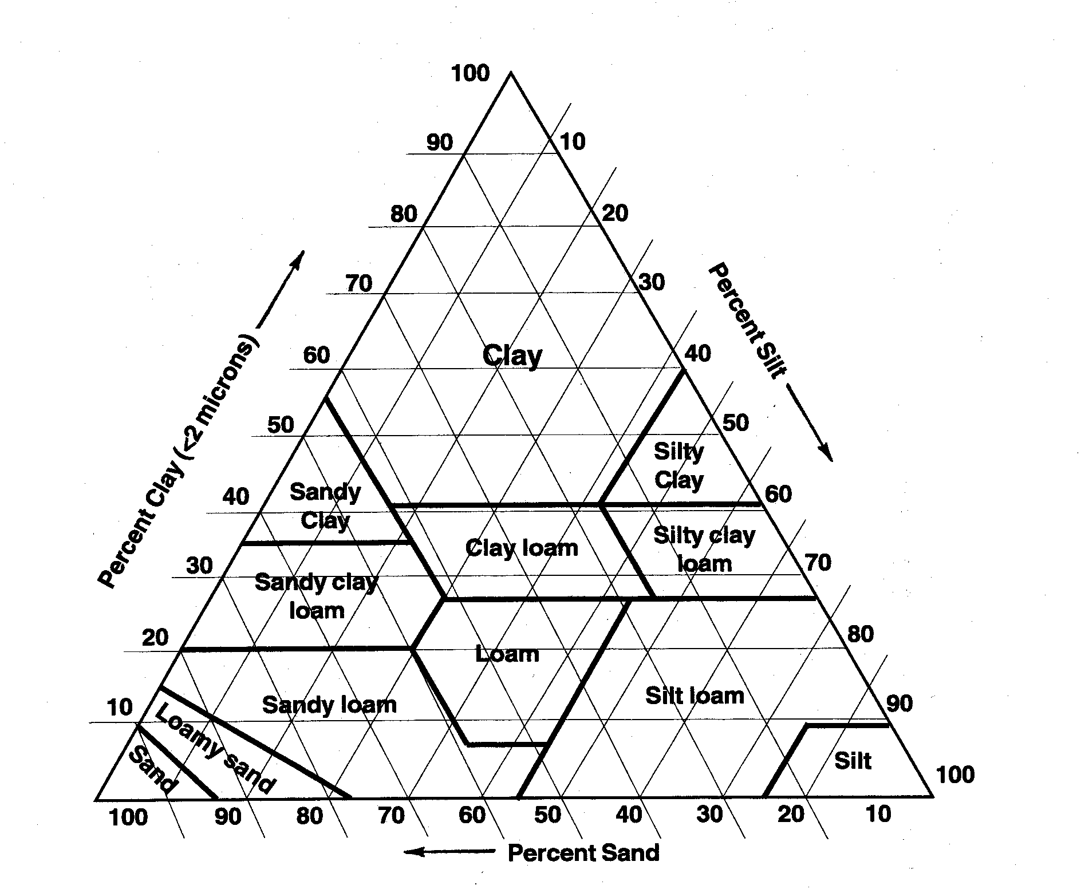
Step3: Use of SSURGO to obtain data (continued…)
Methodology of extracting the data
Any soil type is composed of different percentage of Sand, Silt and Clay.
Texture name of each soil layer can be found in Chorizon table in SSURGO.
The look up table by Rawls et al (1982), was joined with Chorizon table from SSRUGO
Weighted average was taken to compute the value for each Map Unit.
*Python module “pandas” was used to carry out tasks.

Slide 11
Step4: Values for each map unit to Rasters
Example of Raster files created
The table obtained from the end of Step3 was joined to Polygon shapefile in Spatial folder from SSURGO
ArcGIS tool, Feature to Raster was used to convert the feature from SSURGO to the rasters.
Value of the rasters are taken from fields from the joint table, which are Porosity, Saturated Hydraulic Conductivity, Bubbling pressure, Pore size distribution, and residual water content.
Saturated Hydraulic Conductivity
Saturated Soil Moisture Content

Slide 12
Limitation and Future works
Use of pandas module for part of the work has restricted running all of the scripts run from ArcGIS because ArcGIS python environment do not come with pandas.
There are missing data for soil type identified as ‘weather rock’ in the SSURGO database
SSURGO data will have to be downloaded manually

Slide 13
Thank You.
Questions?

