Slide 1




Chapel Hill
Food Shed Analysis: Imagining a relocalized food system
Raymond Stanton
Geog591 – Final Presentation
November 25th, 2015
Notes:
This project represents a joint effort on behalf of a working research group at UNC in collaboration with The Institute for the Environment, School of Library and Information sciences, who helped put together a working capstone.
The foundation of any civilization is the control and assurance of its basic needs: food, shelter, water. Chinese empires toppled and flourished with the changing waters of the yellow river. The Mesopotamian region could have only developed law and governance because they harnessed agriculture--with food security came society.
Our food must address this problem is because agriculture accounts for ~80% of all water consumption. It’s not our thirst that’s running us dry; it’s our appetite. The International Water Management Institute concludes that, “Unless we change the way we use water and increase water productivity…we will not have enough water to feed the world’s growing population.”

Slide 2
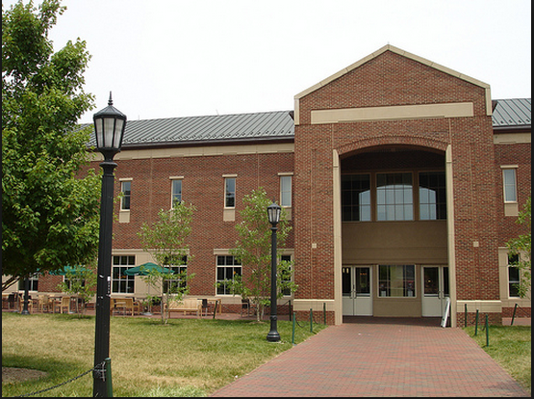



Motivation:
Ecoland Internship
ENEC568 Capstone
CDS Case Study
Notes:
Summer internship. Harnett county proximity to Fort Bragg, in Fayetteville.

Slide 3
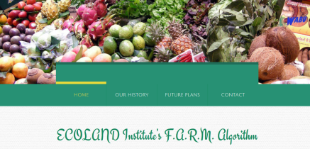
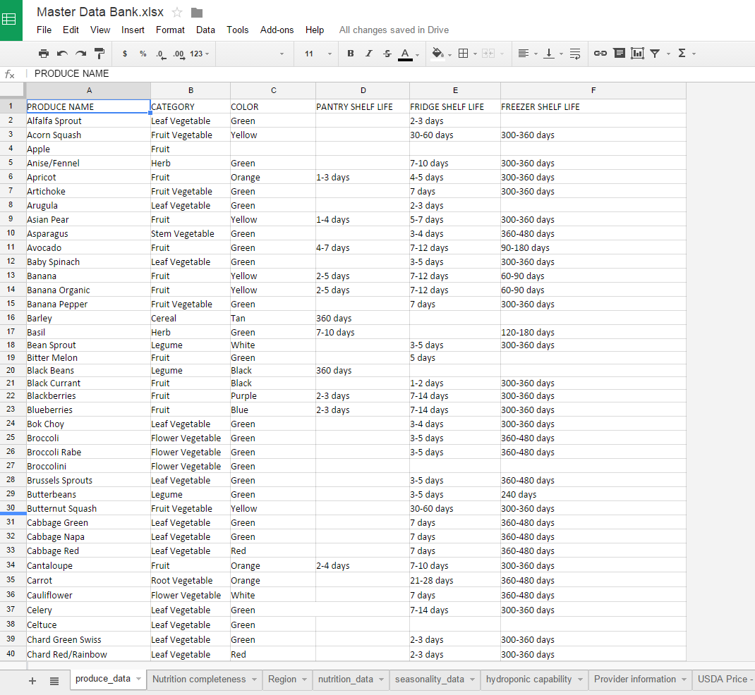
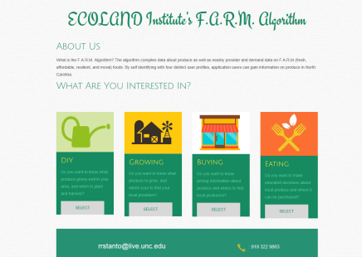
FARM Food Algorithm
Notes:
Produce data from category, seasonality, shelf life, USDA nat’l price, Farmers Market local price, Raleigh/regional Prices, Hydro potential, NC top crop, Nutritrional info (vitamins/minerals),
Decision making tool for food production/purchasing behavior. Locate most cost-effective produce to source locally. Locate most expensive produce items that must be imported. Can Hydro/Aquaponics fill this gap?

Slide 4
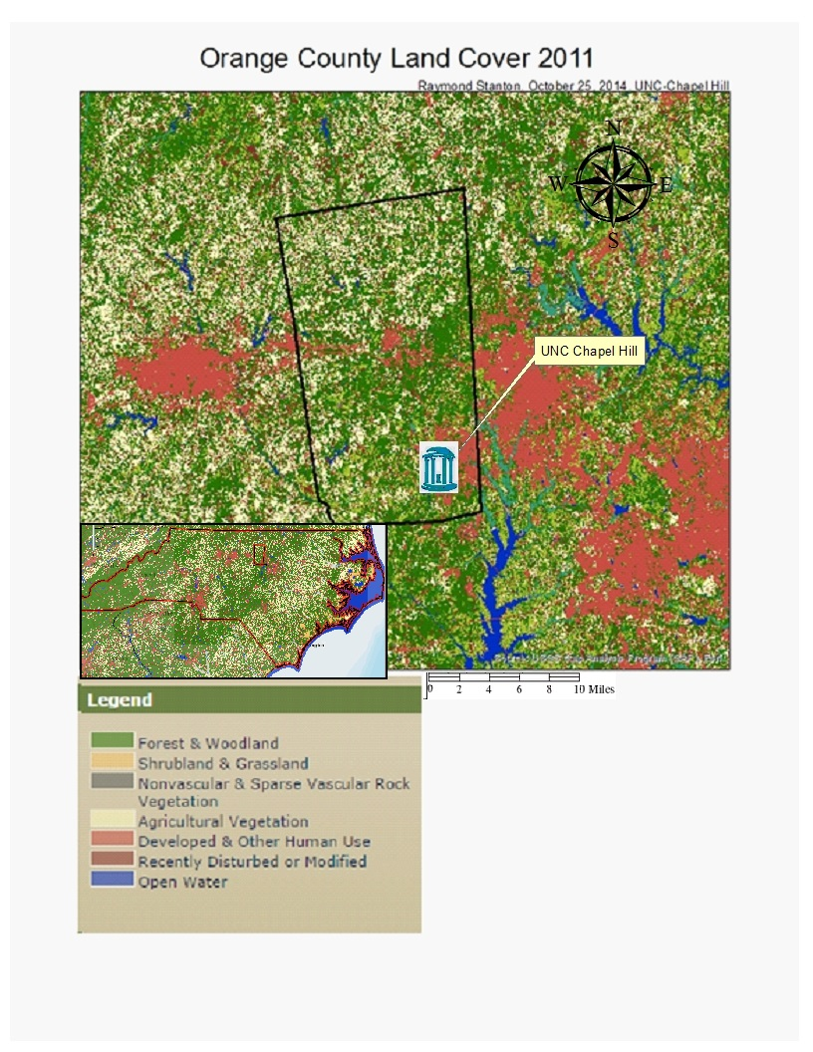
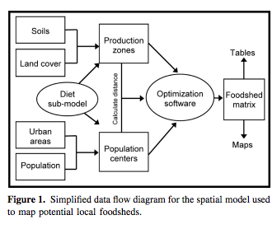
Carolina Dining Services & Food Shed Models
The Map
The Model
Notes:
~22% of OC landuse is agricultural; however only ~7% of that is edible commodities. The vast majority of our “agricultural land cover” is actually just pastureland.

Slide 5
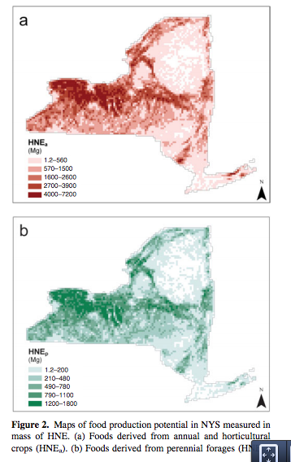
Expected Food Shed Result
Notes:
HNE or Human Nutritional Equivalent is the capacity of nutritional food that can be derived from soil types about population centers.

Slide 6
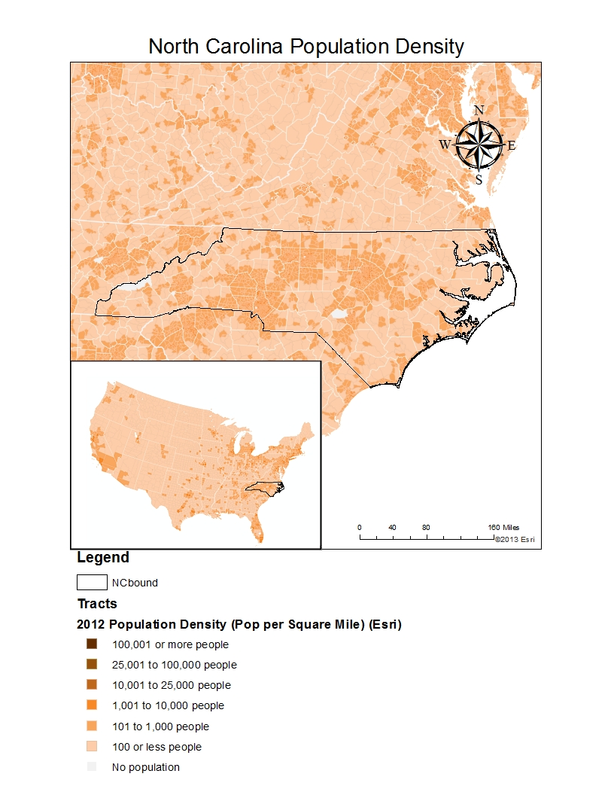
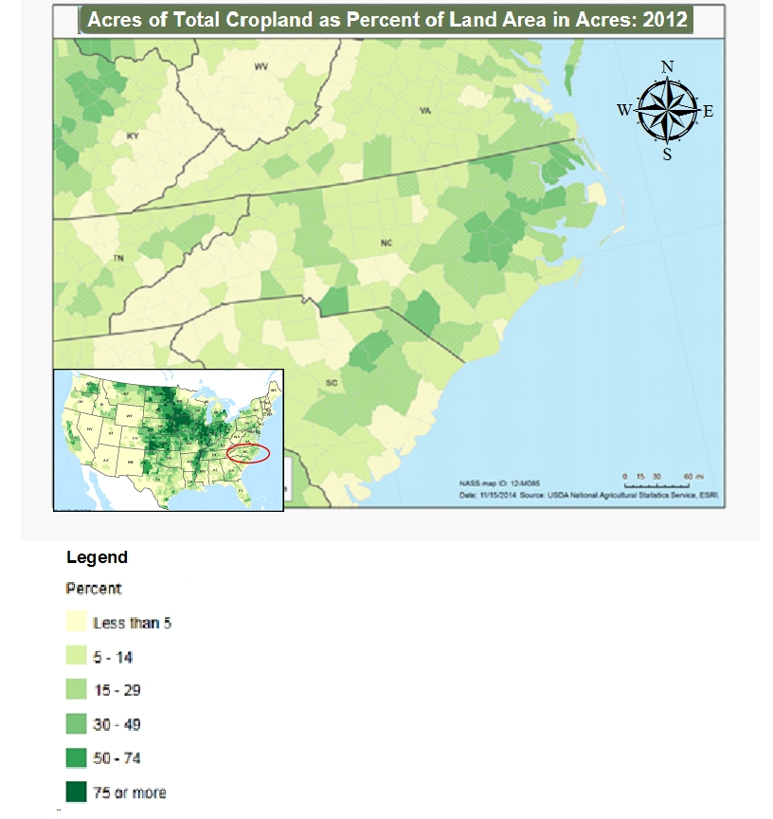
Consumption v. Production
Where the food is eaten.
Where the food is grown

Slide 7
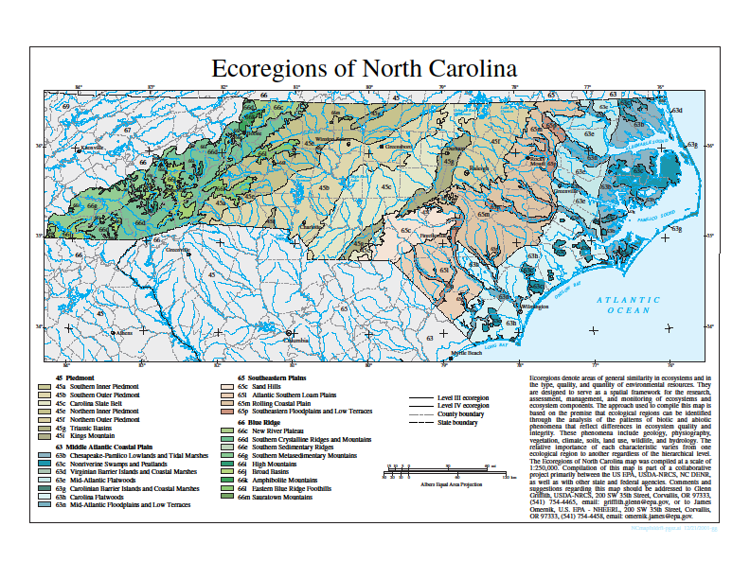
North Carolina Biomes
Notes:
Where and What does NC grow? Conversations with AG extension office and Farmers Marketers.

Slide 8
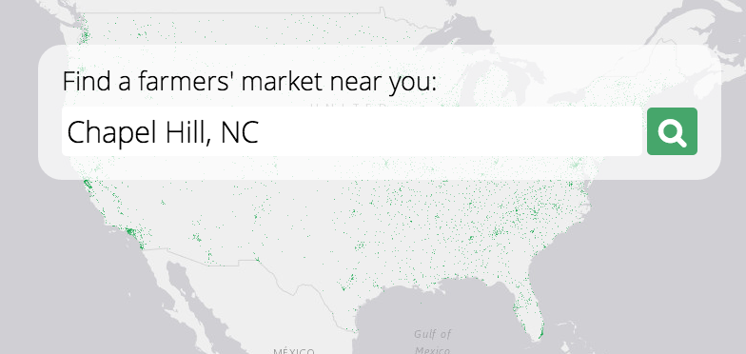
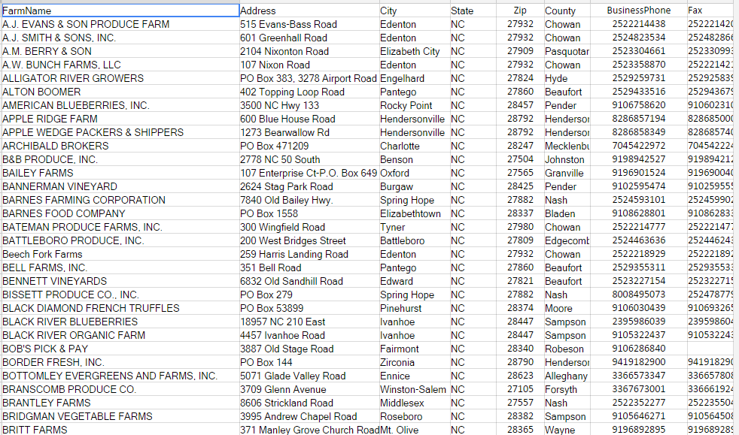
NC producer web-app
Display
Geocoded Address Bank

Slide 9
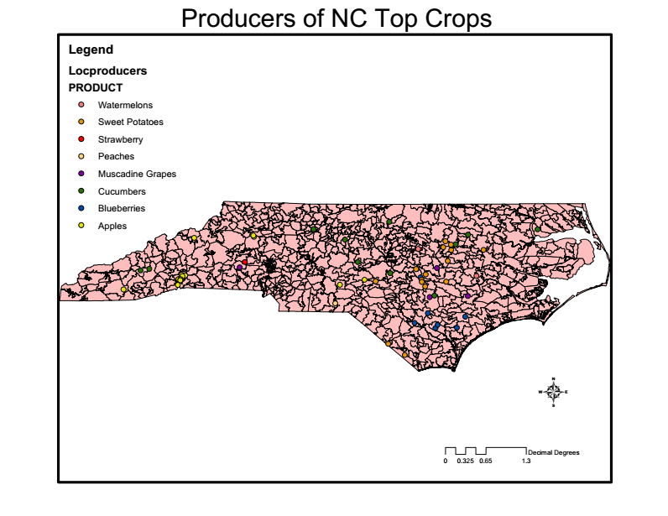
North Carolina Crop Production

Slide 10
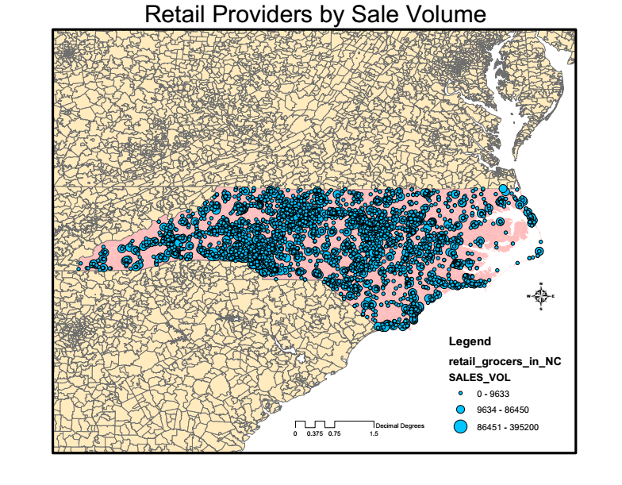
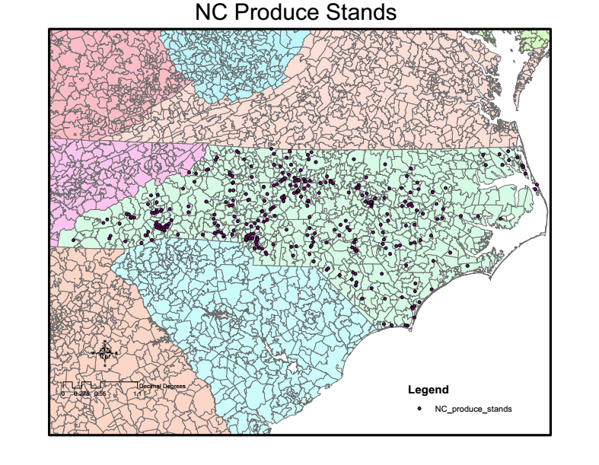
NC Market Forums

Slide 11
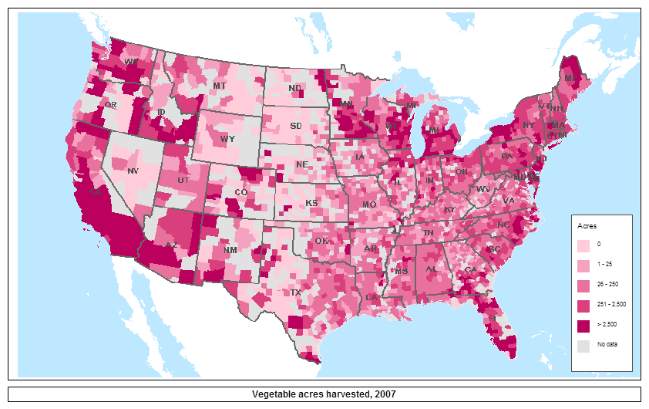
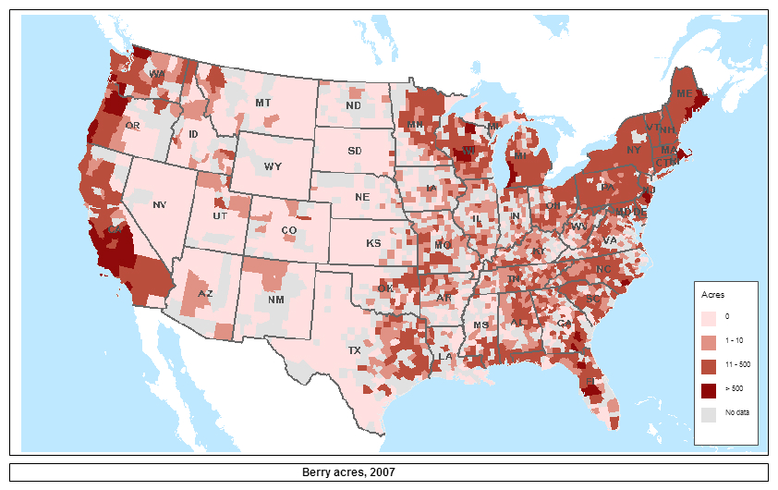
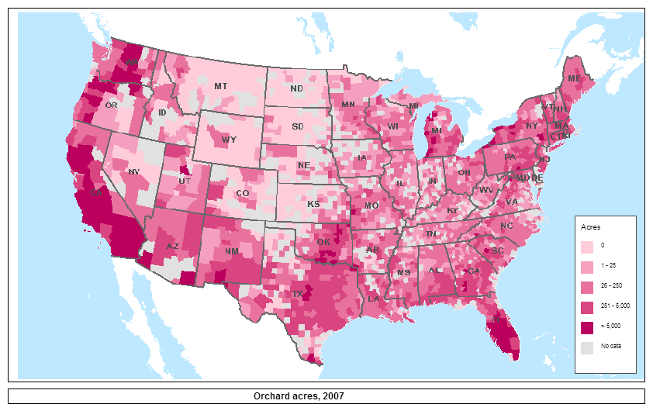
National Food System
Notes:
USDA food environment Atlas, from USDA Census 2007. Proprietary data from CDS.

Slide 12
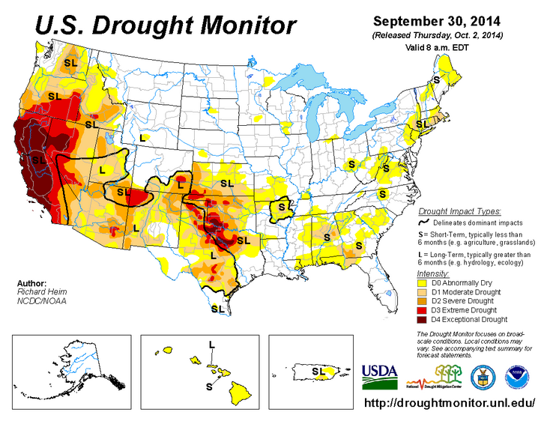
California Drought 2014

Slide 13
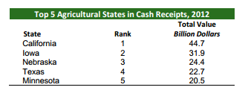
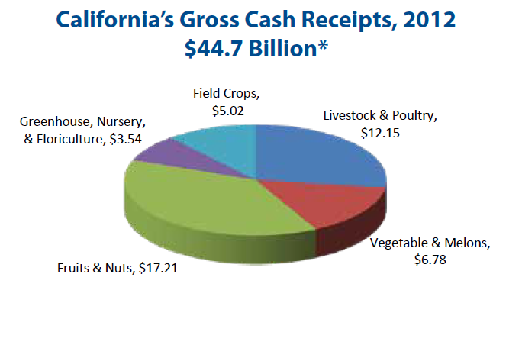
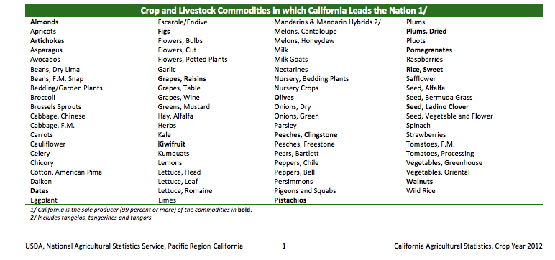
California’s Ag Presence
Notes:
California’s Agricultural Statistical Overview 2013-2014

Slide 14
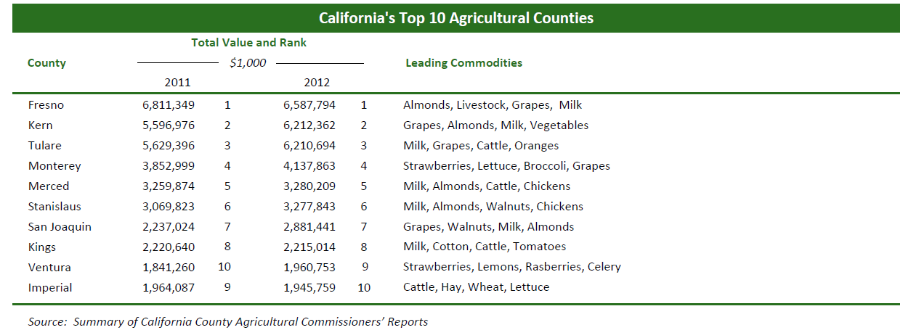
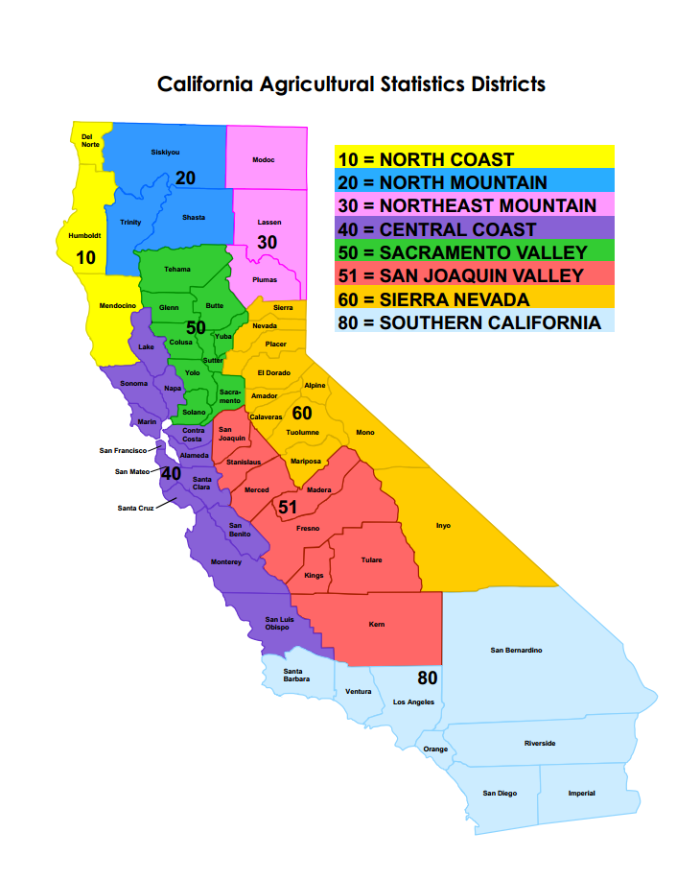
CA Agricultural Districts

Slide 15
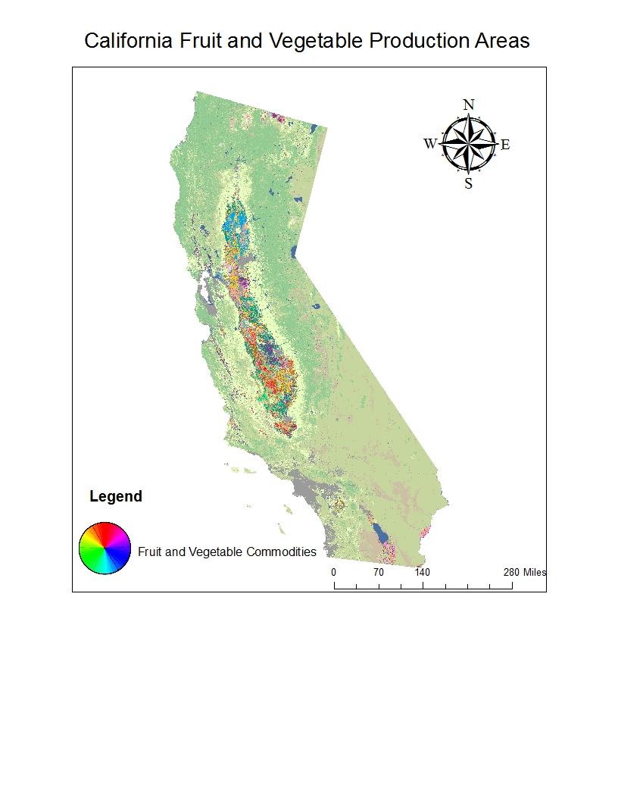
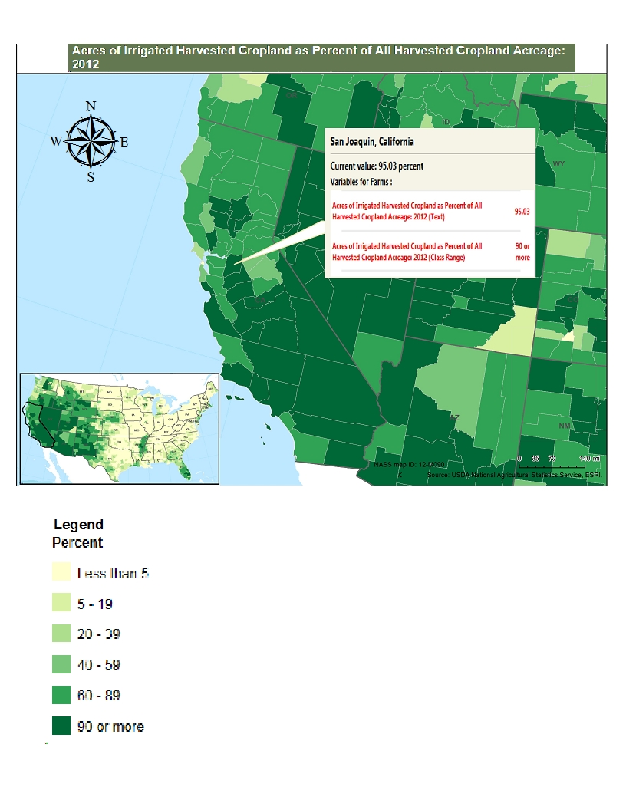
Produce and Water problems
Notes:
The 2012 Census of Agriculture reports that 22 percent of all U.S. farms growing fruit (including berries), tree nuts, and vegetables are in California, accounting for 43 percent of the total acreage for the sector. Most of this acreage is under irrigation—specifically, 98 percent of the State’s land in orchards, 100 percent of the land in berries, and 100 percent of the land planted to vegetables.

Slide 16
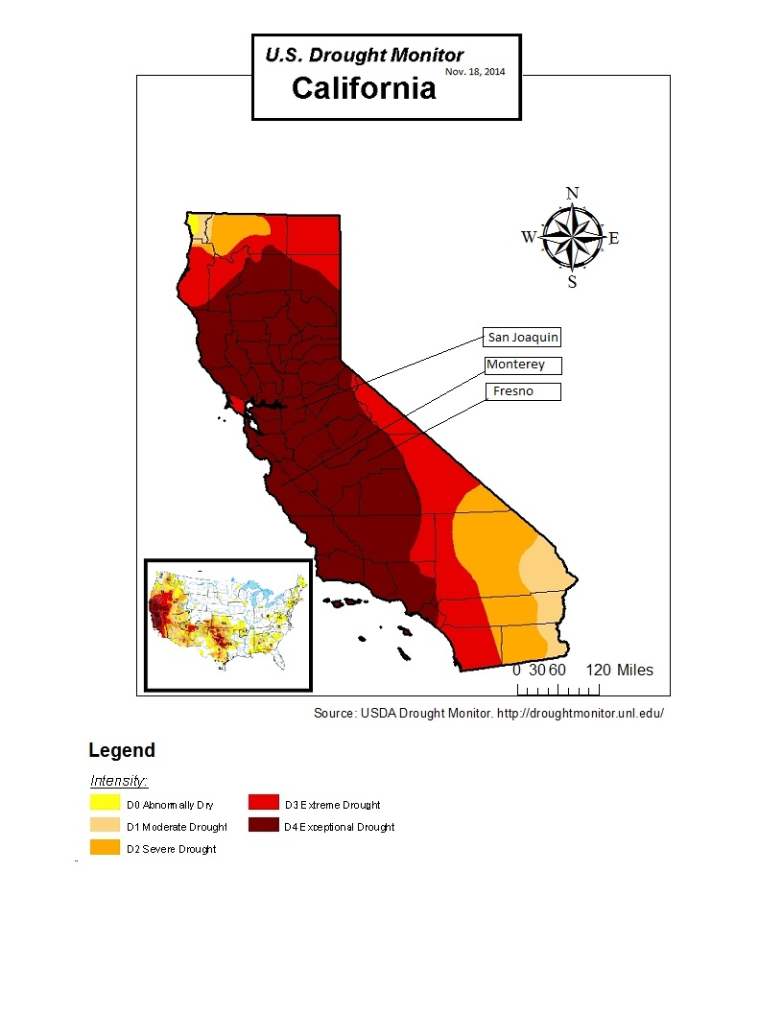
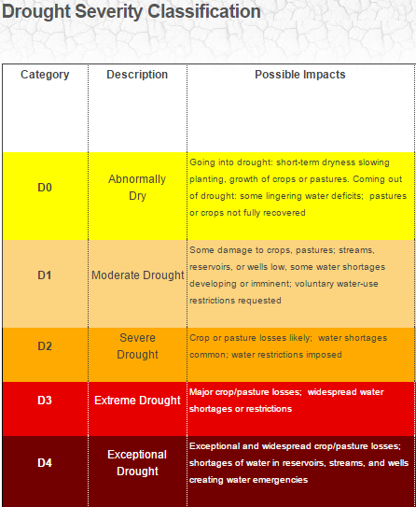
Severity Of CA Drought
Notes:
US Drought monitor. Drought Severity Classification

Slide 17
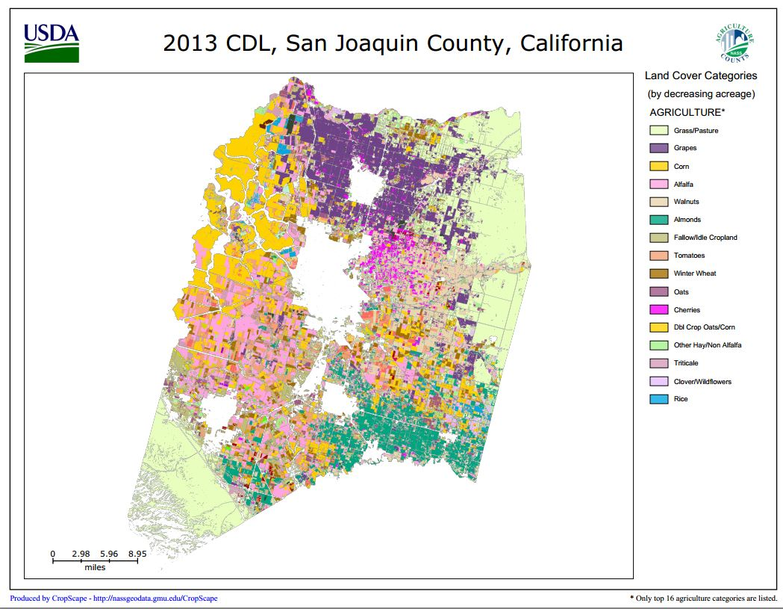
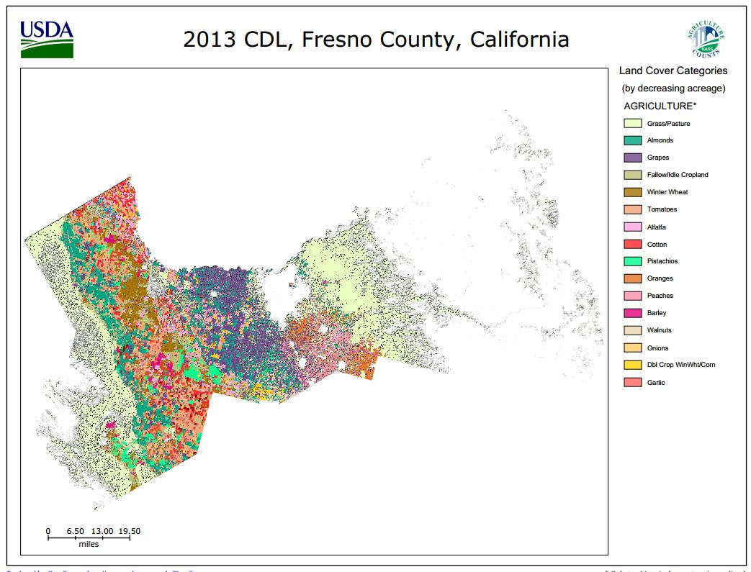
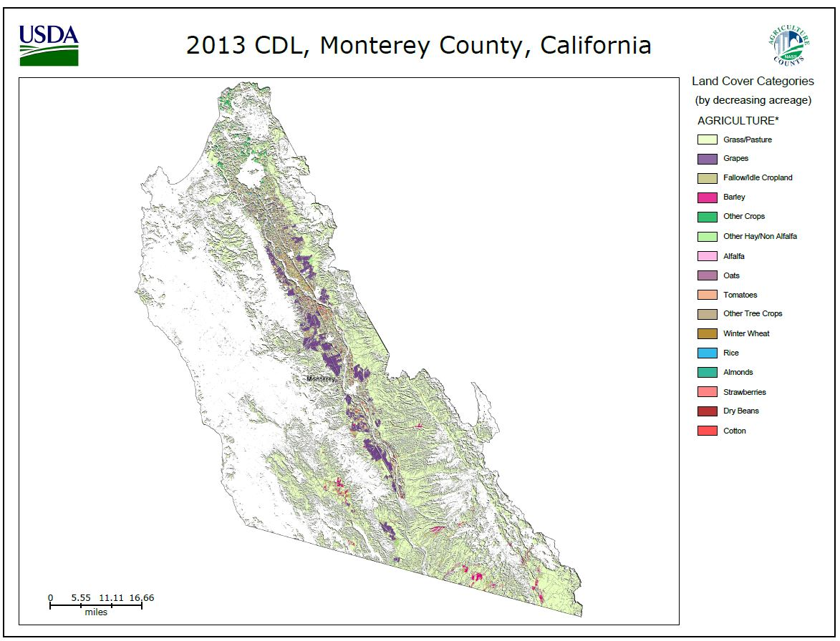
Close-up of Top Counties
Notes:
The San Joaquin Valley is the largest fruit and nut producing district in the State, accounting for 64 percent of total fruit and nut crop value in 2012. Grapes, almonds, pistachios, walnuts, oranges, peaches, tangerines, and sweet cherries are the primary fruit and nut crops produced in the valley.
The San Joaquin Valley also produces one-third of California’s vegetables, which in 2012 amounted to a district total of $2.65 billion in gross farm value (based on County Agricultural Commissioners’ Reports, 2012). It is the second-largest vegetable-producing district in California, next to the Central Coast Valley, which generated $3.36 billion in gross farm value in the same year. 92 percent of harvested vegetable acreage in the Central Coast district is for the fresh market, according to USDA’s 2012 Census of Agriculture, while those in the San Joaquin Valley are more equally divided between the fresh and processing markets (48 percent and 52 percent, respectively).

Slide 18
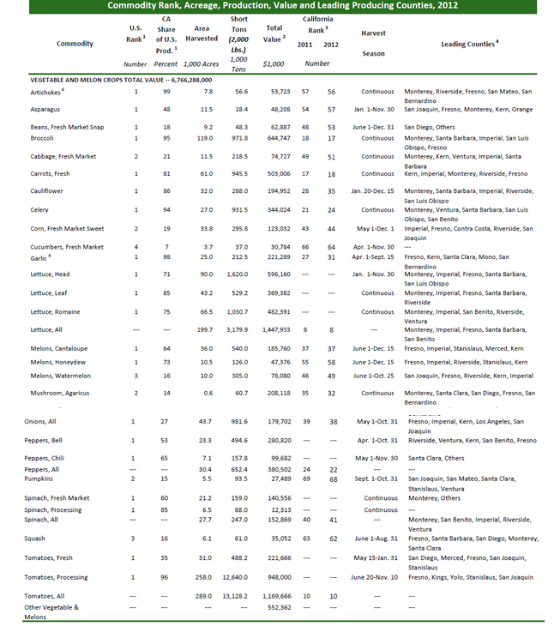
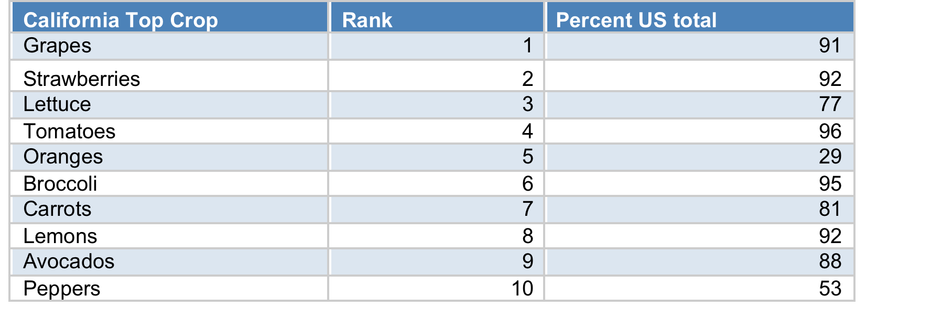
CA Top Crops
Edible Commodities
Fruit/Vegetables Crops

Slide 19
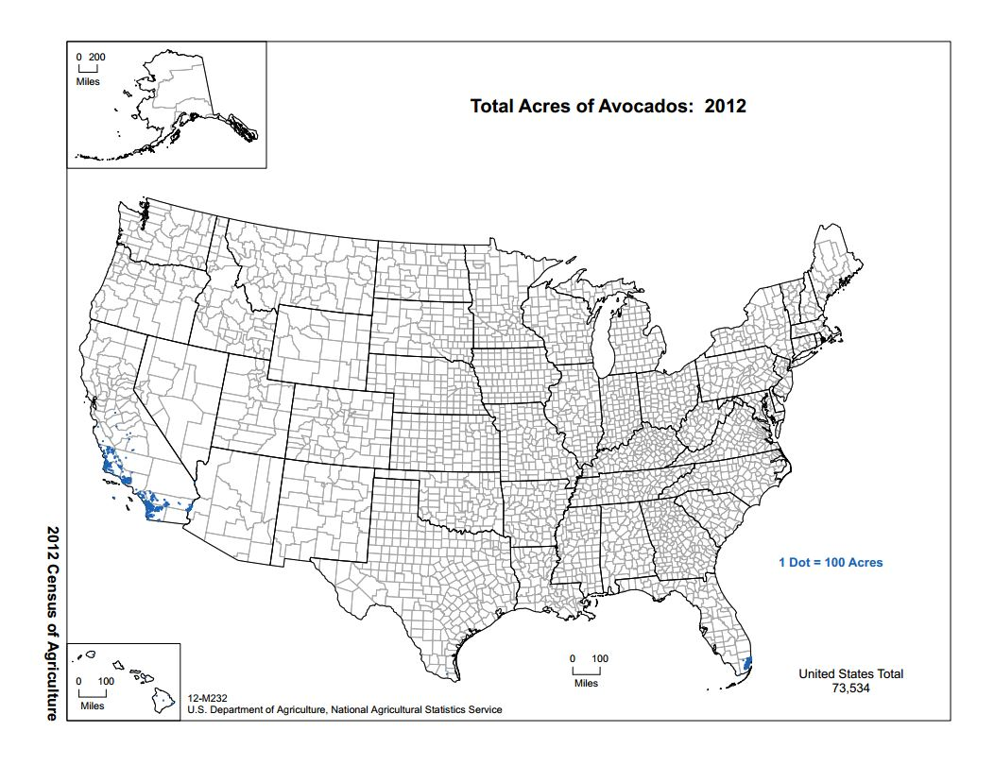
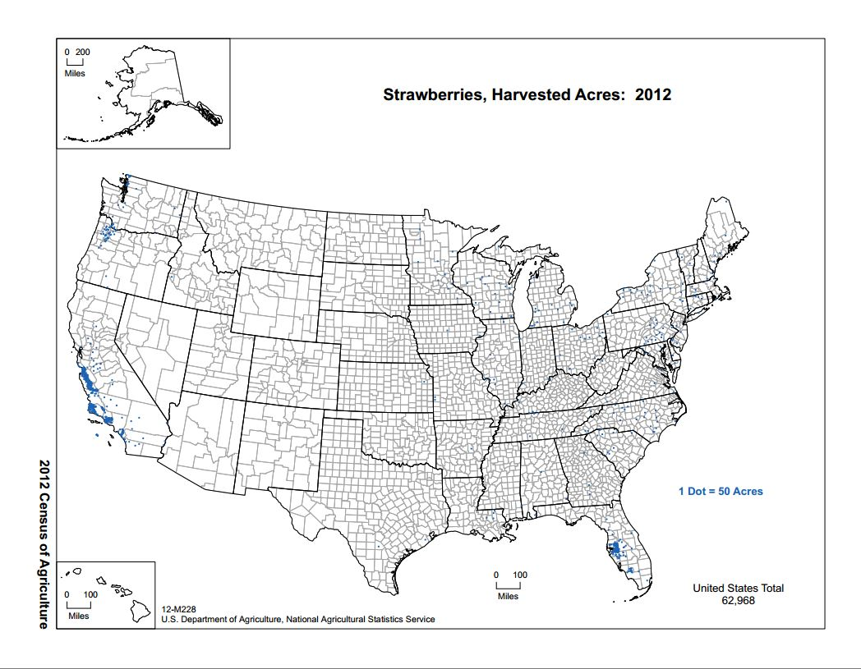
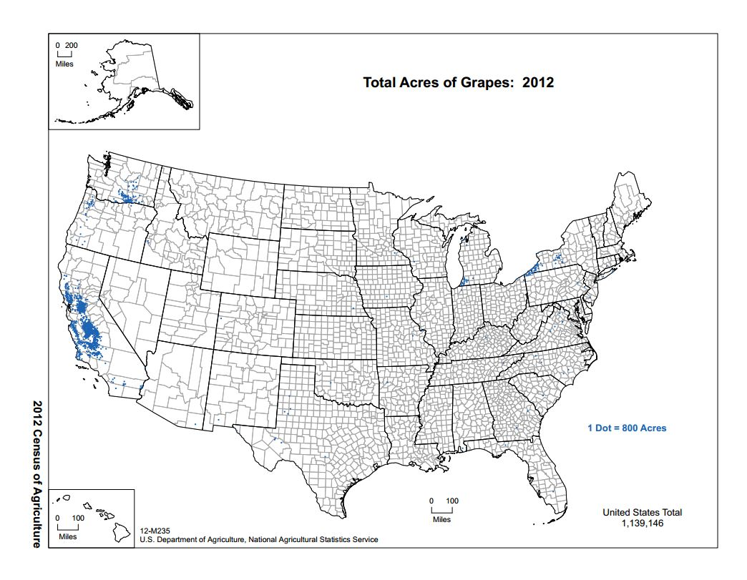
Vulnerability

Slide 20
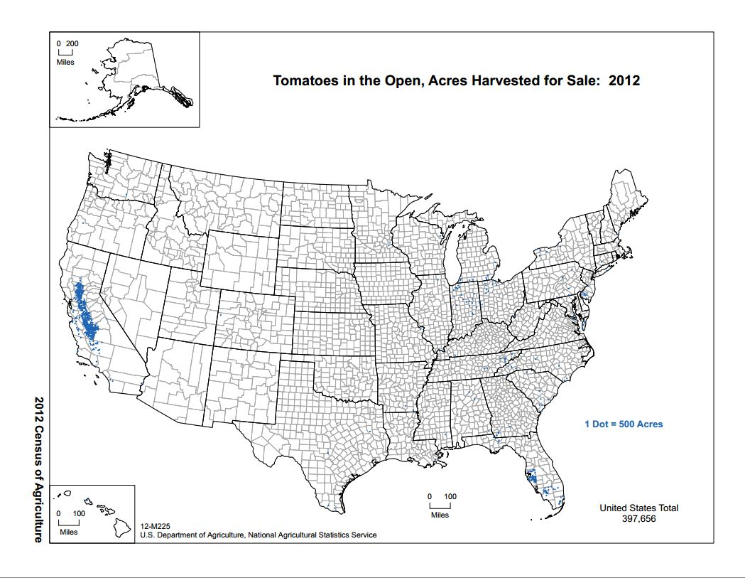
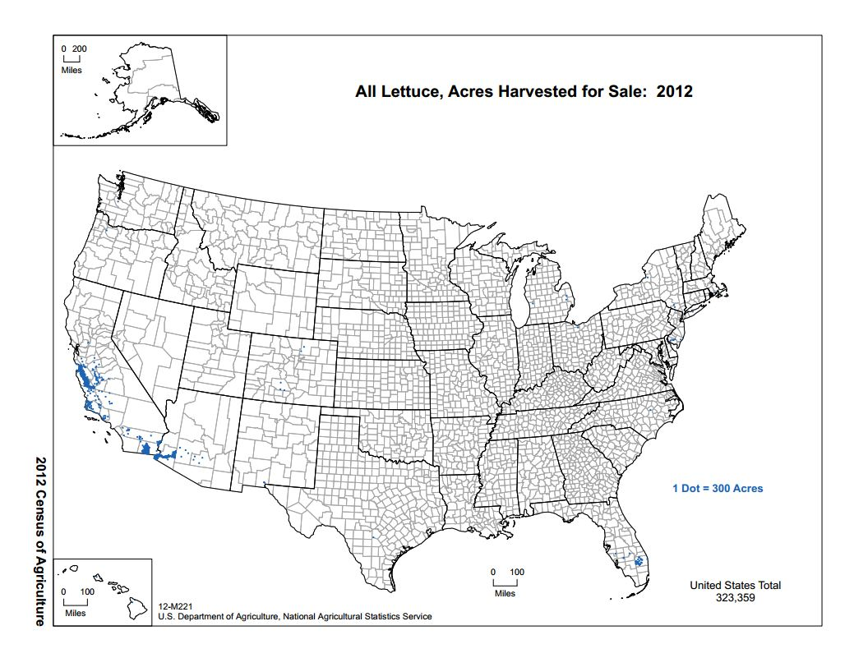
Vulnerability cont.

Slide 21
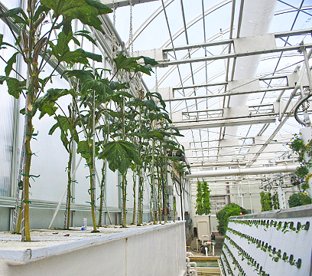
Hydroponics and the Future of Food Supplies
Food and Water
Efficiency/Improvements in Yield
Locating food where there is demand
Urban Agriculture
Notes:
Hydroponic methods are best suited for leafy greens, herbs, and bulb vegetables. Pollinating indoors is an immense cost-burden, and the size of many fruiting trees excludes them from greenhouse production. Leafy greens and other produce items that fit the hydro criteria can be reared using significantly less resources by growing indoors (namely water, pesticides, and fertilizers.).

Slide 22
Limitations
USDA Environmental Food Atlas → USDA AG census reports
Drought Monitor. Soil moisture & Precipitation.
NC Top Crop and group work.

Slide 23
Acknowledgements
David Tarboton – UNC Geog591
Charles Scaife – UNC Geog591
UNC Institute for the Environment – Brian Naess
  --Blaire S., Emily A, Julia A., Mitch D, Cole F.
UNC School of Information and Library Sciences (SILS team)

