Slide 1
Relative levels of alteration of watersheds in North Carolina
Examining anthropogenic influences on rivers popular with recreational paddlers
Katie Lutton
GISWR 2014

Slide 2
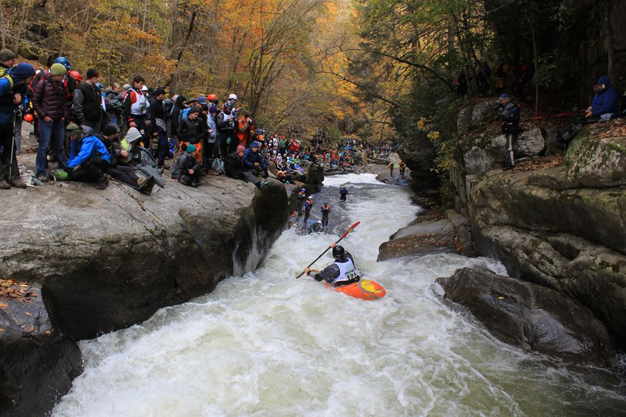
g
The Green Race 2014
Green River Narrows

Slide 3
Purpose: To better understand the extent of alteration of the watersheds of rivers of interest.

Slide 4
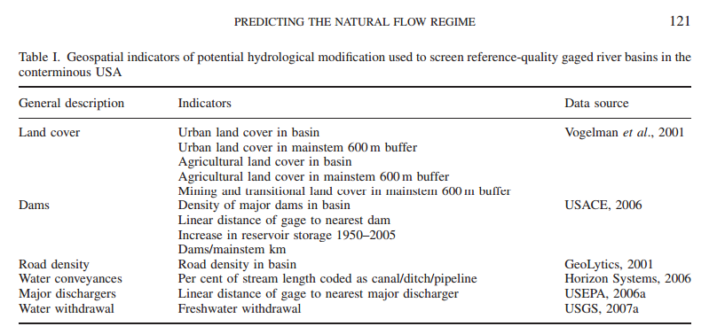
Predicting the natural flow regime: models for assessing hydrological alterations in streams
Carlisle et al., 2009
Objective: Collect data for each potential hydrological modification indicator for each watershed, then rank the watersheds based on levels of indicators of disruptive human activity.

Slide 5
Land Cover
“Urban” = 23 (Developed, Medium Intensity) and 24 (Developed, High Intensity)
“Agricultural” = 81 (Pasture/Hay) and 82 (Cultivated Crops)
Zonal Statistics, Histogram
Source: NLCD 2011

Slide 6
Dams and Dischargers
All vs Major
Sources: Dam Inventory of the NC Division of Energy, Mineral, and Land Resources; Planning Branch of the Division of Water Quality of the NC Department of Environment and Natural Resources

Slide 7
Roads
Source: North Carolina Department of Transportation

Slide 8
Method
Gather data on all the watersheds for all the indicators
For each indicator, rank the watersheds from 1 (least altered) to 8 (most altered)
For each watershed, add up the rankings for each of the indicators to get a total Alteration Ranking

Slide 9
Findings
Watershed rankings on potential hydrologic change indicators
Watershed | Nantahala | Tuckaseegee | Green | French Broad | Eno | Haw | Cape Fear | Neuse
Urban land cover in basin | 1 | 3 | 2 | 5 | 4 | 7 | 6 | 8
Urban land cover in mainstem buffer | 1 | 4 | 2 | 7 | 6 | 5 | 3 | 8
Agricultural landcover in basin | 1 | 2 | 3 | 4 | 7 | 8 | 6 | 5
Agricultural land cover in mainstem buffer | 1 | 5 | 3 | 8 | 6 | 7 | 4 | 2
Mine/transitional land in buffer | 5 | 3 | 1 | 4 | 7 | 2 | 6 | 8
Density of dams in basin | 1 | 2 | 8 | 3 | 4 | 7 | 5 | 6
Distance from point to nearest dam | 5 | 3 | 7 | 1 | 4 | 2 | 6 | 8
Dams/Mainstem | 1 | 2 | 4 | 5 | 3 | 6 | 8 | 7
Road density in basin | 1 | 2 | 7 | 5 | 3 | 8 | 6 | 4
Percent of streamlength coded as pipeline | 8 | 7 | 3.5 | 3.5 | 3.5 | 3.5 | 3.5 | 3.5
Major dischargers | 1.5 | 7 | 1.5 | 4 | 6 | 3 | 8 | 5
Alteration Rank | 26.5 | 40 | 42 | 49.5 | 53.5 | 58.5 | 61.5 | 64.5
The Nantahala watershed ranks the lowest on indicators of anthropogenic alteration, and the Neuse watershed ranks the highest.

Slide 10
Managed Areas
Managed Areas are Federal, State, local or private properties and easements where conservation is one of the management goals.
Source: NCOneMap

Slide 11
Implications for paddling
Flow levels
Flow regime
Water quality
Access
Safety

Slide 12
Possible future research
Predict natural flow regimes of these rivers
Calculate the optimal conditions for paddling each major river
Investigate the local economic impacts of recreational paddling
Learn about short and long term plans of Duke Energy, dam operators
Suggest a feasible plan that considers the interests of the paddling and outdoor recreation community

Slide 13
Sources
NCDOT “Road Characteristics Arc Shapefile Format” (2014).
NC Division of Energy, Mineral and Land Resources “North Carolina Dam Inventory” (2013).
Horizon Systems NHDPlusV2
Multi-Resolution Land Characteristics Consortium “NLCD 2011”
NCOneMap data
Dam Inventory of the NC Division of Energy, Mineral, and Land Resources
Discharger dataset from Planning Branch of the Division of Water Quality of the NC Department of Environment and Natural Resources

Slide 14
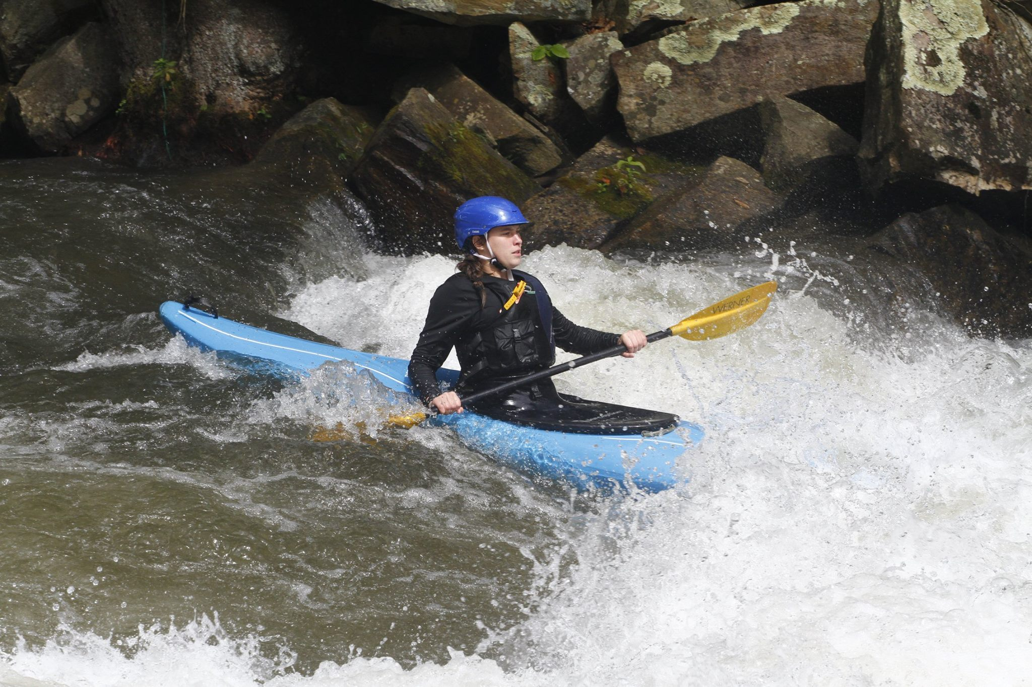
Thank you! Questions?

