Slide 1
Utilizing GIS and Open-Source Data for River Restoration Prioritization
Methodology
GEOG591: GIS in Water Resources
John Lovette
2 December 2014

Slide 2
River Restoration
Huge investment of resources and money
37,099 projects as of 2005
Over $1 billion invested per year
“Restoration projects tend to be site specific, with little attention paid to the processes operating at a larger scale” -White and Fennessy 2005

Slide 3
Goal
River Restoration Prioritization
at a larger spatial scale
Compile database
Assess restoration suitability at the HUC12 scale

Slide 4
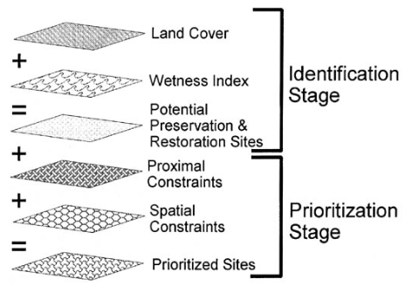
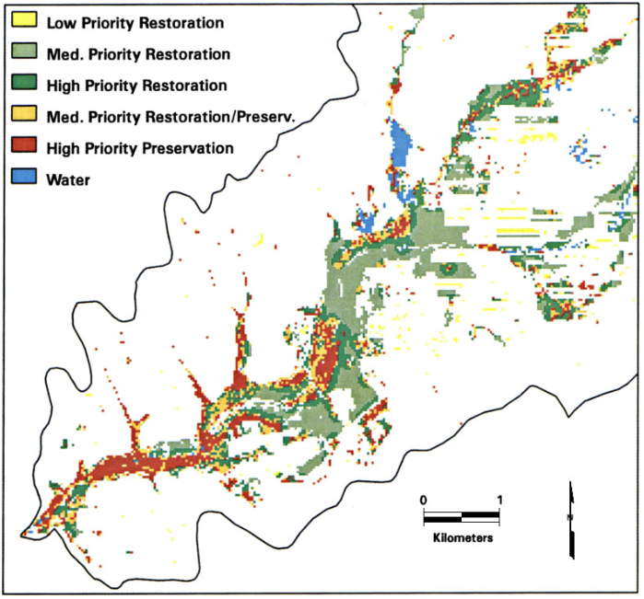
Previous Work: Russell et al., 1997
Basic GIS work
Metrics:
Topographic Wetness Index
Size
Proximity to existing riparian area
Preservation vs Restoration

Slide 5
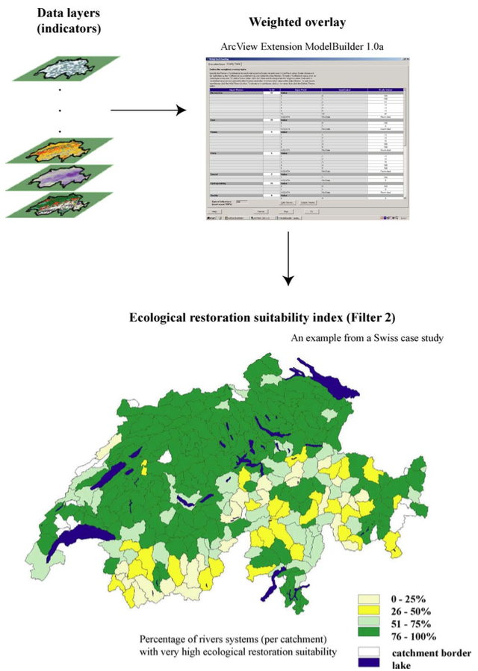
Previous Work: Rohde et al., 2006
Restoration Suitability Index
By catchment
Metrics:
Hydrology
Bed Load (erosion)
Water Quality
Connectivity
Biodiversity
Included public attitude
Multiple Weighting Methods
Expert vs Equal

Slide 6
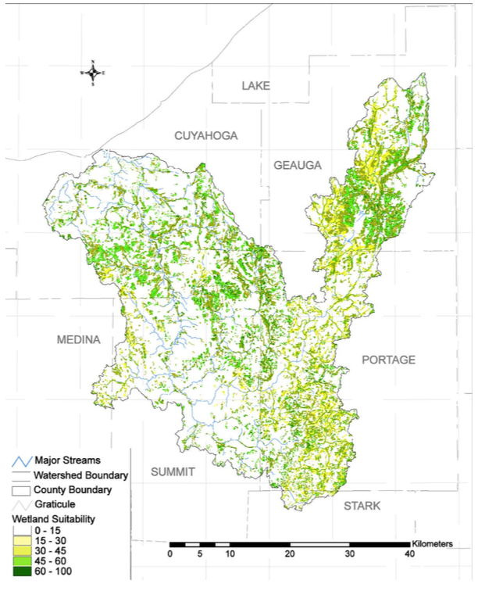
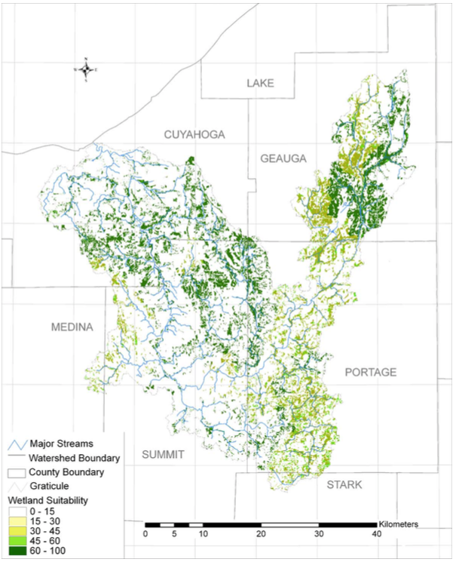
Previous Work: White & Fennessy, 2005
Restoration Suitability Index
Raster analysis
Metrics:
Stream order
Flow length
Saturation index
Land use
Soil type
Multiple weighting methods

Slide 7
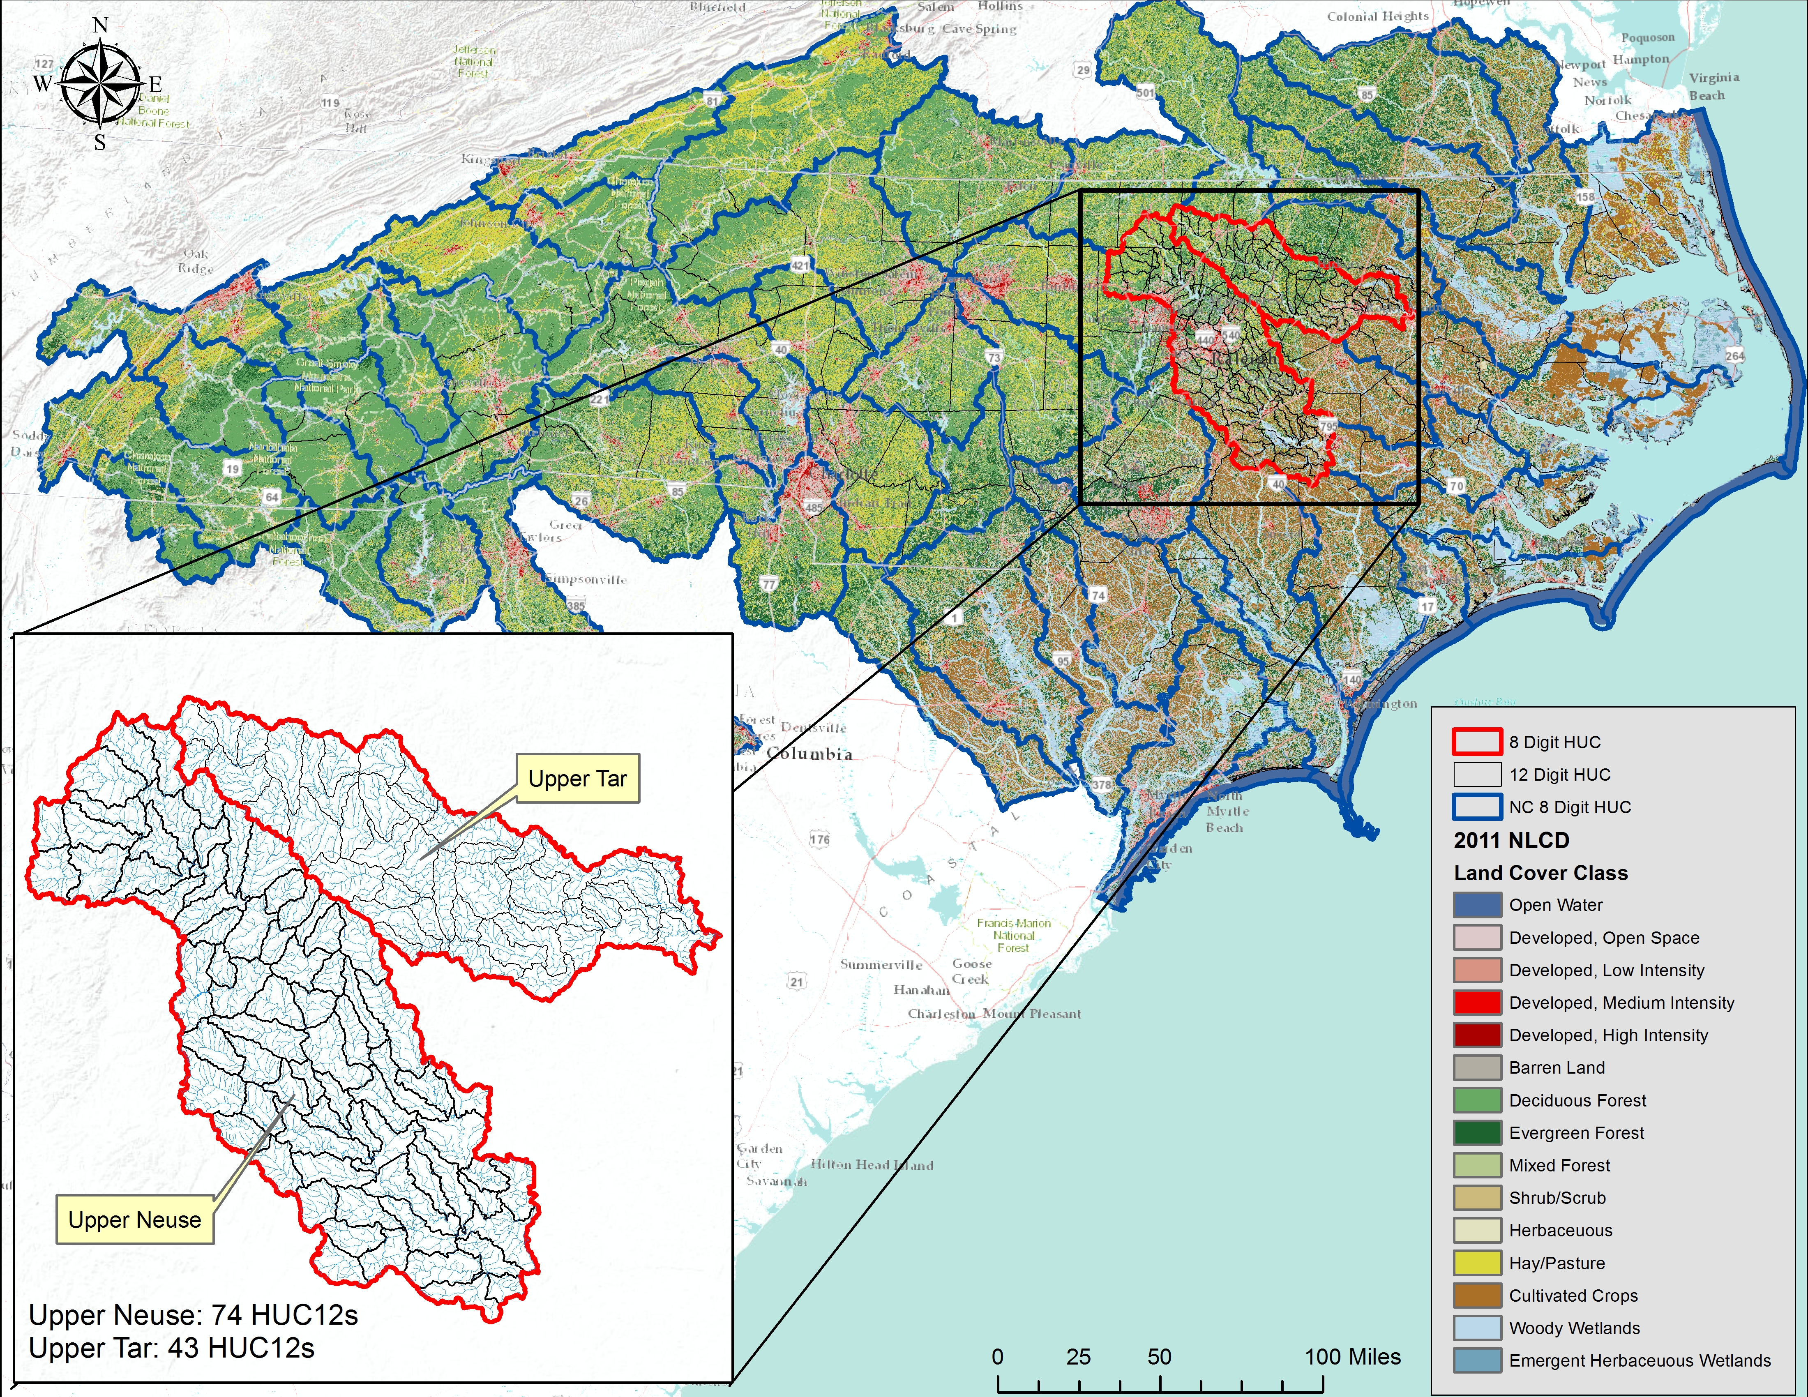
Study Area

Slide 8
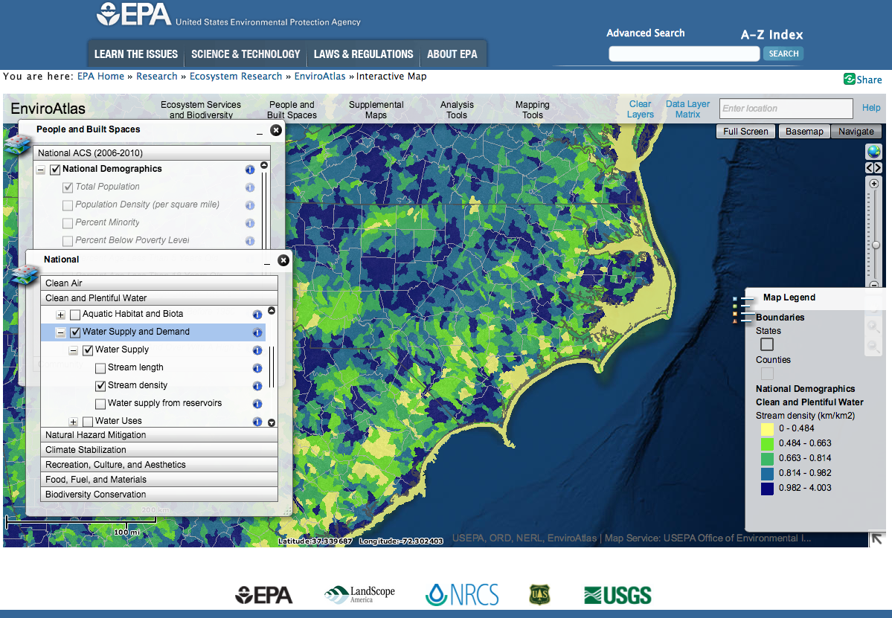
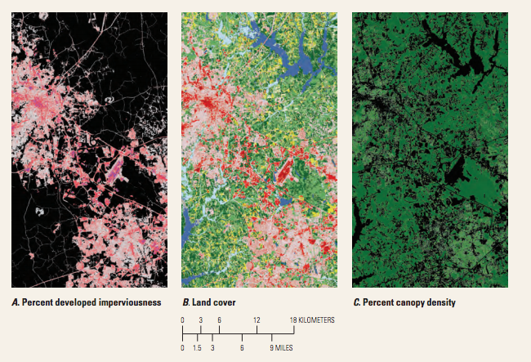
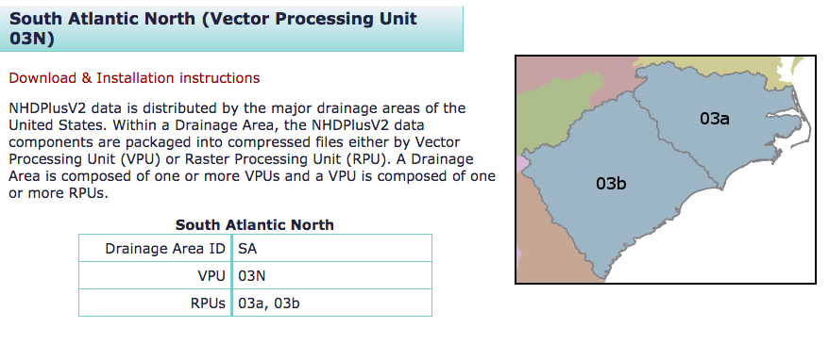
Methods: Data Collection
EnviroAtlas
HUC12
NHDPlus
Stream reach and Catchment
NLCD
30 m² raster

Slide 9
Methods: Restoration Suitability Index
Normalization
Value ranges
Categorization
Score based on range
Weighting
Individual layers to suitability index
Data Layers
Percent impervious
Mean Annual Flow
Drainage Density
Precipitation
Water Demand
Protected Area
Riparian Vegetation
Wetness Index
Hydric Soils
Land Cover
Number of Dams
Biodiversity
Imperiled Species
Percentage Natural Area
Impaired Waters
Ecosystem Rarity Metrics
et cetera…

Slide 10
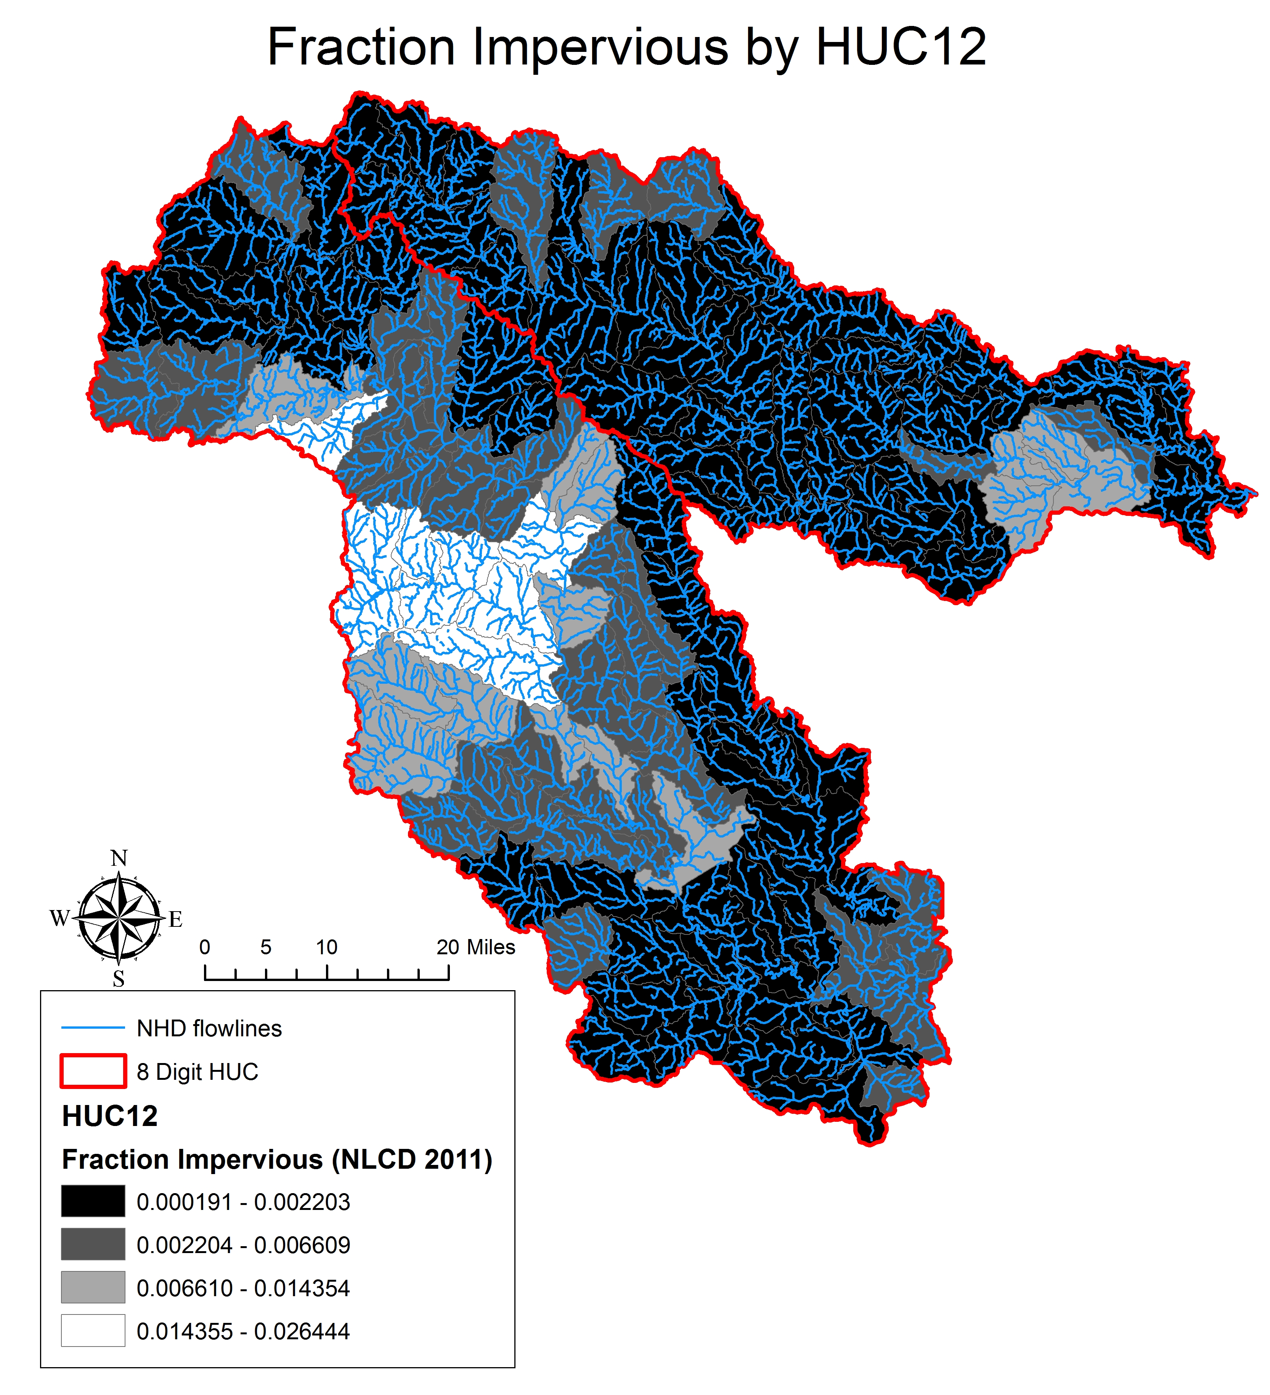
Results
In progress…

Slide 11
Future Work
Project provides database construction and feasibility analysis
Construct ModelBuilder or Python tool for users
Input set of data layers
Accept set weights or alter to fit needs
Assess Restoration Suitability Index
Expand study to physiographic regions and state scales

Slide 12
References
Bernhardt, E. S., M. Palmer, J. Allan, G. Alexander, K. Barnas, S. Brooks, J. Carr, S. Clayton, C. Dahm & J. Follstad-Shah (2005) Synthesizing U. S. river restoration efforts. Science(Washington), 308, 636-637.
Rohde, S., M. Hostmann, A. Peter & K. C. Ewald (2006) Room for rivers: An integrative search strategy for floodplain restoration. Landscape and Urban Planning, 78, 50-70.
Russell, G. D., C. P. Hawkins & M. P. O'Neill (1997) The role of GIS in selecting sites for riparian restoration based on hydrology and land use. Restoration Ecology, 5, 56-68.
White, D. & S. Fennessy (2005) Modeling the suitability of wetland restoration potential at the watershed scale. Ecological Engineering, 24, 359-377.

