Slide 1
Snowfall Runoff Forecasting in San Juan County, UT
Dane Hurst
GIS in Water Resources
Utah State University
Fall 2014

Slide 2
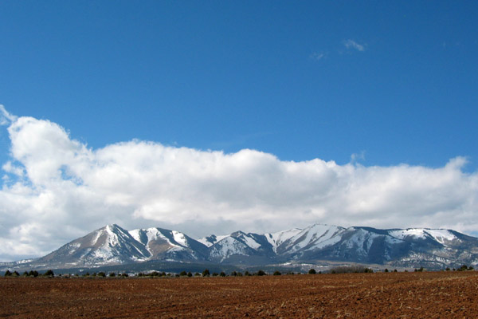
Project Objective
Develop a model to forecast total seasonal snowmelt runoff for two major reservoirs downstream of the Abajo Mountain range in San Juan County, UT

Slide 3
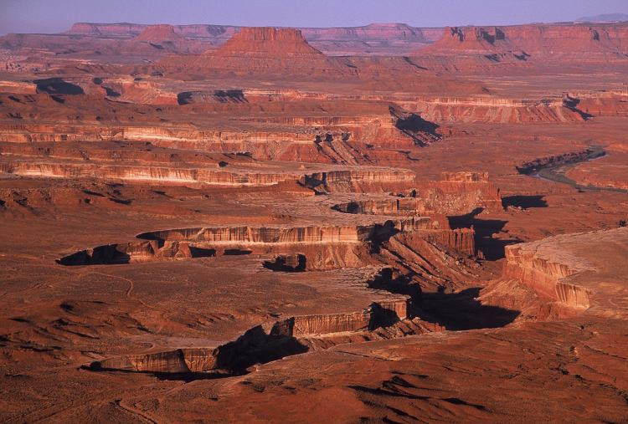
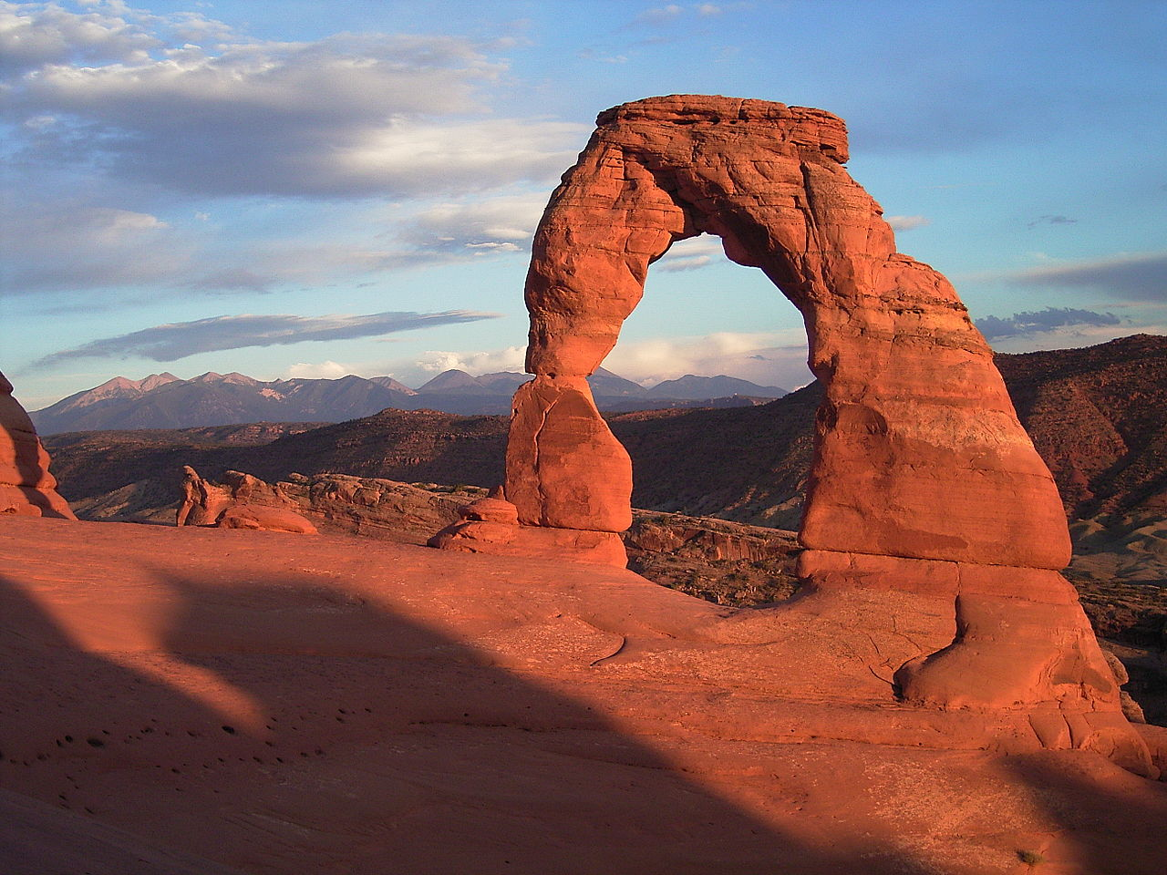
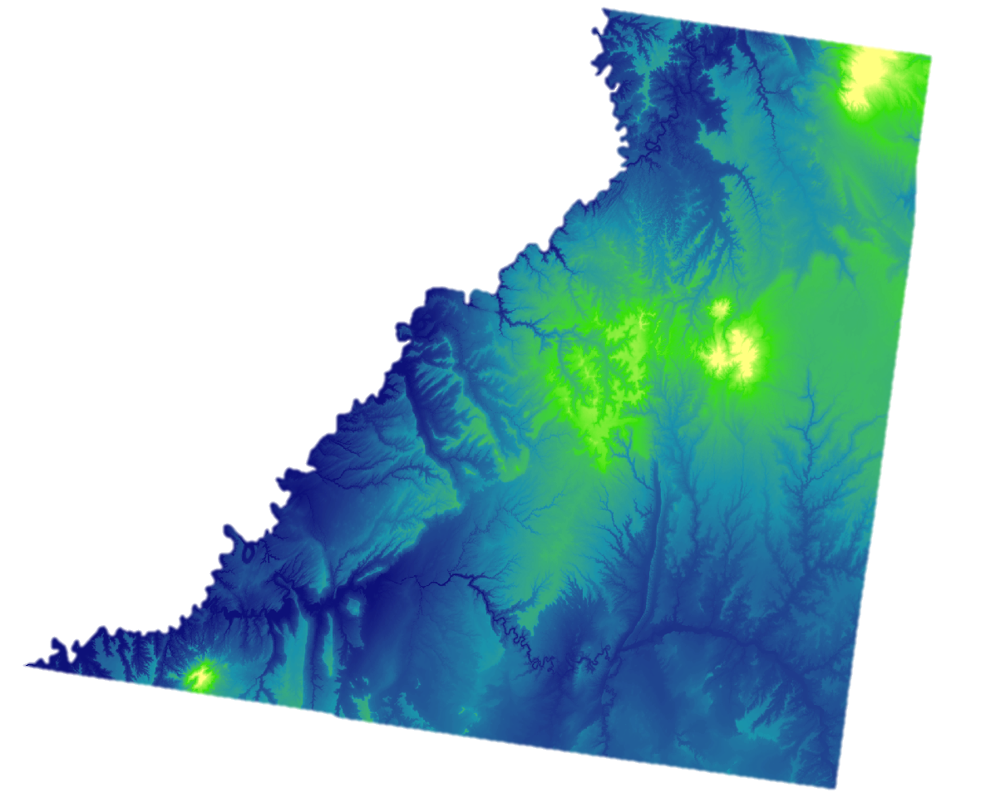
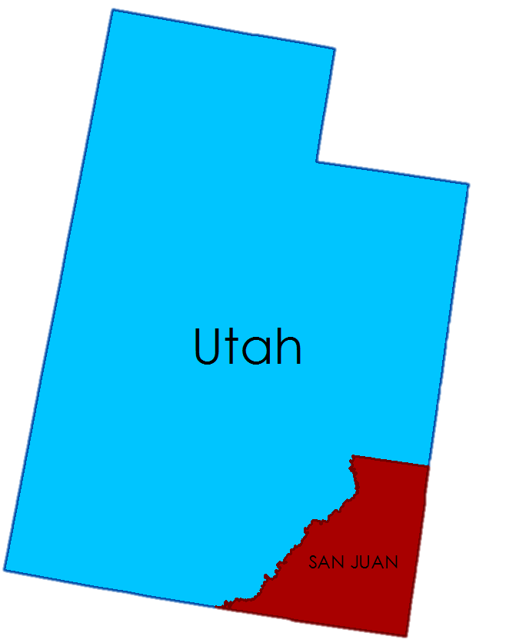
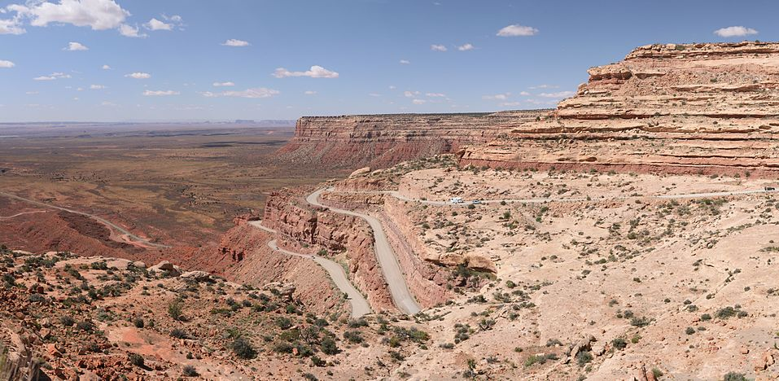
www.wikipedia.com

Slide 4
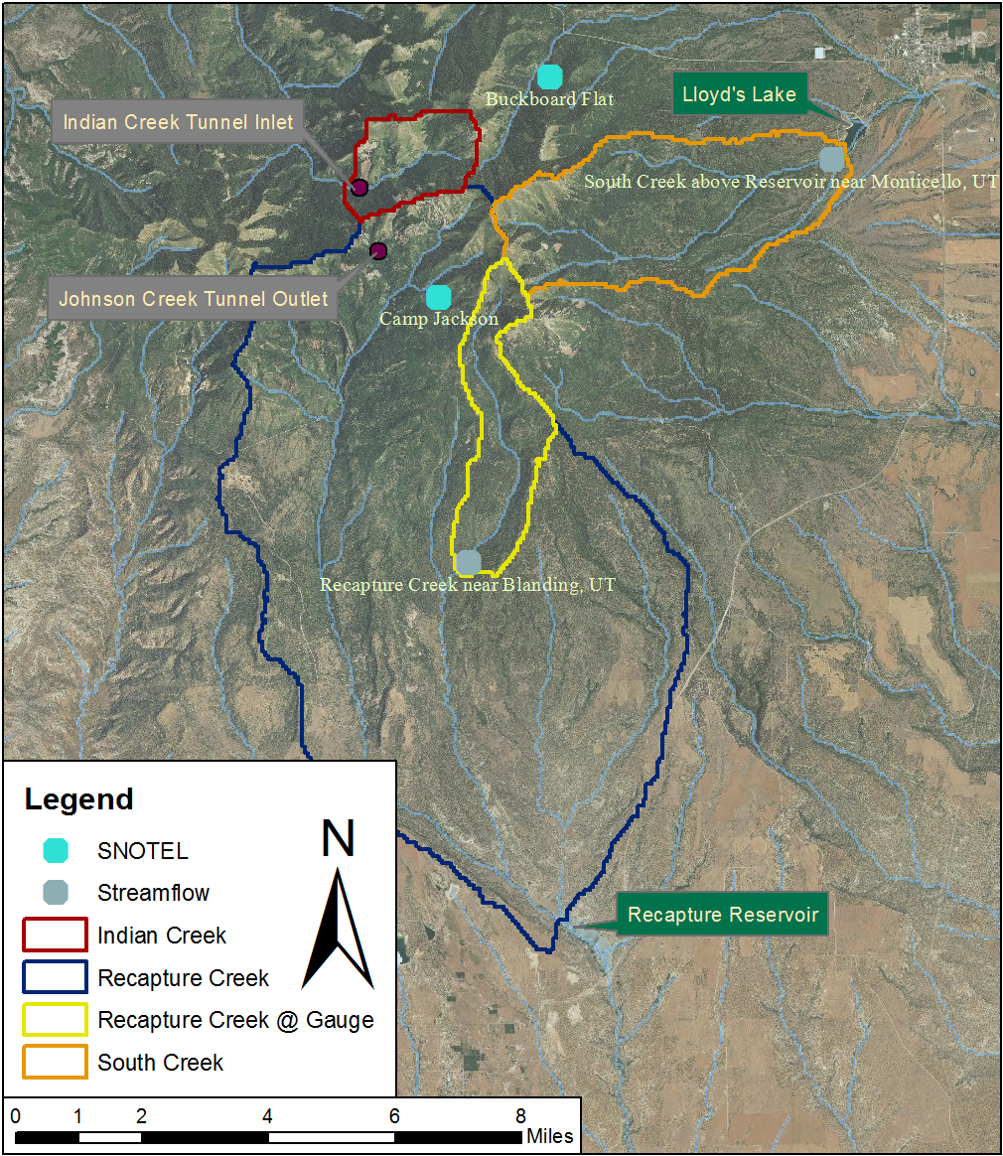
Project Geography
Watershed Name | Area (km²) | Area (mi²)
Recapture Creek | 143 | 55.1
South Creek | 26.8 | 10.4
Recapture Creek @ Gauge | 11.5 | 4.4
Indian Creek | 6.6 | 2.6

Slide 5
Available Datasets
SNOTEL
2 Sites
Daily snow water equivalent (SWE)
USGS stream gauges
2 sites
Daily average flow rate
SNODAS
Modeled daily SWE over continental United States
www.sjrnews.com

Slide 6
End User Process
SNOTEL SWE Reading
Correlation to SNODAS SWE value at the site
Average accumulated SWE over watershed(s)
Correlation to stream flow
Predicted available runoff
Accounts for errors in modeled data
Accounts for spatial variation of snowfall
Accounts for losses (infiltration, evaporation etc.)

Slide 7
Model Development Process
Define project
Define Goals
Gather Data
Stream flow
Process Data
Find seasonal cumulative snowfall using SNODAS
SNODAS
SNOTEL
Find daily SNODAS value at SNOTEL sites
Find total seasonal stream flow volume
Analyze Data
Correlate local SNOTEL SWE to local SNODAS SWE
Correlate SNODAS SWE volume to stream flow volume
Correlate local SNOTEL SWE to stream flow volume
Present Data
Simple Excel workbook to perform calculations
Consider constraints
Develop process plan

Slide 8
Sample Model Development:
2009 Camp Jackson and Recapture Creek (South side)
Description | Value
Maximum SNOTEL SWE | 328 mm
SNODAS SWE at Camp Jackson | 290 mm (113% of SNOTEL)
Average SWE in watershed | 211 mm (72.9% of Camp Jackson)
Area of watershed | 11.51 km²
Volume available in watershed | 2,748,000 m³
Total Spring runoff at gauge | 129,800 m³
Runoff ratio | 0.0472

Slide 9
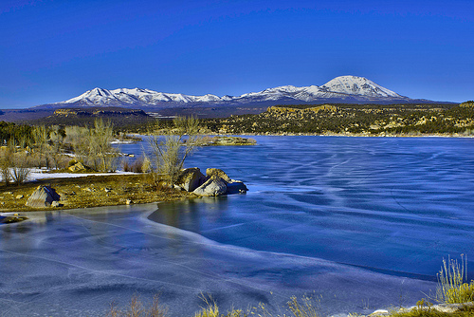
Sample Model Use
2010 Camp Jackson and Recapture Creek (South side)
Description | Value
Maximum SNOTEL SWE | 422 mm
Modeled volume available in watershed | (422 mm)(113%)(72.9%)(11.51 km²) =3,130,393 m³
Modeled runoff | (3,130,393 m³)(0.0472) =147,800 m³
Actual runoff | 158,400 m³
Error | -7.2%
www.hikesandlakes.com

Slide 10
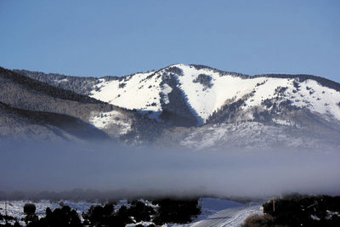
Remaining Work
Calculate seasonal cumulative SWE
Establish correlations
Create Excel workbook to perform calculations
www.sjrnews.com
www.hikesandlakes.com

Slide 11
Future Improvements
Build tool to automate process
Data collection
Processing/Analysis
More rigorous hydrologic model
ckmcdonald on panormio.com

