Slide 1
Using ArcSWAT to evaluate effects of land use change on water quality
Adam Gold
Geog 591
December 2,2014

Slide 2
Outline
SWAT
ArcSWAT
My Model
Results
Future Work
Conclusions

Slide 3
SWAT
Soil and Water Assessment Tool (SWAT)
Hydrologic Transport Model
Objective:
“Predict the effect of management decisions on water, sediment, nutrient and pesticide yields with reasonable accuracy on large, ungaged river basins.”
Developed by USDA and Texas A&M University

Slide 4
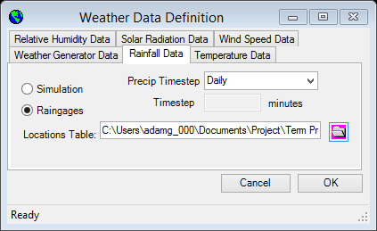
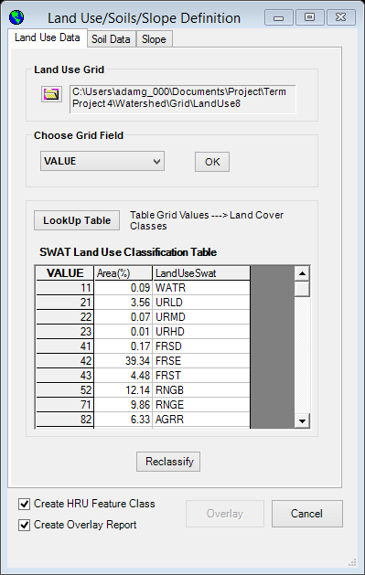
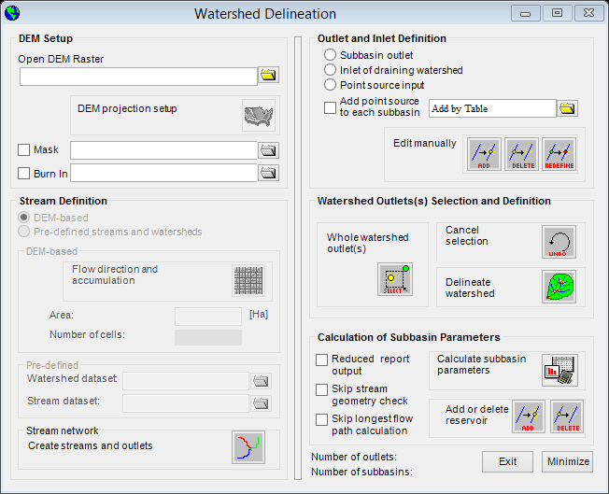
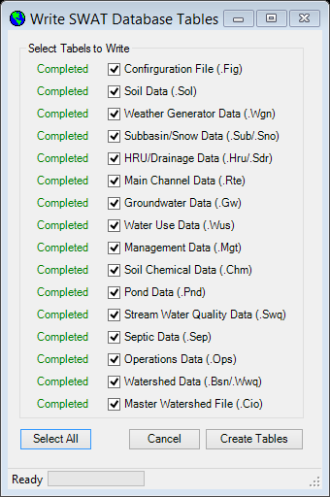
ArcSWAT
ArcGIS Interface for SWAT
Toolbar

Slide 5
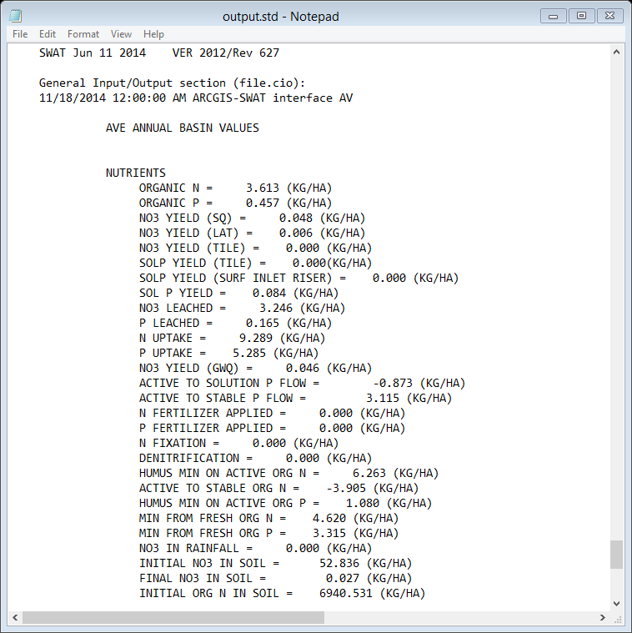
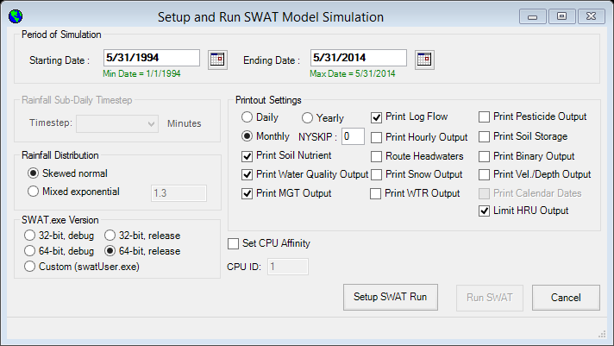
ArcSWAT (cont.)

Slide 6
My ArcSWAT Model
Monthly Predictions
21 Years
Only difference is Land Use data
Uncalibrated
3 Simulations:
  2001 NLCD Land Use
  2006 NLCD Land Use
  2011 NLCD Land Use

Slide 7
My ArcSWAT Model
Eastern NC
36.43 km²

Slide 8
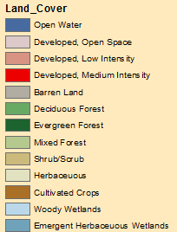
Land Cover, 2001 | % of area
Open Water | 0.09
Developed, Open Space | 3.53
Developed, Low Intensity | 0.07
Developed, Medium Intensity | 0.01
Deciduous Forest | 0.18
Evergreen Forest | 39.35
Mixed Forest | 4.51
Shrub/Scrub | 12.08
Herbaceuous | 9.85
Cultivated Crops | 6.33
Woody Wetlands | 22.76
Emergent Herbaceuous Wetlands | 1.24

Slide 9
Land Cover. 2006 | % of area
Open Water | 0.09
Developed, Open Space | 3.53
Developed, Low Intensity | 0.07
Developed, Medium Intensity | 0.01
Deciduous Forest | 0.17
Evergreen Forest | 23.73
Mixed Forest | 3.77
Shrub/Scrub | 24.81
Herbaceuous | 13.57
Cultivated Crops | 6.33
Woody Wetlands | 22.60
Emergent Herbaceuous Wetlands | 1.31

Slide 10
Land Cover. 2011 | % of area
Open Water | 0.08
Developed, Open Space | 3.54
Developed, Low Intensity | 0.09
Developed, Medium Intensity | 0.02
Barren Land | 0.06
Deciduous Forest | 0.14
Evergreen Forest | 22.29
Mixed Forest | 3.27
Shrub/Scrub | 33.70
Herbaceuous | 6.69
Cultivated Crops | 6.28
Woody Wetlands | 22.62
Emergent Herbaceuous Wetlands | 1.21

Slide 11
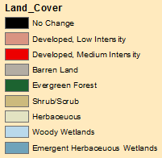
Change, 2001-2011 | Change, % of area
Open Water | -0.01
Developed, Open Space | 0.01
Developed, Low Intensity | 0.02
Developed, Medium Intensity | 0.01
Barren Land | 0.06
Deciduous Forest | -0.04
Evergreen Forest | -17.05
Mixed Forest | -1.24
Shrub/Scrub | 21.63
Herbaceuous | -3.16
Cultivated Crops | -0.05
Woody Wetlands | -0.14
Emergent Herbaceuous Wetlands | -0.03

Slide 12
Year | N03 (kg/ha) | P (kg/ha) | Sediment (T/ha) | Shrub/Scrub (% of Catchment)
2001 | 3.246 | 0.165 | 1.624 | 12.08
2006 | 4.103 | 0.15 | 3.816 | 24.81
2011 | 4.164 | 0.154 | 3.653 | 33.7

Slide 13
Conclusions
Future Work
Calibration
Statistics
ArcSWAT simplifies process of creating SWAT Model
ArcSWAT is useful tool for analyzing possible impacts of water quality

