Slide 1
Flood Zones in Wake County
Georgia Ditmore
University of North Carolina at Chapel Hill
December 1, 2014

Slide 2
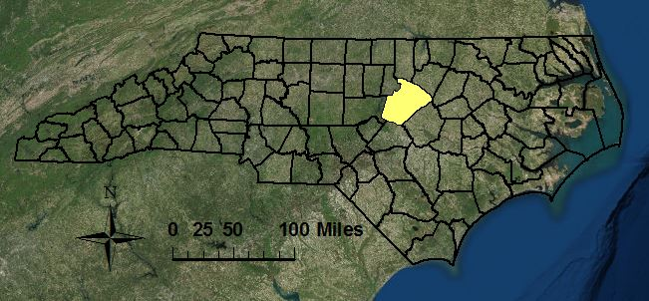
Wake County, North Carolina

Slide 3
Objective
Analyze the factors that affect the extent of the flood impact area and consider how Wake County growth will change those factors.
Proximity to water bodies
Land Cover
Impervious Surface

Slide 4
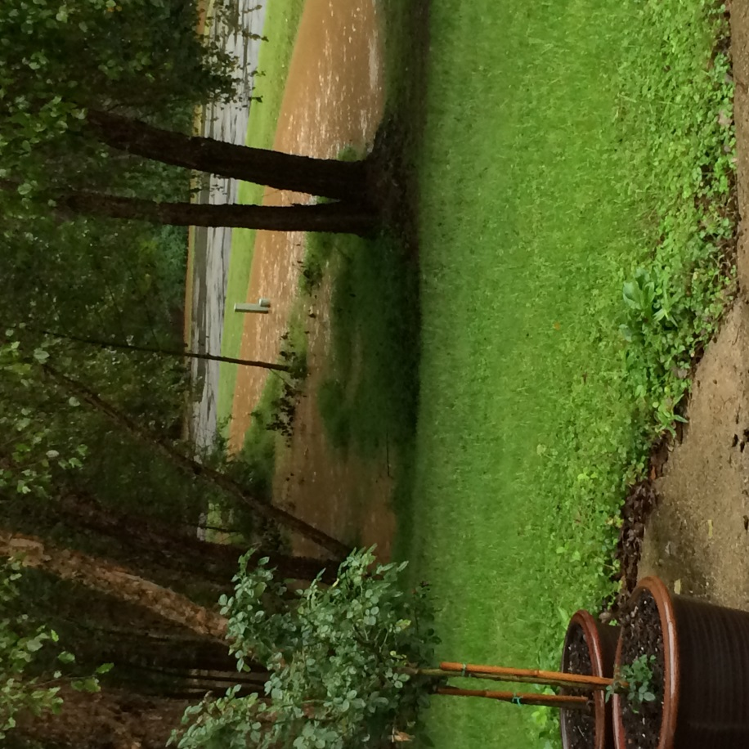
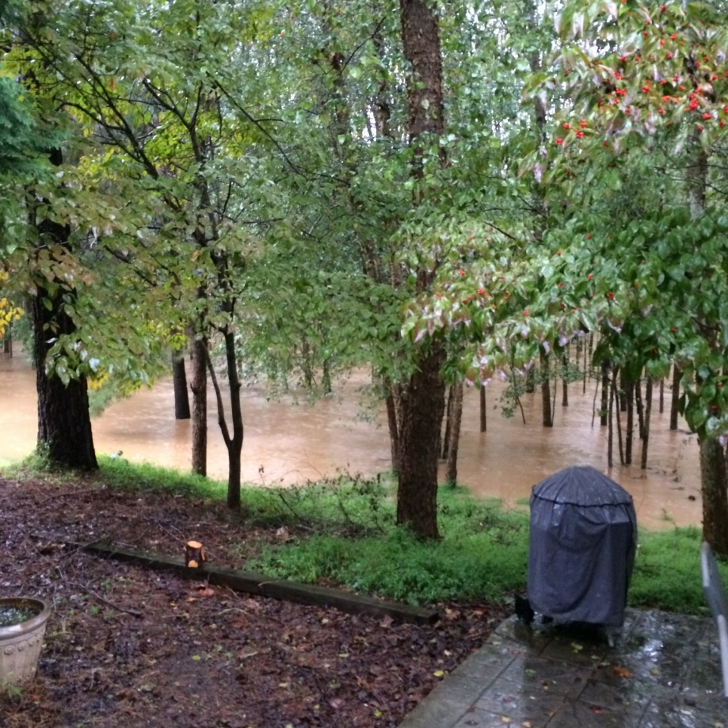
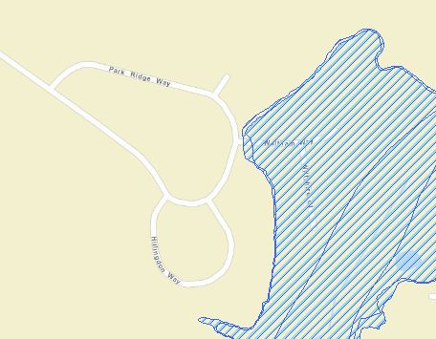
North Raleigh Flooding
Notes:
The permeability of the soil and rock in a drainage basin is a big factor in flooding. If the basin’s soil is impermeable, maybe because it has been saturated by previous rainfall or has been baked by prolonged heating, then any precipitation that falls won’t infiltrate and will instead run straight into the river, increasing the river’s discharge and triggering floods. Similarly, if the rocks in the area are non-porous or impermeable (such as granite or clay) then water won’t be able to infiltrate into the rocks and will, again, run straight off into the river increasing its discharge.

Slide 5
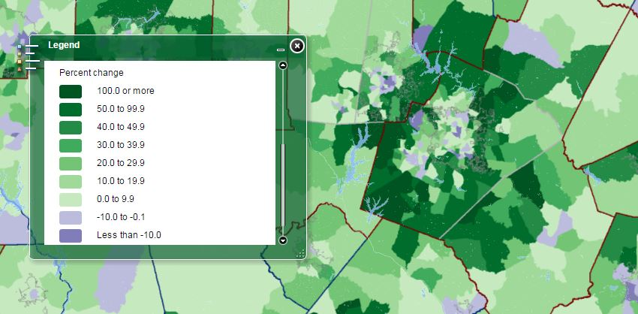
North Carolina Population Change 2000-2010
Notes:
If a river’s drainage basin or floodplain has been heavily urbanised, a river becomes much more prone to flooding. Urbanisation (generally) involves the laying down of tarmac and concrete, impermeable substances that will increase surface runoff into the river and therefore increase the river’s discharge.
Urbanisation often involves deforestation. This (obviously) reduces vegetation cover, reducing infiltration and increasing surface runoff into a river.

Slide 6
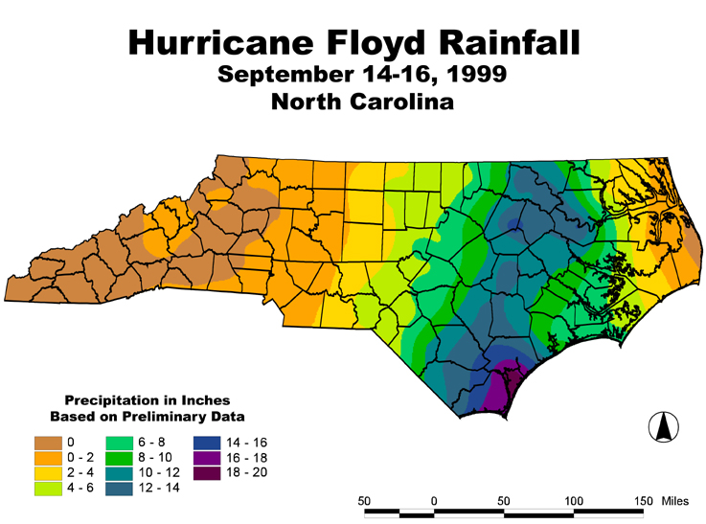
NC Flood Maps
Hurricane Floyd
Community Regulation
Source: http://www.nc-climate.ncsu.edu/office/newsletters/1999Fall
Notes:
In 1999, Hurricane Floyd flooded thousands of square miles of eastern North Carolina and left thousands of people homeless. This disaster highlighted our vulnerability to natural disasters and the need for accurate, up-to-date floodplain maps.
In 2000, FEMA designated North Carolina a Cooperating Technical State to formalize the partnership to modernize flood maps which created the North Carolina Floodplain Mapping Program.
To protect people and property, to make sure that federal flood insurance and disaster assistance are available, to save tax dollars, to avoid liability and law suits, to reduce future flood losses

Slide 7
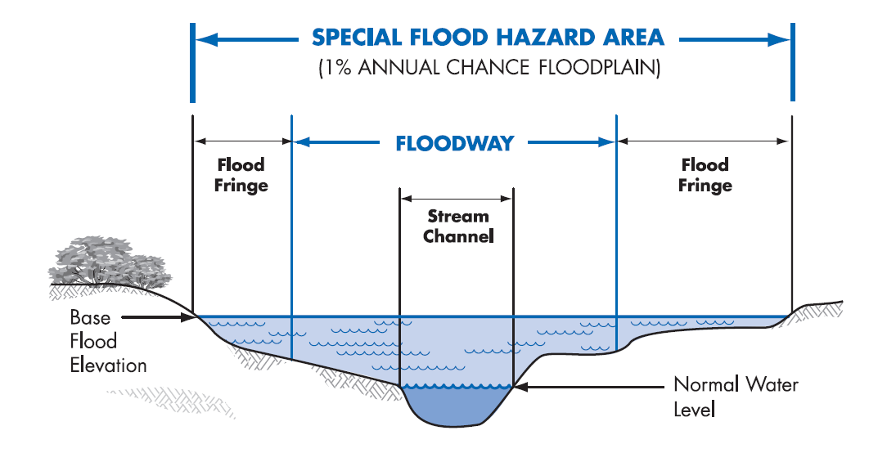
http://www.ncfloodmaps.com/pubdocs/nc_quick_guide_2008.pdf
Notes:
National Standard without regional discrimination adopted by FEMA. The standard has a 1% annual chance flood (or base flood) has a 1% chance of being equaled or exceeded in any given year.

Slide 8
Data
NC Flood Map Flood Zones
Raleigh Building Footprints
USA NHDPlusV2 Streams
NLCD Land Cover
NLCD Impervious Surfaces

Slide 9
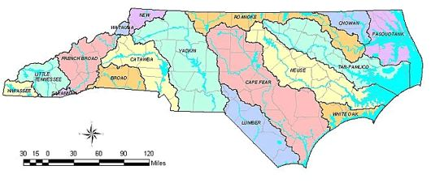
Neuse River Watershed
Wake County

Slide 10
Floodplain
Notes:
Inside Raleigh: 3,116 Buildings fall within the 1% Annual Chance Floodplain including residential and commercial properties.
Within 1/8 mile buffer of area there are 35,435 buildings

Slide 11
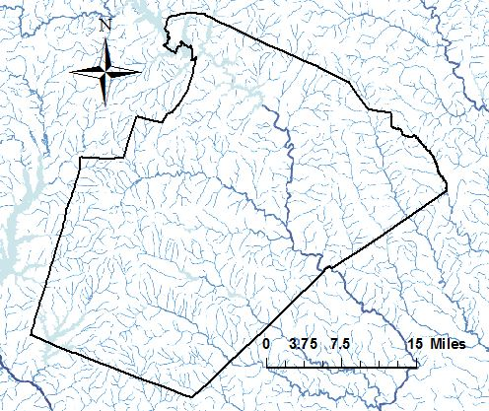
Water Bodies
Notes:
The red areas indicate developed areas of low, medium, and high intensity. The total developed areas accounts for 30.1% of the county. Most of that read areas falls in or near the 1% annual chance floodplain.

Slide 12
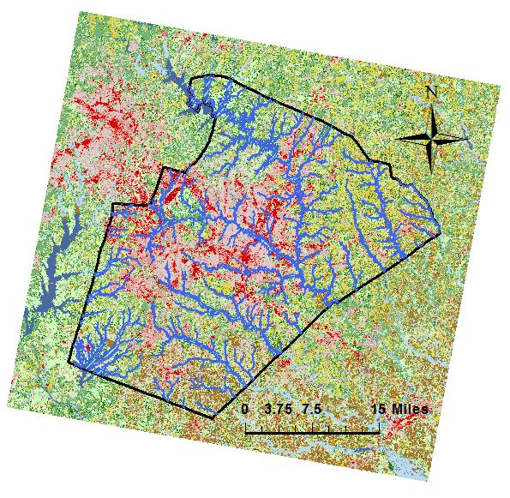
Land Cover
Notes:
The red areas indicate developed areas of low, medium, and high intensity. The total developed areas accounts for 30.1% of the county. Most of that red areas falls in or near the 1% annual chance floodplain.

Slide 13
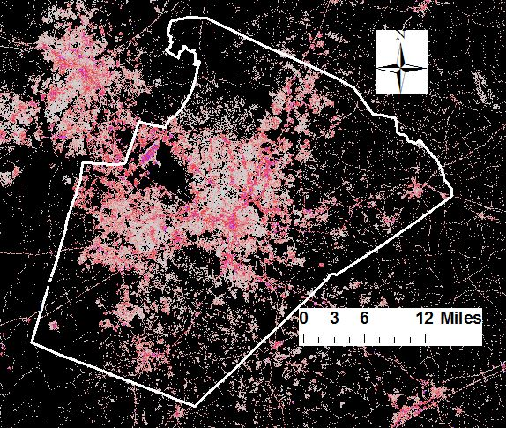
Impervious Surfaces
Notes:
The red areas indicate developed areas of low, medium, and high intensity. The total developed areas accounts for 30.1% of the county. Most of that read areas falls in or near the 1% annual chance floodplain.

Slide 14
Conclusion
Moving forward flood zones should be compared temporally to consider changes in land cover and impervious surfaces
A slight increase in the flood zone area would jeopardize a substantial number of properties within the county
Hydrologic analysis for flood mapping can include many factors
Notes:
The size and shape of a river’s drainage basin dictates how much precipitation the river can receive and how quickly it will arrive (the lag time). A large drainage basin means that the river’s catchment area is large so it will collect a lot of water, increasing discharge. If the basin is circular in shape, the precipitation will enter the river at roughly the same time because all points in the basin are equidistant from one another. This will produce a high peak discharge and can lead to flash floods.
http://www.dem.ri.gov/programs/bpoladm/suswshed/pdfs/imperv.pdf

Slide 15
Works Cited
https://geographyas.info/rivers/flooding/
http://www.dem.ri.gov/programs/bpoladm/suswshed/pdfs/imperv.pdf
http://www.ncfloodmaps.com/
http://ehs.ncpublichealth.com/oswp/nps/resources.htm
http://www.mrlc.gov/nlcd11_data.php
http://www.census.gov/population/metro/data/thematic_maps.html

