Slide 1
Pivot Finder ArcGIS Tool
Justin Dietrich
CEE 6440 GIS in Water Resources
November 20, 2014

Slide 2
Introduction
Smart Agriculture
Land Optimization + Water Optimization
Water Optimization → Center Pivots
Land Optimization → Getting a circular pivot to fit well onto a square (or other shaped) agricultural parcel.
Aka “This is a round peg, square hole problem”
Notes:
Not to mention barns, roads, rivers, and telephone poles, all which ned to be avoided.

Slide 3
Project Objectives
Develop a tool to assist professionals optimally place a center pivot on an agricultural parcel

Slide 4
General Approach
Methods
Challenges
Create Transportable Toolbox to contain scripts
Create Python Scripts to automate the process as much as possible
Should be a 4 Step Process
Programming!!!
Working with coordinate system problems
Communicating with the user how to use the tools

Slide 5
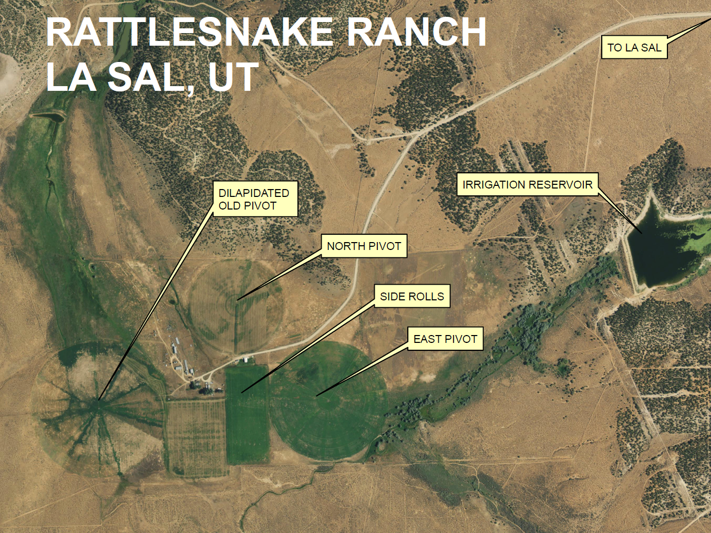
PROVIDES 100’ OF HEAD
Notes:
The best way to demonstrate my project is with an example.

Slide 6
Step 0: Get Toolbox
Toolbox is a stand-alone file package that can be moved easily and viewed in the Catalog Window of ArcGIS

Slide 7
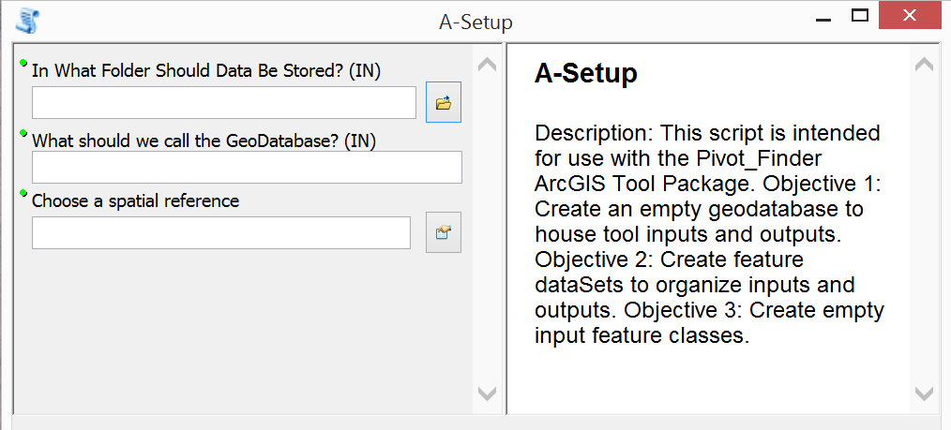
Step 1: Setup GDB

Slide 8
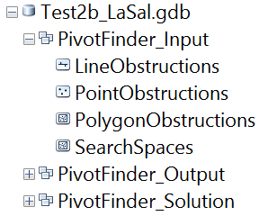
Step 1 Result
Script creates a GDB filled with everything needed for the tools to run

Slide 9
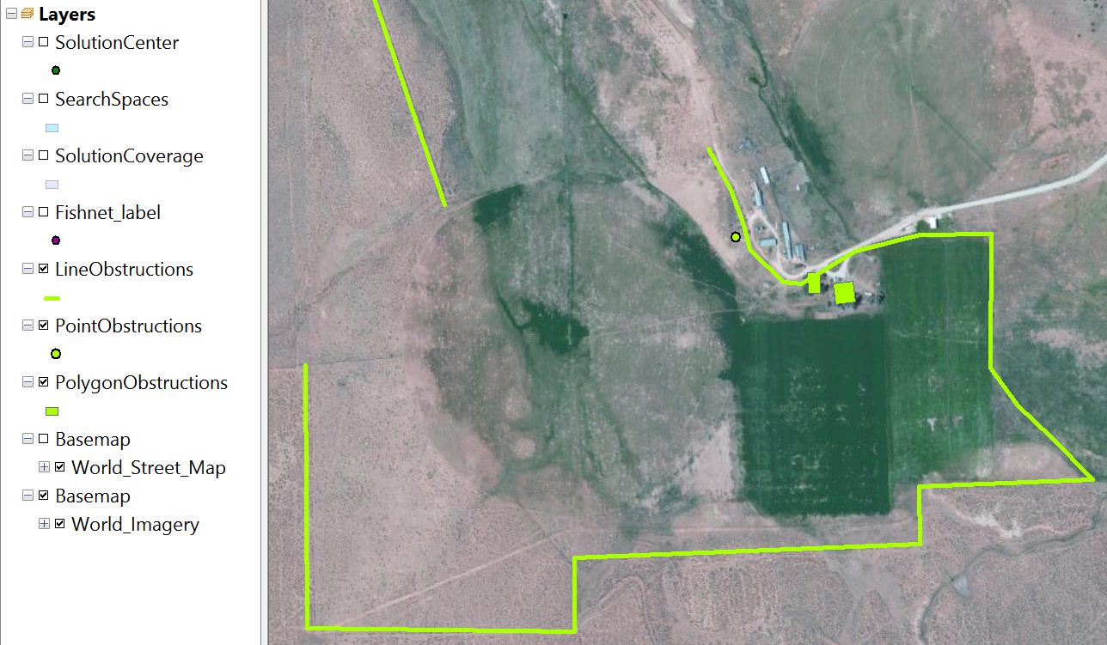
Step 2a: Define Boundaries
Notes:
This is user defined, which is going to be the hardest part

Slide 10
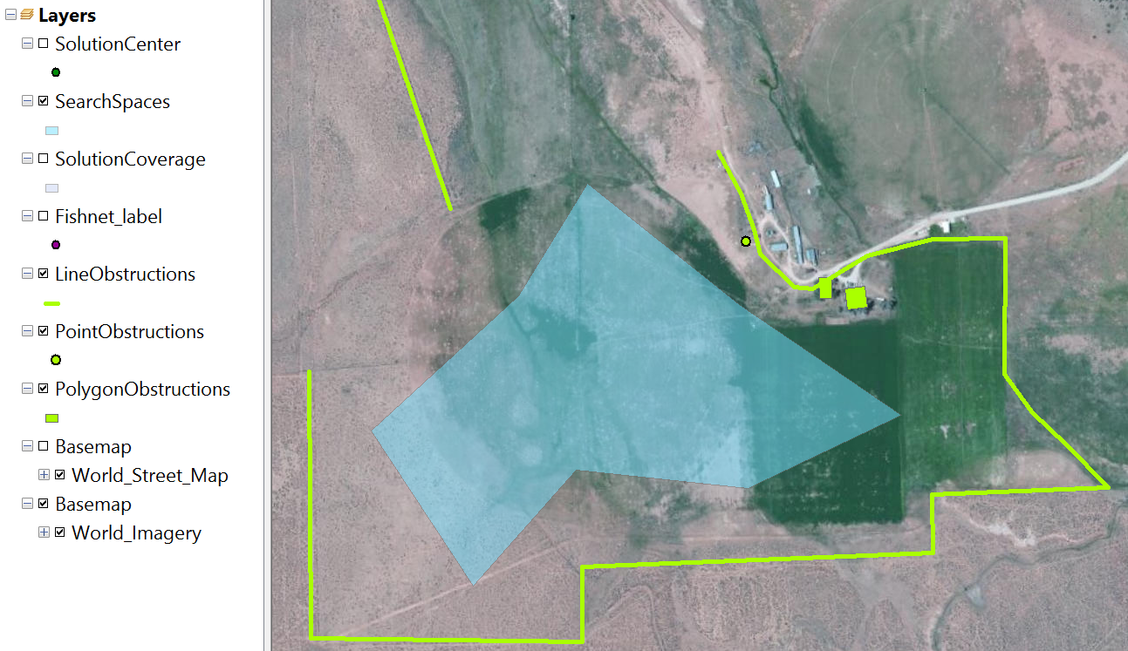
Step 2b: Define Search Space

Slide 11
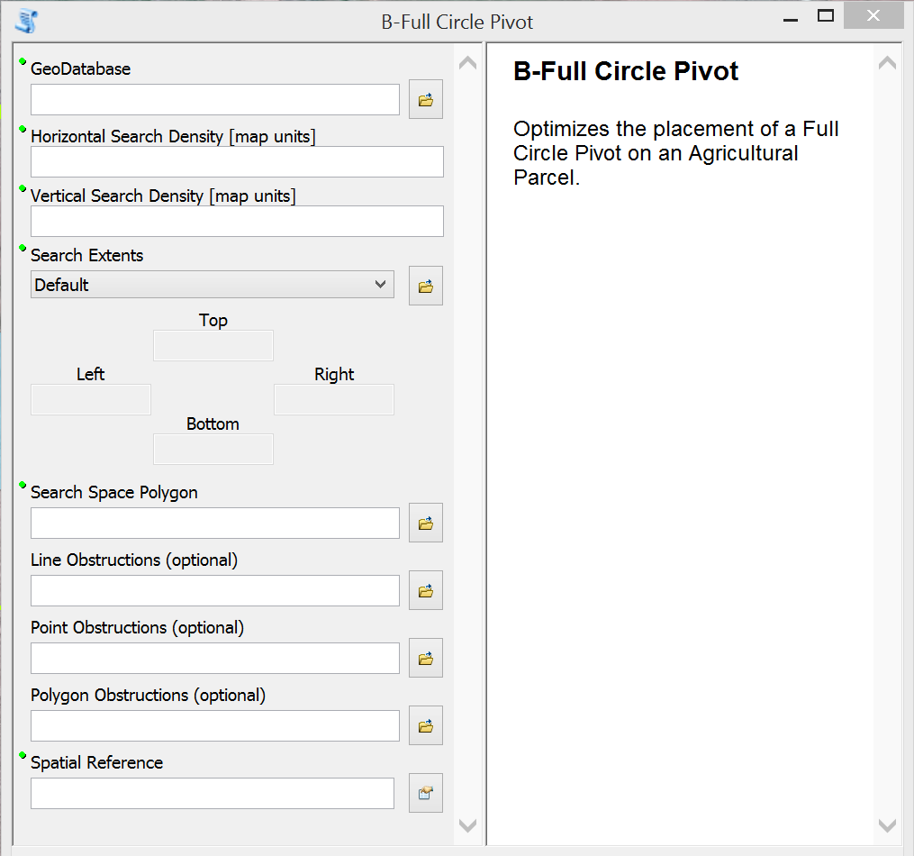
Step 3: Get Solution

Slide 12
Step 3: Get Solution (continued)

Slide 13
Step 3: Get Solution (continued)

Slide 14
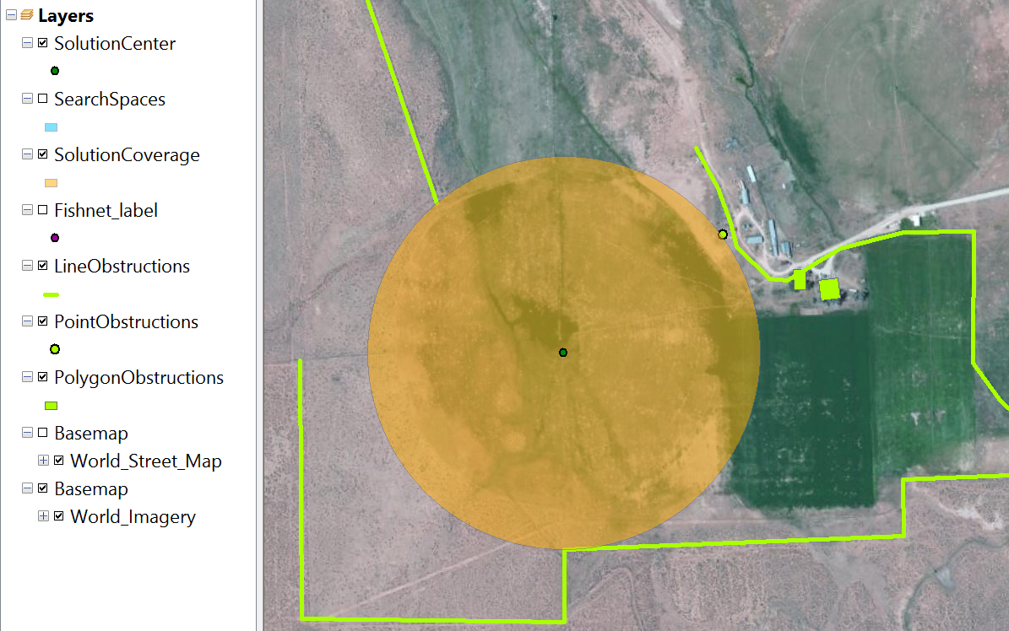
Step 4: Interpret Results
Notes:
Solution Center is what we’re after, it is a single point, with a corresponding pivot length and center location.

Slide 15
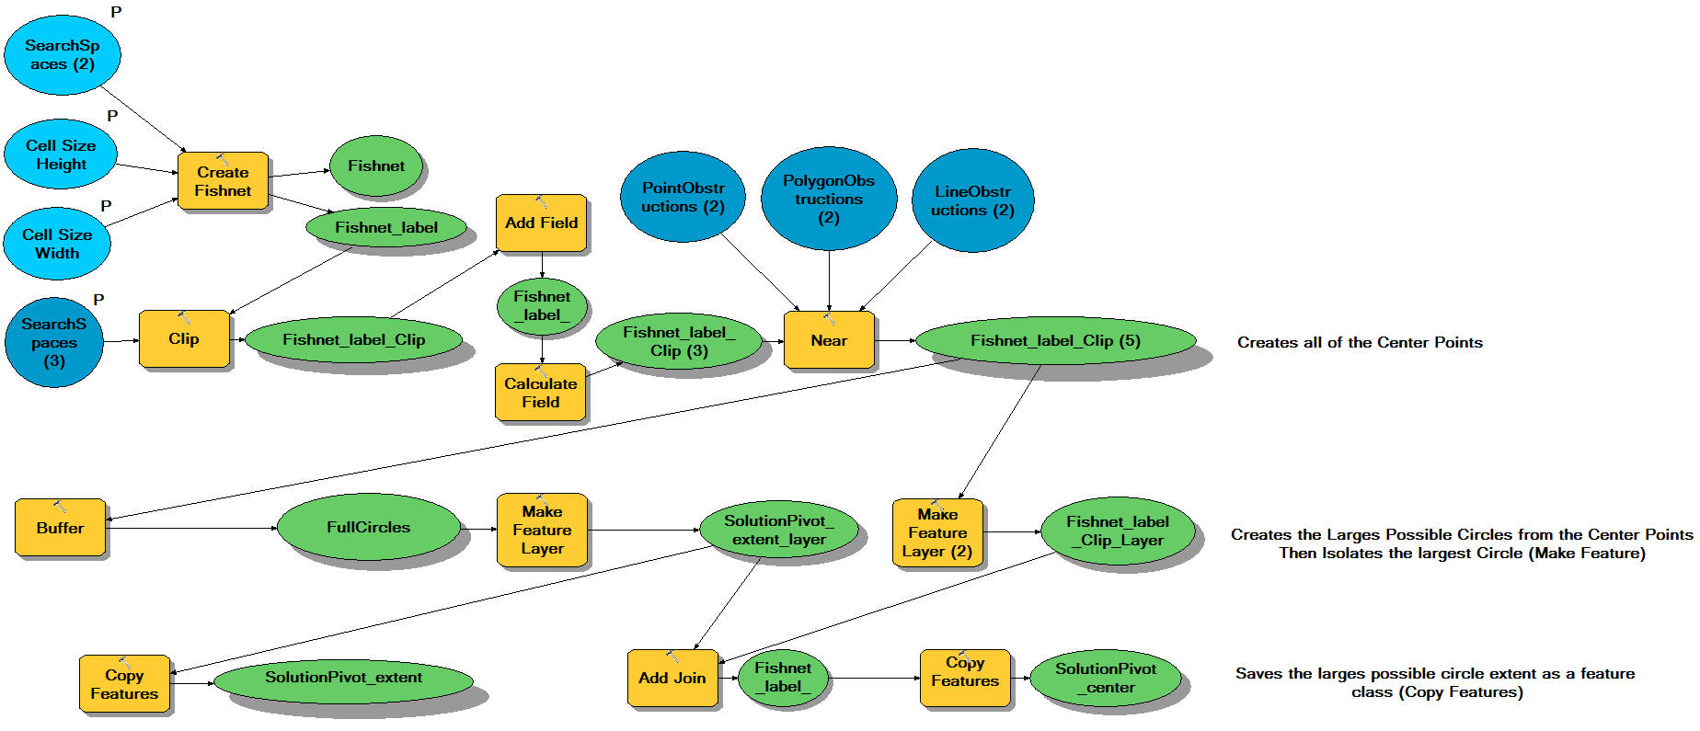
Lets Look Under the Hood!

Slide 16
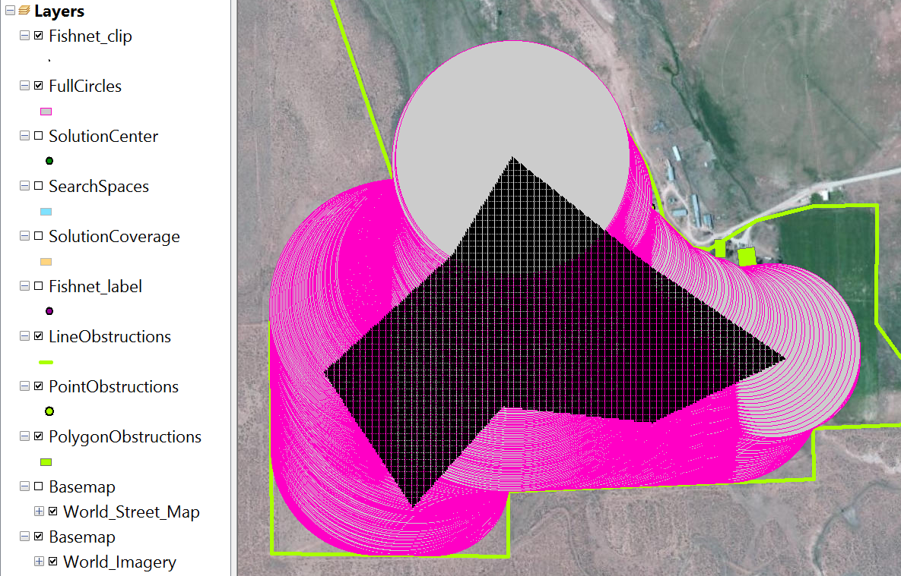
Under the Hood (Continued)

Slide 17
Under the Hood (Continued)
23699 Possible Solutions
Rank Solutions By Suitability
Produce Single-Feature Feature Class Outputs
All in 20.6 Seconds on my i5 processor

Slide 18
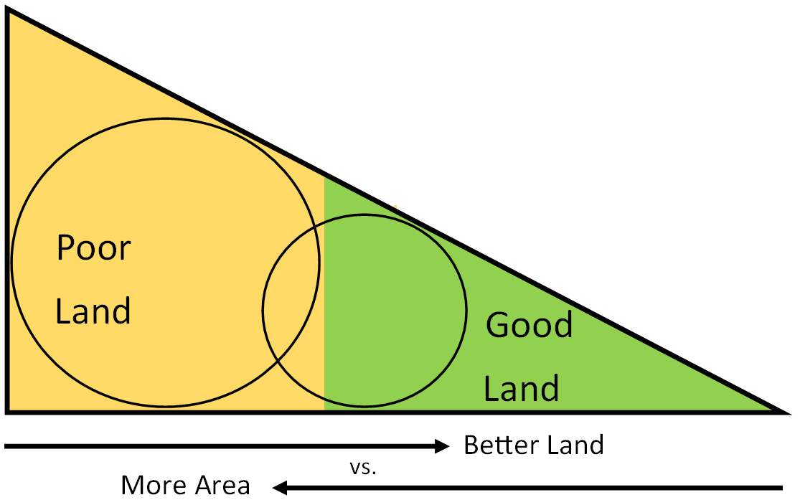
What’s Next?

Slide 19
PROVIDES 100’ OF HEAD
Notes:
The best way to demonstrate my project is with an example.

Slide 20
Conclusion
The foundation has been created and additional functionality can now be added.
Performance is Excellent.
Supporting documentation will be key to making the tool package usable.

Slide 21
Special Thanks
Dr. Tony Castronova
StackOverflow
Google
ArcGIS Online Resources

