Slide 1
Impact assessment of a Hydropower Plant Reservoir in a National Park
Author: Henrique de Paula
Date: 11-20-2014

Slide 2
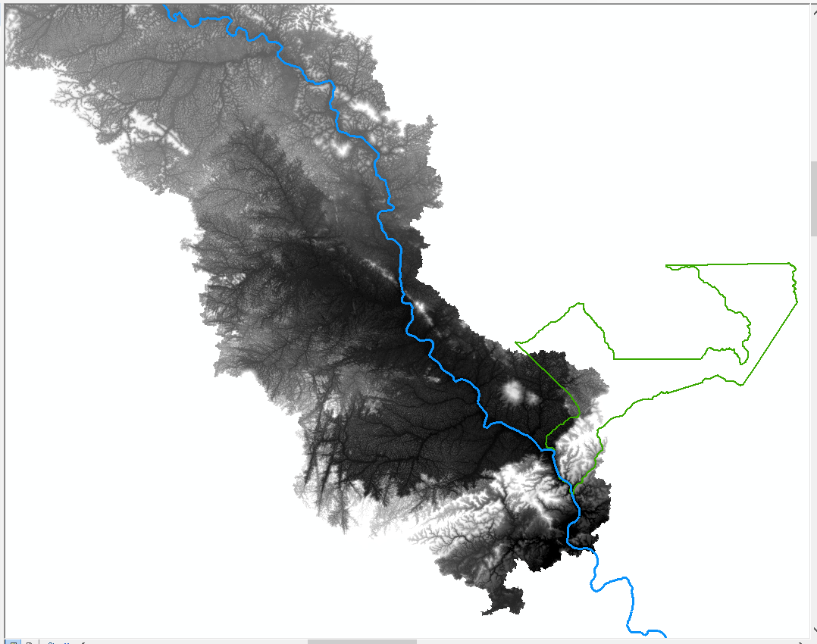
What impact are we talking about?

Slide 3
Why worry about it?
Source: www.greenpeace.org
Beautiful “Manure” Hill
Example: total flooded area (516 km²) x natural river area (228 km²)
Source: www.greenpeace.org

Slide 4
What do we want to calculate?
Total flooded area due to reservoir formation
Flooded area inside the National Park
Total Flooded Area
Installed Power Capacity
Flooded Area Inside National Park
Total Unit Area

Slide 5
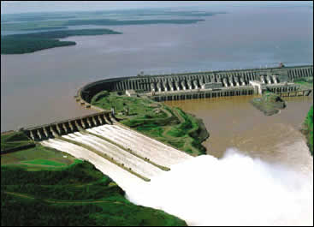
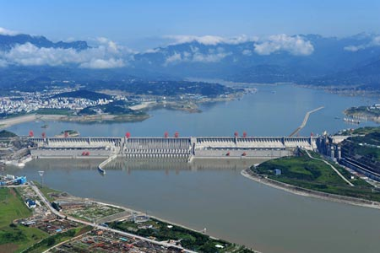
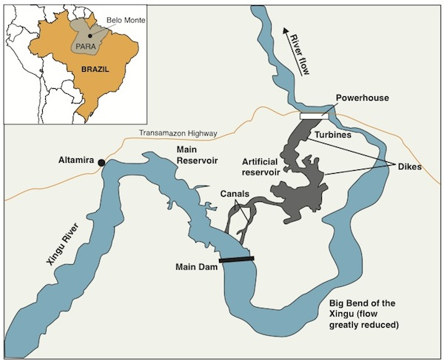
Some comparative numbers
Plant | Power Capacity (MW) | Flooded area (km2) | A/P Ratio
Itaipu | 14,000 | 1350 | 0.096
Plant | Power Capacity (MW) | Flooded area (km2) | A/P Ratio
Three Gorges | 22,500 | 1045 | 0.046
Plant | Power Capacity (MW) | Flooded area (km2) | A/P Ratio
Belo Monte | 11,000 | 516 | 0.047

Slide 6
Input Data
Now, back to our dam…
Digital elevation model of the region – SRTM raster file*
Dam geographic location – XY point
Conservation Unit boundaries – feature class obtained from ICMBio Institute
Data manipulation
Dam catchment area – Watershed delineation webservice tool
Total flooded area – Less than equal Spatial Analyst Math tool*
Flooded area inside National Park – Extract by mask Extraction tool
All layers projected to South America Albers Equal Area Conic Projected Coordinate System

Slide 7
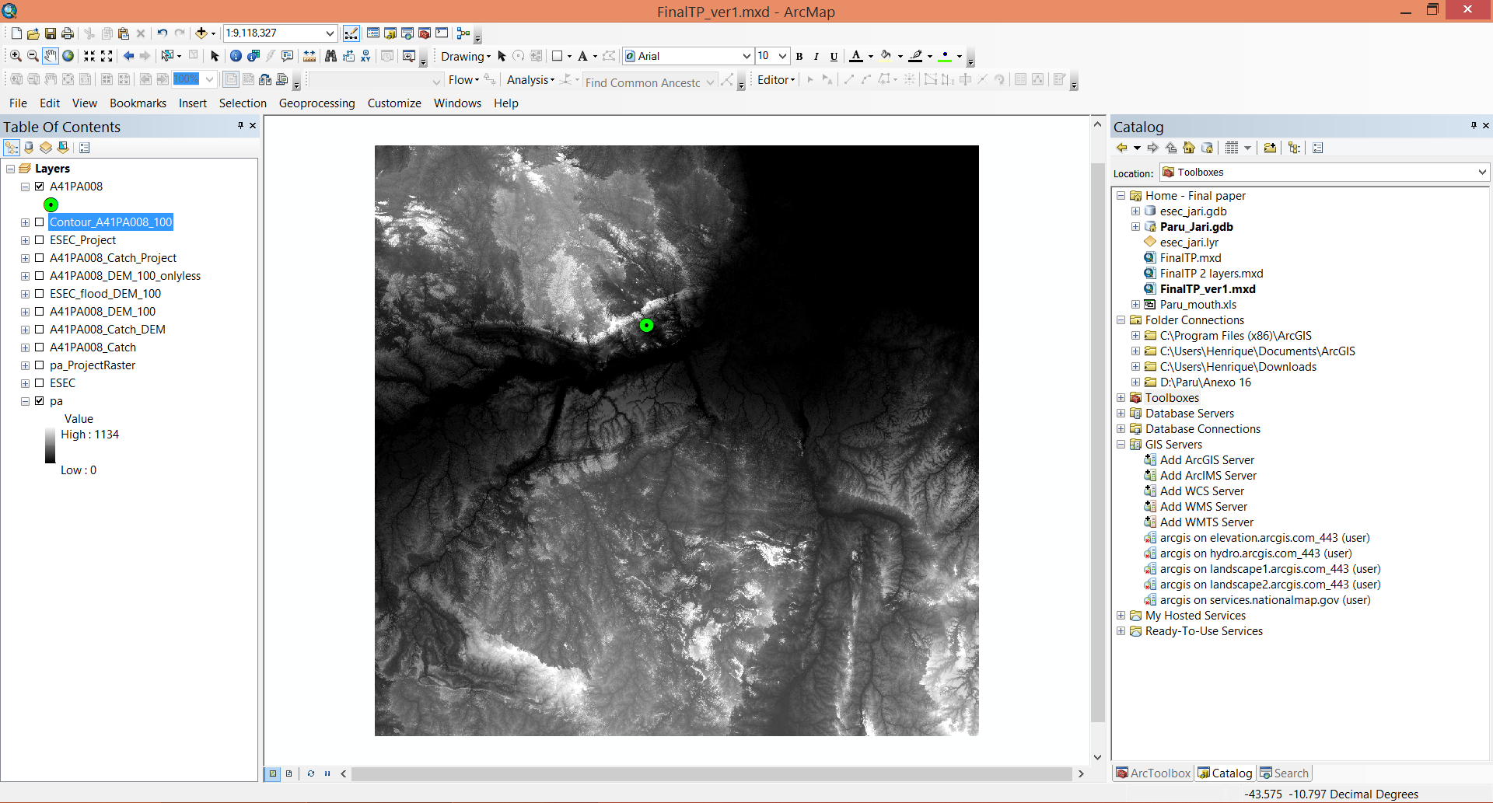
Data manipulation – From this…

Slide 8
…to this…

Slide 9
…and finally this!

Slide 10
Calculations (1/2)
Energy and Installed Power Capacity
E = γ.Q.H [MWavg]
E → Firm Energy
γ → Water specific mass x gravity x equipment efficiency x conversion factor – usually 0.0088
Q → Monthly average flow during the Critical Period
H → Net mean drop
P = E/Fc [MW]
P → Installed Power Capacity
FC → Capacity Factor – in Brazil, 0.55 for planning purposes
Different values of H → Different E, P and flooded areas

Slide 11
Calculations (2/2)
Flooded Area (A1) – Total flooded area from ‘Less than equal’ tool
Number of cells equal to “1” x cell area
Flooded Area (A2) – Flooded area inside Conservation Unit from ‘Extract by mask’ tool
Number of cells equal to “1” x cell area
Conservation Unit Area (A3) – From polygon attributes
$Total flooded area \left(A1\right)÷Power capacity (P)$
$Flooded area inside unit \left(A2\right)÷Total unit area (A3)$

Slide 12
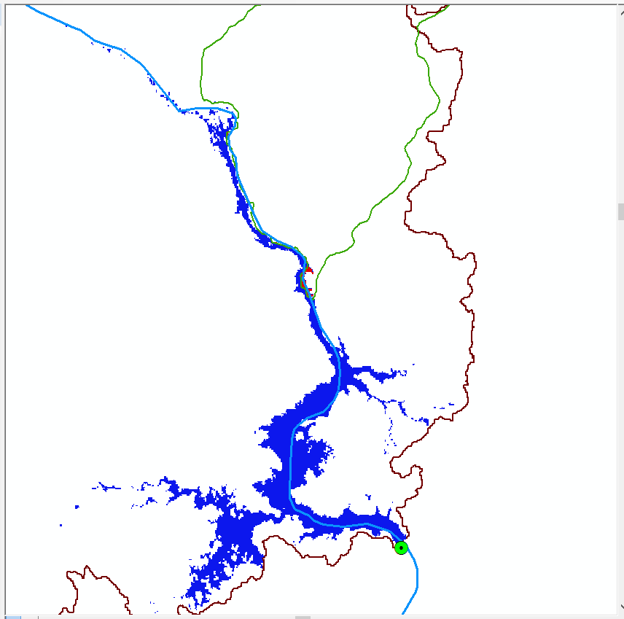
Example
For H = 100 m
E = 0.0088 x 92 x 758.6
= 614.15 MWavg
P = 614.15 / 0.55
= 1116.66 MW
A1 = 101.92 km²
A2 = 1.16 km²
A3 = 2310 km²
A1/P = 0.091 km²/MW
A2/A3 = 0.05%

Slide 13
Assumptions / Challenges
Accurate representation of surface elevation by the DEM → obtain better resolution models is not an easy task*
Simplified method to calculate energy generation and installed power capacity → simulation of hydropower plant operation will result in better estimations
Inexistence of leaks in the reservoir → calculated flooded area may be larger than the actual one

Slide 14
Work to be done
Finish the tool being developed for these calculations using Model Builder
Test the tool
Report the results
Possible improvements
Obtain higher resolution DEM files
Calculate energy based on the hydropower plant operation
Have XY dam location as a user input

Slide 15
Thank you!

