Slide 1
Increasing Storage Capacity For Woodruff Creek Reservoir
Tyler Stuart
GIS for Water Resources

Slide 2
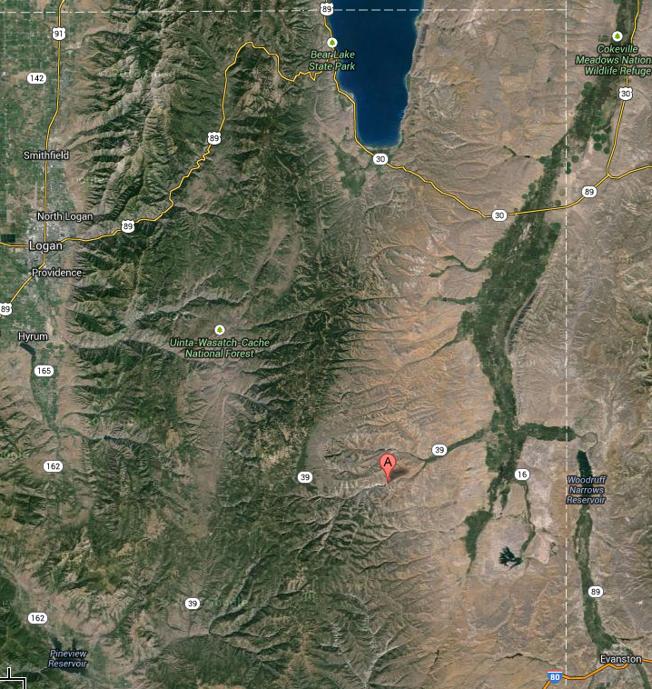
Where Is Woodruff Creek Reservoir?

Slide 3
Background
Built in 1970 with Storage Capacity of 3400 acre-ft
1970 Water Right Allowed 6,000 acre-ft between Woodruff Creek and Birch Creek Reservoirs
Provides about 20 days of water for Agriculture
Woodruff Creek has Spilled Every Year since Construction where Birch Creek spills about 1 in every 15 years

Slide 4
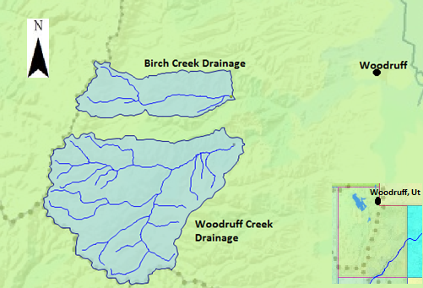
Background
Additional 8,000 acre-ft of storage was given in the 1980’s for the two reservoirs
New reservoir means lower priority
Option: Increase Storage Capacity of Woodruff Creek Reservoir

Slide 5
Water Availability
Is there even 8,000 acre feet of extra water?

Slide 6
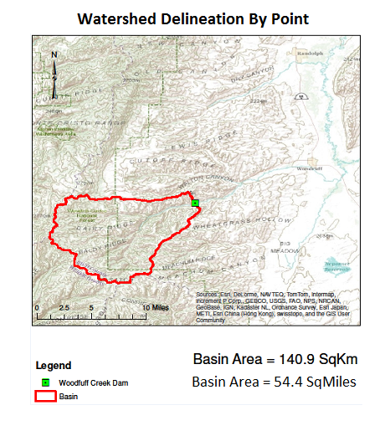
Precipitation Volume
Find Total Area
Average Precipitation
Total Volume

Slide 7
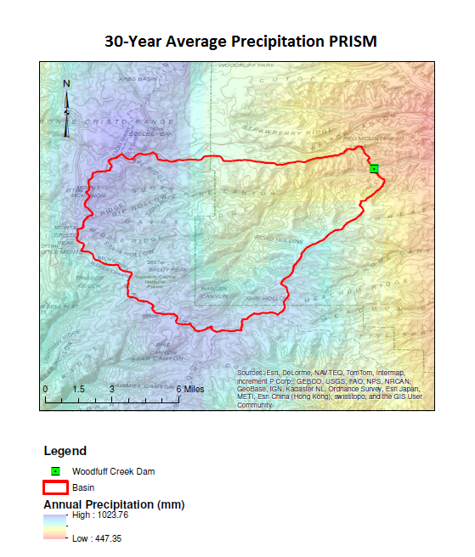
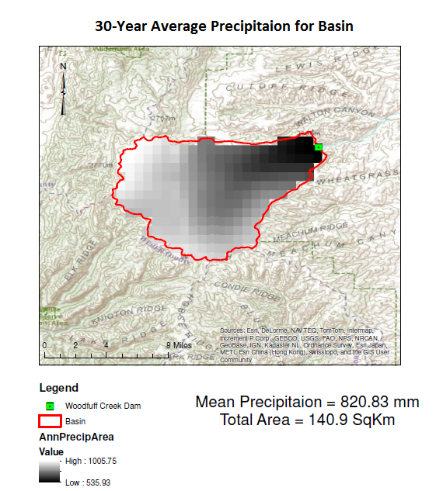
Total Precipitation Volume= 93,760 acre-ft

Slide 8
Runoff Ratio
15 Years of USGS Stream flow Data
Each Year compared to Precipitation for that year
$$Runoff Ratio=\frac{Stream Flow Data}{Total Yearly Precipitation}$$
Prism annual precipitation is from January to December
Needed data for Utah Water Year (October to September)

Slide 9
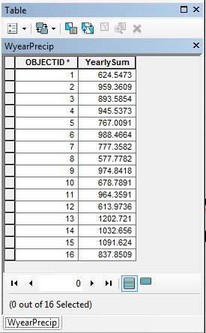
Python
Grouped all monthly prism data into water year
Defined Specific Zone for Statistics
Used function “ZoneStatisticsAsTable” to calculate Average Precipitation over watershed for each year

Slide 10
Average Runoff Ratio
Start Date | End Date | Water Year | Total Runoff (Acre-ft) | Precipitation (mm) | Precipitation (ft) | Precip Volume (Acre-ft) | Runoff/ PrecipVolume
Oct-70 | Sep-71 | 1971 | 31791.00 | 959.36 | 3.15 | 109583.95 | 0.29
Oct-71 | Sep-72 | 1972 | 29683.16 | 893.59 | 2.93 | 102070.68 | 0.29
Oct-72 | Sep-73 | 1973 | 16597.11 | 945.54 | 3.10 | 108004.93 | 0.15
Oct-73 | Sep-74 | 1974 | 20585.42 | 767.01 | 2.52 | 87612.37 | 0.23
Oct-74 | Sep-75 | 1975 | 19861.91 | 988.47 | 3.24 | 112908.55 | 0.18
Oct-75 | Sep-76 | 1976 | 14997.44 | 777.36 | 2.55 | 88794.50 | 0.17
Oct-76 | Sep-77 | 1977 | 3670.30 | 577.78 | 1.90 | 65997.29 | 0.06
Oct-77 | Sep-78 | 1978 | 16211.53 | 974.84 | 3.20 | 111352.27 | 0.15
Oct-78 | Sep-79 | 1979 | 17627.69 | 678.79 | 2.23 | 77535.35 | 0.23
Oct-79 | Sep-80 | 1980 | 27012.81 | 964.36 | 3.16 | 110154.87 | 0.25
Oct-80 | Sep-81 | 1981 | 6500.06 | 613.97 | 2.01 | 70131.75 | 0.09
Oct-81 | Sep-82 | 1982 | 25412.21 | 1202.72 | 3.95 | 137381.99 | 0.18
Oct-82 | Sep-83 | 1983 | 34952.69 | 1032.66 | 3.39 | 117956.10 | 0.30
Oct-83 | Sep-84 | 1984 | 34257.37 | 1091.62 | 3.58 | 124691.79 | 0.27
Oct-84 | Sep-85 | 1985 | 25797.99 | 837.85 | 2.75 | 95704.35 | 0.27
Oct-85 | Sep-86 | 1986 | 41448.17 | 1178.47 | 3.87 | 134611.90 | 0.31
 |  |  |  |  |  | Average= | 0.21

Slide 11
Average Annual Runoff
$$Average Runoff=Basin Area×30yearAve×Runoff Ratio$$
$$Average Runoff=34,816 acres×2.69 ft×0.21$$
$$Average Runoff=20,0008 acre−ft$$

Slide 12
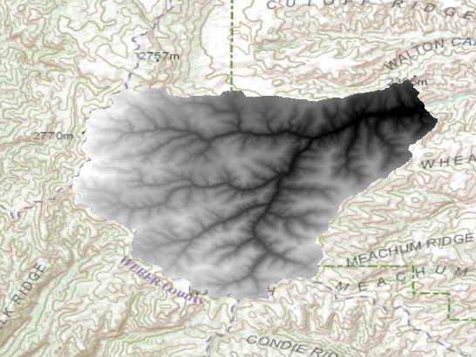
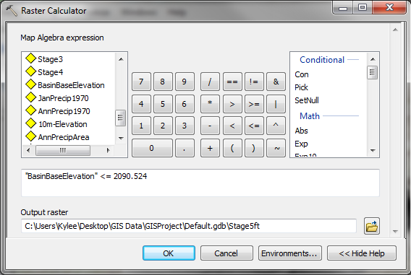
Stage Storage per Foot of Increase
BasinBaseElevation (NED 10m)

Slide 13
Stage Storage per Foot of Increase
$$Additional Volume=\left(New Elevation−Mean Elevation below\right)×Number of Cells×Cell Area$$
$$Total Volume=Current Storage+Additional Storage$$

Slide 14
Stage Storage per Foot of Increase
ft Raised | Elevation (ft) | Elevation (m) | Number of Cells Below | Average Elevation | AdditionalVolume (m^3) | Additional Volume (Acre-ft) | New Volume of Reservoir (Acre-ft)
1 | 6854.675 | 2089.305 |  |  |  |  | 3401
2 | 6855.675 | 2089.61 |  |  |  |  | 3401
3 | 6856.675 | 2089.914 | 3998 | 2090 | 9755 | 8 | 3409
4 | 6857.675 | 2090.219 | 4204 | 2090 | 134192 | 109 | 3510
5 | 6858.675 | 2090.524 | 4354 | 2090 | 262982 | 213 | 3614
6 | 6859.675 | 2090.829 | 4459 | 2090 | 398099 | 323 | 3724
7 | 6860.675 | 2091.134 | 4583 | 2090 | 535569 | 434 | 3835
8 | 6861.675 | 2091.438 | 4692 | 2090 | 677243 | 549 | 3950
9 | 6862.675 | 2091.743 | 4821 | 2090 | 822077 | 666 | 4067
10 | 6863.675 | 2092.048 | 4935 | 2090 | 970714 | 787 | 4188
11 | 6864.675 | 2092.353 | 5031 | 2090 | 1122819 | 910 | 4311
12 | 6865.675 | 2092.658 | 5142 | 2090 | 1277581 | 1036 | 4437
13 | 6866.675 | 2092.962 | 5238 | 2090 | 1435945 | 1164 | 4565
14 | 6867.675 | 2093.267 | 5344 | 2090 | 1596894 | 1295 | 4696
15 | 6868.675 | 2093.572 | 5436 | 2090 | 1761264 | 1428 | 4829
16 | 6869.675 | 2093.877 | 5540 | 2090 | 1928917 | 1564 | 4965
17 | 6870.675 | 2094.182 | 5636 | 2090 | 2099184 | 1702 | 5103
18 | 6871.675 | 2094.486 | 5741 | 2091 | 2272517 | 1842 | 5243
19 | 6872.675 | 2094.791 | 5857 | 2091 | 2448929 | 1985 | 5386
20 | 6873.675 | 2095.096 | 5981 | 2091 | 2629247 | 2132 | 5533

Slide 15
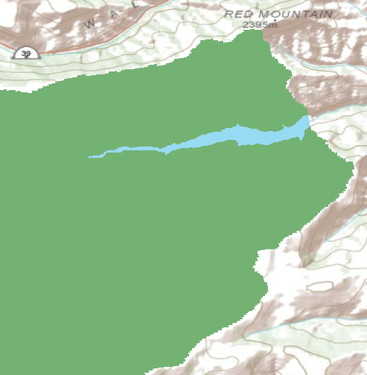
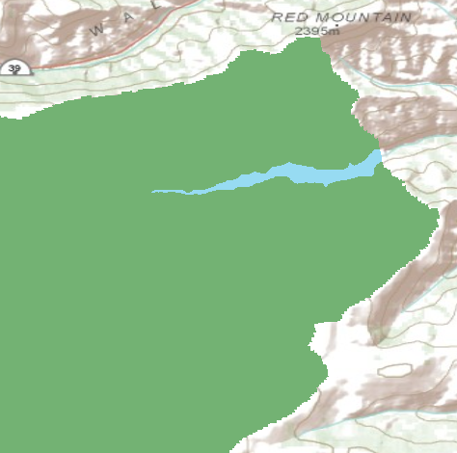
20 ft Increase 4 ft Increase

Slide 16
Conclusion
The Reservoir topology is such that little extra storage is gained as the dam is raised
Simple preliminary calculations could have killed my optimism mush sooner
An optimization Model should be run to see if early releases in conjunction with storage increase can accommodate the desired flows.

Slide 17
Questions?
Thanks to Dr. Tarboton and Tseganeh Zekiewos

