Slide 1
The Use of LiDAR Data to Analyze Snowpack with ArcGIS
By: Sam Tyler

Slide 2
Outline
Daniel Forest
Objectives
LiDAR flight data
2008; March 28th, April 28th
2009; March 18th, March 27th, May 27th, July 08th
Classification
Process/ Method
Model Builder to automate
Results
Conclusion

Slide 3
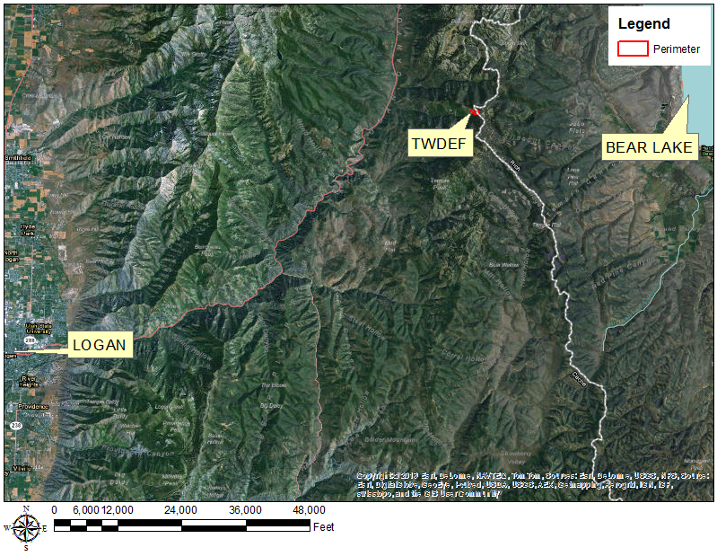
Daniel Forest (TWDEF)
Location: 30 miles Northeast of Logan, Utah
TWDEF area of .78km^2
Elevation: 8600ft
Watershed contributes to the Logan River and Bear Lake
Vegetation

Slide 4
Objectives
Will TWDEF LiDAR data determine snow depth?
Compare LiDAR data to field measurements of Vinod Mahat
Compare LiDAR depth to SNOWTEL data.

Slide 5
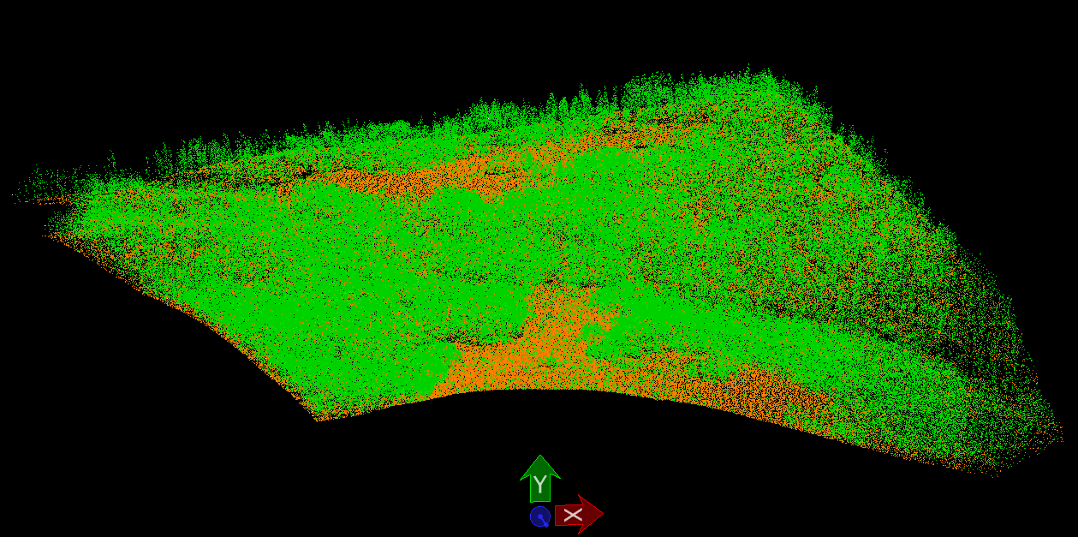
LiDAR Data Classification

Slide 6
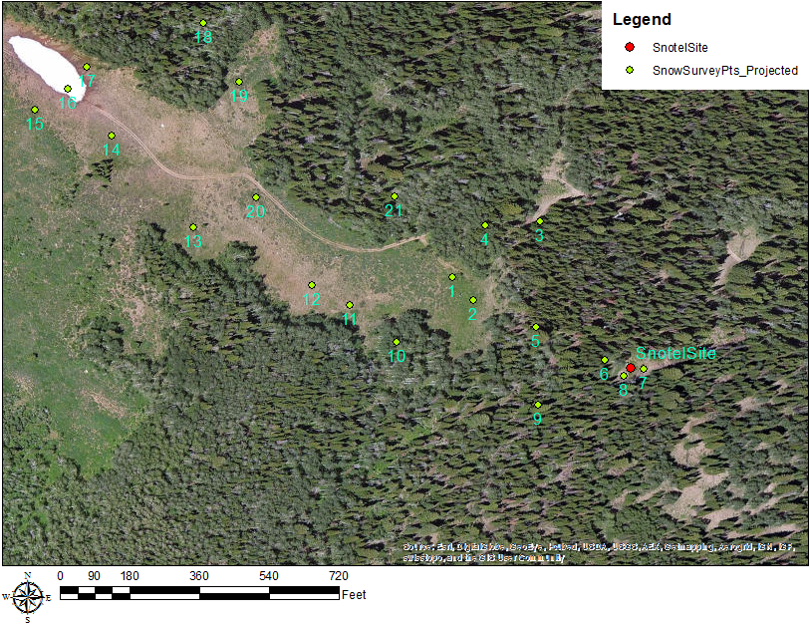
Snow Survey & SNOTEL Site Locations
21 snow survey points
Visited every two weeks: 2007-2009
Imagery Map

Slide 7
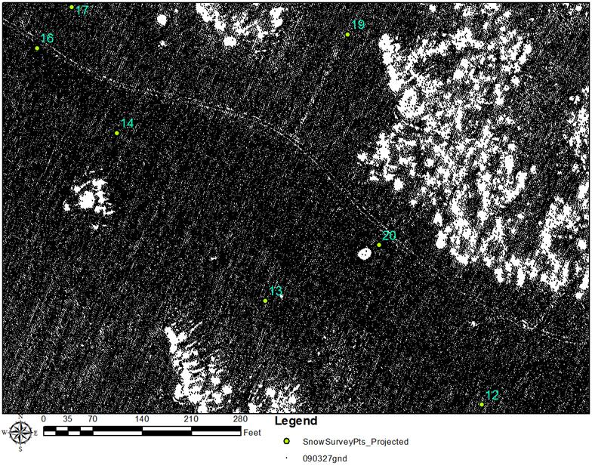
XYZ Data ArcGIS
March 27, 2009
July 8, 2009
XYZ Ground Classification

Slide 8
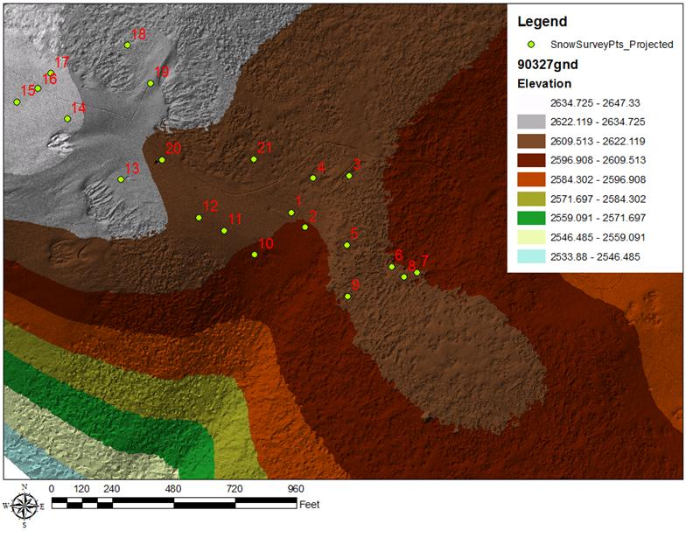
Tin
Tin 3D Analyst Tool
Point Cloud Density

Slide 9
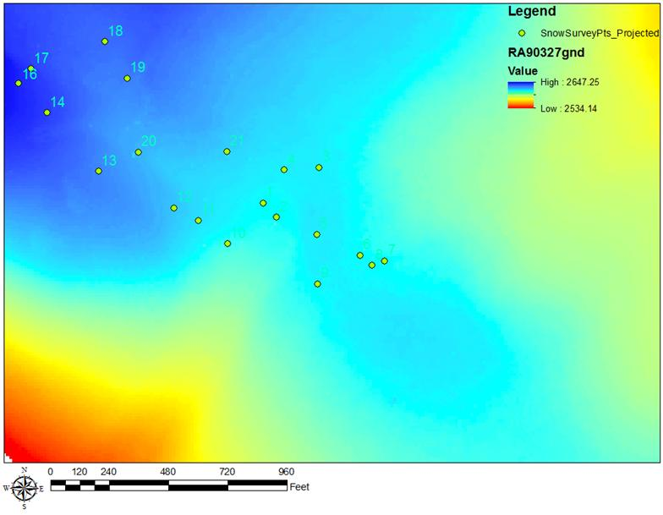
Conversion to Raster
Tin to Raster 3D Analyst
Ease Calculations

Slide 10
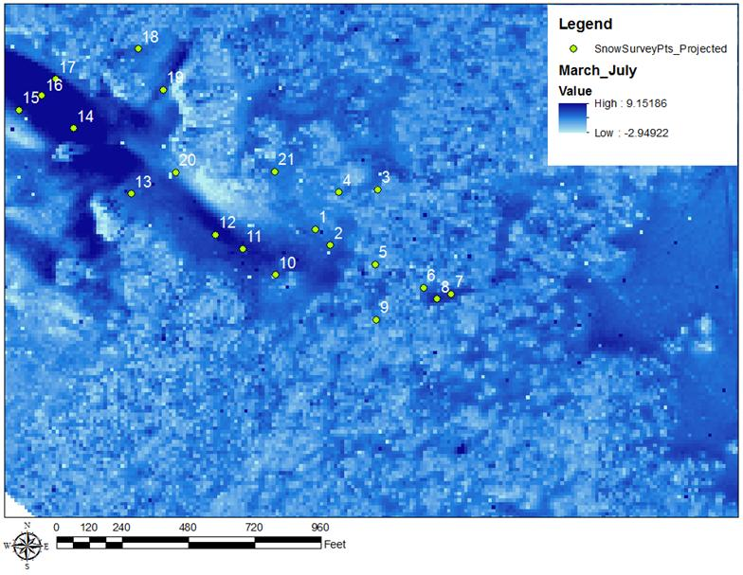
Raster Difference
Minus Tool
March 27, 2009 minus July 8, 2009

Slide 11
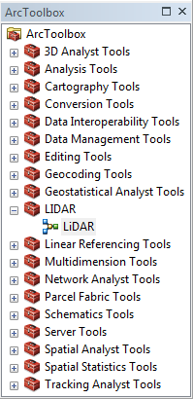
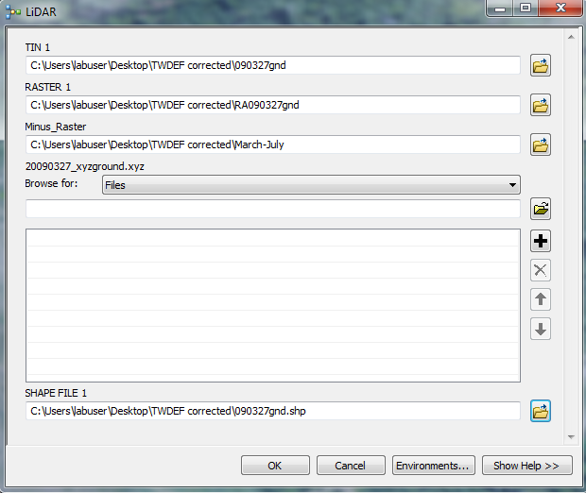
Model Builder

Slide 12
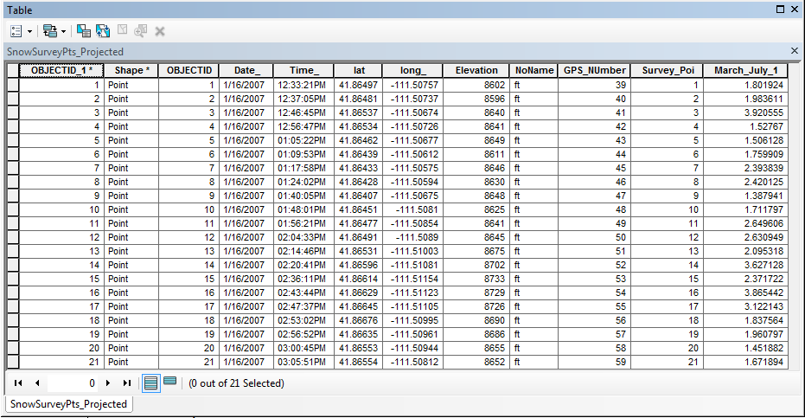
Value Output to Snow Survey Points

Slide 13
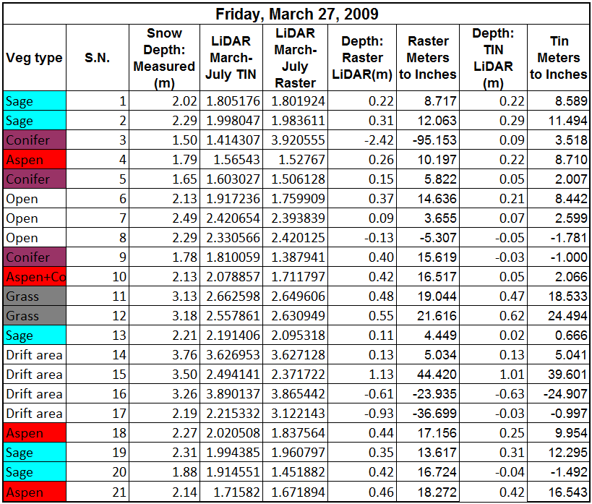
GIS Data to Excel for Comparison
Vinod ground measurements
Comparison of Tin LiDAR to Raster LiDAR
Conversion from meters to inches

Slide 14
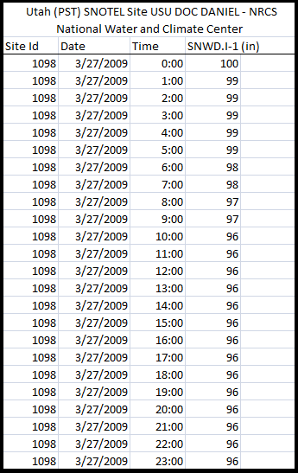
SNOTEL Data Analysis
SNOTEL data: 24 hours
96”
LiDAR
95”

Slide 15
Conclusion
TWDEF LiDAR accuracy.
Accuracy requirements while using LiDAR data.
0-9 inches
Considerations while using TWDEF LiDAR :
Classification
Reflection
Time difference
LiDAR depth vs. SNOWTEL

Slide 16
Acknowledgements
Vinod Mahat
Dr. David Tarboton
Tseganeh Zekiewos
Brad Carter
Questions?

