Slide 1
OGDEN RIVER FLOOD FORECASTING USING SNOWPACK LEVELS
PREPARED BY: MICHAEL BUDGE
CEE 6440
GIS IN WATER RESOURCES
FALL 2013
Notes:
My name,
name of the report

Slide 2
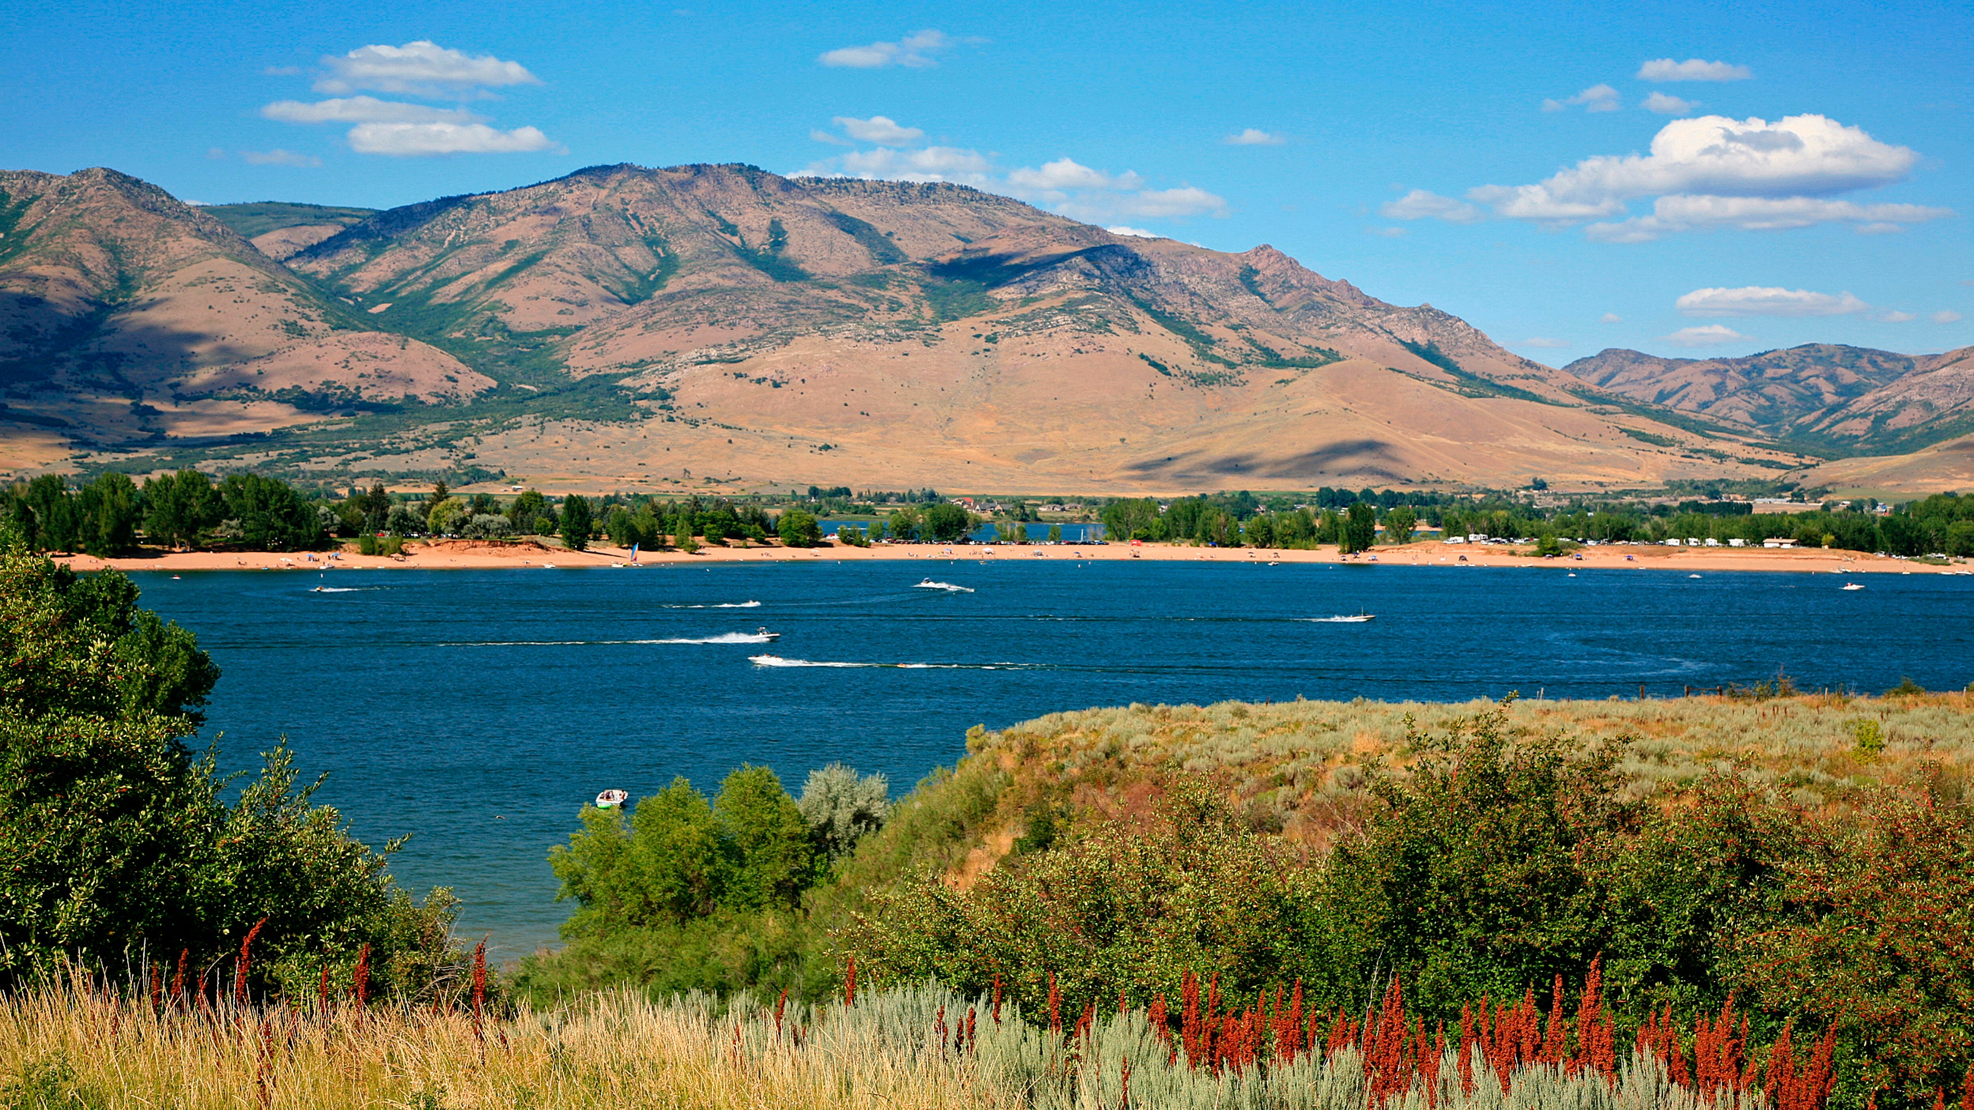
Notes:
Talk about PV reservoir. Res. built for 2 main purposes: 1. Flood Control (done thru controlling releases) 2 waters supply ( inflows < outflows, extra volume in pool)
complex system of objectives, constraints and operations
operators use hydrologic modeling & analysis to predict runoff flows
prevent flooding in wet years or retain storage to meet demands in dry years

Slide 3
BACKGROUND: OGDEN RIVER WATERSHED
Ogden River Watershed area: 203,218 acres
Ogden River - North, Central, South Forks. Flows to Great Salt Lake and provides water to Ogden, Utah
Two reservoirs: Pineview (1941) & Causey (1966)
Pineview capacity: 110,150 acre-feet

Slide 4
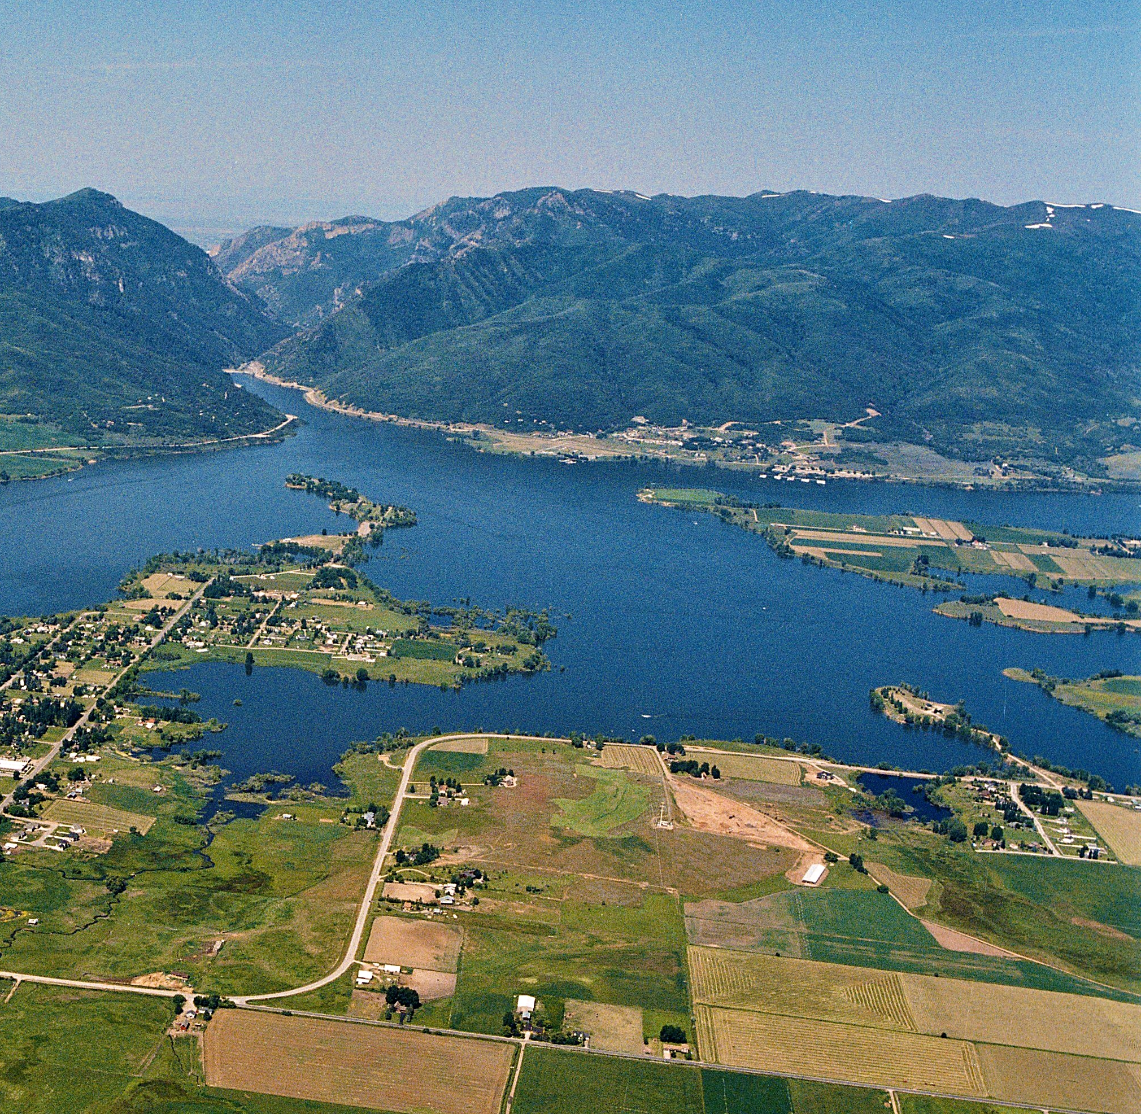
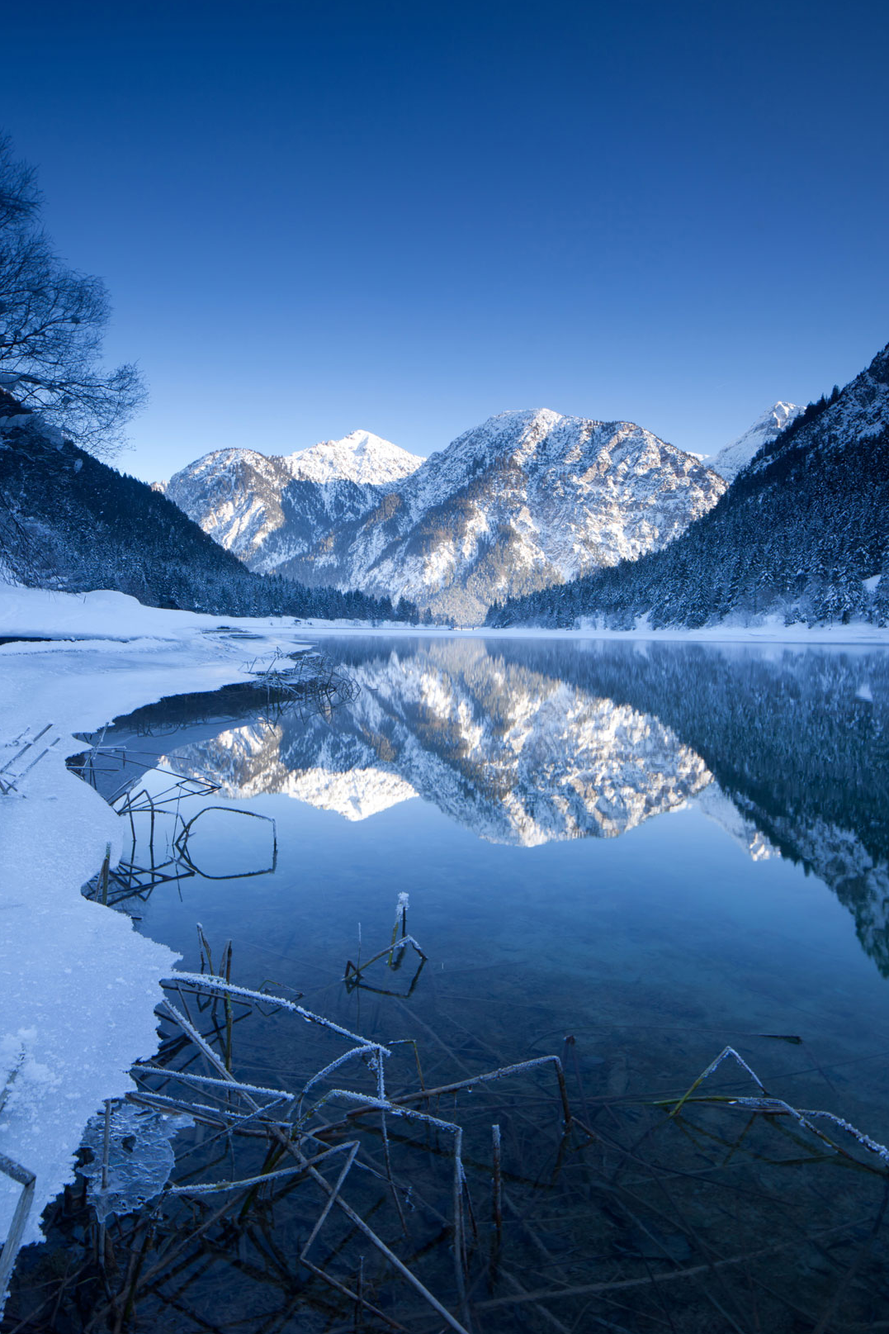
INTRODUCTION
PURPOSE: reduce damage from flooding on the Ogden River & retain storage in dry seasons thru snowpack analysis
Predict inflow volumes for water supply forecasts and peak flows for flood control.
Active storage pool levels are decreased to increase flood control capacity when high inflows are predicted.
Notes:
Aid res. ops in forecasting floods and dry years thru snowpack levels analysis
SP levels related to inflows - both volume and peak flow rate
pool levels decreased in order to store the excess flow

Slide 5
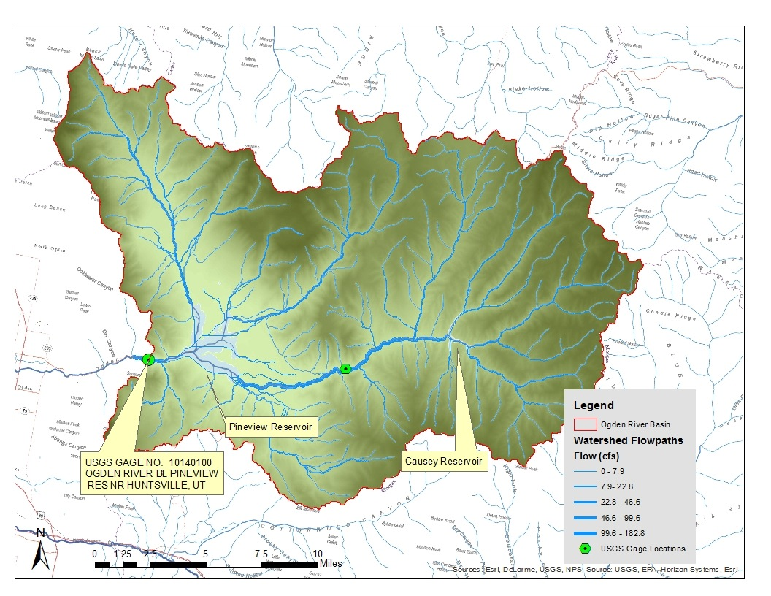
Notes:
DEM created with delineated flow paths in the Ogden River Watershed.

Slide 6
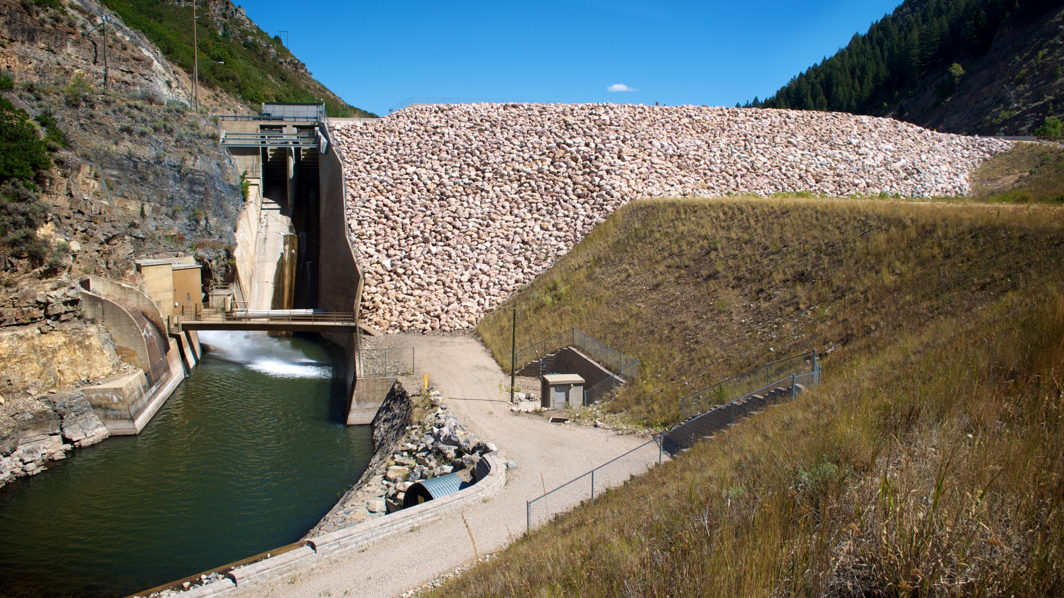
METHOD
Notes:
Reservoir operations data obtained from USBR

Slide 7
SNOTEL
SNOWPACK TELEMETRY
automated snowpack & climate sensors
over 100 sites in Utah
operated by NRCS
provides real-time snow depth and snow water equivalent (SWE) data
© www.nps.gov
Notes:
SNOTEL input data to obtain forecast seasonal inflow

Slide 8
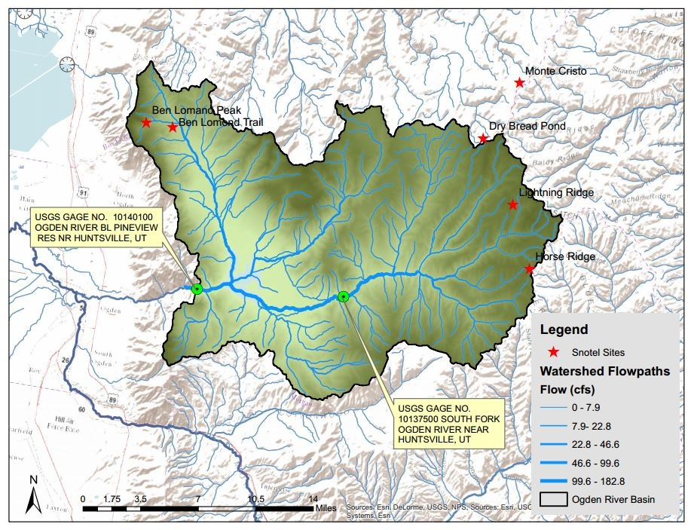
Notes:
These are the locations of the SNOTEL sites near the study area

Slide 9
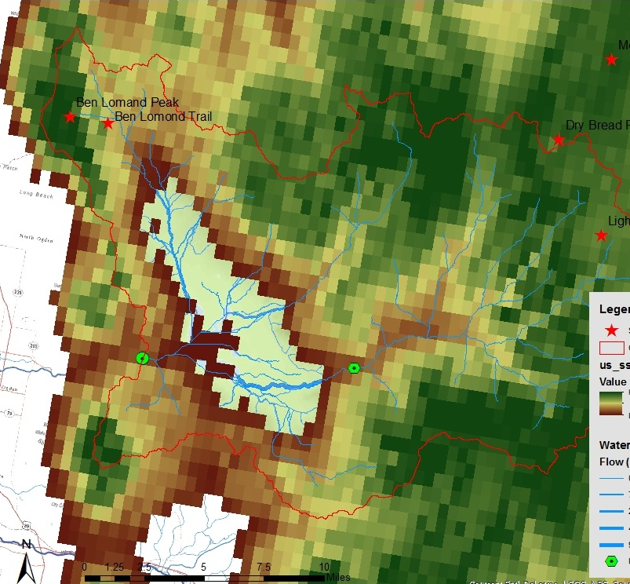
SNODAS
SNOW DATA
ASSIMILATION SYSTEM
Product of National Snow & Ice Data Center (NSIDC)
Snow level dataset derived from:
satellite imagery
airborne observations
ground measurements
available as a raster dataset in ArcMAP
Notes:
Image on the right is the raster dataset overlay- green values here represent greater SWE depths

Slide 10
METHODS: SNOW DATA SOURCES
April 1 SWE from one SNOTEL site
SWE averaged over 6 SNOTEL sites near the watershed
SWE estimated from the SNOTEL SWE and elevation using the DEM elevations in the watershed
SWE estimated from SNODAS dataset
Notes:
input: SWE leves
output: Res inflows

Slide 11
Notes:
Data points represent SWE depths at each SNOTEL site and volume of Spring inflow into PV res. from the corresponding year of measurement
Blue and dark green are single sites. Blue points are yearly averages over all sites

Slide 12
Notes:
Similar to previous graph- x axis represents peak flow rate into PV res.
From these plots, you could predict the peak flow and inflow volume based on the april 1 SWE
BUT - these relationships don’t capture the complexity of the land elevation

Slide 13
Notes:
So this is a relationship between SWE measurement and site elevation.
each color reps a different year’s data
linear regression best fit line fit for each years data to produce equations (one is shown)

Slide 14
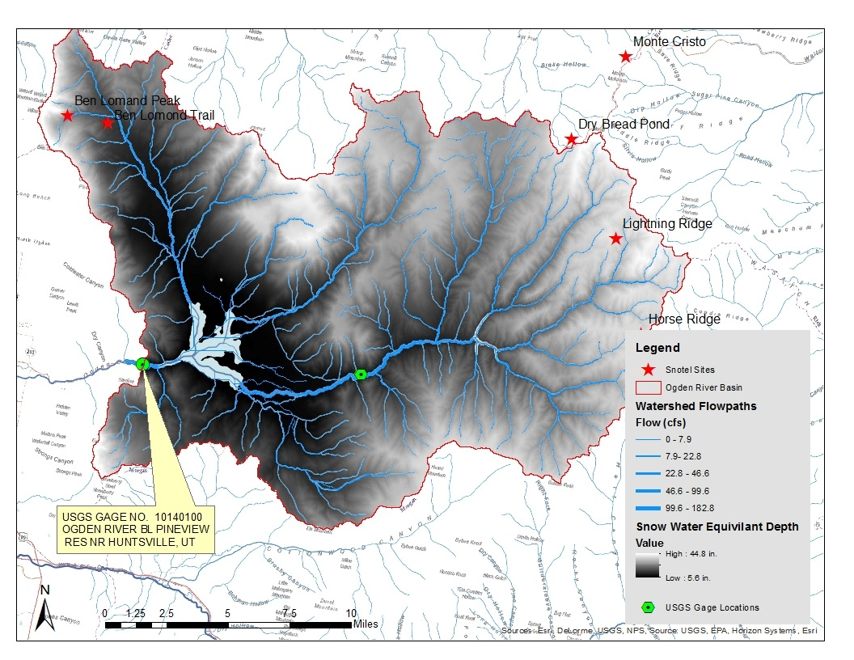
Notes:
In ArcMap the DEM was used to produce a raster dataset of snowfall depth across the entire watershed.
Using Map Algebra and the Raster Calculator the equations from the previous graph were used to output SWE depths as a function of elevation
This is April 1, 2011. Lighter values are deeper SWE levels

Slide 15
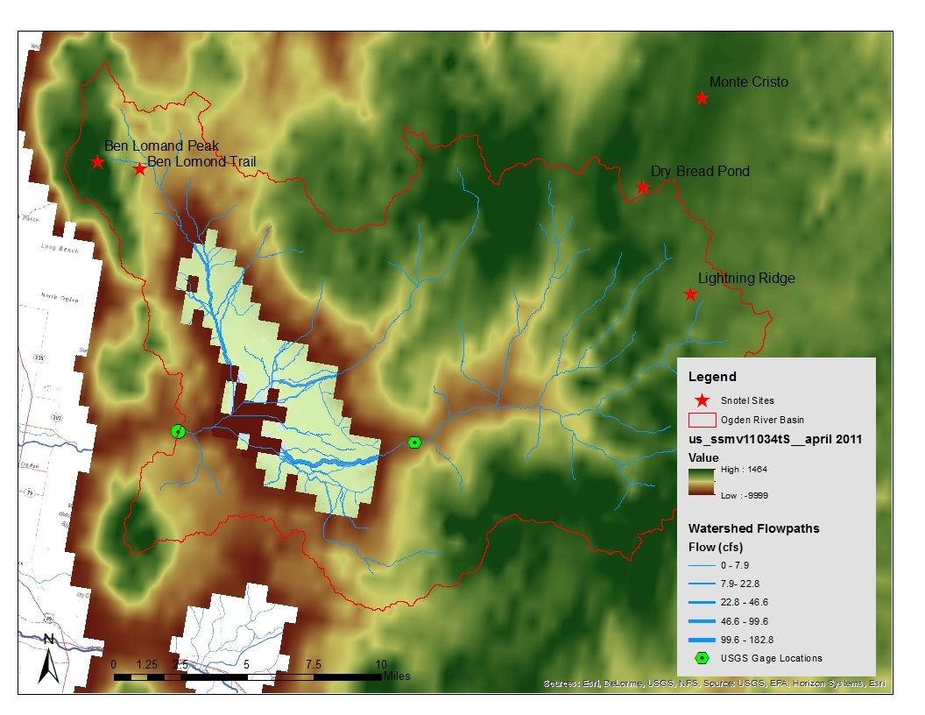
Notes:
Similarly, SNODAS data for the western US was extracted over the watershed area.
Year 2011 - Green represents higher levels. Areas with no data are clear.
Mean SWE depth was obtained from the layers in ArcMap

Slide 16
Notes:
Plot of calculated volume of SWE in acre-ft in watershed on april 1 over each year studied.
different methods
Blue line represents PV inflow volume each year. [this is for comparison only - different orders of magnitude - SWE only 1% of inflow total)
shows direct correlations and best methods

Slide 17
Notes:
Note different units for Pink line (cfs vs acre-ft) For comparison purposes

Slide 18
UNCERTAINTY
errors in input data / measurement
fitting trend lines in graphs for raster equations
models do not perfectly represent reality
Notes:
Data measurements could have errors that affect outcomes
Trendlines- some years data did not create linear regression best fit lines that lead to accurate SWE volume estimates

Slide 19
CONCLUSION & RECOMMENDATIONS
Flooding: Estimating SWE depth from SNODAS data was the best predator of peak flow
Water Supply: Estimating SWE using SNOTEL data and the DEM elevations was the best predictor of inflow volume

Slide 20
SOURCES
Questions?
US Bureau of Reclamation www.usbr.gov
Natural Resources Conservation Service SNOTEL www.wcc.nrcs.usda.gov/snotel
National Snow & Ice Data Center www.nsidc.org

