Slide 1
Water resources In Iron and Washington Counties
An Alternative to the Lake Powell Pipeline Project
Jesse Pope
CEE 6440

Slide 2
Population Projections

Slide 3
Water Demand Projections

Slide 4
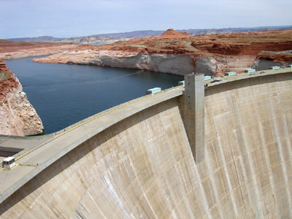
Lake Powell Pipeline Project
Diverts nearly 80,000 AFY from Lake Powell to Washington and Iron Counties
Approximately 180 miles of pipeline will be used
Total Cost = $1.5 Billion Dollars

Slide 5
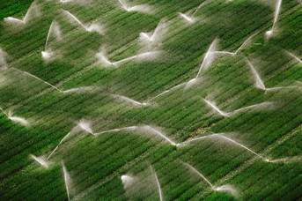
Alternative Water Sources
Water Reuse
Washington County reuses 3,900 acre-feet per year
Agricultural Water Transfers

Slide 6
Agricultural Water Transfers
4.5 acre-feet of water is used to irrigate one acre of crop in Washington County every year.
1.7 acre-feet of water is used to irrigate one acre of crop in Iron County every year

Slide 7
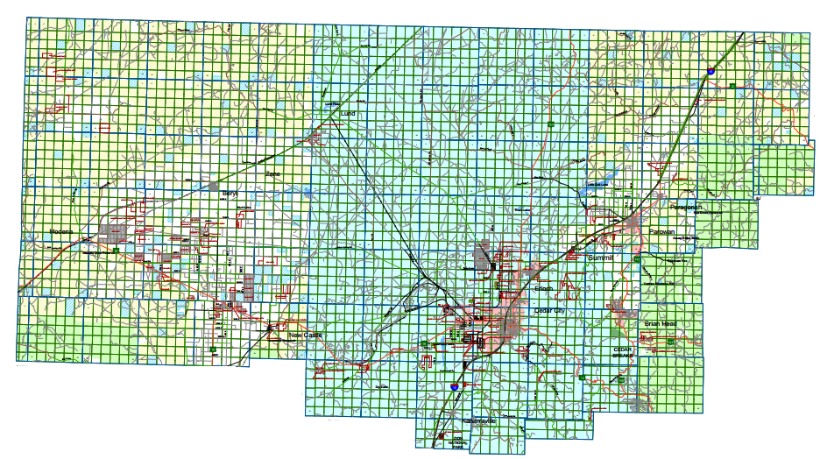
Central Iron County Water Conservancy District

Slide 8
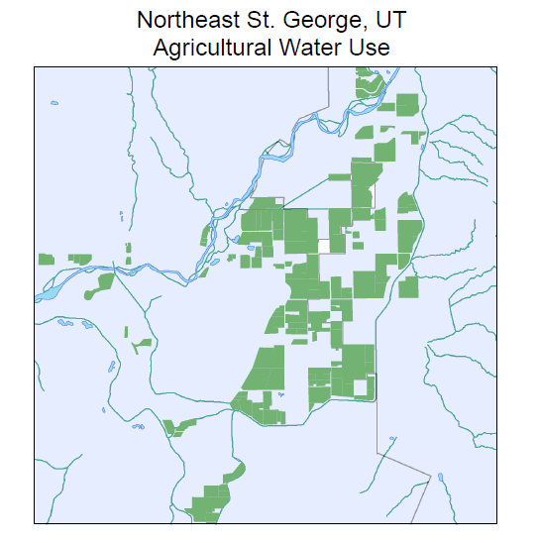
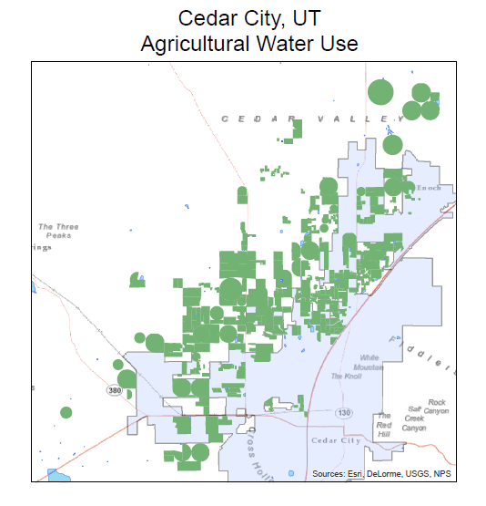
Agricultural Water Use Maps

Slide 9
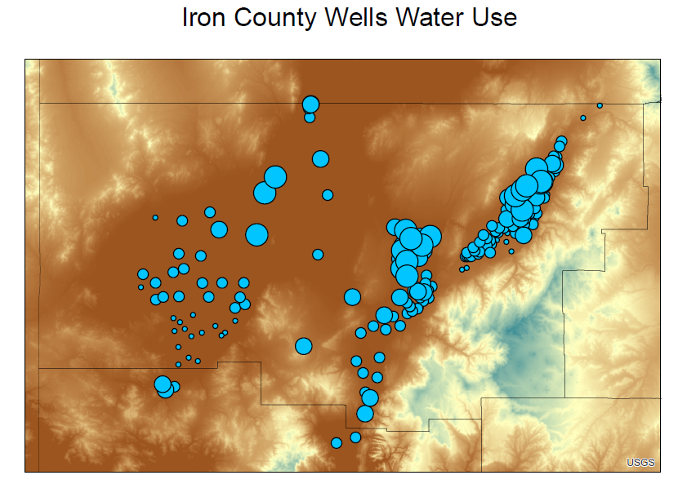
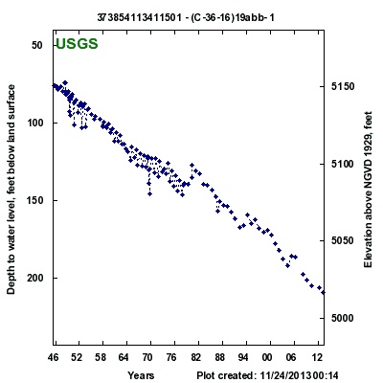
Well Water Use

Slide 10
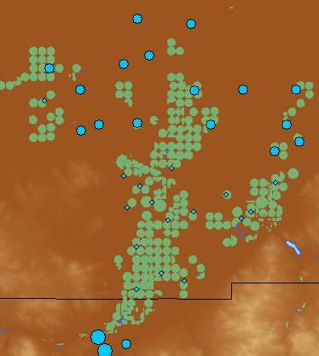
Well Water Use

Slide 11
Combine Water Sources
A total of 5480 AFY of potable water will be available in 2060.
This is less than the estimated 6200 AFY water demand.

Slide 12
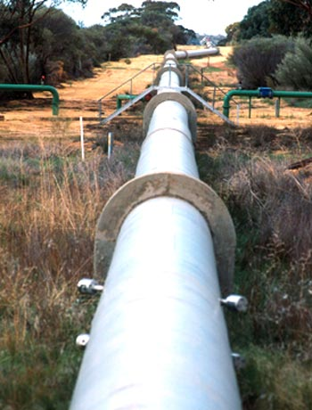
Combine Water Sources
In total, Washington and Central Iron Counties combined have enough water to support both populations.
Cedar Valley Pipeline Proposal will carry water from Washington County to Iron County.

Slide 13
Questions?

