Slide 1
Exploring Arc Hydro Capabilities to Represent Water Management Data
CEE 6440 – GIS in Water Resources Term Project
Adel M. Abdallah
Dec. 3, 2013
Notes:
Thanks Dr. Bishop for this class. It helped me in my research a lot.

Slide 2
Outline
Background and Motivation
Objective
Methods
Result and Conclusions

Slide 3
Background and Motivation
Water Management includes allocating water supply sources to competitive users’ demand
Water management data is scattered
We need to represent water management data in a consistent geodatabase

Slide 4
Water Management Data Model
WaM-DaM
Key concept: Networks comprised of nodes and links

Slide 5
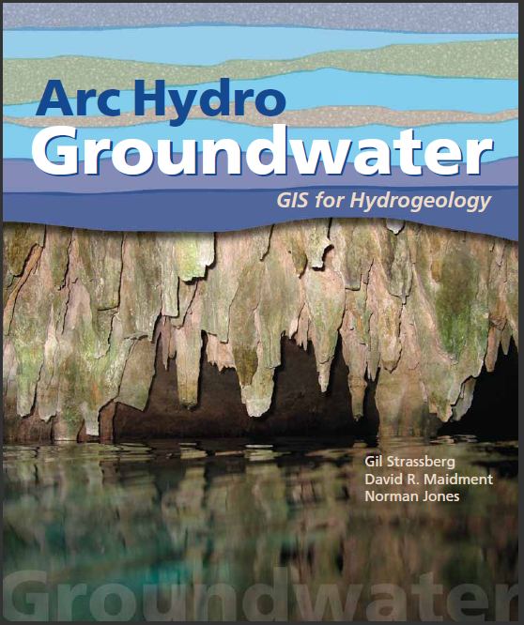
Arc Hydro Groundwater
Arc Hydro Groundwater is a geodatabase design for representing groundwater datasets within ArcGIS.
The data model helps to archive, display, and analyze multidimensional groundwater data
Tools that help to import, edit, and manage groundwater data

Slide 6
Objective
Can we use Arc Hydro Groundwater to represent Water Management data?

Slide 7
Methods
Identify study area and data sources
Explore the geodatabase of Arc Hydro GW
Get the data to ArcGIS and Load it to Arc Hydro GW
Investigate the network configuration

Slide 8
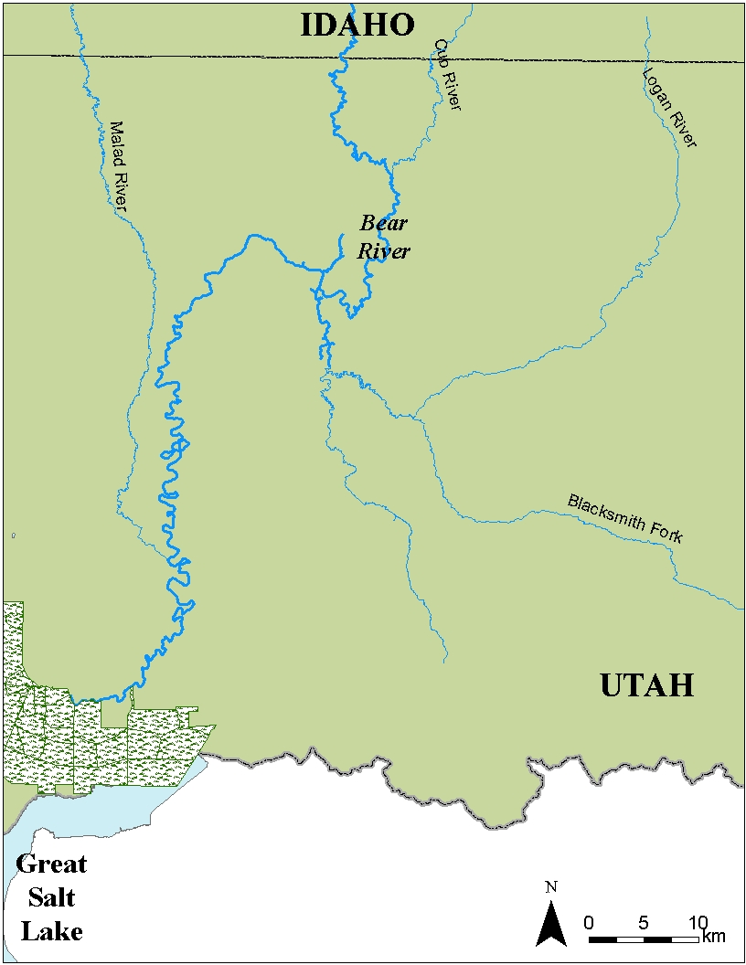
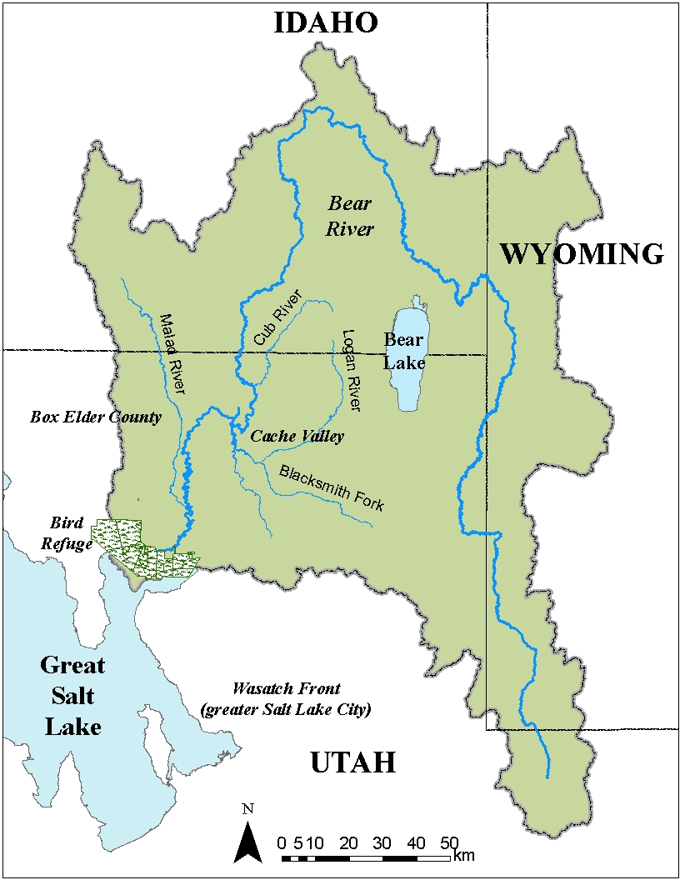
1. Study Area: Lower Bear River, UT
QX61-Malad River
QX5-Lower Bear
Cutler
QX6-Cache GW
Cache Valley
Bear River Canal Company
New Cache
QX15-South Cache Reach Gain/Loss
New Box Elder County
South Cache
QX27-Box Elder GW
South Cache
QX22-Malad Reach Gain/Loss
QX41-Blacksmith Fork
Box Elder County
Hyrum
QX46-Little Bear
Bird Refuge
Reservoir, proposed
Reservoir, existing
Urban Use
Ag. Use
Wetland

Slide 9
2. Explore the Geodatabase of Arc Hydro
# | Feature class | Types of water resources features supported by Arc Hydro GW
1 | HydroPoint | Bridge, DamWeir, Gate, Lock Chamber, Rapids, Reservoir, SinkRise, SpringSeep, Structure, Water Intake, Outflow, Waterfall
2 | MonitoringPoint | Well, Water IntakeOutflow, Gate, DamWeir, Gaging Station, Gate, Lock Chamber, Reservoir, SinkRise, SpringSeep
3 | WaterBody | Playa, Ice Mass, LakePond, Reservoir, SwampMarsh, Estuary
4 | WaterLine | ArtificialPath, Bridge, CanalDitch, Coastline, Connector, DamWeir, Flume, Gate, Levee, Lock Chamber, Nonearthen Shore, Pipeline, Rapids, Reef, Shoreline, SinkRise, Sounding Datum Line, Special Use Zone Limit, StreamRiver, Tunnel, Wall, Waterfall
5 | Well | Irrigation, Monitoring, Public Supply, Domestic, Industrial, Commercial, Stock, Test Hole, Unused

Slide 10
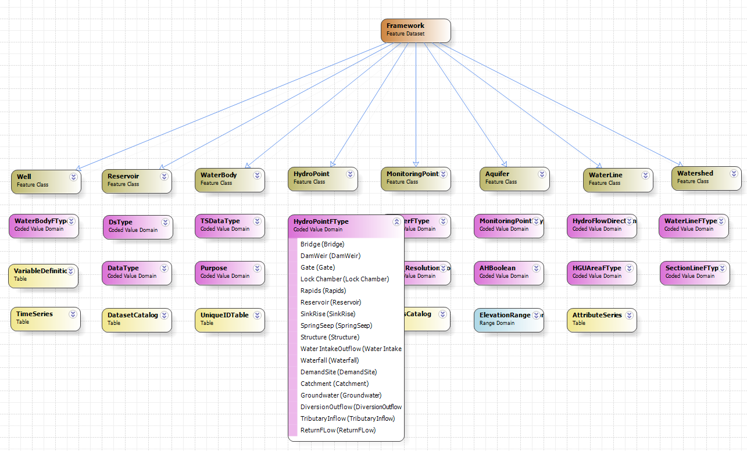
ArcGIS Diamgrammer
To access and modify the geodatabase to fit Water Management data

Slide 11
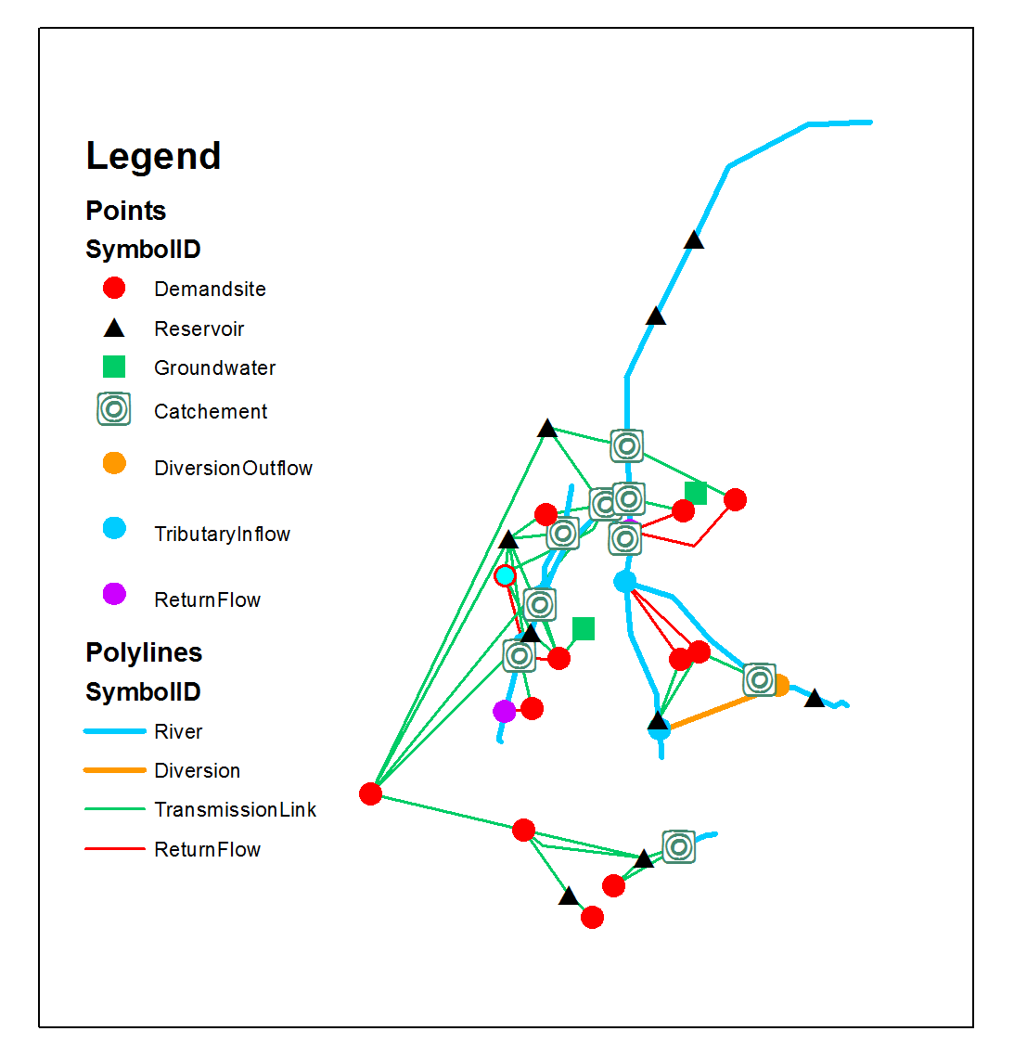
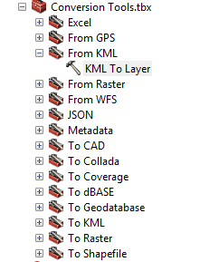
3. Get the data to ArcGIS
Export WEAP schematic to a kmz format
Import the kmz file to ArcMap

Slide 12
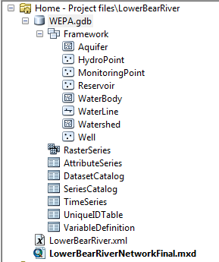
Create the new geodatabase
Import the shapefiles of feature classes to the new geodatabase using the tool “Data Load”

Slide 13
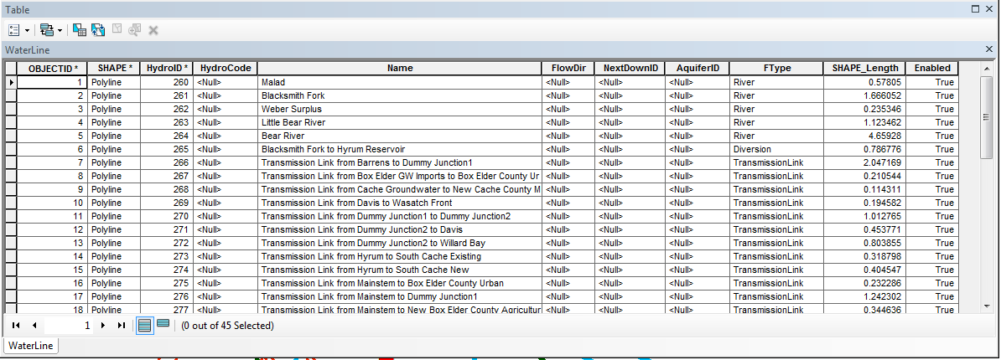
Load the data to Arc Hydro GW
Assign HydroIDs to the points and lines
Load times series data to the Time Series Table
Join the Time Series with the feature class (e.g., WaterLine … Little Bear River)

Slide 14
4. Investigate the network configuration
In Hydrology, water flows downhill
But in Water Management, water flows uphill towards money and power
Arc Hydro GW works well for Hydrology but it seems that we need to use other GIS tools to configure the flow directions (needs further work)

Slide 15
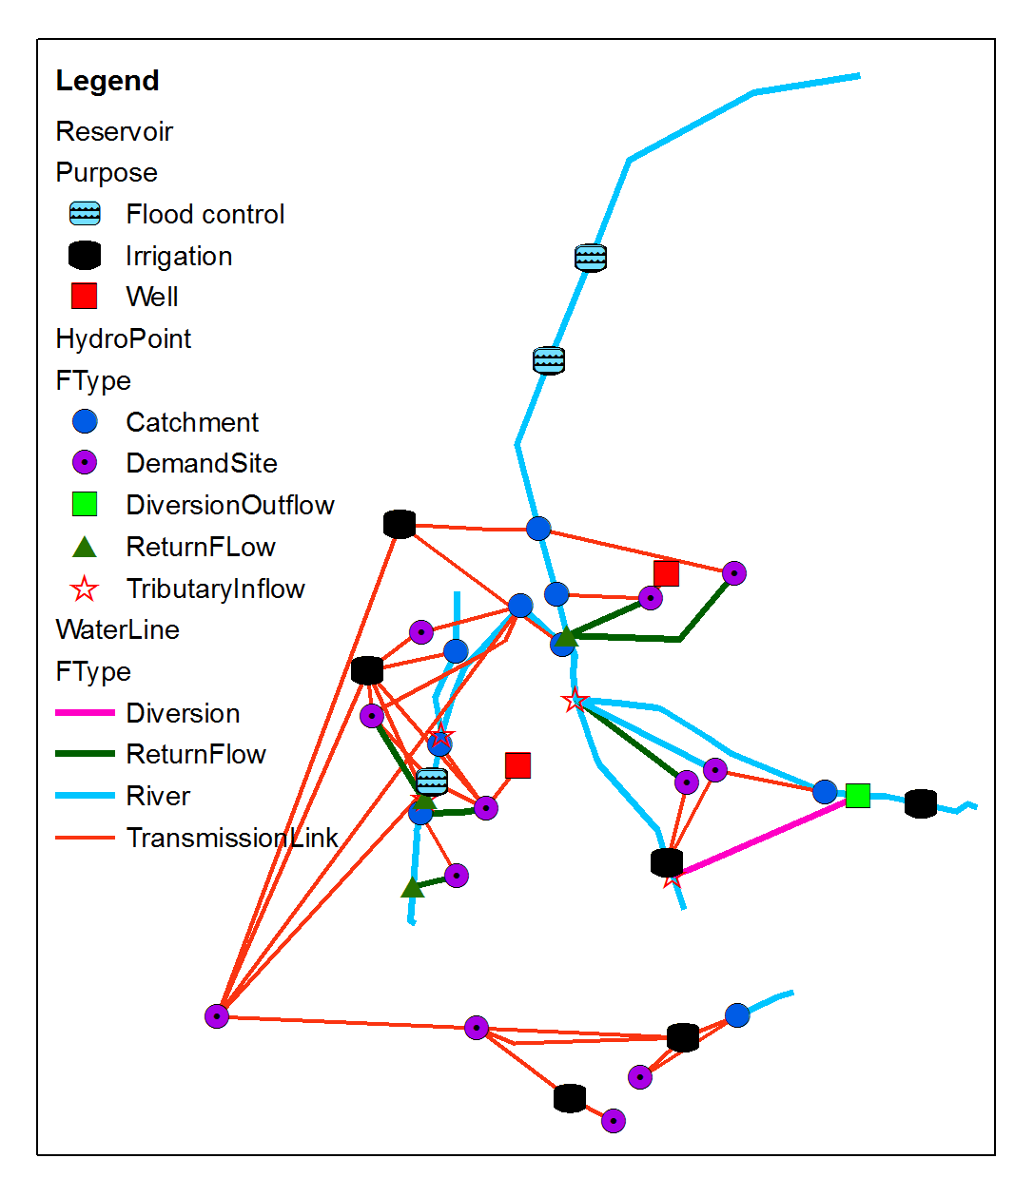
Results
The Lower Bear River network in the figure
Yes we can represent water management data in Arc Hydro Groundwater but the network connectivity needs more investigations

Slide 16
Visualize time series data within Arc GIS

Slide 17
Future directions
Get insights from traffic and electricity data models and how they build networks
Introduce new water management tools and concepts to Arc Hydro Groundwater…Arc WaM-DaM?

Slide 18
Conclusions
Arc Hydro Groundwater data model is flexible and can support water management objects
Arc Hydro needs some adjustments to accommodate the flow directions
Using a standard Geodatabase for water management data can help others understand what's going on

Slide 19
Thank you for listening!
Questions?

