Slide 1
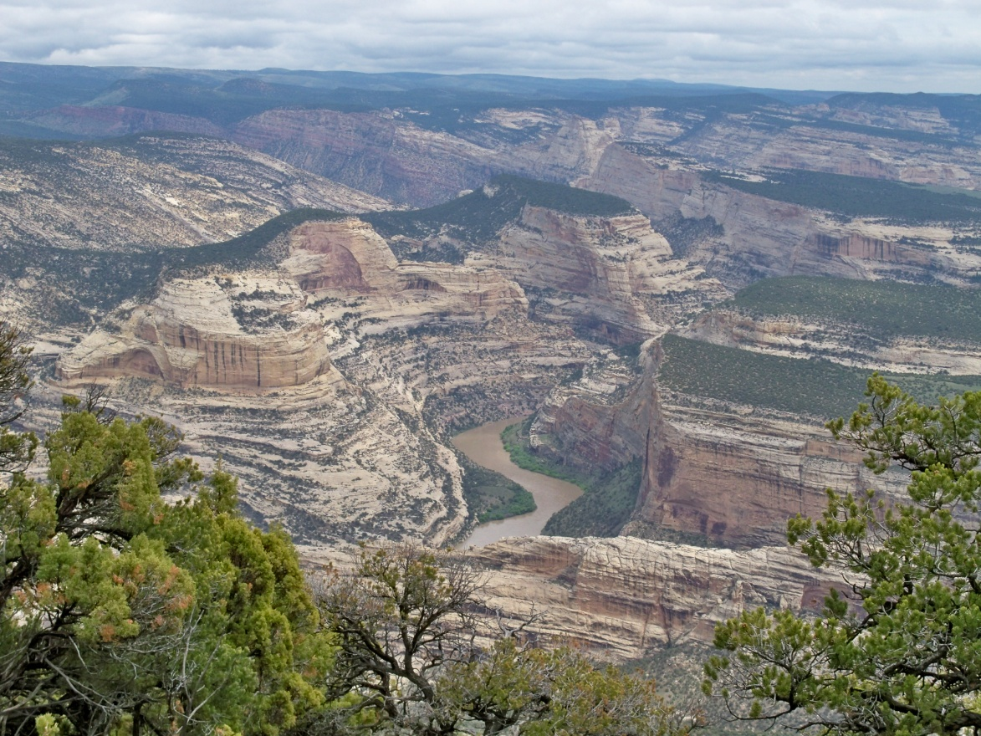
Flow Prediction on the Yampa River
BY: Trevor Price

Slide 2
Yampa River - Wild River

Slide 3
Downstream Flooding (2011)

Slide 4
Peak Flow Prediction to Prevent Flooding

Slide 5
Peak Flow – Yampa River
Preventitive Flood Action
Reservoir Storage
Sandbag
Dikes, etc.

Slide 6
Objective
Predict the Peak Flow for the Yampa River
Define the Study Area
Collect Data
Interpolate Snow Water Equivalent (SWE) data
Determine Runoff Ratio Relationship
Determine SWE vs Peak Flow Relationship

Slide 7
Study Area (StreamStats)

Slide 8
Study Area imported into GIS

Slide 9
HUC 8 Watersheds
ArcGIS Toolbox: Clip (Analysis)
HUC 8 Watershed | Area (sq.mi.)
Upper Yampa | 2590
Lower Yampa | 1550
Little Snake | 3060
Muddy | 1010

Slide 10
Digital Elevation Model (DEM)
ArcGIS Toolbox: Mosiac (Data Management)

Slide 11
Digital Elevation Model (DEM)
ArcGIS Toolbox: Mosiac (Data Management)

Slide 12
Stream Gages
ArcGIS Toolbox: Clip (Analysis)

Slide 13
SNOTEL Sites Snow Water Equivalent (SWE)
18 Sites Near and Within
Yampa River Basin

Slide 14
Work in Progress
Interpolate SWE data
Find average SWE for the watershed
Determine Runoff Ratio Relationship
Using SWE and Stream Gages
Determine SWE vs Peak Flow Relationship
This will be used to estimate the peak flow for any given year.

Slide 15
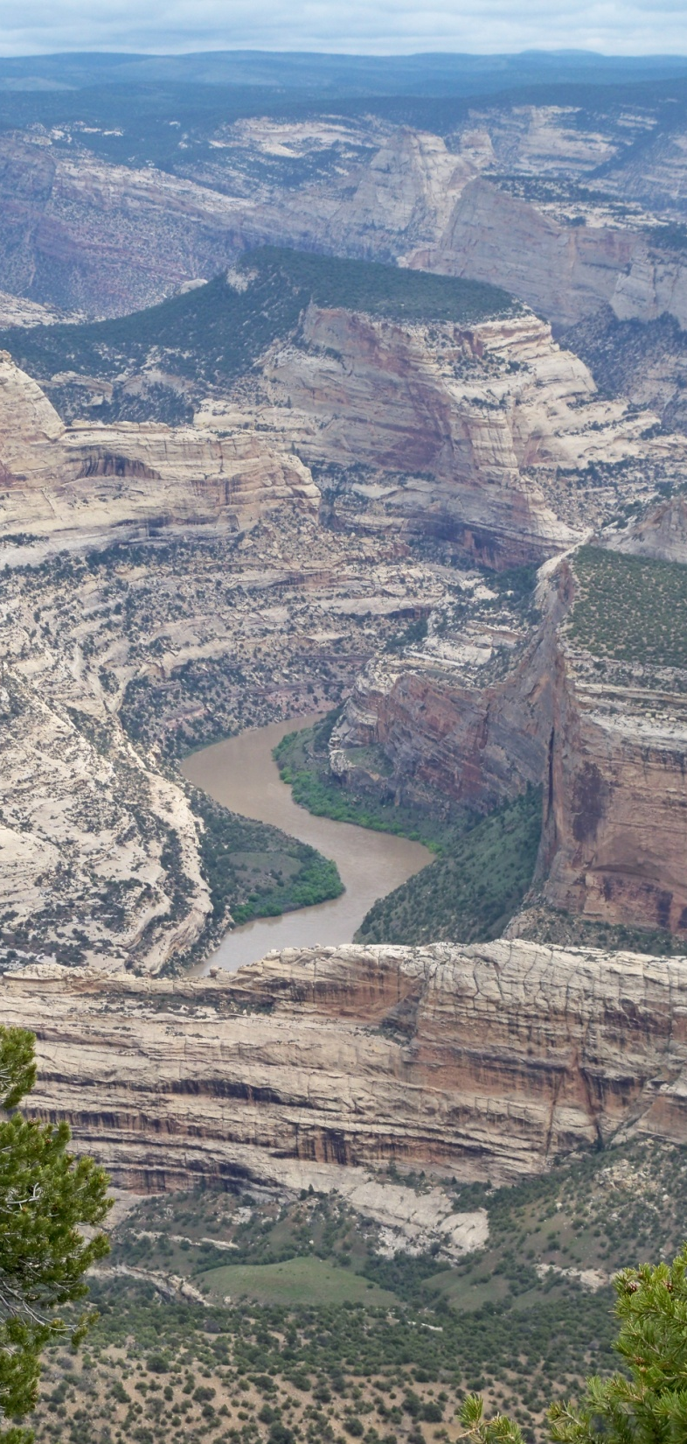
Uncertainties
Storm Patterns
Snow Drifting (Due to Wind)
Land Cover (Vegetation)
Slope of Land
Direction of Slope (Facing Sun)
Climate (Melting Rate)

Slide 16
???Questions???

