Slide 1

The Bear River
Utah’s Last Untapped Water Source
Trevor Datwyler
CEE 6440

Slide 2
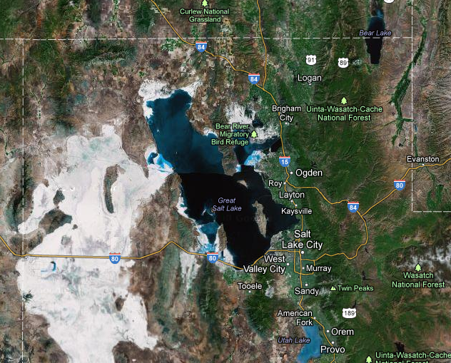
The Bear River
The average annual flow of the Bear River into the Great Salt Lake is about 1.2 million acre-feet.

Slide 3
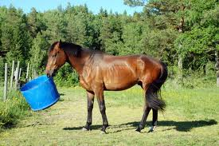
Wasted Water?
As water becomes
more and more scarce,
All the cities are trying
to get their share of Bear River water before it enters the Great Salt Lake…
from: colourbox.com

Slide 4
Bear River Development Act (1991)
220,000 Ac-ft of Developable Water
60,000 Ac-ft for Cache County*
  *This is contingent upon Cache County’s ability to show a need for the water and prove “beneficial use.”
Typical Culinary Water Usage in Utah
  Indoor Use: 60 gallons per capita per day (gpcd)
  Outdoor Use: 134 gpcd (Watering lawns etc.)

Slide 5
Cache County Water Master Plan
Having a Water Master Plan in place is the first step in determining the future need for the additional water
Water Conservancy Districts – Governing body to manage water
  Lobbying – Keeping a seat at the legislative table
  Does Cache County need a District?

Slide 6
Purpose & Objectives
Combine water use data, water supply, and population projections into a series of easily interpreted maps for Cache County.
  Objective: Provide clear data to the public, so that in seconds, the viewer will understand when additional water is needed in Cache Valley Communities.
  Increasing public education will ensure that the best decision is made, not just the easiest.

Slide 7
Purpose & Objectives
  Objective:
    Show possible solutions to utilize additional Bear River Water.
    The outcome of these objectives will (hopefully) be that when election time comes, the average voter will understand when additional water is needed in Cache County, and how we can utilize it.

Slide 8

Tools
Excel – manage population, water source, demand data
GIS – Join tables to feature classes
Taudem watershed delineation tools

Slide 9


Data Sources
Population data from the Bear River Association of Government (BRAG)
Water Use Data from the Utah Division of Water Resources (DWRe)
Water Rights Data from the Utah Division of Water Rights (DWRi)
Miscellaneous Data – gis.utah.gov
  Roads, City Boundaries, Watersheds, Aquifers, Water bodies, Soil Data, Dams, DEMs, Aerials

Slide 10
Population

Slide 11
Supply vs. Demand

Slide 12
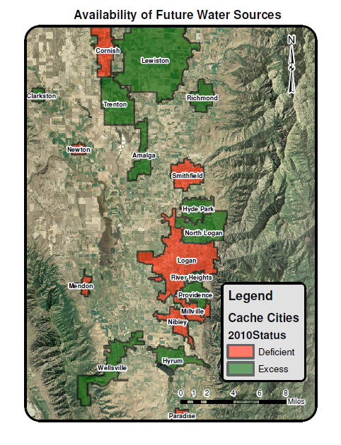
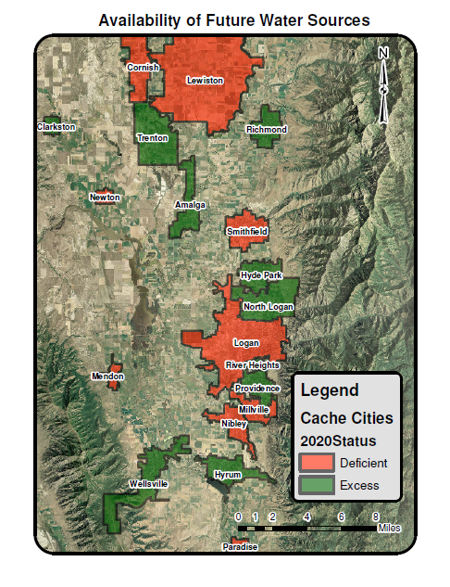
Cache County Water Master Plan
Note: Currently waiting on updated data from DWRe. Data from 2000 used for analysis.

Slide 13

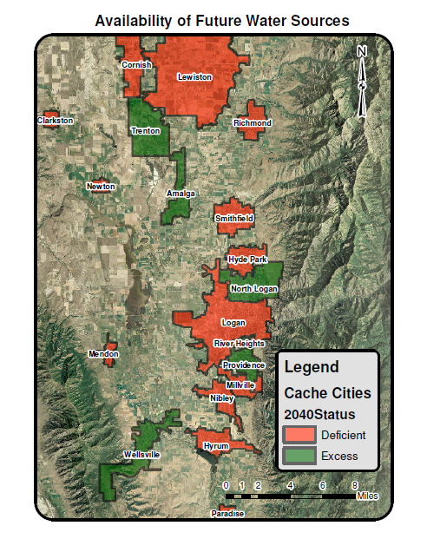
Cache County Water Master Plan
Note: Currently waiting on updated data from DWRe. Data from 2000 used for analysis.

Slide 14
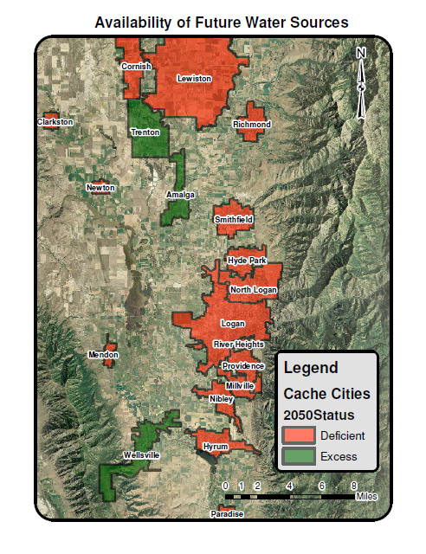
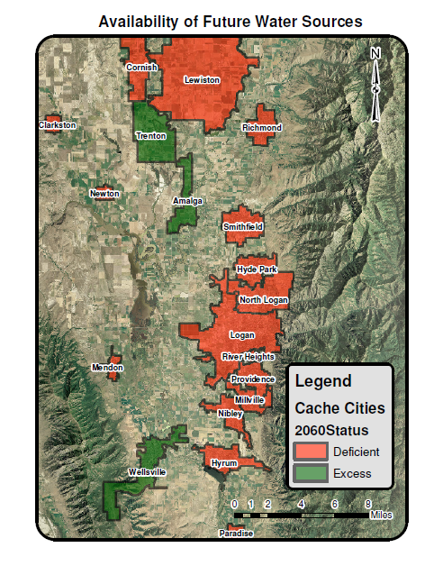
Cache County Water Master Plan
Note: Currently waiting on updated data from DWRe. Data from 2000 used for analysis.

Slide 15
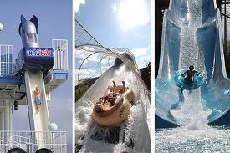
How do you put the water to beneficial use?
from: articles.orlandosentinel.com

Slide 16
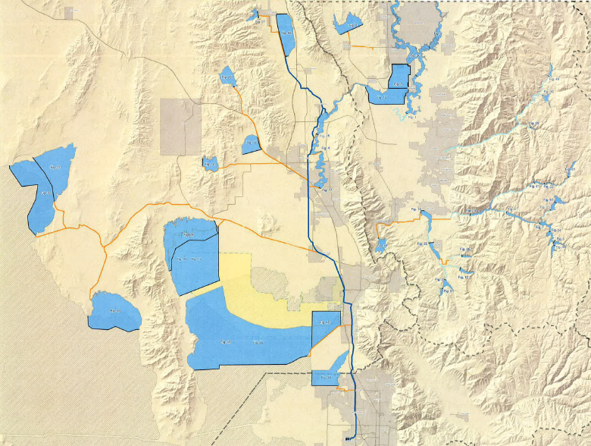
Build a Dam!
Temple Fork
Cache County
Logan Canyon
Blacksmith Fork
Willard Bay
45 possible options analyzed, sites not finalized
From: Bowen Collins, HDR, DWRe

Slide 17
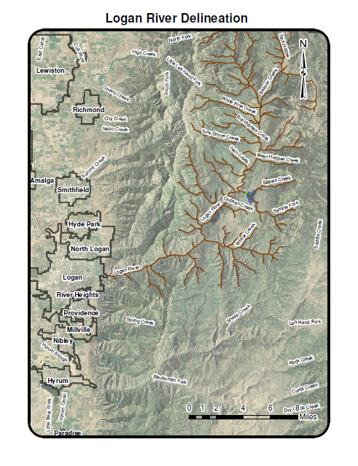
Watershed Delineation: Logan Canyon
Using Taudem
  Pit removal
  D8 Flow Directions
  D8 Contributing Area
  Stream Definition by Threshold
  Stream Reach and Watershed

Slide 18
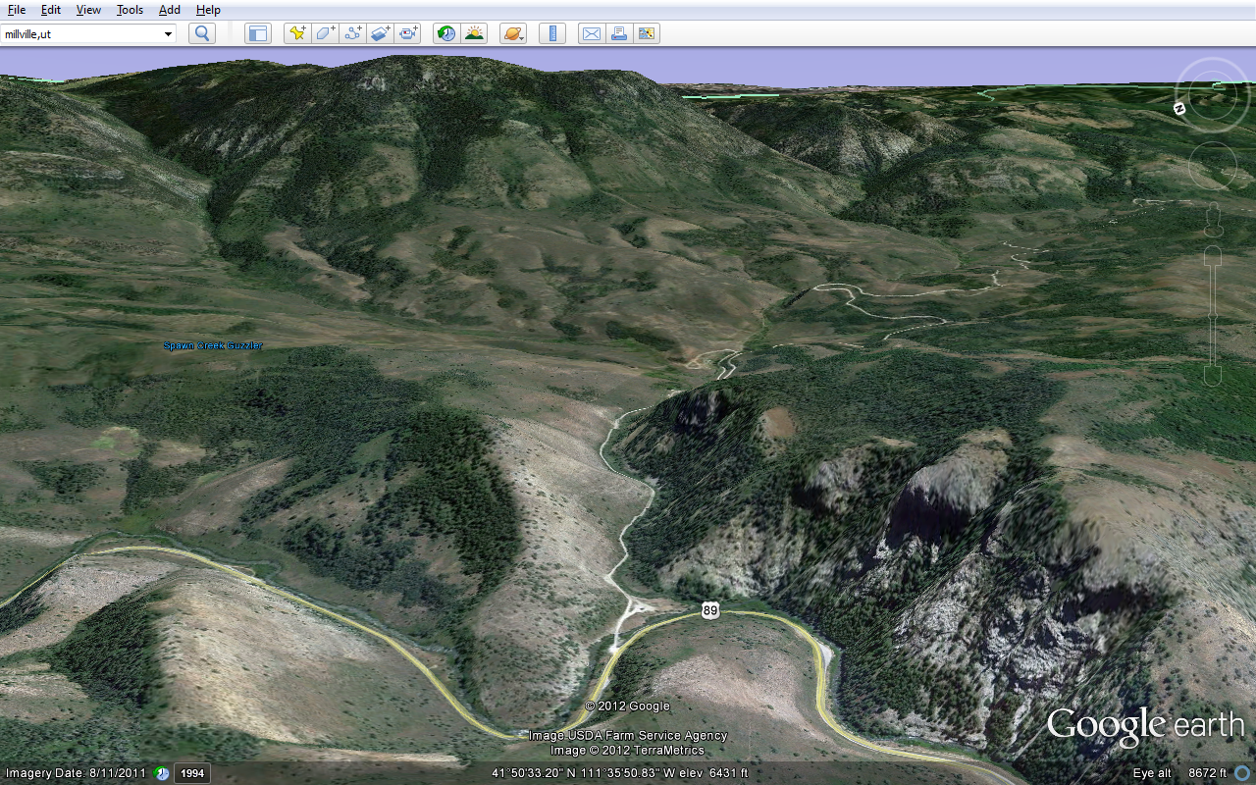
Temple Fork Potential Dam Site
Dam Location

Slide 19
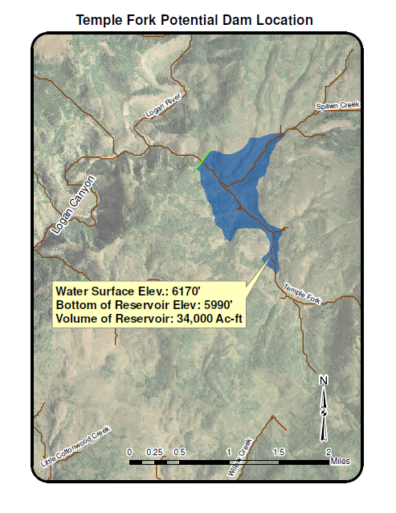
Plan View
Surface Area: 355 Acres
Volume 34,000 Ac-ft
It’s not the full 60,000 Ac-ft, but it’s a start

Slide 20
Sequent Peak Analysis
Additional Analysis Needed:
  How long would it take to fill the dam?
    Average annual flow data needed
  Is it Feasible?
  Cost Analysis

Slide 21
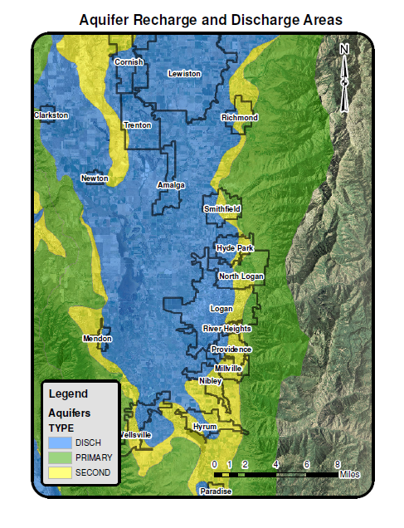
Aquifer Recharge
Utilize the underground reservoirs that already exist

Slide 22
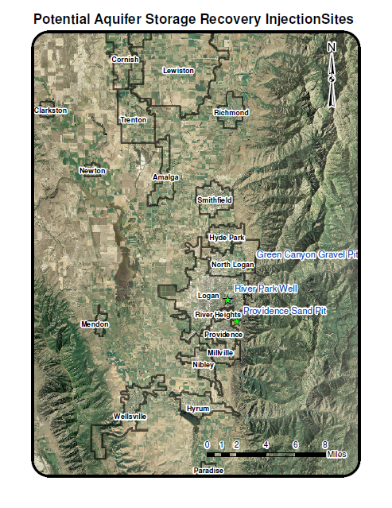
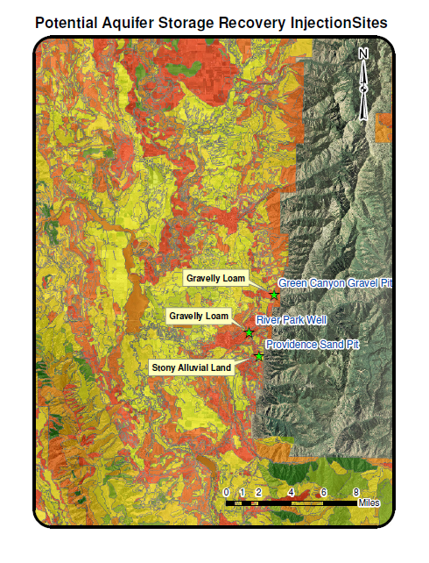
Aquifer Storage and Recovery (ASR)

Slide 23
Conclusion: Why is public education necessary?
Public buyoff is crucial in water resource projects
Conservancy District
  Past Elections have failed
    Fear of the unknown
    Insufficient explanation
Benefit of Possible Interconnects

Slide 24
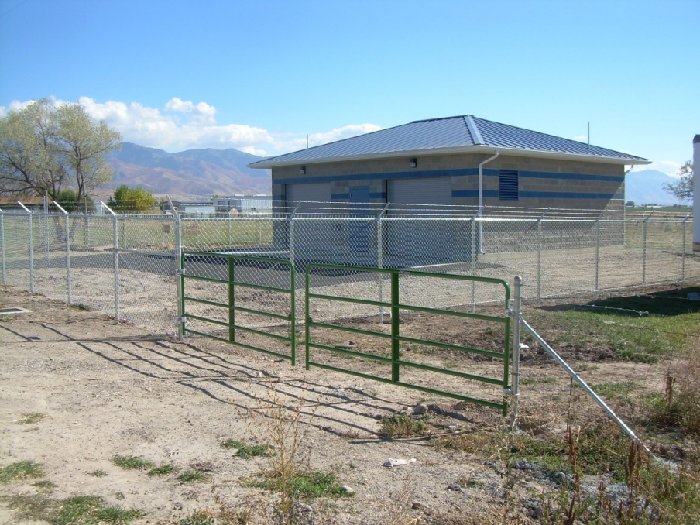
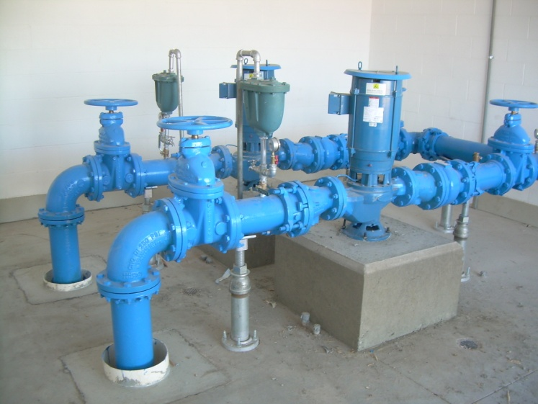
Example: Trenton & Amalga Water System Interconnect

Slide 25
Questions

